Slide 1
WELCOME

Slide 2


BANGLADESH UNIVERSITY OF ENGINEERING & TECHNOLOGY
A Presentation on
Construction of
Beam,Column & Slab

Slide 3
Load Transfer
Load
Slab
Beam
Column

Slide 4
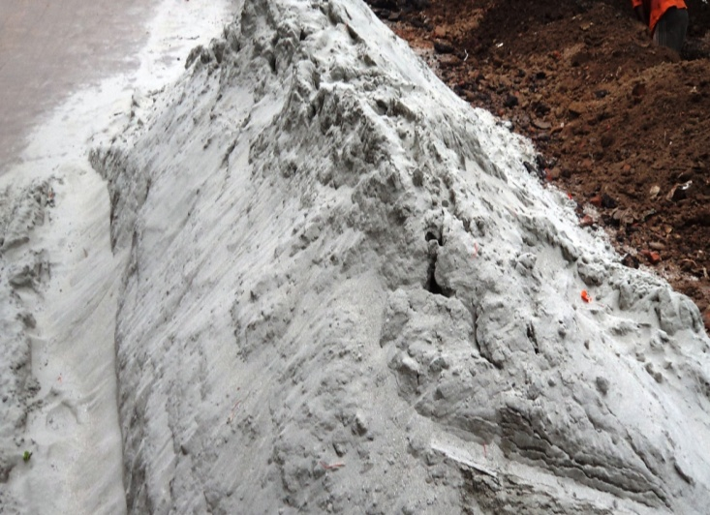
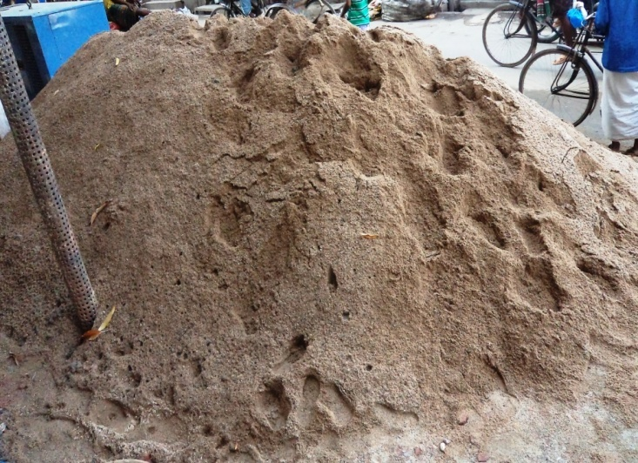
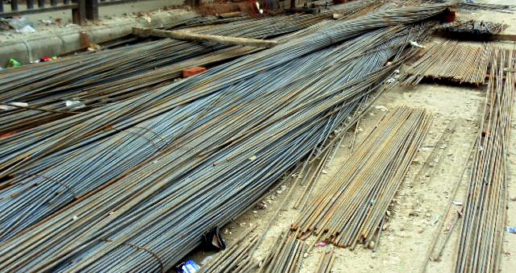
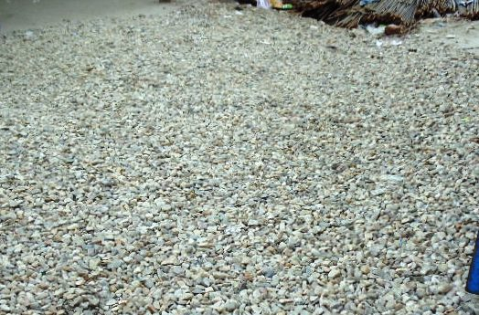
Materials
Cement
Fine Aggregate
Reinforcement
Coarse Aggregate

Slide 5
Steps of Construction
Reinforcement
Formwork
Concrete casting
Compaction
Removal of formwork
Curing

Slide 6
Column Construction

Slide 7
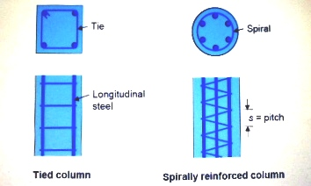
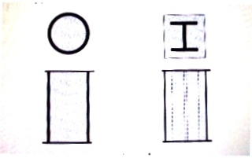
Types of Column
Column
Short column Slender Column
Tied columns
Spirally reinforced columns
Composite columns
Composite Columns

Slide 8
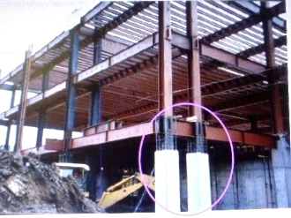
Column Details
Columns-
mainly carry loads in compression
carry bending moment as well
Columns of Steel Structures

Slide 9
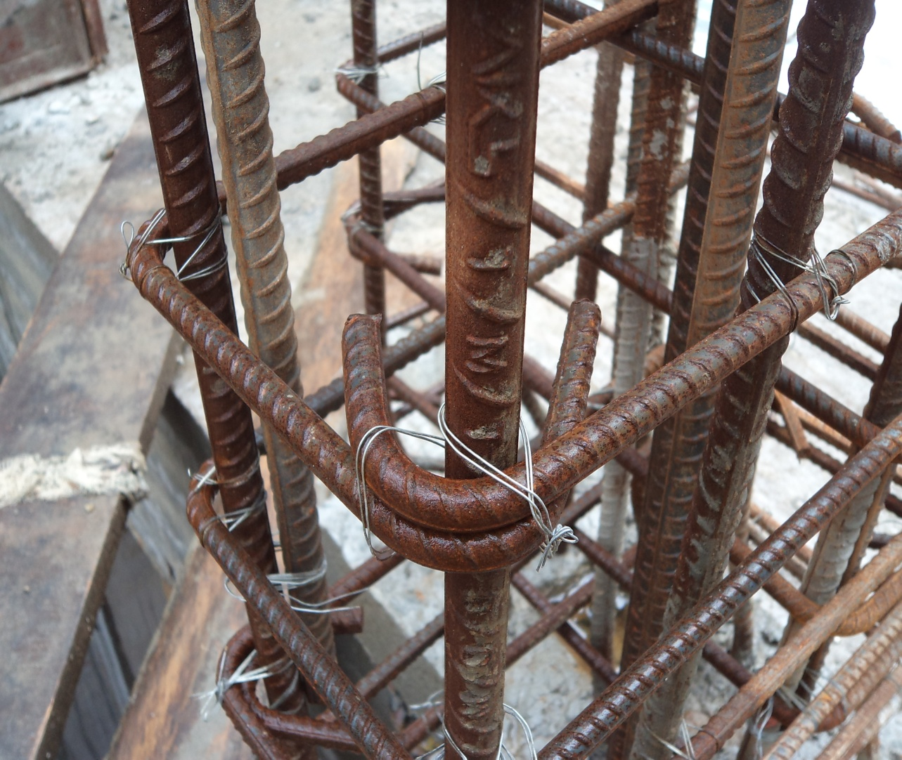
Column Details
Ties In Column
45 degree angle
Hook

Slide 10
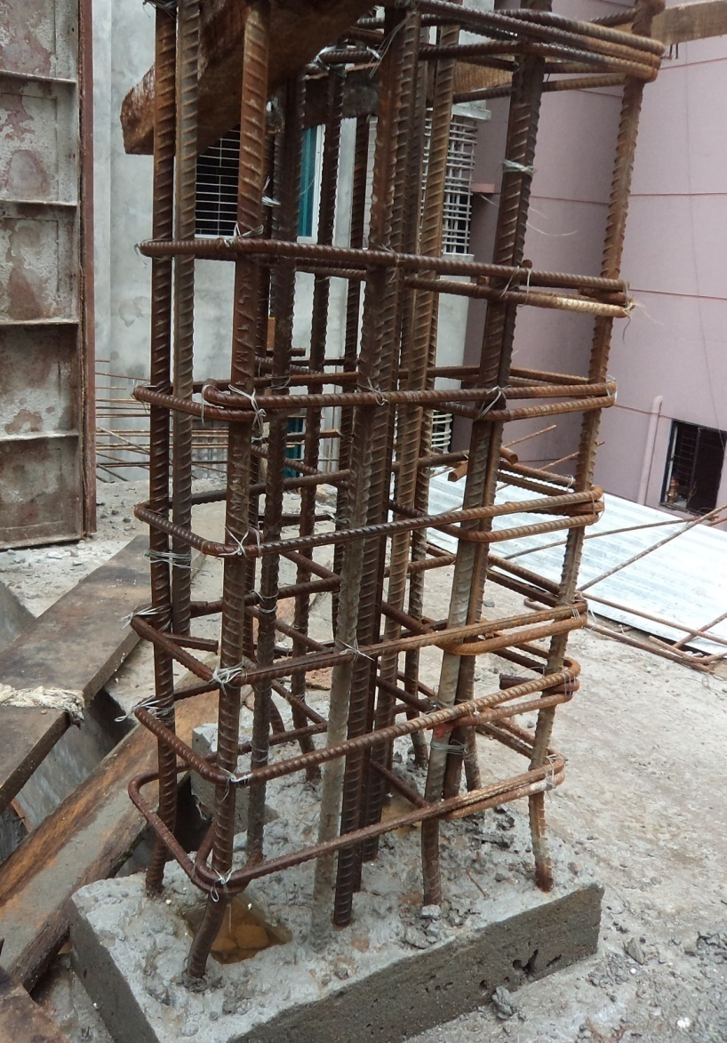
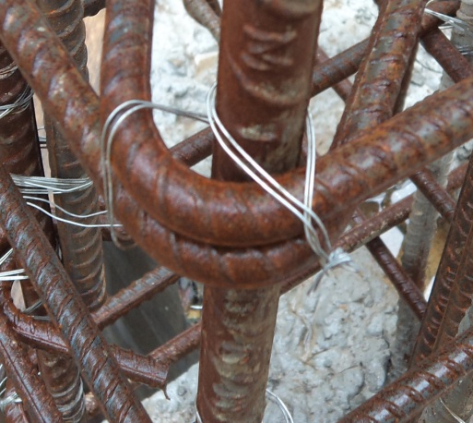
Reinforcement
Two ways of
binding
Reinforcement-
Welding
Wiring
GI wire used in binding

Slide 11
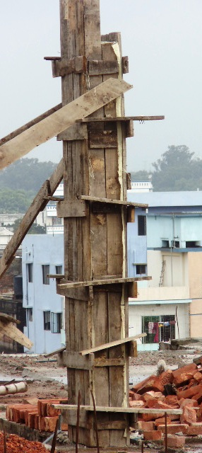
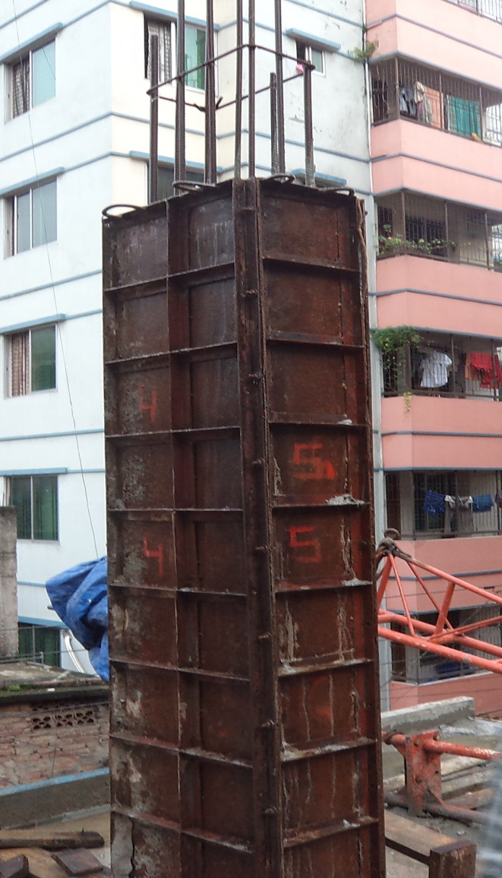
Shuttering
Wood shuttering
Steel shuttering

Slide 12
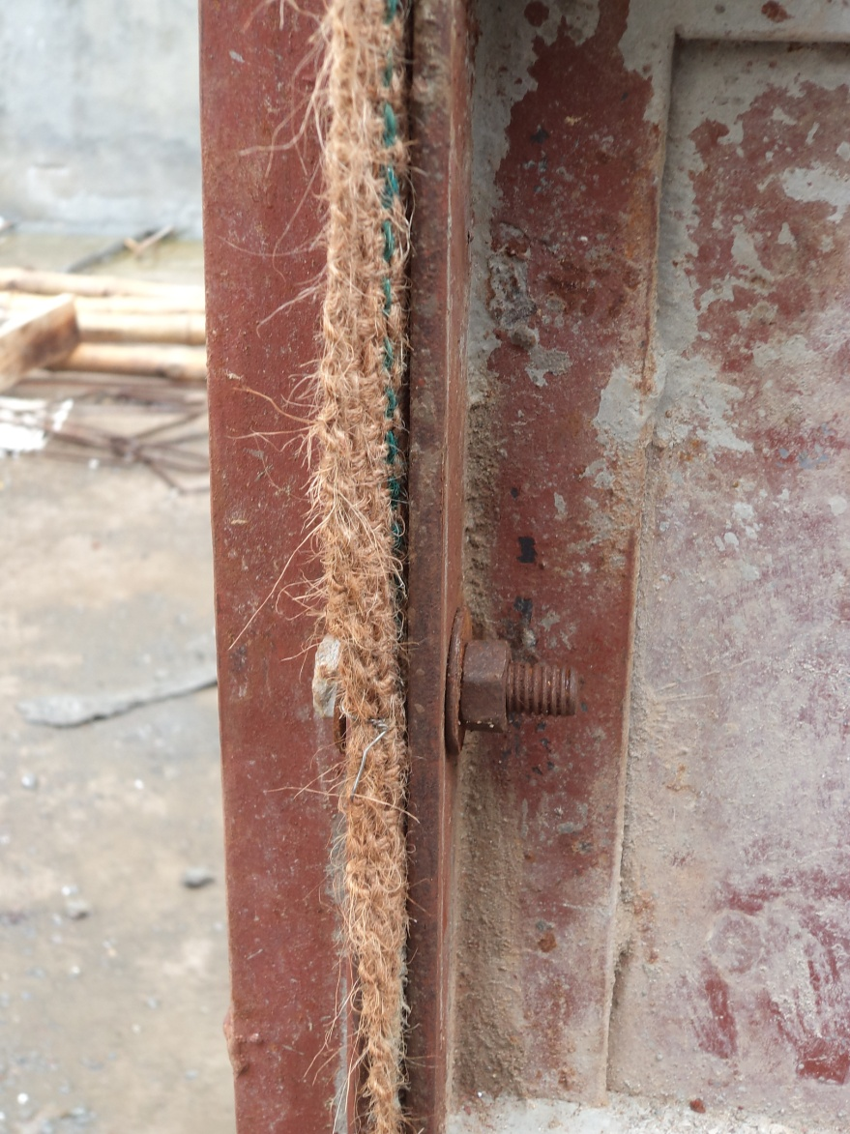
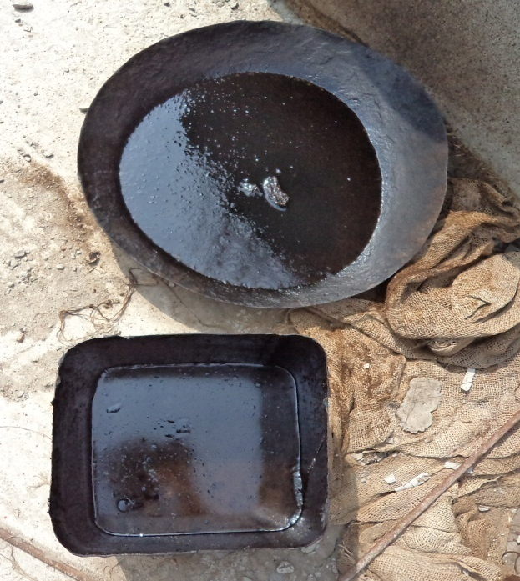
Shuttering
Gunny bags
Grease

Slide 13
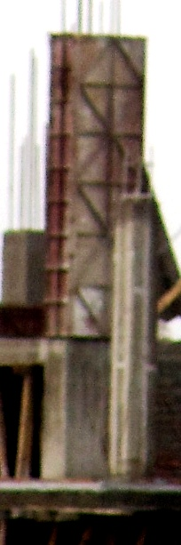
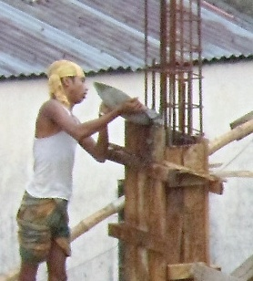
Concrete Casting
Concrete Casting is generally done in two lifts-
2nd lift
1st lift

Slide 14
Concrete Casting
The reasons behind this is-
Difficulties in compaction
Segregation
Heat evolve during hydration

Slide 15
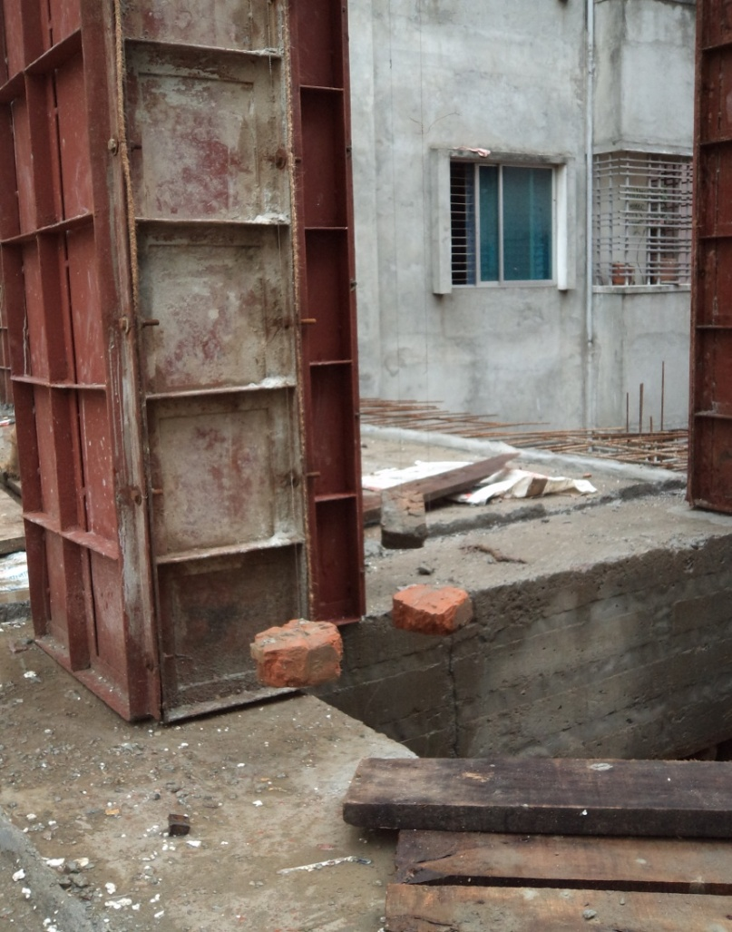
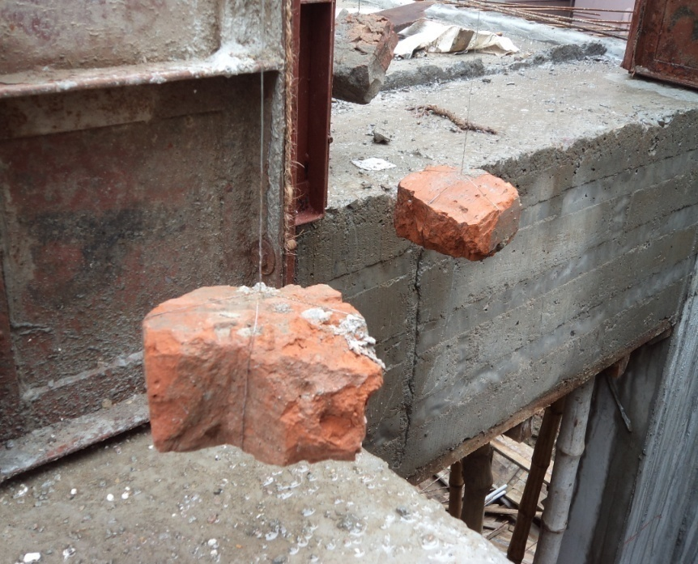
Column Details
Verticality of Column
Bricks used in field instead of plumb bob

Slide 16
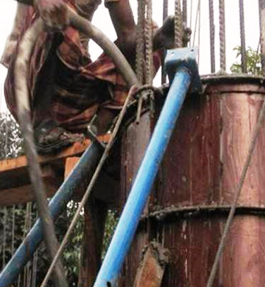
Compaction
Compaction can be done in different ways. Such
as:
1. Hand Compaction
Vibrator

Slide 17
Compaction
Minimizing void is very important to gain estimated strength.
So to minimize void compaction is obligatory.
If we do not provide proper compaction then the concrete will be of lesser strength

Slide 18
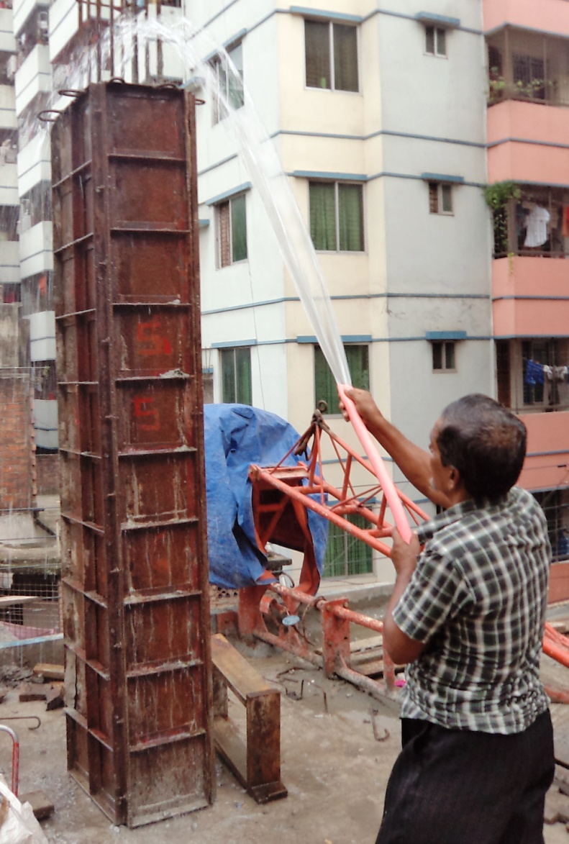
Curing
The set concrete is kept continuously damp for some days in order to enable gain more strength

Slide 19
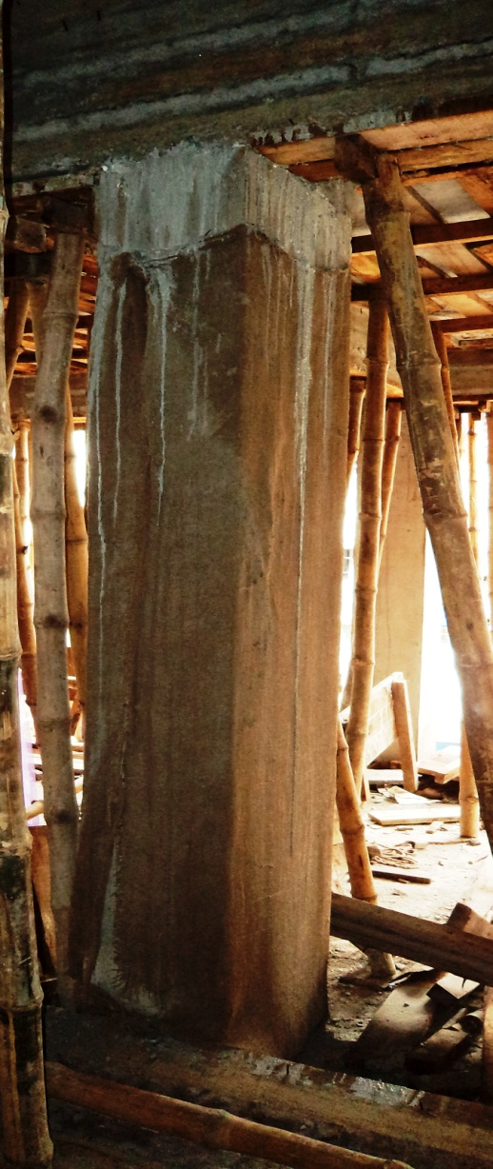
Curing
Curing is done for 21 days , because water is required for Hydration Reaction of Concrete

Slide 20
Beam Construction

Slide 21
Reinforcement of Beam

Slide 22
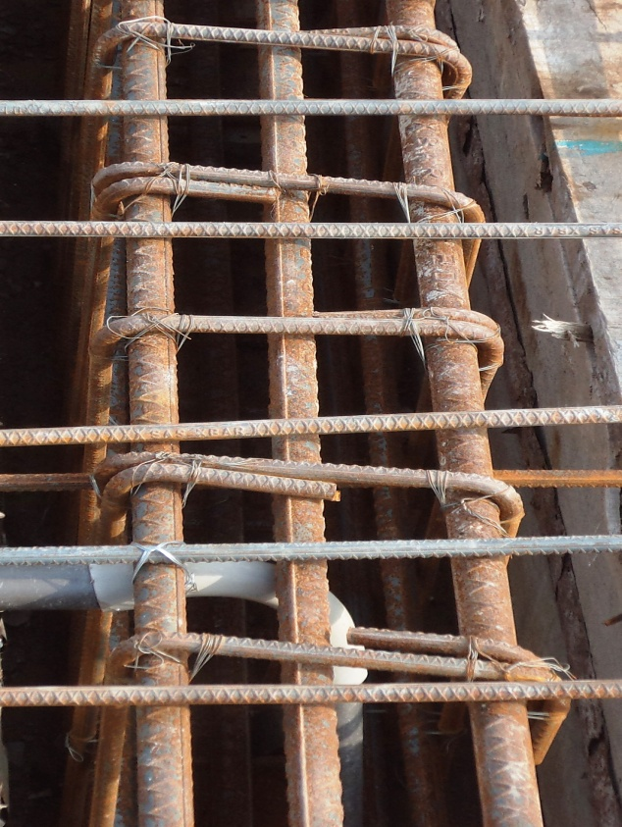
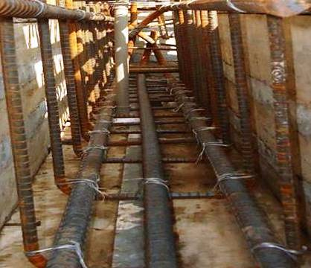
Reinforcement of beam
Minimum 4 rods are used
Extra top & bottoms are used to prevent further bending
Extra Top
Extra
Bottom

Slide 23
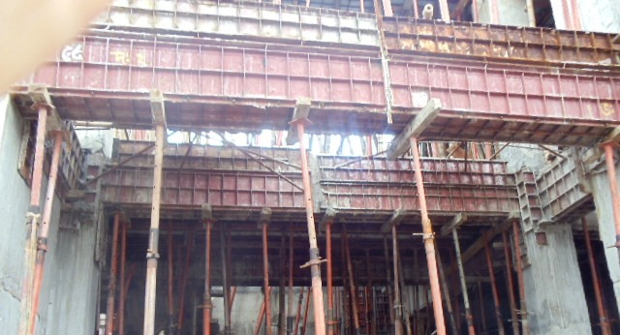
Types of beams
Simply Supported Beam
Cantilever Beam
Overhanging Beam

Slide 24
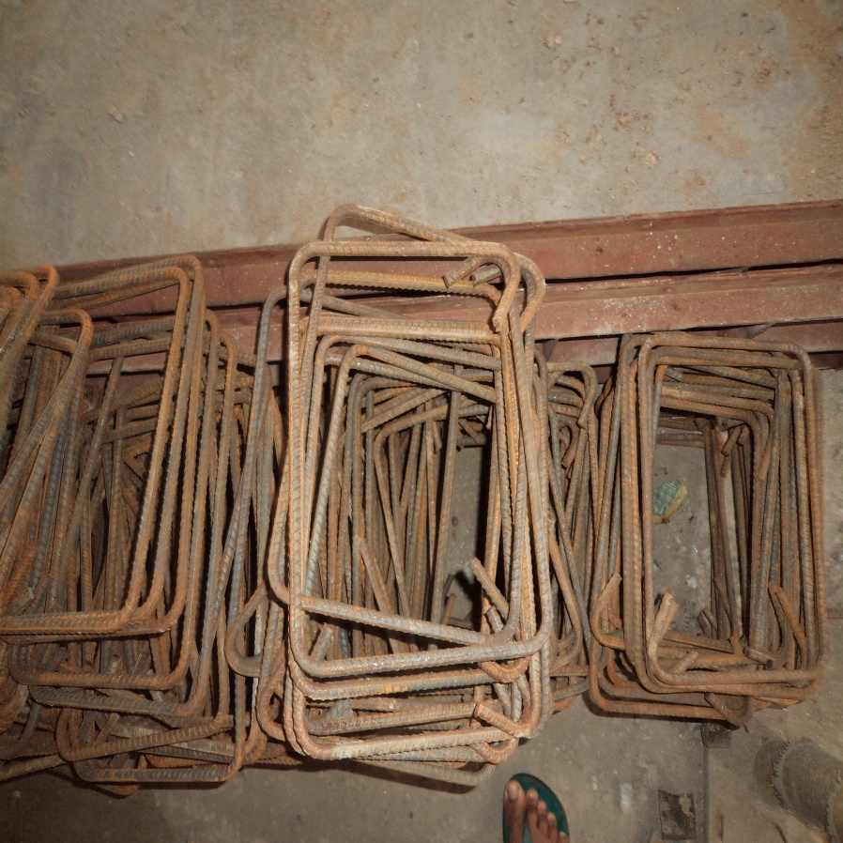
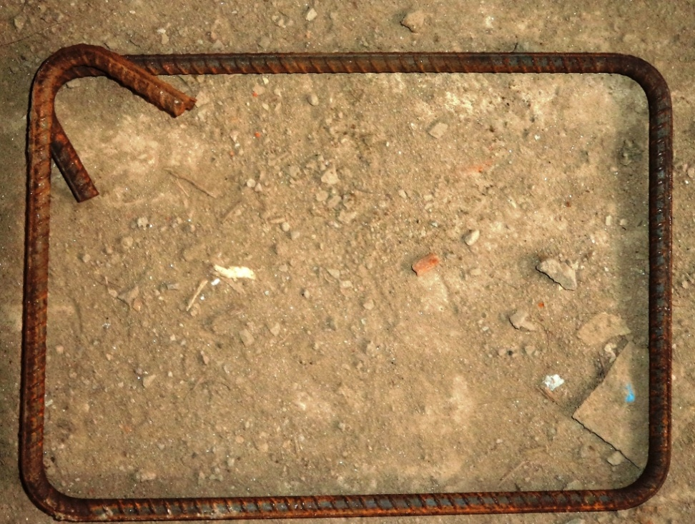
Stirrups

Slide 25
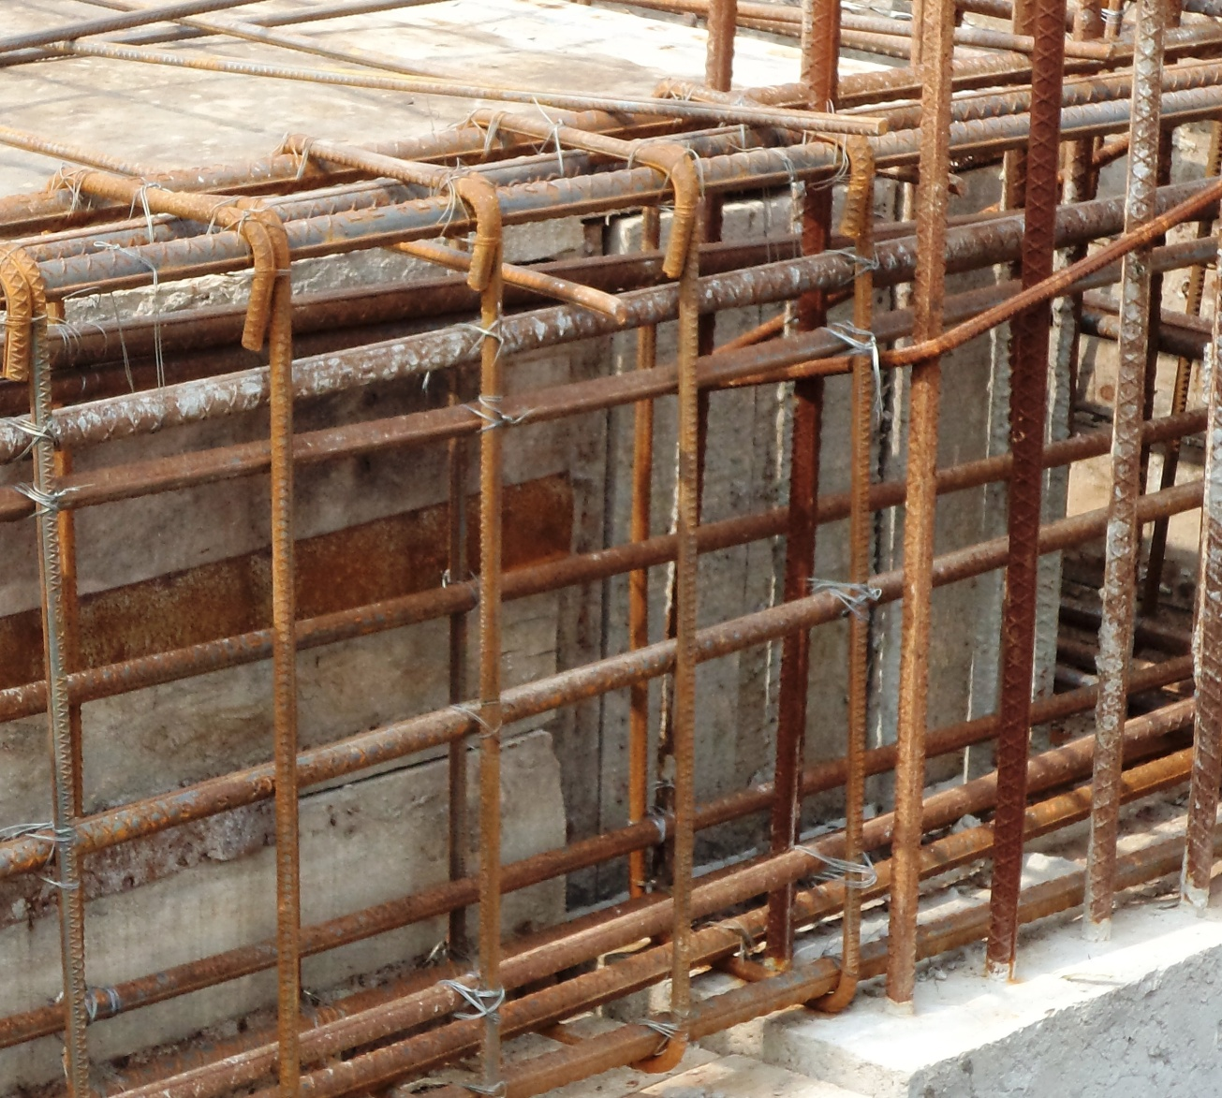
Stirrup Bending
90 degree hooking

Slide 26
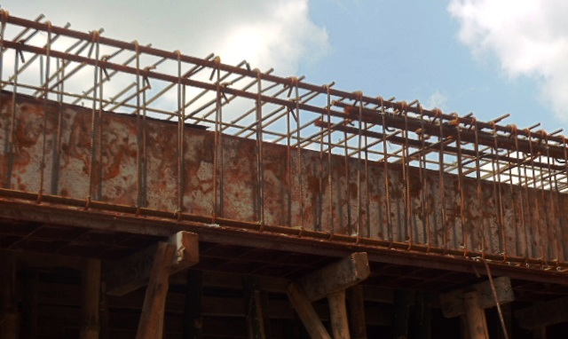
Distance between stirrups
Long distanced stirrups
Close distanced stirrups

Slide 27
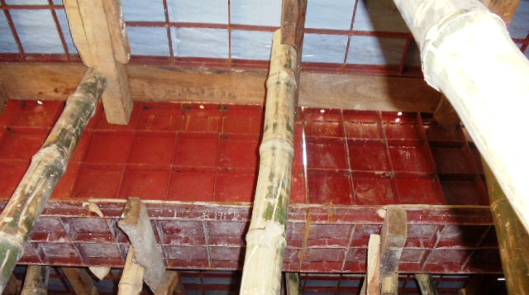
Beam Shuttering

Slide 28
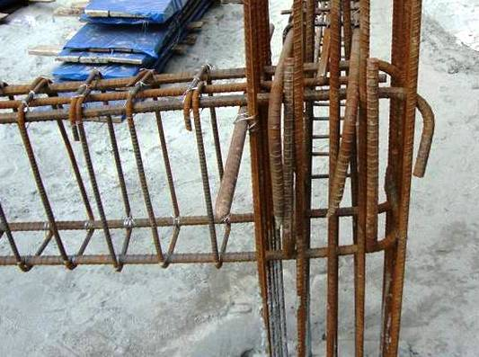
Reinforcement alignment
Rods are bended at the end

Slide 29
Slab Construction

Slide 30
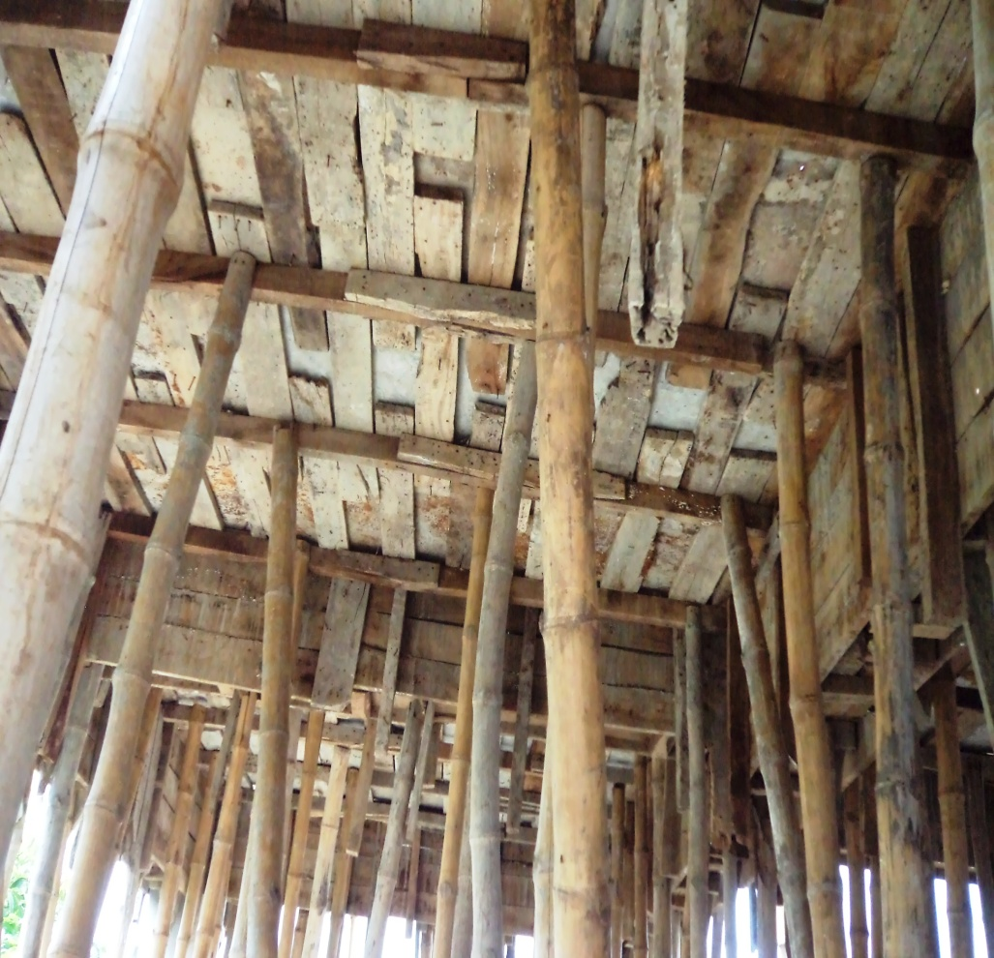
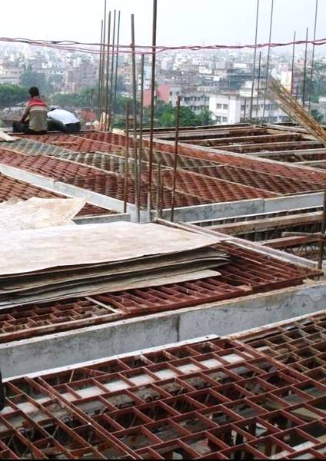
Form Work / Shuttering
Timber formwork
Steel formwork

Slide 31
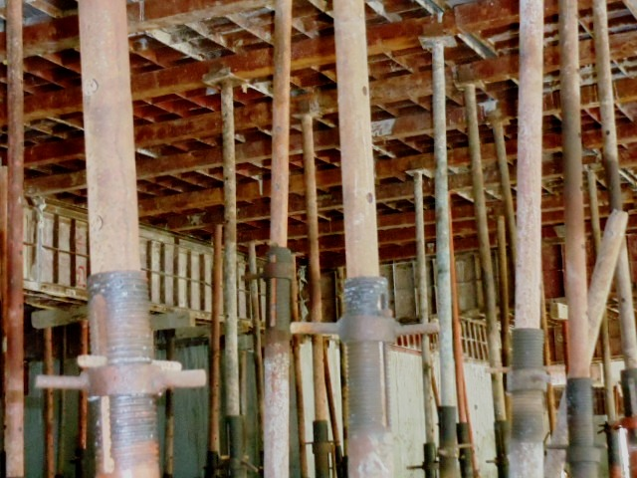
Shuttering of Slab
Plate
Ledger
Prop

Slide 32
Different types of slabs
Slab
Granite Slabs
Marble Slabs
Wood Slabs
Concrete Slabs
Two way slab
Flat slab
Beam slab
One way Slab
Ribbed slab

Slide 33
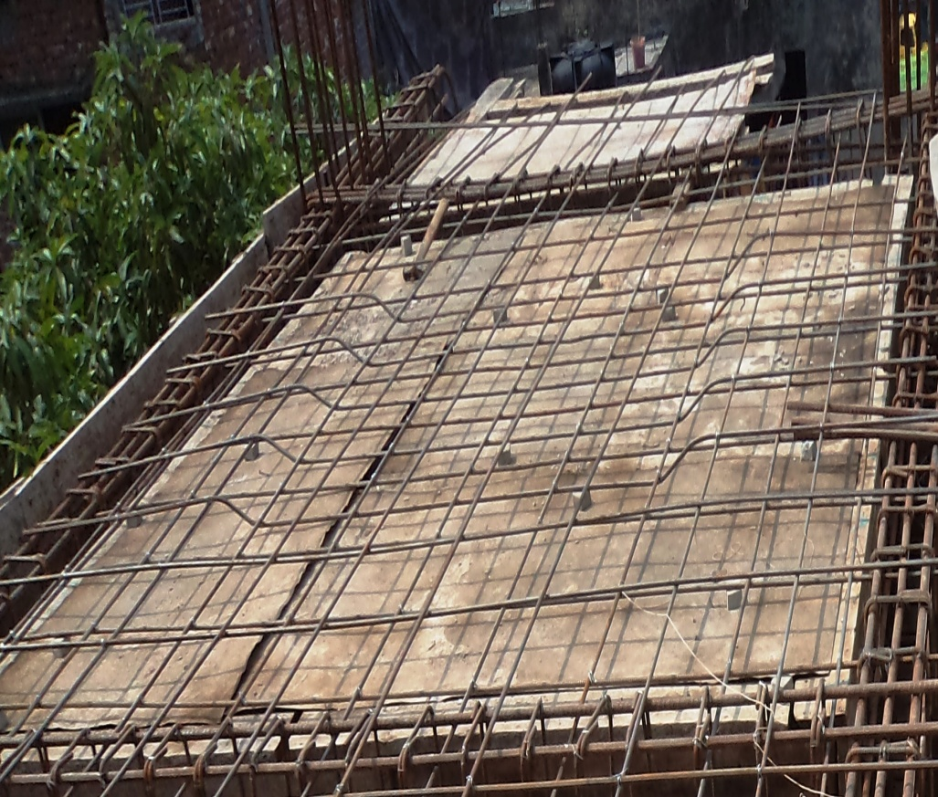
Different types of slabs
Depending on reinforcement alignment slabs are basically two types:
1. One way slab
( length/width> 2)
2. Two way slab
(length/width<=2)

Slide 34
C.C Block

