Slide 1
CE-200
Details of Construction
Deep Foundation

Slide 2
DEFINITION
Deep Foundations are those
  in which the depth of the foundation is very large in comparison to its width.

Slide 3
When Used?
In cases where
  The strata of good bearing capacity is not available near the ground.
In these cases the foundation of the structure has to be taken deep with the purpose of attaining a bearing stratum which is suitable and which ensures stability and durability of a structure.
The bearing stratum is not the only case. There may be many other cases. For example, the foundation for a bridge pier must be placed below the scour depth, although suitable bearing stratum may exist at a higher level.

Slide 4
Forms of Construction
Most common forms of construction pertaining to deep foundations are:
  Pile Foundation (more commonly used in building construction)
  Cofferdams
  Caisson or Well Foundation

Slide 5
Pile Foundations
Where Used :
  stratum of required bearing capacity is at greater depth
  water-logged soil
Advantages:
  Provides a common solution to all difficult foundation site problems
  Can be used for any type of structure and in any type of soil

Slide 6
Pile Foundations(contd.)
Situations Which Demand Pile Foundation :
Firm hard bearing strata is located at quite a large depth.
Sub-soil water table is so high that it can easily affect the other foundations.
Large fluctuations in sub-soil water level.
When it is not possible to maintain foundation trenches in dry condition by pumping, due to very heavy inflow of seepage or capillary water.
Canal or deep drainage lines exist near the foundations
Where raft foundations are either very costly or their adoption impossible due to local difficulties.
When structures are located on river-bed or sea-shore and foundations are likely to be scoured due to action of water.

Slide 7
Types of Piles Based on Function
a) Classification based on Function or Use
    Bearing Piles or End Bearing Piles
    Friction Piles or Skin Friction Piles
    Sheet Piles
    Tension Piles or Uplift Piles
    Anchor Piles
    Batter Piles
    Fender Piles
    Compaction Piles

Slide 8
Types of Piles Based on Function (contd)
    Bearing Piles
Driven into the ground until a hard stratum is reached.
Acts as pillars supporting the super-structure and transmitting the load to the ground.
Piles, by themselves do not support the load, rather acts as a medium to transmit the load from the foundation to the resisting sub-stratum.

Slide 10
Types of Piles Based on Function (contd)
    Friction Piles (Floating Piles)
Piles are driven at a site where soil is weak or soft to a considerable depth and it is not economical or rather possible to rest the bottom end of the pile on the hard stratum,
Load is carried by the friction developed between the sides of the pile and the surrounding ground ( skin friction).
The piles are driven up to such a depth that skin friction developed at the sides of the piles equals the load coming on the piles.
Skin friction should be carefully evaluated and suitable factor of safety applied, as it is this which is supporting the whole of structure over its head.
The load carrying capacity of friction pile can be increased by-
    increasing diameter of the pile
    driving the pile for larger depth
    making surface of the pile rough

Slide 11
Types of Piles Based on Function (contd)

Slide 12
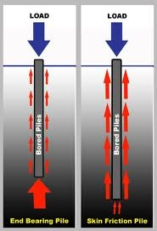
Types of Piles Based on Function (contd)

Slide 13
Types of Piles Based on Function (contd)
    Sheet Piles
Sheet piles are never used to provide vertical support but mostly used to act as retaining walls. They are used for the following purposes:
    To construct retaining walls in docks, and other marine works.
    To protect erosion of river banks.
    To retain the sides of foundation trenches.
    To confine the soil to increase its bearing capacity.
    To protect the foundation of structures from erosion by river or sea.
    To isolate foundations from adjacent soils.

Slide 14
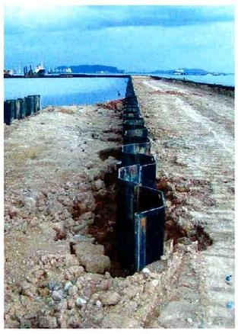
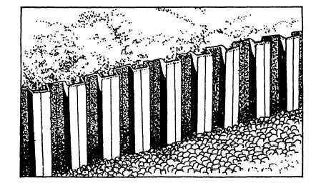
Types of Piles Based on Function (contd)
Figure: Sheet Piles

Slide 15
Types of Piles Based on Function (contd)
    Anchor Piles
Piles are used to provide anchorage against horizontal pull from sheet piling wall or other pulling forces.
Batter piles:
Piles are driven at an inclination to resist large horizontal and inclined forces.
Fender piles:
Piles are used to protect concrete deck or other water front structures from the abrasion or impact caused from the ships or barges.
Ordinarily made up of timber.
Compaction piles:
When piles are driven in granular soil with the aim of increasing the bearing capacity of the soil, the piles are termed as compaction piles.

Slide 16
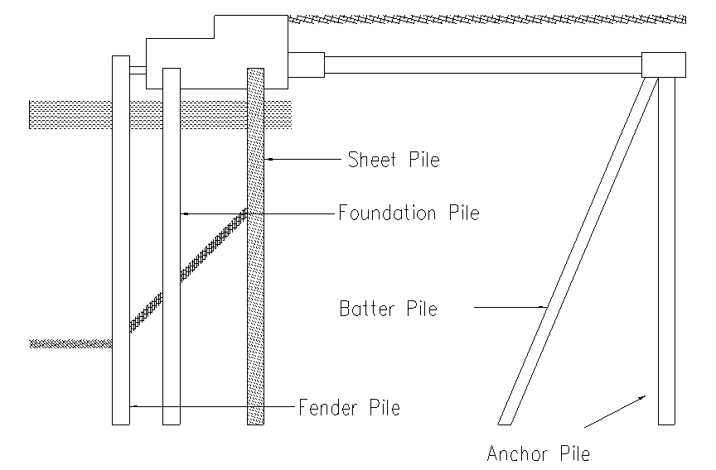
Types of Piles Based on Function (contd)

Slide 17
Types of Piles Based on Materials
a) Classification based on Materials
    Timber Piles
    Concrete Piles
    Composite Piles
    Steel Piles

Slide 18
Types of Piles Based on Materials (contd)
    1. Timber Piles:
  Economical to support light structure.
  Transmission of load takes place by the frictional resistance of ground and the pile surface.
  Piles are driven with the help of pile driving machine in which drop hammers delivers blows on the pile head.
  To facilitate driving, the lower end is pointed and provided with a cast iron conical shoe.
  Piles are subjected to decay for alternate dry and wet condition (on account of variation of ground water level)

Slide 19
Types of Piles Based on Materials (contd)

Slide 20
Types of Piles Based on Materials (contd)
    Advantages of Timber Piles:
  Economical where timber is easily available.
  Can be driven rapidly & as such saves time.
  Because of elasticity, timber piles are recommended for sites subjected to unusual lateral forces e.g. ship, ferry terminals.
  Do not need heavy machinery and elaborate technical supervision.
  Being light, they can be easily handled.
  They can be easily withdrawn if needed.

Slide 21
Types of Piles Based on Materials (contd)
Disadvantages of Timber Piles:
  Timber piles must be cut off below the permanent ground water level to prevent decay.
  Liable to decay or deteriorate by salt water/insects.
  Restricted length. It is rather difficult to procure piles in required size and length.
  Low bearing capacity.
  They are not very durable unless suitably treated.
  It is difficult or rather impossible to drive these piles into hard stratum

Slide 22
Concrete Piles
Concrete Piles are of 3 types:
  Pre-cast Piles
  Cast in situ Piles
  Prestressed Concrete Piles

Slide 23
Concrete Piles (contd)
Pre-cast Piles:
Cast and cured in the casting yard, then transported to the site of driving.
If space available it can be cast and cured near the work site.
Driven in similar manner as timber piles with the help of piles drivers.
Function of reinforcement in a pre-cast pile is to resist the stresses during handling, driving and final loading on the pile rather than strengthen the pile to act as a column.

Slide 24
Concrete Piles (contd)
Advantages of Pre-cast Piles:
Very effective
Simple quality control
Improves the entire area
Disadvantages of Pre-cast Piles:
Limited in length
Difficult to transport
Not suitable for densely built up area
Requires costly equipment

Slide 25
Concrete Piles (contd)
Cast-in-Situ Piles:
Cast in position inside the ground.
First of all a bore is dug by driving a casing pipe into the ground.
Then the soil from the casing is jetted out and filled with cement concrete after placing necessary reinforcement in it.
Cast-in-situ piles are of two types:
  Cased Cast-in-Situ Piles: metallic shell is left inside the ground along with the core
  Uncased Cast-in-Situ Piles: metallic shell is withdrawn

Slide 26
Concrete Piles (contd)
Advantages of Cast-in-Situ Concrete Piles:
Not limited in length
Can be cast at any place
Requires less equipment
Cost is less and is depended on the size
Disadvantages of Cast-in-Situ Concrete Piles:
Quality control is difficult
Load carrying is mostly done through end bearing only
Skin frictional resistance is very low.

Slide 27
Concrete Piles (contd)
Advantages of Concrete piles:
Durability is independent of ground water level.
For large size and greater bearing power number of piles required is much less.
Can be cast to any length, size or shape.
Can be used to marine work without any treatment.
Material required for manufacture is easily obtainable.
Concrete piles can be monolithically bonded into pile cap which is not possible in wooden piles.

Slide 28
Concrete Piles (contd)

Slide 29
Concrete Piles (contd)
Disadvantages of Concrete piles:
Costlier than timber piles.
Can not be driven rapidly.
Required elaborate tech supervision and heavy driving machines.
Must be reinforced to withstand handling stresses.

Slide 30
Concrete Piles (contd)
Prestressed Concrete Piles
Prestressed piles are always pre- cast.
The greatest disadvantage of large weight and difficulty in handling of pre-cast pile is eliminated by prestressed concrete piles.

Slide 31
Concrete Piles (contd)
Advantages of Prestressed Concrete Piles
It has greater ability to withstand extremely hard driving.
It is more durable in sea water because of absence of crack.
It has greater column capacity than the conventional piles of same dimension since the concrete is all in compression
It has lesser handling costs because of light weight.

Slide 32
Composite Piles (contd)
Piles of two different materials are driven one over the other, so as to enable them to act together to perform the function of a single pile.
This type of composite pile is used with the object of achieving economy in the cost of piling work.

Slide 33
Composite Piles

Slide 34
Selection of Type of Pile
The nature of the ground, where piling operation is to be carried out, determines to a large extent the choice of type of pile to be used.
In addition, the other important factors which must be considered in this regard are:
  The nature of the structure.
  Loading conditions.
  Elevation of the ground water level.
  Probable length of pile required.
  Availability of materials and equipment.
  Factors which may cause deterioration of pile.
  Probable cost of pile.

Slide 35
Causes of Failure of Piles
Load on the pile is more than the designed load.
Defective workmanship during casting of the pile.
Displacement of reinforcement during casting.
Bearing pile resting on a soft strata.
Improper classification of soil.
Improper choice of the type of pile.
Insufficient reinforcement in the pile.
Decay of timber piles due to attack by insects.
Buckling of piles due to inadequate lateral support.
Defective method adopted for driving the pile.
Incorrect assessment of the bearing capacity of the pile.
Lateral forces not considered in the design of piles.

Slide 36
Pile Driving
  By Drop Hammer.
  By Steam Hammer.
  By Water Jets (Wash Boring ).
  By Boring (Auger Boring).

Slide 37
Drop Hammer
  Hammer is raised by a rope or a steel cable
  Then it is allowed to drop on pile cap
  Weight of drop depends on the shape and length of pile and the nature of the ground
  Takes a lot of time

Slide 38
Steam Hammer
  Hammer is automatically raised and dropped.
  A steam cylinder and piston is used.
  Steam pressure and the rate of hammer blow are kept uniform.

Slide 39
Wash Boring
Wash boring is a fast and simple method for advancing holes in soft to stiff cohesive soils and fine sand. Boulders and rock can not be penetrated by this method.
The method consists of first driving a hollow steel pipe known as casing pipe/drive pipe in to the ground.
Through this casing pipe, a hollow drilled rod with a sharp chisel or chopping bit at the lower end known as water jet pipe or wash pipe is inserted.
Upper end of wash pipe is connected to water pump and lower end is contracted to produce get action.

Slide 40
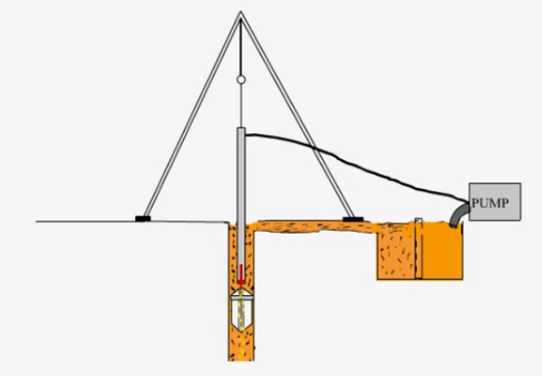

Slide 41
Wash Boring (contd)
Water is forced under pressure through the drill rod which is alternatively raised and dropped, and also rotated. The resulting chopping and getting action of the bit and water disintegrates the soil.
The cuttings are forced up to the ground surface in the form of soil-water slurry through the annular space between the drill rod and the casing.
The slurry is collected and samples of materials are obtained by settlement.

Slide 42
Boring
Can penetrate beds of hard soil or soft rock
Augur or Rotary Drilling can be used.
Precast and In-situ piles may be used.

Slide 43
Cofferdams
Cofferdams may be defined as a temporary structure constructed in a river or a lake or any other water bearing surface for excluding water form a given site to enable the building operation to be performed on dry surface.
Cofferdams may be divided into the following category based on the materials used during construction:
    Earthier cofferdam.
    Rock fill cofferdam.
    Single-walled cofferdam.
    Double-walled cofferdam.
    Crib V
    Cellular cofferdam.(Circular or diaphragm type)

Slide 44
Caissons
Caissons are water light structures made up of wood, steel or reinforced concrete, constructed in connection with excavation for foundations of bridges, piers, abutments in river and lake dock structure fore shore protection etc.
The caisson remains in its pose and ultimately becomes as integral parts of the permanent structure.
Caisson can be broadly classified into the following three types:
    Open Caisson
    Box Caisson (Floating Caisson)
    Pneumatic Caisson

