Slide 1
Surface Finishing
Welcome to Our
Presentation
Submitted to : Md. Shariful Islam
Md. Maksimul Islam

Slide 2
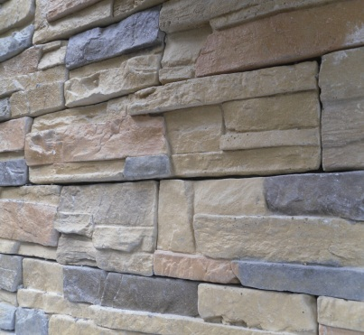
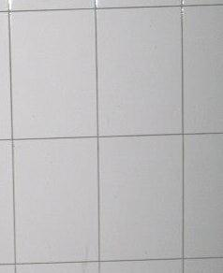
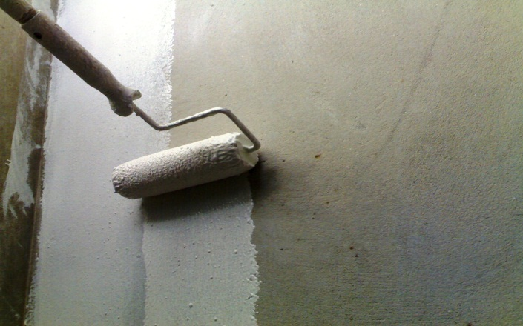
Objectives
To understand surface finishing
To know different types of surface
finishing
To learn the process of surface finishing.

Slide 3
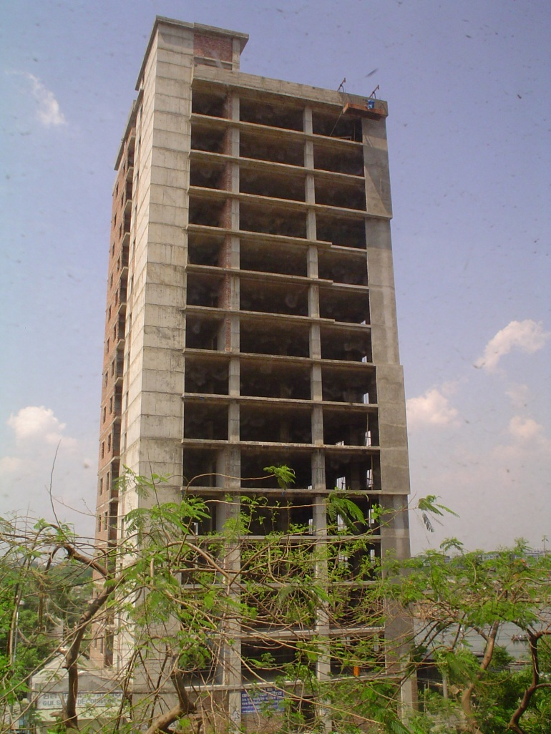

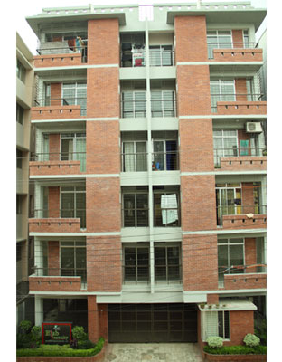
What is Surface Finishing ???
Column
Slab
Beam
art of covering surface
Final touch of any construction

Slide 4
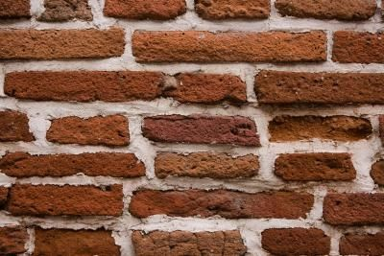
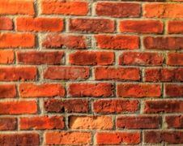
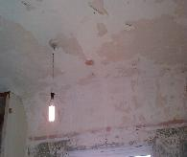
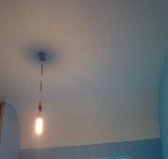
Purposes of Surface Finishing
to protect the surface from weathering effect
to make the surface decorative
to provide a smooth surface
Without
With
Without
With

Slide 5
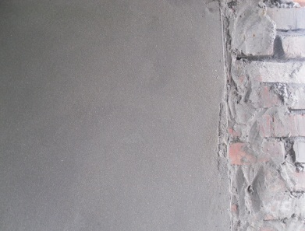

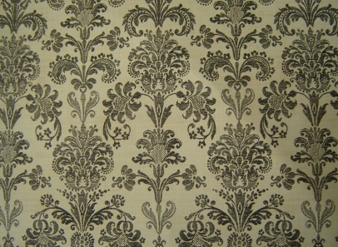
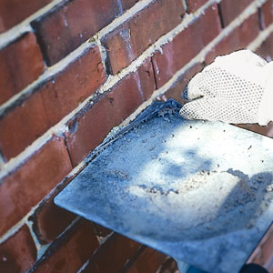
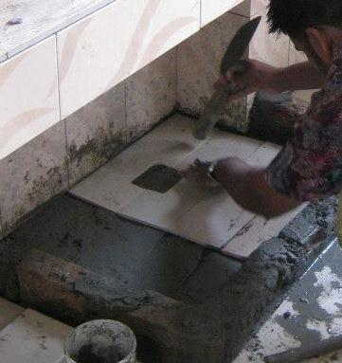
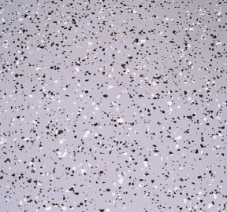
Types of Surface Finishing
Wall Finishing
Interior Wall Finishing
Exterior Wall Finishing
Floor Finishing
Plastering
Painting
Wall paper
Pointing
Tiles Fitting
Mosaic

Slide 6
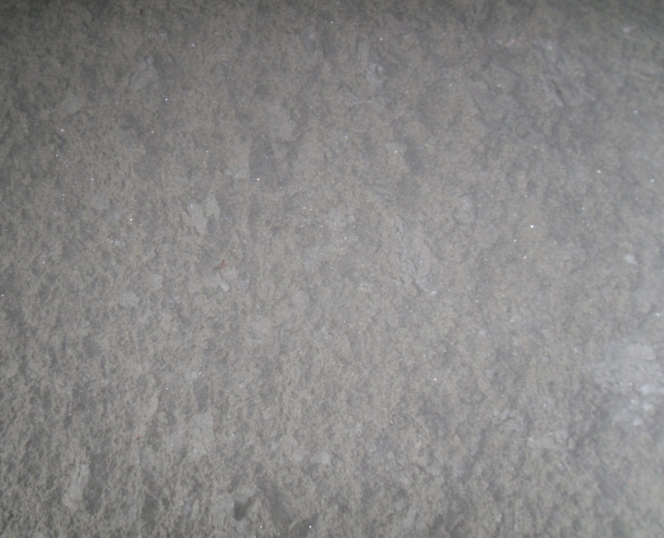
Plastering
Internal and external application of solid materials
Solid materials comprise of
Sand
Lime or cement
Other additives
Materials are applied wet in coats.
To provide smooth, hard surface finish

Slide 7
Purposes of Plastering
To provide an even, smooth, regular, clean and durable finished surface.
To protect the surface
To conceal the defective workmanship.

Slide 8
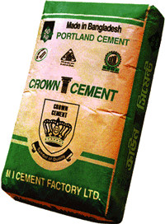
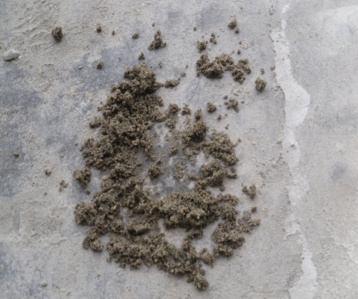
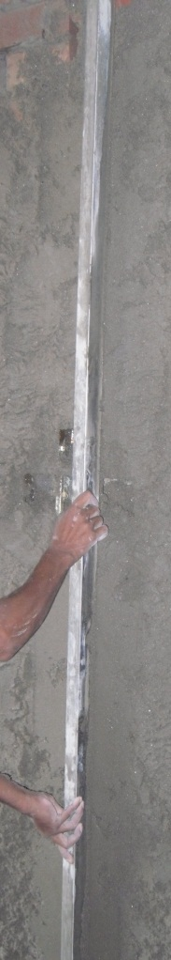
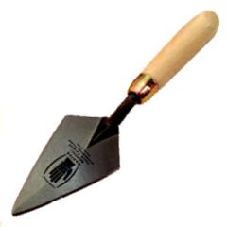
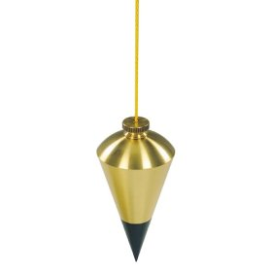
Materials and tools
Bulk Coarse Sand
Cement
Plumb Bob
Trowel
Leveler
Notes:
Check the Fm

Slide 9
Steps of Plastering
Preparation of Mortar
Applying Mortar to Wall
Leveling the applied Mortar
Checking if the wall is vertical
Curing
Fully Plastered Wall

Slide 10
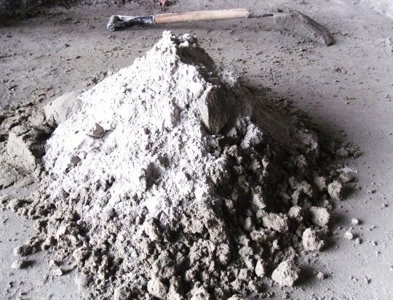
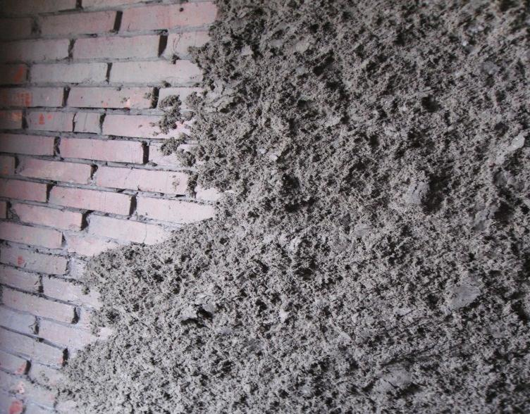
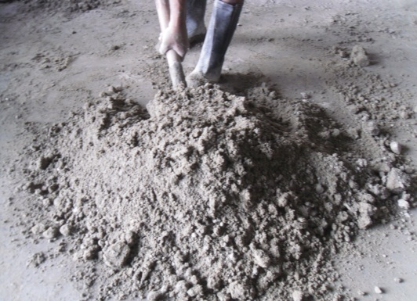
Steps of Plastering
Preparation Of Mortar
Applying Mortar to Wall
Cement : Sand :-
for wall 1:4
for ceiling 1:3
Mixing of cement and bulk sand.
The look of the wall after applying mortar

Slide 11
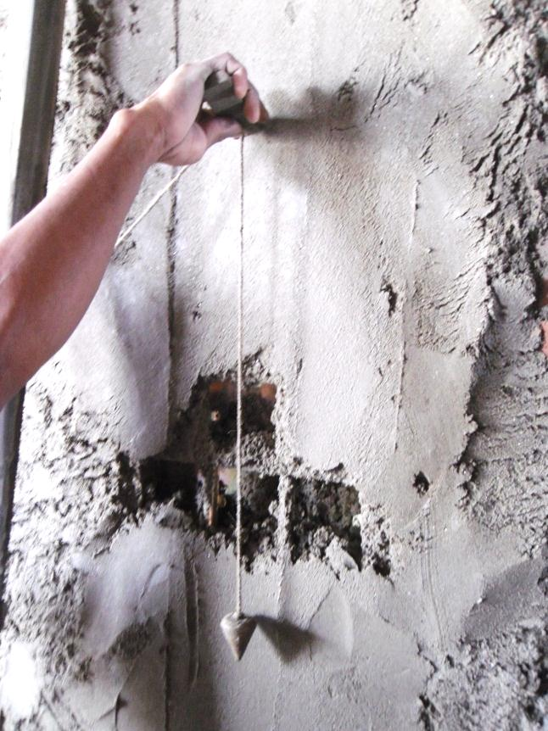
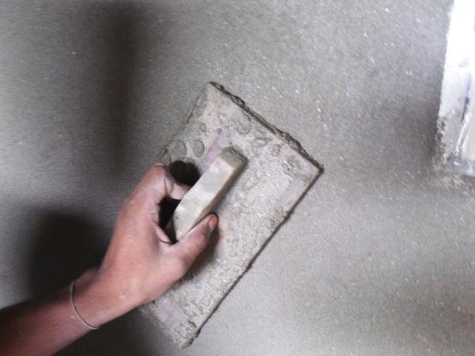
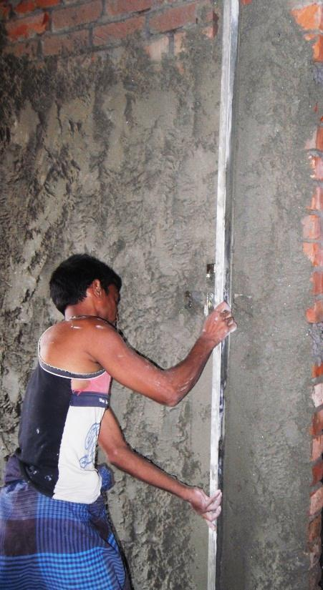
Steps of Plastering
Leveling the applied Mortar
Checking if the wall is vertical
Leveling with
Trowel
Leveling Rod
Plumb Bob

Slide 12
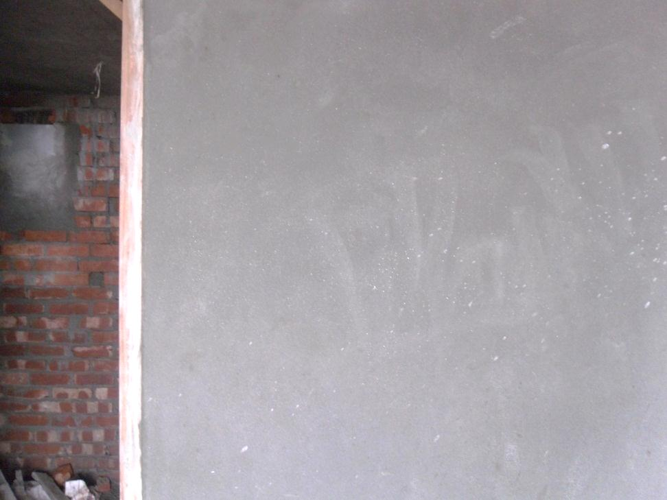
Steps of Plastering
Plastered Wall
Things to be taken care of
water should not be used
while applying mortar
Curing should start after
24 hours.

Slide 13
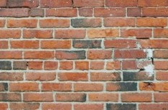
Pointing
Final treatment done to the joints of the masonry
Purpose:
To increase durability of exterior wall
To improve the appearance
Process:
Removal of dust from joints
Washing the surface
The mortar is then carefully placed
The finished surface is
well-watered for a period of time

Slide 14
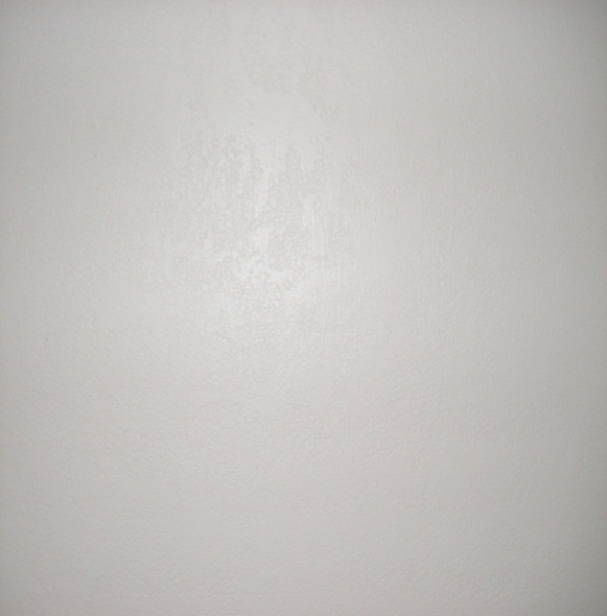
Painting
Application of oil paint to timber, metal and plaster.
Paint is
A protective or decorative layer.
Composed of i. liquid medium
ii. A coloring agent
iii. Other agent
Applied in Coats
to provide a pleasant appearance.
Notes:
Liquid medium- linseed oil or water
Coloring agent – pigment
Other agents - to flow or drying of paint

Slide 15
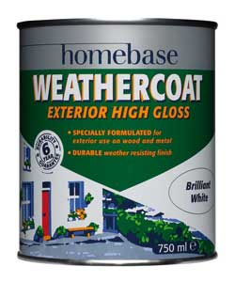
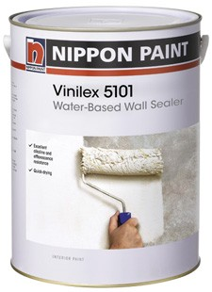
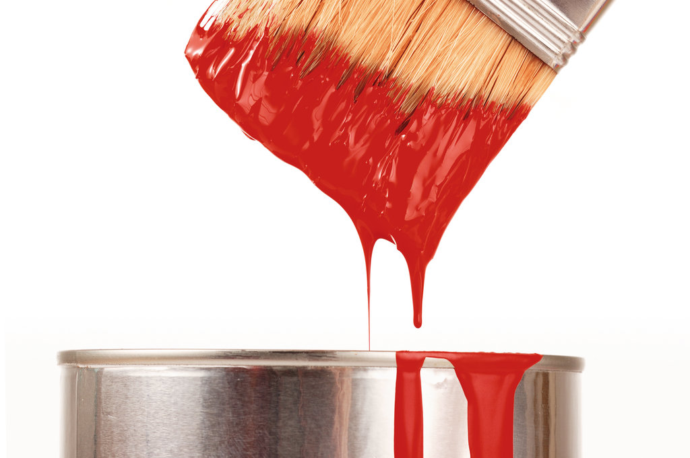
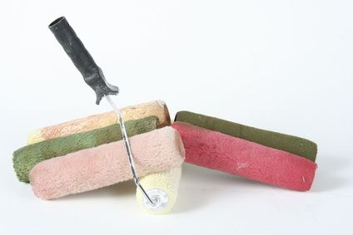
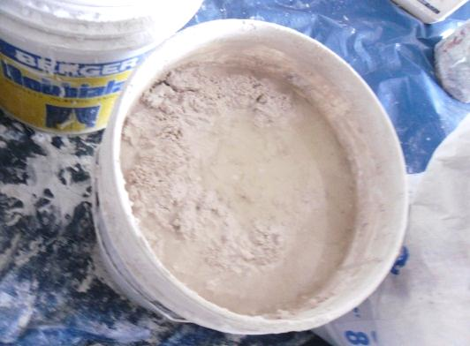
Materials and tools
Weather coat
Sealer
PAINT
Roller
Putty
Notes:
Nippon Vinilex 5101 Water-Based Wall Sealer is suitable for masonry surfaces. It is formulated to prevent deterioration of emulsion paints by alkalinity of surfaces. This wall sealer is recommended for use in both interior and exterior plastered walls, ceilings, plaster, brickwork and wall boards. Based on specially formulated acrylic it is designed to provide maximum protection against alkali and moisture, enhancing the performance of top coat. A water-based wall sealer stops liquid water from entering the surface, but allows water vapour out. It is a breathable product that can be applied to brick, concrete block, stucco or any masonry material.
Weather coat-Specially formulated weather beating formulation that gives a flexible, crack resisting, high gloss finish.
Putty-it easier to paint the wall. They told me that to use putty makes the wall flat and look nicer and you are able to paint the wall easily

Slide 16
Steps of Painting
Stone Throwing
Applying Sealer
Interior Wall
Exterior Wall
Applying Putty
Applying Weather Coat
Applying Paint
Painted wall
Painted wall
Notes:
All the application are coating

Slide 17
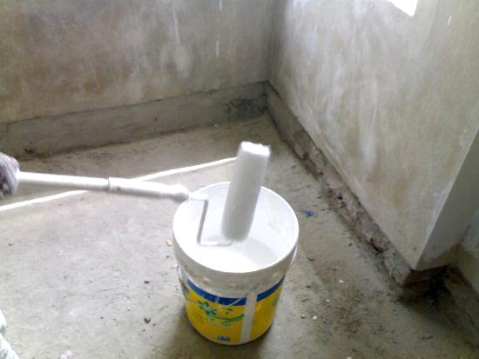
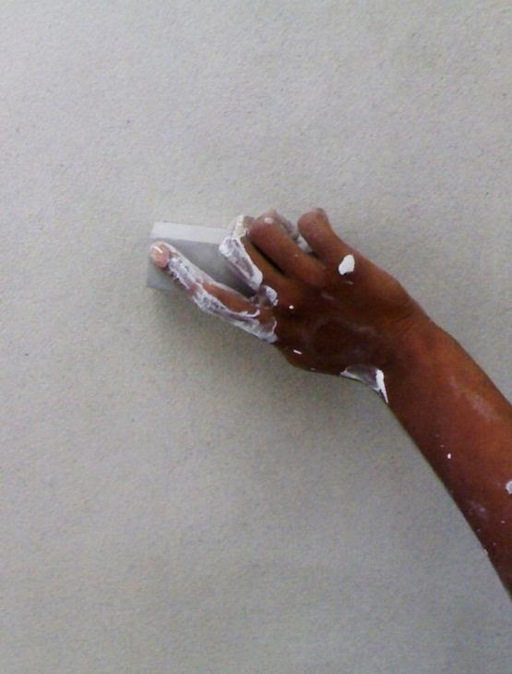
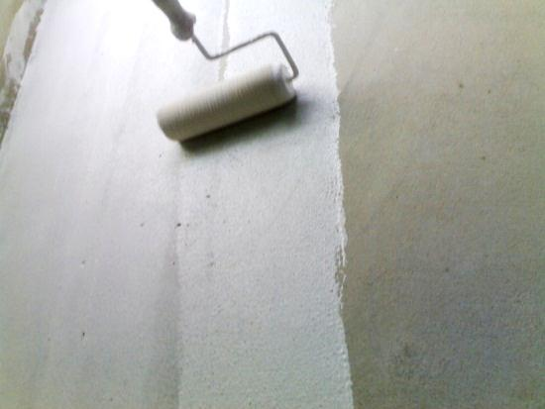
Steps of painting
Stone throwing
Applying Sealer
Stone
Sealer : Water:-
2:1
Removing the roughness of the wall.
Applying the first coat

Slide 18
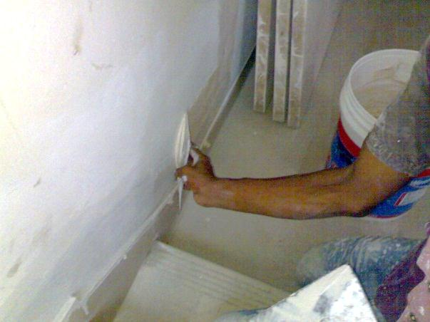
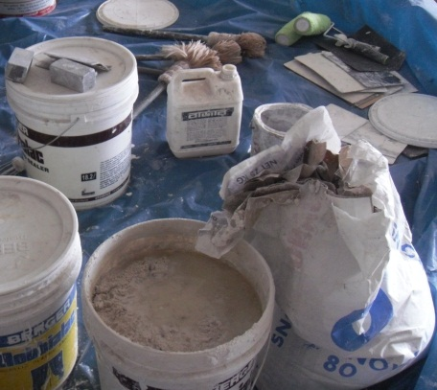
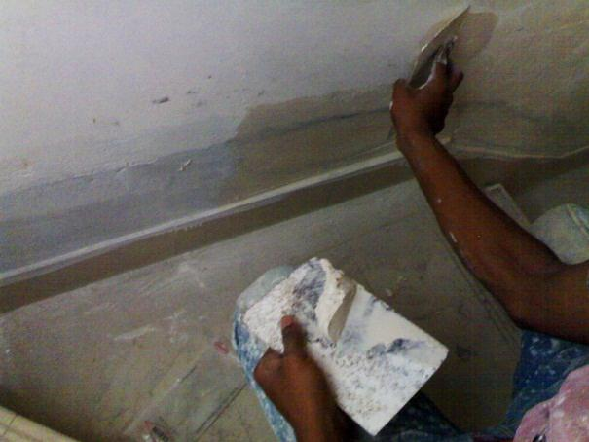
Steps of painting Interior wall
Making of Putty
Applying Putty
A glue type material
Composed of
Chalk Powder
Enamel Paint
Plastic Paint
Water
Applying putty along a line
Furnace asbestos

Slide 19
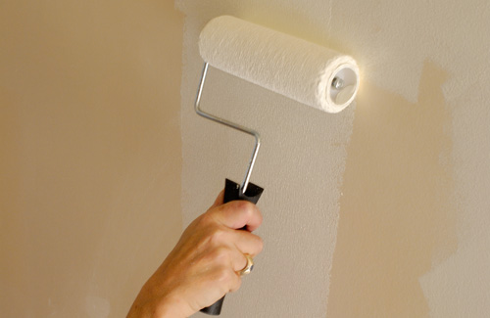
Steps of painting
Applying Paint
In Interior wall, paint is used after some preparation
In Exterior wall weather coat is used
In both cases paint is applied in 3 coats
Second coat is applied minimum 7 days after the first coating

Slide 20
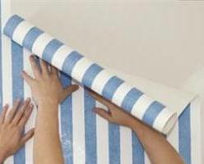

Wallpaper
A type of recent times interior
wall finishing
Wallpaper is
Roll paper material
Have printed pattern.
Pasted to wall or ceiling
Develops decorative finishing to
interior walls.
Pasting Wallpaper
Decorated Wall

Slide 21
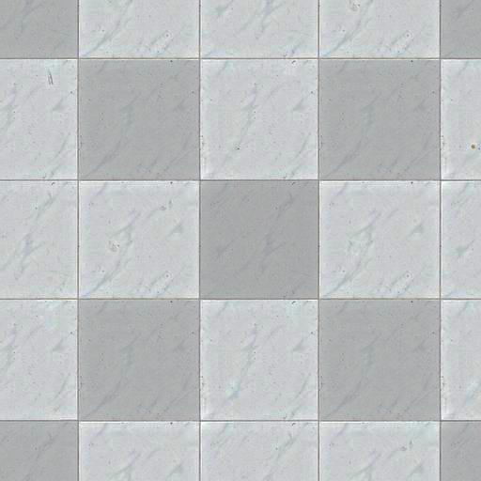
Tiles Fitting
Fitting of tiles in the floor.
Tiles is
A flat thin slab
Made of fired clay,
rubber, linoleum, etc.
Square or rectangular
and sometimes ornamental
To make the floor flat and decorative

Slide 22
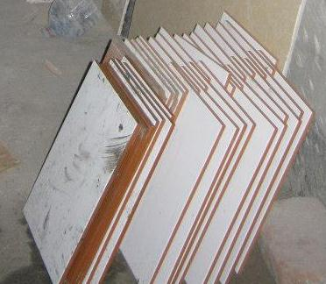
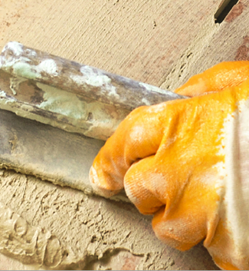
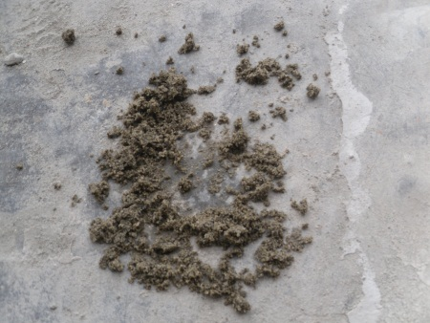
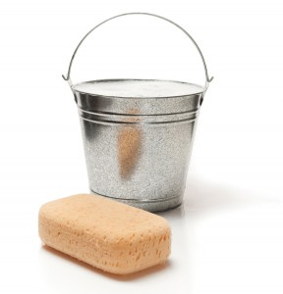
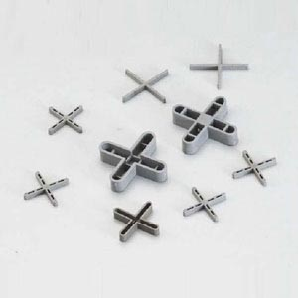
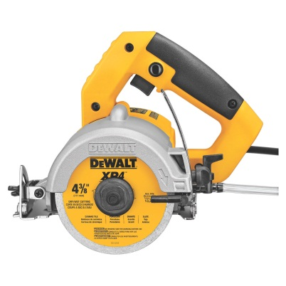
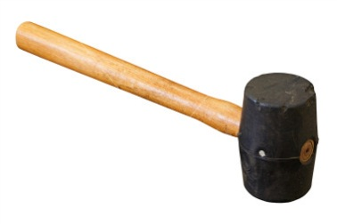
Materials and tools
Tiles
Cement
Bulk Sand
Grout
Tiles spacer
Hammer
Sponge and Bucket
Tiles Cutter

Slide 23
How to Fit a tile ???
Checking if the floor is level
Tiling the total surface area
Chipping the floor or the wall
Laying a thin set of mortar
spreading grout over the thin set
Fitting the tiles
Filling in the joints with grout
Ceramic Floor Tiles

Slide 24

fitting tiles
Checking if the floor is level
Tiling the total surface area
Find out the center of the room with tape measure
Done with a leveling tool such as spirit level
To ensure the progress of further work without problem
For proper initialization of tiles fitting.
To find out the required amount of tiles needed for the work done.

Slide 25



fitting tiles
Laying a thin set of mortar
Chipping the floor or the wall
Chipping the floor with hammer
Thin set of mortar
Appearance of a wall after chipping
Grout

Slide 26



fitting tiles
Fitting the tiles
Spreading grout over the thin set of mortar
Taking necessary measurement
fitting the tiles with hammer

Slide 27


fitting tiles
Cutting the tile
Filling in the joints with grout
Filled with grout (made of white cement)
Sometimes necessary to cover the extra space
Joints between the tiles

Slide 28

fitting tiles
Things to be taken care of
Ceramic Floor Tile
Good workmanship is a must
water screening test :
to check that no water
is penetrating through tiles

Slide 29
Mosaic
made up from small pieces of glass and stone
provides durable walking surface
Process:
Cleaning the floor
Preparing and applying the thin set
Setting the mosaic in place over the thin set
Continually to clean the mosaic surface
Allowing the recommended thin set manufacturer time to dry.
To grout the surface of the marble mosaic

Slide 30
Prepared By:
1004002 - Azmayeen Rafat Shahriar
1004007 - Sarsiz Alam
1004016 - S.Mm Mahmudul Haque
1004021 - Iftekhar Mahmud
1004026 - Md. Abdul Hannan Prodhan
1004032 - Shah Waliul Hoque Chowdhury
1004038 - Pritom Paul
1004046 - Sk. Md. Mashrur
1004051 - Mousumy Aktar
1004056 - Asaduzzaman Pintu
1004063 - Md Arafat Saklain

Slide 31


