Slide 1
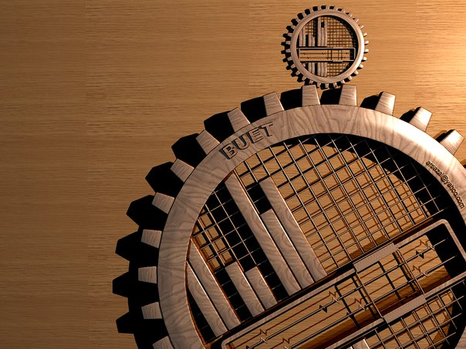
BANGLADESH UNIVERSITY OF ENGINEERING & TECNOLOGY.
COURSE NO :
CE 200
COURSE TITTLE :
DETAILS OF CONSTRUCTION.

Slide 2
Observing the process of foundation.
Group: II

Slide 3
Foundation
What is foundation?
Purpose of foundation.
Types of foundation.

Slide 4
Classification of foundation
Foundation
Deep/Pile
Foundation
Pile
Caission
Shallow
Foundation
Single
Continuous
Combined
Wall
Mat
Strap
Cofferdams
Cast in situ
Precast

Slide 5
Cast in situ
The machines
Reinforced bar
Piling process
Drilling
Driving the pile
Pouring CC

Slide 6

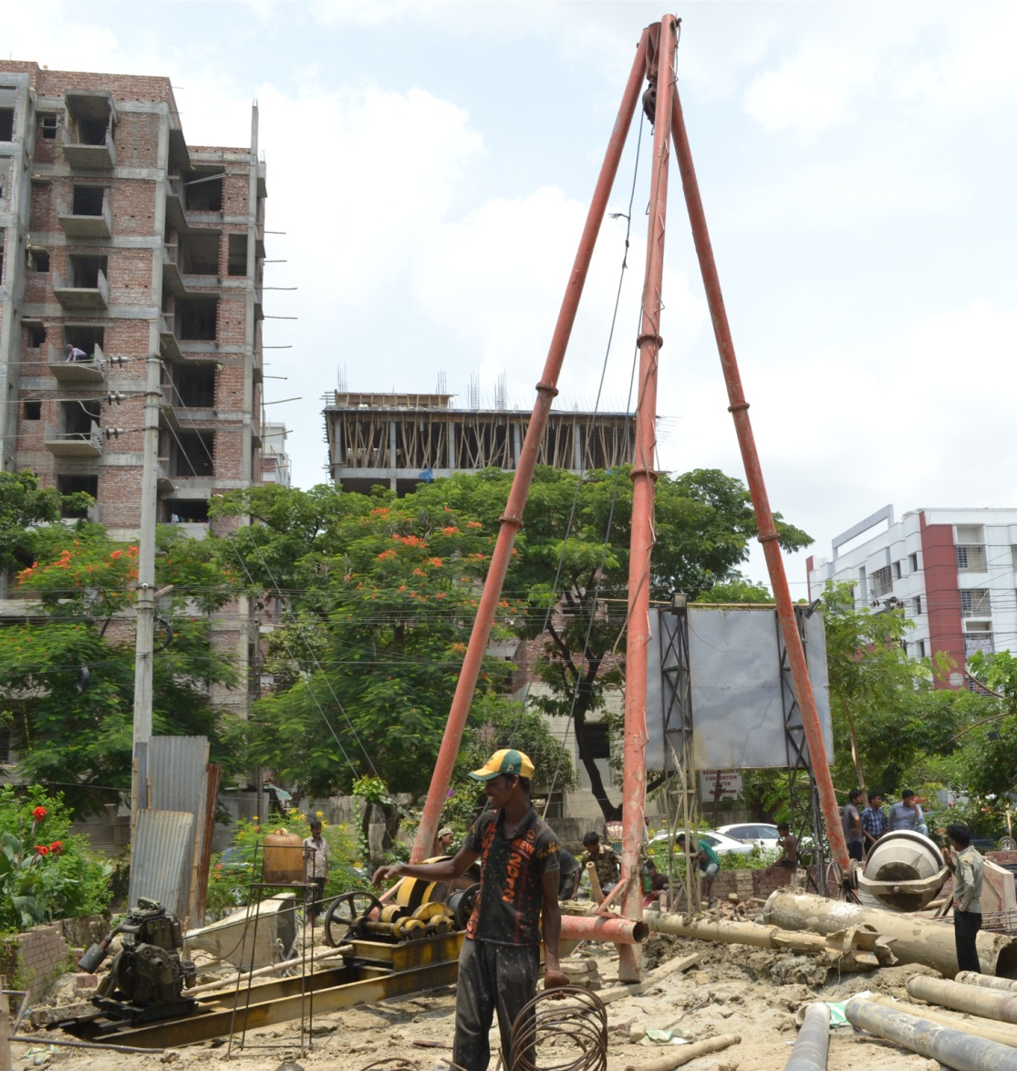
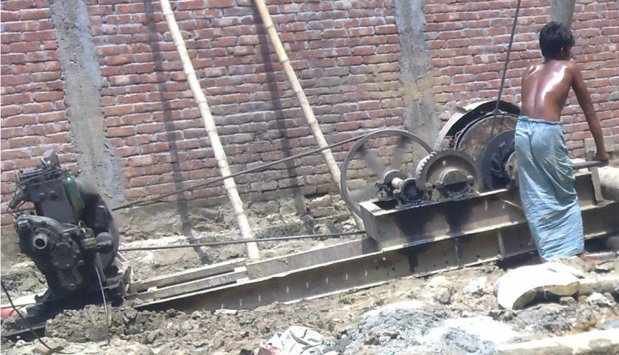
The machines
TRI POD
WINGS MACHINE

Slide 7
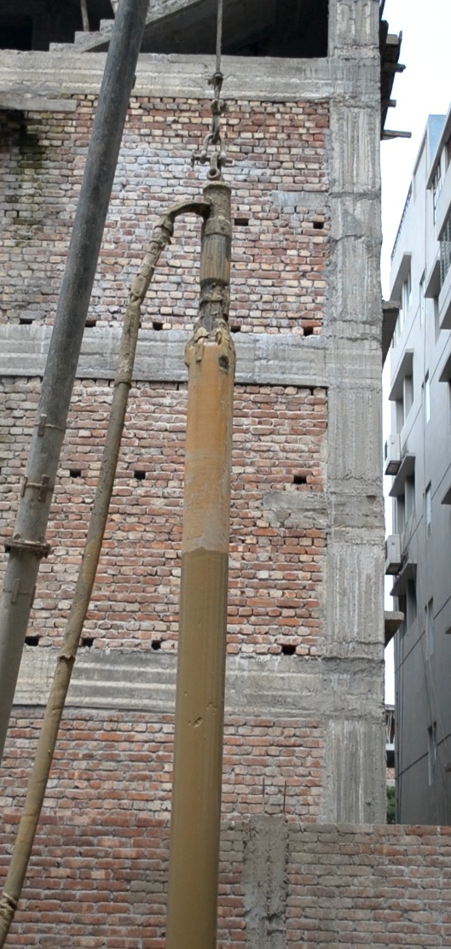
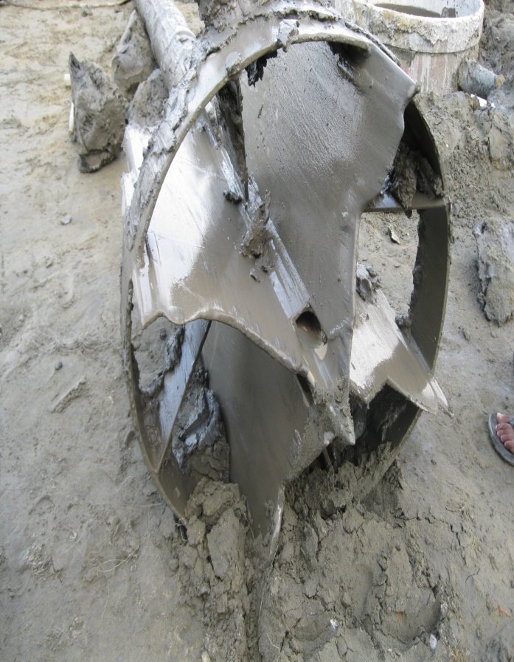
ROPE
DRILLING PIPE
HOSE PIPE

Slide 8
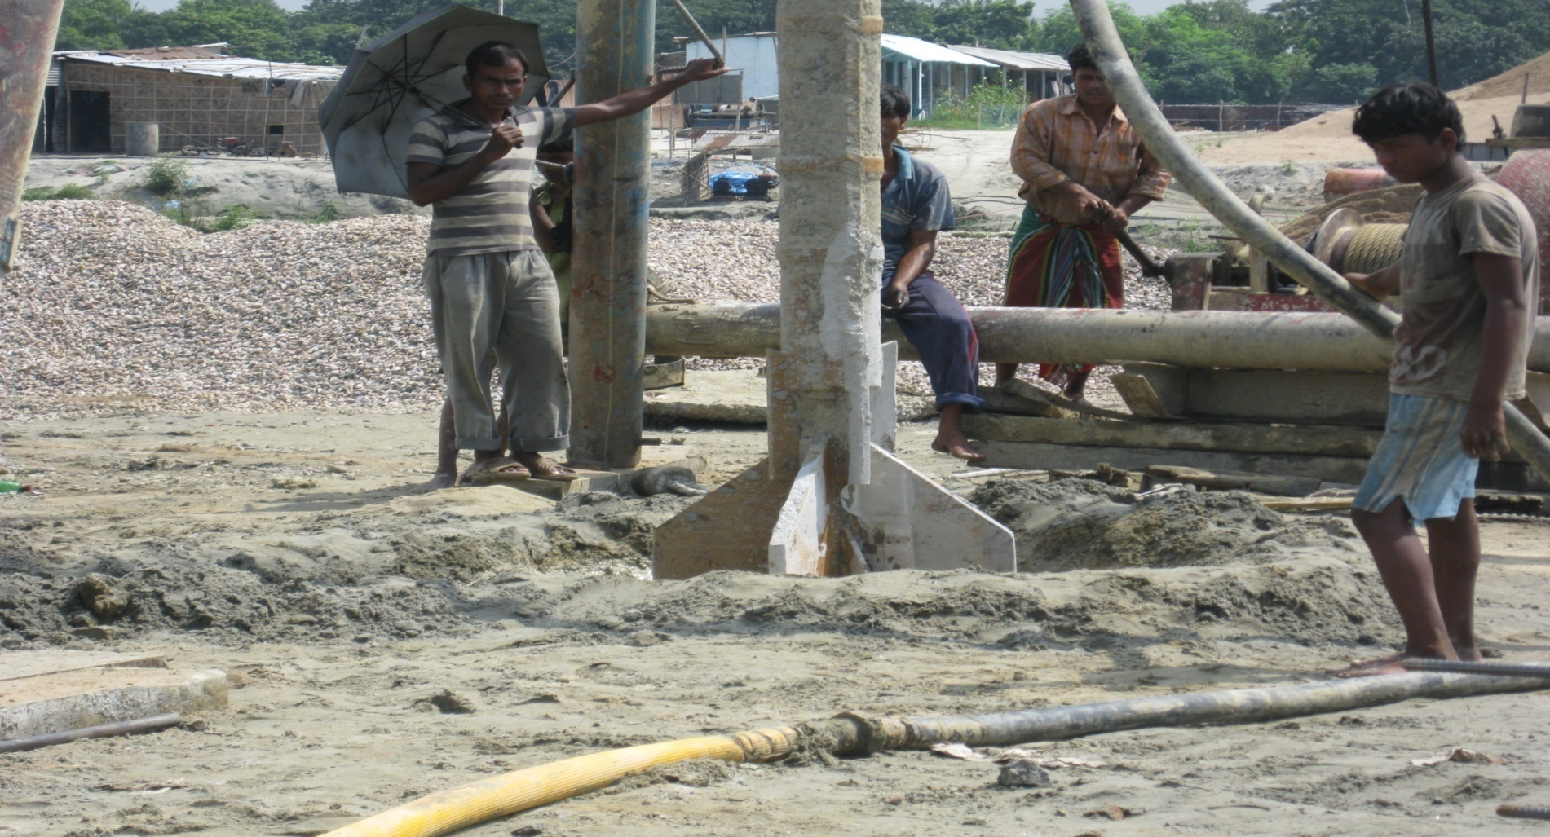
BORE PIPE
.

Slide 9
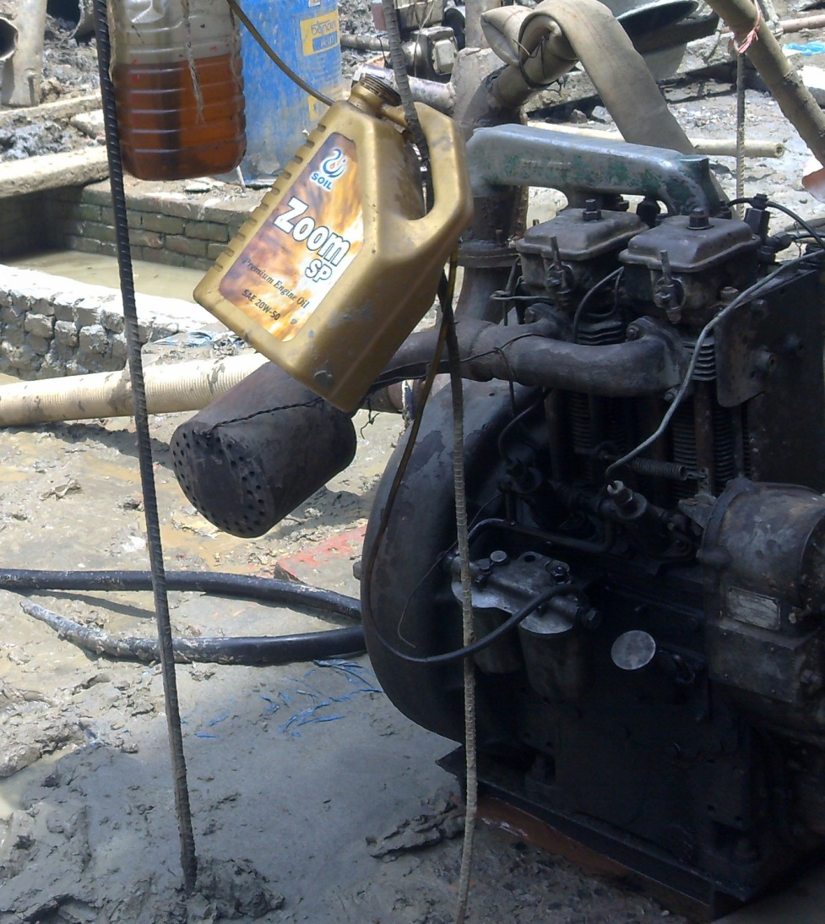
Pump

Slide 10
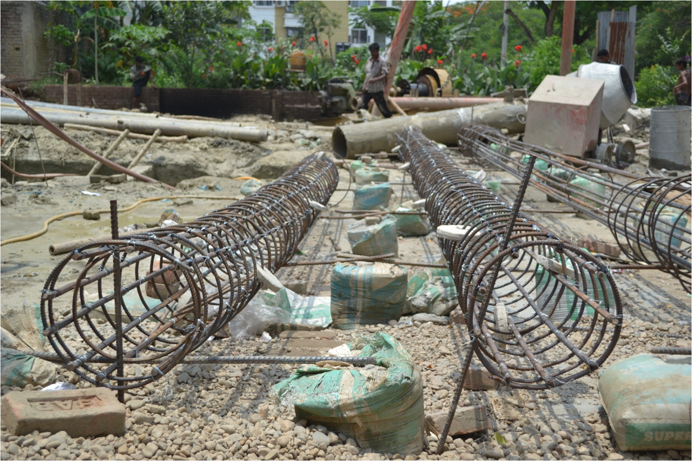
Reinforced bar

Slide 11
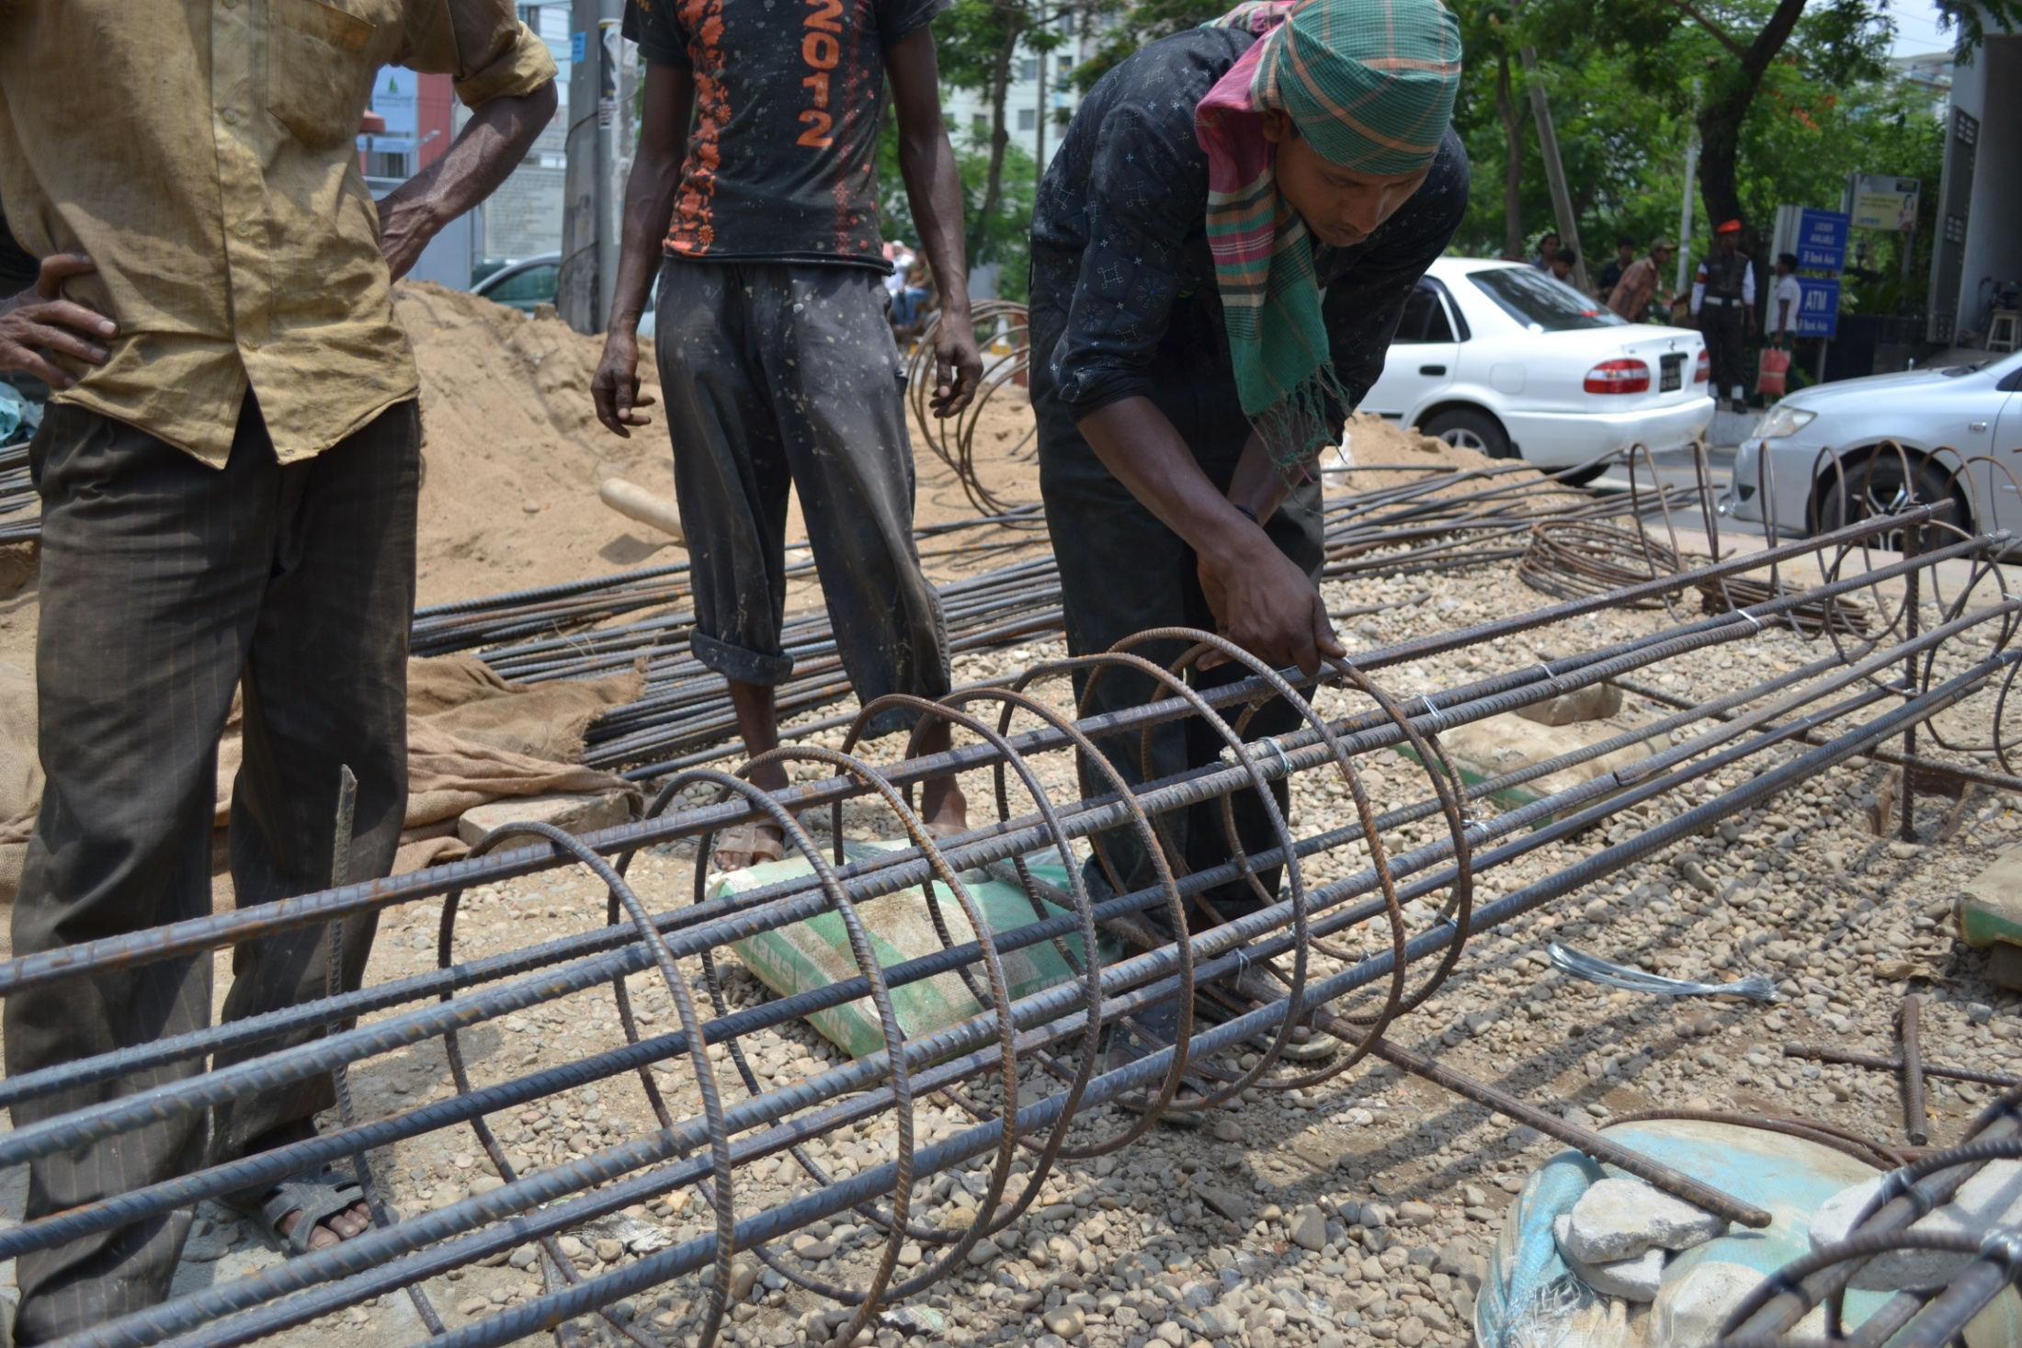
Main components of reinforced bar:
Main Bar
Spiral

Slide 12
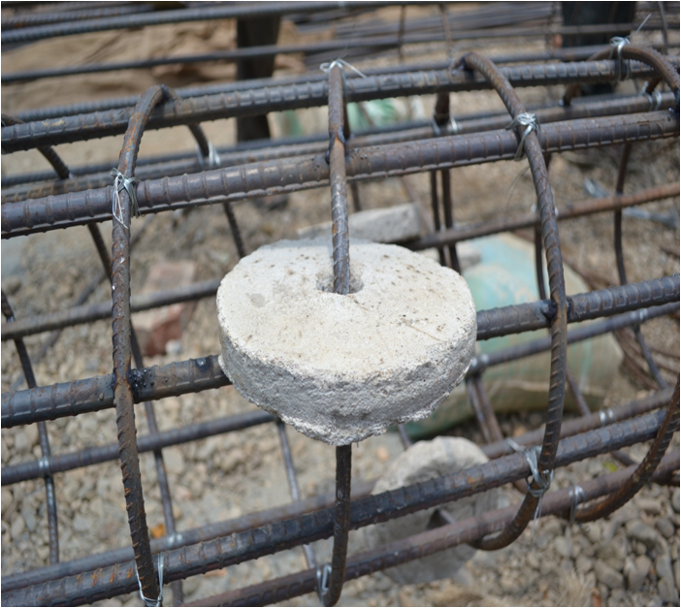
Main Bar
Spiral
Disks

Slide 13
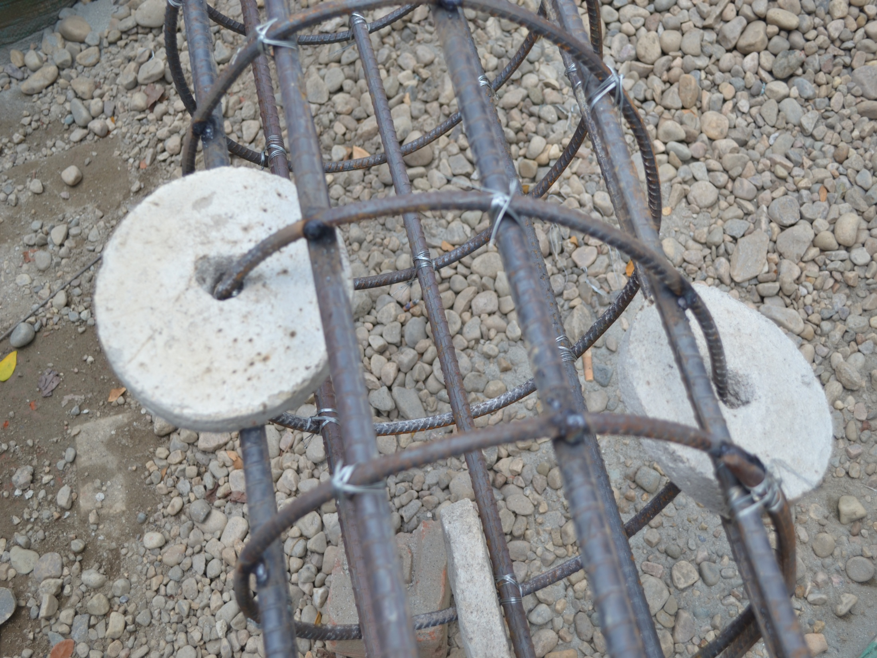
Main Bar
Spiral
Disks
Joints

Slide 14
The Drilling process

Slide 15


Slide 16
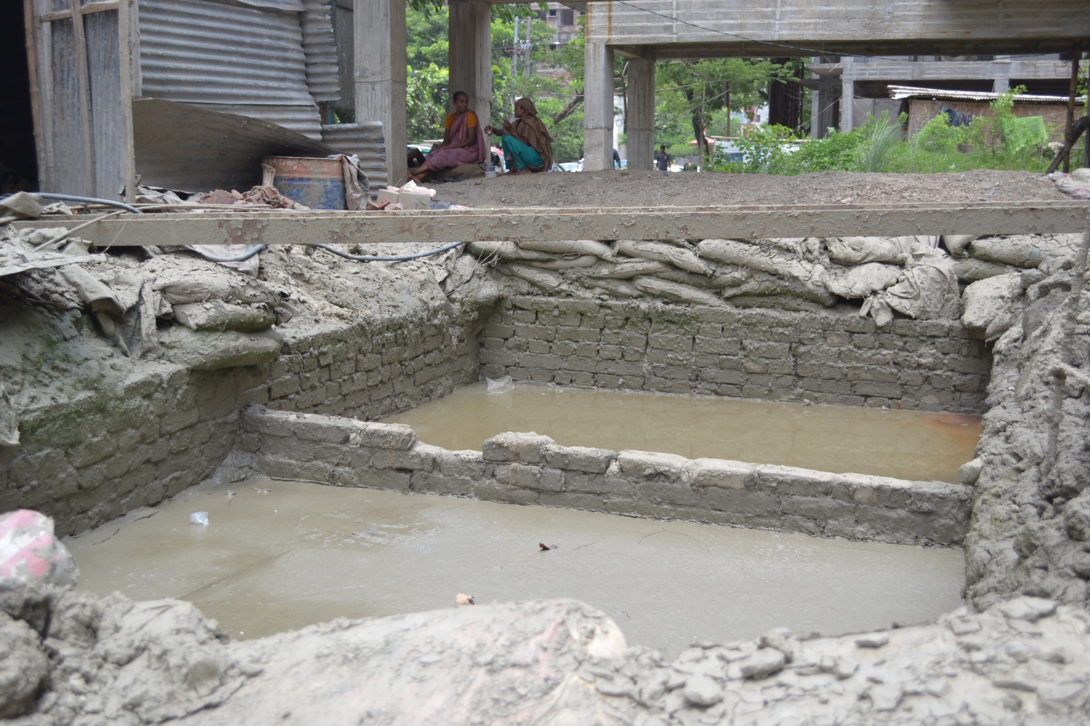
Water source
Connected to
Hose pipe
Water and mud
From bore whole

Slide 17
Driving the pile

Slide 18
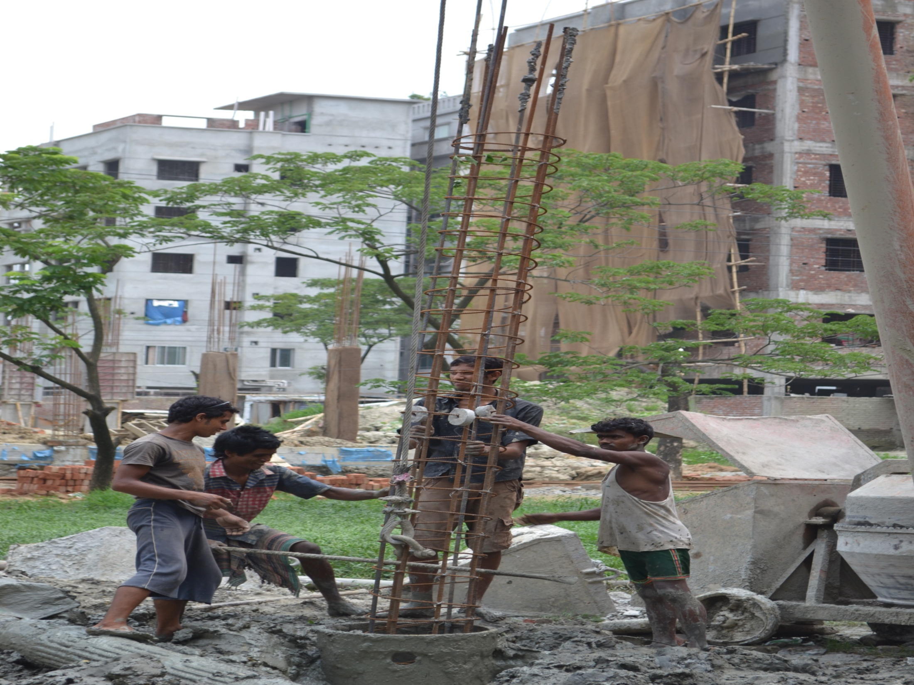
Uplifting

Slide 19
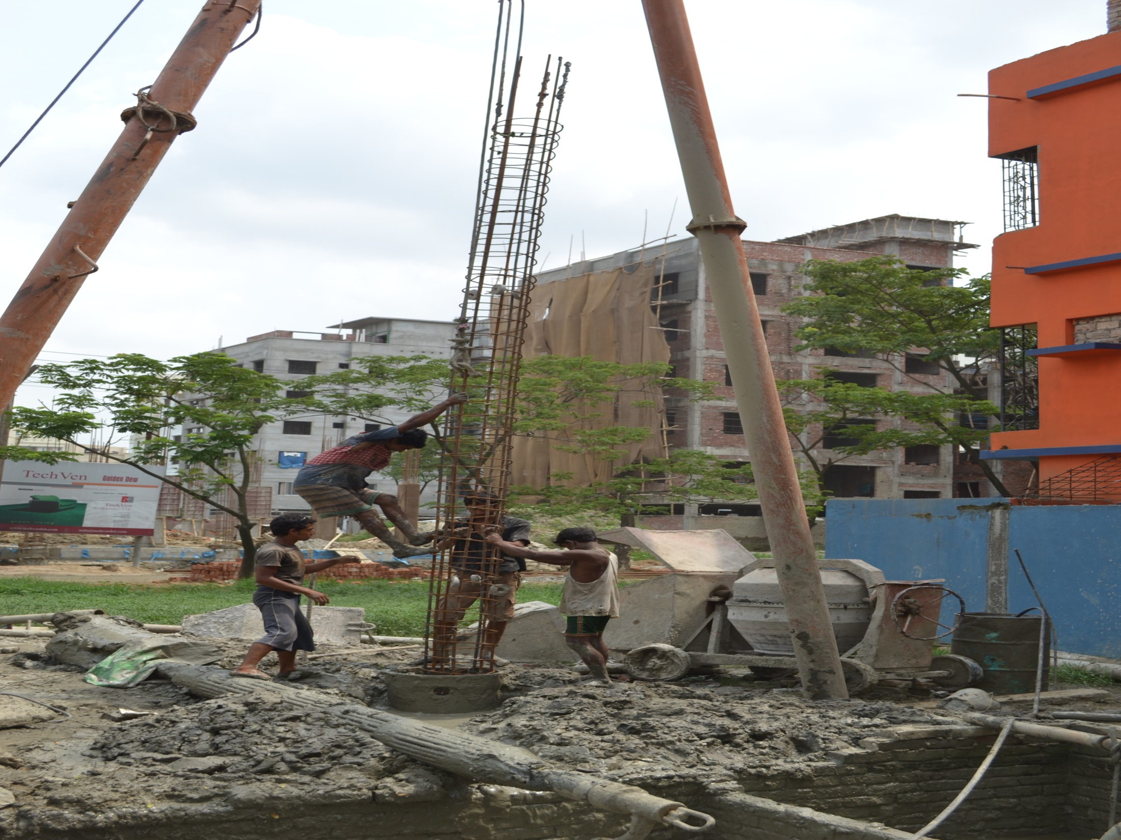
Driving and setting

Slide 20
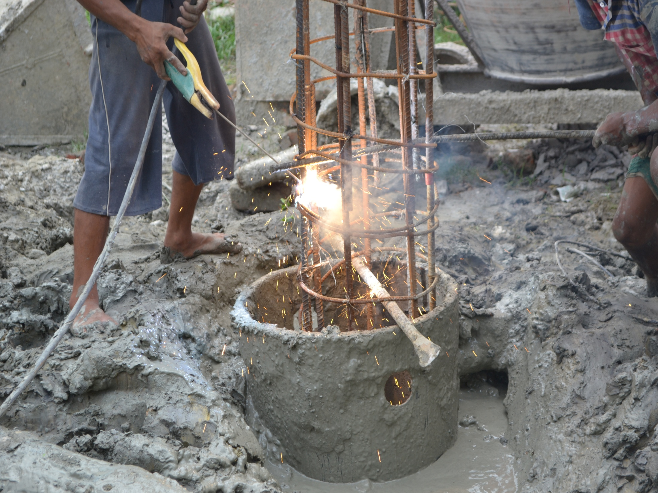
Lapping

Slide 21
SETTING UP
TREMIE PIPE

Slide 22
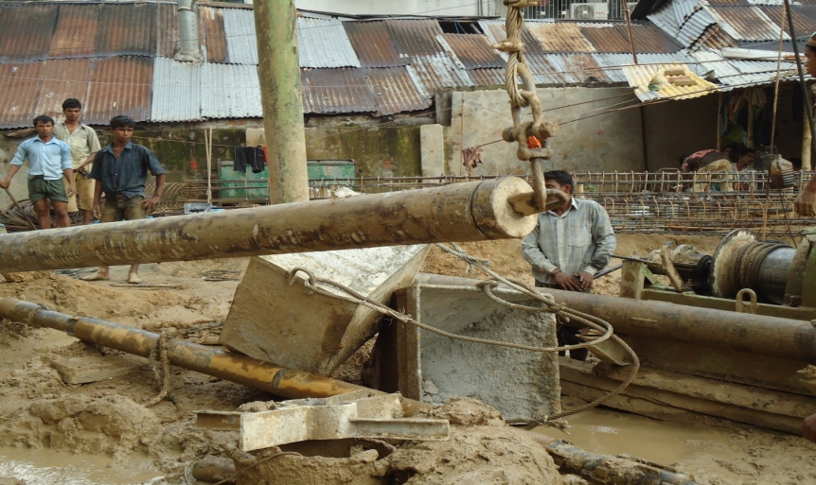
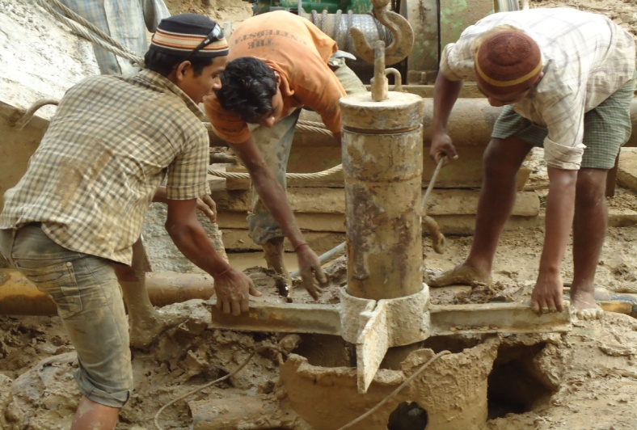
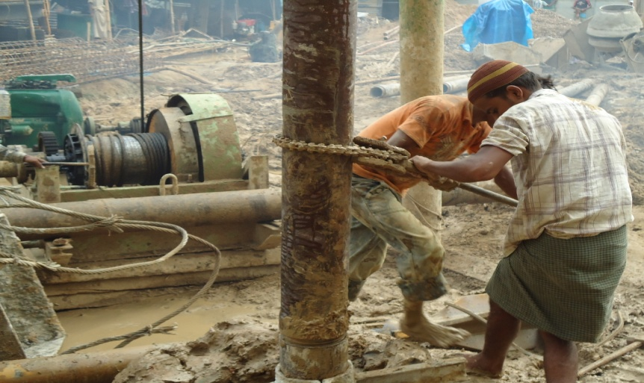
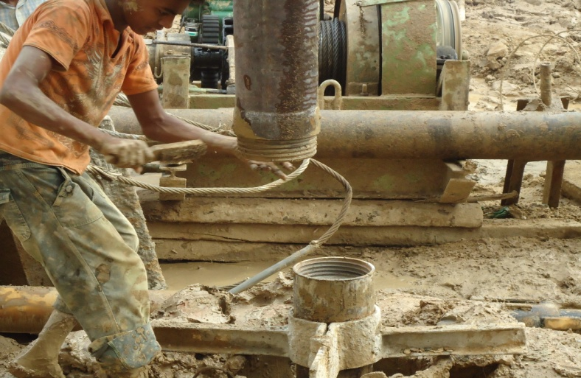
UPLIFTING
CLAMPING
THREADING WITH CHAIN
JOINING

Slide 23
Pouring CC

Slide 24
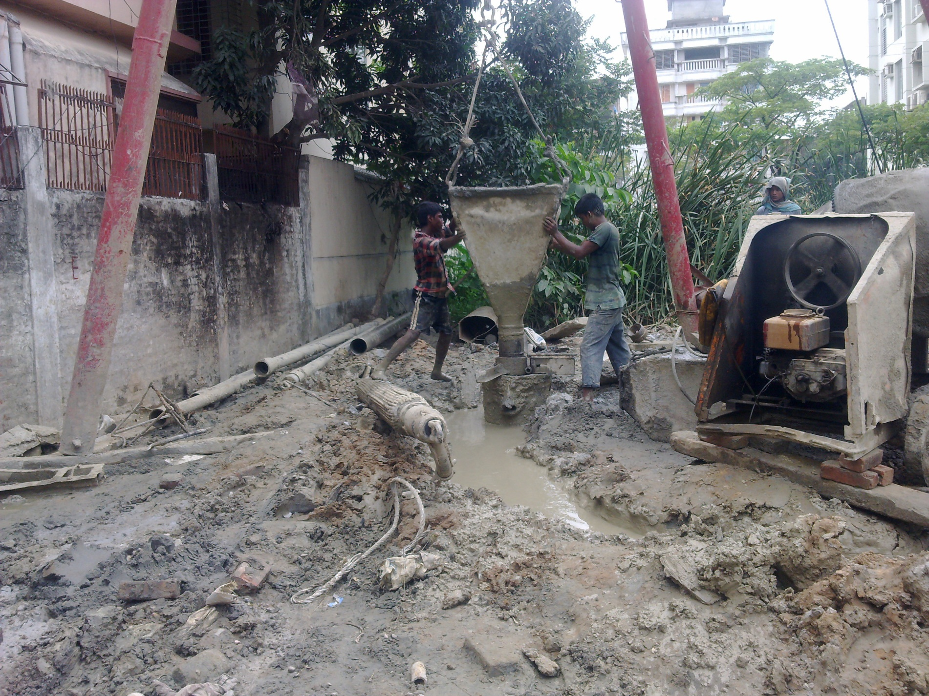

Slide 25
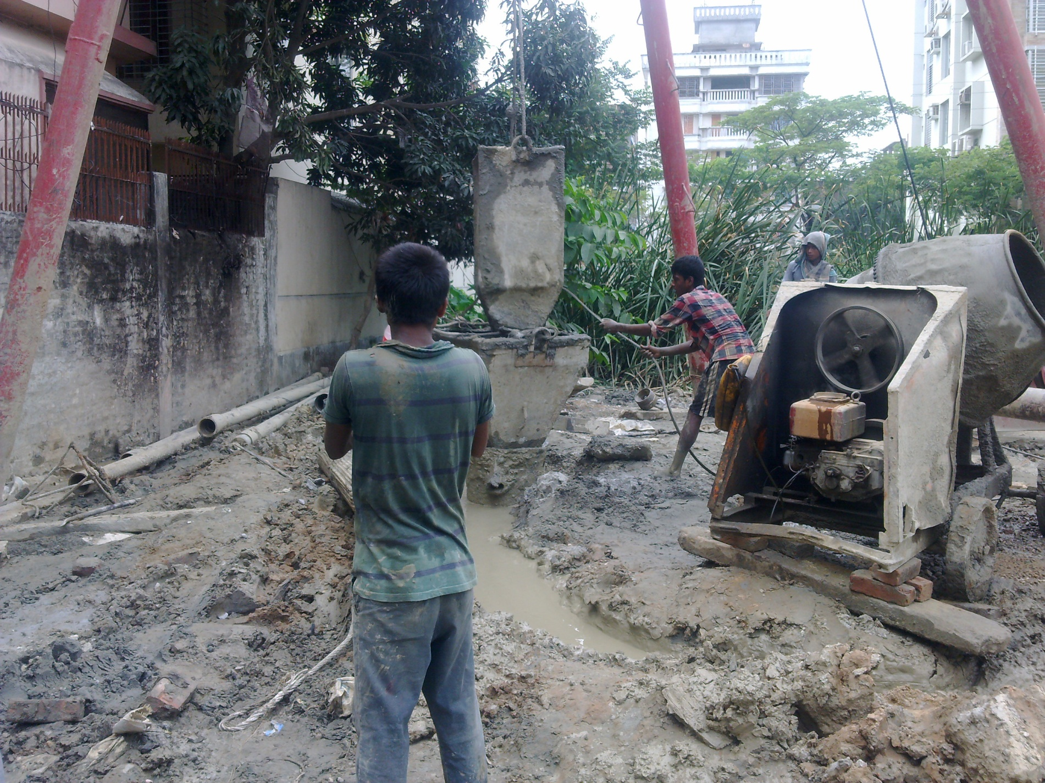

Slide 26
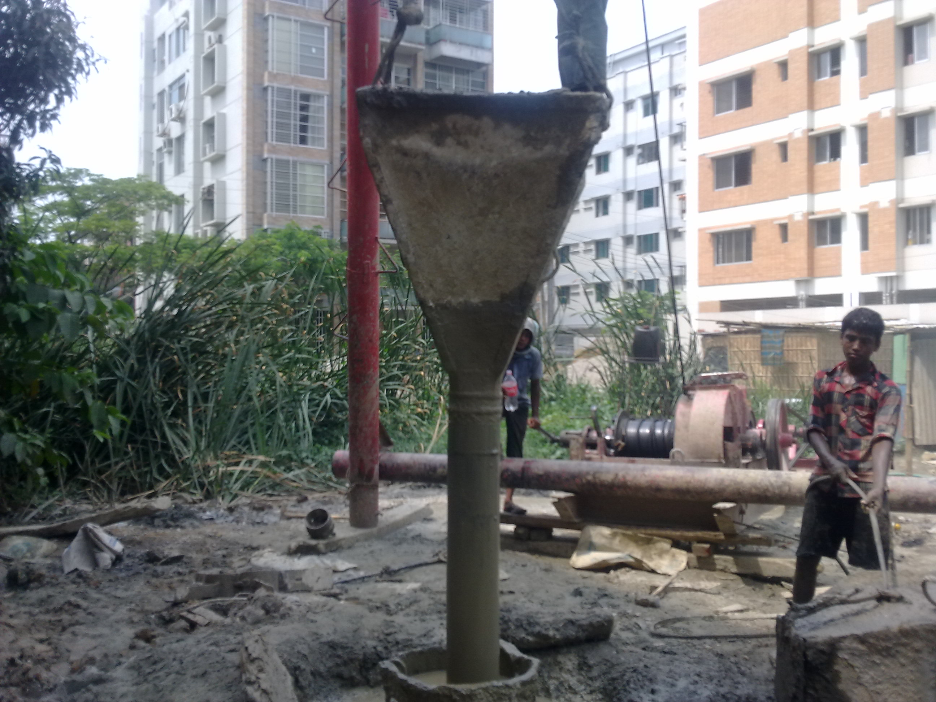

Slide 27
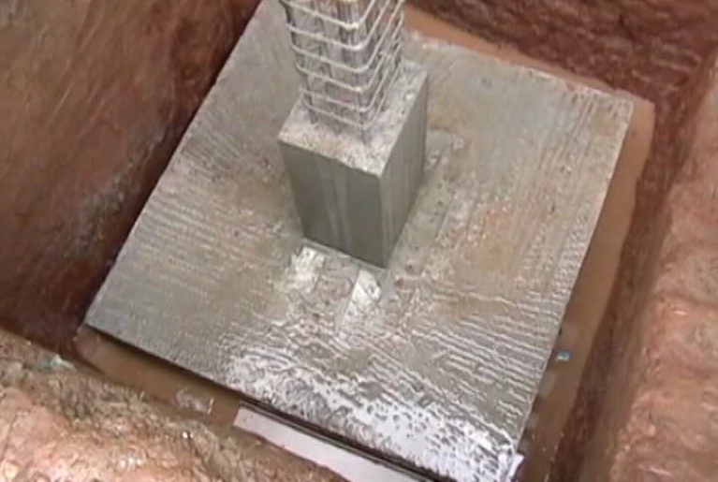
Shallow Foundation

Slide 28
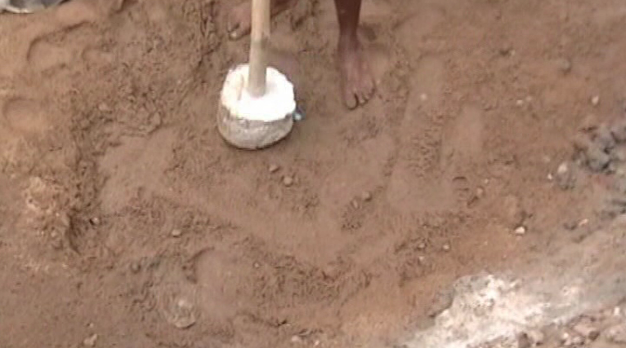
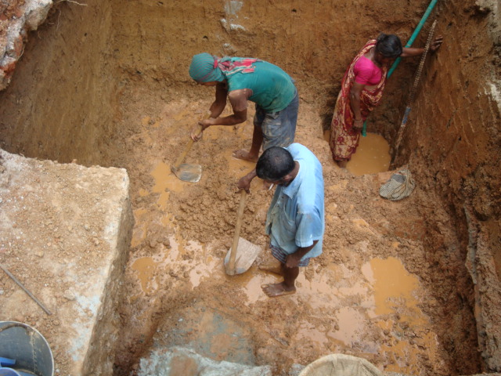
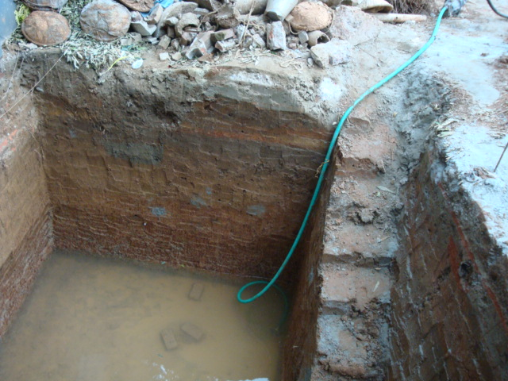
Excavation
Removing water
Leveling the soil

Slide 29
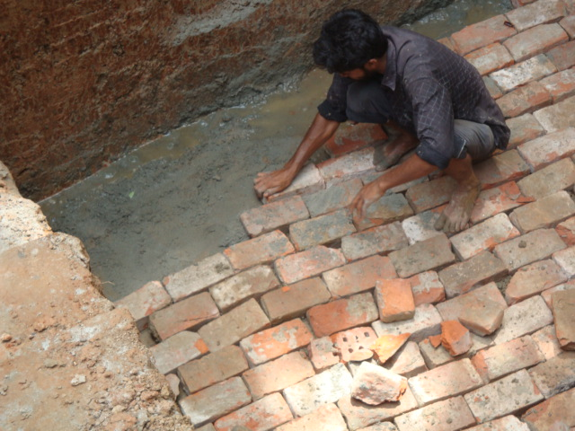
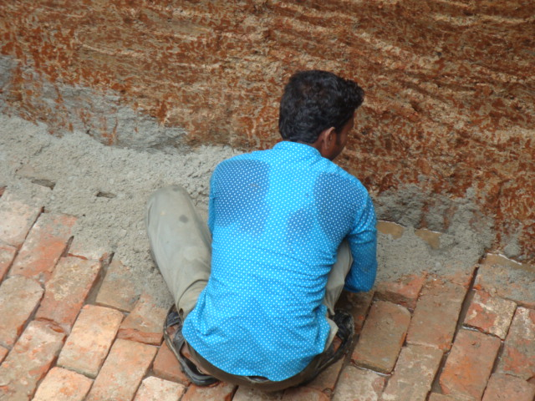
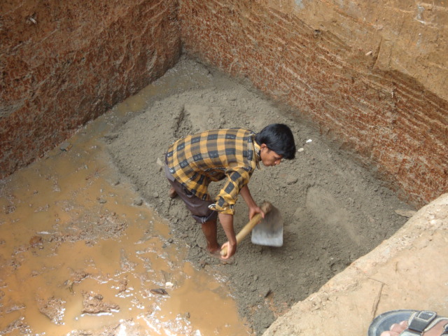
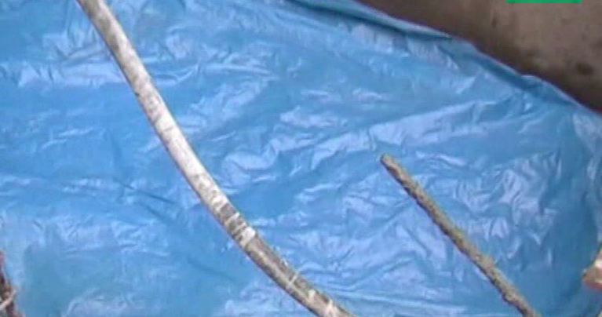
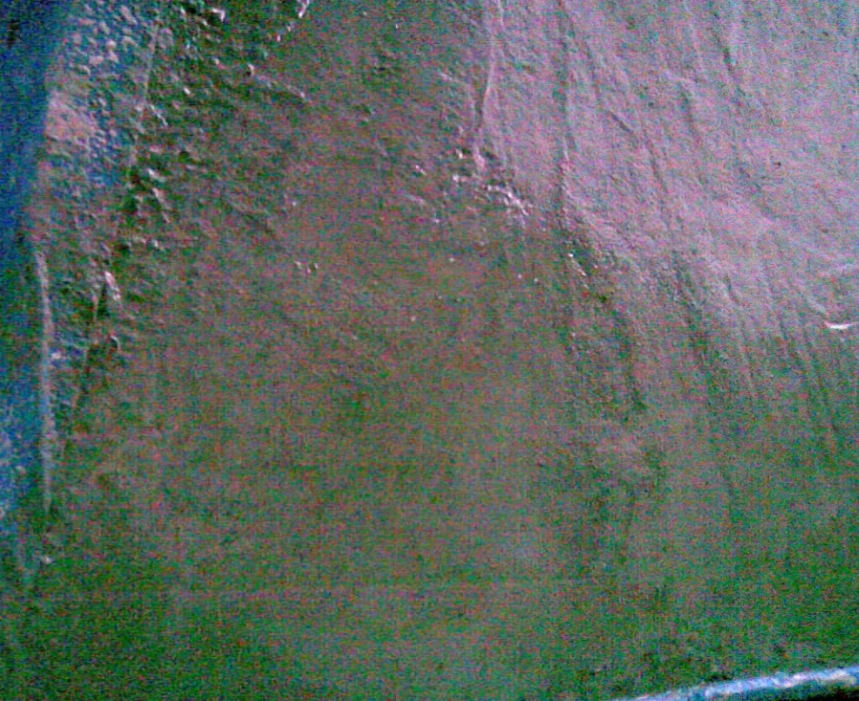
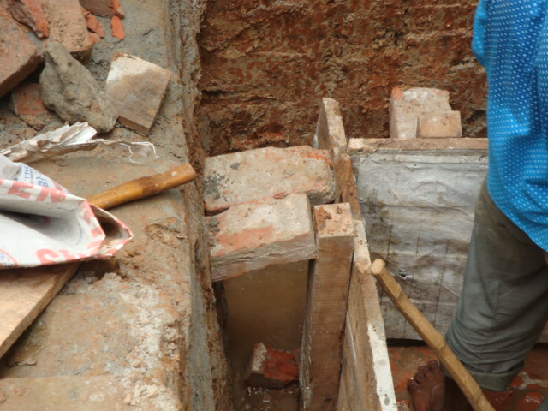
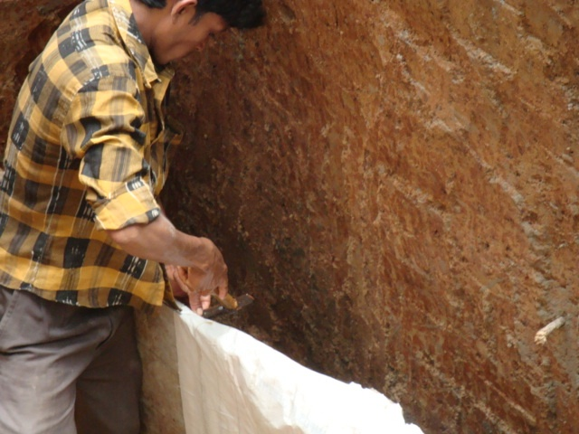
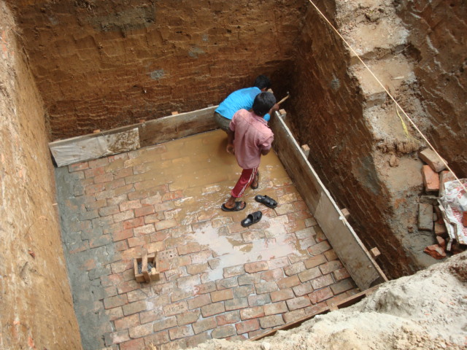
Filling Sand
Brick Placing
Filling Gap
Polythene layer
Shuttering
Given C.C. layer
Leak proofing
Given Clear Cover

Slide 30
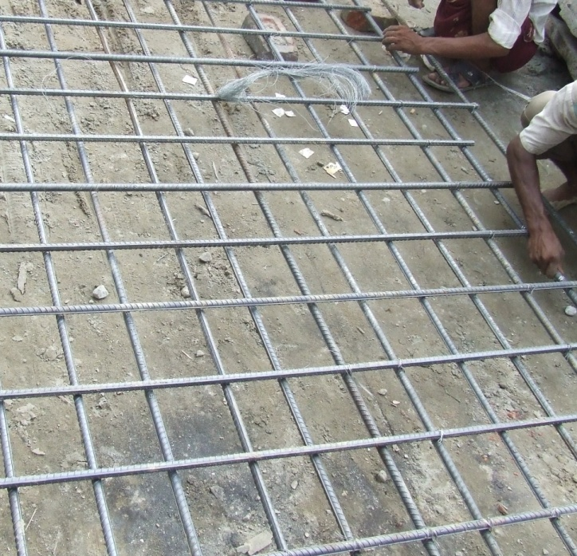
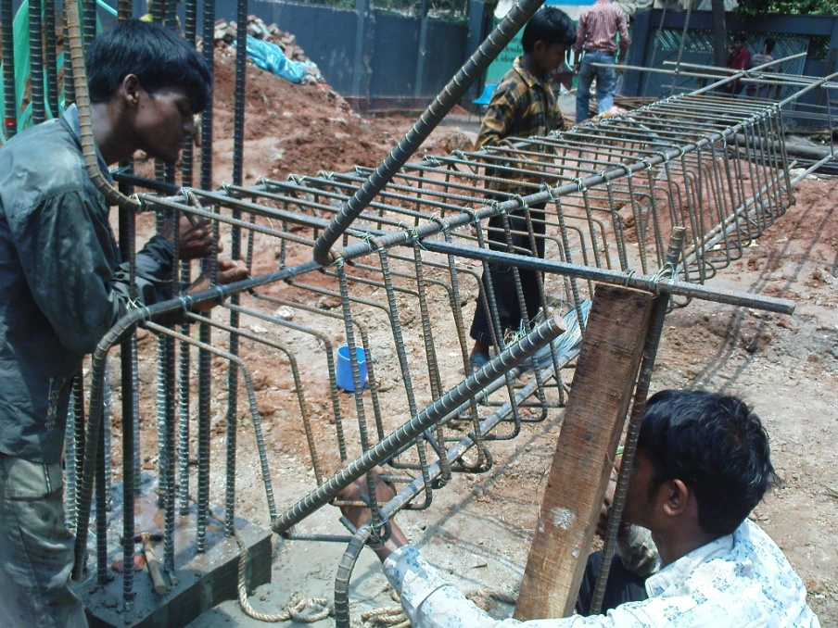
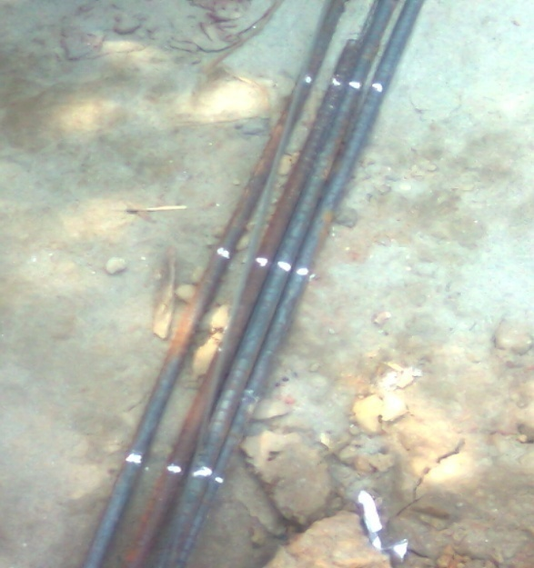
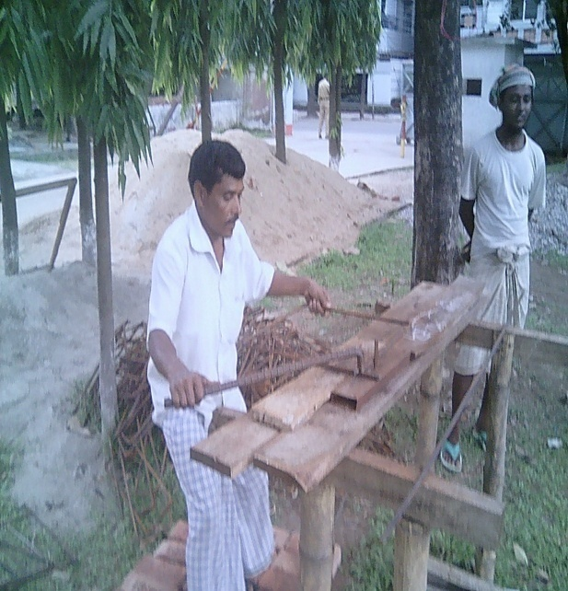
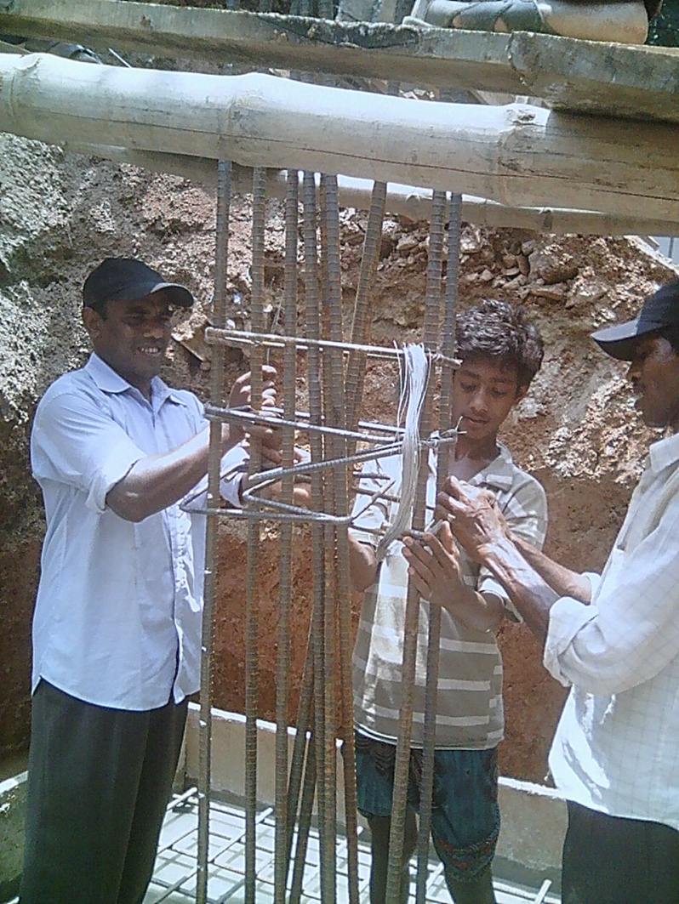
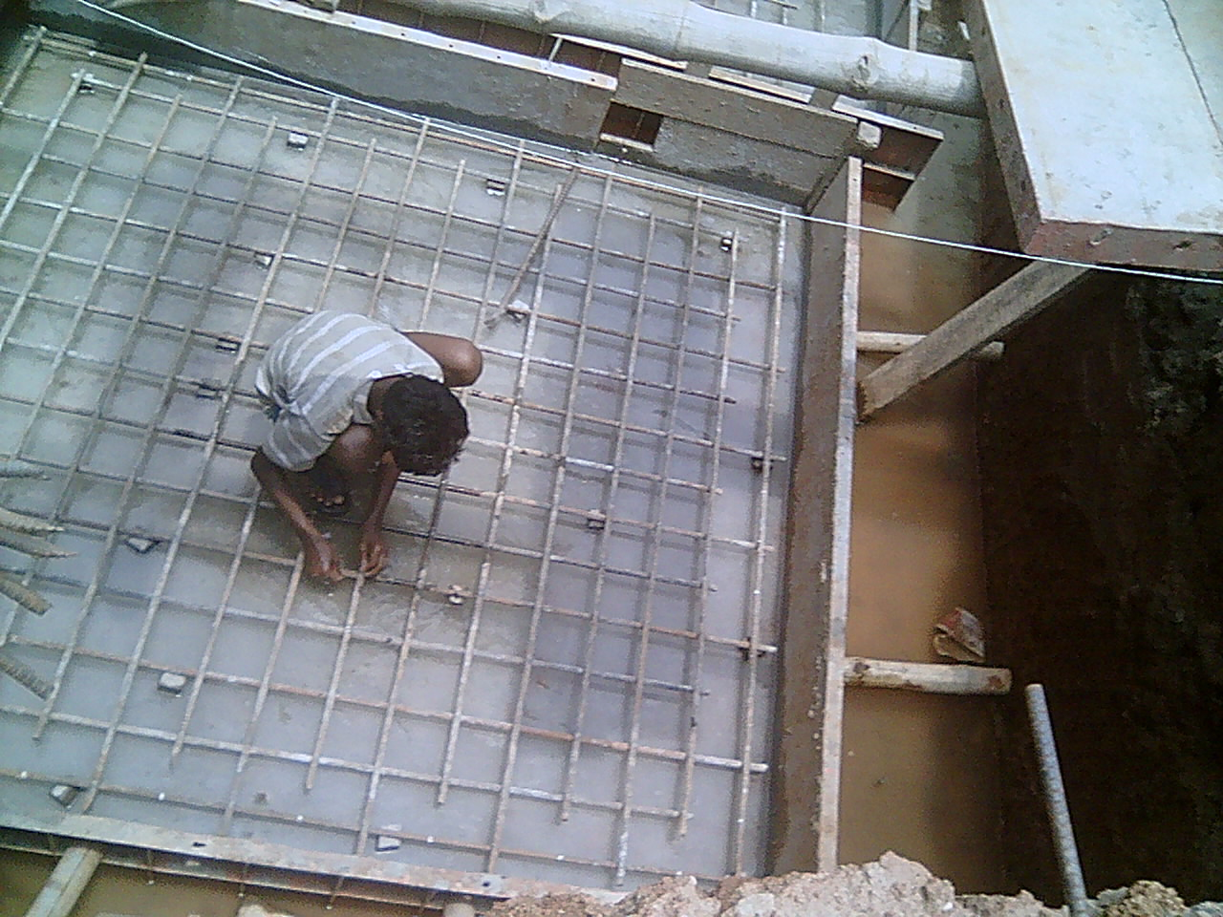
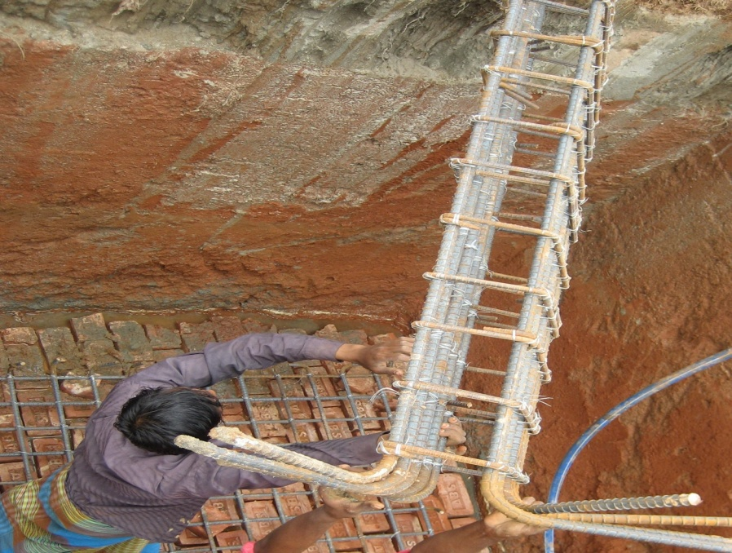
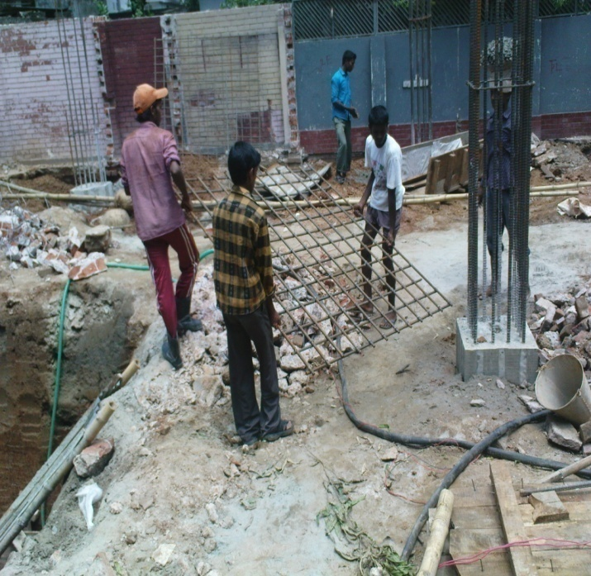
Reinforcement Preparing
Preparing after Placing
Preparing after Placing
Prepare And Placing
Prepare And Placing

Slide 31
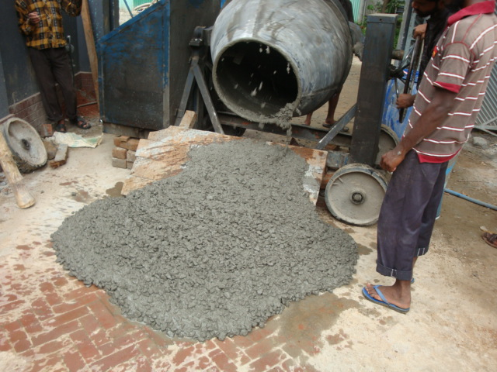
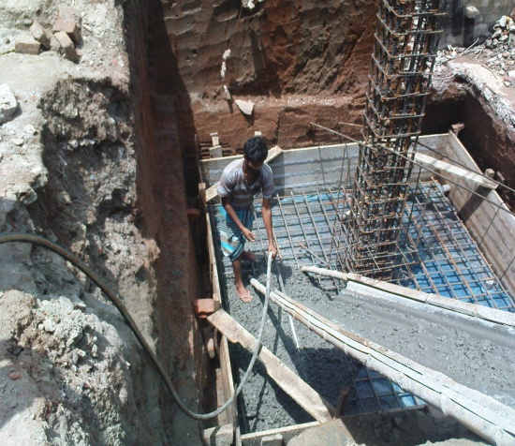
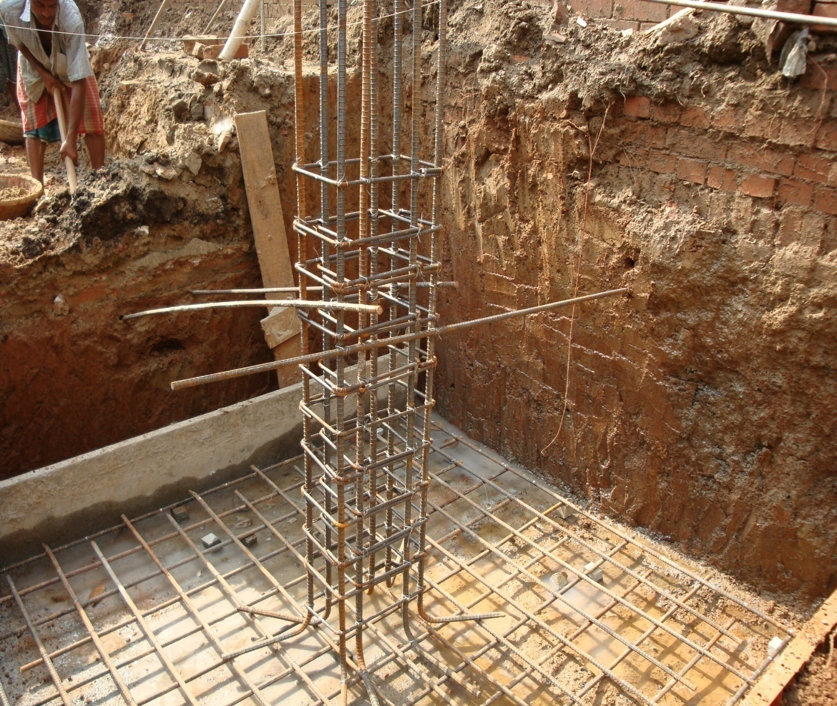
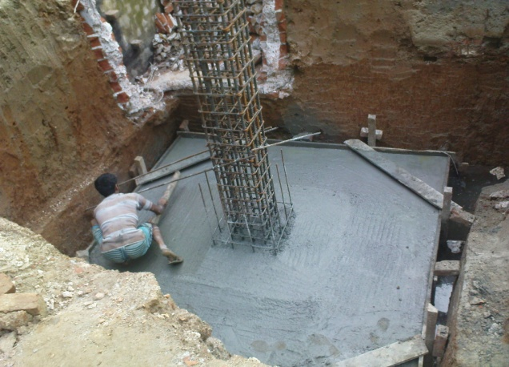
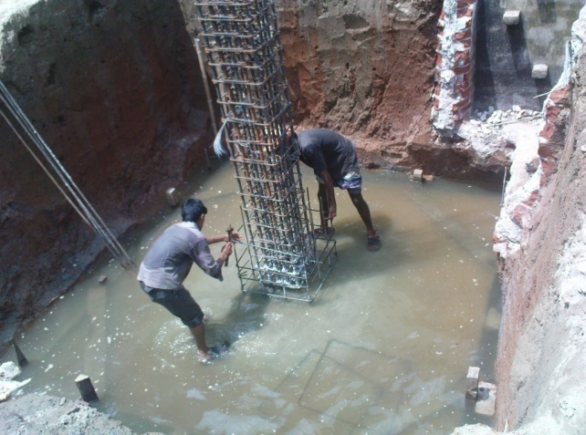
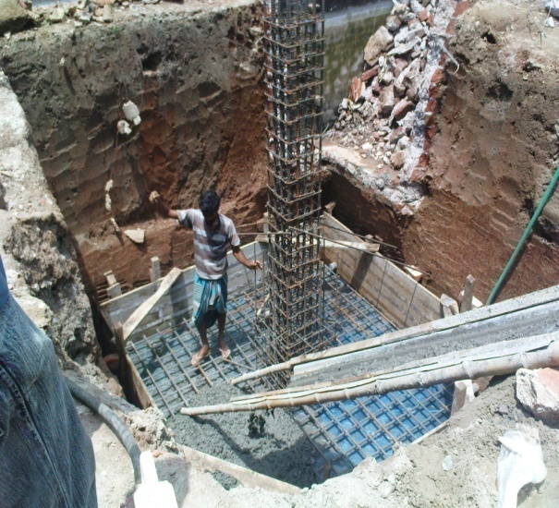
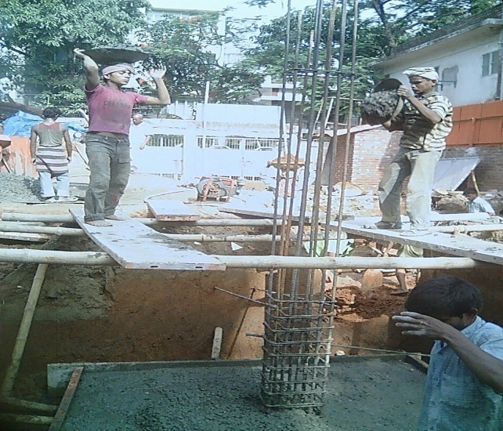
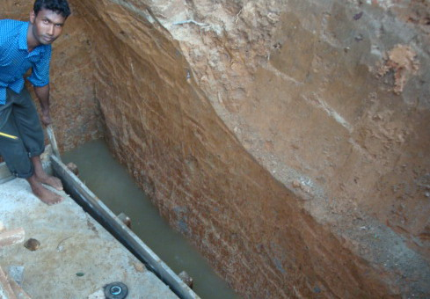
Vibrating
Prepared Concrete
Concrete Dressing
Curing and extra bar
Removing Formwork
Automatic Casting
Manually Casting
C.C. Cubes with Support Bar

Slide 32





Prepared Formwork
Placing Formwork
Filling Gap With Mud
Inside Formwork
Watering Formwork

Slide 33





Casting Concrete
Leaking Concrete
Vibrating
Roding with Rod
Roding With Bamboo

Slide 34








Before Compaction
After Compaction
Damages
Filling Damage
Curing
Backfilling
Backfilled Short Column
Removing Formwork

Slide 35

Group II

Slide 36
Sources:
Sites:
Basundhara Project
Information:
Google
Building Construction
Sushil Kumar
Figures and photos
Form the sites

