Slide 1
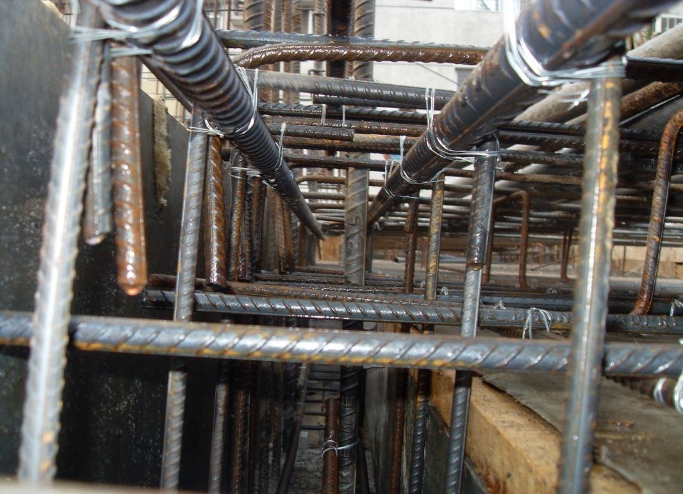
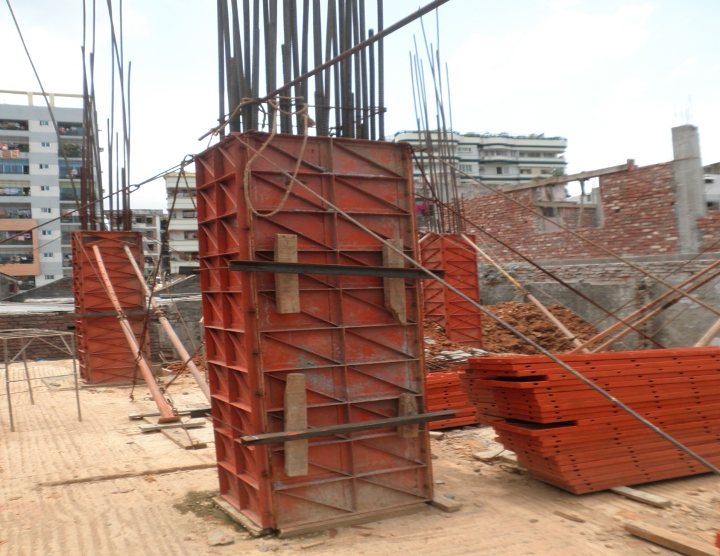
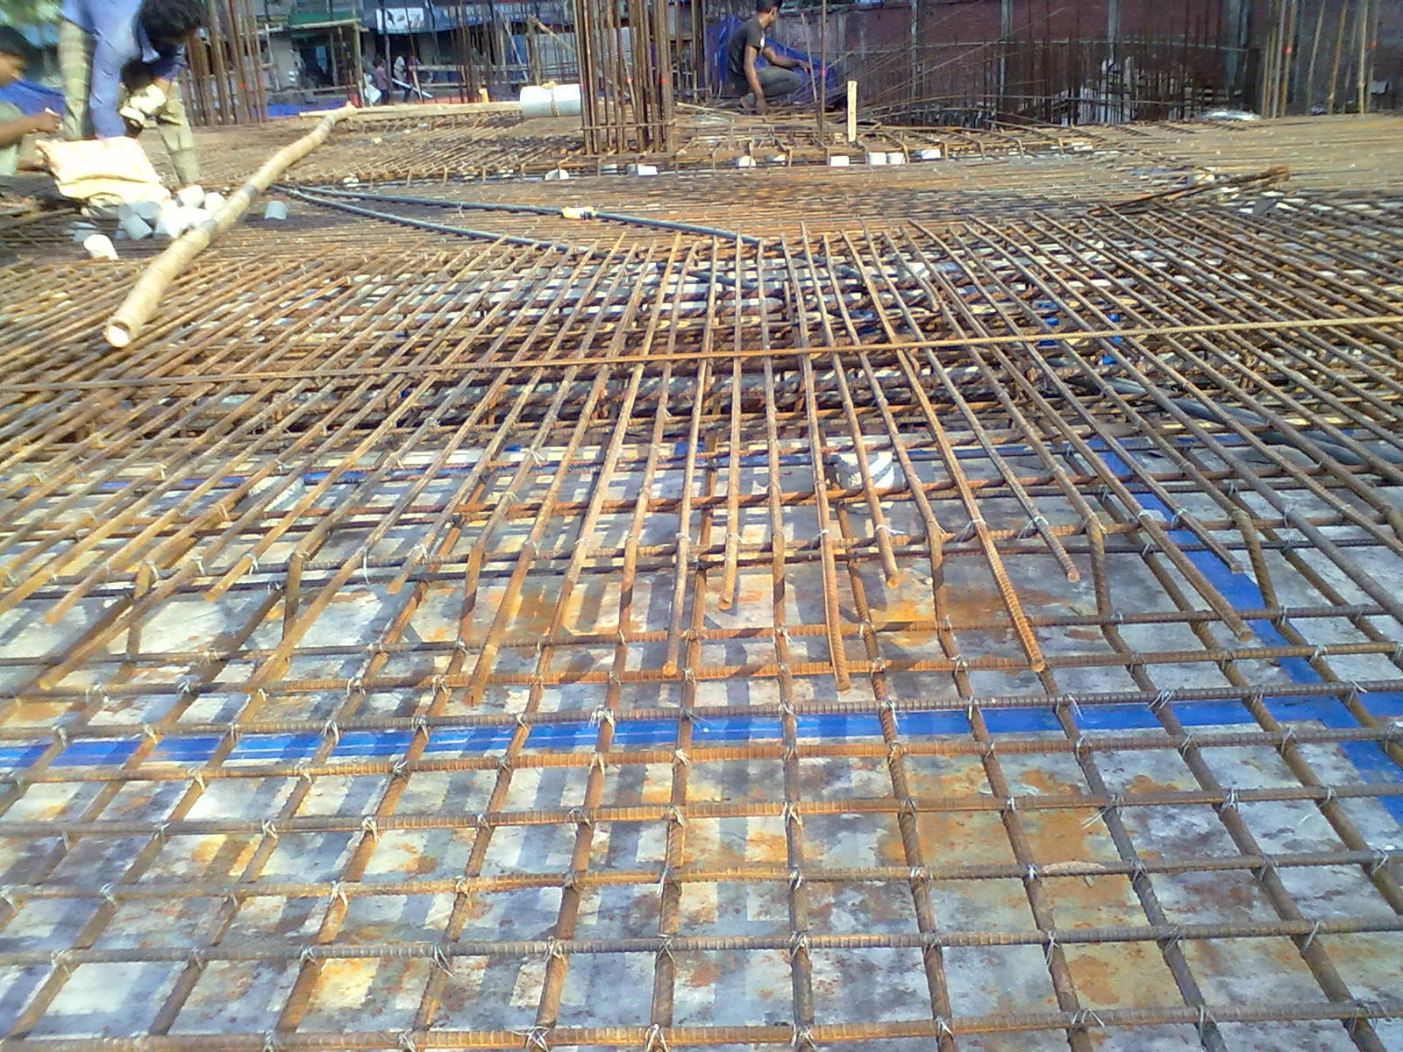
Building Components
BEAM
Column
SLAB

Slide 2





Load Bearing Mechanism
Concentrated Loads
Concentrated Loads
Concentrated Loads
Details of Construction

Slide 3
Column Construction
Reinforcement
Concrete Casting
Curing
Removal of Shuttering
Formwork
Details of Construction

Slide 4
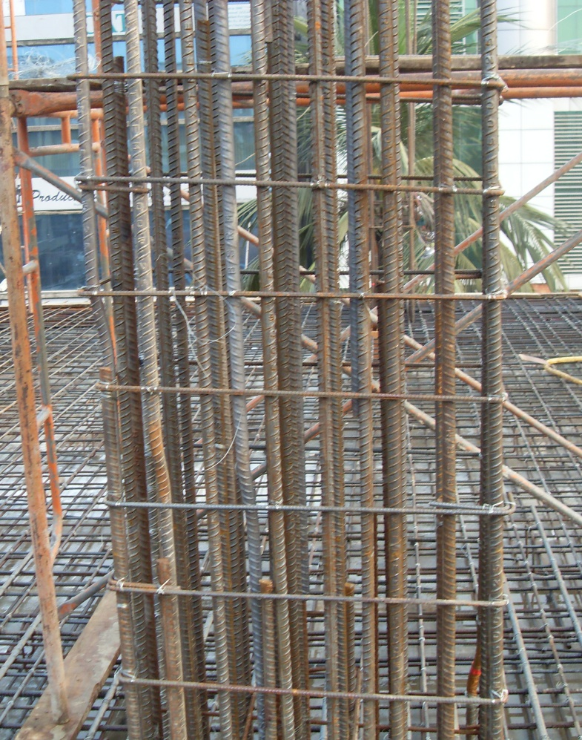
Reinforcement of column
Vertical Load
Lateral Load
Reinforcement takes the lateral load as well as vertical load.
Details of Construction

Slide 5
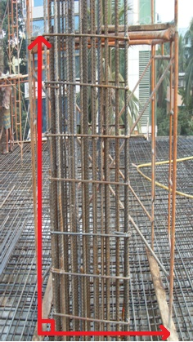
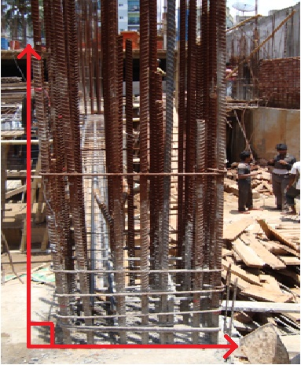
Reinforcement of column
Long Distance
Ties
After using ties
Closely placed Ties
Ties are used to hold the steel reinforcement vertical
Details of Construction

Slide 6
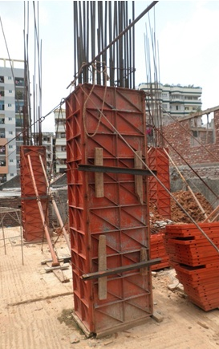
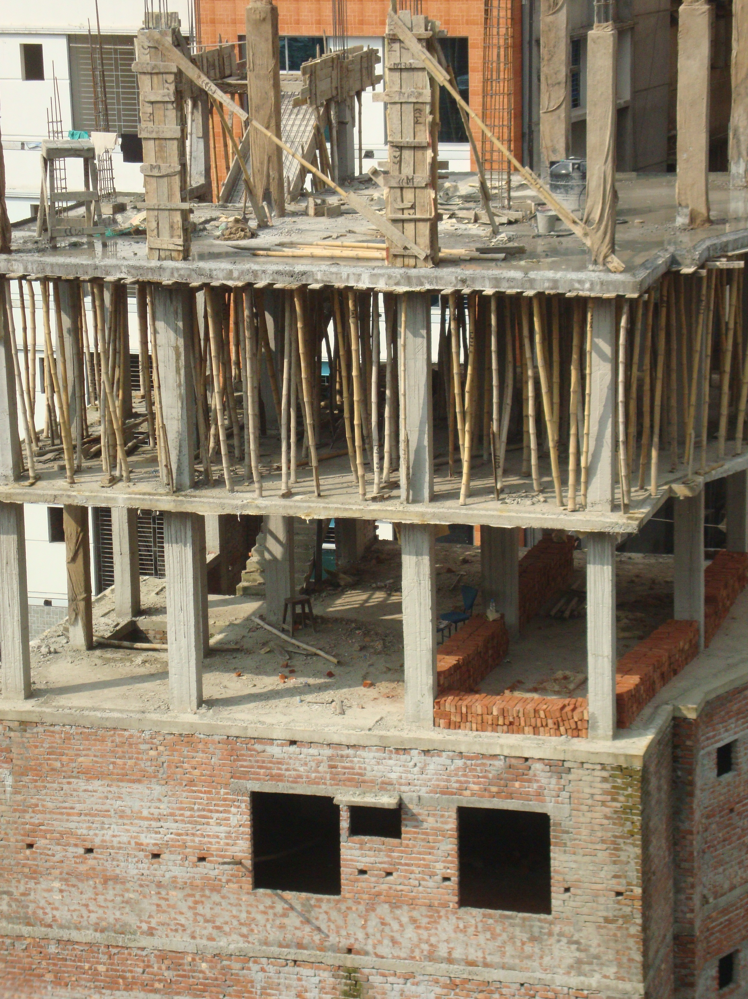
Formwork
Steel Shuttering
Wooden Shuttering
Details of Construction

Slide 7
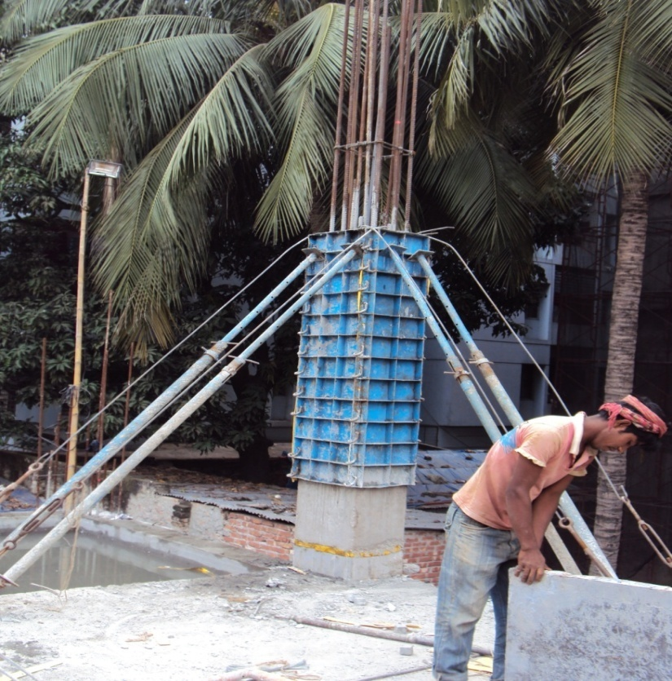
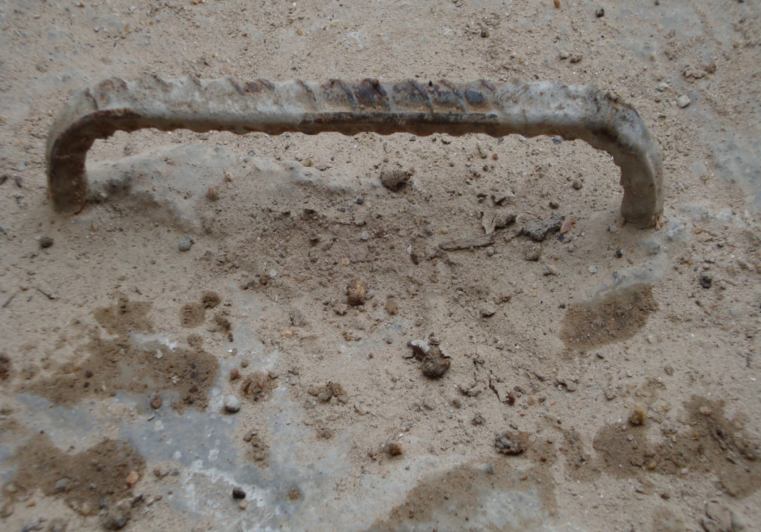
Formwork
Props are used to hold the shuttering.
‘U’s are provided to support them.
Details of Construction

Slide 8
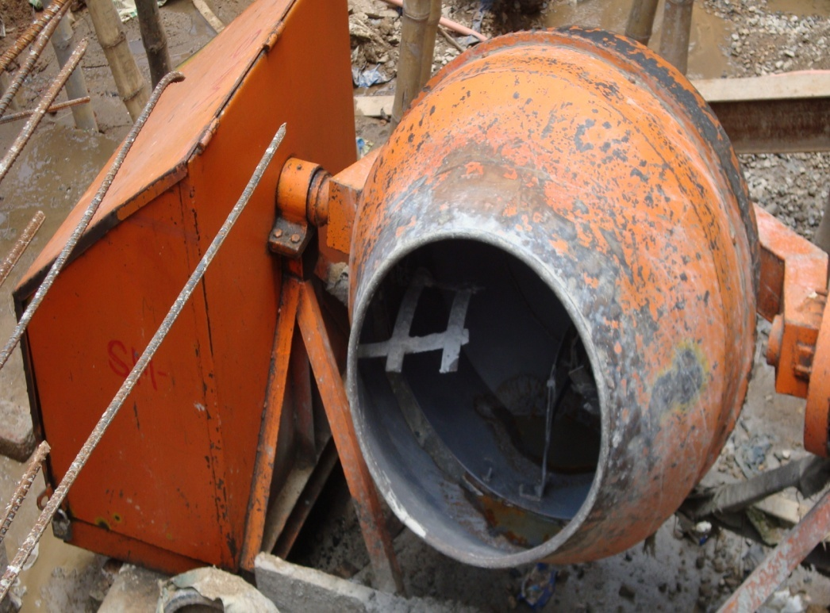
Concrete Casting
By mixing cement, CA, FA & water in proper ratio(according to mix design) a mixture of standard consistency made.
A Typical Mixer Machine
Details of Construction

Slide 9
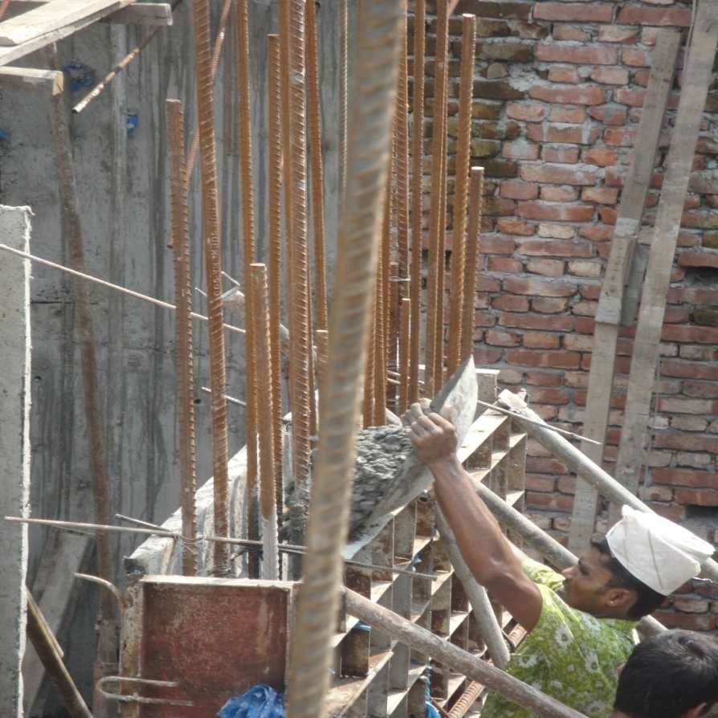
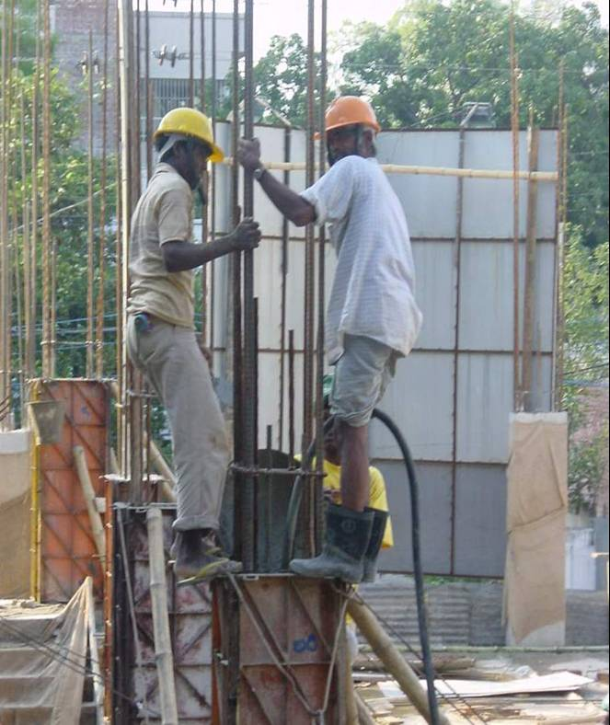
Concrete Casting & Compaction
Casting
Compaction
Details of Construction

Slide 10
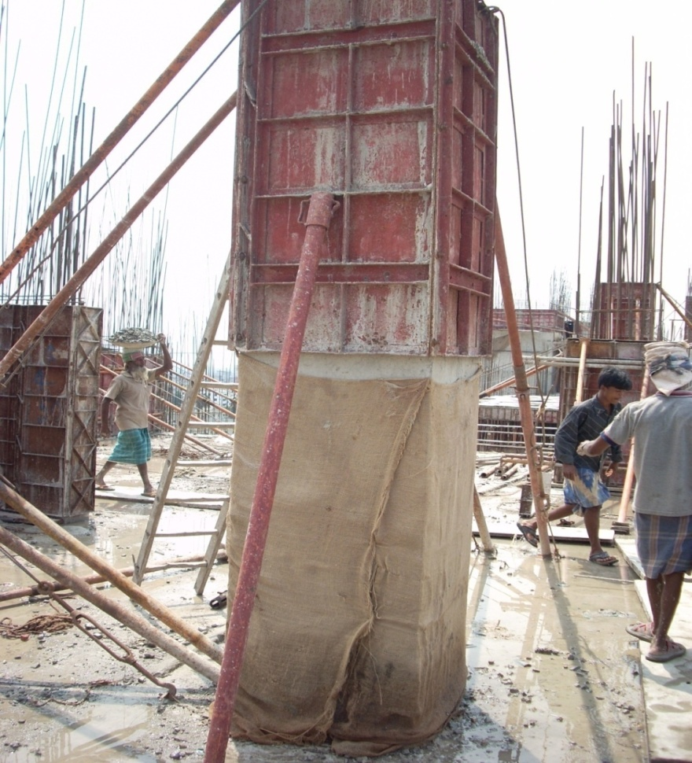
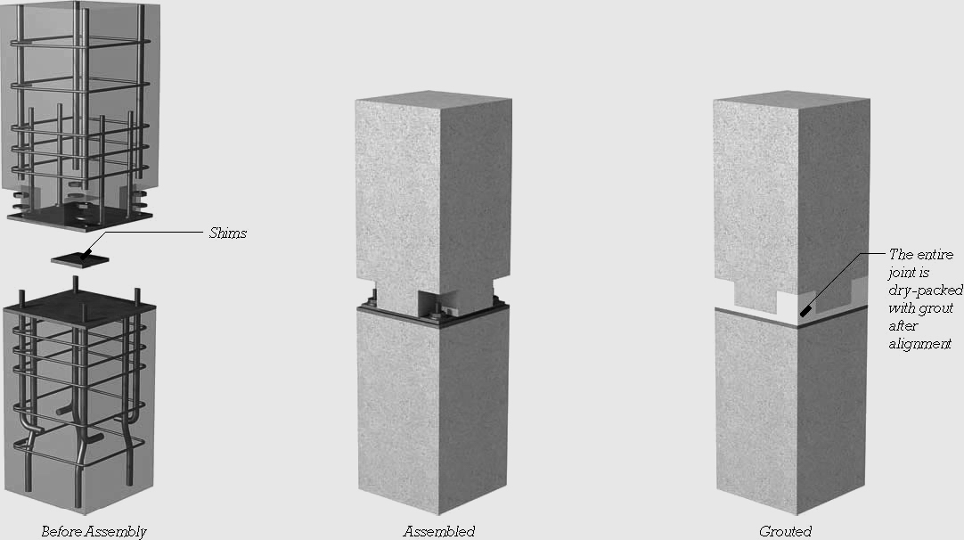
Column Casting
Usually Columns are cast in two lift
Details of Construction

Slide 11
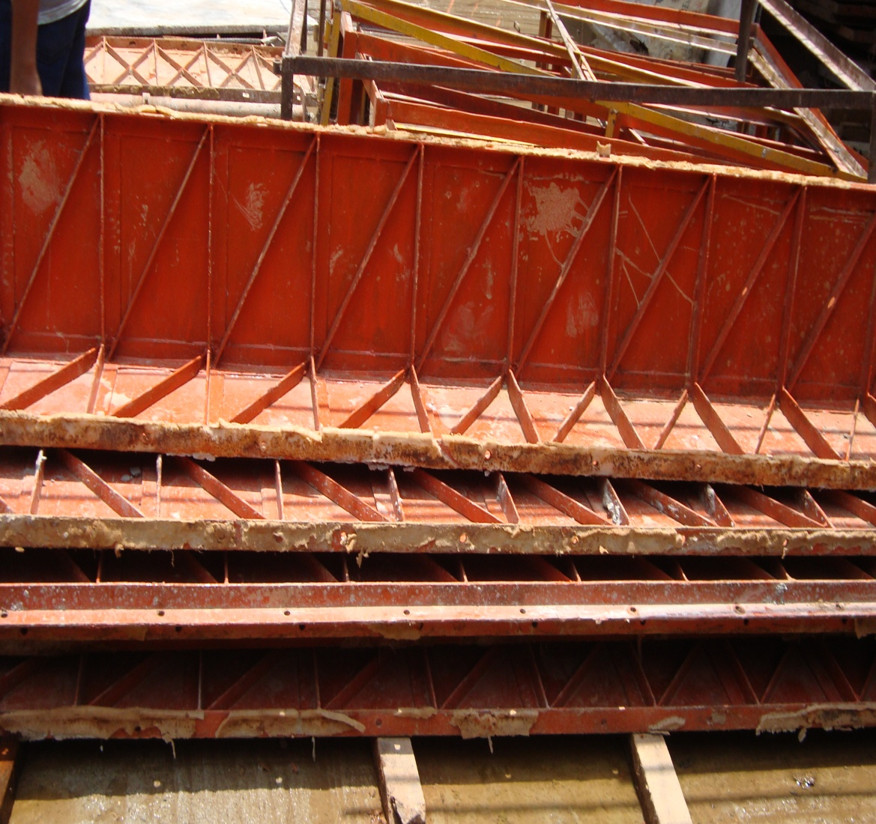
Removal of shuttering
After Three days Shutters are removed
Details of Construction

Slide 12
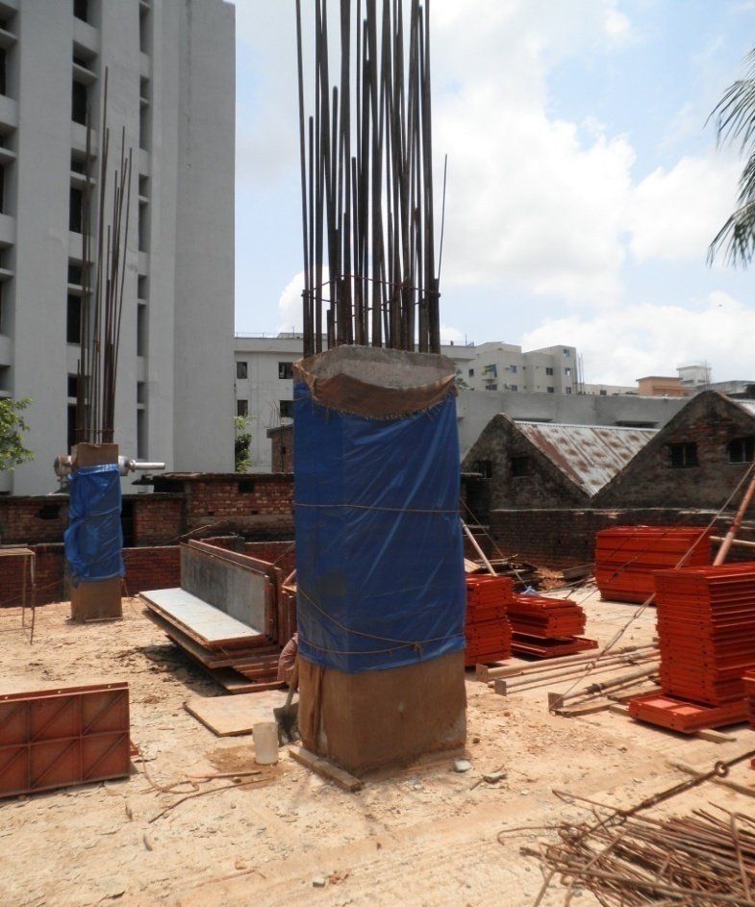
Curing
Curing is done for 21 days , because additional water is required for Hydration Reaction of Concrete.
Details of Construction

Slide 13

Column Formation
Concentrated tie work
Column Reinforcement
Light tie work
Concrete
Casting
Wooden Formwork
Concentrated tie work
Details of Construction

Slide 14
Beam Construction
Reinforcement
Formwork
Concrete Casting
Removal of Formwork
Curing
Details of Construction

Slide 15
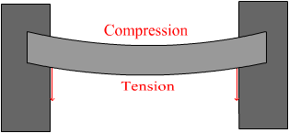
Reinforcement of Beam
Shear Force
Shear Force
Beam is a flexural member which takes both tension and compression.
Extra bottoms are provided at excessive tensile zone.
Extra tops are provided at Shear force developing zones.
Shear Force
Shear Force
Details of Construction

Slide 16
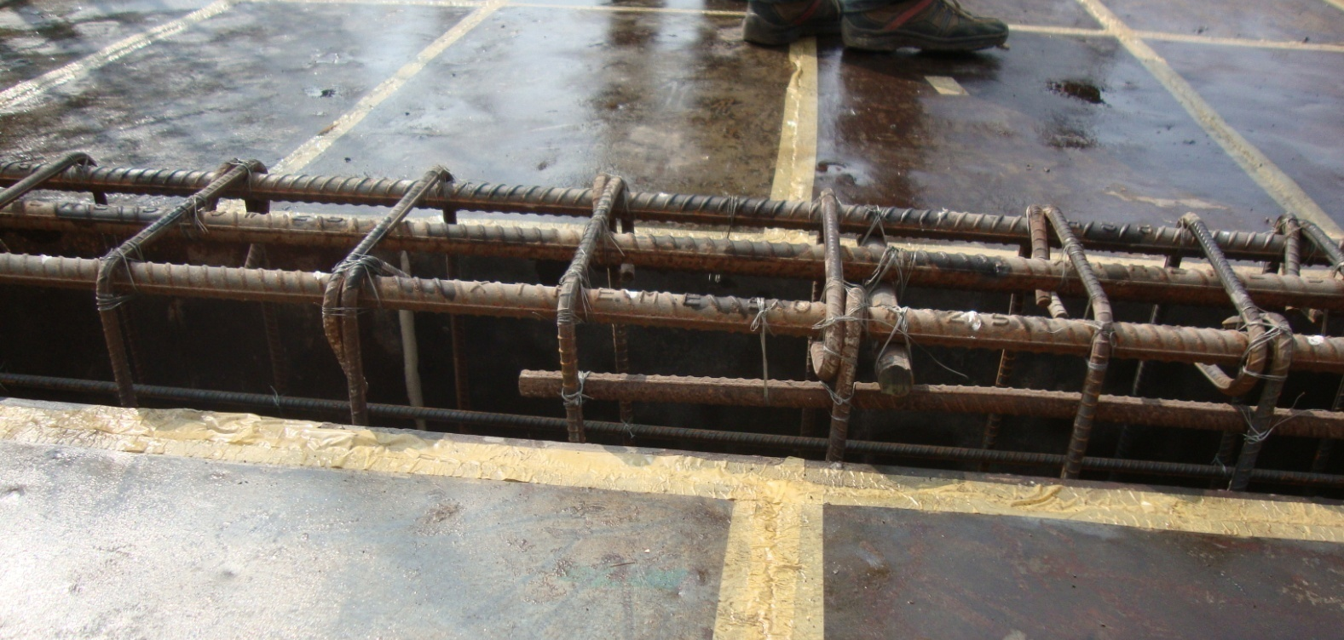
Reinforcement of Beam
Extra Top
Extra Top
Carrier
Details of Construction

Slide 17
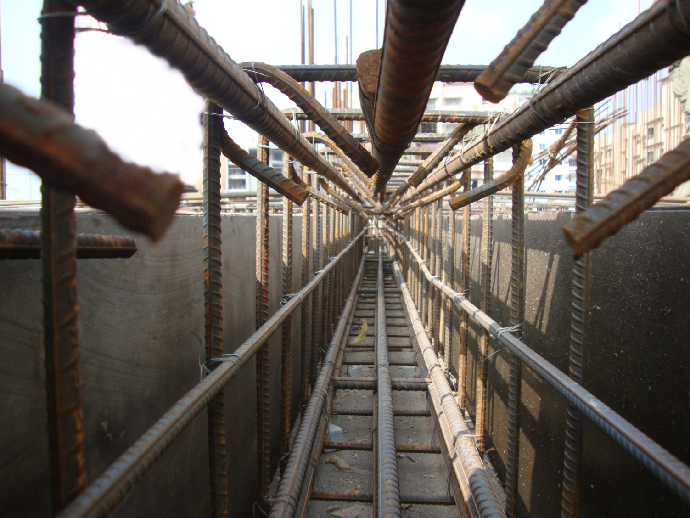
Reinforcement of Beam
Extra Bottom
Details of Construction

Slide 18
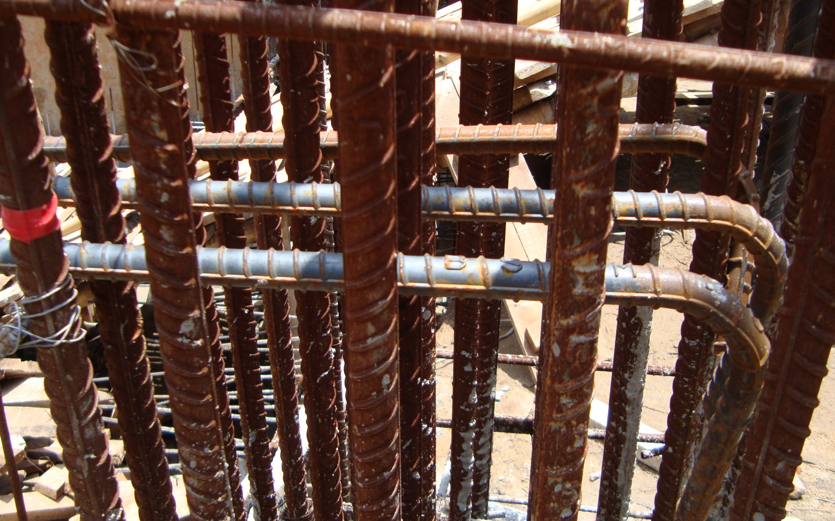
Reinforcement of Beam
Rods Are Bent at the end of the span
Details of Construction

Slide 19
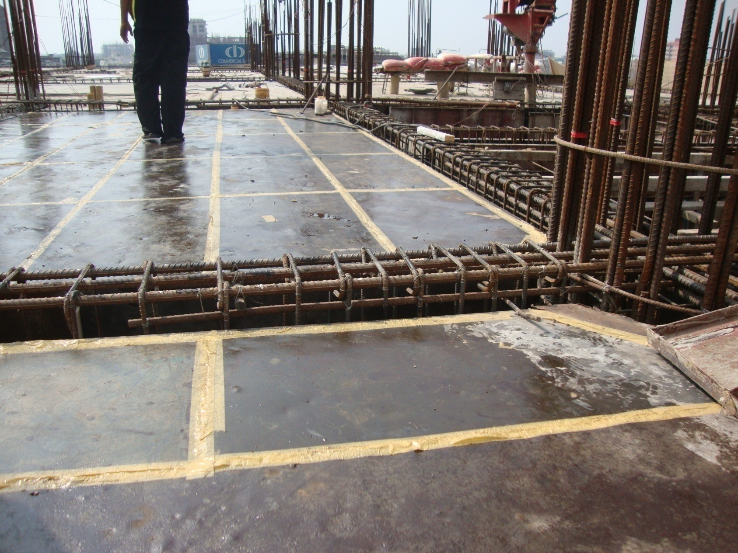
Reinforcement of Beam
Stirrup placement in Beam
Long
Distanced
Stirrups
Close
Stirrups
Details of Construction

Slide 20
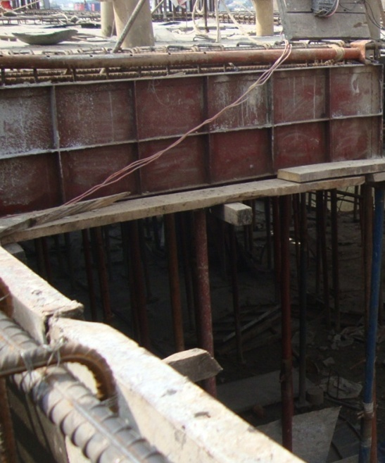
Formwork
1st Base shuttering
2nd Side shuttering
Side Shuttering
Base Shuttering
Props
Details of Construction

Slide 21
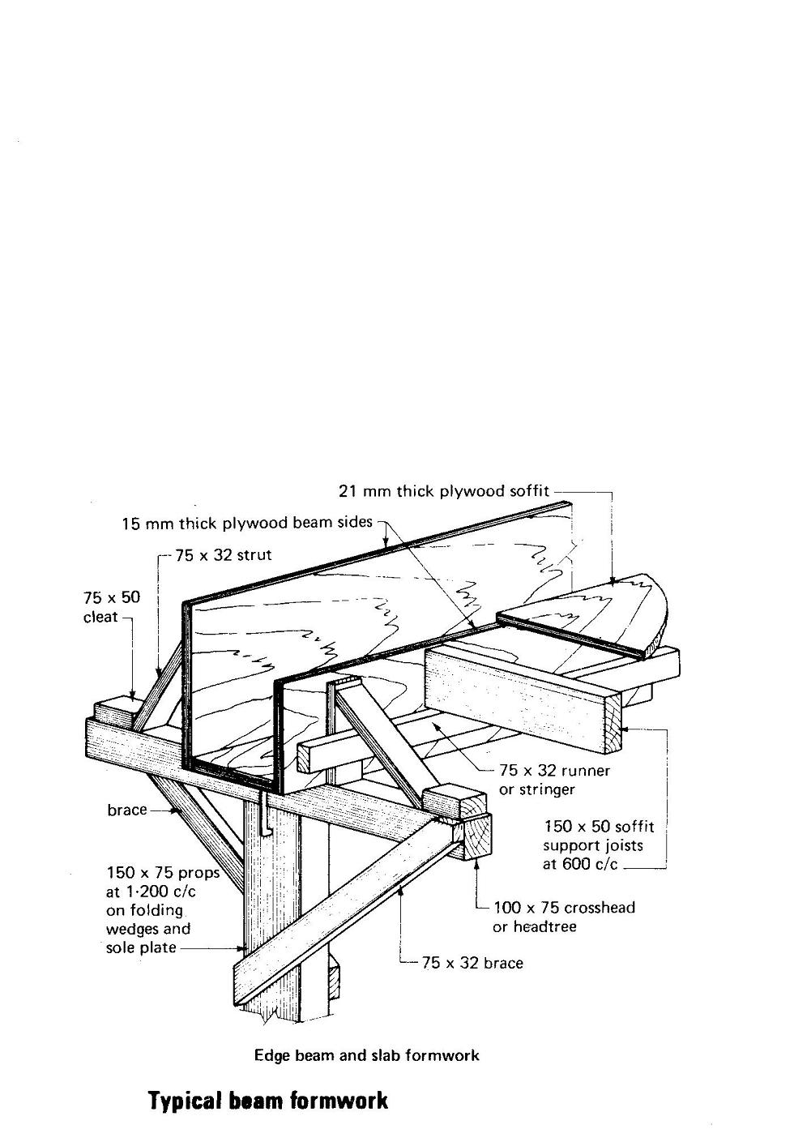
Formwork
Details of Construction

Slide 22
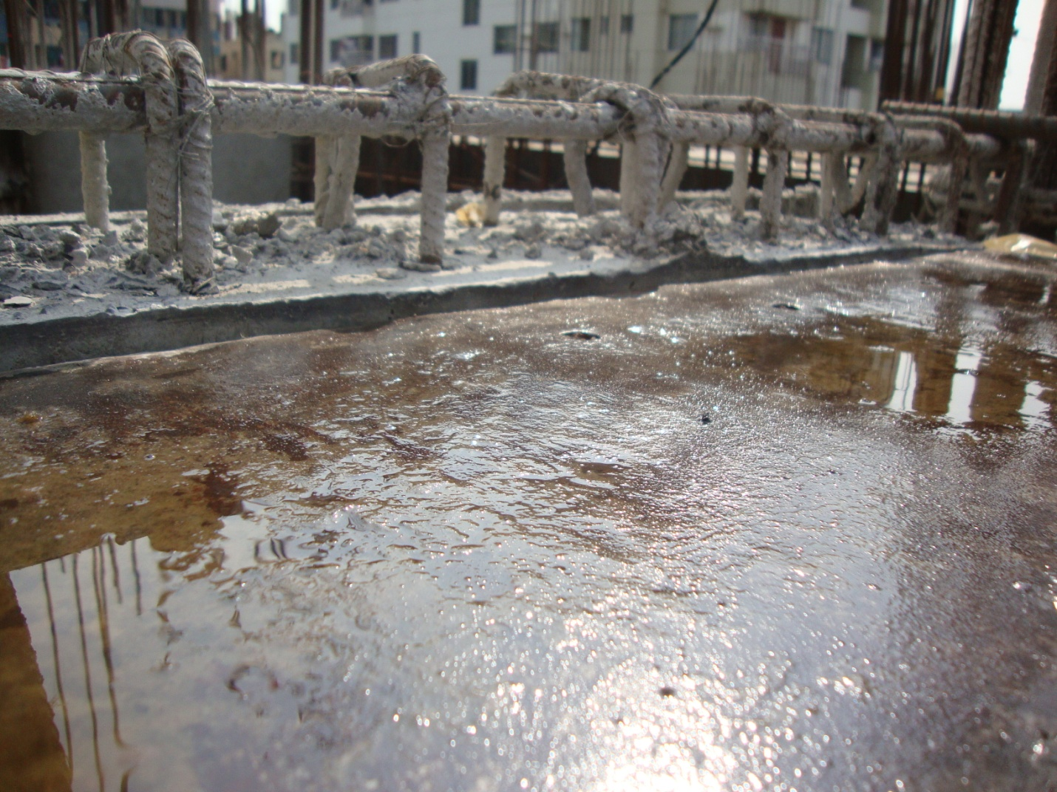
Casting
Generally Beam and slab are cast together but sometimes beam casting is done alone before slab.
Beam Reinforcement
Slab
Details of Construction

Slide 23
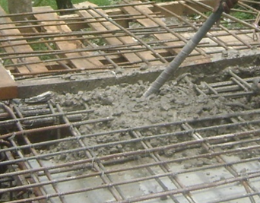
Casting
Compaction
Normally compaction is done by using internal vibrator
Metal nose
Vibration causes the concrete layer to compact
Details of Construction

Slide 24

Beam Formation
Concentrated Stirrups
Straight Bars
Concrete Casting
Concentrated Stirrups
Beam Reinforcement
Crank Bars
Formwork
Details of Construction

Slide 25
Slab Construction
Formwork
Concrete Casting
Removal of Shuttering
Curing
Reinforcement
Details of Construction

Slide 26
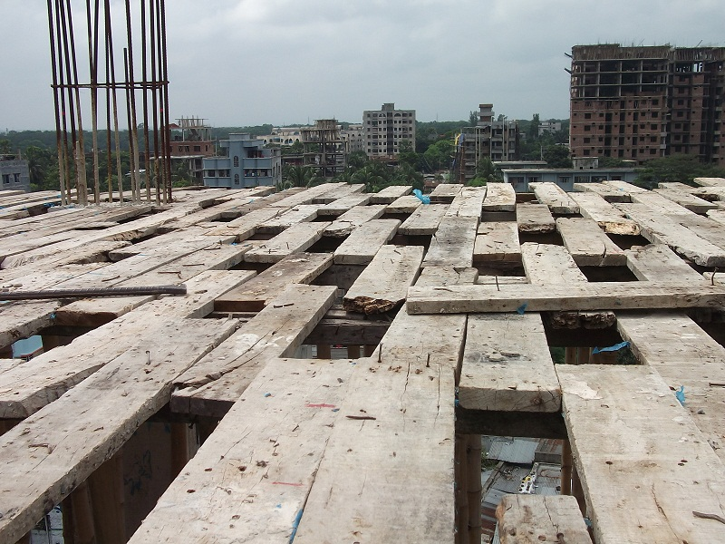
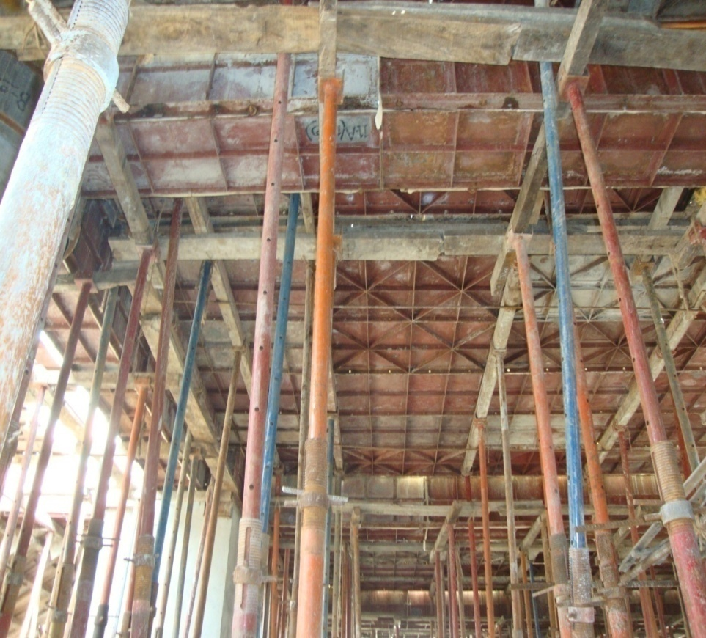
Formwork or Shuttering
Wooden Shuttering
Steel Shuttering
Details of Construction

Slide 27
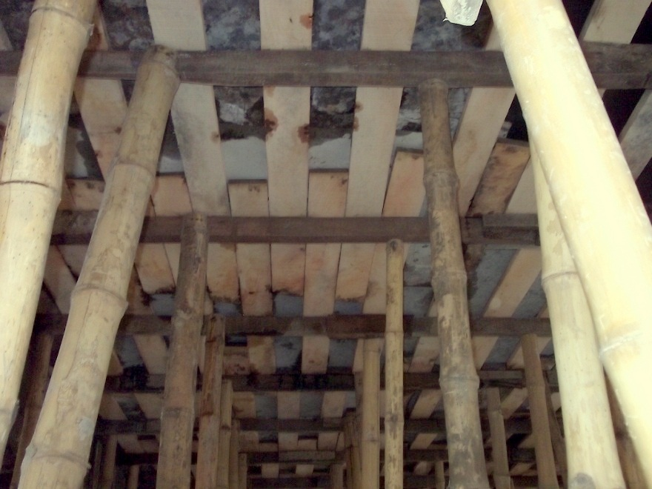
Shuttering
PLATE
PROP
Details of Construction

Slide 28
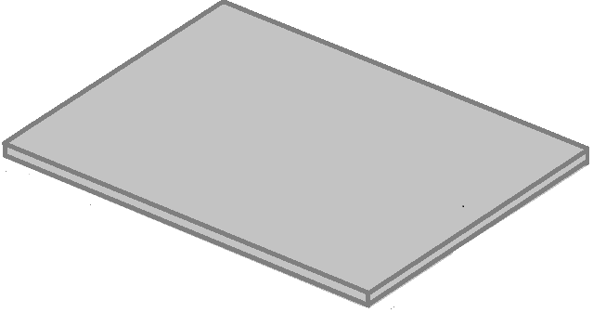
Reinforcement Placing
-Straight Bars -Cranked Re-bars -Extra Re-Bars
Details of Construction

Slide 29
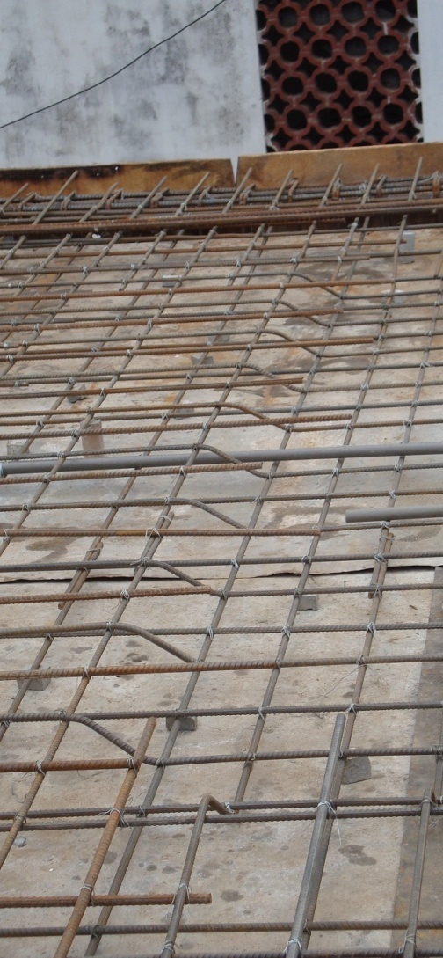
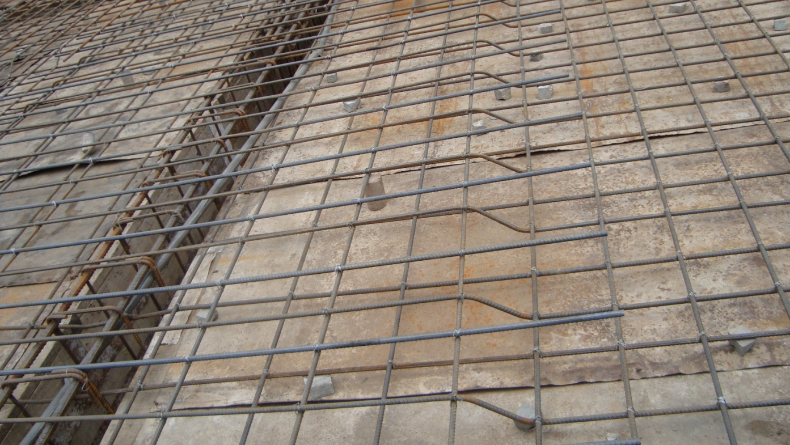
Crank Bars
BEAM
SLAB-BEAM JOINT
Alternative crank bars are provided to resist tension near the slab-beam joint.
Details of Construction

Slide 30
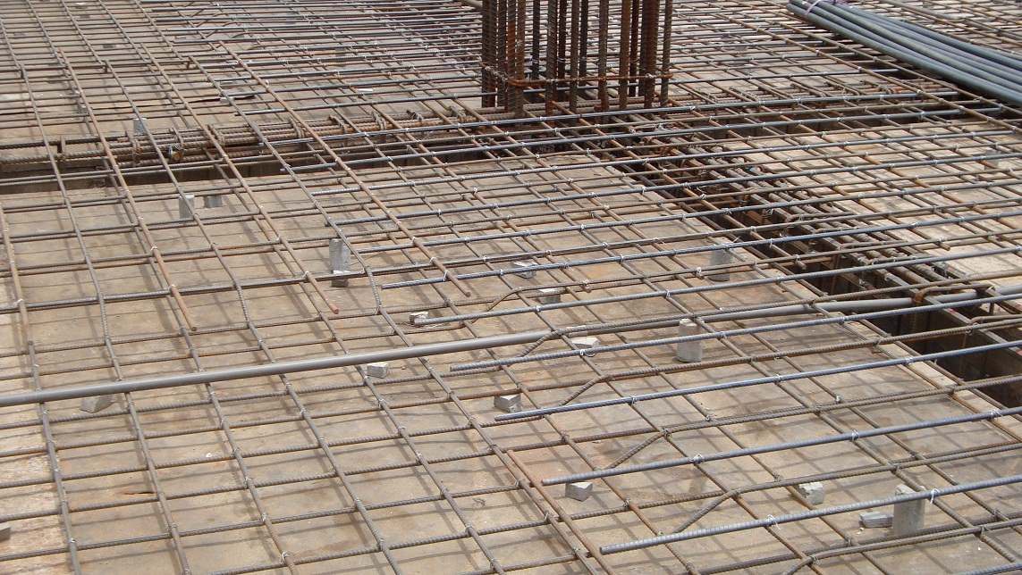
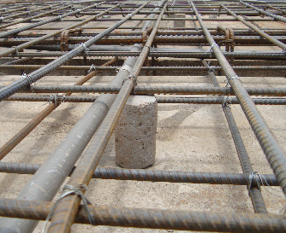
Clear Cover
CC Blocks can be either cylindrical or cubic. They are provided to maintain a constant height.
Details of Construction

Slide 31
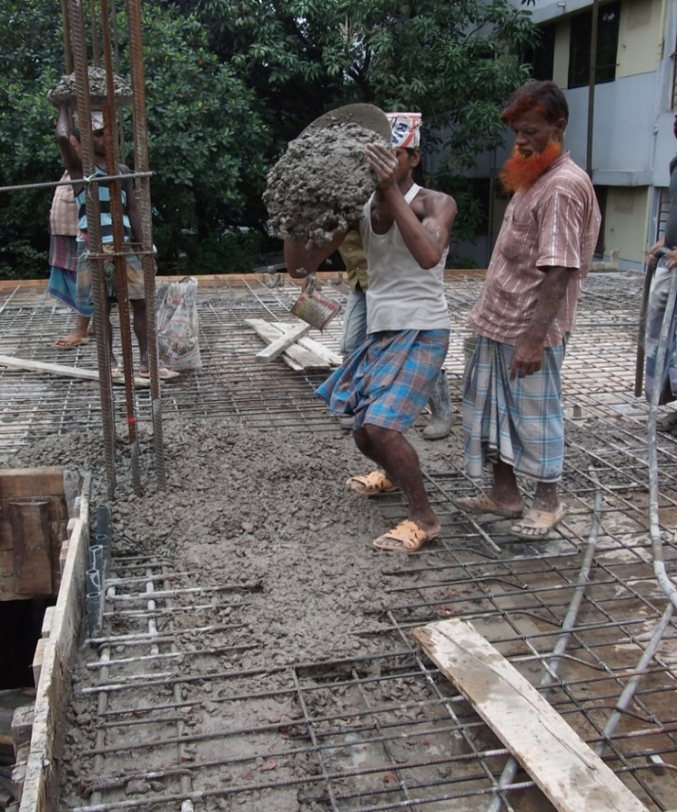
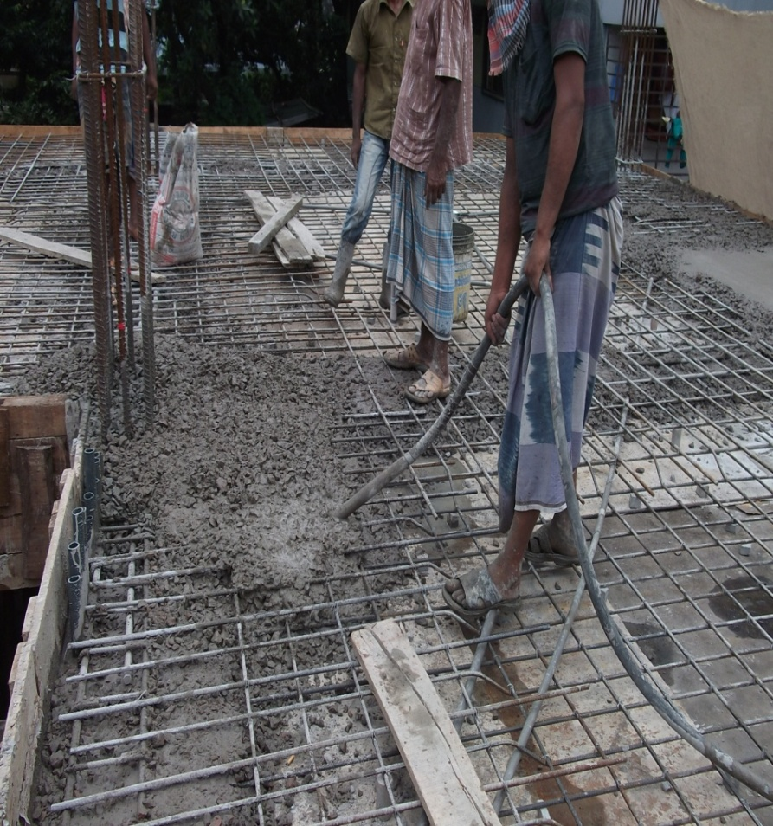
Slab Casting & Compaction
Casting
Compaction by Vibrator
Details of Construction

Slide 32
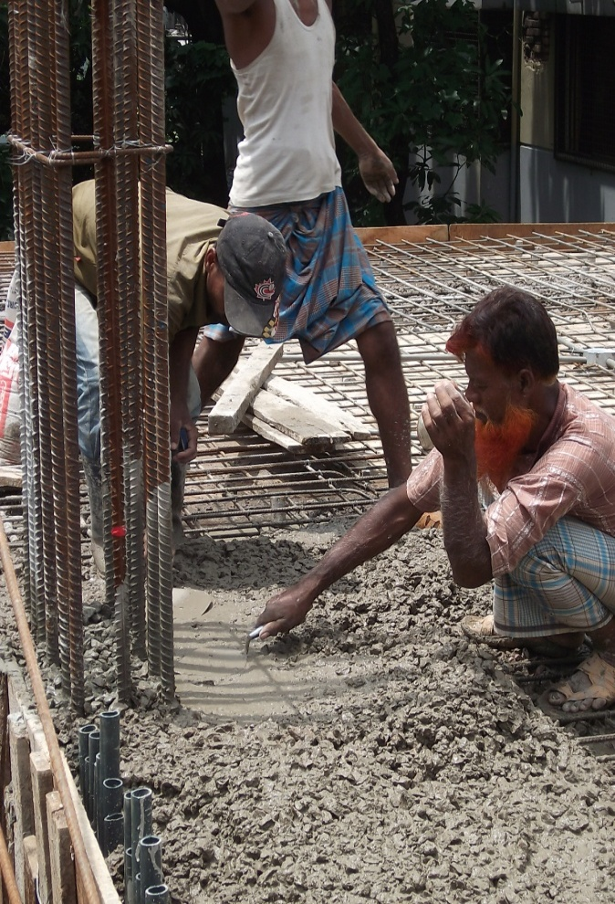
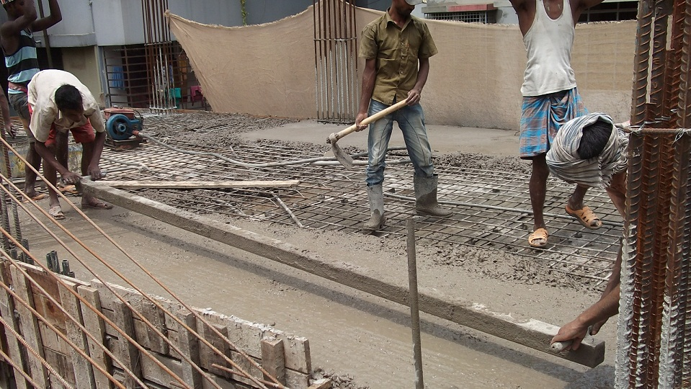
Leveling
HAND LEVELING
Details of Construction

Slide 33

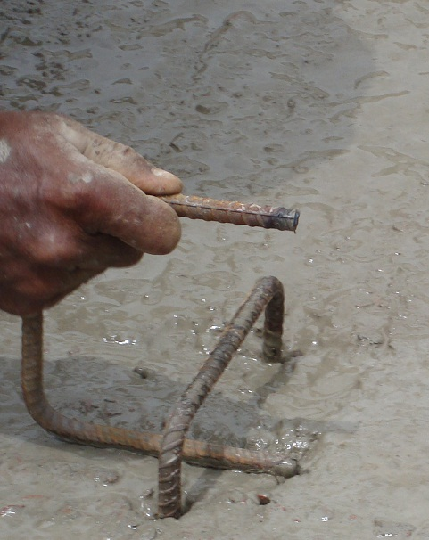
Placing U-Bar
Details of Construction

Slide 34
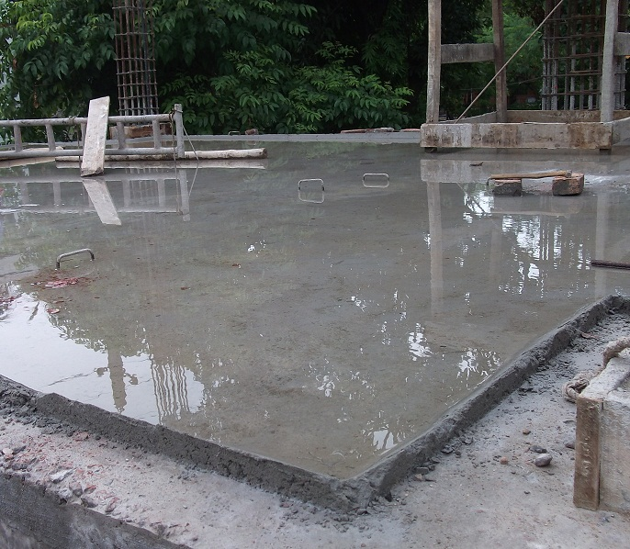
Curing
Water Cure-Ponding Method
Details of Construction

Slide 35
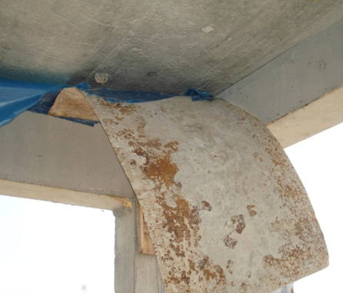
Removal of Shutter
After 21 days of curing, formwork of slab is removed.

Slide 36
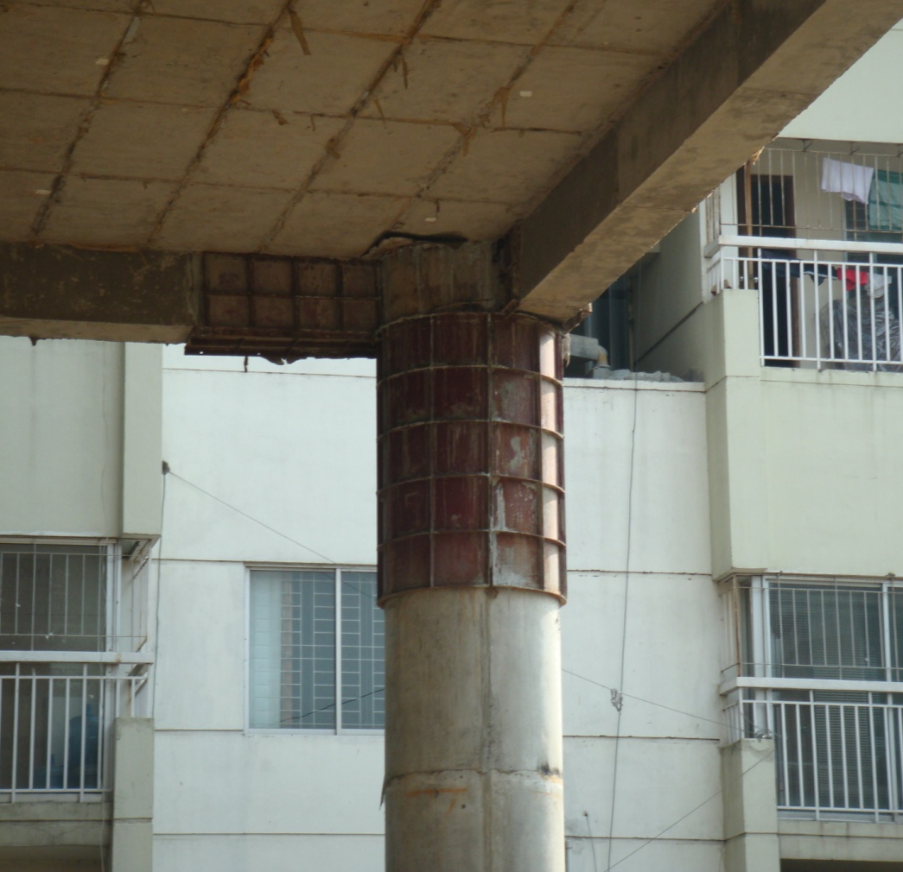
Special Observation
Glued Shutter
Due To
Improper Use
Of Light Oil
Details of Construction

Slide 37
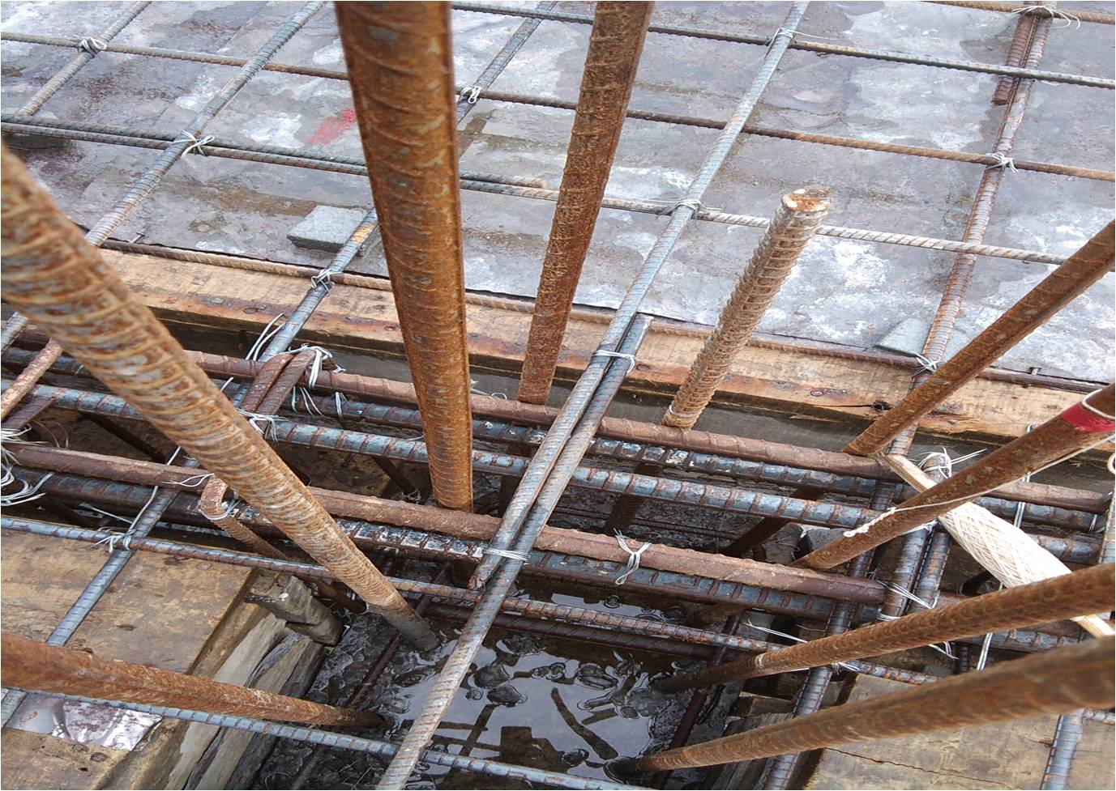
Special Observation
Overlapping at the beam column joint makes the structure weak
Details of Construction

Slide 38
Prepared By-
Roll No.:
1004003
1004011
1004017
1004024
1004027
1004036
1004037
1004044
1004052
1004060
1004062
Thank you….

