Slide 1
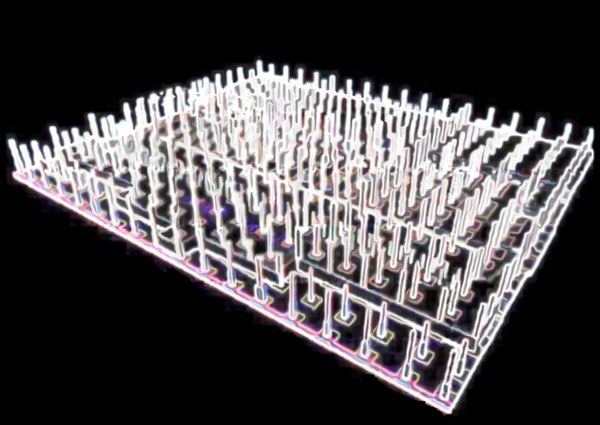
A PRESENTATION ON MAT FOUNDATION

Slide 2
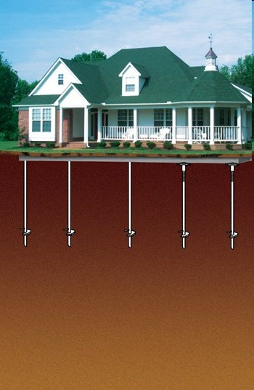
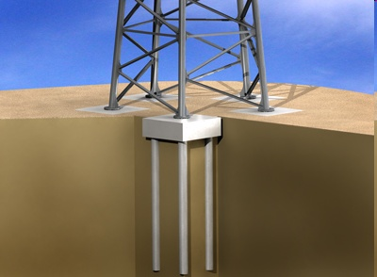
WHAT IS FOUNDATION?
Foundation is the sub-structure of a building that transfers the entire weight of the structure and it loads on to the ground strata below ground level.

Slide 3
TYPES OF FOUNDATIONS
Shallow Foundation
Spread Footing
Grillage Foundation
Eccentrically Loaded Foundation
Combined Footing
Mat or Raft Foundation
Deep Foundation
Pile
Cofferdams
Caissons

Slide 4
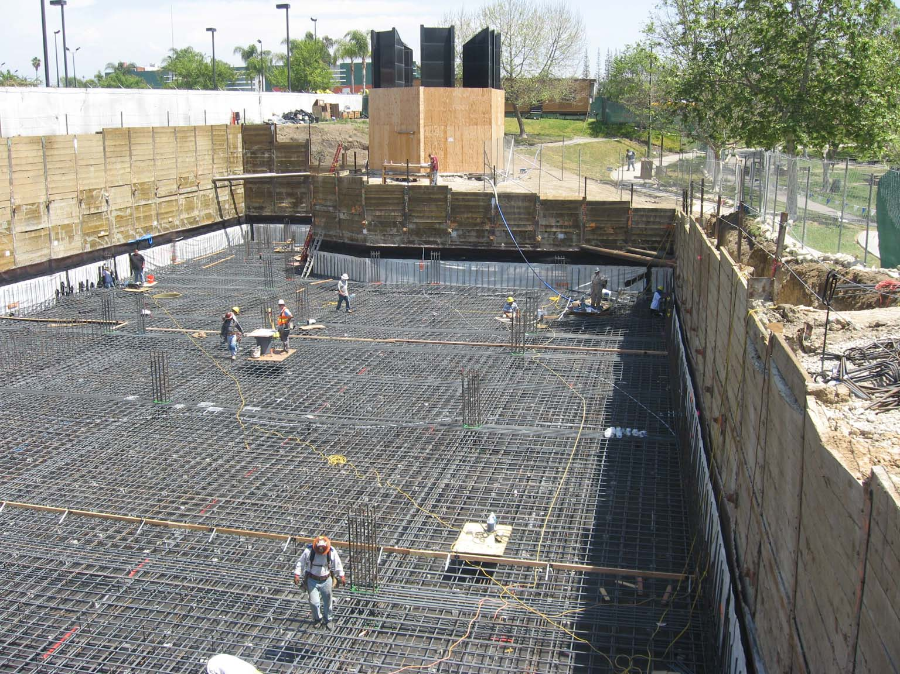
MAT FOUNDATION
Mat or Raft Foundation is combined footing that covers the entire area beneath the structure and supports all walls and columns. This raft or mat rest directly on soil or rock, but can also be supported on piles as well.

Slide 5
SUITABILITY
Whenever the allowable pressure on soil is so small or the load of the building is so large that individual footings would cover more than 50% of the structural plan area.
For buildings having single or multiple basement. For example, to
build several levels of parking, access to subway station, etc
For erratic soils or soils having compressible lenses. Thus making the
estimation of overall and differential settlement difficult.
For buildings where the use of individual footing will lead to largely varying
bending moment and thus differential settlement of individual footing will
lead to distress in the building .

Slide 6
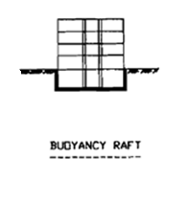
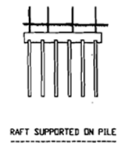
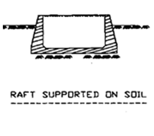
TYPES OF MAT FOUNDATION
Classification based on the method of their support:
a) Raft Supported on Pile
b) Raft Supported on Soil
c) Buoyancy Raft

Slide 7
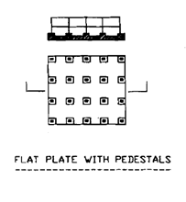
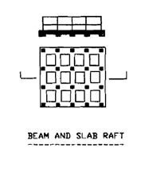
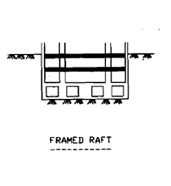
TYPES OF MAT FOUNDATION
Classification based on the structural system:
a) Flat Plate with Pedestals
b) Beam and Slab Raft
c) Framed Raft

Slide 8
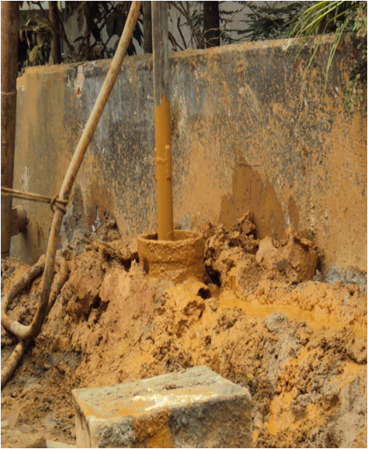
SOIL TEST
Soil test is an important part in the selection of the type of foundation to be used for the structure.
Soil test includes drilling bore hole at various points on the construction site. Then executing test like:
Standard penetration Test.
Recording GWT.
Collection of samples in disturbed and
undisturbed state.
Grain size analysis and moisture content.
Direct shear test.
Specific gravity.
Atterberg limits.
Unconfined compression and Consolidation
test.

Slide 9
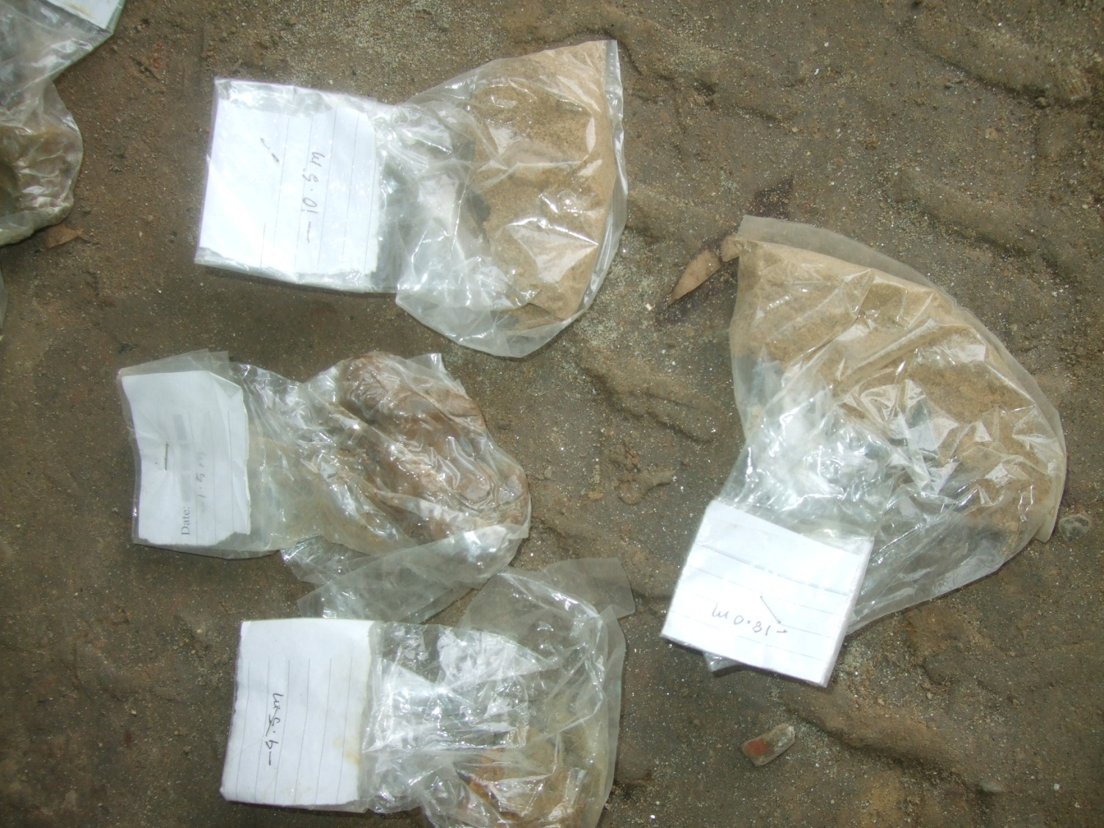
SOIL TEST
Soil samples collected from various depths.

Slide 10
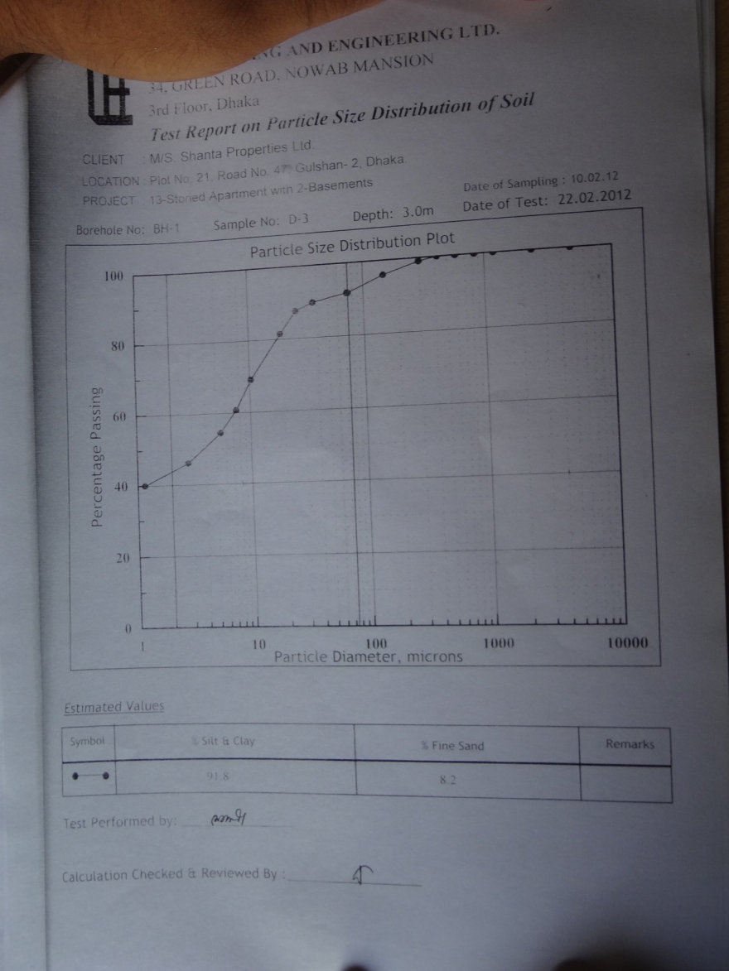
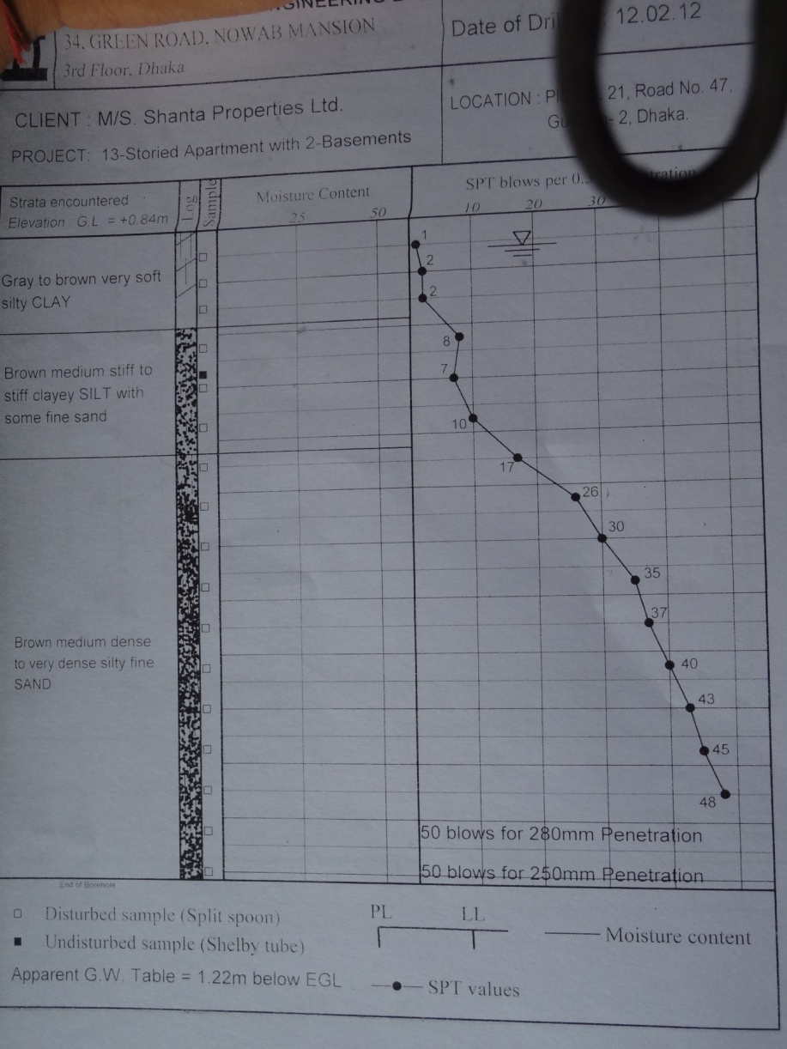
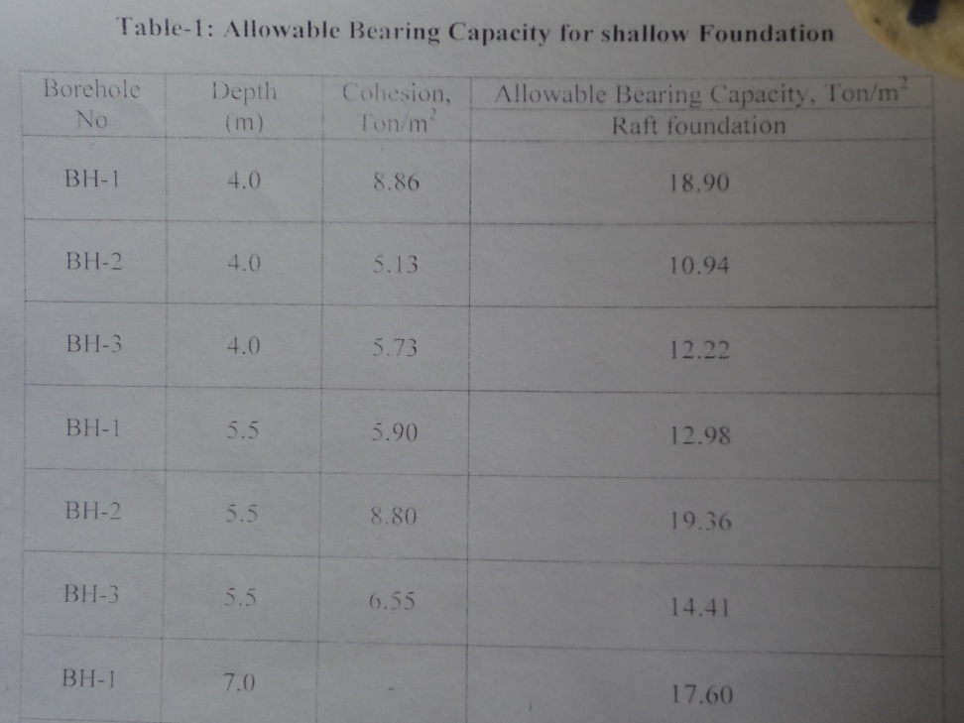
SOIL TEST REPORT

Slide 11
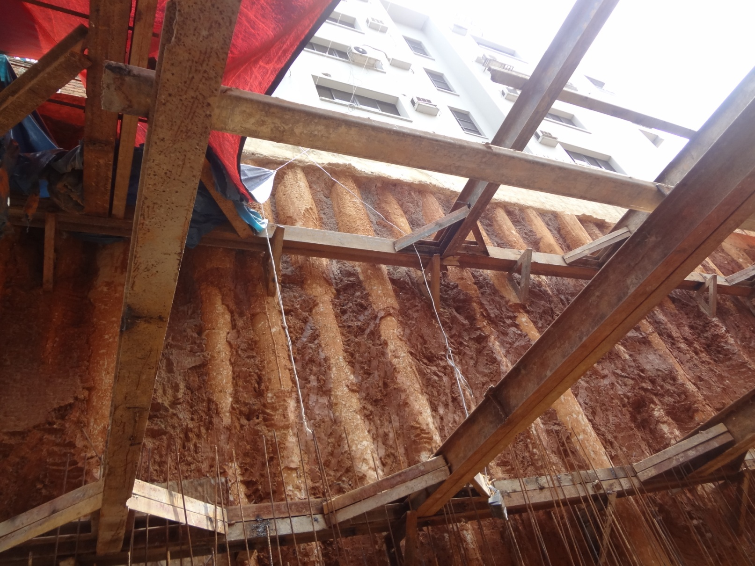
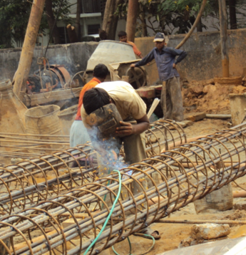
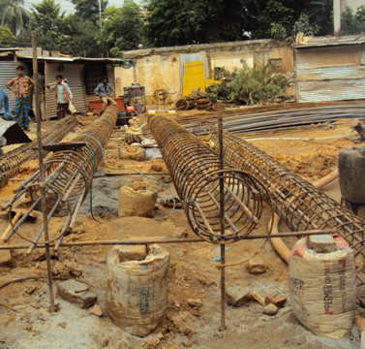
SHORING

Slide 12
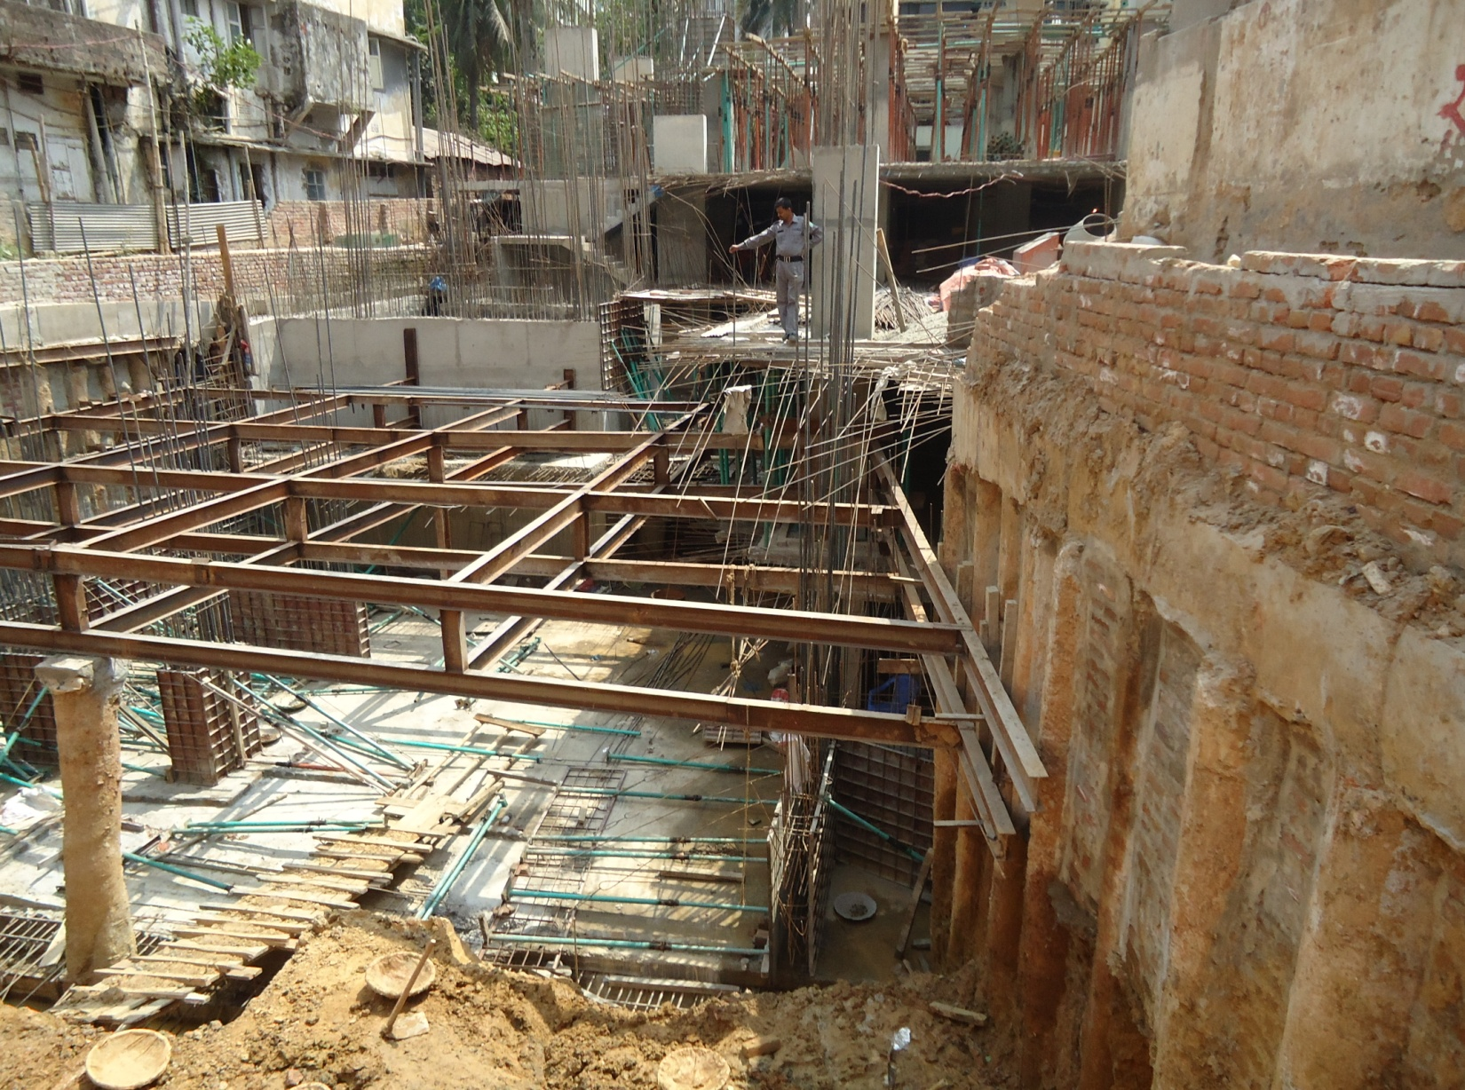
SHORING AND AUXILIARY STRUCTURES
Strut
Tie Beam
Bracing
King’s Post
Shore Pile

Slide 13
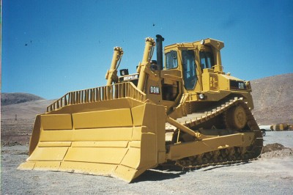
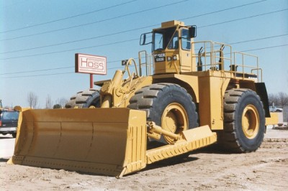
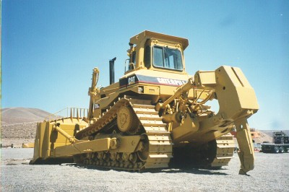
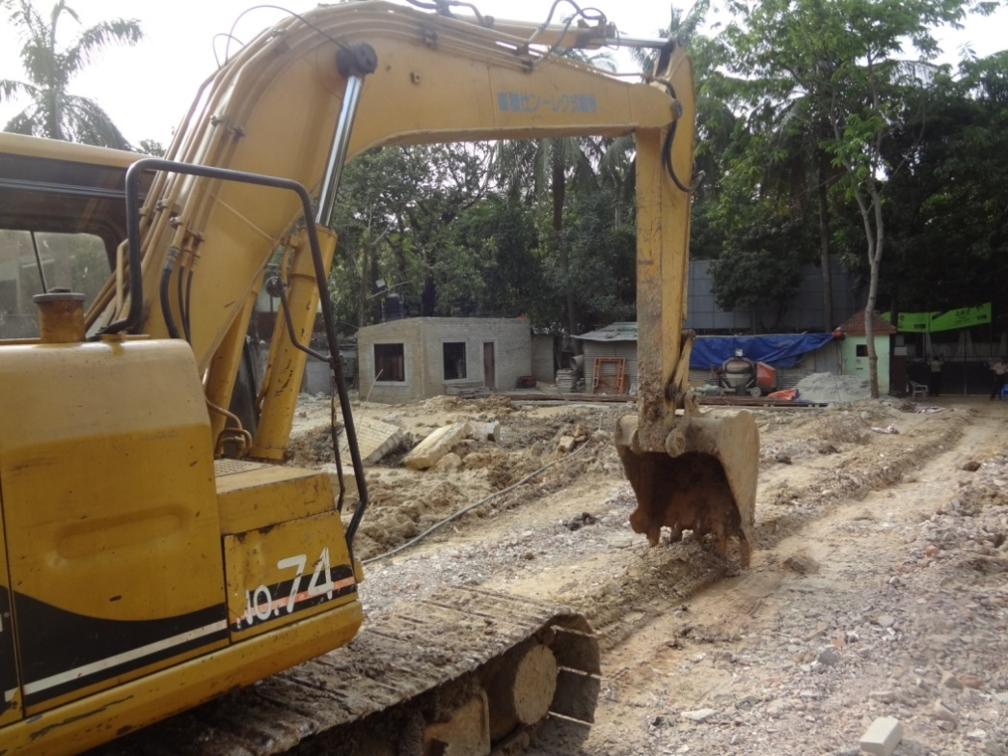
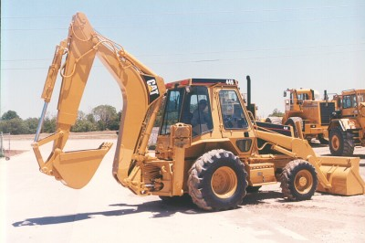
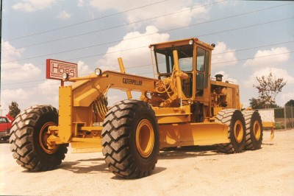
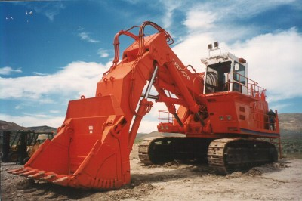
EXCAVATION

Slide 14
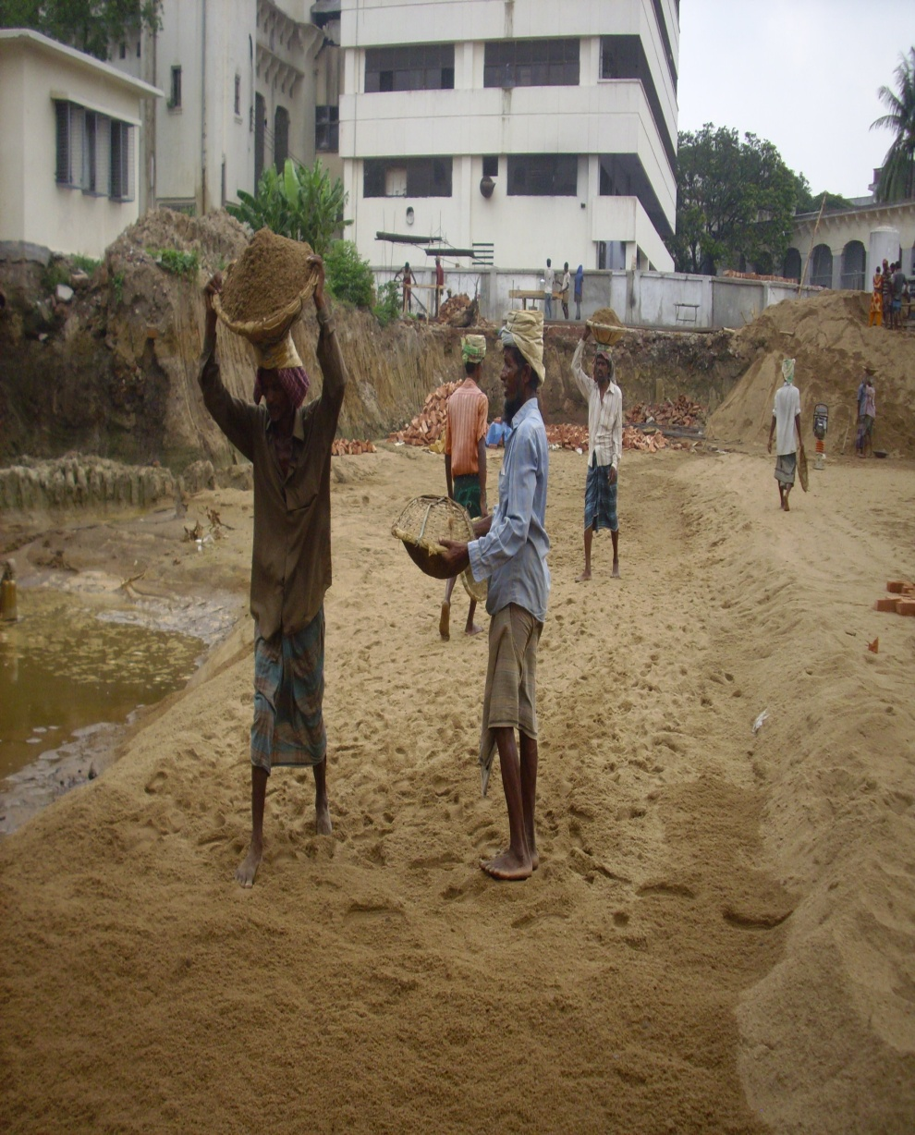
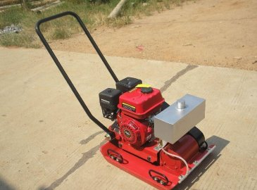
LEVELLING

Slide 15
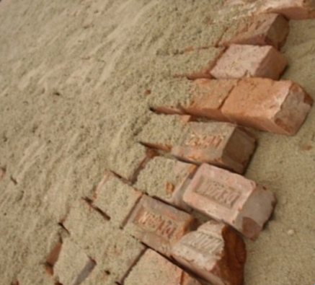
BRICK FLAT SOLING

Slide 16
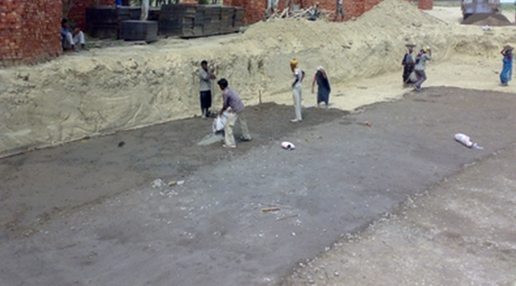
CEMENT CONCRETE LAYER

Slide 17
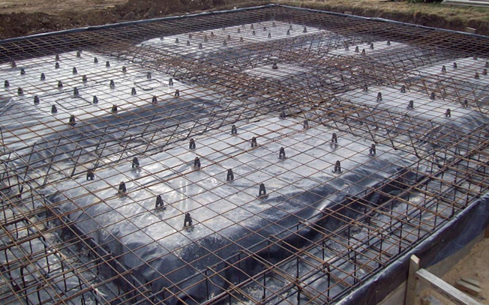
DAMP PROOF COURSE

Slide 18
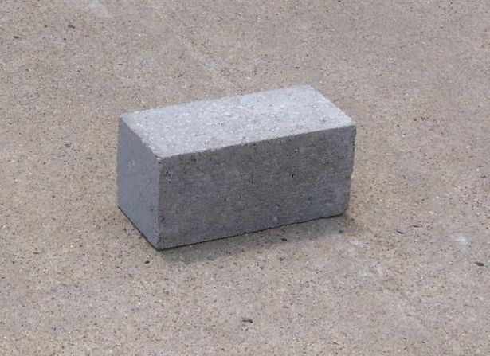
CEMENT CONCRETE BLOCKS

Slide 19
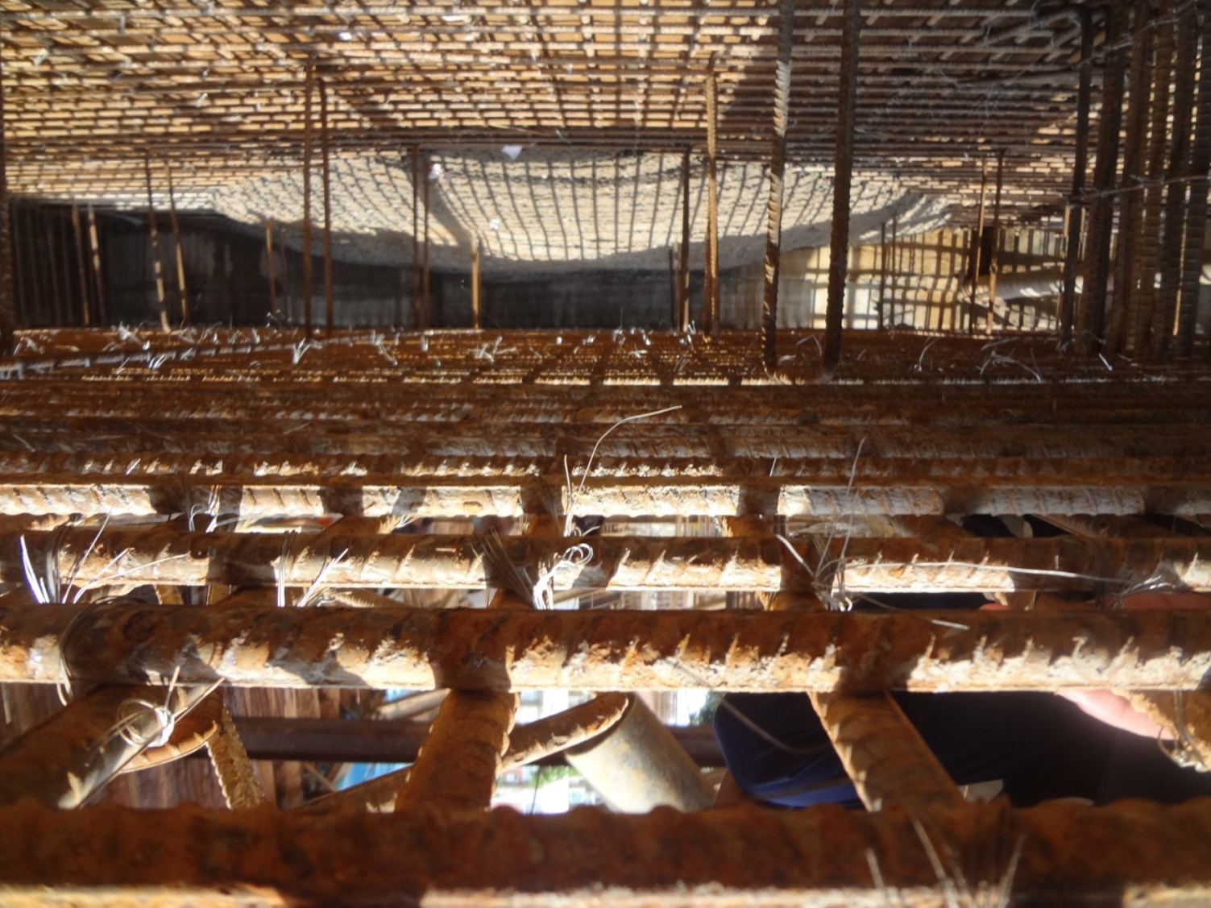
REINFORCEMENT PLACING
Top layer reinforcement
Bottom layer reinforcement
Chair

Slide 20
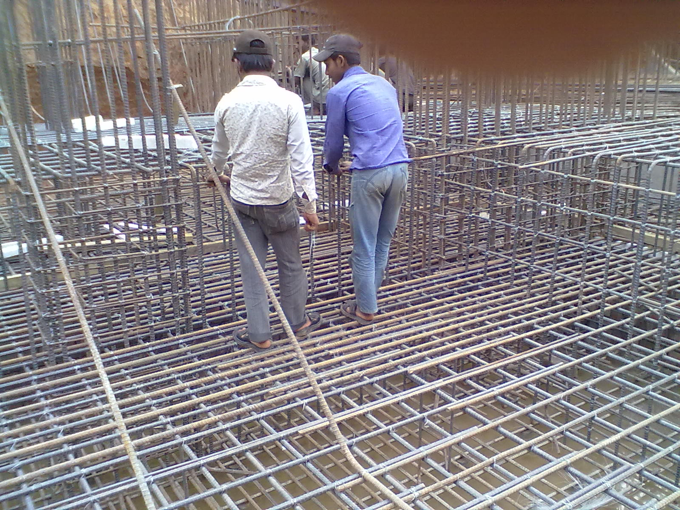
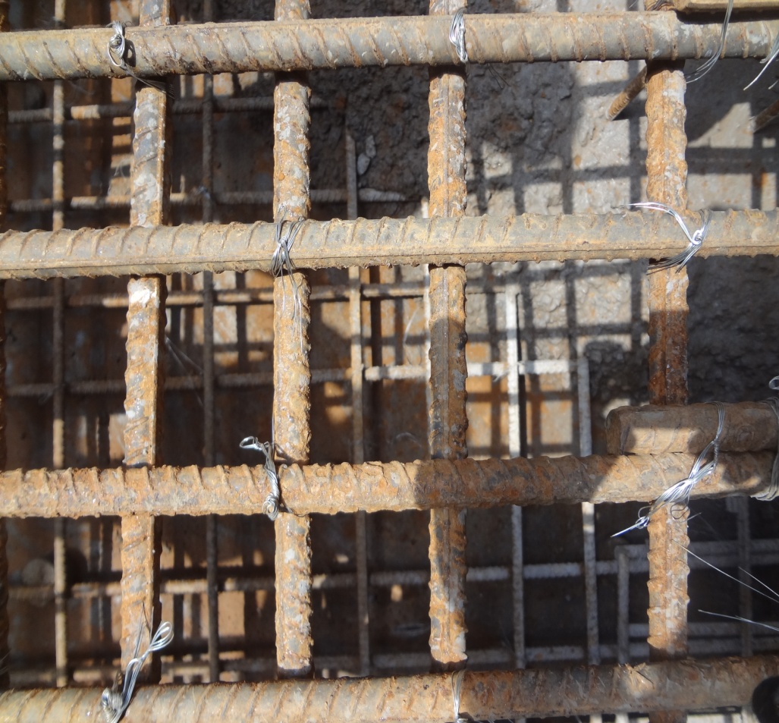
Tying of Chair Rebar and Layer Rebar with GI wires
GI wires to join rods

Slide 21
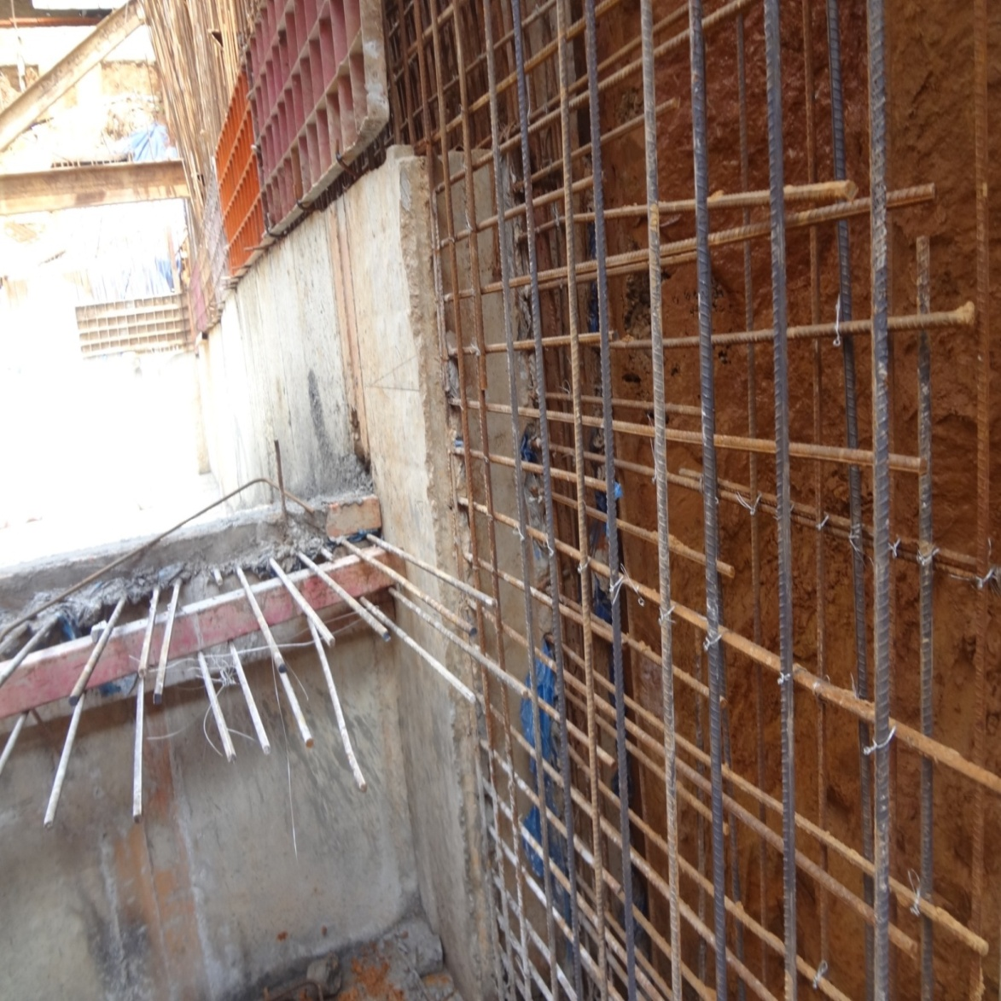
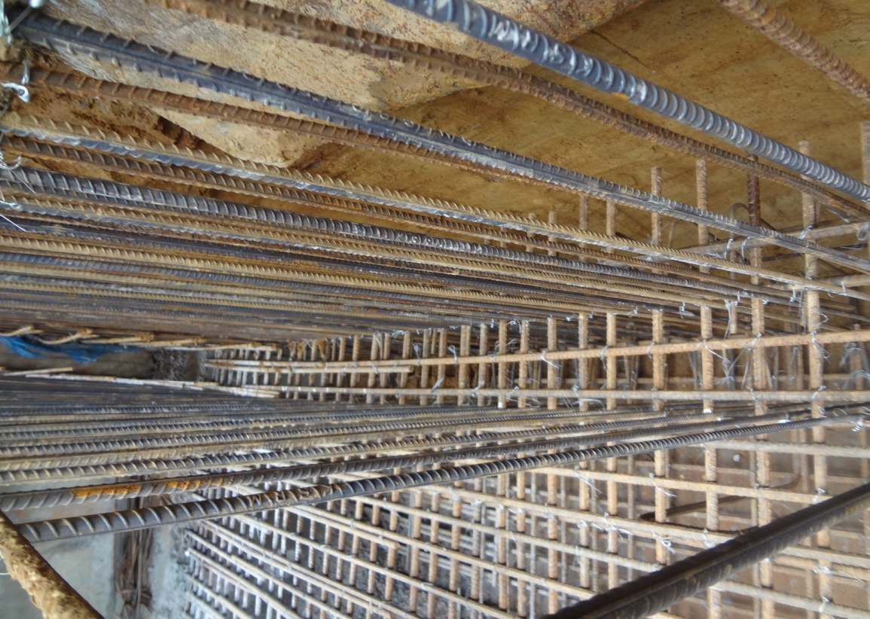
RETAINING WALL
Foundation work is done 20’-30’ below ground level.
Retaining wall provided to retain the increase of pressure with depth.
Cross Section through retaining wall

Slide 22
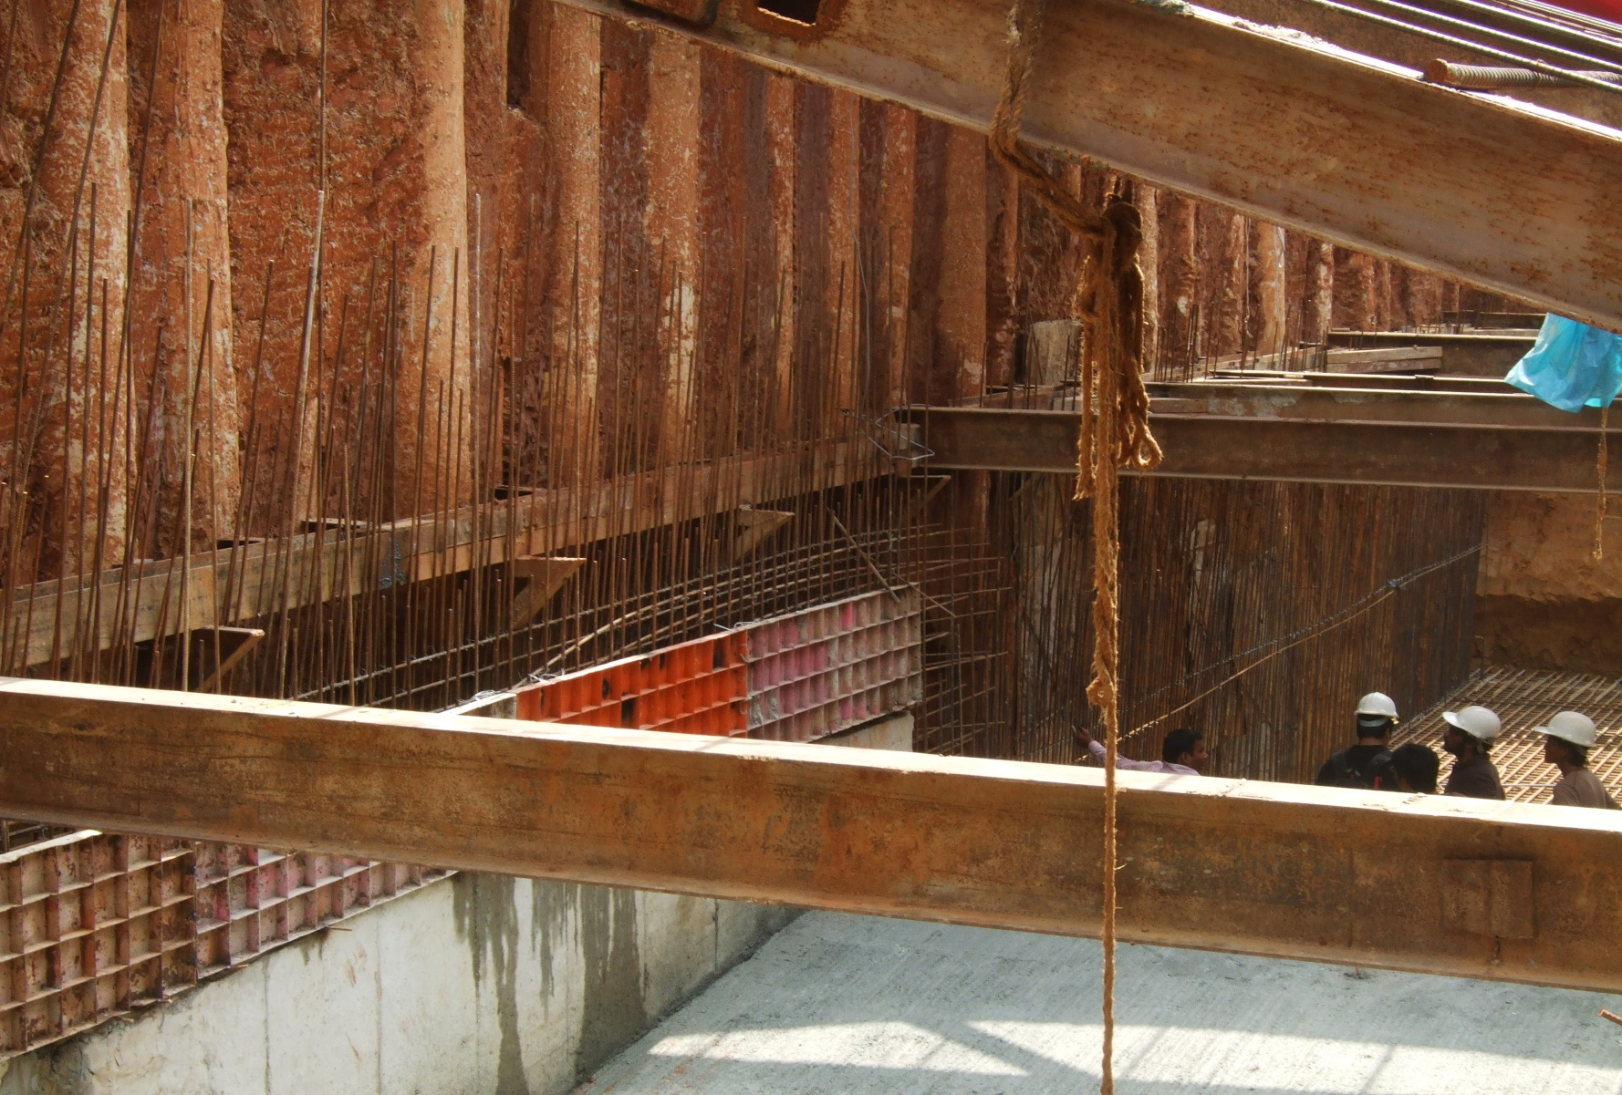
Retaining wall with shuttering

Slide 23
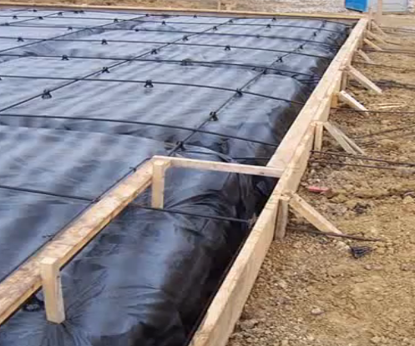
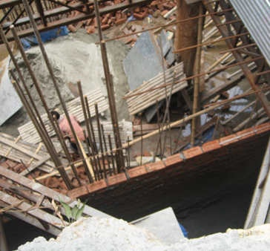
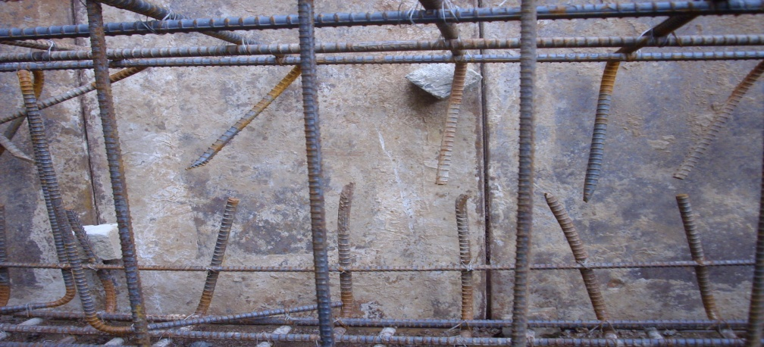
FORMWORK
Wooden Formwork
Shuttering wall
Plane Sheet formwork

Slide 24
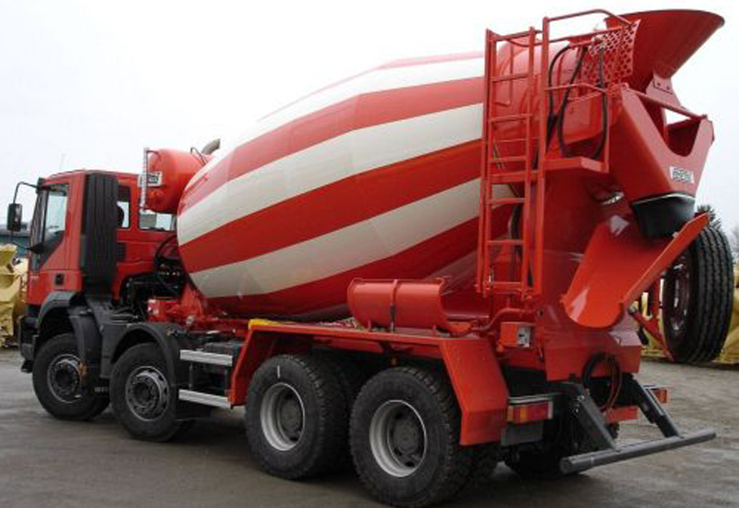
CONCRETE MIXING AND CASTING

Slide 25
CASTING
Mat Foundation covers huge area
Casting whole area at once will cause the setting time of concrete to be exceeded
The Mat Foundation is cast in parts

Slide 26
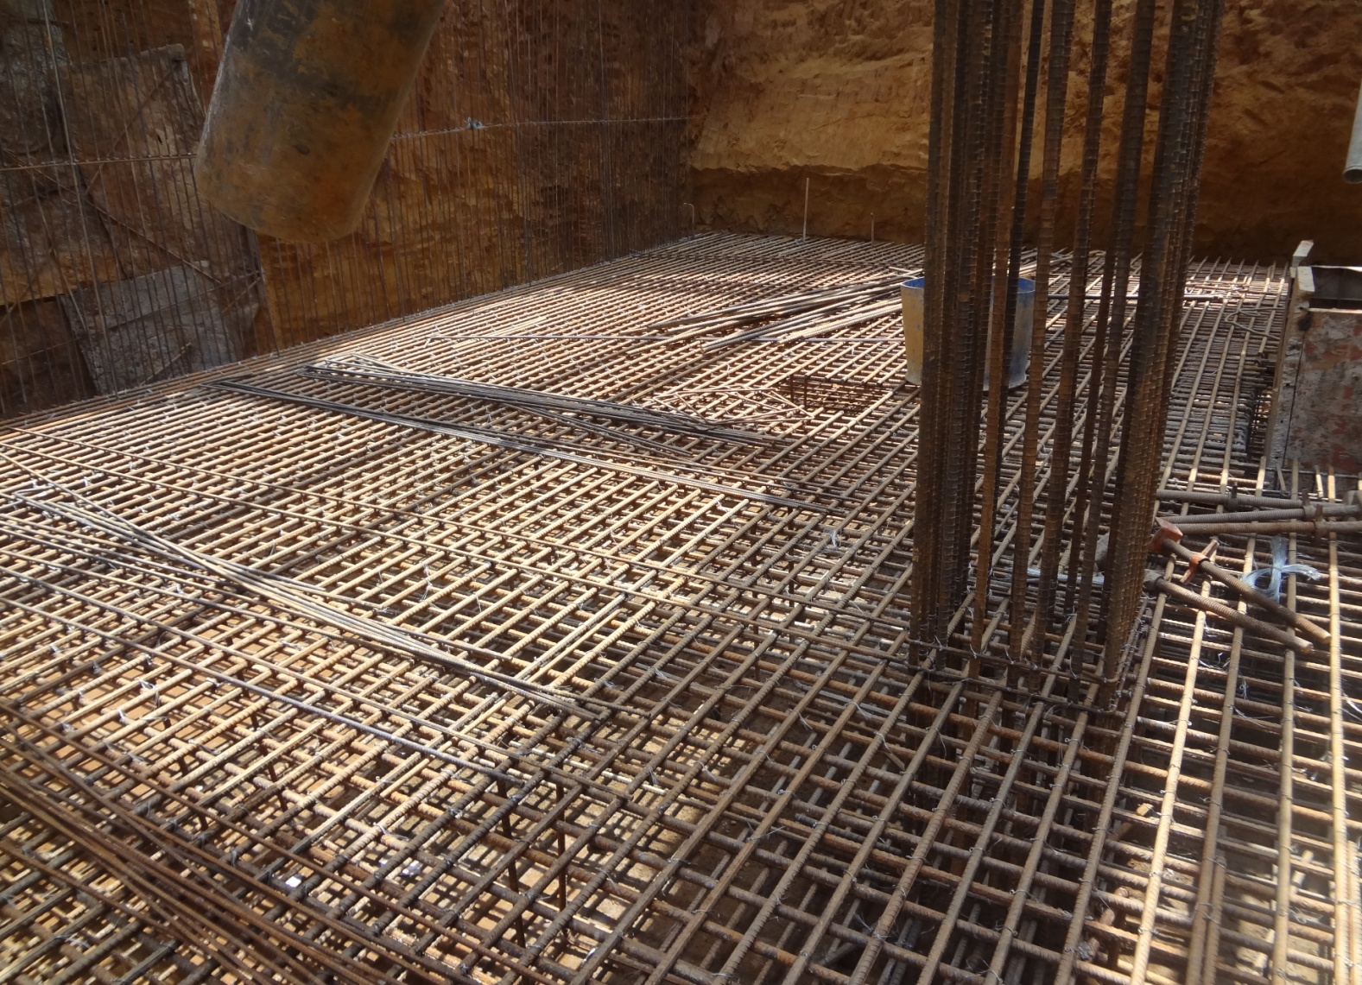
MAT BEFORE CASTING

Slide 27
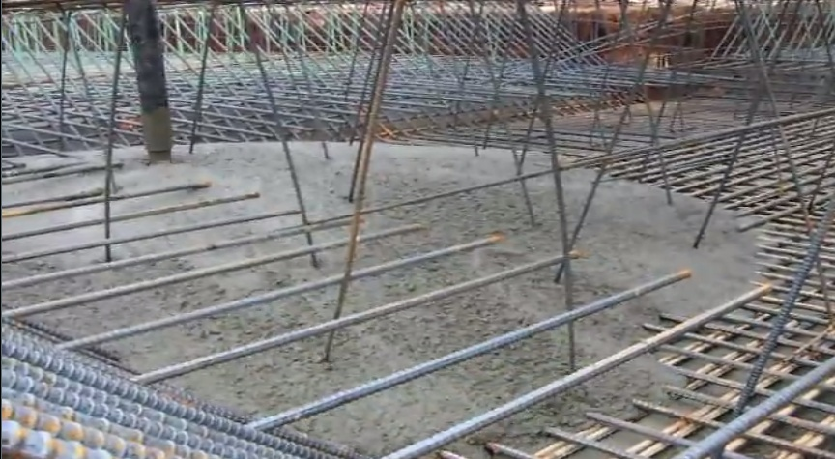
CASTING IS TAKING PLACE

Slide 28
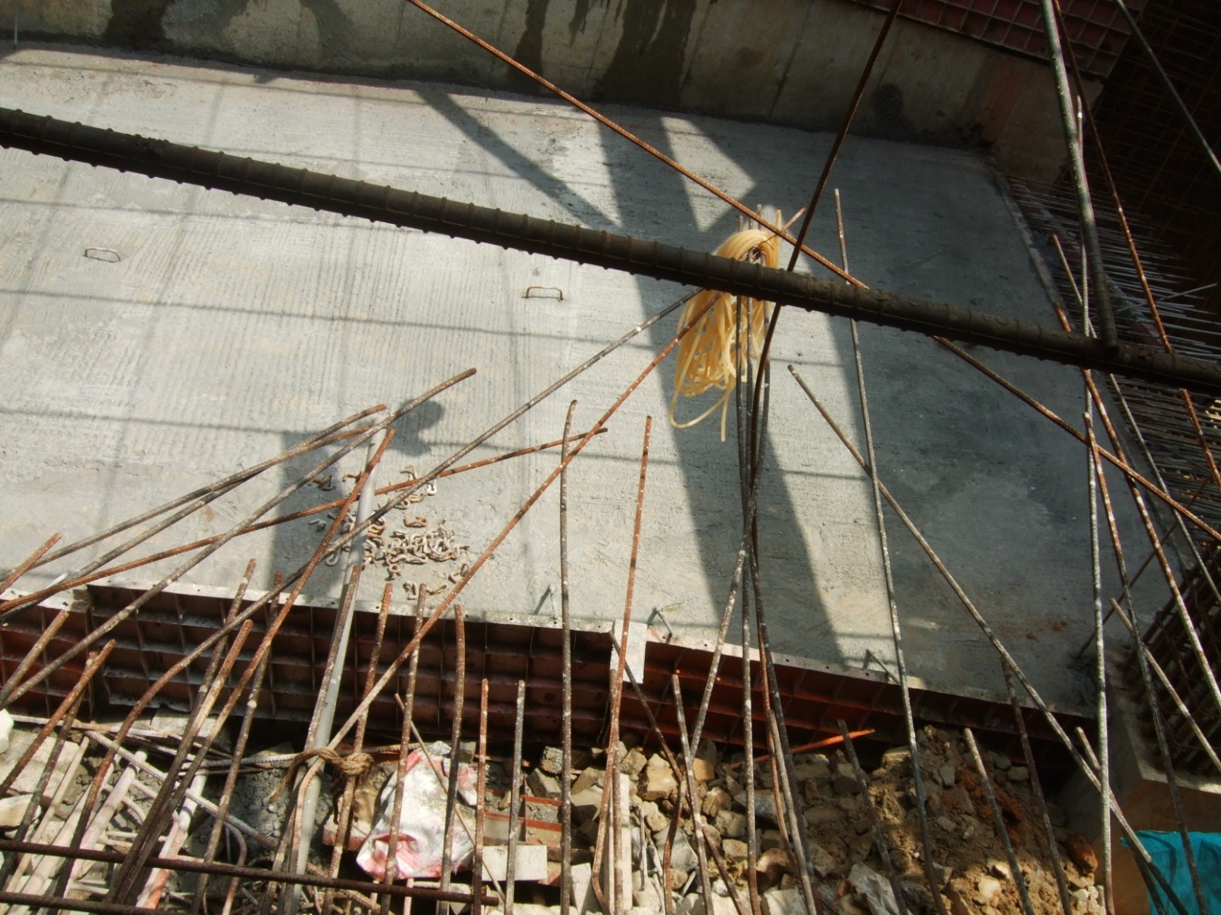
AFTER CASTING

Slide 29
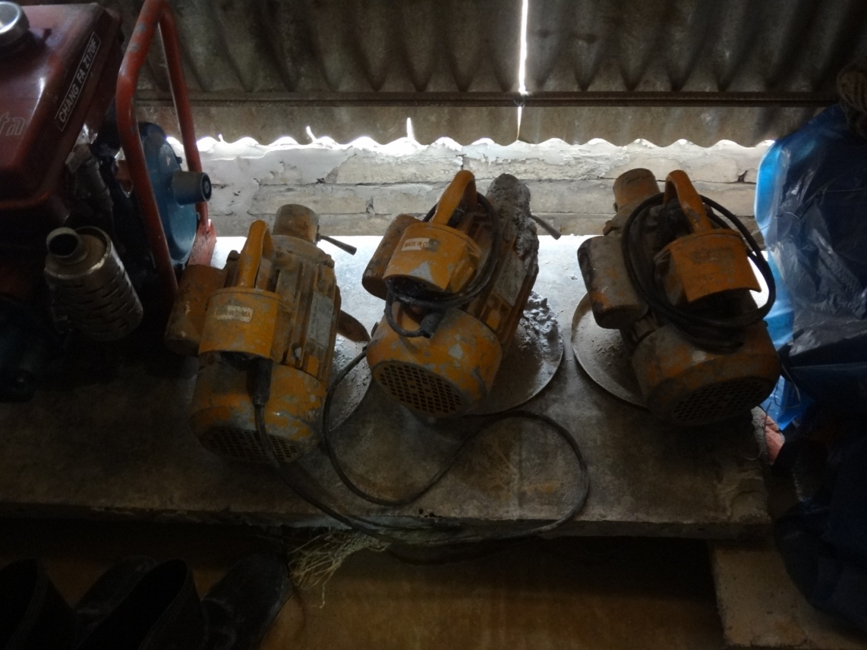
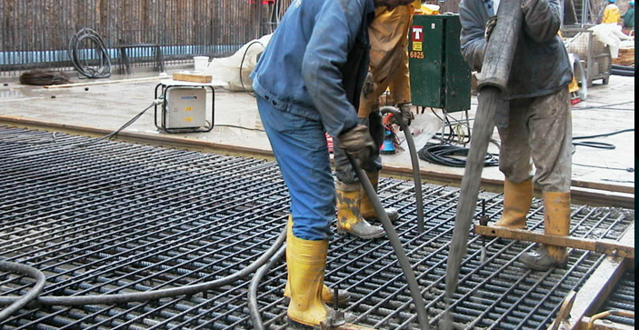
COMPACTION
Diesel Compactor
Electrical Compactor

Slide 30
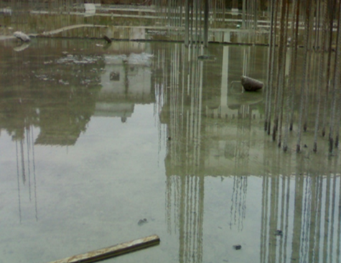
CURING
Curing is mandatory to achieve the desired strength of concrete. Minimum Curing time is 28 days.

Slide 31
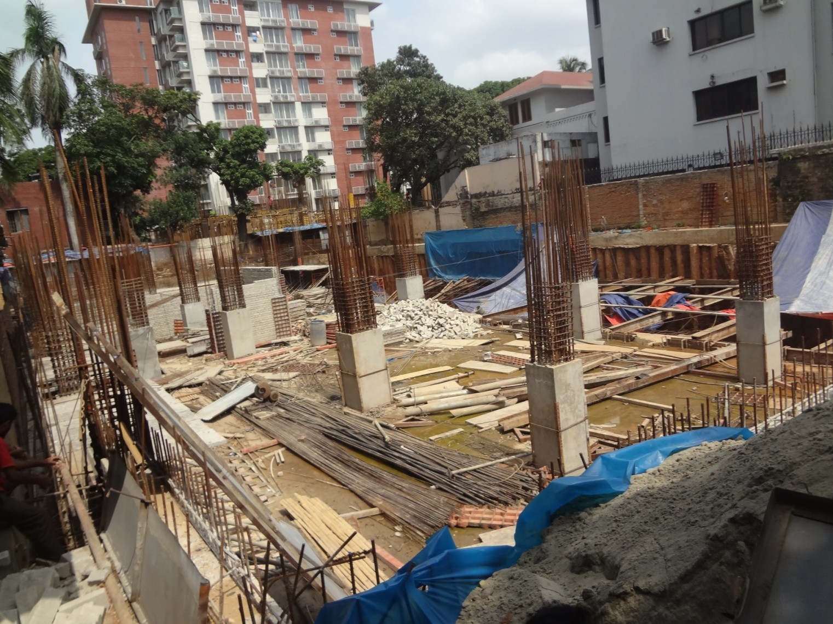
COMPLETED MAT FOUNDATION

Slide 32
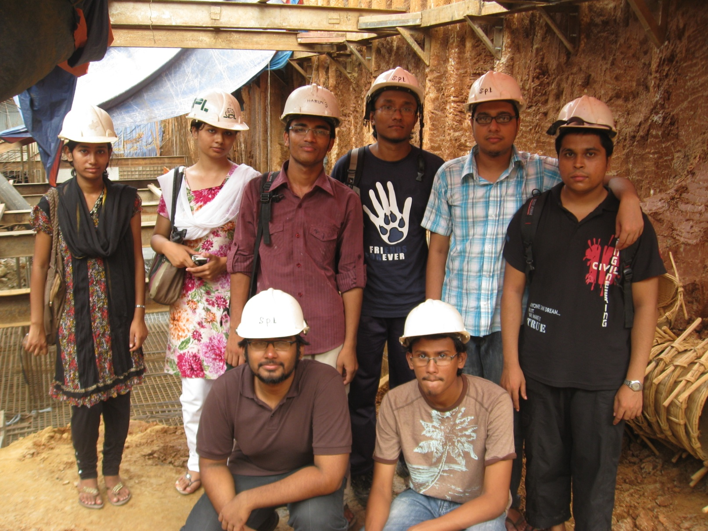
Prepared by...
1004006 Fahmida Rahman Fami
1004009 Nazmus Sakib
1004018 Zishan Ahmed
1004020 Swakshar Saha
1004029 Nayeem Rahman Khan
1004031 Troyee Saha
1004041 Rafid Shams Huq
1004048 Hossoin Sho Von
1004054 Saikat Hasnat
1004055 Samira Naushin

Slide 33

Special thanks to:

