Slide 1
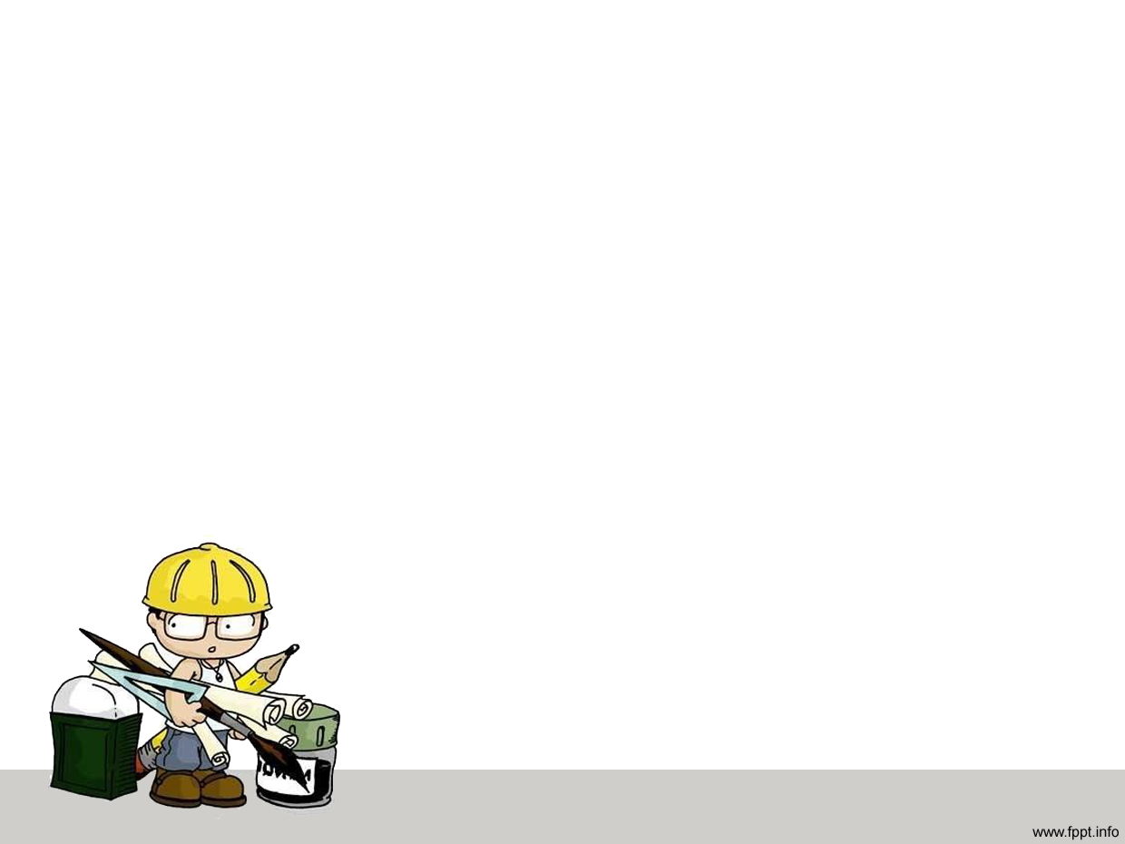
Process of plasterwork
Presented by:
Group – 2
Student ID: 1104148-1104164

Slide 2
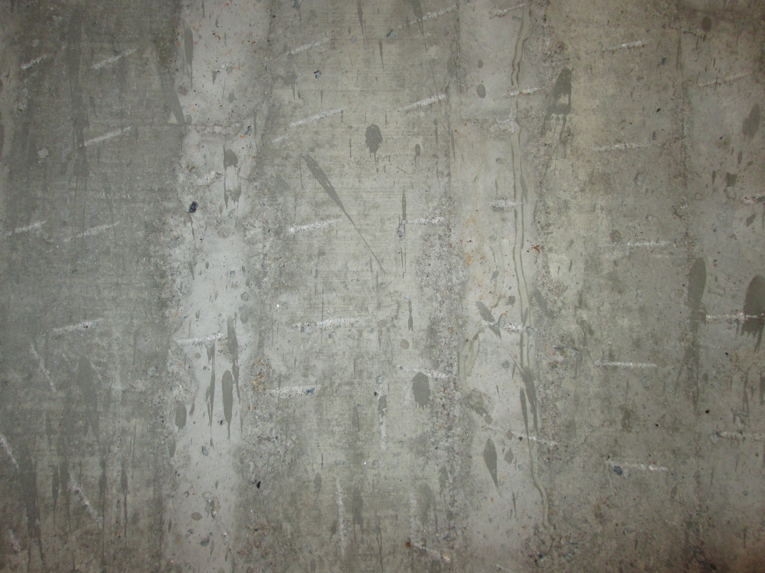
Plasterwork:
The art of covering the surface of masonry work with a suitable material is called plastering.

Slide 3
Why it is necessary
To protect the external surfaces against penetration of rain water and other atmospheric agencies
To give smooth surfaces in which dust and dirt can not lodge
To give decorative effect
To protect surfaces against vermin
To conceal inferior materials and defective workmanship

Slide 4
Types:
A fine paste of mortar made by mixing cement with sand or fat lime with sand or surkhi in addition to sufficient quantity of water.
When cement is used as a binding material, the plaster is called cement plaster and if lime is used as the binding material, it is called lime plaster.
Other than these, Mud plaster, Stucco plasters are also included amongst various types.

Slide 5
Suitability of different Types of plastering

Slide 6
Cement Plastering:
External finishings
Internal renderings of common as well as important buildings
Damp conditions

Slide 7
Lime Plastering
Internal renderings of buildings.
Not commonly adopted these days.

Slide 8
Mud plastering
Adobe walls
Requires additional waterproofing.

Slide 9
Stucco plastering
External as well as internal surfaces of buildings to provide an excellent finish
All types of decorative plasterworks

Slide 10
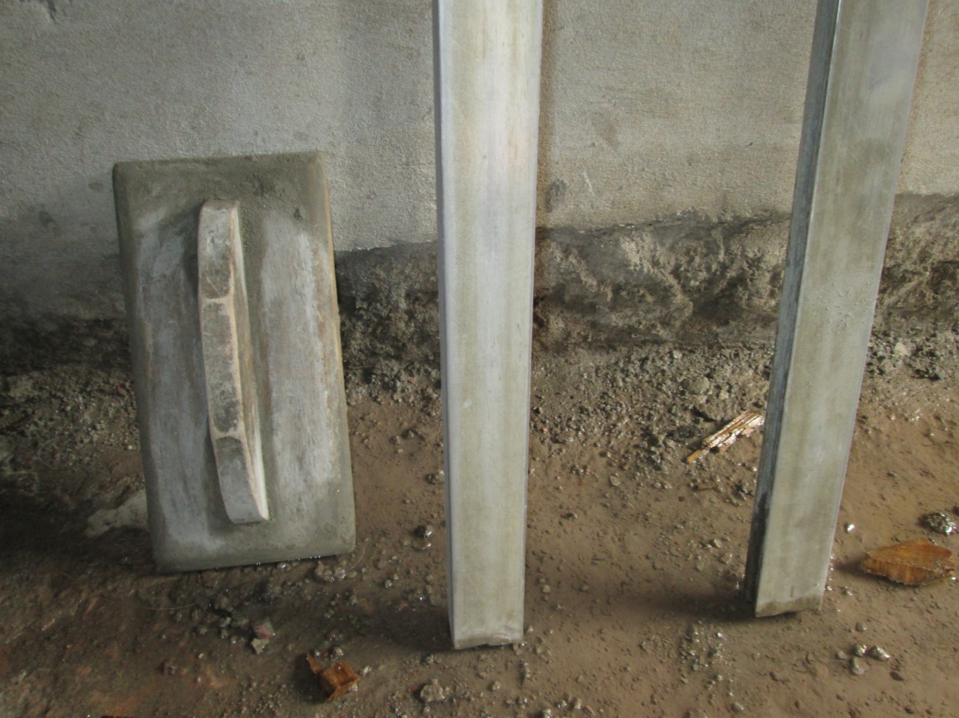
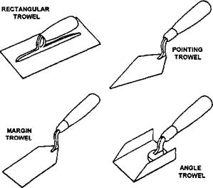
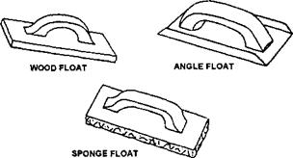
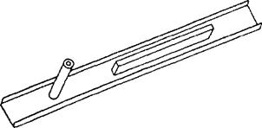
FLOATS
TROWELS
DARBY
TOOLS OF PLASTERING

Slide 11
Steps of plastering
Preparing Surface for Plastering
Wetting The Surface
Grouting
Covering with Mortar Paste
Leveling with Plumb Bob
Applying Second Layer
Leveling and Smoothing
Brushing with flower broom & Sponge

Slide 12
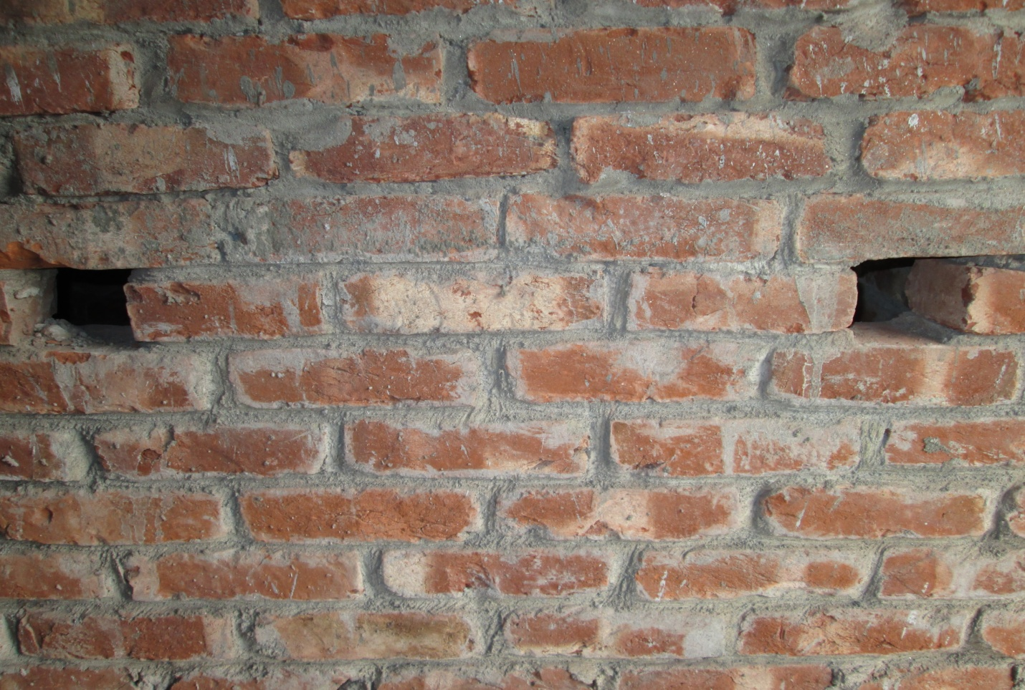
Preparing Surface for Plastering
Raking the surface
Removing Efflorescence
Improving Adhesion

Slide 13
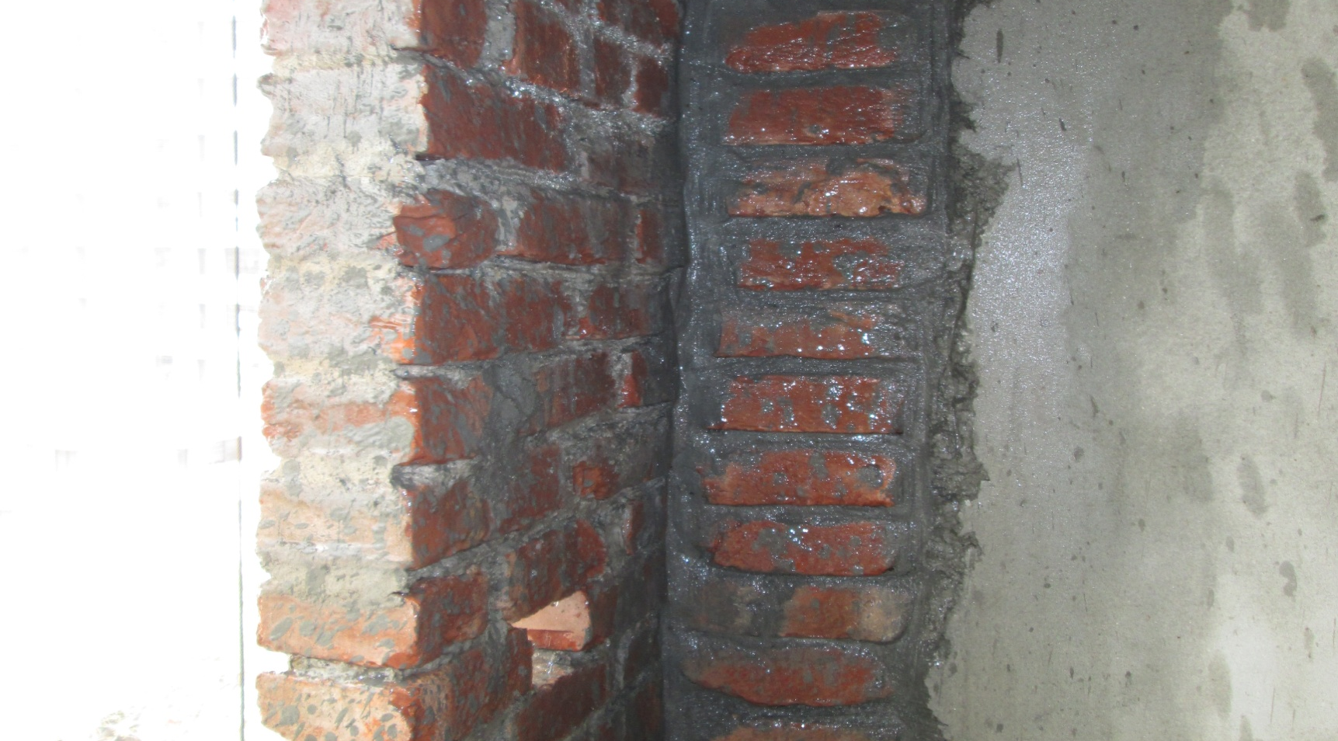
Wetting The Surface
Surface kept wet for at least 6 hours prior to plastering
Ensuring Saturated condition of Bricks or surface to be plastered

Slide 14
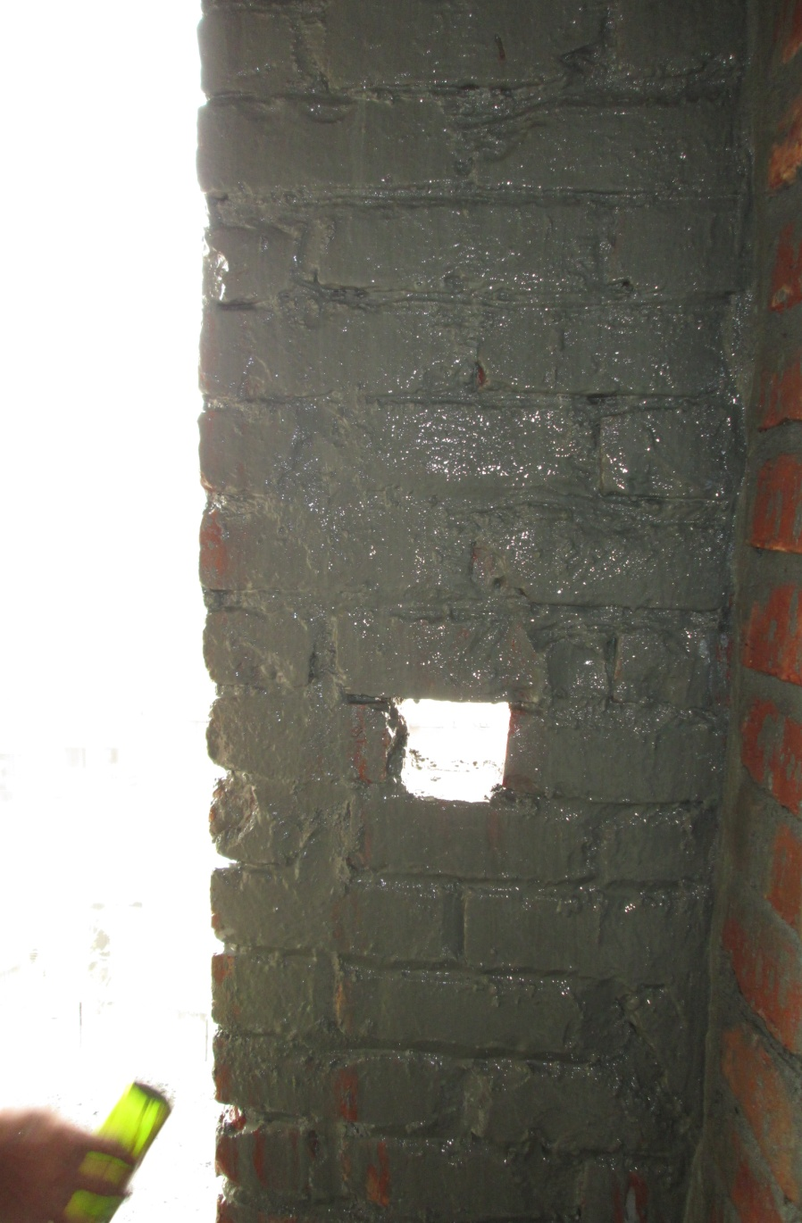
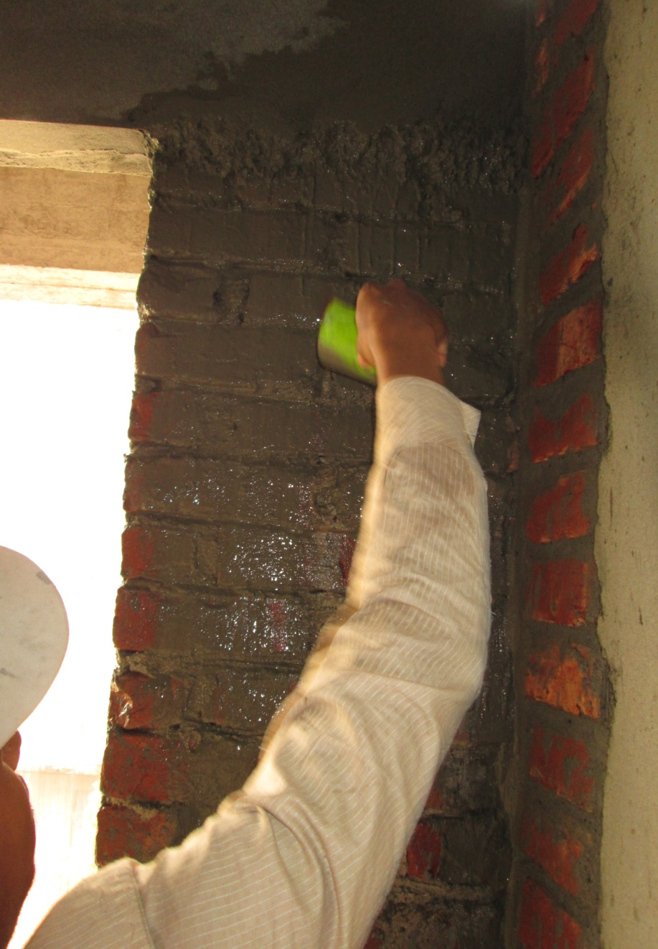
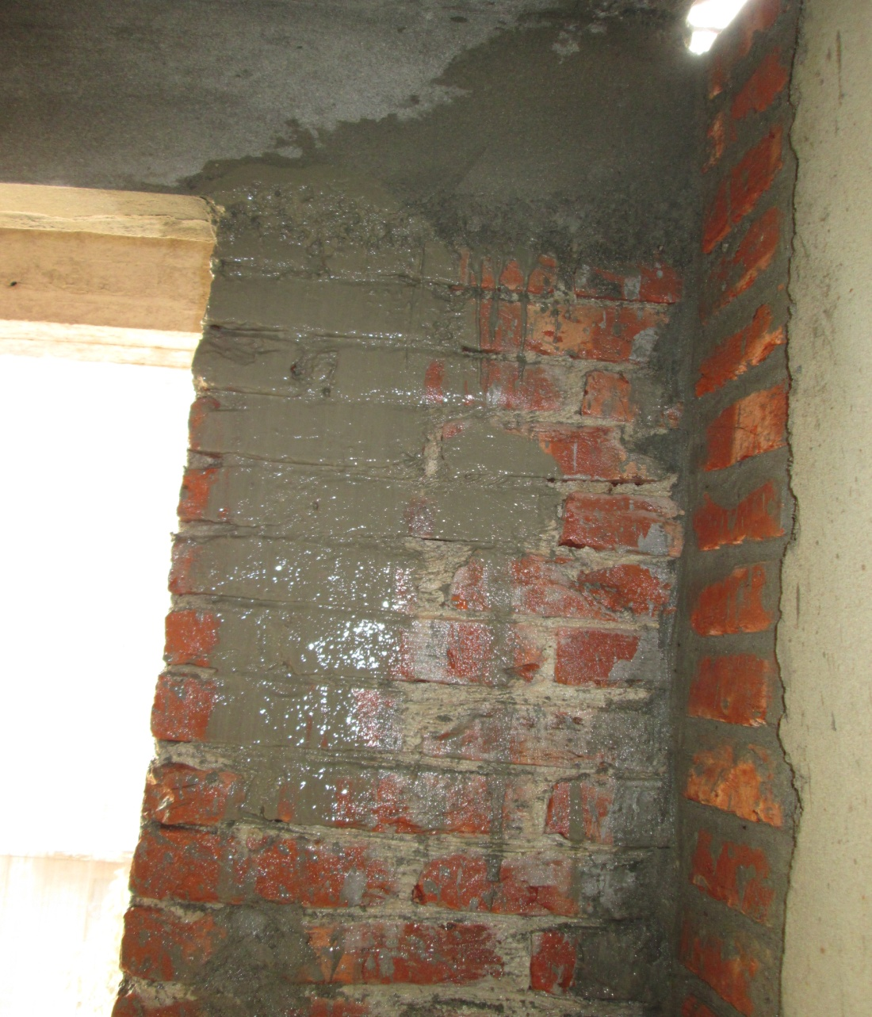
Grouting
Renders the function of glue in plastering

Slide 15
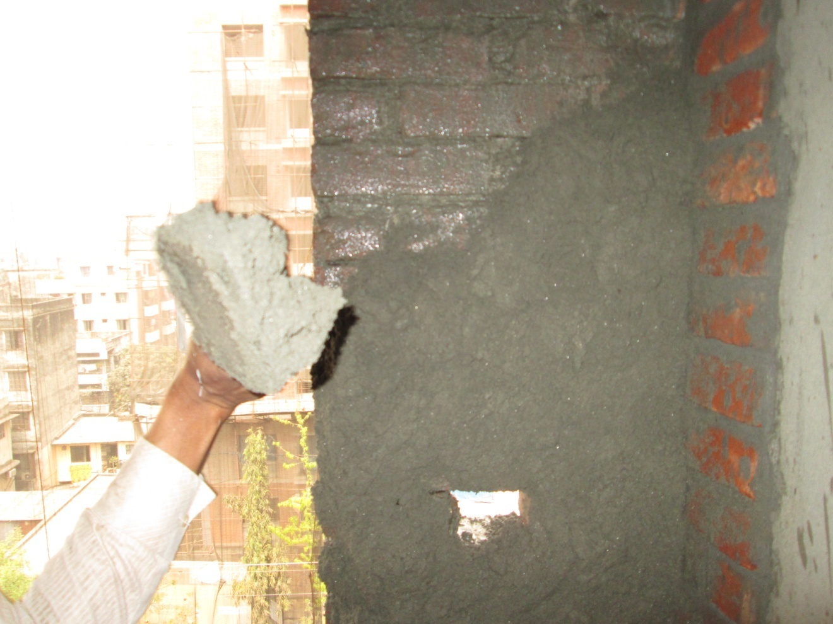
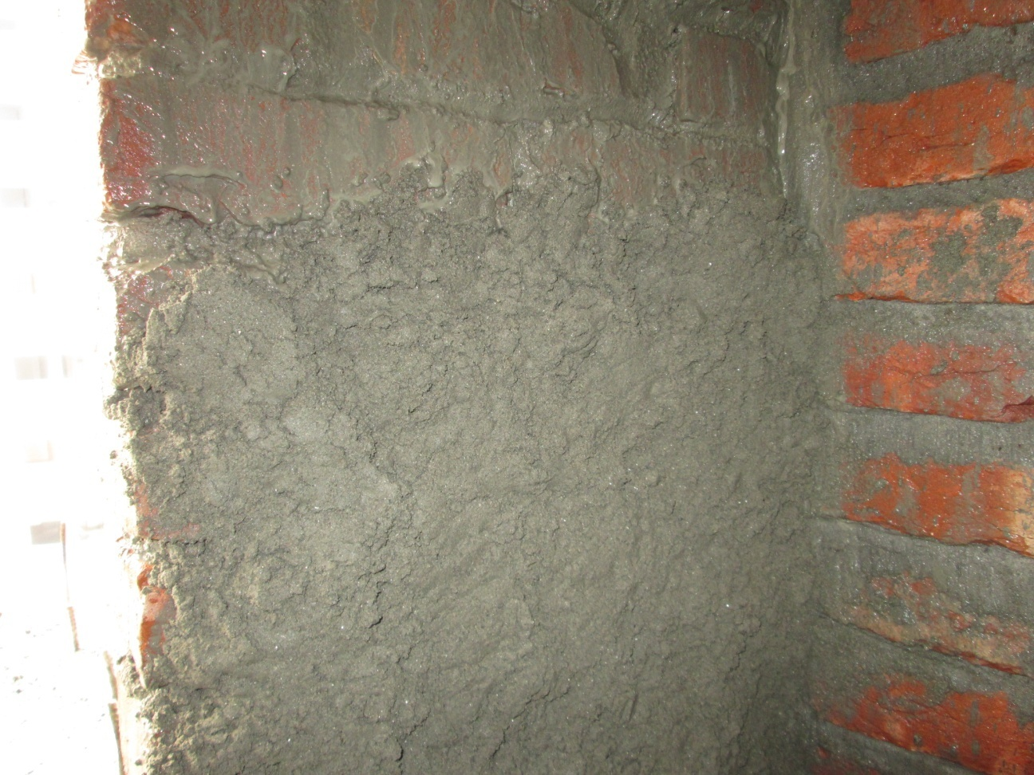
Covering with Mortar Paste

Slide 16
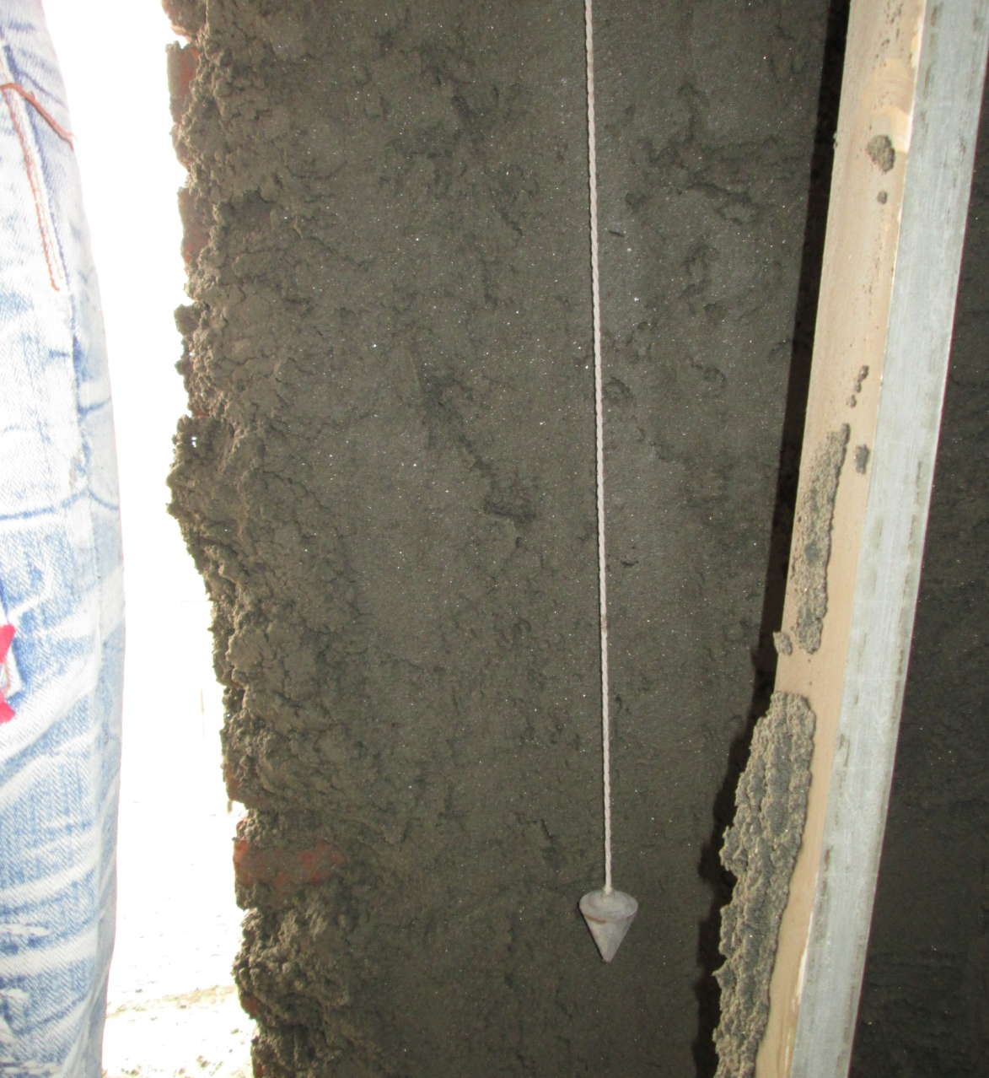
Leveling with Plumb Bob
Maintaining surface alignment

Slide 17
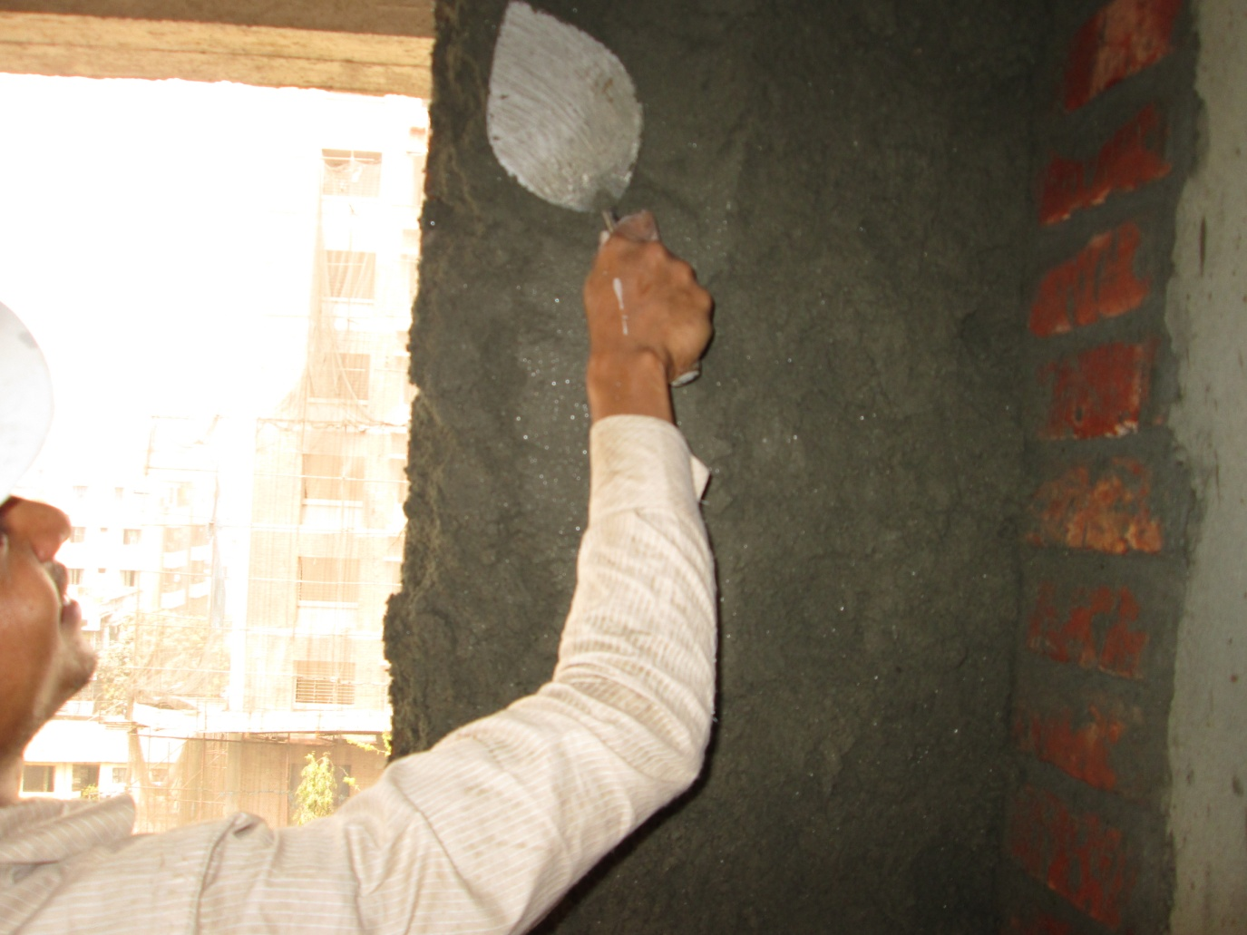
Applying Second Layer

Slide 18
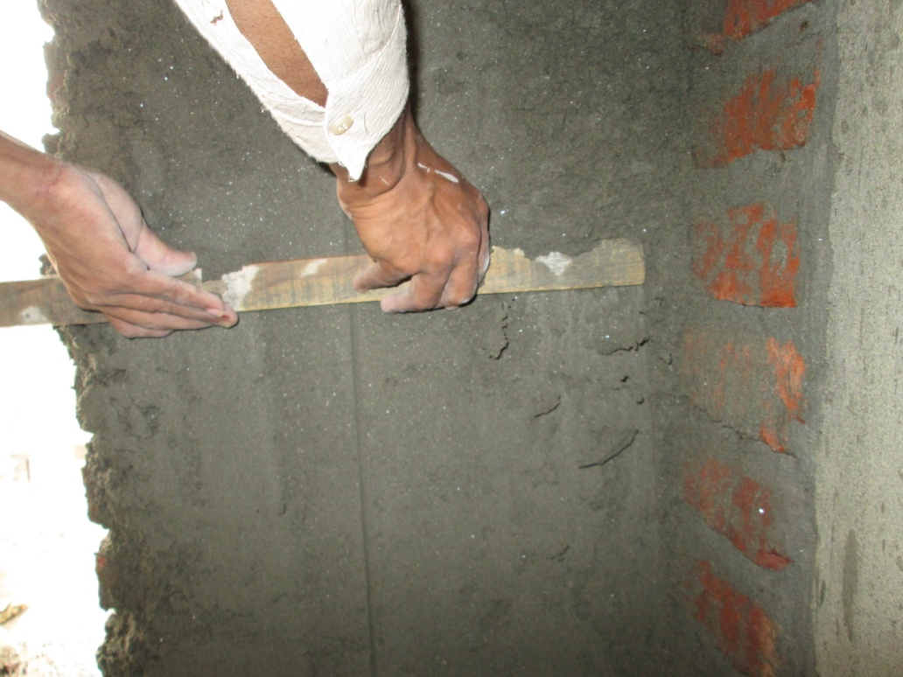
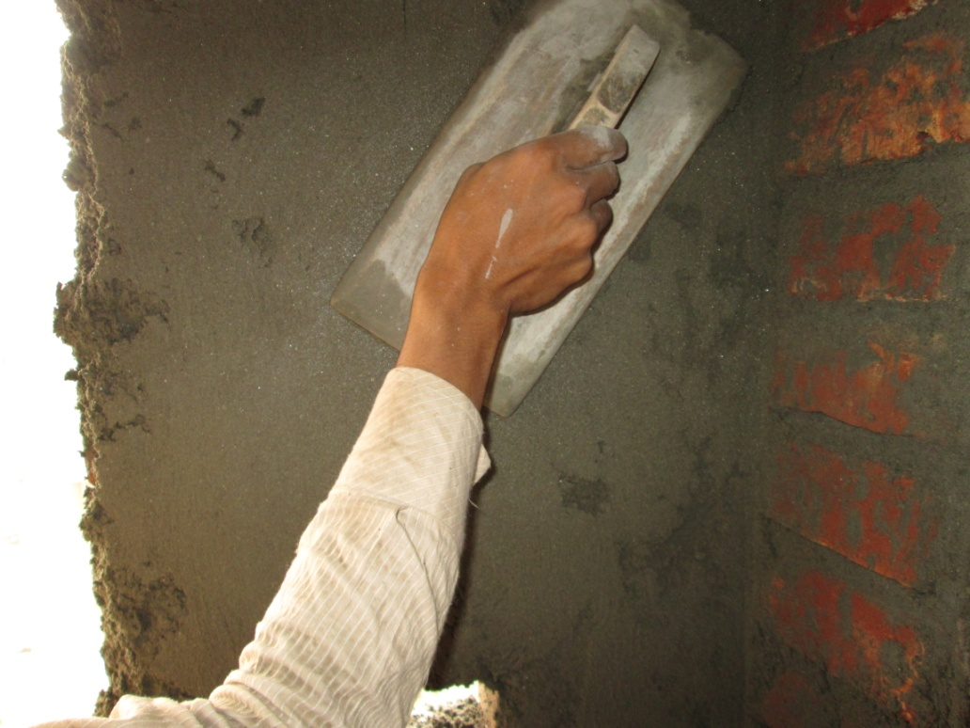
Leveling and Smoothing

Slide 19
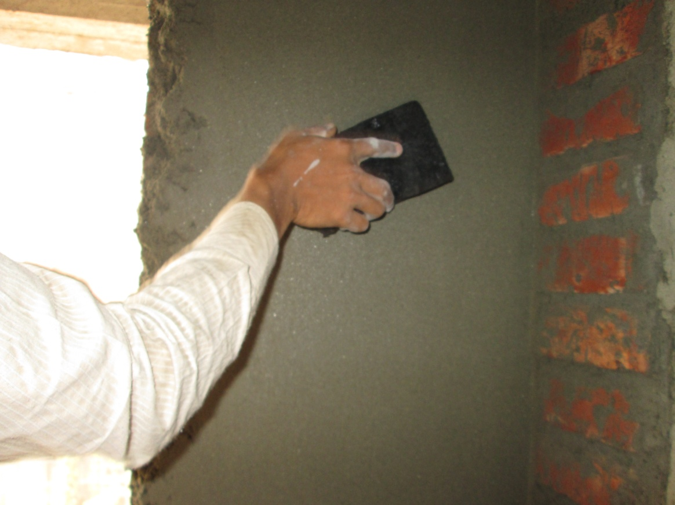
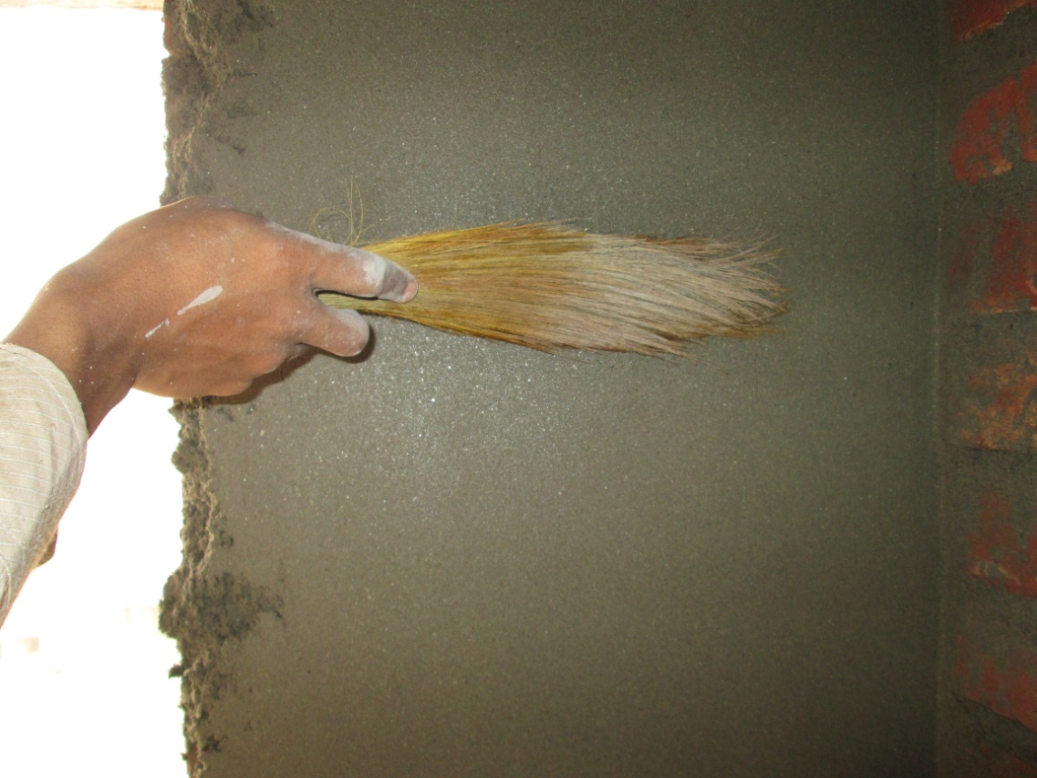
Brushing with flower broom
Smoothing by broom
Smoothing by sponge

Slide 20
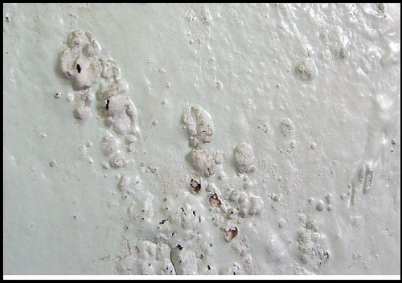
Defects in plaster work
Blistering of plastered surface: Formation of small patches of plaster swelling out beyond the plastered surface, rising out of late slaking of lime particles in the plaster

Slide 21
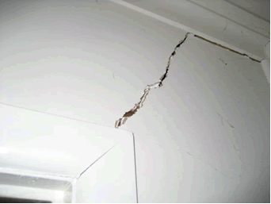
Cracking: caused by
Imperfect preparation
Structural defects
Discontinuity of surface
Movements in background or surface due to thermal expansion or rapid drying or shrinkage
Faulty workmanship

Slide 22
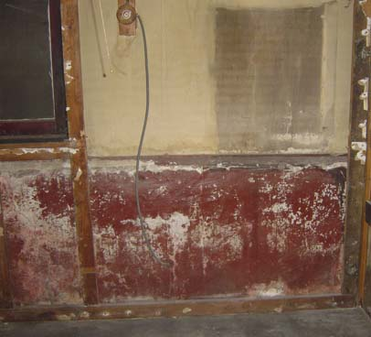
Efflorescence:
Whitish crystalline substance on the surface due to presence of salts in plastering materials as well as building materials like brick, sand, cement even water.
Gives a very bad appearance and affects the adhesion of paint.
Can be removed by dry brushing and washing the surface repeatedly.

Slide 23
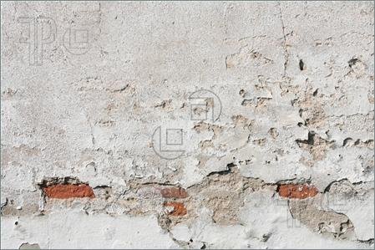
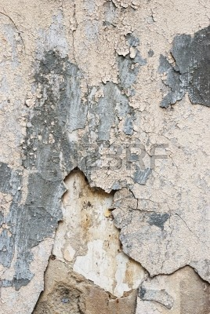
Flaking: Formation of very loose mass of plastered surface due to poor bond between successive coats.
Peeling: Complete dislocation of some portion of plastered surface, resulting in the formation of a patch. This also results from imperfect bond.

Slide 24
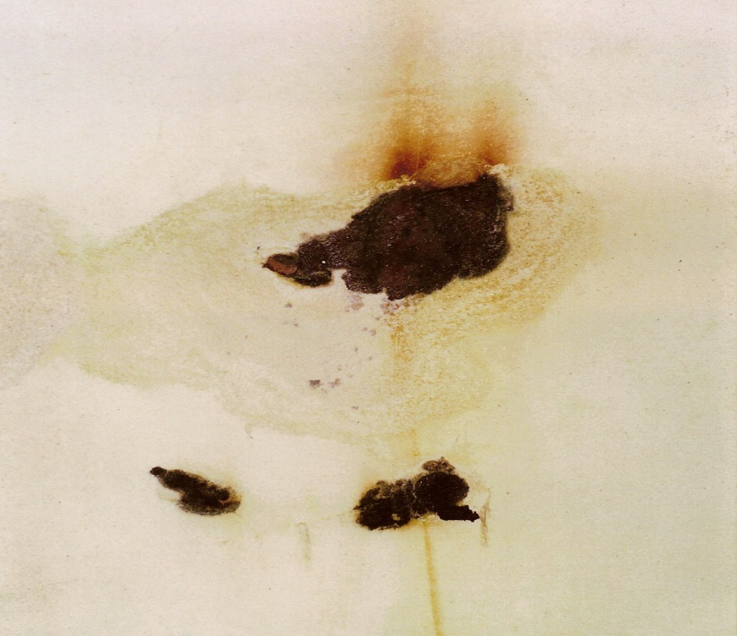
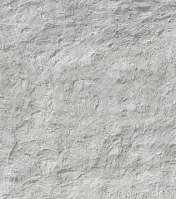
Popping: Formation of conical hole in the plastered surface due to presence of some particles which expand on setting.
Rust stains: Formed when plaster is applied on metal laths
Uneven surface : Happens because of poor workmanship

Slide 25
Recommendations:
Brick and concrete surface joints
Plastering of outer surfaces
Curing
Modern implementations
Environmental friendly plasters

Slide 26
T h a n k y o u

