Slide 1
A Presentation on
Shore Piling

Slide 2
What is Shore Pile ?
Shore Pile means a supporting structure for the prevention of collapse of any construction. It can resist the lateral pressure of the soil, water etc.

Slide 3
Necessity of Shore Piling
When walls bulge out
When walls crack due to unequal settlement of foundation and repairs are to be carried out to the cracked wall.
When an adjacent structure needs pulling down.
When openings are to be newly made or enlarged in a wall.

Slide 4
Types of Shore Pile
Based on the Site
On Shore
Off Shore

Slide 5
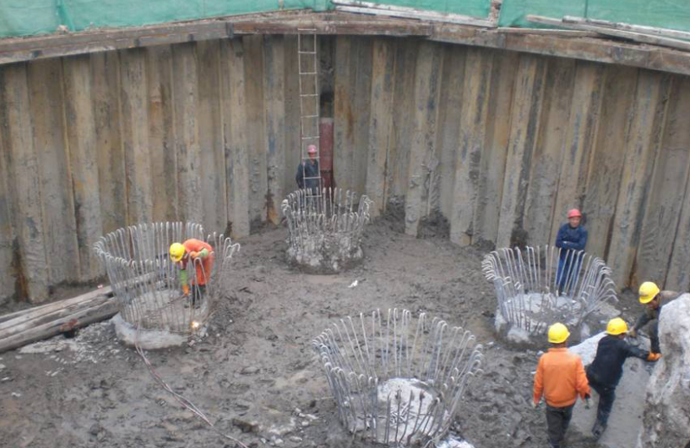
On Shore
The pile which is cast on land resist the lateral forces of the soil , form of the prop or support usually temporary that is used during the repair or original construction and in excavations.

Slide 6
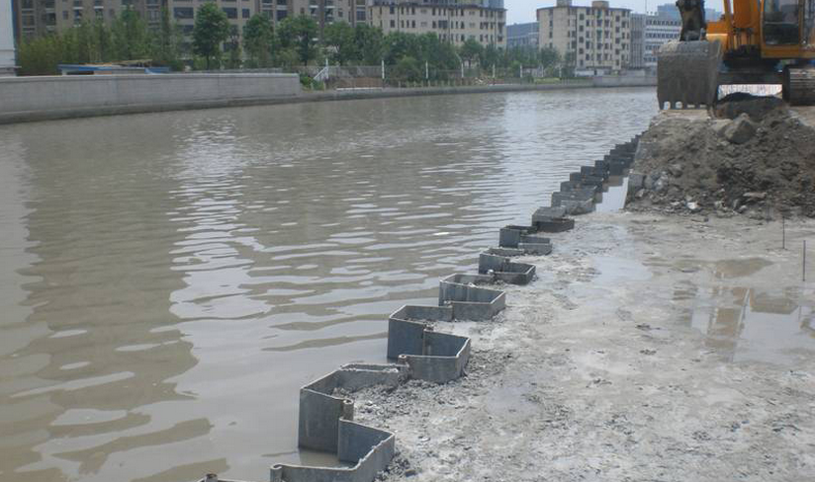
Off Shore
Off shore piles are long and slender members which transfer the load to deeper soil or rock of high bearing capacity avoiding shallow soil of low bearing capacity . They also transfer the load of the structure to the bearing ground located at some depth below ground surface.

Slide 7
Based on Materials
Timber Pile
Steel Pile
Concrete Pile

Slide 8
Timber Pile
The pile which is made of timber and inserted into the soil throw hammering. Wooden pile are made in various sizes and forms. Nature of site condition determine the choice of a particular type. In places where excavation is small and the ground water problem is not serious. If the water tightness is required to a great extent, lapped sheet piling is used. In this case, each pile is made up of two plungs, either spiked or bolted to one another . Timber sheet piles have light weight and as such the equipment required for pile driving is also light. This is considered to be an advantage timber piles have over piles of other materials.

Slide 9

Steel Pile
Straight web type
Straight web types of piles are used where the piles are liable to be subjected to tensile forces and interlocking strength is of prime importance
Shallow or deep arched web type
Arched web type are used where the piles are required to resist bending stresses.
Z web type

Slide 10
Concrete Pile
Pre-Cast piles:
Defined as reinforced concrete piles which is molded in the circular, square, rectangular or octagonal form.
Cast in Situ Piles :
Piles which are cast in position inside the ground
Prestressed Piles :
Precast piles are the piles that are cast under stress

Slide 11
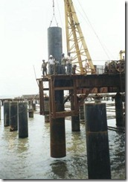
Off Shore Pile Construction
Off Shore Piling (Marine Piling)
Setting out of Piling Point
The pile point shall be marked
Surveyor shall mark the exact pile
Installation of Permanent Casing

Slide 12
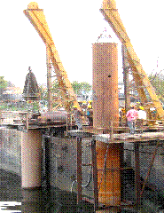
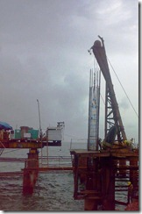
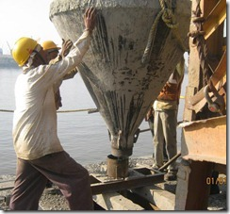
Drilling of Bore Hole
Reinforced Cage Installation
Pile Concreting

Slide 13
I. Cast-in-Situ Pile
2. On Shore Piling (Land Piling)
Wooden pegs are used to mark out the centre position of each bored pile.
Positioning of Bored Pile
Selection of driving equipment
Hydraulic or electric vibrators are used for driving.
Installation of Casing
A casing is driven into the ground by a vibro-hammer, leaving about 1 metre length of the casing protruding from the ground
Augering of Borehole
Auger is used as a drilling tool to cut and remove the soil within the casing to form a borehole

Slide 14
Installation of Steel Cage
The crane lifts up the steel cage and places it within the borehole.
Concreting of Borehole
Concrete is poured into the borehole to form the bored pile.
Extraction of Casing
The vibro-hammer extracts the casing from the ground.
Repetition of Process
Steps 3 - 7 are repeated till the entire length of the contiguous bored pile wall construction is completed.
Inserting Beam Cap
An iron beam is welded on each of the piles head

Slide 15
II. Pre-Cast Pile
Selection of Driving Equipment
Proper driving equipment is selected.
Hydraulic or electric vibrators are mostly used for driving precast pile.
Creating Bore Hole
In dry soil, boring is done by augering, in soft rocks, rotary well drills may also be used.
The bore is made to the required depth of the pile.

Slide 16
Tensile forces can not be supported.
A compromise has to be found.
When one pile is driven, another pile within 10 ft of the previous one cannot be driven before 24 hours
The piles are inserted 2-4ft inside the land boundary
Installation of Piles
Inserting Beam Cap
In dry soil, boring is done by augering, in soft rocks, rotary well drills may also be used.
The bore is made to the required depth of the pile.

Slide 17
Advantages
Can be used in space constraint and deep
excavation
Play their role of earth retention
Utilized to support vertical loads,
Economical and Reliable
Available and Practicable
Requires less material than a traditional gravity
wall.
Restricts ground movements
Protects the neighboring structures

Slide 18
Disadvantages
Effective as long as the water level is brought down
Do not allow full property line
Have to make sure specific filling
Poor workmanship creates significant problems
Large openings leads to failure of wall
Relatively impervious soils may cause blow out of base
Notes:
HAve

Slide 19
Questions
and
Queries??

Slide 20
Presented By
1104034
1104035
1104036
1104037
1104038
1104039
1104040
1104041
1104042
1104043
1104045
1104046
1104047
1104049
1104050

Slide 21
Thank You

