Slide 1
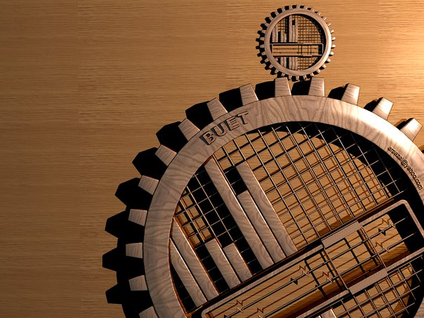
BANGLADESH UNIVERSITY OF ENGINEERING & TECNOLOGY
BANGLADESH UNIVERSITY OF ENGINEERING & TECNOLOGY
COURSE NO : CE 200
COURSE TITTLE : DETAILS OF CONSTRUCTION
COURSE NO : CE 200
COURSE TITTLE : DETAILS OF CONSTRUCTION

Slide 2
SHORE PROTECTION
GROUP 3

Slide 3

What is Shore Protection?
Shore protection refers to guarding the shore of the construction site by inserting steel or concrete shores into the ground.
It is mainly used for huge load bearing buildings and roads constructed near any water body.

Slide 4
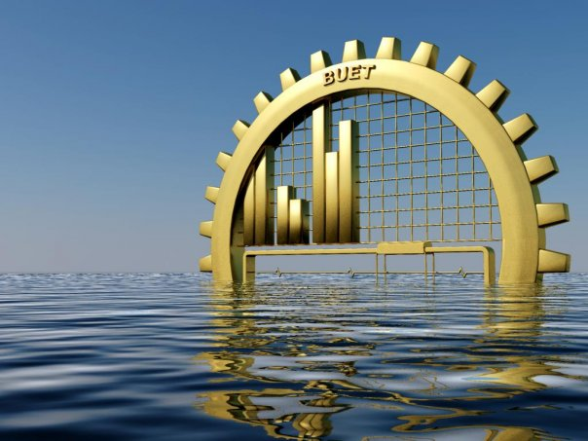
CONTENTS :
SITE INFORMATION
PROTECTIONS
IN THE CONTEXT OF BANGLADESH
DRAWBACKS
PURPOSES
INSTRUMENTS USED
PILING PROCEDURE
AUXILIARY STRUCTURES
ARISING SITUATIONS
ADVANTAGES
DEFINITION

Slide 5

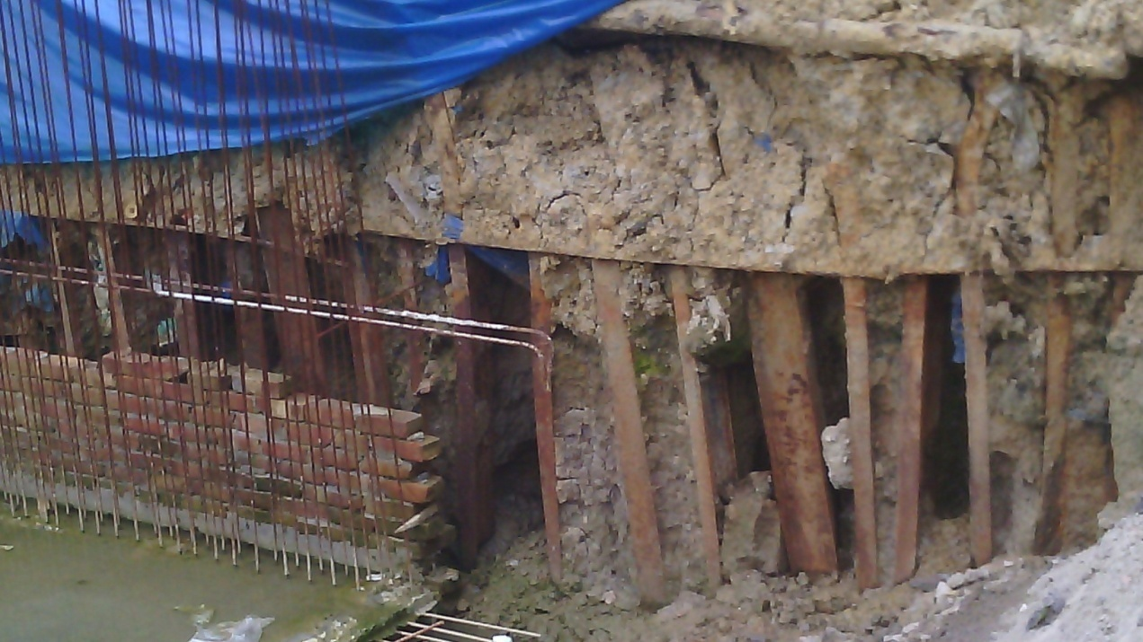
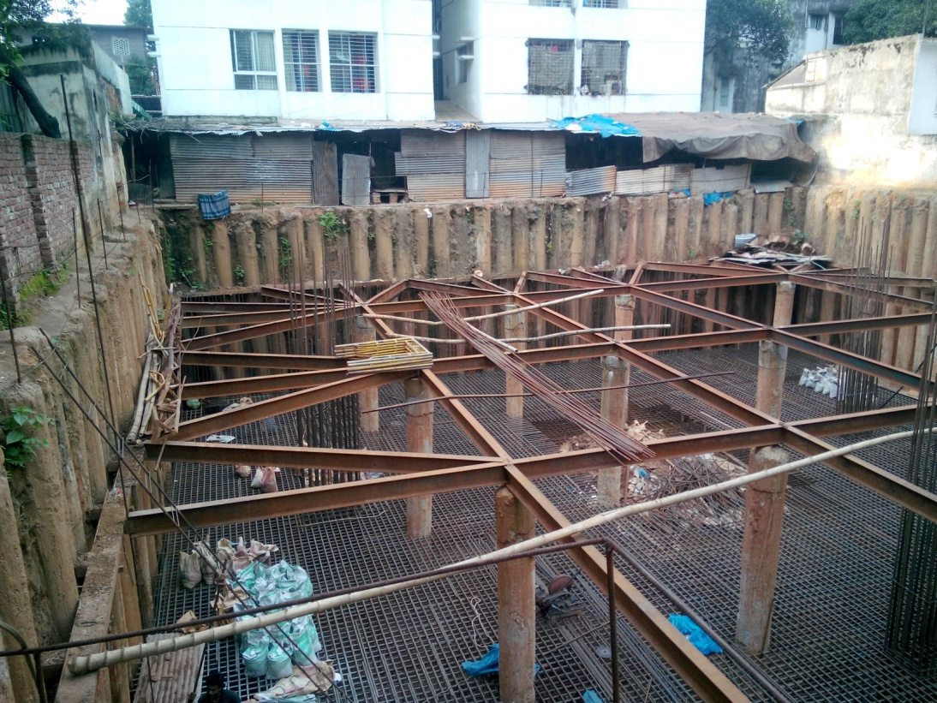
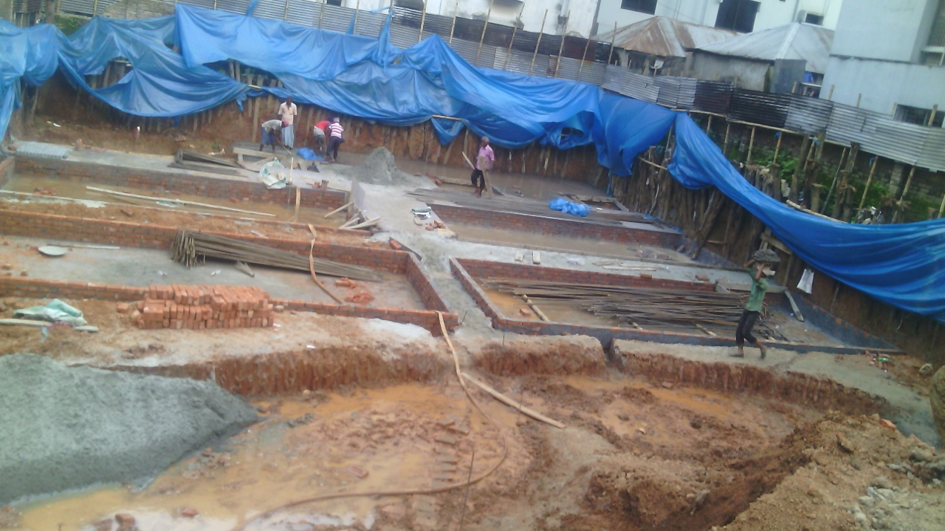
SITE DESCRIPTION
SITE NO 1 :
CONSTRUCTION SITE OF A 5 STOREYED BUILDING NEAR MANIPUR SCHOOL : BRANCH 2
SITE NO 2 :
SITE OF A 15 STOREYED BUILDING NEAR SHAT MASJID ROAD,TO THE WEST OF “ACADEMIA”
SITE NO 3 :
MULTIPURPOSE APARTMENT BY CONCORD,NORDA,GULSHAN

Slide 6

PILES AND SHORE PILES
Generally piles are sunken support for building: A vertical wood, metal, or concrete support for a building or other structure that is driven into the ground
Shore piling is a commonly used term before installation of the mat foundation of the building needs to be done: Shore piles support the surrounding loads and prevent the surrounding soil from breaking in at the time of construction.

Slide 7
PURPOSES :
* Supporting the load of surrounding structures during construction.
* Remains in the ground and serves as a retaining structure.
* Creates a continuous wall along the boundary.
* Prevents further decay.
* Averts the collapsing of the existing structure.

Slide 8

Instruments used for shore piling
Generally two types of instruments are used to drive shore piles underground:
Pile driver : Mechanical device used to drive piles.
Hammering : Done with the help of tripod and tri ropes.

Slide 9
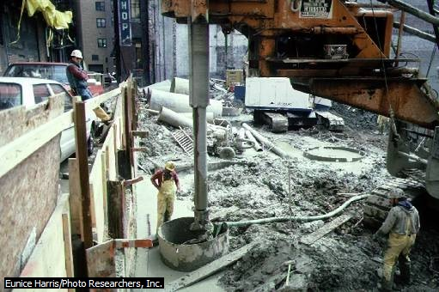
PILE DRIVER
.
Here, a pile driver pushes concrete pilings into the earth to help support an office building in Boston.

Slide 10

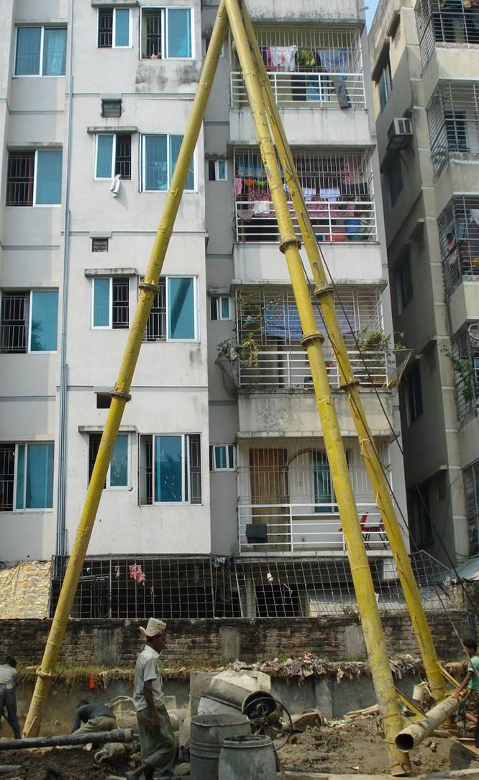
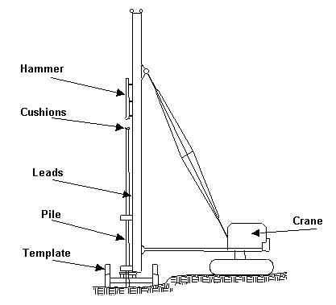
EQUIPMENT USED FOR HAMMERING
Tri pod
Shore piles driven underground by hammering through a CRANE
Tri rope

Slide 11
PROCEDURE :
DIGING PITS FOR PILING
BUILDING REINFORCEMENT
CASTING PILES
SETTING PILES
CONSTRUCTING TIE BEAM
EXCAVATION
ADDING UP JOIST
JOIST IN INTERSECTION
PREPARING FOR FOUNDATION

Slide 12


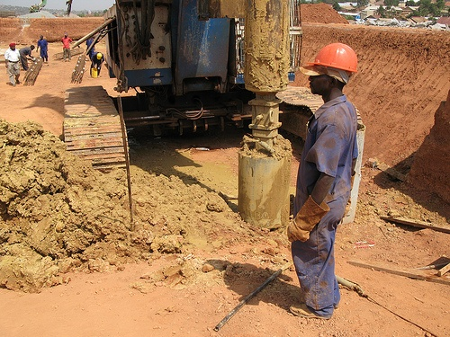
DIGING PITS FOR PILING
Pits are dug for piling with the help of wash boring on the border line of area.
Pits are generally dug 55’ deep.

Slide 13

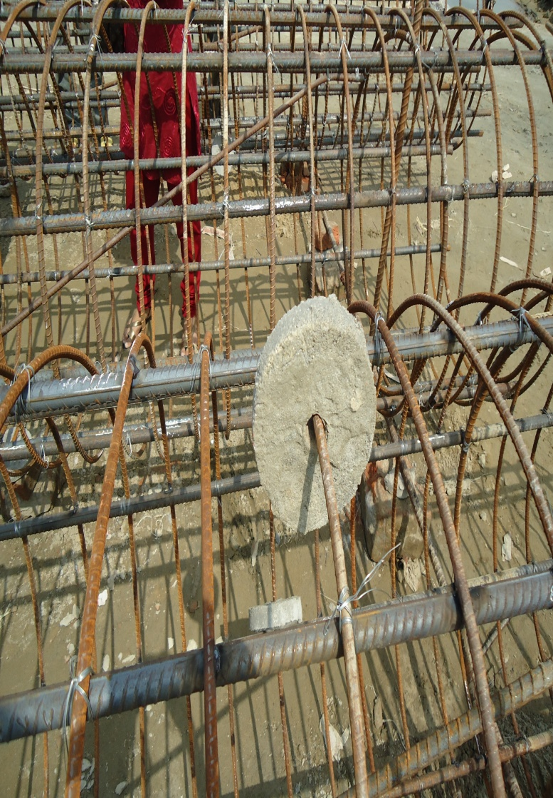
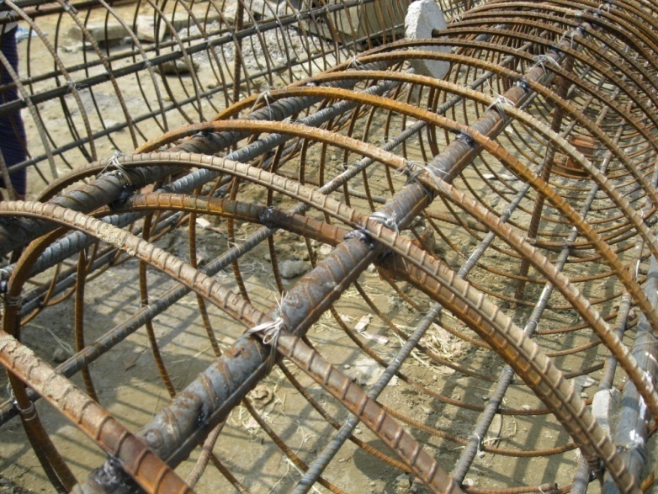
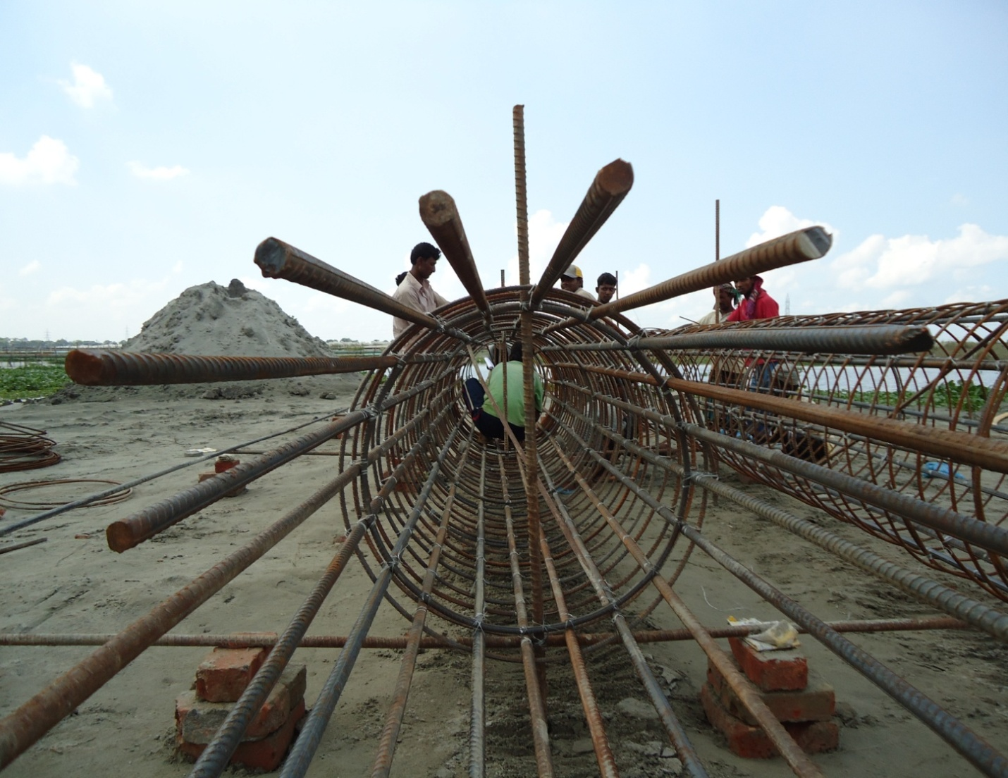
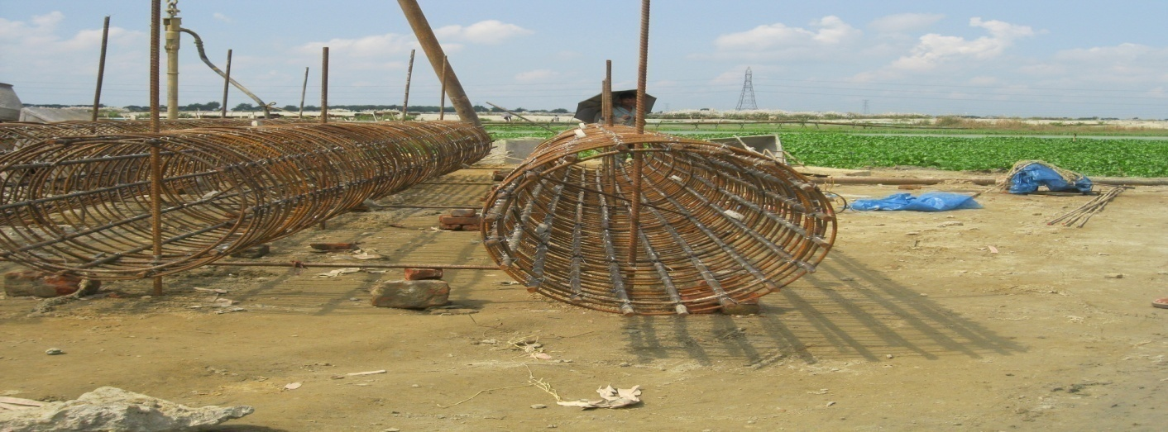
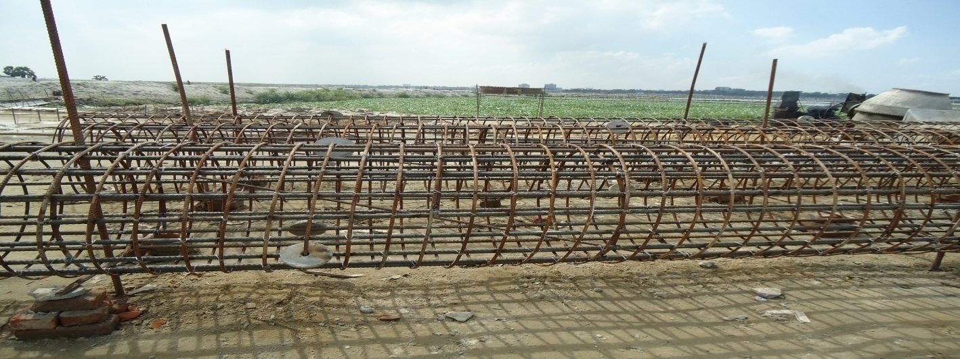
RE- INFORCEMENT BAR SETTING
SETTING PARTS
Main rebar
Spirals
Disk
16mm dia
straight
bars
10mm dia
spiral bars

Slide 14

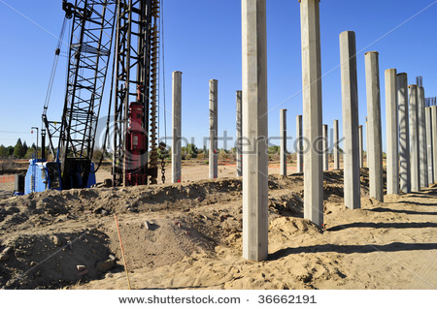
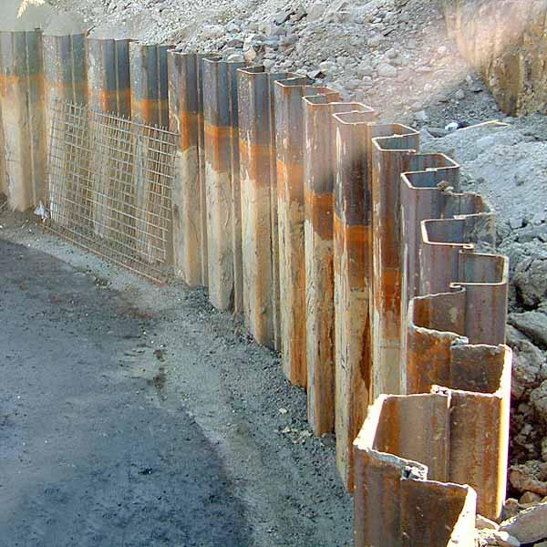
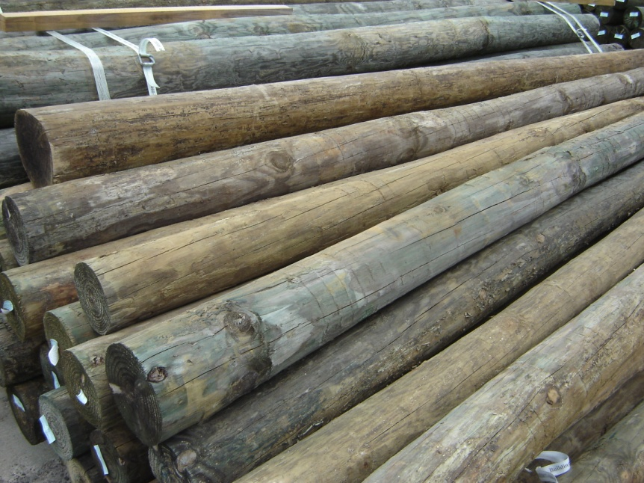
PILES USED IN CASTING
Shore guard revolutionized the sheet piling industry 25 years ago.
Different types of piles can be casted along the shore;
STEEL RUSTS is expensive and requires endless maintenance.
TRETED WOOD leaches toxic chemicals into the undergroud water.
CONCRETE PILES can settle and crack exposing internal steel.

Slide 15

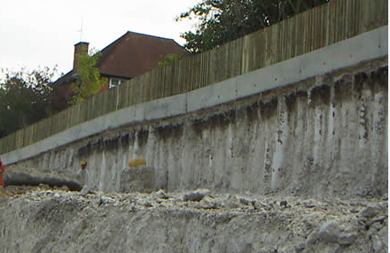
SETTING
Piles are left for setting for 18 days.
CONSTRUCTION OF TIE BEAMS
Constructed to join the piles of border line
TIE BEAMS

Slide 16
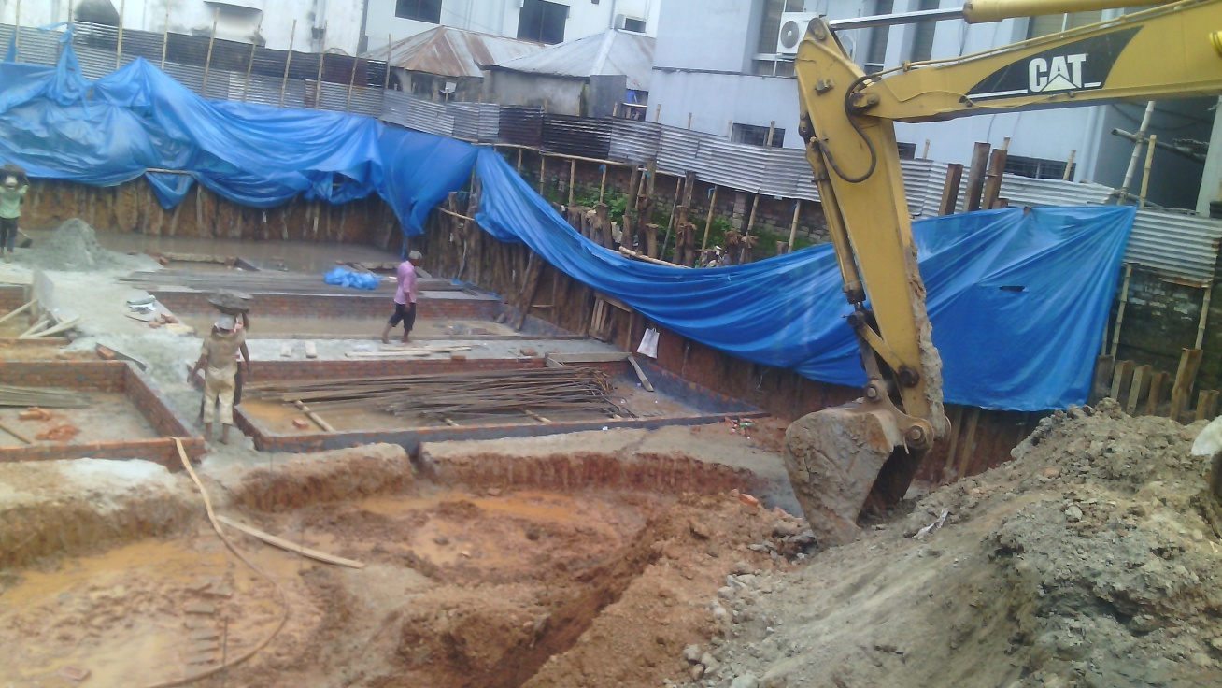
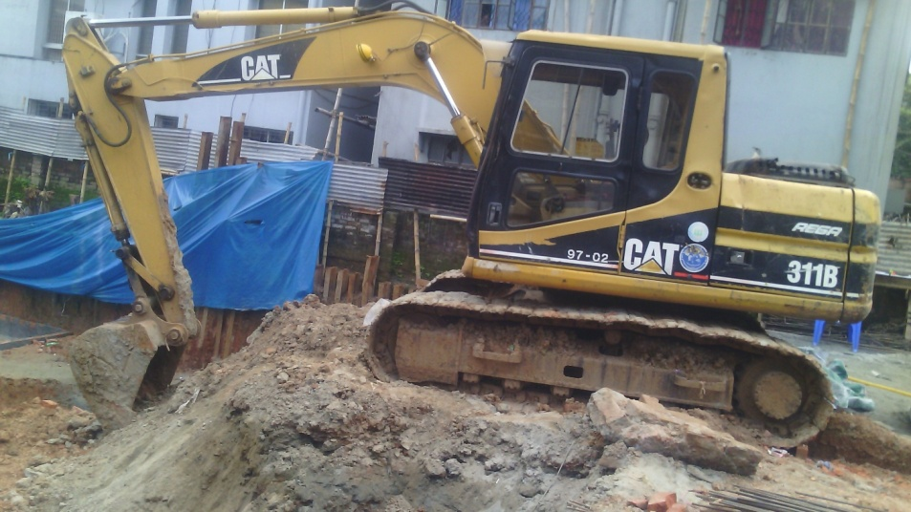
EXCAVATION
Excavation is done vertically 7´ below and horizontally 5´ long surface from the boundary

Slide 17

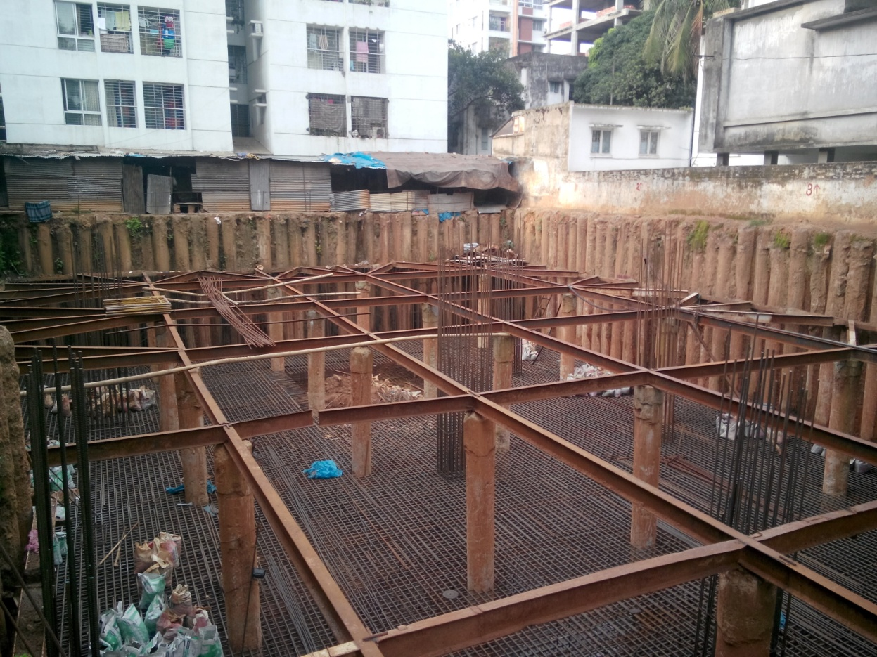
ADDING UP JOIST
JOIST IS ONE OF THE HORIZONTAL SUPPORTING MEMBERS ; made of engineered wood ,steel or concrete in order to support the beams laid out in a repetitive manner.
Here the joists are designed to support the anticipated load over a long period through bracings
JOIST

Slide 18

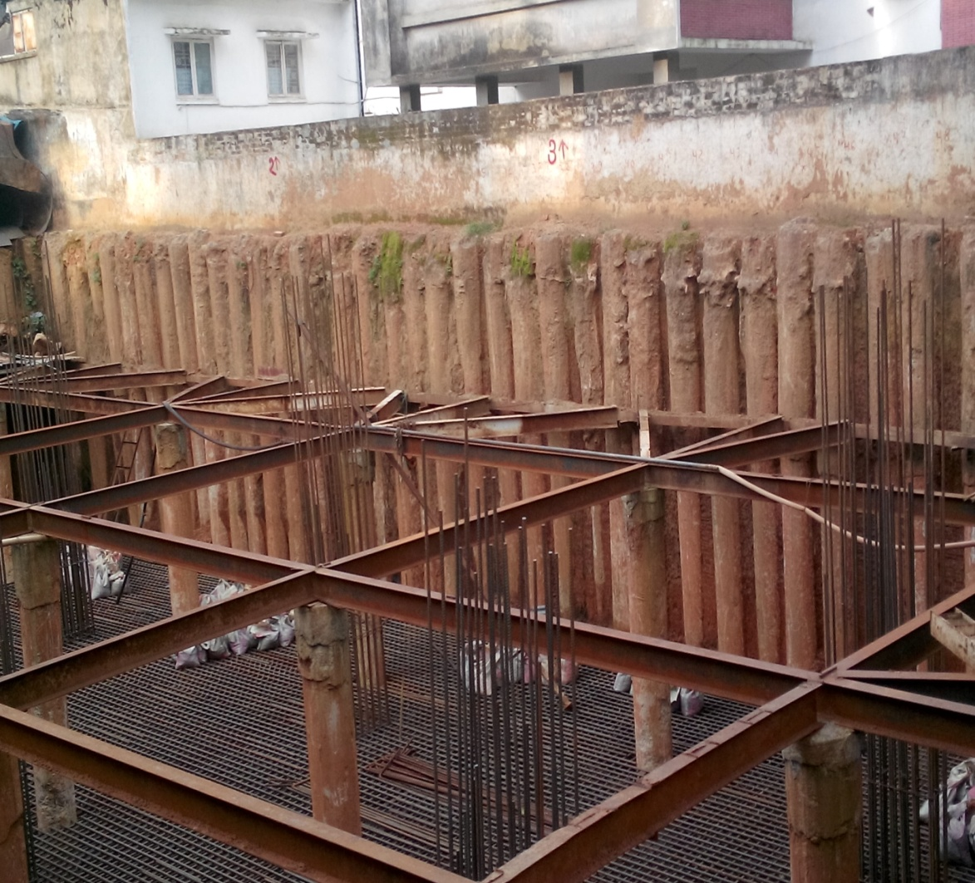
SHORING AND AUXILIARY STUCTURES
Shore pile
Bracing
Strut
King post

Slide 19
ARISING SITUATIONS :
WEAK GROUND ( in case cast in situ will be used)
PRESENCE OF ALLUVIAM
STRONG GROUND WATER FLOW (permanent casting should be used)
FIRM STRATUM (cast in situ or pre cast piles should be used)

Slide 20

BENEFITS
* Protection of neighboring structures.
* Protection from vibration.
* Guarding from seismic waves.
* Supporting super structures.
* Sometimes does the function of piles.

Slide 21

DRAWBACKS:
In spite of being necessary for big budget and huge load transferring structures, shore piling has several drawbacks; which are -
# EXPENSE
# NOISY DRIVING
# DECAY PREVENTION
# DIFFICULTY IN CASTING

Slide 22
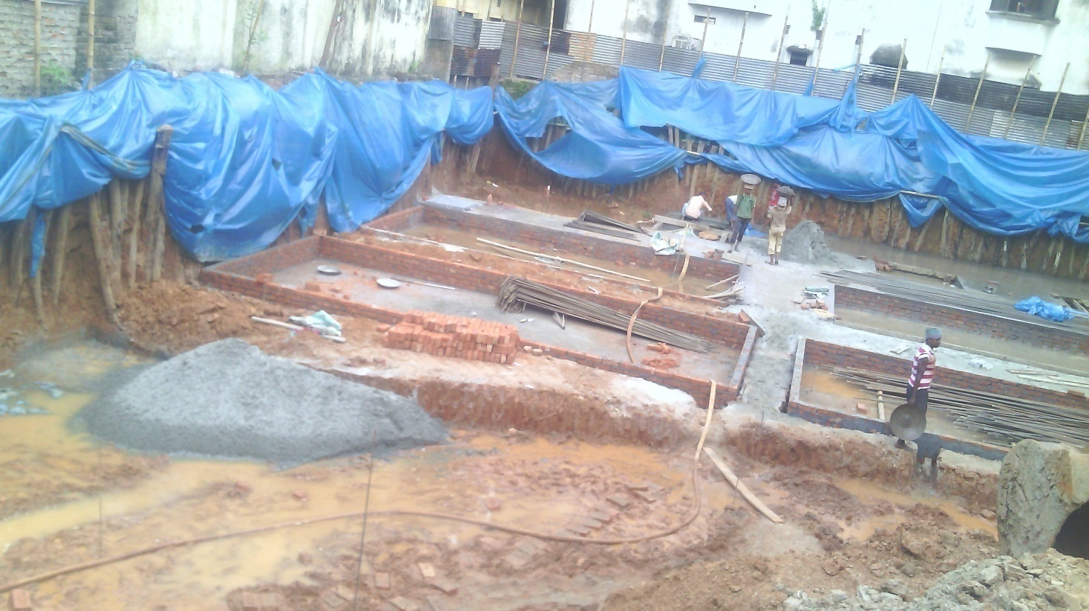
Shore pile protection
SHORE PILES
Shore piles are getting protected from rain water by water proof plastics

Slide 23
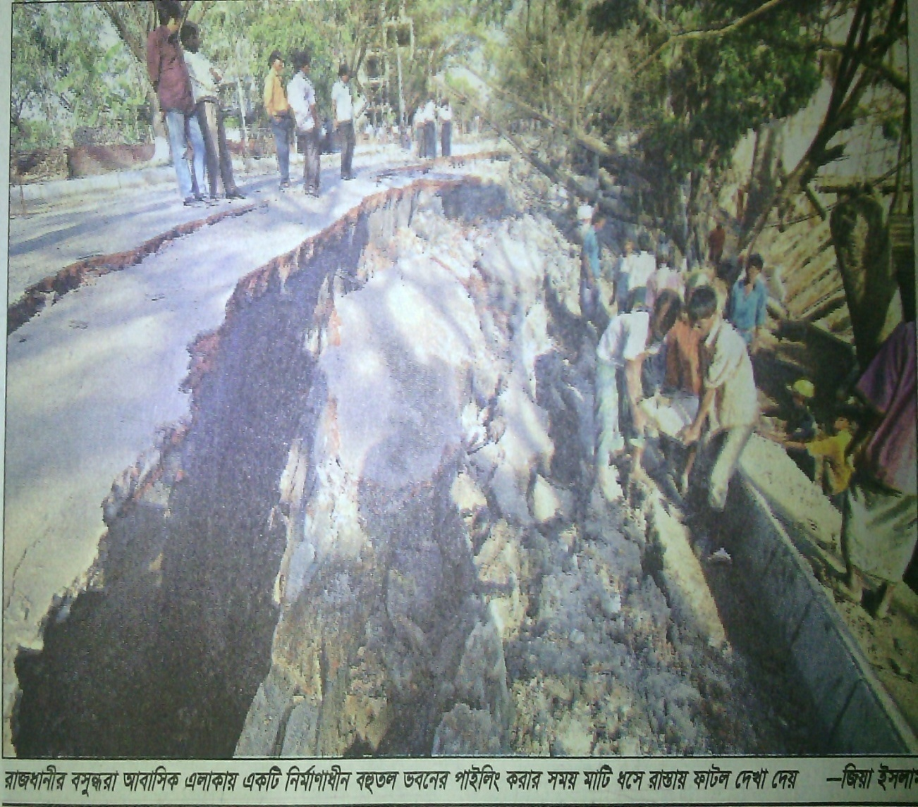
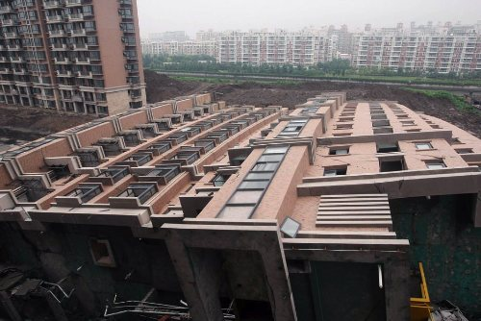
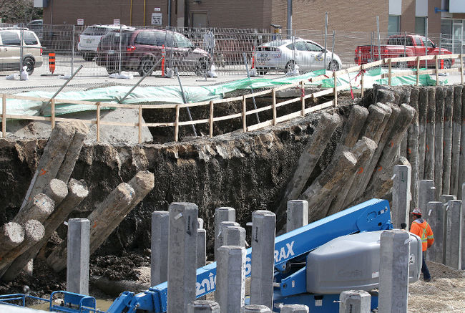
CONSEQUENCES OF POOR SHORE PILING
An excavation with poor shoring caused collapse the road near bashundhara residential area
A building at the Lotus Riverside complex in Shanghai’s Minhang district collapsed because of poor shore piling
Poor shoring caused damage of Sherbrook street in Canada

Slide 24
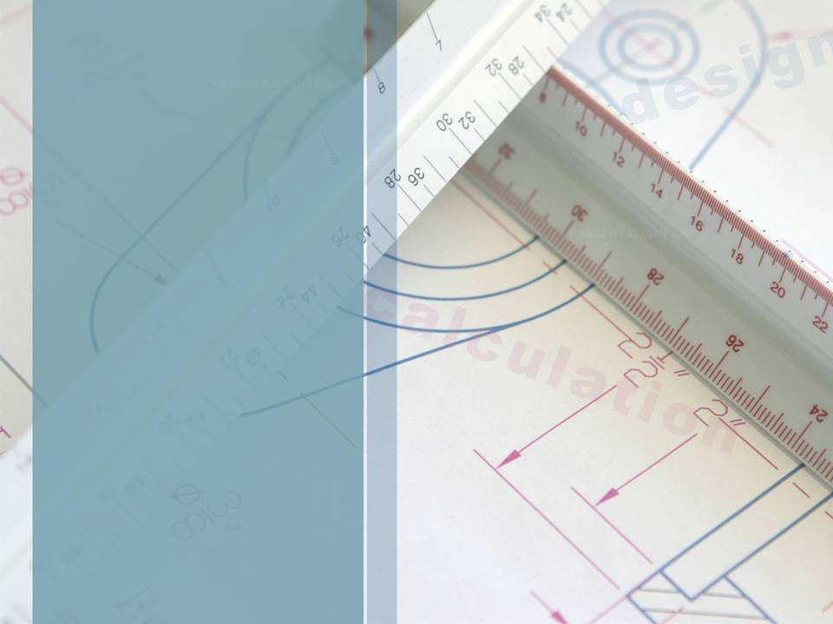

SHORE PILING IN THE CONTEXT OF BANGLADESH
In BANGLADESH shore piling is easier to be executed and it is also necessary to be provided for our geo logical condition
* SINCE HARD STRATA IS DIFFICULT TO BE FOUND,SHORE PILES CAN BE DRIVEN EASILY INTO THE GROUND.
* BEARING CAPACITY IS LOW, SO FOR HEAVY LOAD STRUCTURES,SHORE PILING IS A MUST.

Slide 25
SOURCES
LAYOUTS : FROM THE SITE AND CAD ROOM
INFORMATION : FROM THE SITE ENGINEERS AND INTERNET
FIGURES : FROM THE SITE
INTERNET

Slide 26
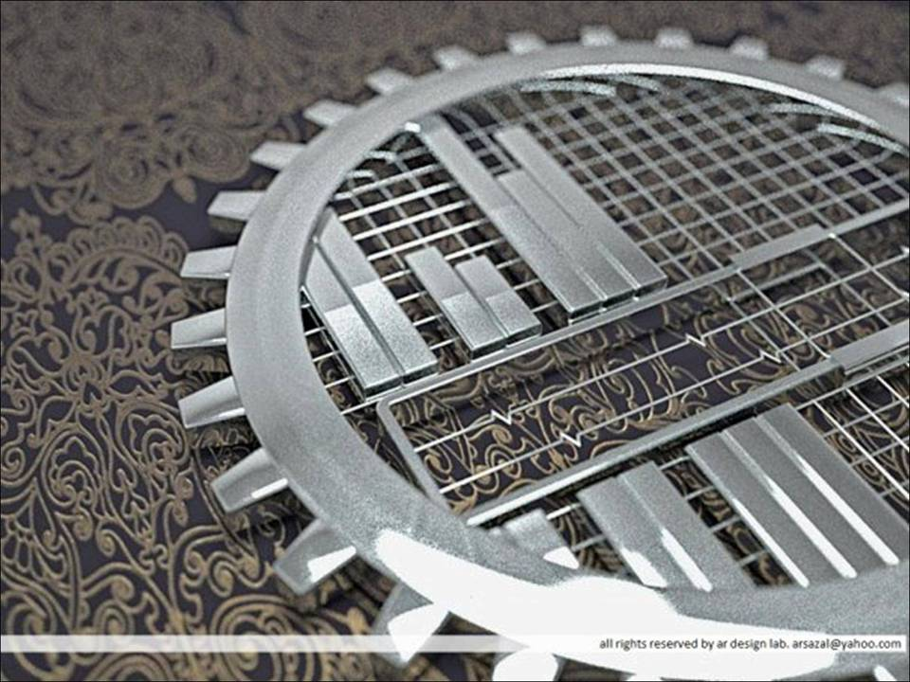
ACKNOWLEDGEMENT

Slide 27
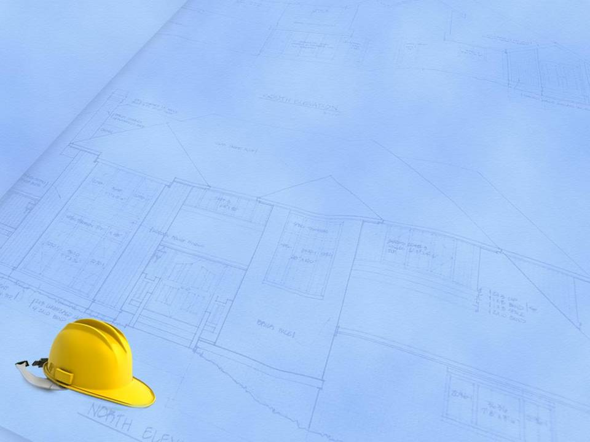
PRESENTATION BY
GROUP 3

