Slide 1
Surface Finishing
Welcome to Our
Presentation
Submitted to : Md. Shariful Alam
Md. Maksimul Islam

Slide 2
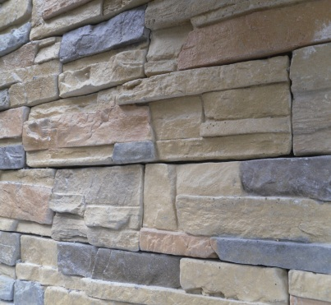

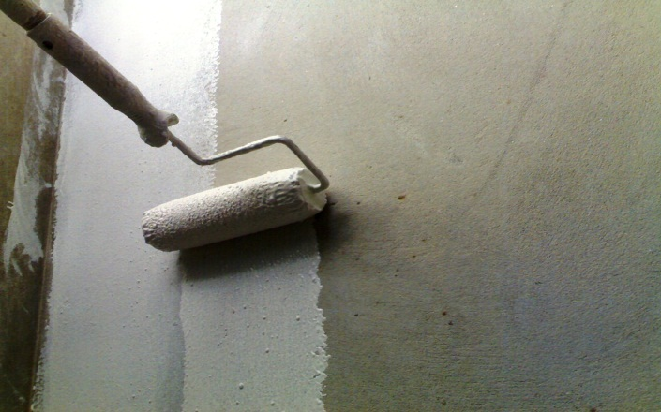
Objectives
    acquainting with surface finishing
    knowing different types of surface finishing
    the process of surface finishing
    .

Slide 3
What is Surface Finishing ???
Notes:
Is an art treating the suface with suitable materials

Slide 4
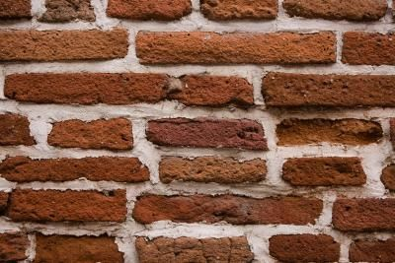
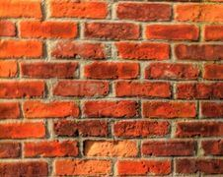
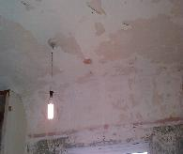
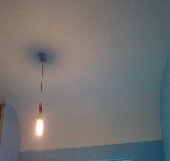


Purposes of
Surface Finishing
to protect the surface
making the surface decorative
to provide a smooth surface
Before
After

Slide 5
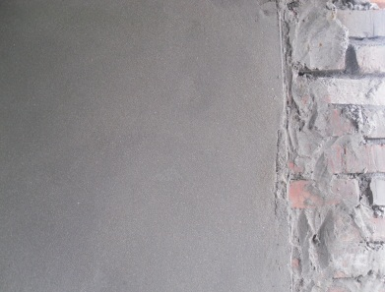

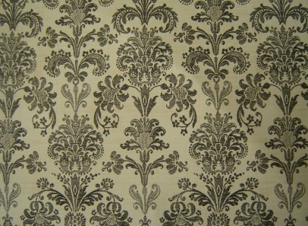
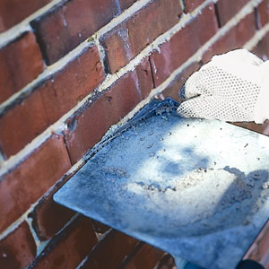
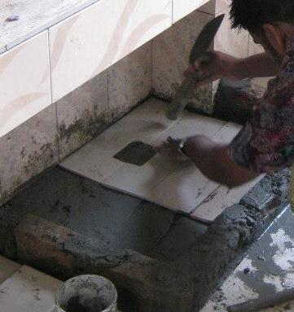
Types of
Surface Finishing
Wall Finishing
        Interior Wall Finishing
        Exterior Wall Finishing
Floor Finishing
Plastering
Painting
Wall paper
Pointing
Tiles Fitting

Slide 6
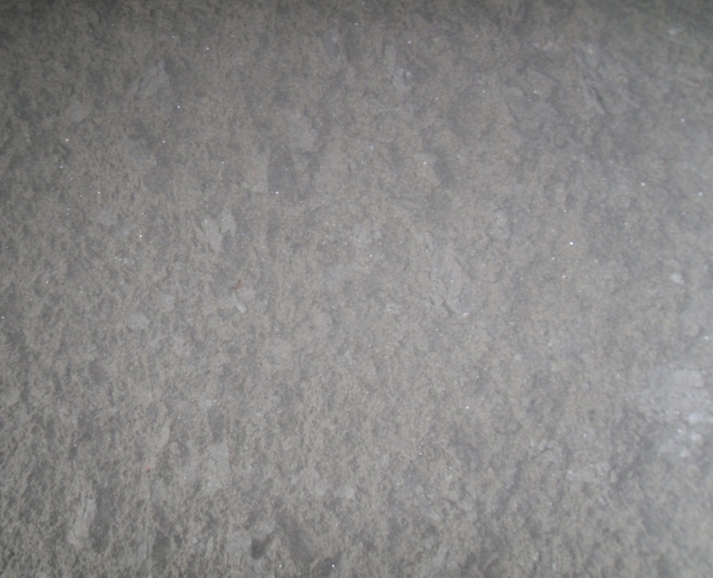
Plastering
Internal and external application of solid materials
Solid materials comprises of
                sand
                lime or cement
                other additives
materials are applied wet in coats.
To provide smooth, hard surface finish

Slide 7
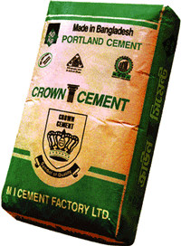
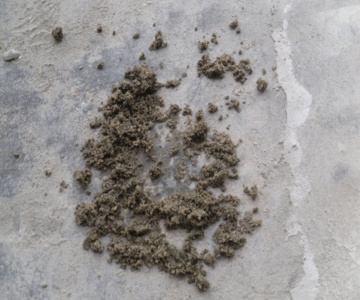
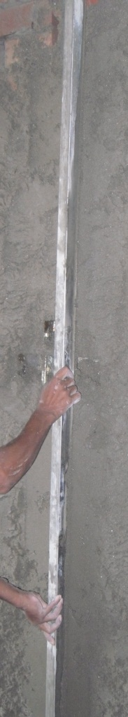
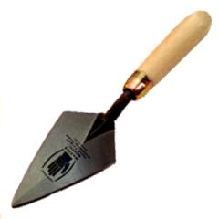

Materials for plastering
Bulk Sand ( F.M> 2:8)
Cement
Plumb Bob
Trowel
Leveler
Notes:
Check the Fm

Slide 8

Steps of Plastering
Preparation of Mortar
Applying Mortar to Wall
Leveling the applied Mortar
    checking if the newly plastered wall is vertical
    water should be used after 24 hours of plastering.
Plastered Wall

Slide 9
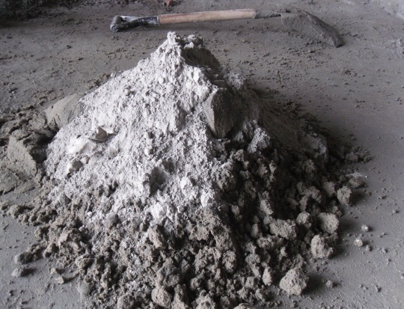
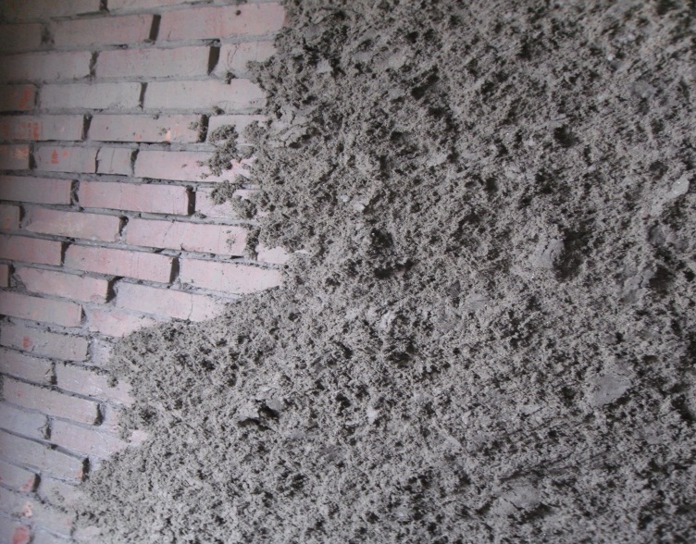
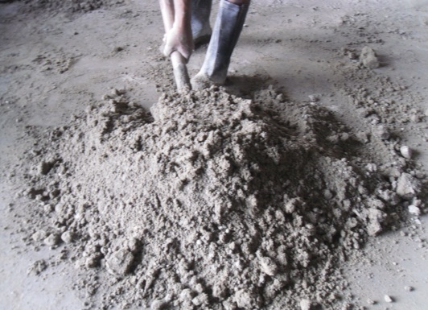
Steps of Plastering
Preparation Of Mortar
Applying Mortar to Wall
Cement : Sand :-
for wall 1:4
for ceiling 1:3
Mixing of cement and bulk sand.
The look of the wall after applying mortar

Slide 10
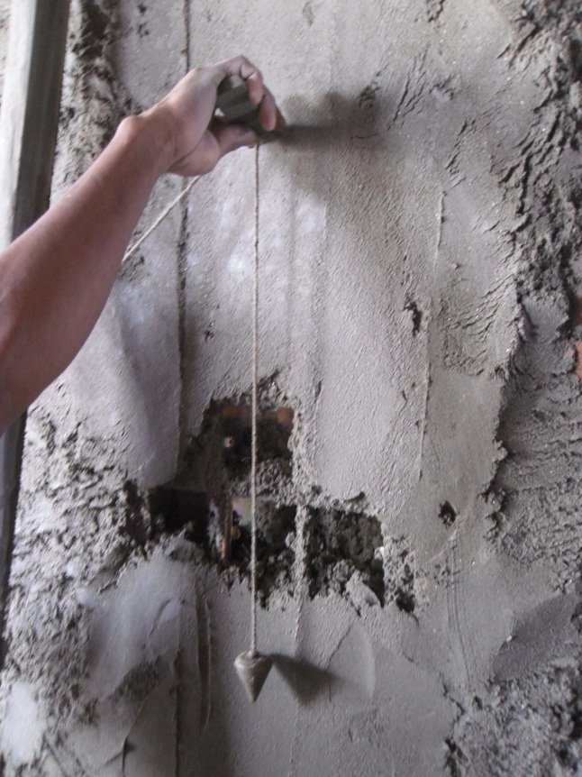
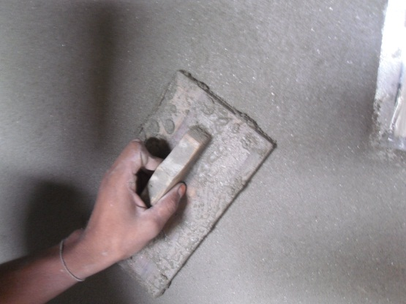
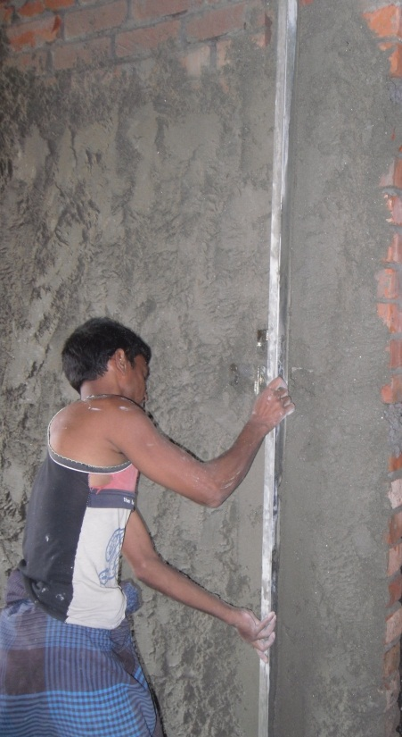
Steps of Plastering
Leveling the applied Mortar
Checking if the plastered wall is vertical
Plumb Bob
Leveling with
  Trowel
  Leveling Rod

Slide 11
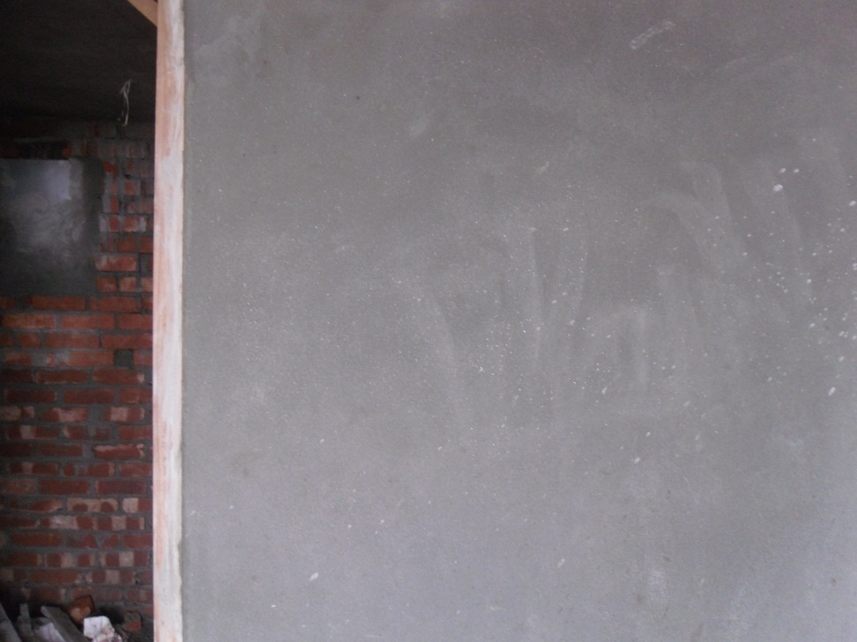
Steps of Plastering
Plastered Wall
Things to be taken care of
water should not be used while applying mortar
Curing should start after 24 hours.

