Slide 1

BANGLADESH UNIVERSITY OF ENGINEERING & TECHNOLOGY
A PRESENTATION ON
CONSTRUCTION OF
COLUMN, BEAM & SLAB

Slide 2
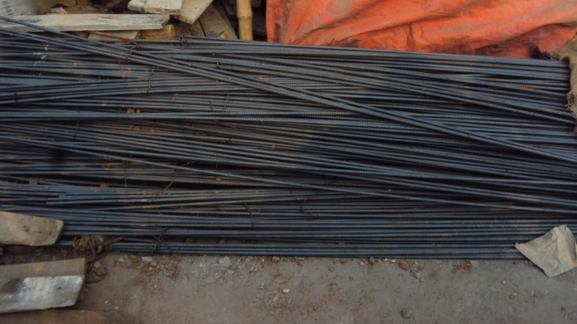
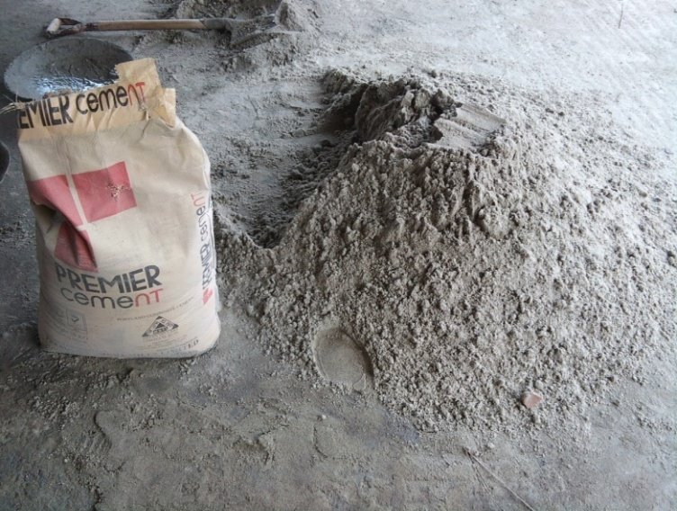
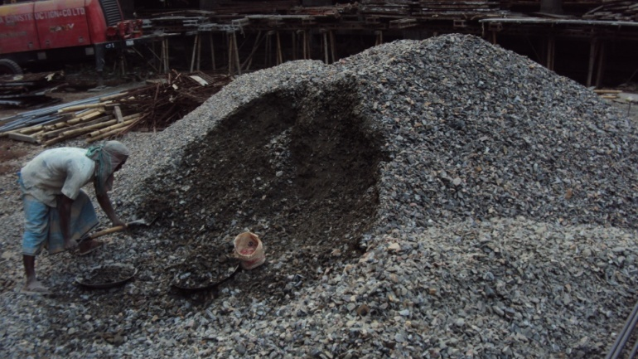
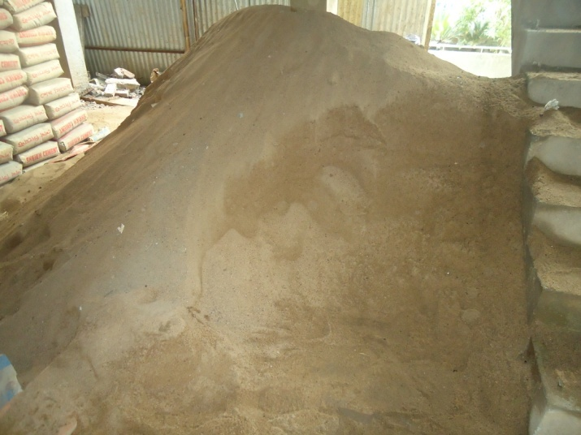
Materials
Reinforcement Bar
Cement
Coarse Aggregate
Fine Aggregate

Slide 3
Components of Frame Structure
LOAD TRANSFORM
SLAB
BEAM
COLUMN

Slide 4
Steps of Construction
Reinforcement
Formwork
Concrete Casting
Compaction
Removal of Formwork
Curing

Slide 5
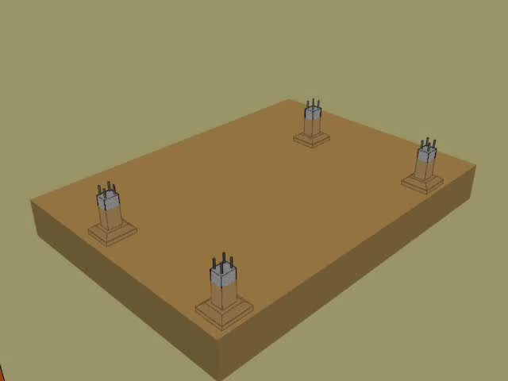

Slide 6
Column Construction

Slide 7
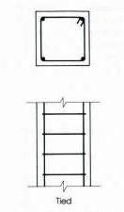
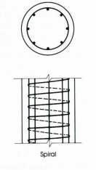

SHORT COLUMNS
Reinforced concrete columns are generally short columns. Here we will deal with the Short columns only. Short columns can be classified as follows:
Tied column
Spiral column
Composite column
TIED
SPIRAL
COMPOSITE

Slide 8
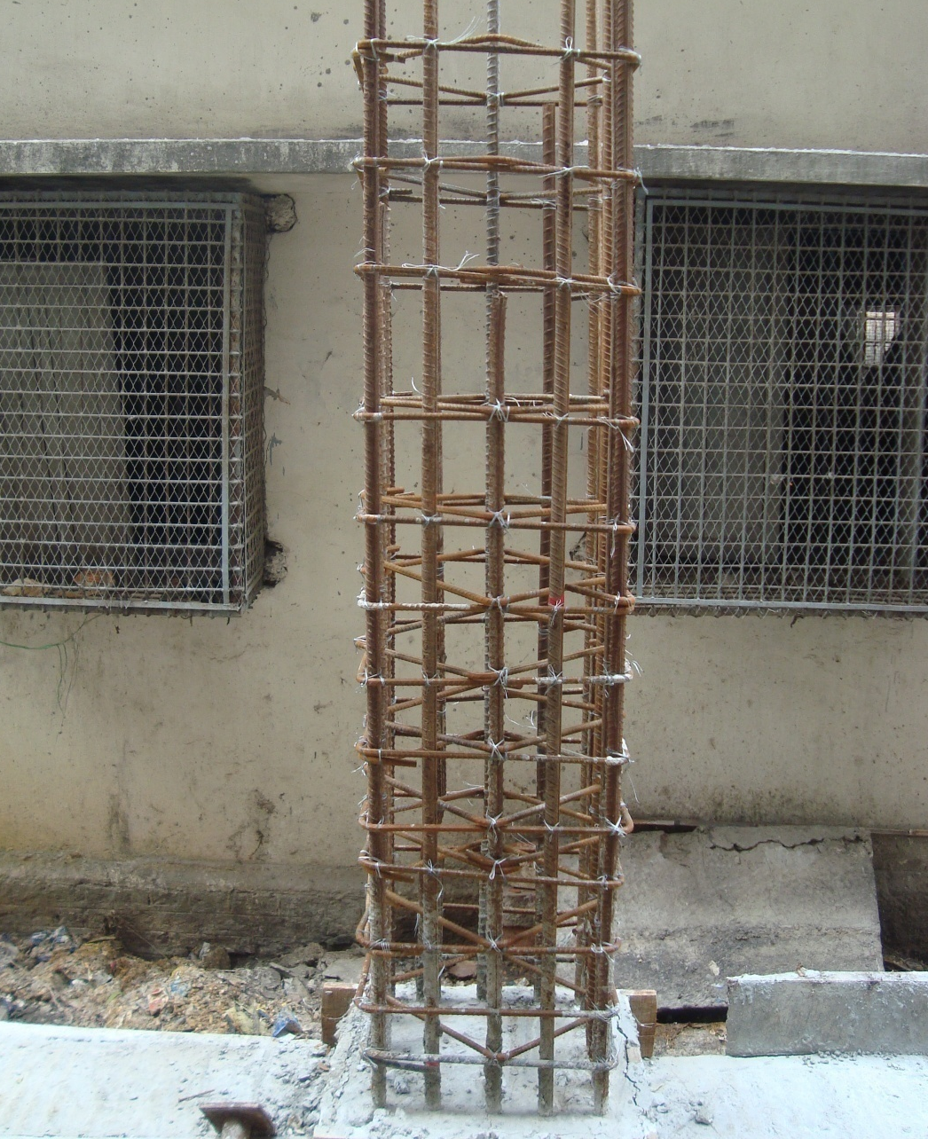
Reinforcement Alignment
Column bears normal stress as well as lateral loads.
Load

Slide 9
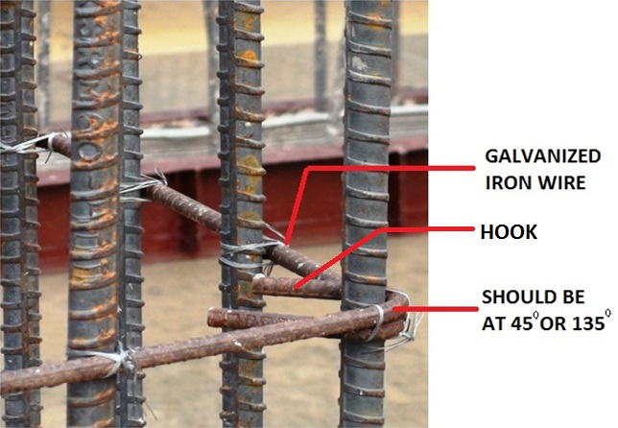
TIES IN COLUMN
RECTANGULAR TIES

Slide 10
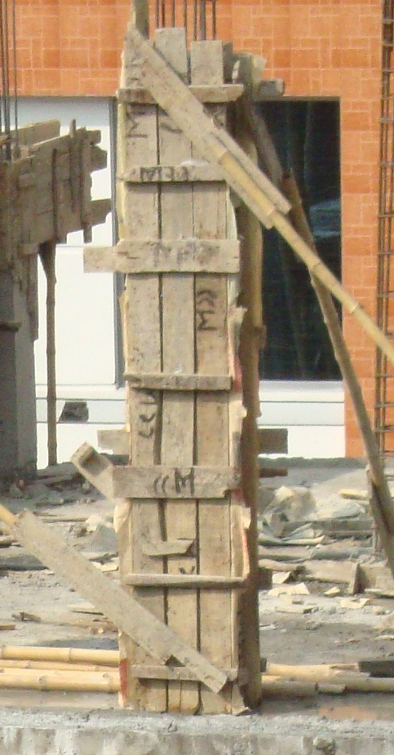
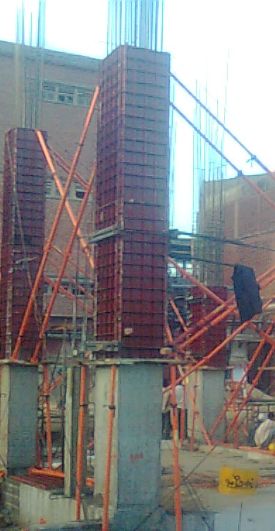
Shuttering
Wood Shuttering
Steel Shuttering

Slide 11
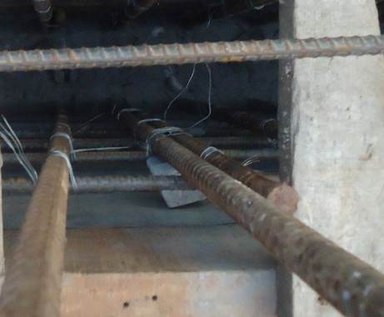
C.C. Blocks
Use of C.C blocks to maintain clear cover

Slide 12
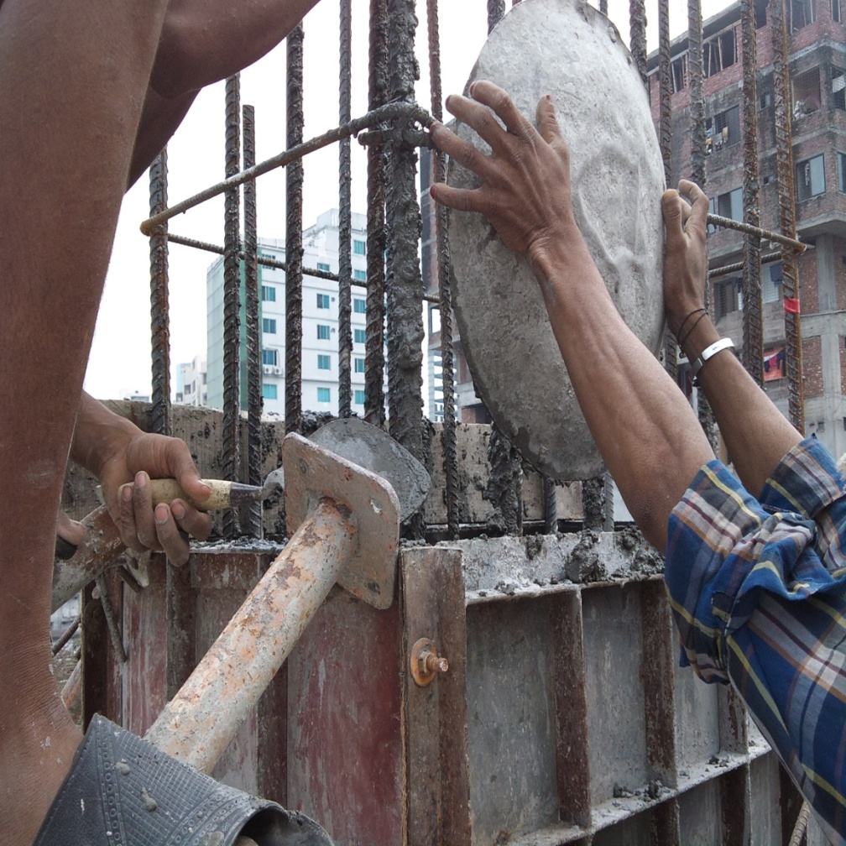
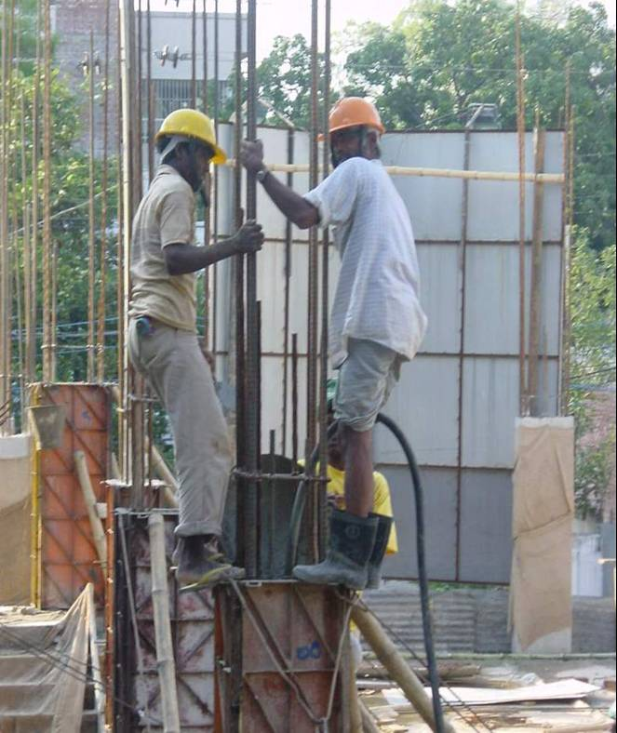
Casting
Casting
Use Of Vibrator

Slide 13
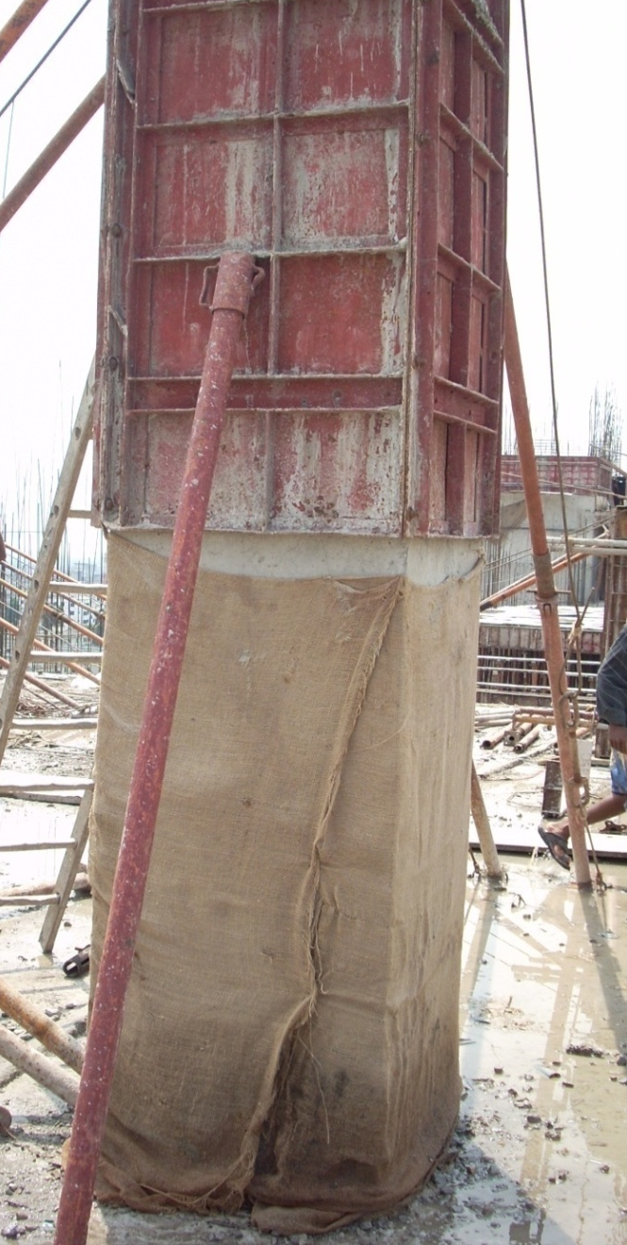
Casting (Cont.)
Column casting is done in at least two lifts because-
Difficulties in compaction
Segregation
Heat evolve during hydration

Slide 14
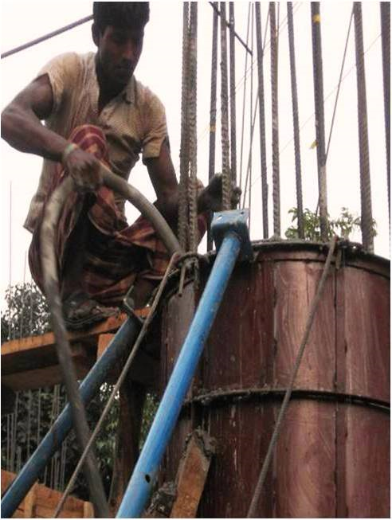
COMPACTION
Compaction is done by Roding or Poker Vibrator.
It is done to avoid voids inside the concrete.
COMPACTION
VIBRATOR NOZZLE
COMPACTION BY VIBRATOR

Slide 15
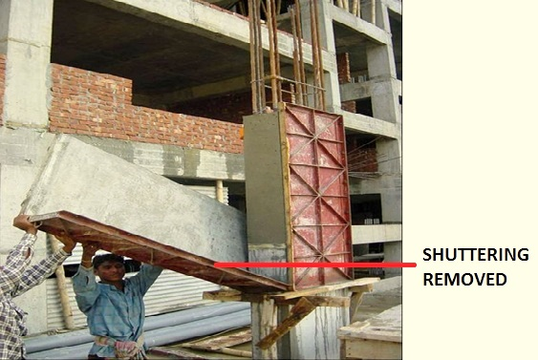
SHUTTERING REMOVAL
For column the side shutters are removed after
2-3 days.
REMOVAL OF SHUTTERING

Slide 16
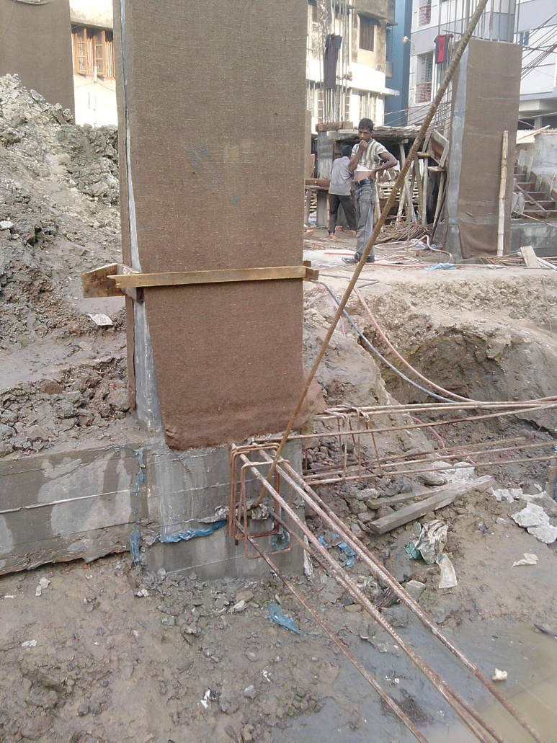
Curing
Curing is done for 21 days , because water is required for Hydration Reaction of Concrete.

Slide 17
Beam Construction

Slide 18
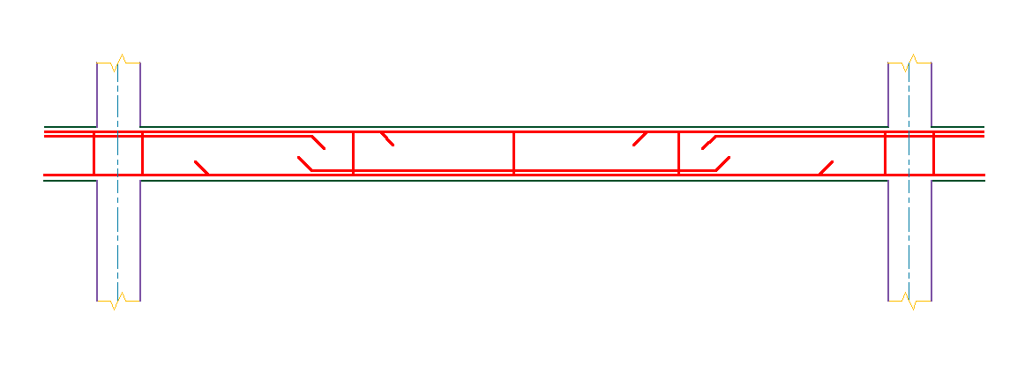
Reinforcement of beam
Extra top
Stirrups
Extra bottom
Main re-bars

Slide 19
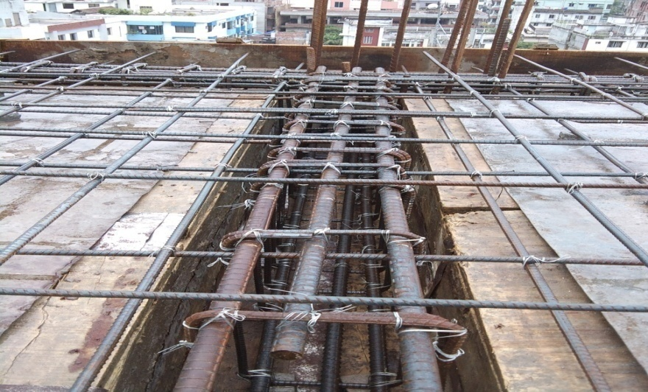
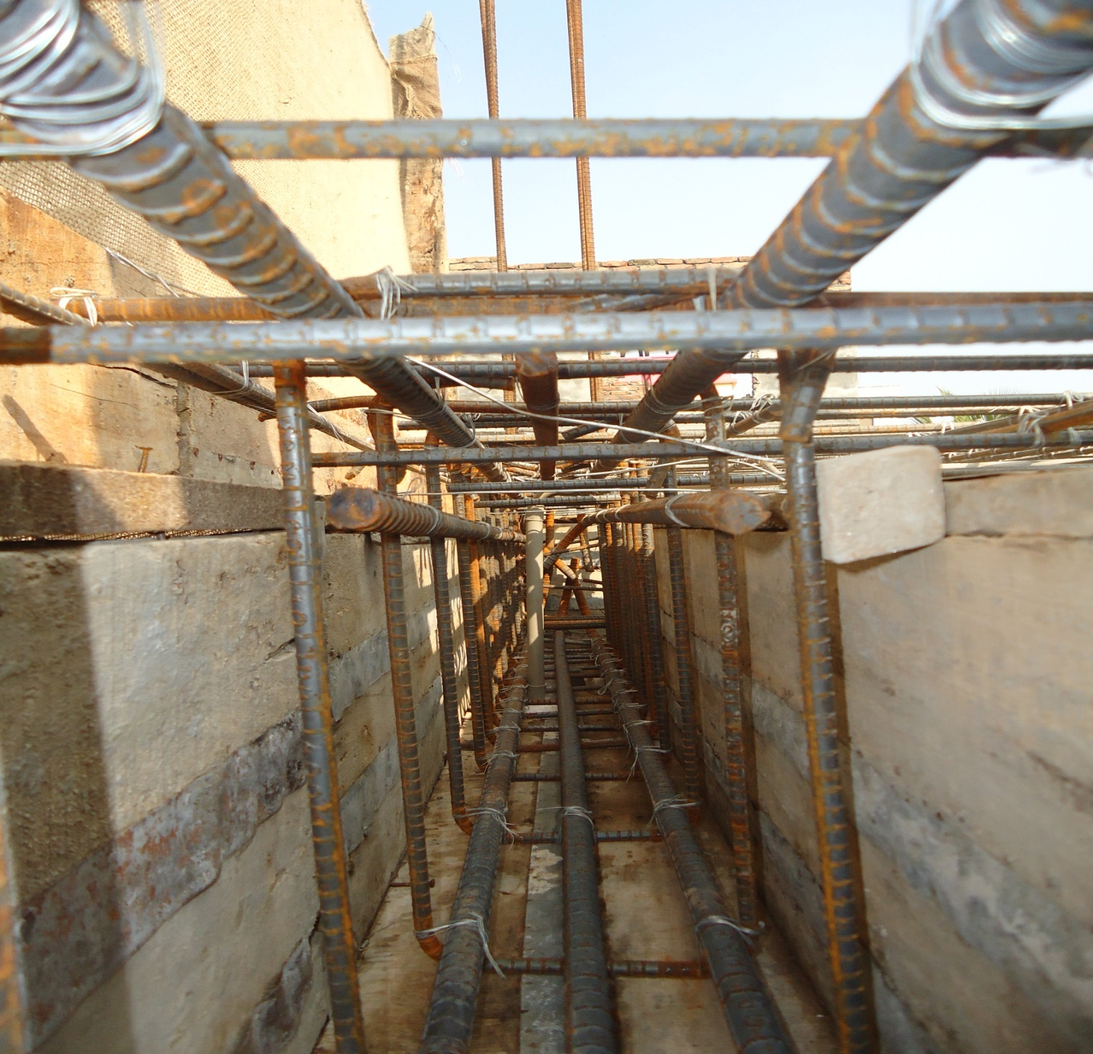

Reinforcement
Minimum 4 rod is used to construct a beam
Extra (top and bottom) rod is used if required
Extra top
Extra bottom

Slide 20
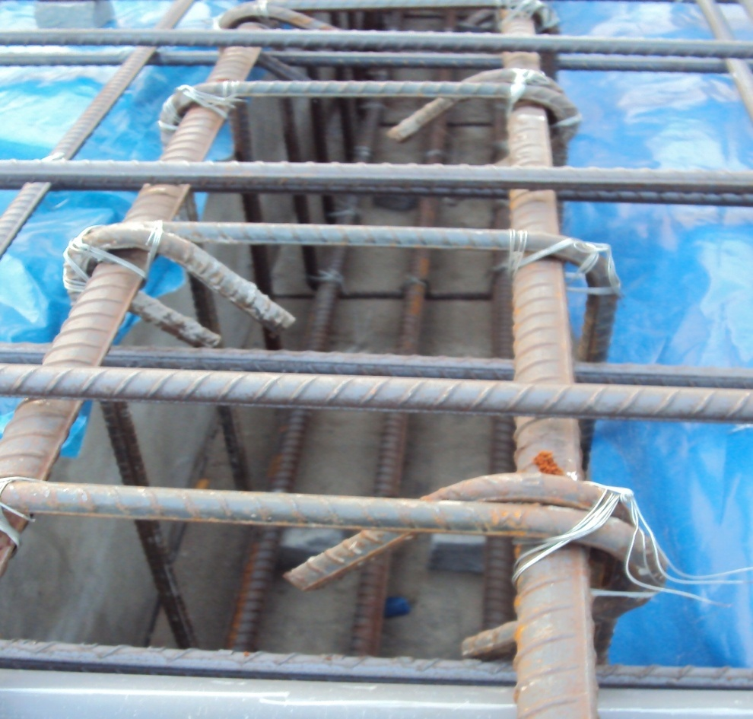
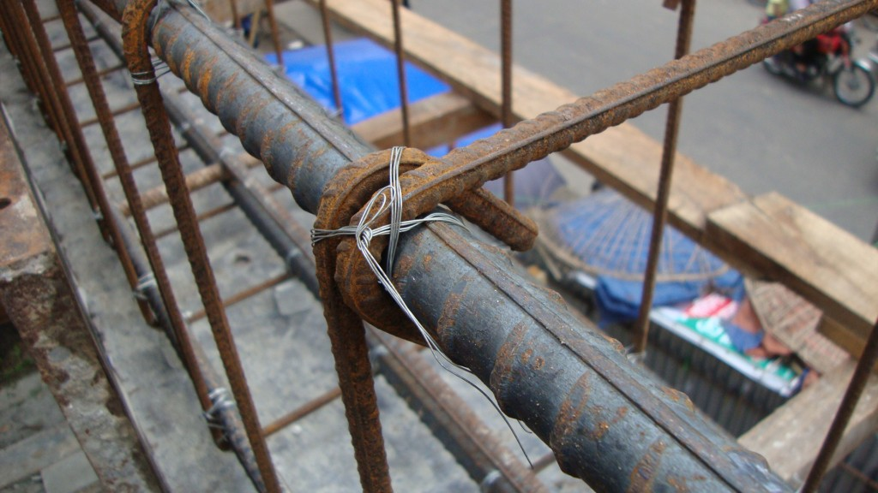
Hooks
Alternate hooking
Hooking 45˚

Slide 21
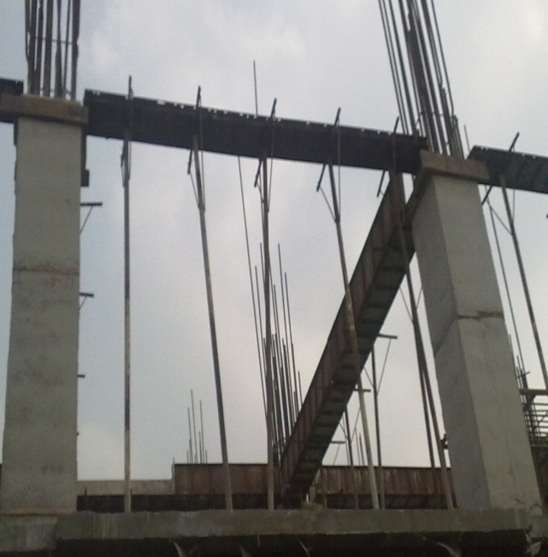
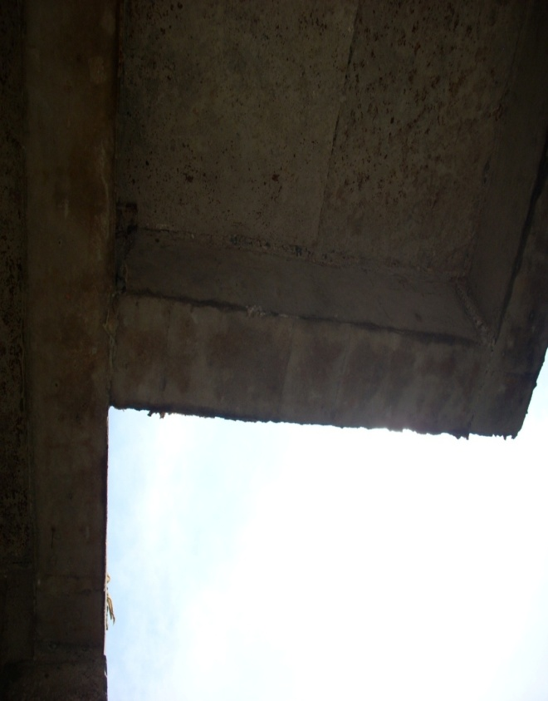
TYPES OF BEAMS
Simply Supported Beam
Cantilever
Beam

Slide 22
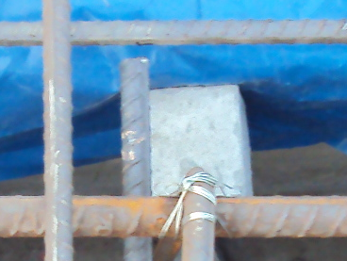
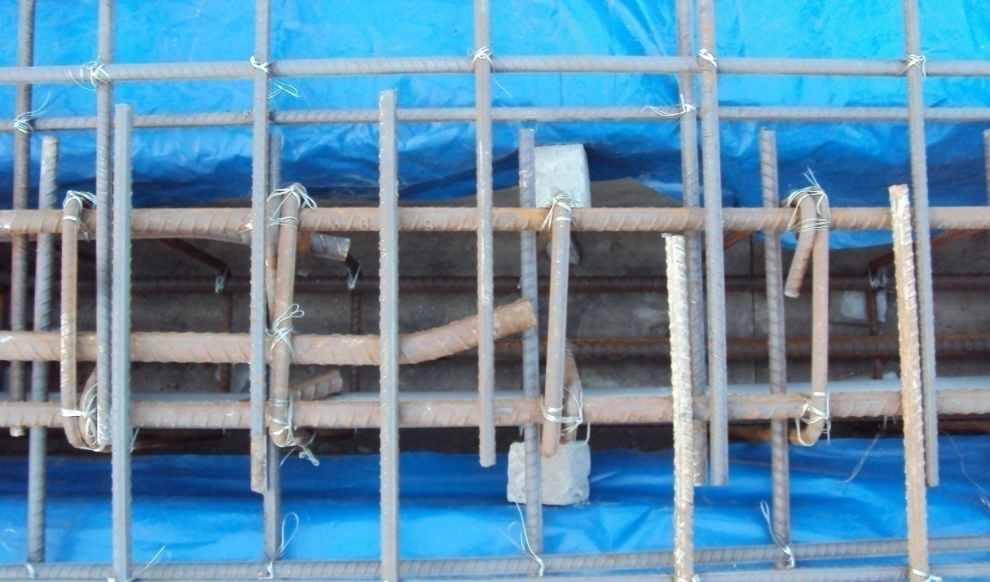
Clear coverage
C.C. block

Slide 23
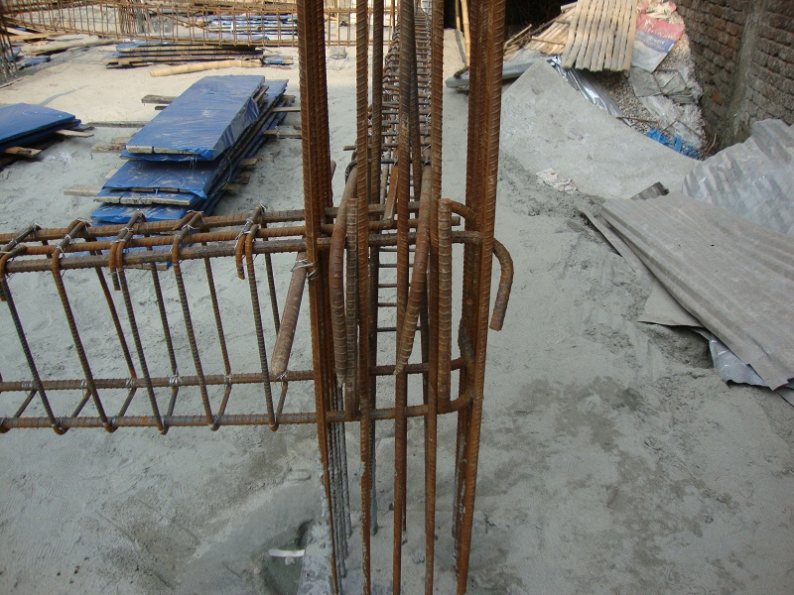
Reinforcement Alignment (Cont.)
Rods are bended at the end

Slide 24
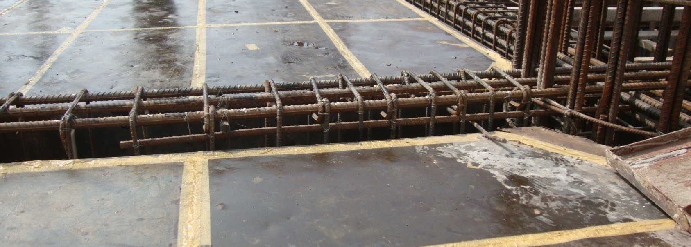
Stirrups
Long
Distanced
Stirrups
Close
Stirrups

Slide 25
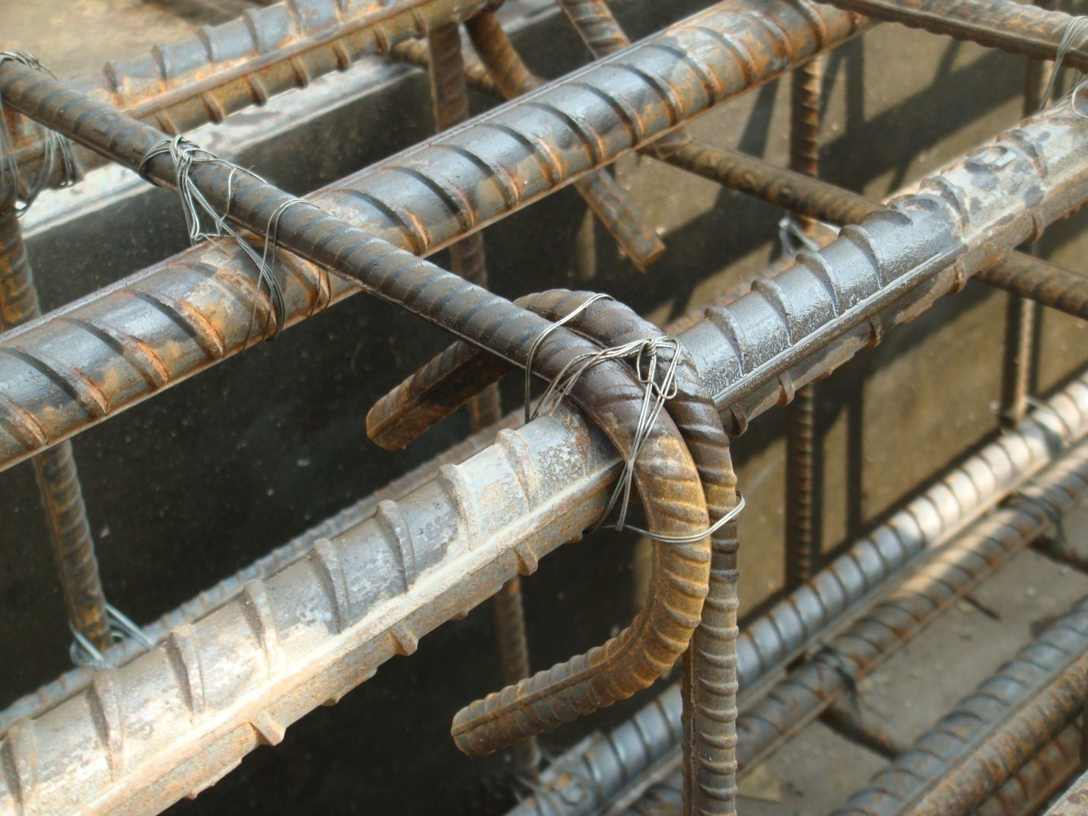
Stirrups (Cont.)
45⁰

Slide 26
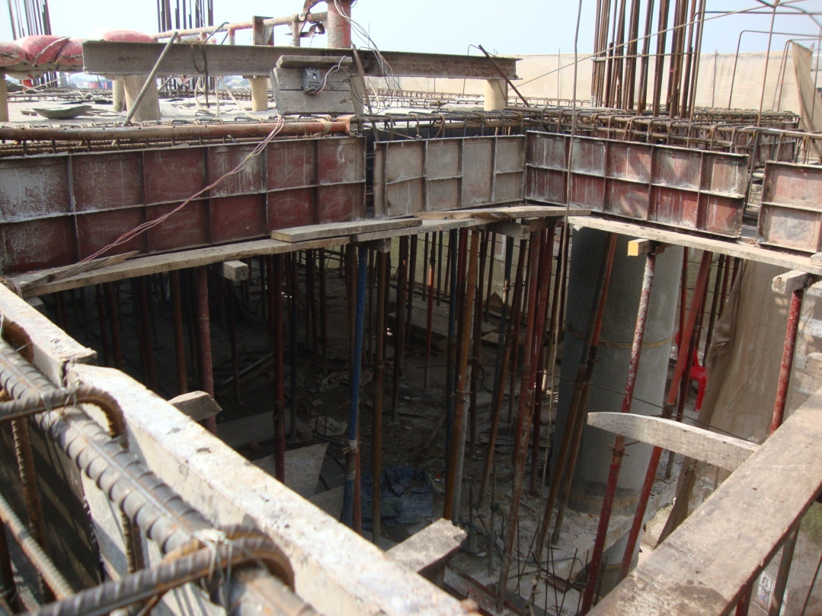
Beam Shuttering

Slide 27
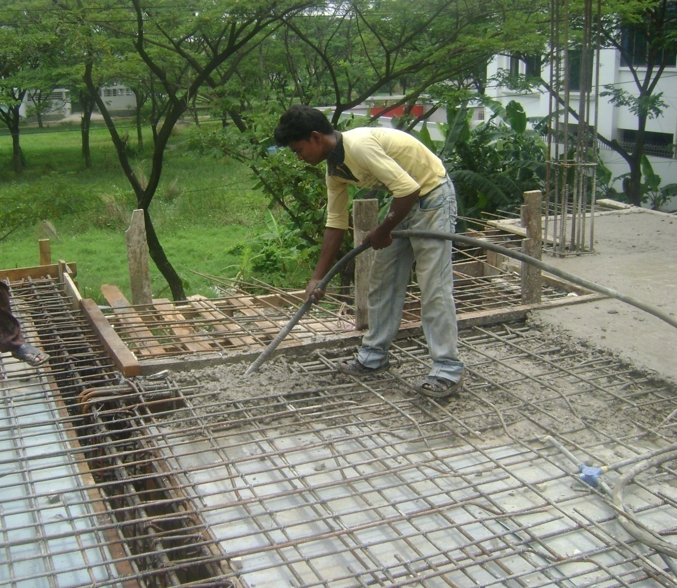
Beam Casting
Vibrator is used to minimize the amount of voids

Slide 28
Slab Construction

Slide 29
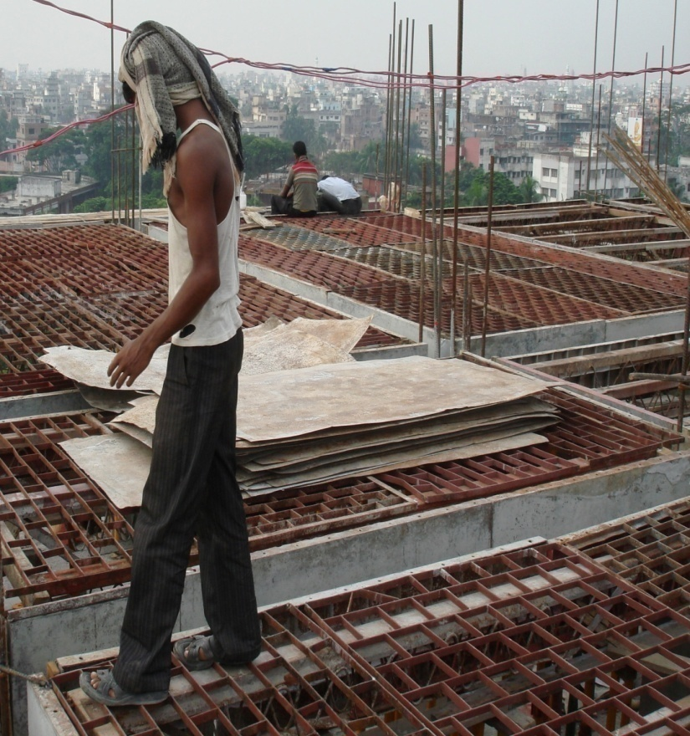
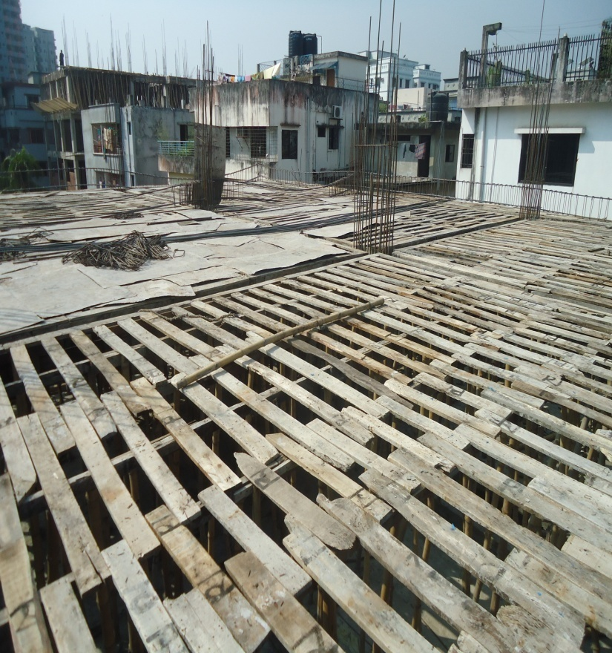
Formwork or Shuttering
TYPES OF FORMWORK
Steel Formwork
Timber Formwork

Slide 30
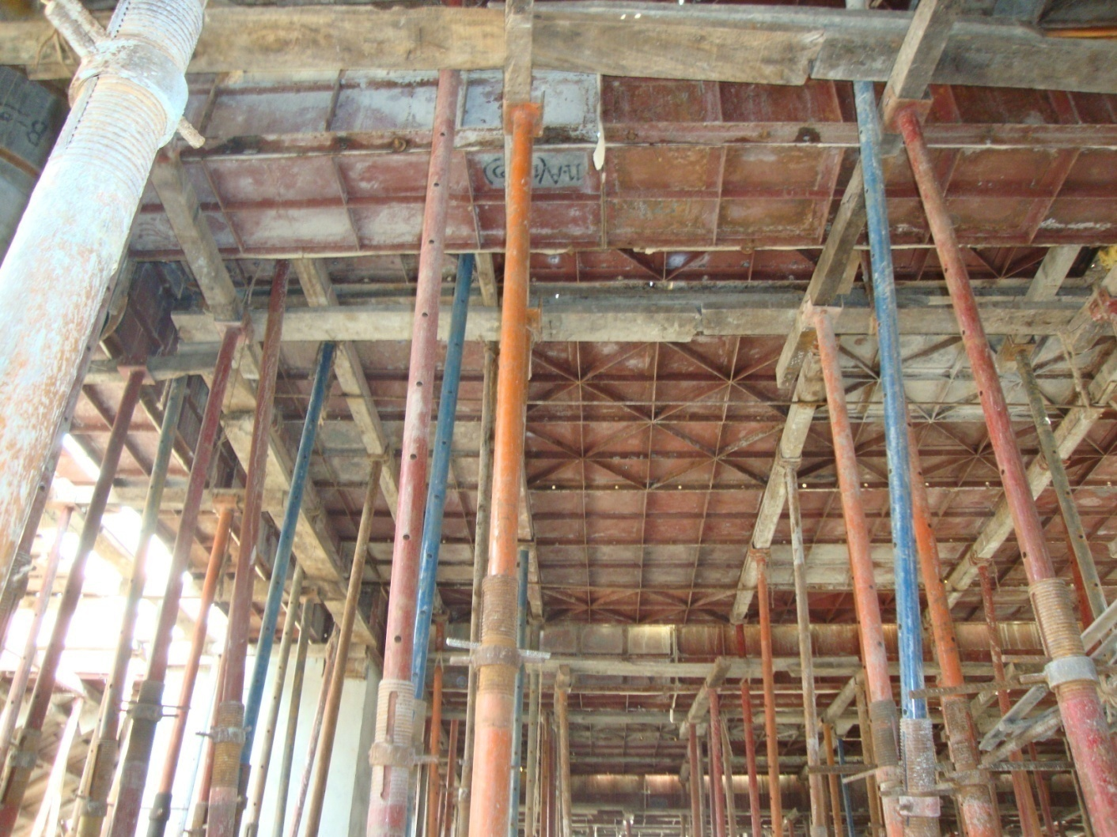
Shuttering of Slab
Ledger
Plate
Prop

Slide 31
Reinforcement alignment for slab
One way slab
Length/width >2
Two way slab
Length/width <=2

Slide 32
REINFORCEMENT PLACING
Straight Re-bars
Cranked Re-bars
Extra Re-bars

Slide 33
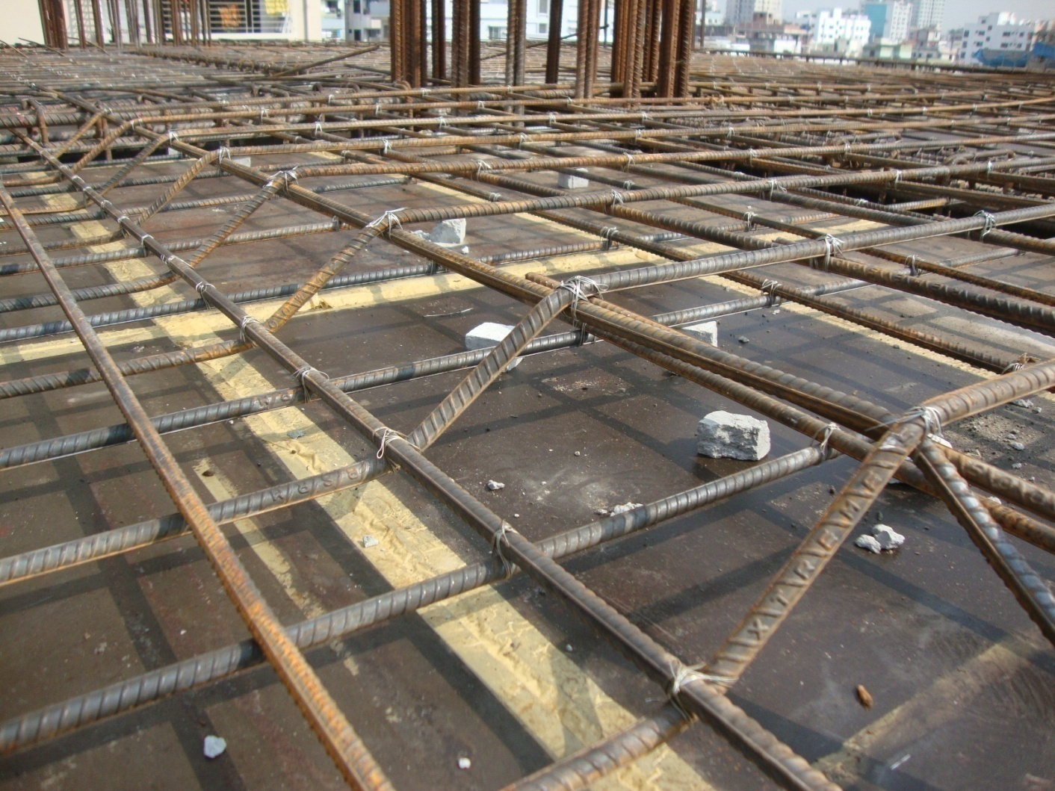
Crank Rods
Beam
Beam
To Resist Negative Moment At The Slab-Beam Joint, Crank Rod is Used

Slide 34
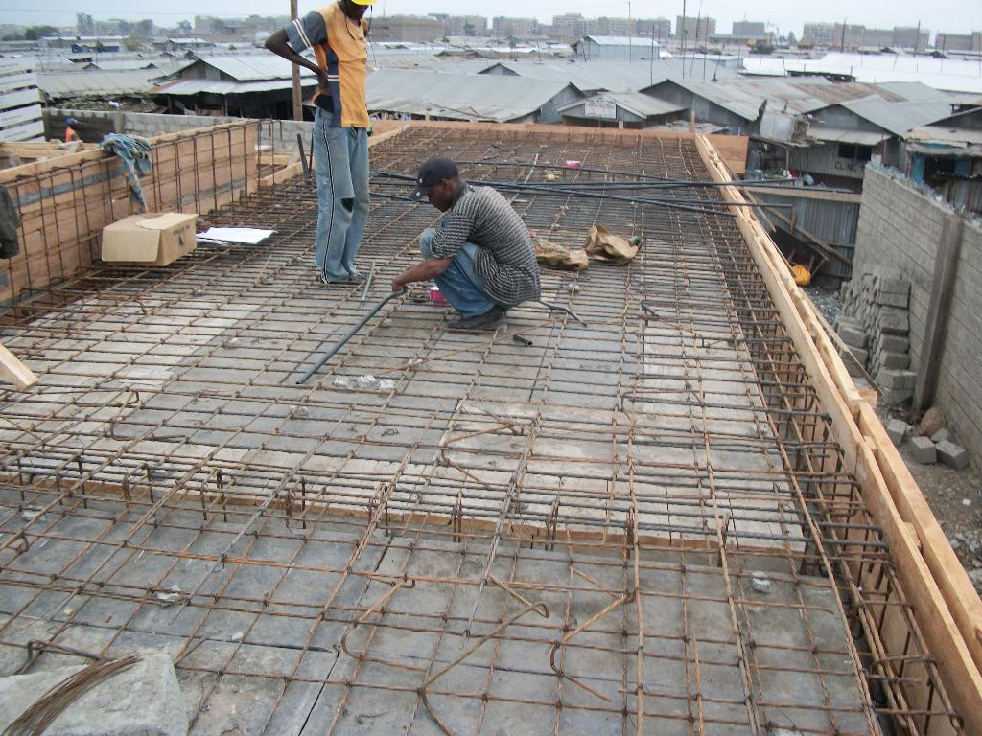
Chair

Slide 35
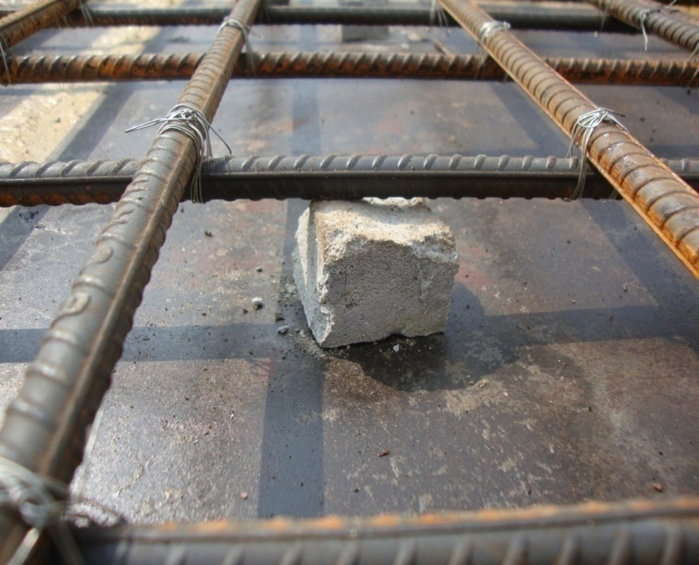
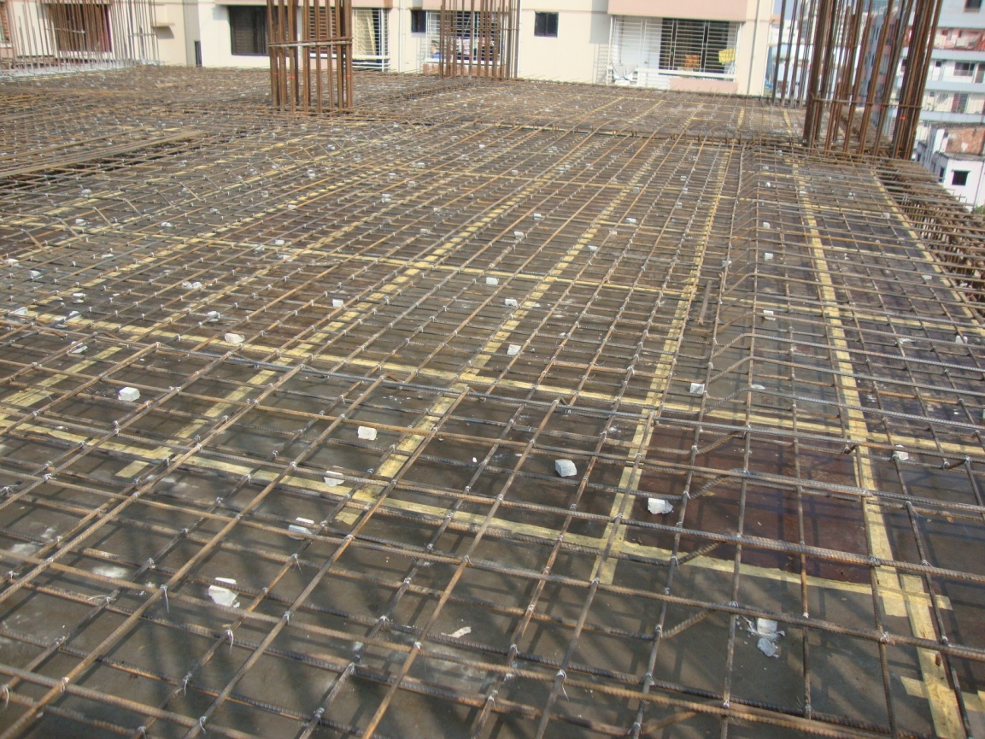
C.C. Blocks
C.C. blocks (¾”x ¾”) are used to maintain Clear Cover. It could be cubic or cylindrical

Slide 36
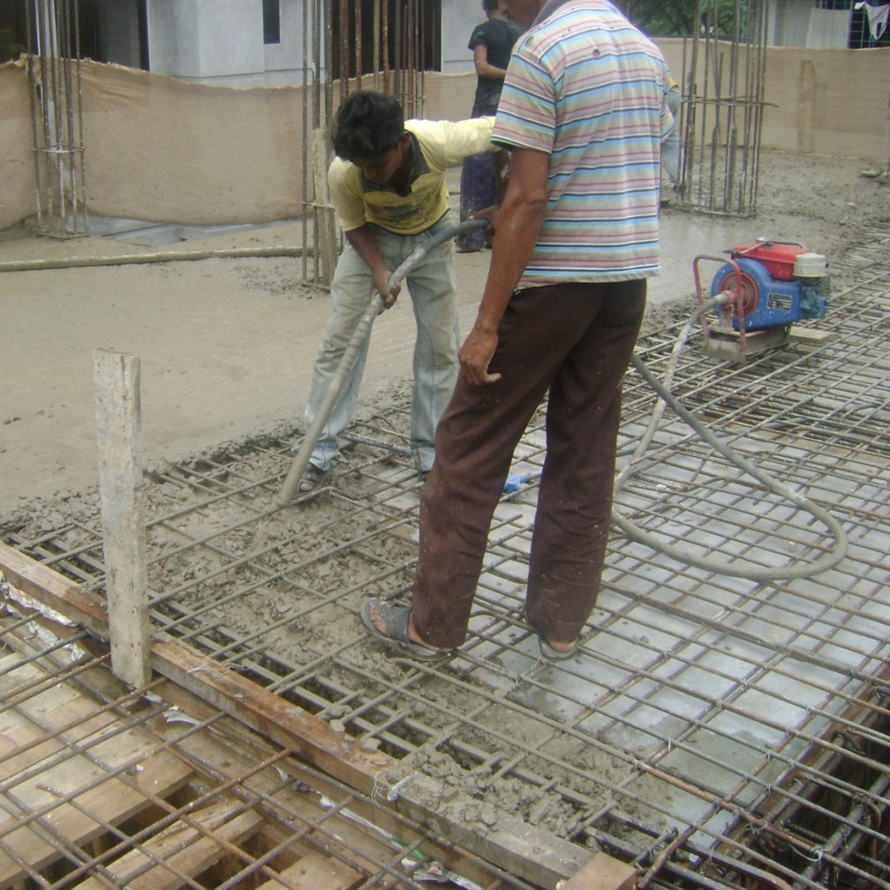
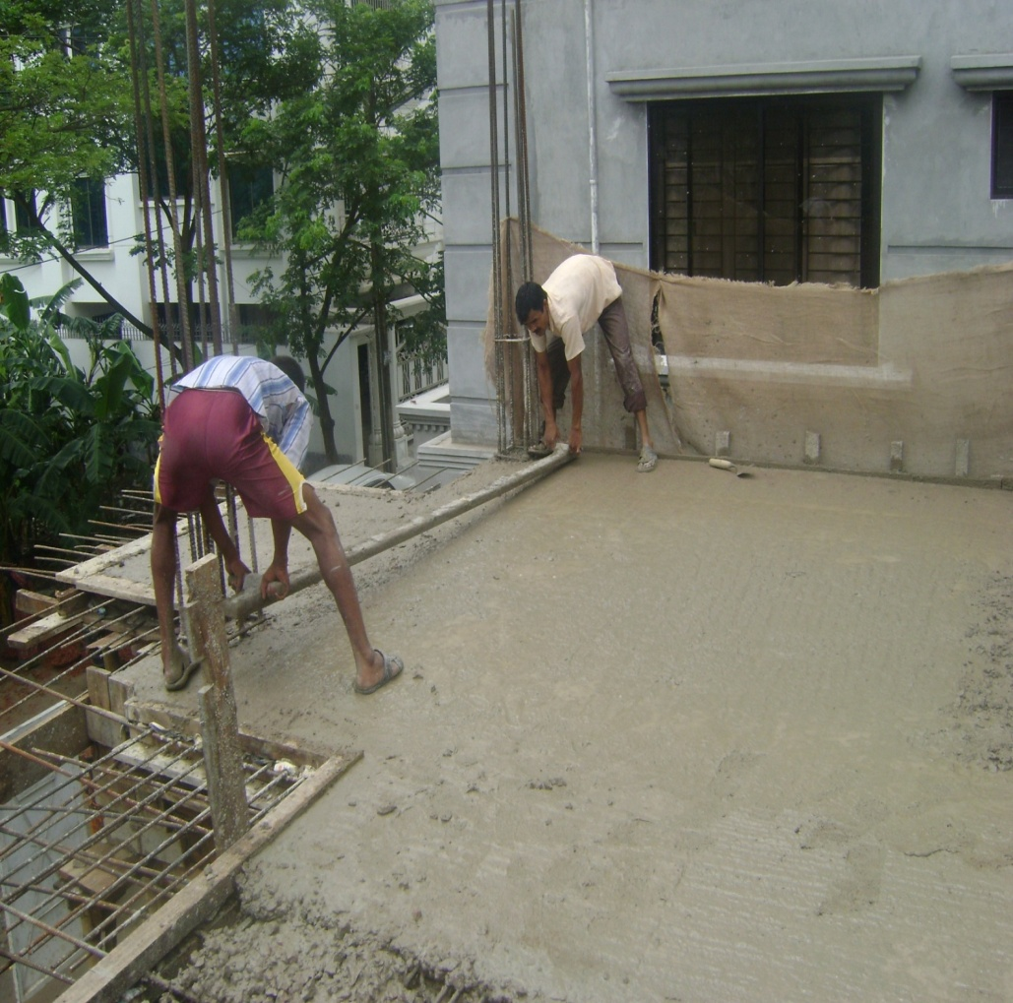
Slab Casting (Cont.)
Use Of Vibrator
Leveling

Slide 37
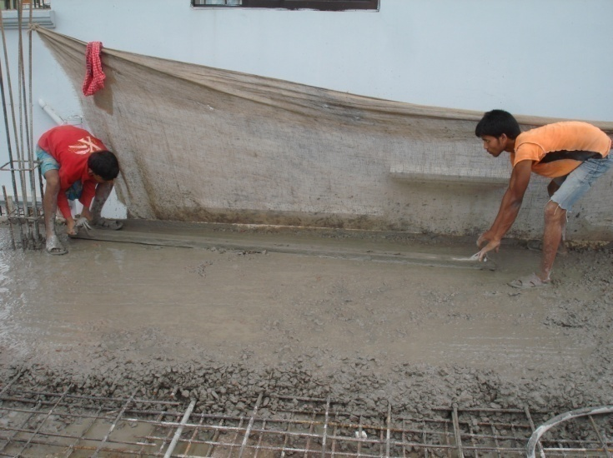
Leveling
Patta

Slide 38
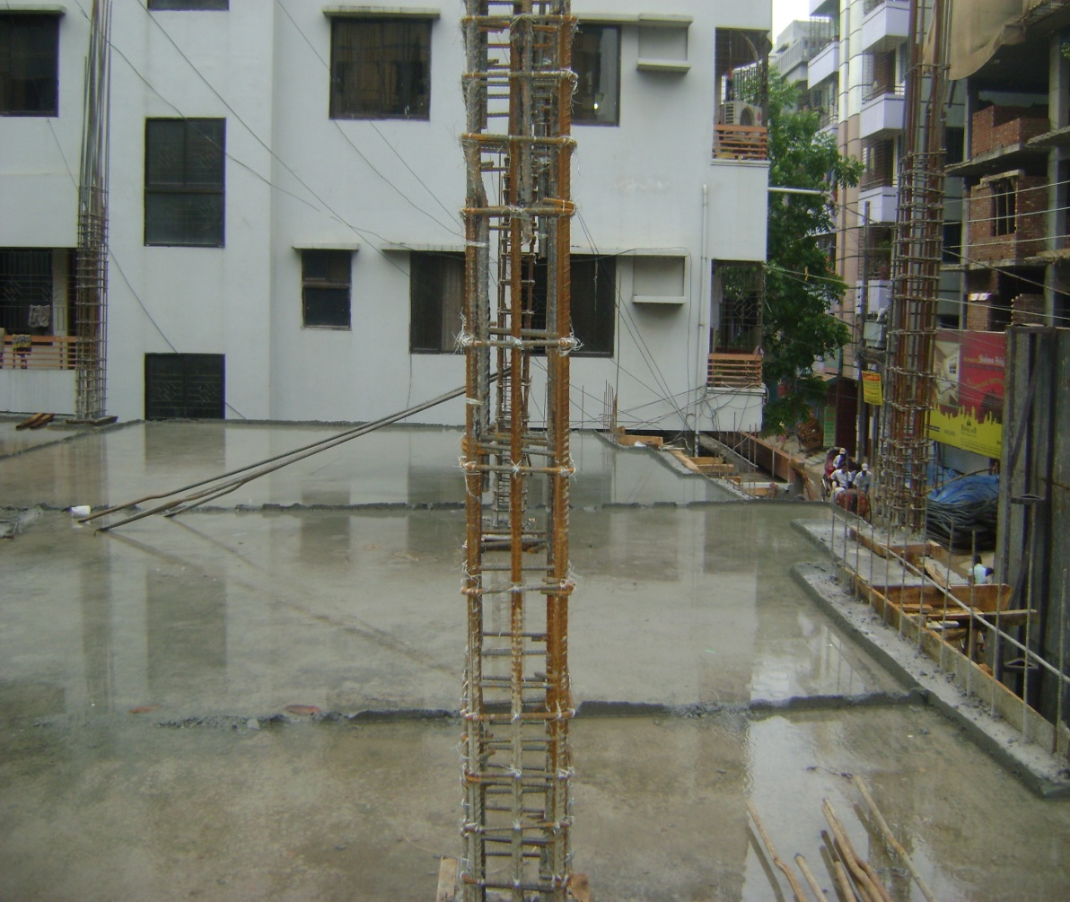
Slab Curing
3”
2”
Curing is done for 21 days
Ponding Method

Slide 39
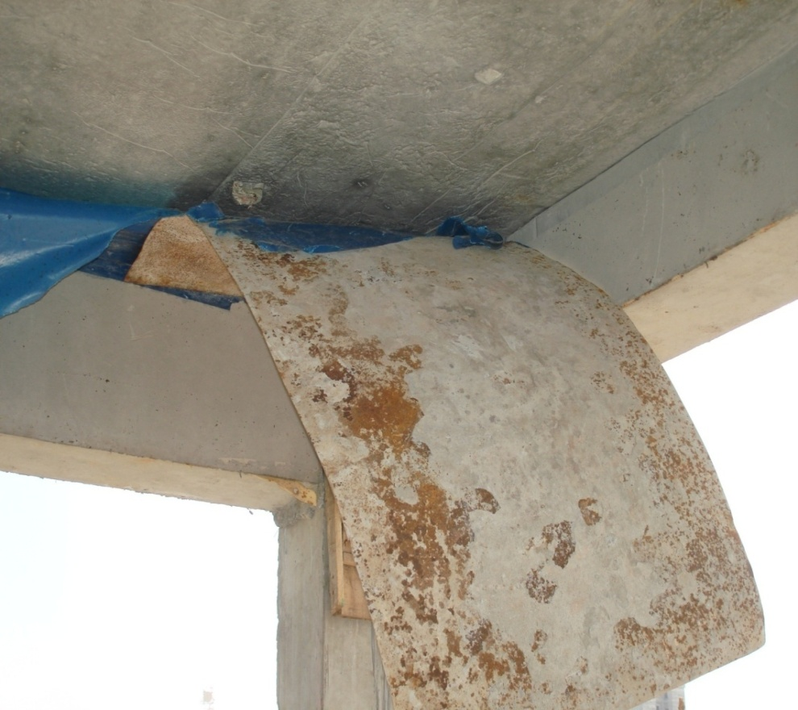
Removal of Formwork
After 21 days of curing, the formwork of slab is removed
Bottom formwork of beam is also removed with this

Slide 40
Special Observations

Slide 41
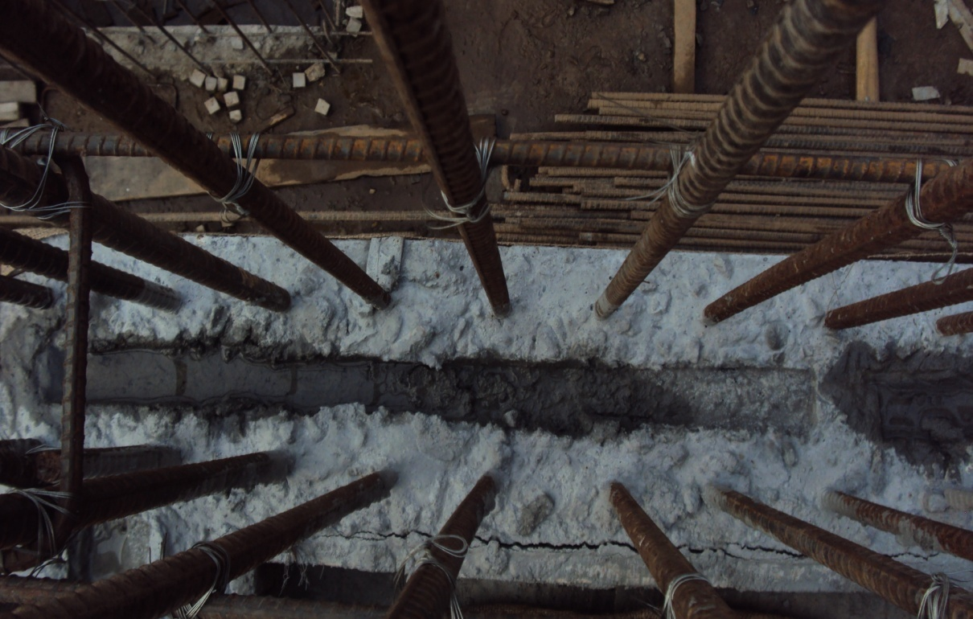
Binding of old and new concrete
Groove
A piece of wood or brick is used as groove
It is used to bind new and old concrete
Groove

Slide 42
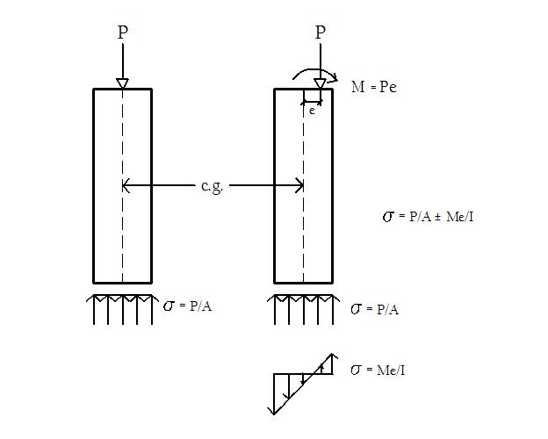
Vertical alignment of column
REASONS
Shifted load causes internal moment
Stress becomes higher than calculated

Slide 43
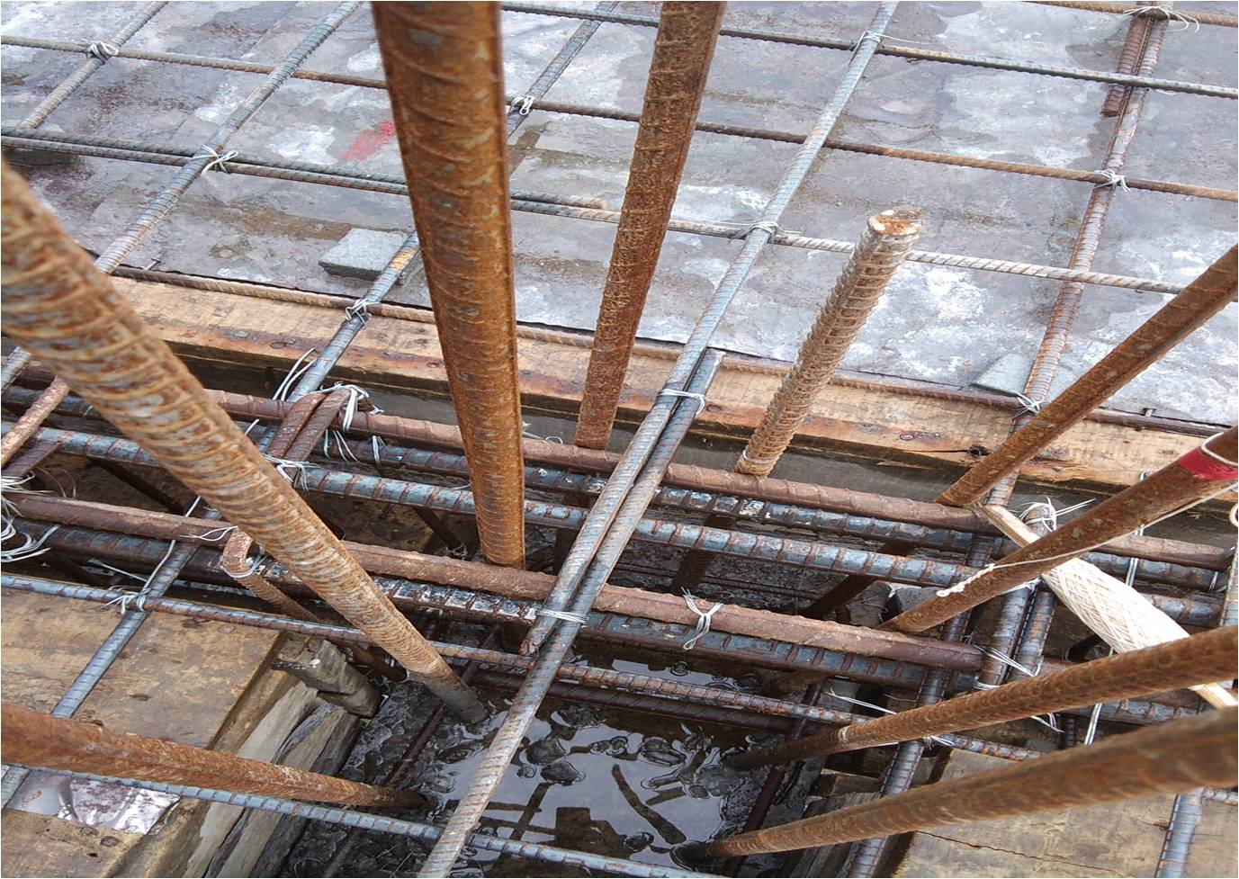
Overlapping at the beam column joint makes the structure weak

Slide 44
THANK
YOU

