Slide 1
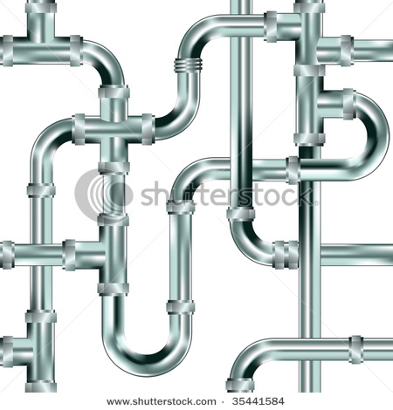
Presentation
Topic
PLUMBING SYSTEM

Slide 2
Here we go…………….
Ready…………….
Set………………….
Plumb!!!!!!!!!!!!!!!!

Slide 3
What is Plumbing System?
The entire system of piping, fixtures appliances, etc, for providing water and gas supply to a building.
Used as a means for supply of fresh water and disposal of waste water from the building.

Slide 4
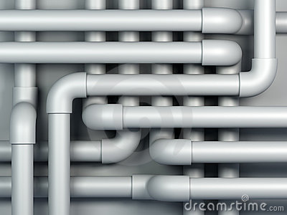
Objectives
Of
PLUMBING SYSTEM

Slide 5
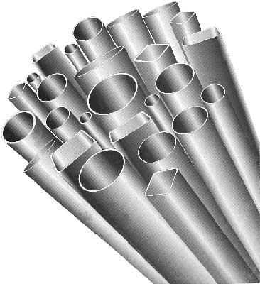
To provide sufficient amount of water to serve each fixture.
To provide of no opportunity of backflow of used water into the water supply pipes.
Water supply goals

Slide 6
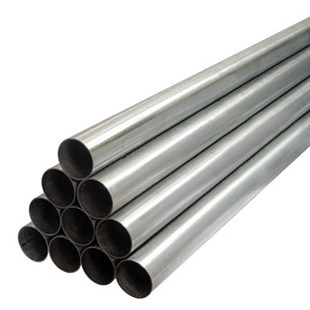
Wastes should be disposed of promptly and hygienically
Drainage systems should be of adequate size and easily cleaned
Drainage systems should be equipped with liquid seal traps
Waste disposal goals

Slide 7

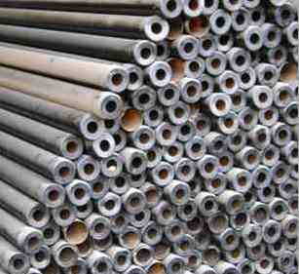
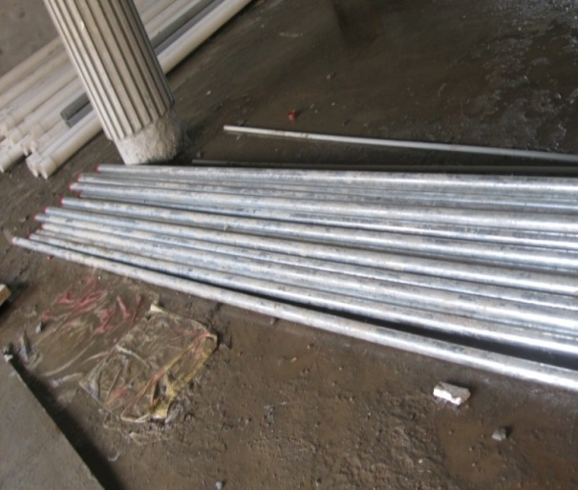
Plumbing Components
PIPES
Pipes
Taps, Valves
and stopcocks
Fixtures
Water tanks
Steel pipes
Galvanized Iron
pipes

Slide 8
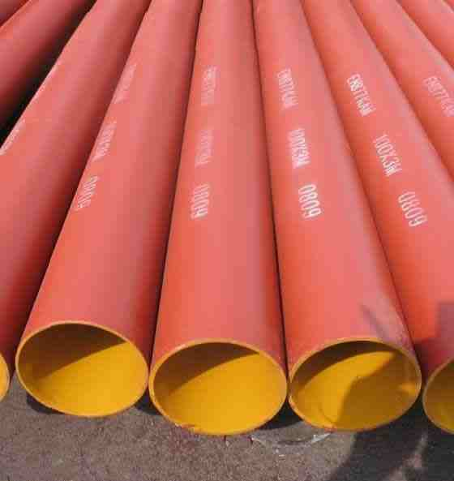
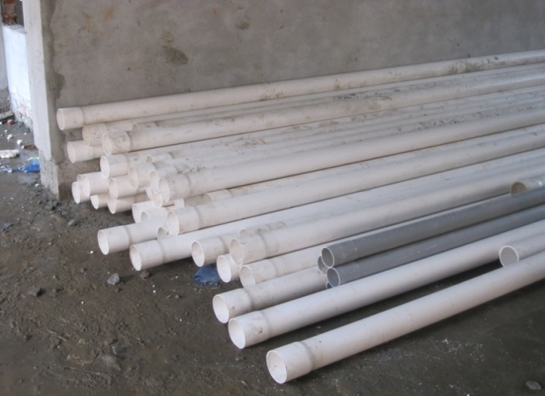
Plumbing Components
PIPES
Pipes
Taps, Valves
and stopcocks
Fixtures
Water tanks
Cast Iron pipes
P.V.C pipes

Slide 9
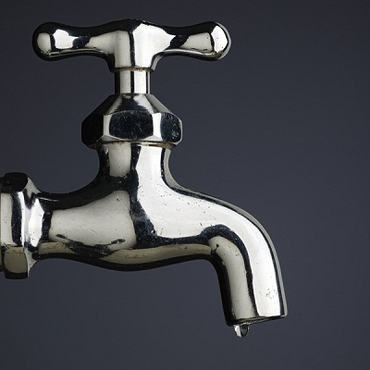
Plumbing Components
Taps, Valves and stopcocks
Pipes
Taps, Valves
and stopcocks
Fixtures
Water tanks
TAP

Slide 10
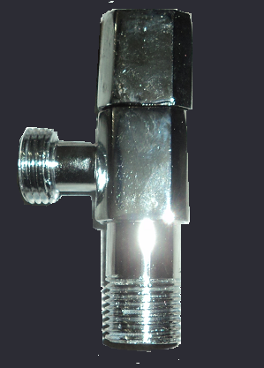
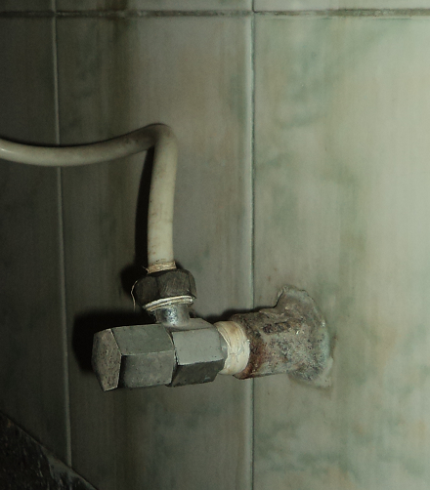
Plumbing Components
Taps, Valves and stopcocks
Pipes
Taps, Valves
and stopcocks
Fixtures
Water tanks
USE
VALVES

Slide 11
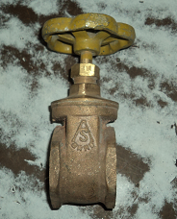
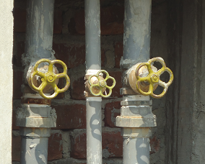
Plumbing Components
Taps, Valves and stopcocks
Pipes
Taps, Valves
and stopcocks
Fixtures
Water tanks
STOPCOCK
USE

Slide 12
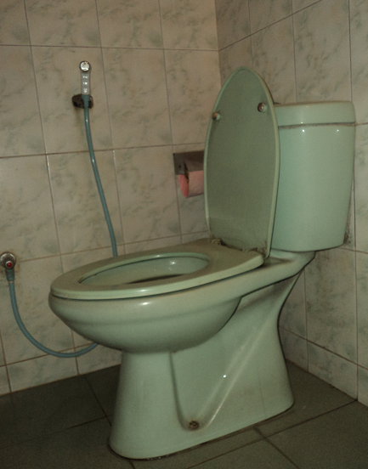
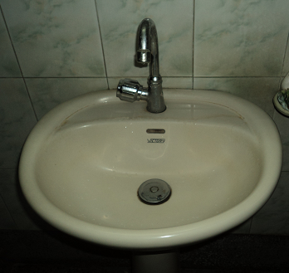
Plumbing Components
Fixtures
Pipes
Taps, Valves
and stopcocks
Fixtures
Water tanks
Water closet
Lavatory

Slide 13
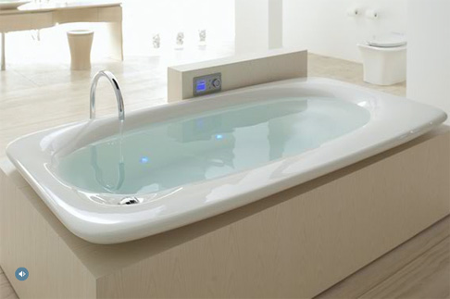
Plumbing Components
Fixtures
Pipes
Taps, Valves
and stopcocks
Fixtures
Water tanks
TUB

Slide 14
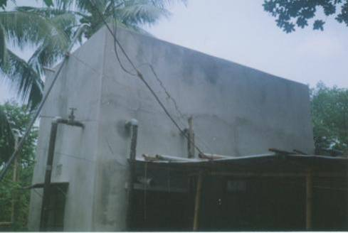
Plumbing Components
Water tanks
Pipes
Taps, Valves
and stopcocks
Fixtures
Water tanks

Slide 15
Types of Joints
Elbow joint
U-Trap Joint
Coupling
Tee
Cap

Slide 16

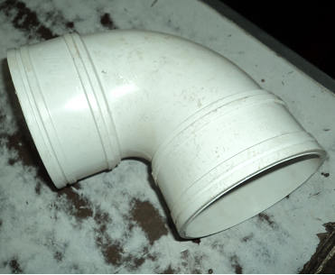
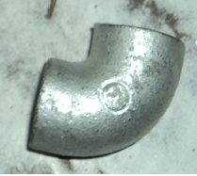
Elbow Joint
Pipe fitting installed between two lengths of pipe.
Allow a change of direction, usually a 90° or 45° angle.
Used for connecting hoses to valves and water pressure pumps.

Slide 17
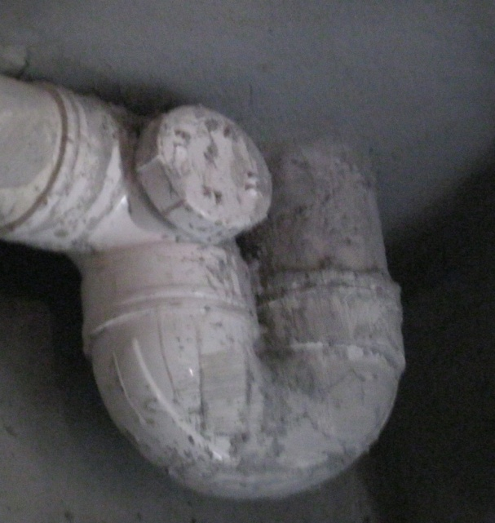
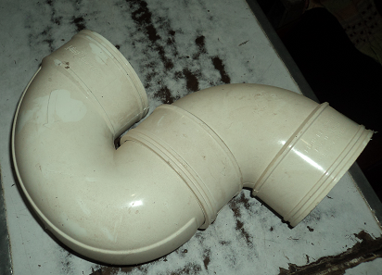
U-trap joint
A kind of u shape joint or trap joint
Used in case of joining sanitary wastage pipes.

Slide 18
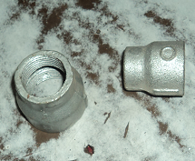
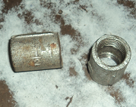
Coupling
A very short length of pipe that allows two pipes to be joined.
If the two ends of a coupling are different then it is usually referred to as an adapter.
When the two ends use the same connection method but are of a different size, they are called reducing coupling or reducer.

Slide 19
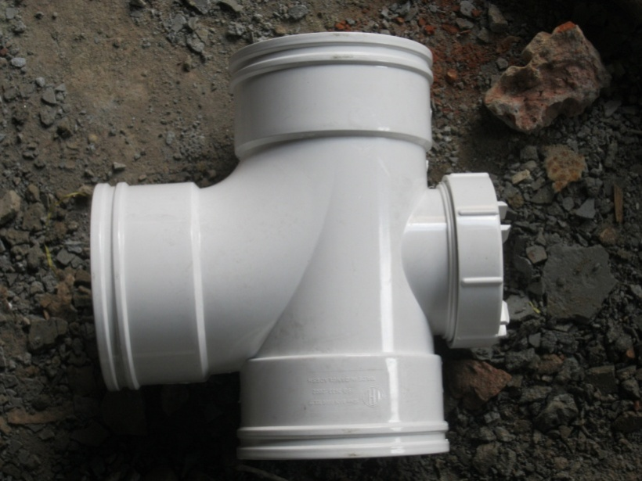
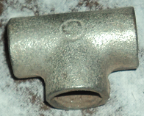
Tee Joint
Most common pipe fittings used for connecting pipes of different diameters.
Made of various materials and available in various sizes and finishes.
Extensively used in pipeline networks to transport two-phase fluid mixtures.

Slide 20
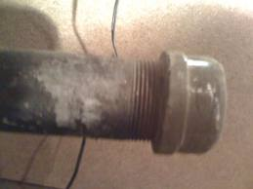
Cap
A type of pipe fitting covering the end of a pipe.
Usually liquid or gas tight.
Used for providing a future connection point.

Slide 21
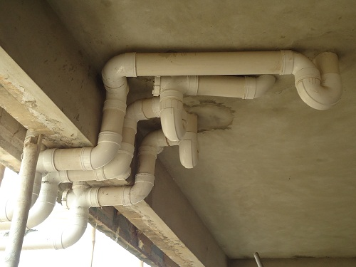
Joints In Practical Field
U-trap joint
Elbow Joint
Tee Joint

Slide 22
Types of
Plumbing
Water Supply Plumbing
Drainage Plumbing

Slide 23
Water supply Plumbing
Direct system
Indirect system

Slide 24
Direct system
Supply of water is given to various floors in a building directly from the main.
Sufficient pressure is provided to feed all the floor and sanitary fitting at the highest part of the building.

Slide 25
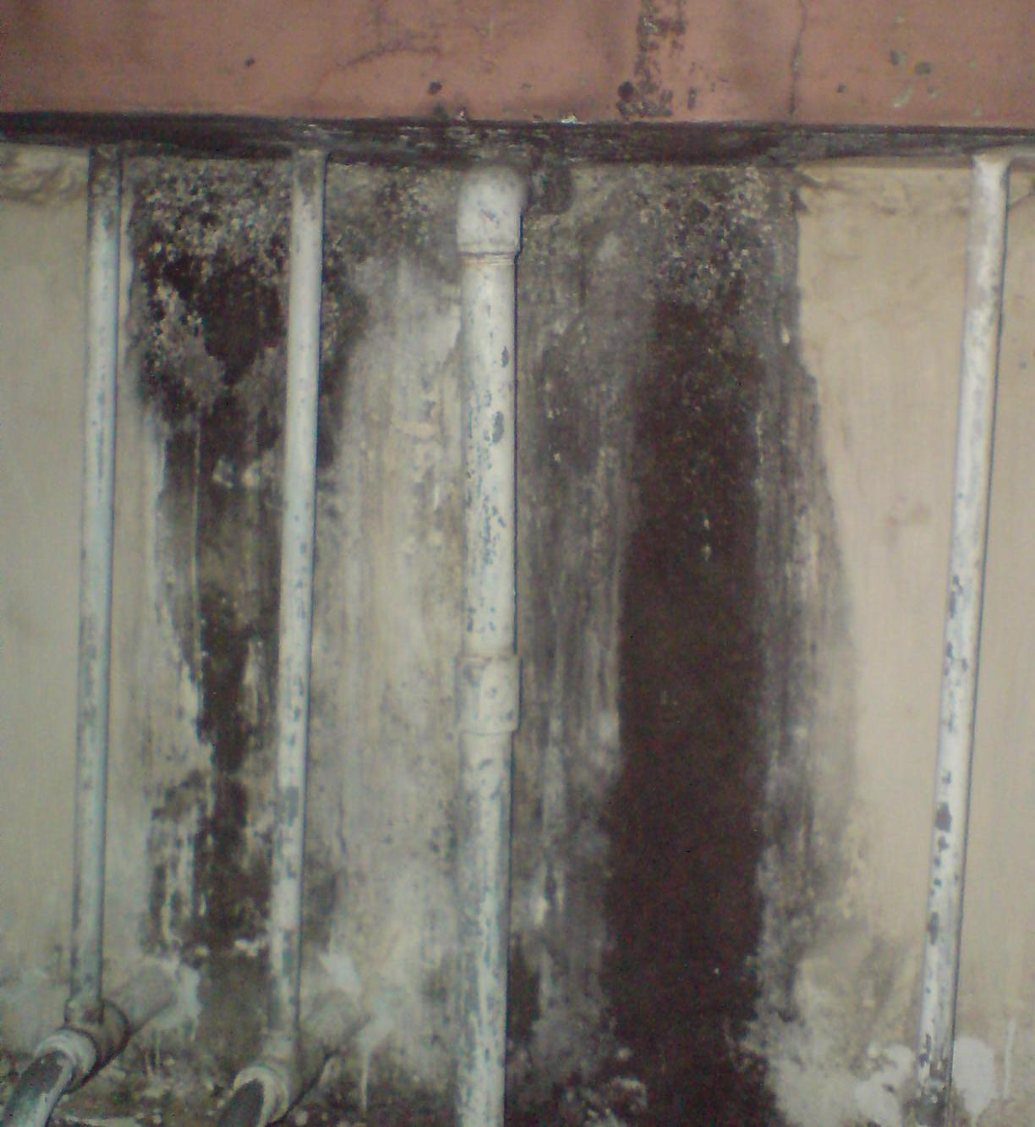
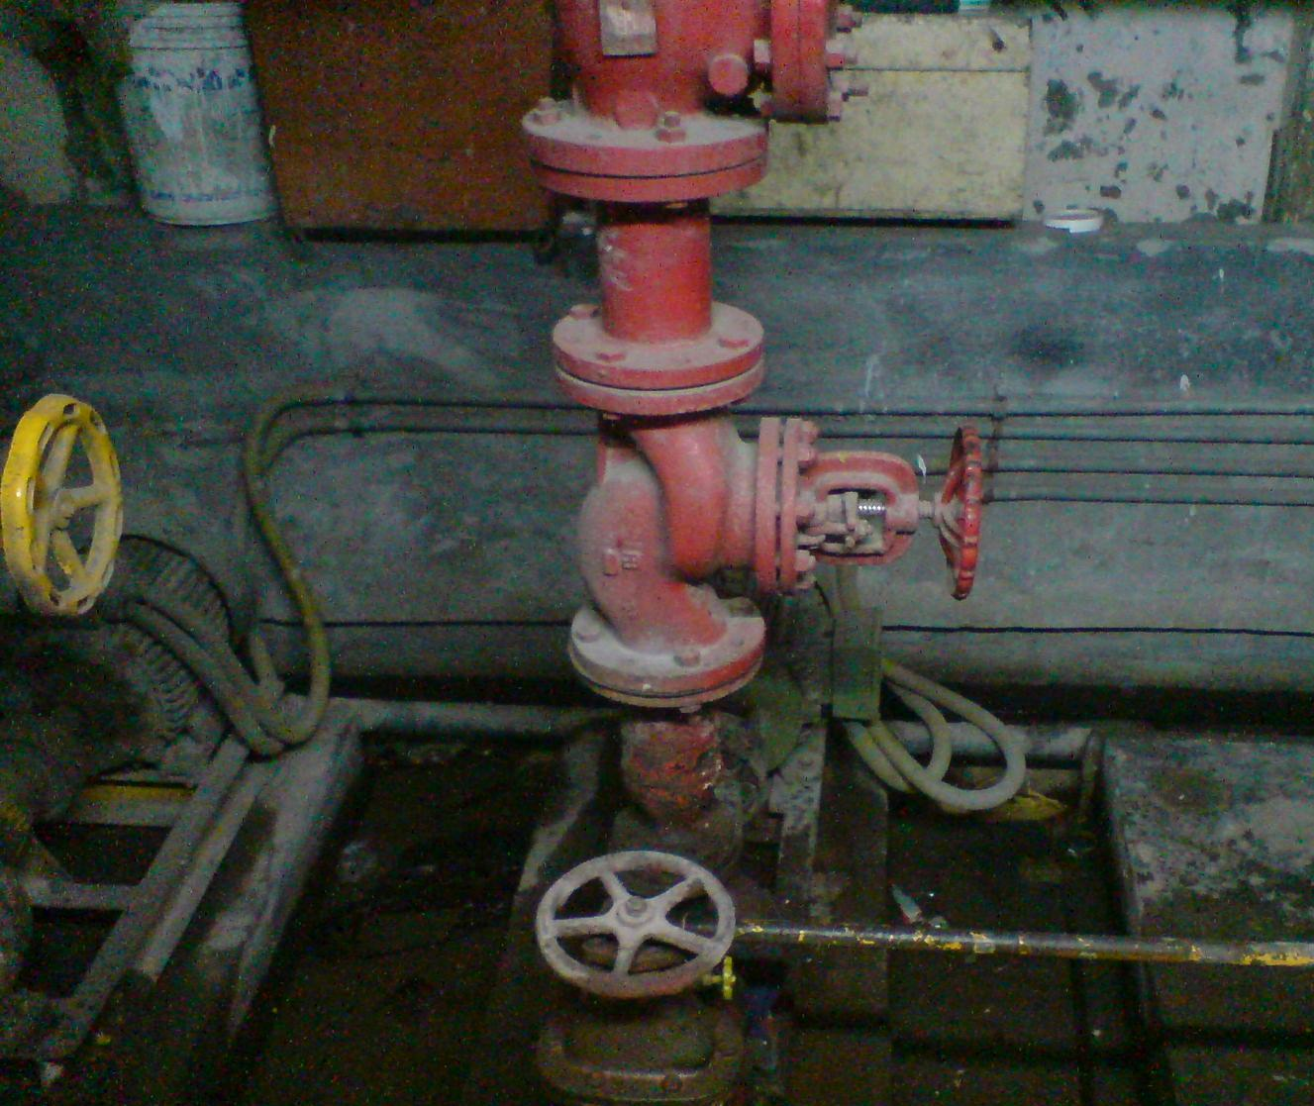
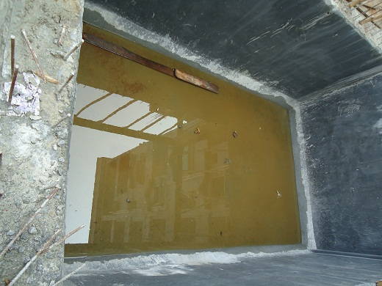
Up feed
the procedure of storing water into the overhead storage tanks
Water is supplied in suffucient pressure by machine or by providing mechanical energy

Slide 26
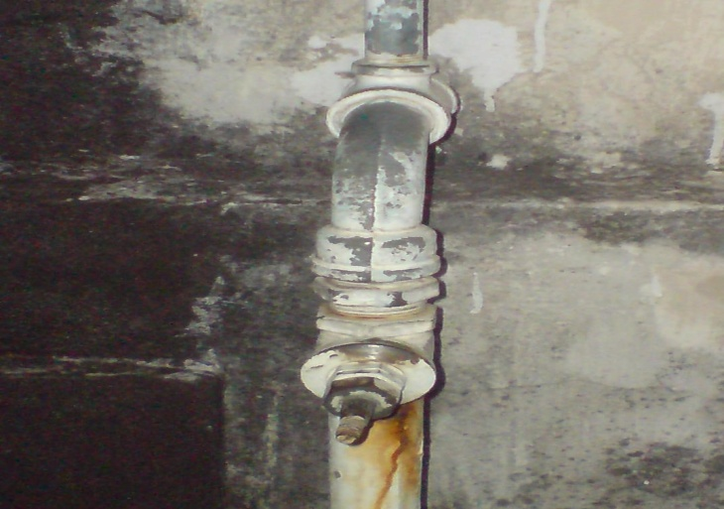
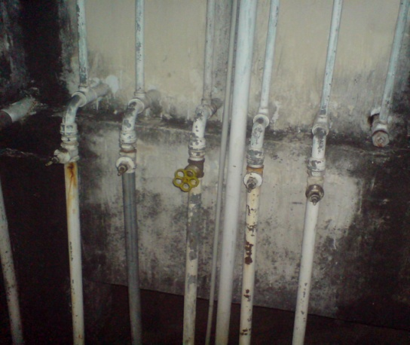
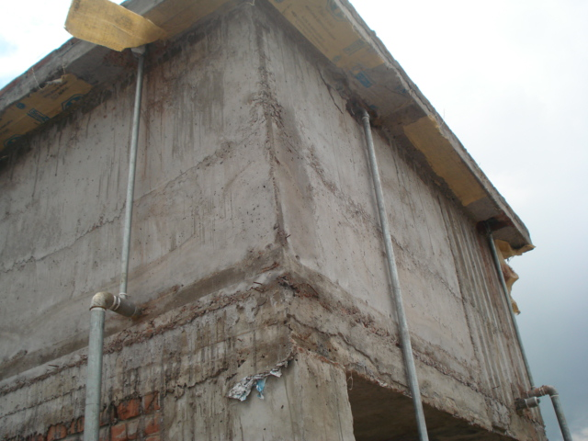
Down feed
water is distributed to the floors from the overhead storage tanks
no need of extracting extra pressure because of gravitational energy water is distributed along the floors
One Pipe down feed Line
.
Many pipes down feed line

Slide 27
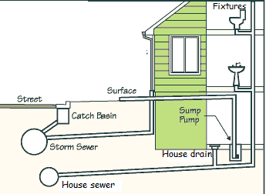
Drainage system
The drainage system means the removal of all the wastages or water wastages in a distributed way.

Slide 28
Drainage Pipe Requirements
Provision of adequate supports for drainage pipes during construction of building.
Pipe lay out should be direct and simple. Pipes should be laid in straight lines.
Any abrupt changes in the direction of flow should be avoided. The contained angle between two intersecting pipes should not exceed 45º.
Installation be not done so as to impair structural safety of a building.
The drainage pipes should be sufficiently strong and durable. They should also be air-tight and gas tight.
Drainage system

Slide 29
The pipe-joints should be strong and leak proof.
The entire network of pipes should have ample means for cleaning and removing obstruction.
Traps are required for every fixture.
Any possibility of air-locks, siphonage, undue deposits and obstruction should be thoroughly looked into and avoided.
Pipes when not embedded should run clear of the wall with a minimum clearance of 5 cm.
Each stack should be suitably covered on top above roof by copper or galvanized iron wire dome.
Drainage system

Slide 30
Drainage system
Sanitary Drainage System
Storm Water Drainage System
Sanitary drainage system
The system that drains water from sinks, tubs, showers, lavatories & soil matter from toilets is known as sanitary drainage system. Here two pipe system is commonly used.
Storm water drainage system
The system that collects storm water from roofs, yards & areaways is known as storm water drainage system.

Slide 31
sanitary drainage system
Components
House sewer
House drain
Soil, waste,
vent stacks
Fixture branches &
branch vents
Fixture traps
Fixtures

Slide 32
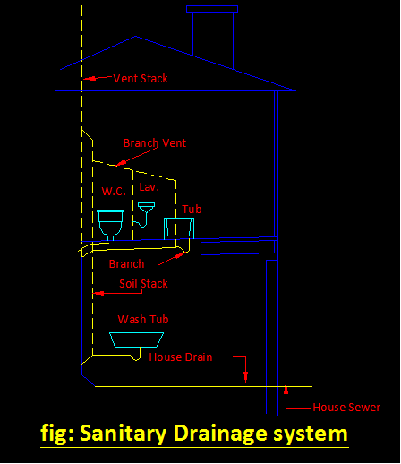
sanitary drainage system

Slide 33

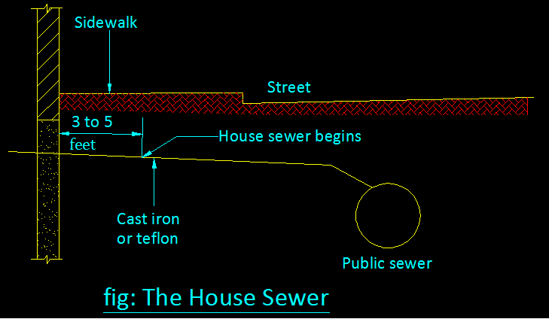
1. House Sewer
portion of pipe that extends from the public sewer pipe in the street to about 3 to 5 feet from the house.
Depending upon the local Plumbing codes the pipes may be of cast iron, galvanized steel, lead, copper, PVC or other approved materials.
If the sewer line passes within 10 ft (3 m) of a drinking water supply line under pressure, the house sewer line must be leak proof.

Slide 34
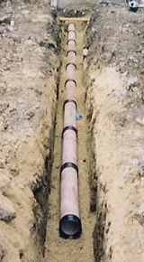
House drain
The house drain is the horizontal pipe inside the house into which the vertical soil & waste stacks discharge.
Since sewage in the house drain flows into the public sewer by gravity, the public sewer must of necessity be deeper below the grade line than the house drain.

Slide 35
Soil, Waste & Vent stacks
The vertical pipes of the sanitary drainage system.
Distinction must be made between soil, waste & vent stacks.
Soil stack receives the soil matter from the water closet.
The lavatory & tub drain into the waste stack.
The pipe above the point where the lavatory & the tub drain into the waste stack becomes a vent stack.
Vent stack is provided to remove unwanted odorous gases and insects.

Slide 36
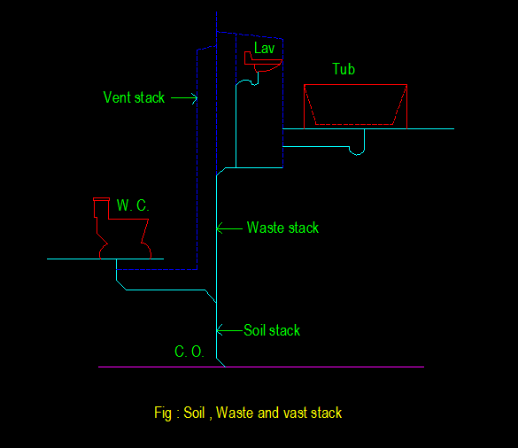
Soil, Waste & Vent stacks

Slide 37
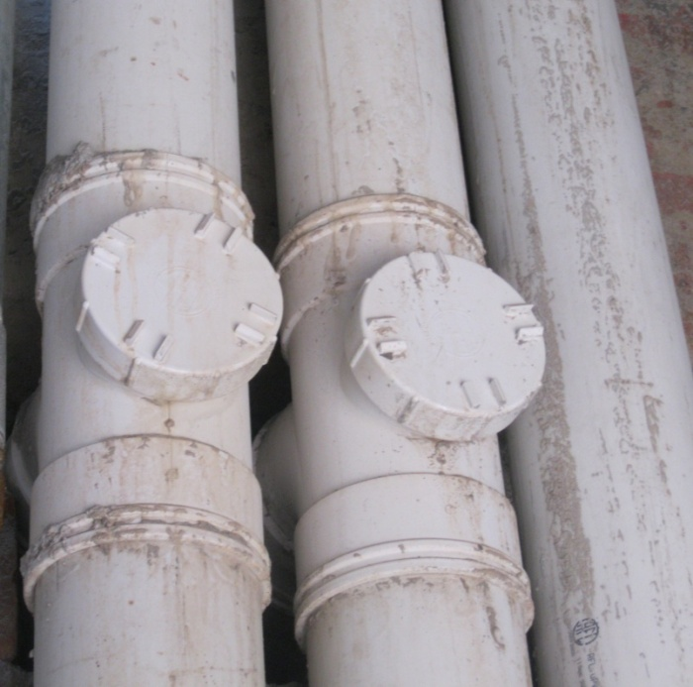
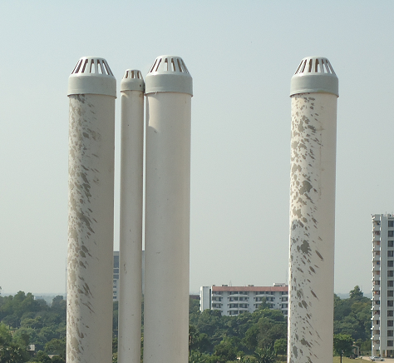
Soil, Waste & Vent stacks
Soil stack
Waste stack
Vent stack
Vent stack

Slide 38
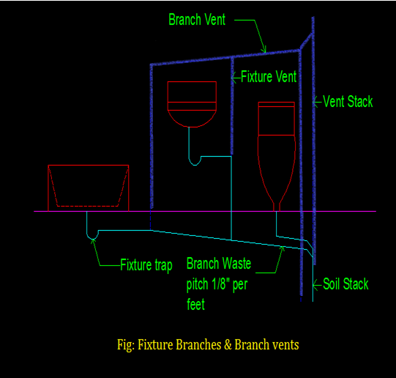
Fixture branches & branch vents
Fixture branch is the horizontal pipe running from the fixture trap to the vertical soil or waste stacks.
The fixture vents are the horizontal piping that run from near the fixture trap, then overhead of the fixture to the vent stack.

Slide 39
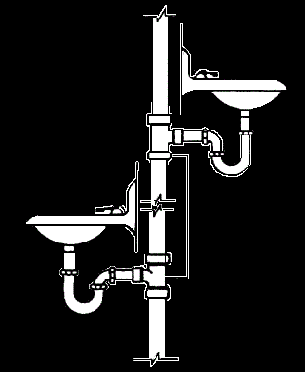
Fixture Traps
Every fixture has a trap which is directly under the fixture & ‘U’ shaped.
The trap has a water seal, that prevents odors & gases within the pipe from entering the living areas.
Traps must be protected from freezing & must be vented to prevent siphonage of the fixture trap.
Vent
Lavatory
Fixture trap

Slide 40
Fixtures
Kitchen sink
Lavatory
Toilet bowl
water closet
Shower
Shower stall
Bathtub.

Slide 41
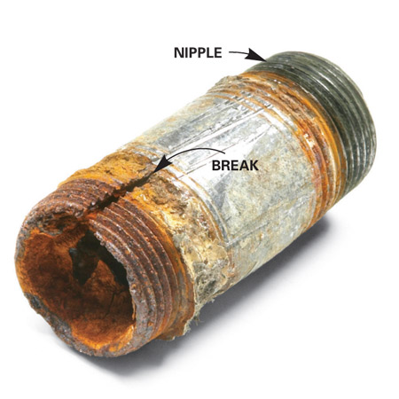
Common Plumbing Problems
Different kinds of metal pipes cannot be combined because of chemical reactions
Joints can be broken during threading
Leakage occurs during placement of pipes
Water reservoir should be built in a certain height to ensure sufficient water pressure

Slide 42
Recommendation
Plumbing materials and workmanship should conform to accepted quality standards.
Plumbing installations should be tested and disinfected before being put into service.
Adequate training should be provided for plumbing professionals and the public should be made aware of the dangers of poor plumbing.
Plumbing systems should be properly maintained.

Slide 43
Wastes should be disposed of promptly and hygienically.
Drainage systems should be of adequate size and easily cleaned.
Drainage systems should be equipped with liquid seal traps.
Hot water systems should be carefully designed to avoid health hazards
Deleterious substances should be excluded from sewers
Backflow of sewage should be prevented.
Recommendations

