Slide 1
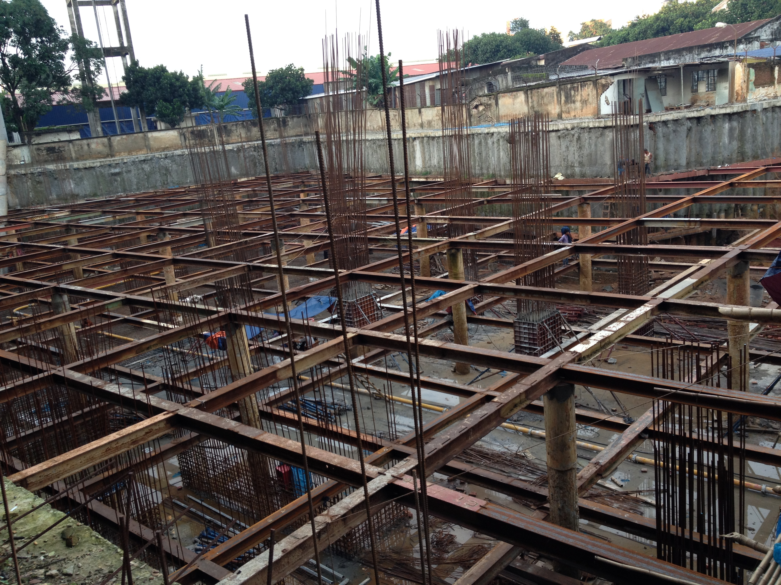

Bangladesh University Of Engineering & Technology
Presentation On
WATER PROOFING OF BASEMENT
Presented By: Group 1
Sanjida Islam Archi
Shuvro Kumar Chakravorty
Khondokar Al Momin
Gazi Md Imran
Md. Lutfor Rahman
Ehshan ur Rahman
Md Shahadat Hossain
Md Saiful Islam
Md.Sajedur Rahman

Slide 2
WHAT IS WATERPROOFING
Waterproofing is the formation of an impervious barrier
prevent water entering
escaping water from various sections of building structures
resistance to humidity or dampness

Slide 3
Where Water proofing is needed
Internal areas :
bathrooms
shower recesses
laundries
toilets
External areas
roofs , planter boxes
podiums , balconies , terraces
retaining walls , Basement
swimming pools

Slide 4
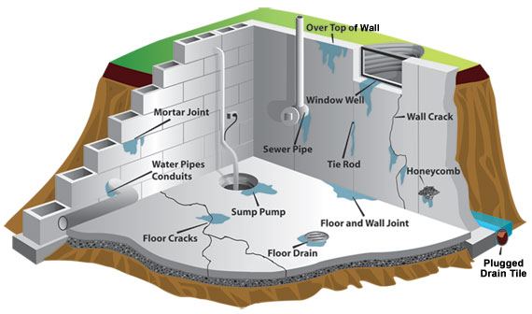
Water Proofing on Basement

Slide 5
HOW WATER PERMEATES IN THE UNDERGROUND STRUCTURES
Soil contains a huge amount of water in its pores
water has its own pressure, varies with the depth, the hydrostatic pressure increases.
Soil itself has also its own pressure. This total pressure forces water to create cracks in Basement.

Slide 6
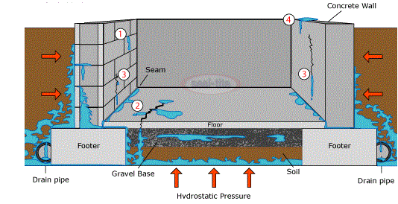
HOW WATER PERMEATES IN THE UNDERGROUND STRUCTURES

Slide 7
Where it is more necessary
In the areas where it rains often .
In the hilly area where underground water has a flow

Slide 8
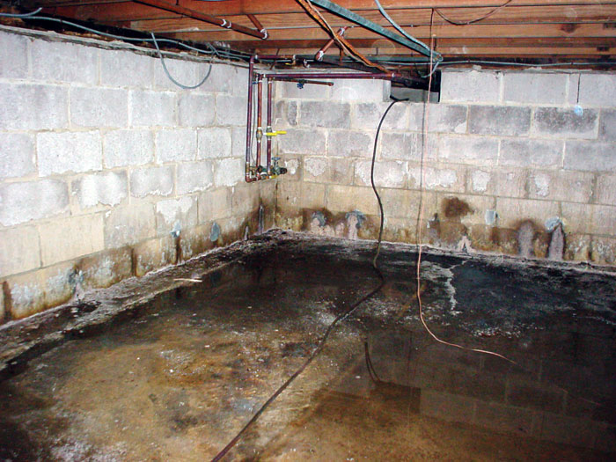
Water Damages In Basements
Shorter life span
Cracks
Corrosion
Weakening the joints
Swelling of plasters
Electrical Hazard
Deterioration of Building Facade

Slide 9
Water Proofing Materials
Additives
Waterproof Cement
Ferrocement
Waterproof Membrane
Tar & Bitumen
Bentonite

Slide 10
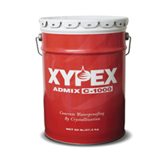
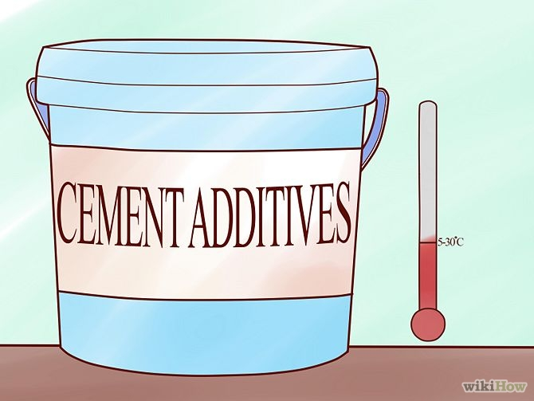
Additives
Krystol Mortar Admixture
Xypex Admix

Slide 11
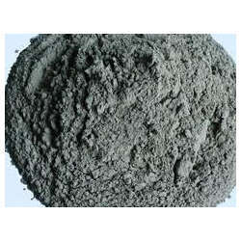
Waterproof Cement
Cement processed by
mixing water proofing
additives and epoxies

Slide 12
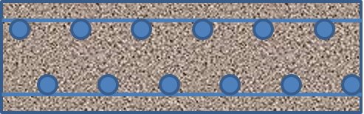
Ferrocement
wire mesh mortar
6mm ~ 20 mm
Component Materials:
Cement
Aggregate (sand)
Water
Reinforcement

Slide 13
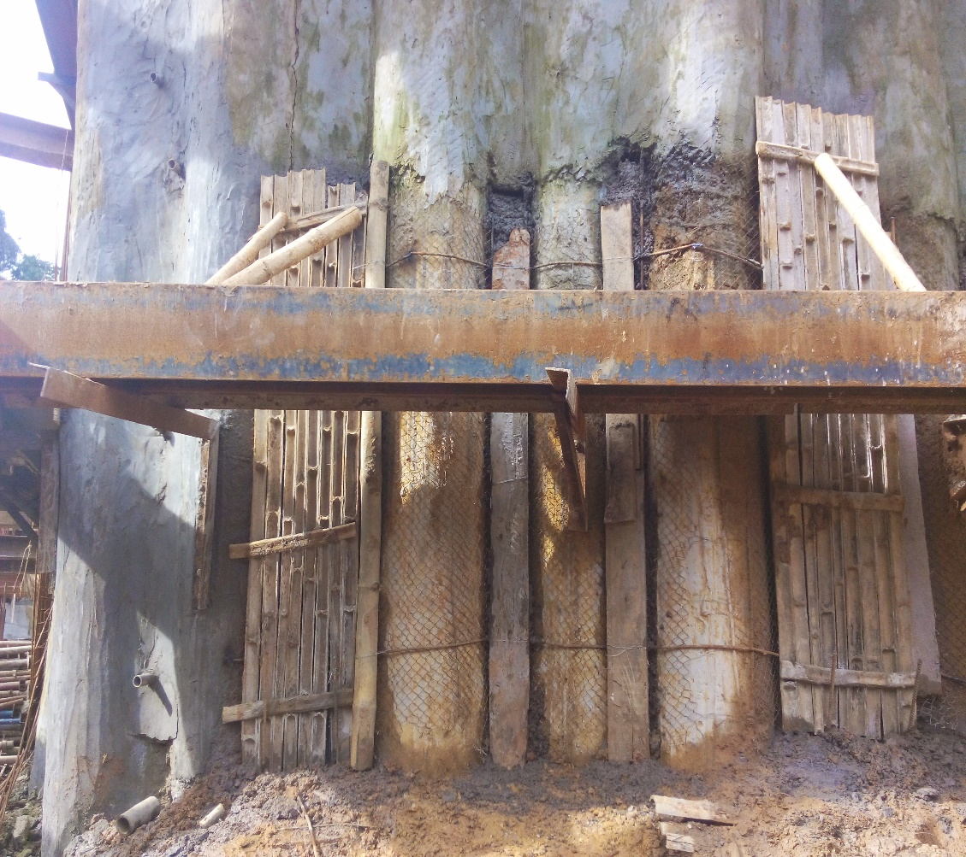
Ferrocement
Ferrocement provides
higher tensile and flexural strength
resists corrosion
provide a crack free, tough dependable surface free
highly crack resistant
have excellent bond with the surface
highly impervious nature

Slide 14
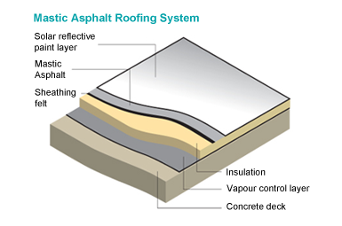
Water Proofing Membrane
Bitumenus Felts
Mastic Asphalts
Silicon
Epoxy
Different Polymers

Slide 15
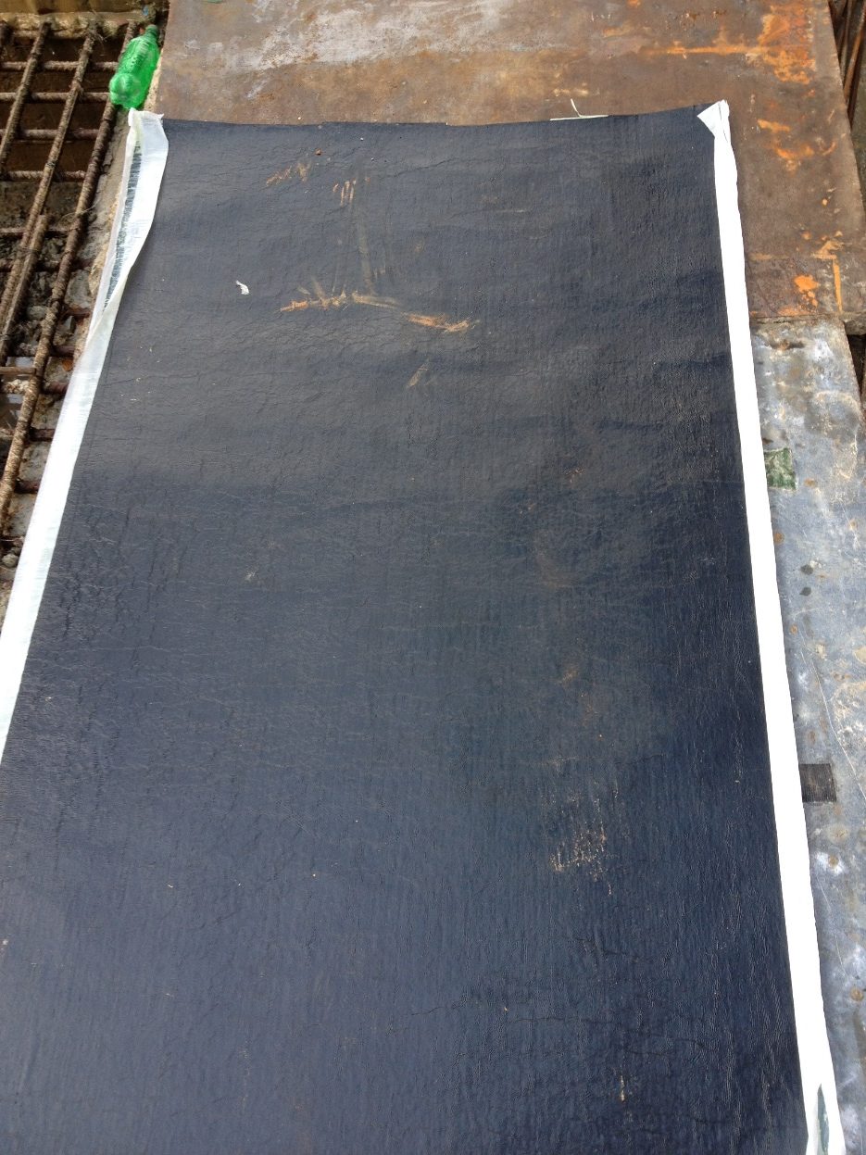
Felt Paper
Felt paper or asphalt felt paper is a sheet material
impregnated with bitumen (asphalt) , similar to tar paper
common grades
type 1 (number 15)
type 2 (number 30)

Slide 16
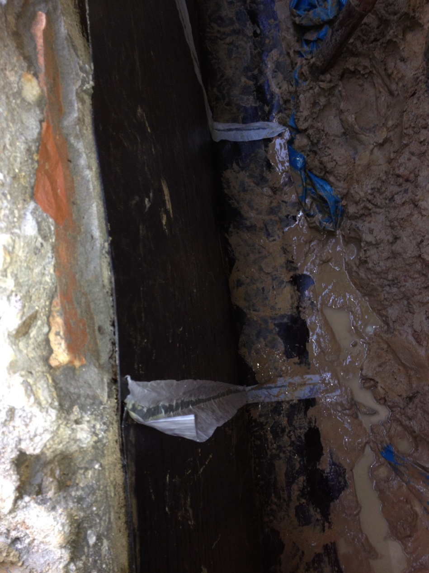
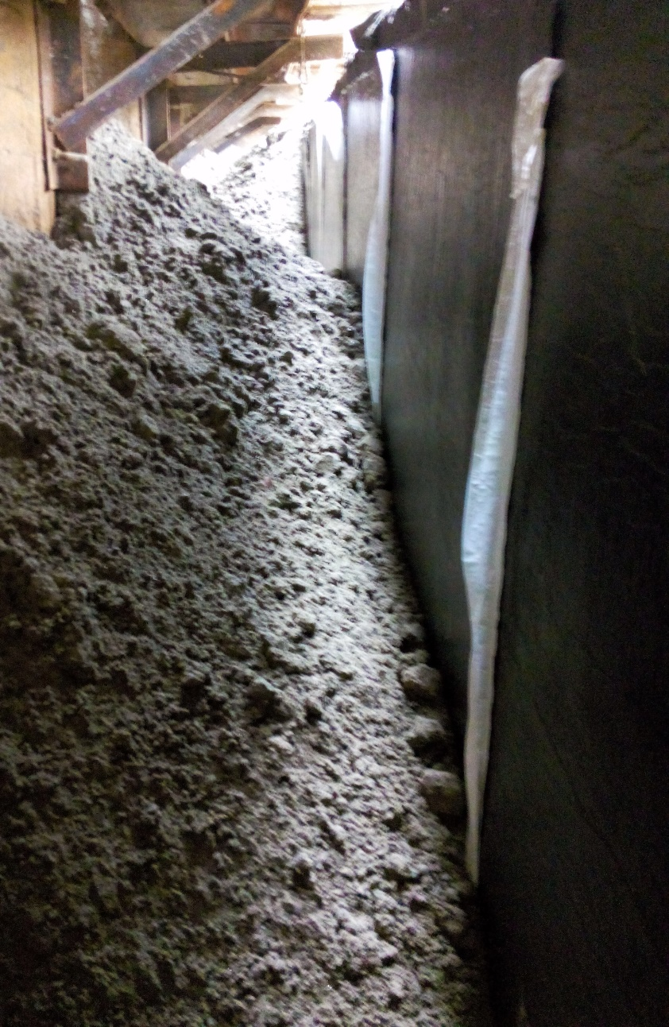
Felt Paper
Felt Paper

Slide 17
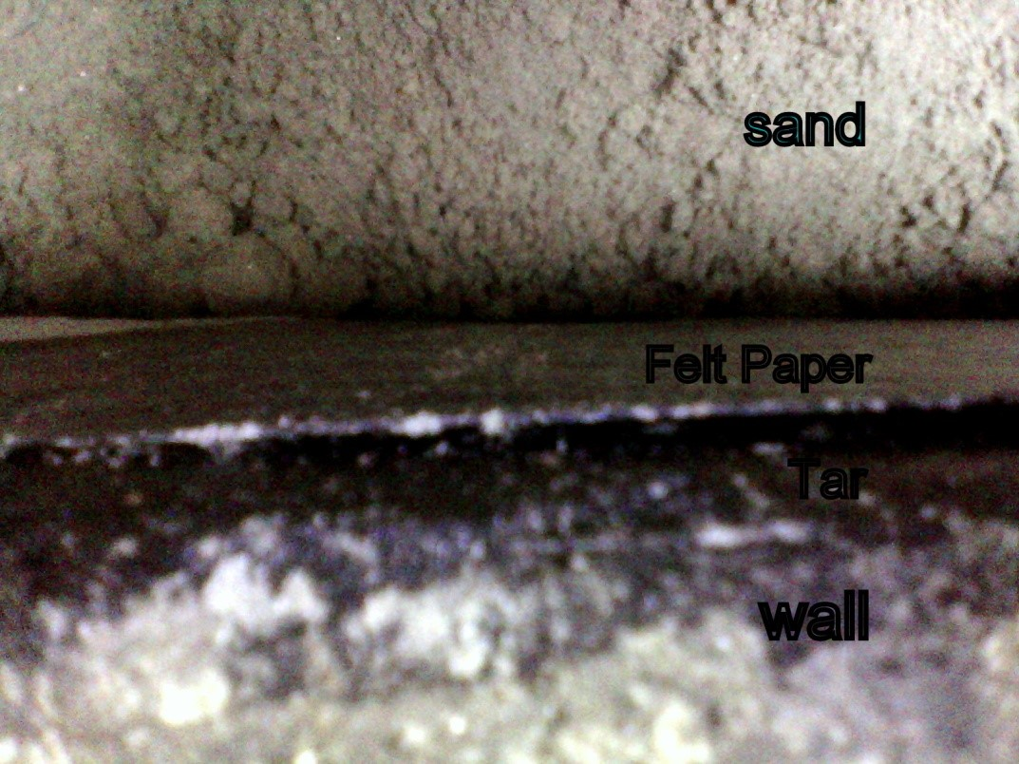
Felt Paper
Steps:
Rubbing Bitumen on the wall
Push china felt paper on the Bitumen layer
Use sand for tightening

Slide 18
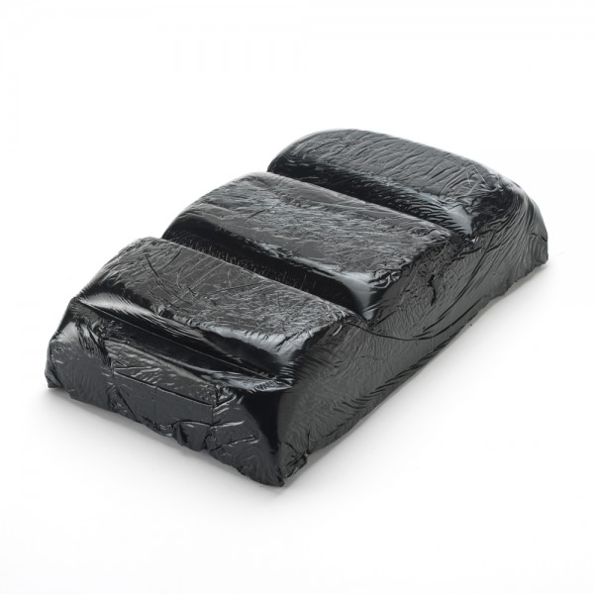
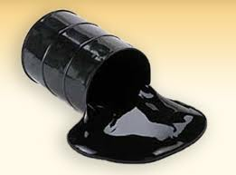
Tar & Bitumen
Bitumen (asphalt) is a mixed substance made up of organic liquids

Slide 19
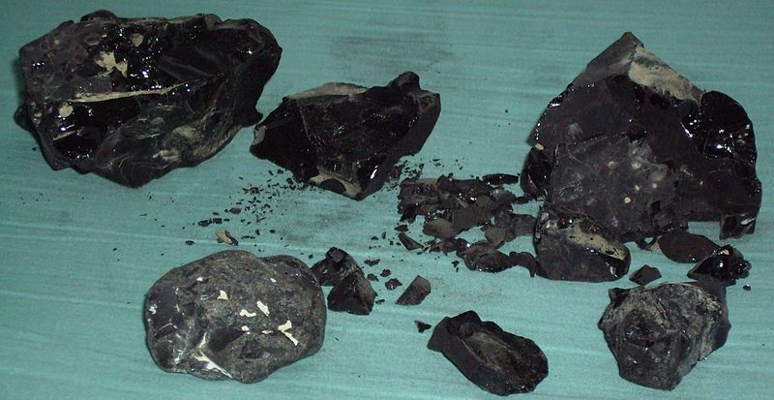
Tar & Bitumen
Characteristics Of Tar & Bitumen
highly sticky
Viscous
waterproof

Slide 20
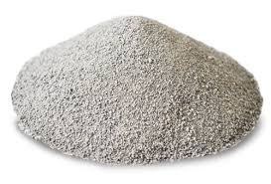
Bentonite
Bentonite is an absorbent aluminium phyllosilicate, impure clay consisting mostly of montmorillonite
Types Of Bentonite
Sodium Bentonite
Calcium bentonite
Potassium bentonite

Slide 21
Stepss Of Water Proofing
taking proper consideration at the design stage
choosing the right product for the job
taking adequate preparation
managing the correct application

Slide 22
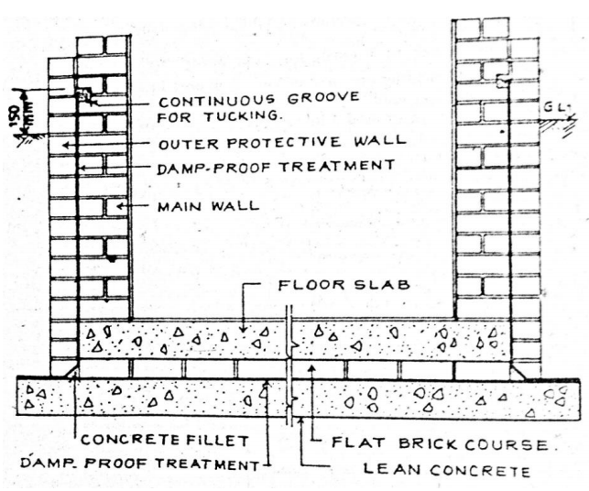
Water Proofing For Simple Basement & Ordinary Soil

Slide 23

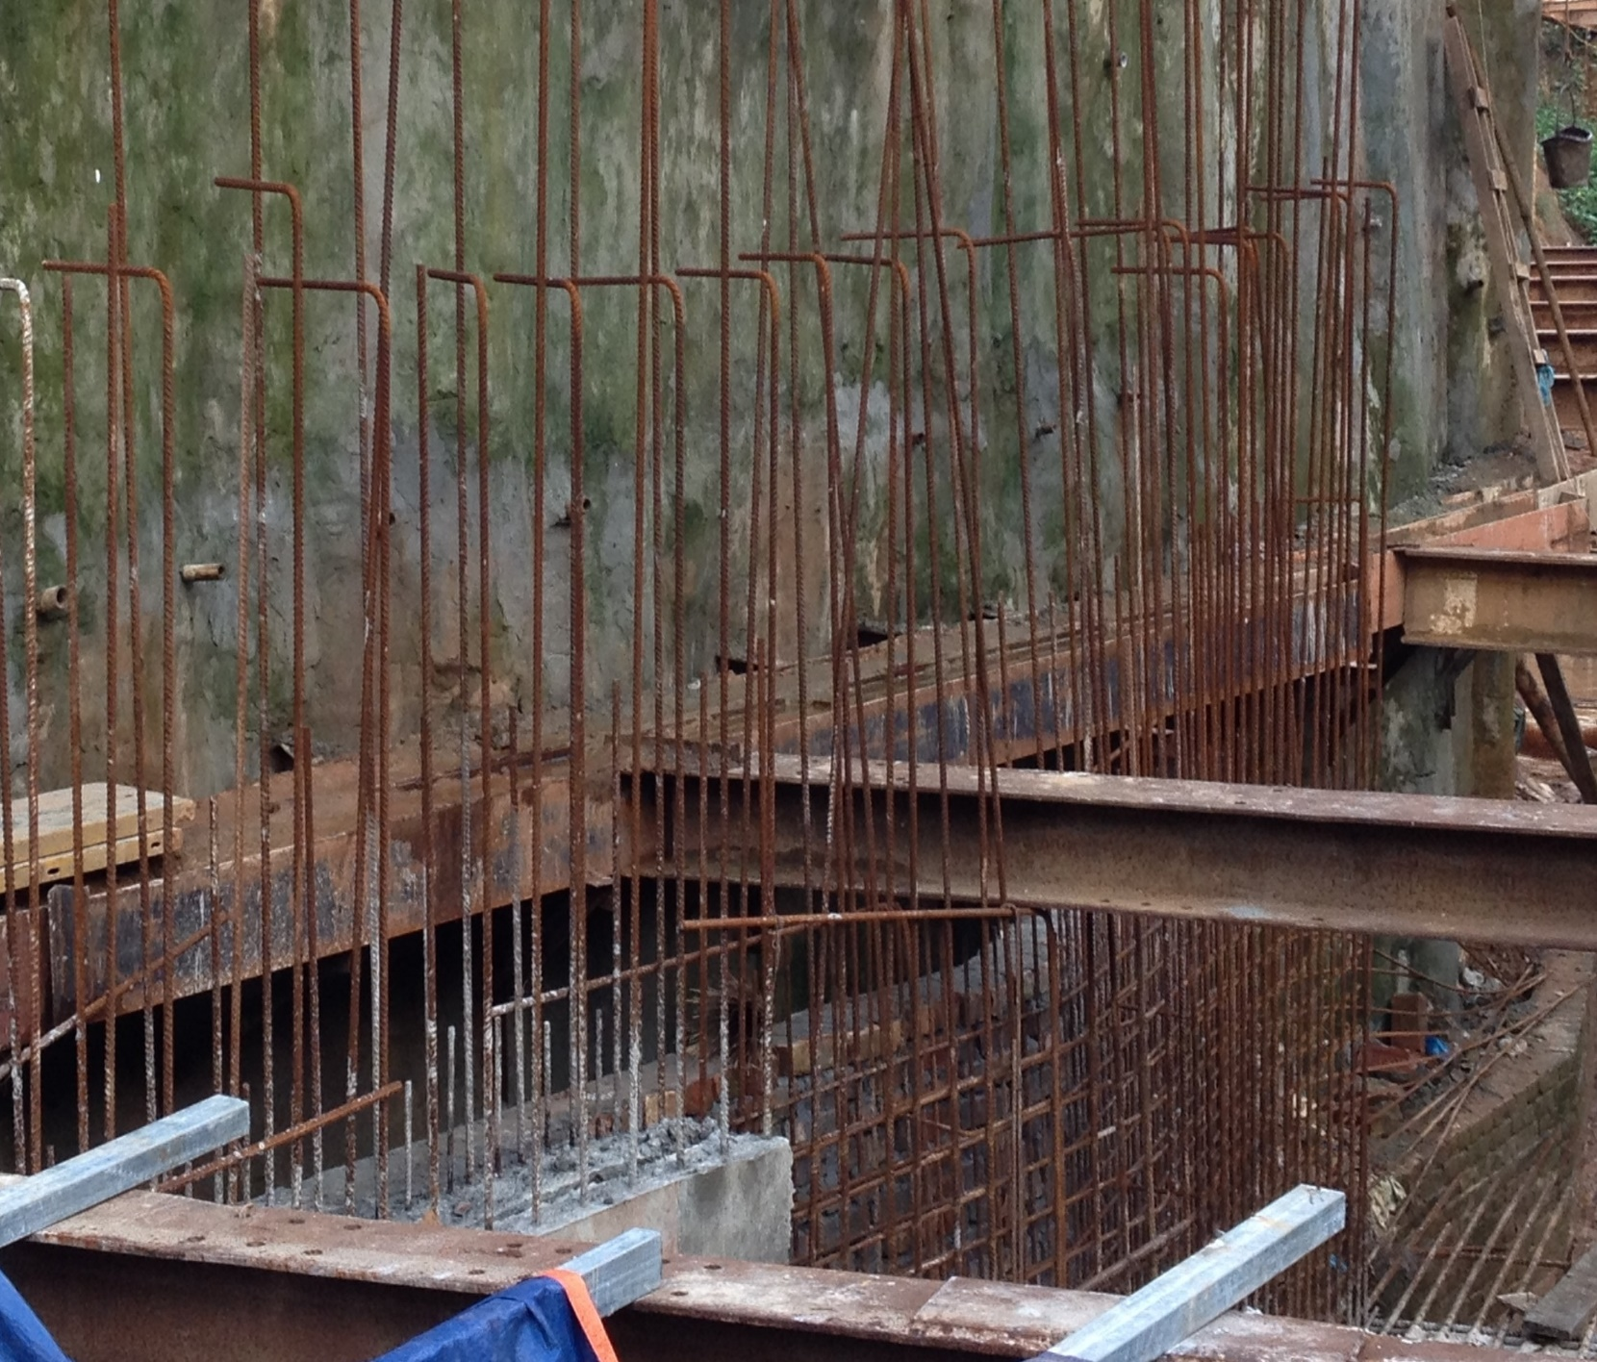
Water Proofing for Deep Basement or Damp Soil
Ferrocement layer on shore piles
Sand Fill
Brick wall
Retaining wall

Slide 24
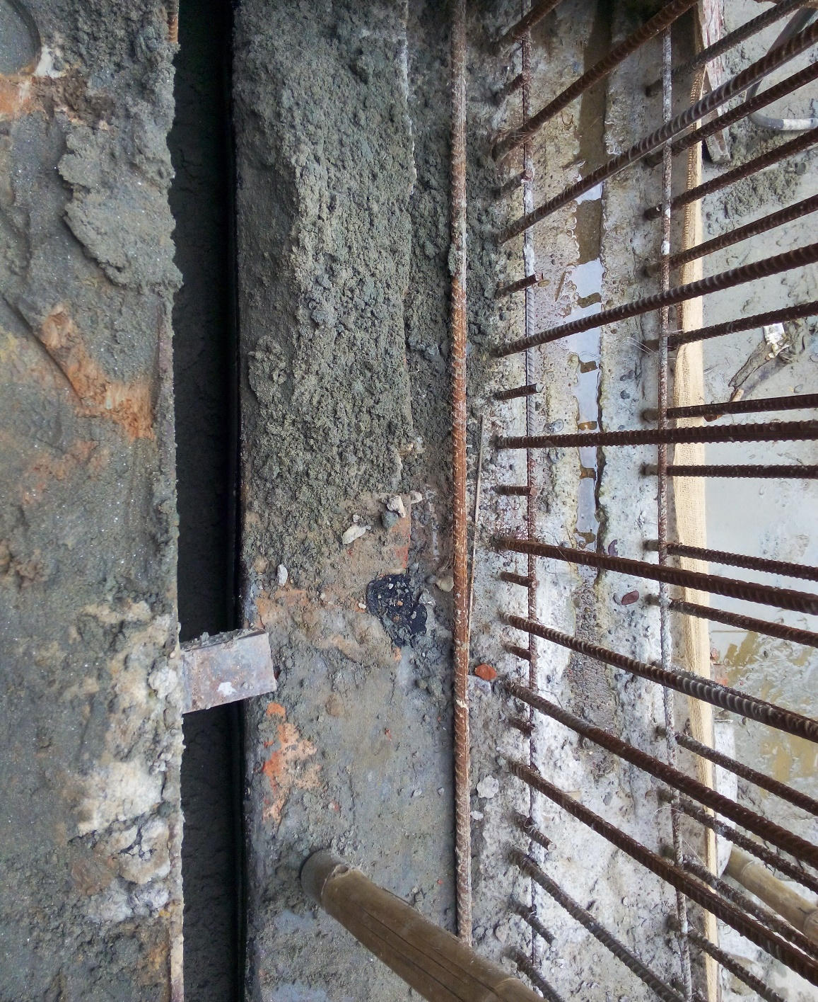
Water Proofing for Deep Basement or Damp Soil
Sand Fill
Brick wall
Retaining wall
Felt paper is placed on the external surface of the brick wall

Slide 25
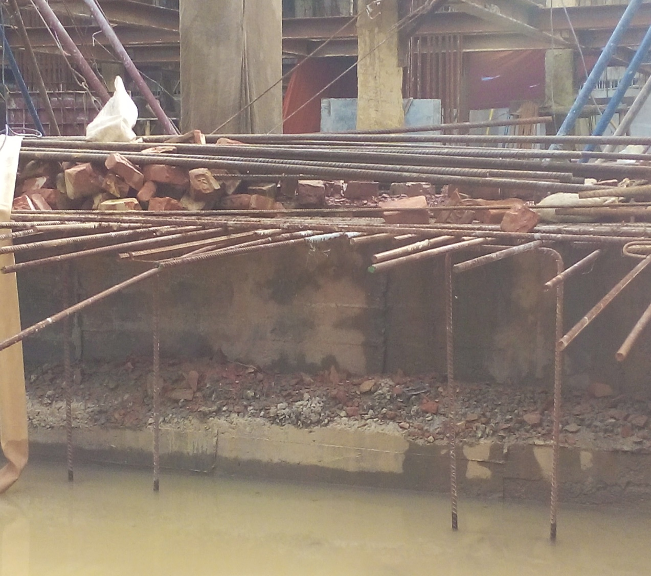
Water Proofing for Deep Basement or Damp Soil
Reinforced Concrete
With Additives
CC Layer
Water Proofing Membrane
( Polythene / Tar )
Sand

Slide 26
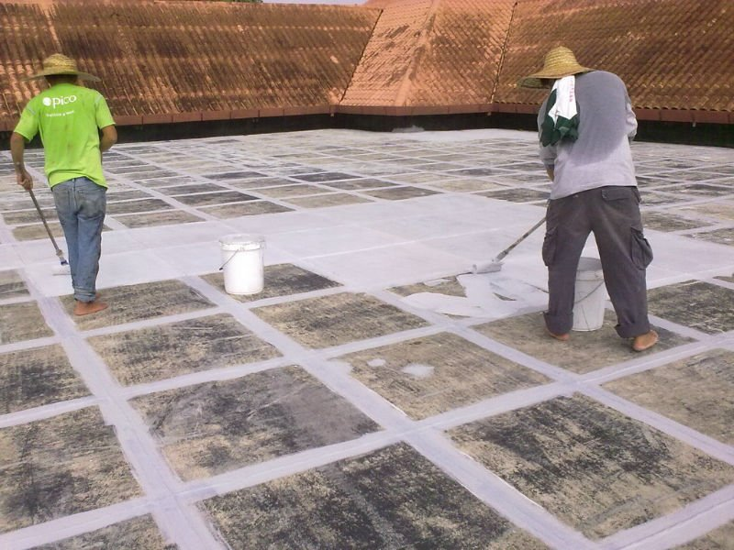
Cure
No permanent cure
Ferrocement and sodium
bentonite can be used in the
internal surface
Curing external surface is
difficult for deep basement
and deep excavation

Slide 27
IMPORTANCE OF WATER PROOFING IN BANGLADESH
The soil of Bangladesh is mostly deposited by the numerous rivers
For the geographical environment of our country it rains a lot in the monsoon
the structures of our country are in a great risk to be attacked by ground water.

Slide 28
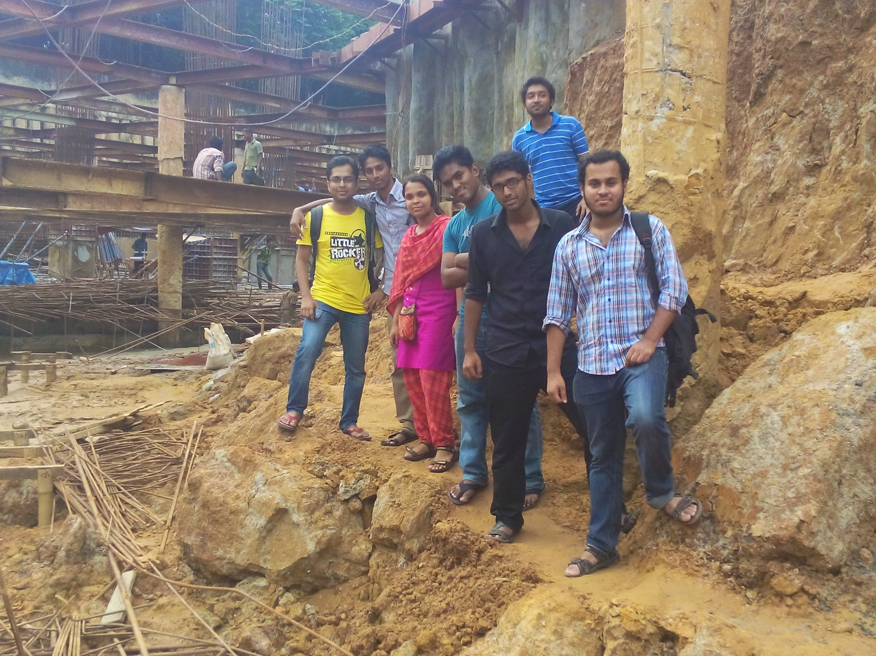

Slide 29

Thank You

Slide 30

Any Question

