Slide 1
CORROSION &
ITS PREVENTION

Slide 2

CAUSE OF CORROSION IN RC ELEMENTS
Air (O₂) enters through porous concrete + Fe = Fe₃O₄ (Rust)
Concrete boundary
Increased volume of Fe₃O₄ exerts swelling pressure on the surrounding concrete and pushes it to fall apart. This is called Spalling of Concrete. This opens up concrete against weather effect so that corrosion of reinforcements is accelerated. Eventually the structural element (slab, beam, column etc.) becomes vulnerable to collapse.

Slide 3
PREVENTION OF CORROSION IN RC ELEMENTS
During construction:
Proper placement and compaction of concrete
Providing adequate clear cover
Floor slabs:
20 mm
Floor beams:
37mm
Columns:
37mm (above ground)
75 mm (below ground)
GL
Cast in-situ pile: 75mm
Precast pile: 25mm
Shallow Foundations: 75mm
After construction:
Repair with Ferrocement
Recast

Slide 4
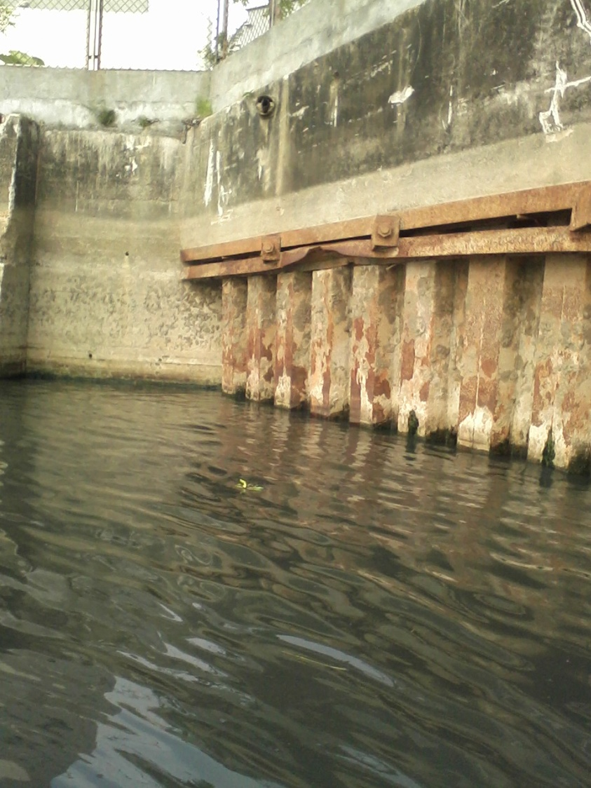
CORROSION OF STEEL MEMBERS
Jetty structure
Steel piles
Sheet Piles
H- section
Z- section

Slide 5
PREVENTION OF CORROSION OF STEEL MEMBERS
During construction:
By coating with Enamel paints, epoxy, bitumen etc.
Providing adequate Additional/Sacrificial Thickness
Say, required thickness = t
Rate of corrosion for a given environment = r mm/year
Design life of the member = X years
Additional Thickness to be provided = X*r
Therefore, the thickness that should be provided in the beginning should be = t + X*r

