Slide 1
STRESS-STRAIN BEHAVIOUR OF DIFFERENT MATERIALS IN ISOTHERMAL CONDITION
--PROF. DR. ABDUL JABBAR KHAN

Slide 2
CLASS ATTENDANCE

Slide 3
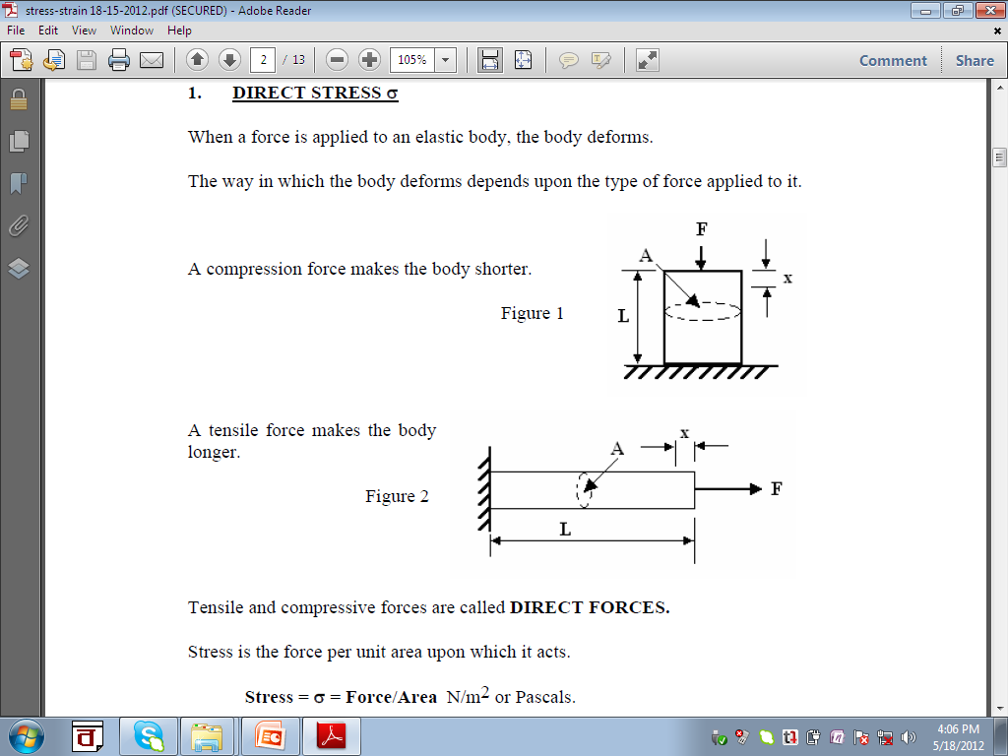
Stress and Strain

Slide 4
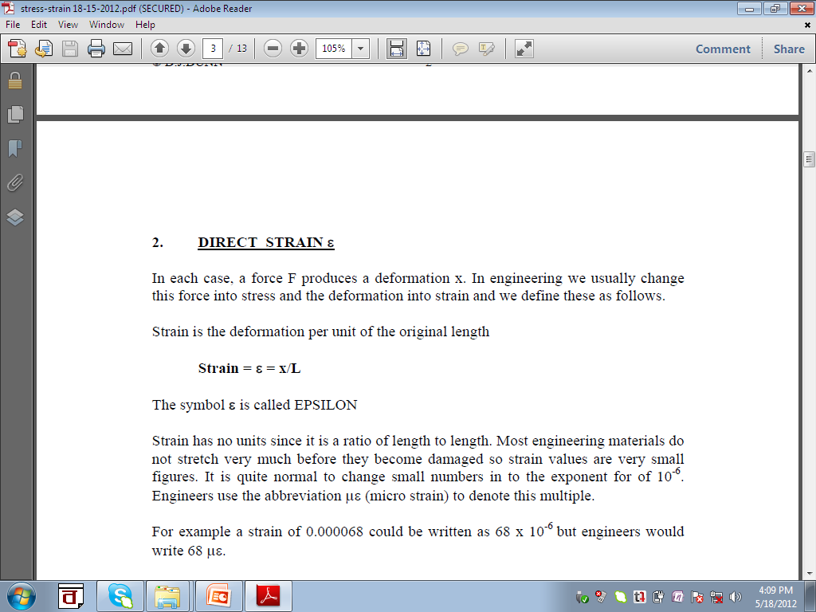
Stress and Strain

Slide 5
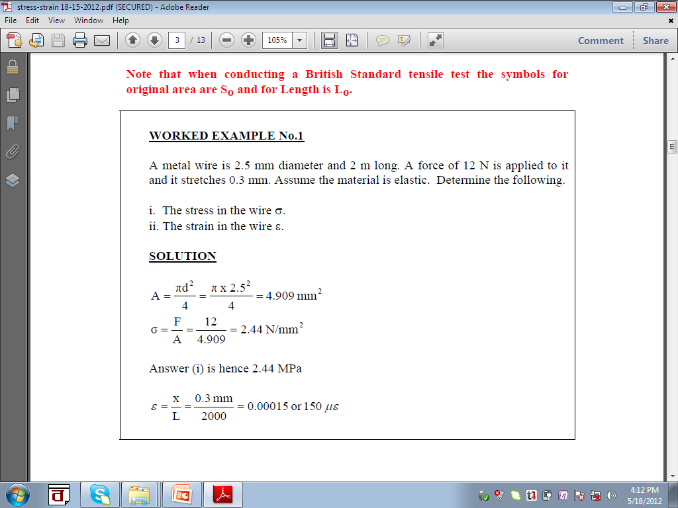
Stress and Strain

Slide 6
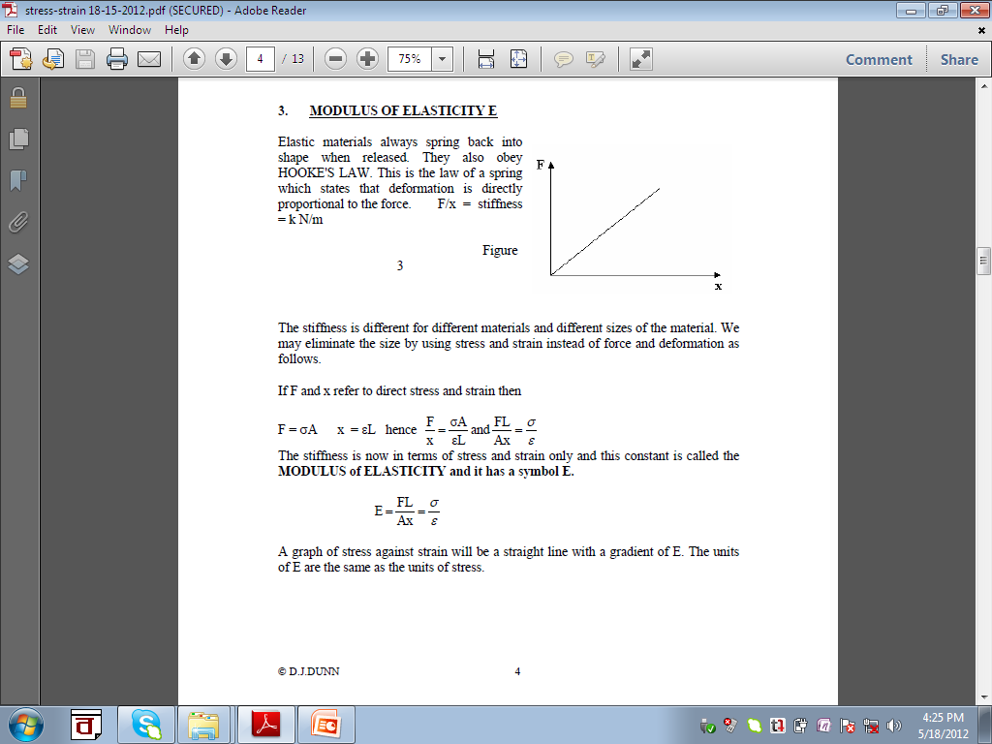
Stress and Strain

Slide 7
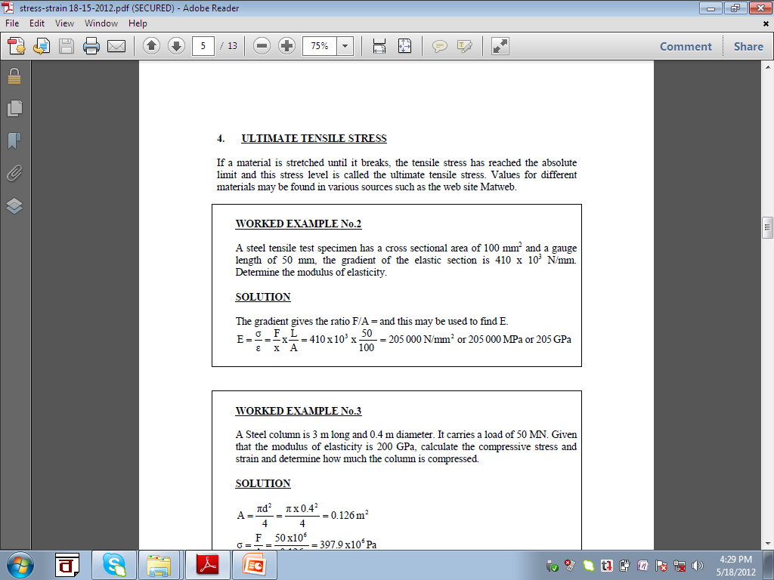
Stress and Strain

Slide 8
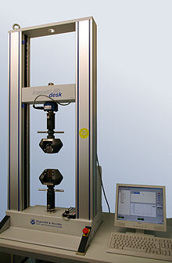
Universal Testing Machine

Slide 9
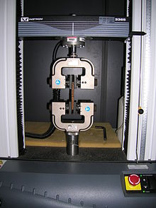
Closer Look

Slide 10
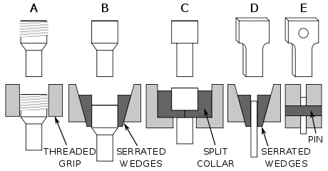
Different Types of Grips

Slide 11
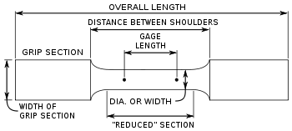
Definition of Gage Length

Slide 12
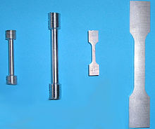
Test Specimens

Slide 13
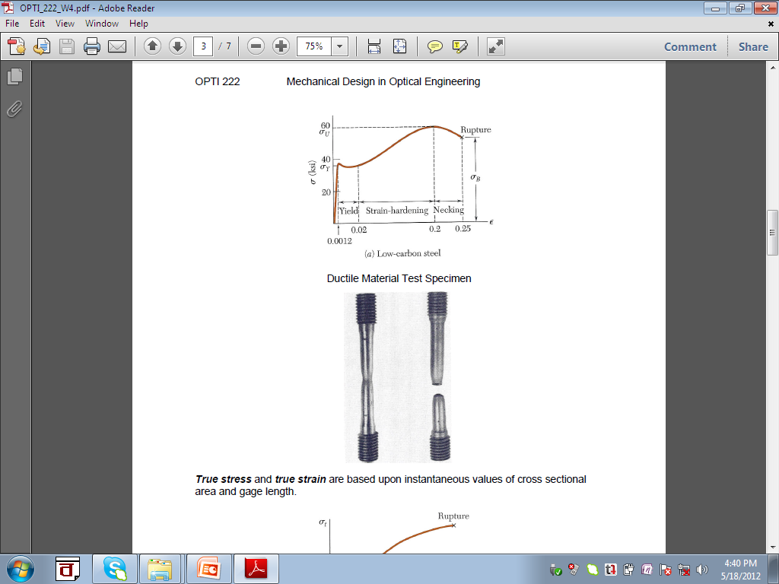
Stress-Strain Curve

Slide 14
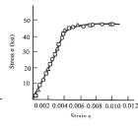
Stress-Strain Curve
b) Aluminum alloy

Slide 15
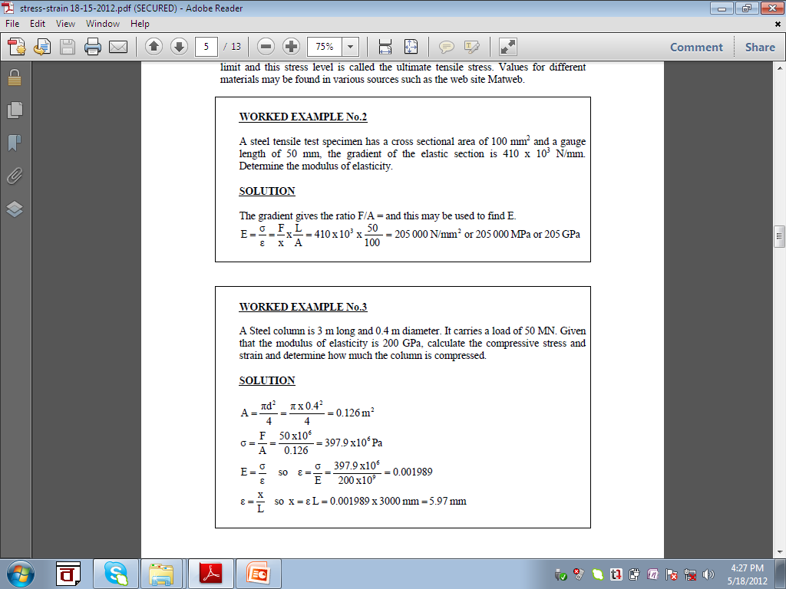
Stress and Strain

Slide 16
Stress and Strain

Slide 17
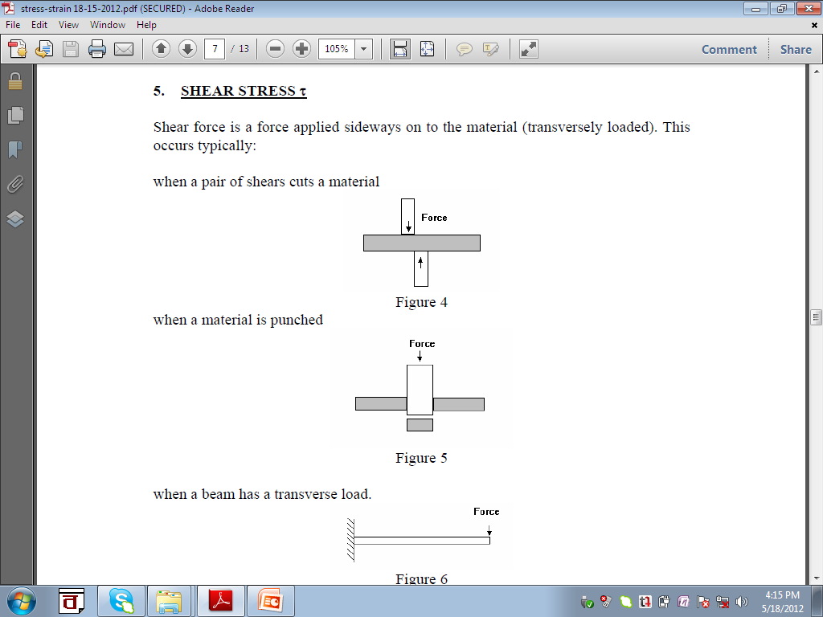
Stress and Strain

Slide 18
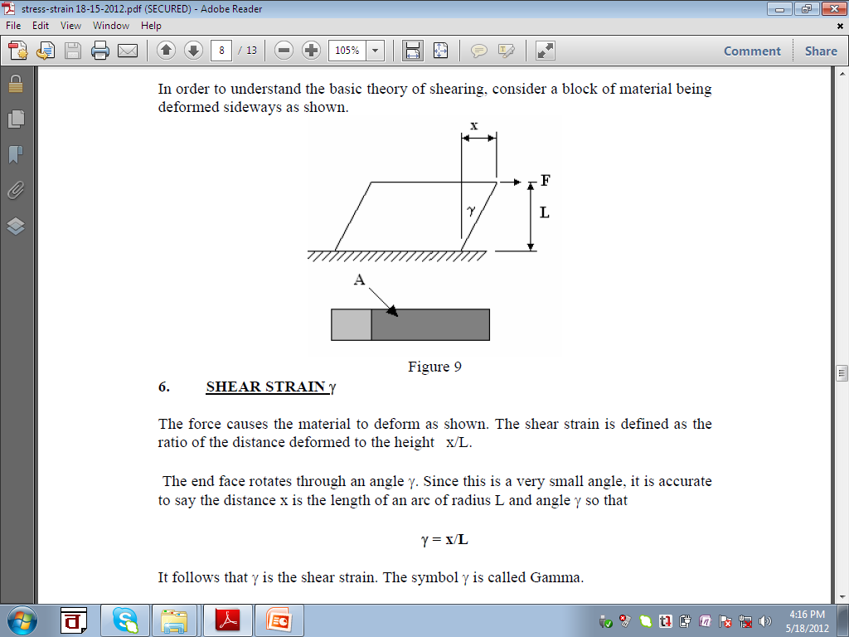
Stress and Strain

Slide 19
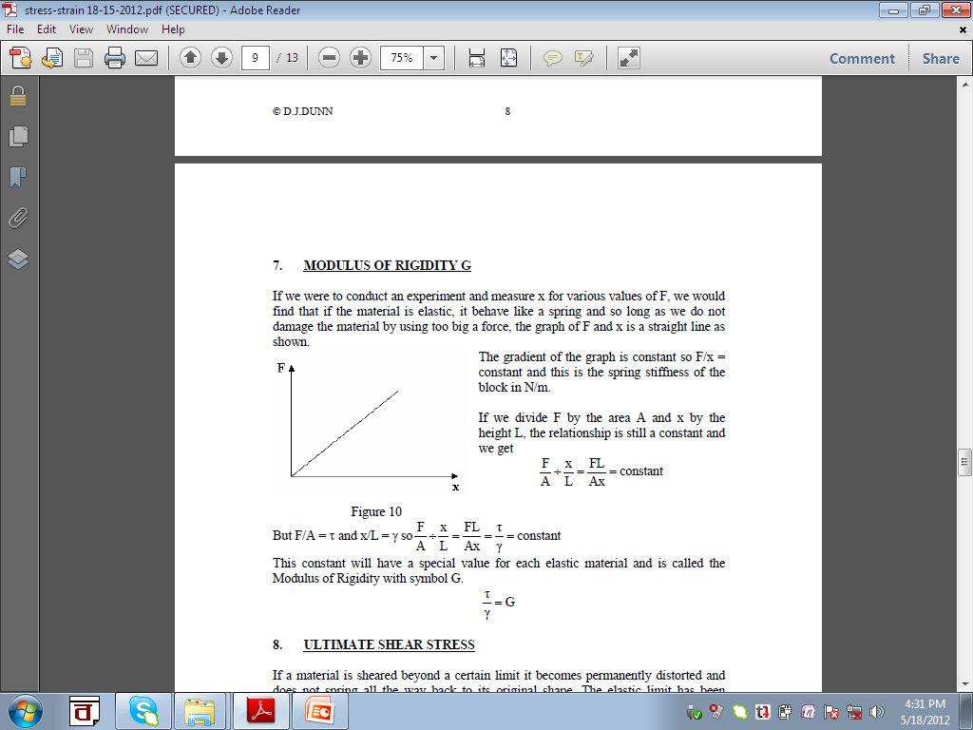
Stress and Strain

Slide 20
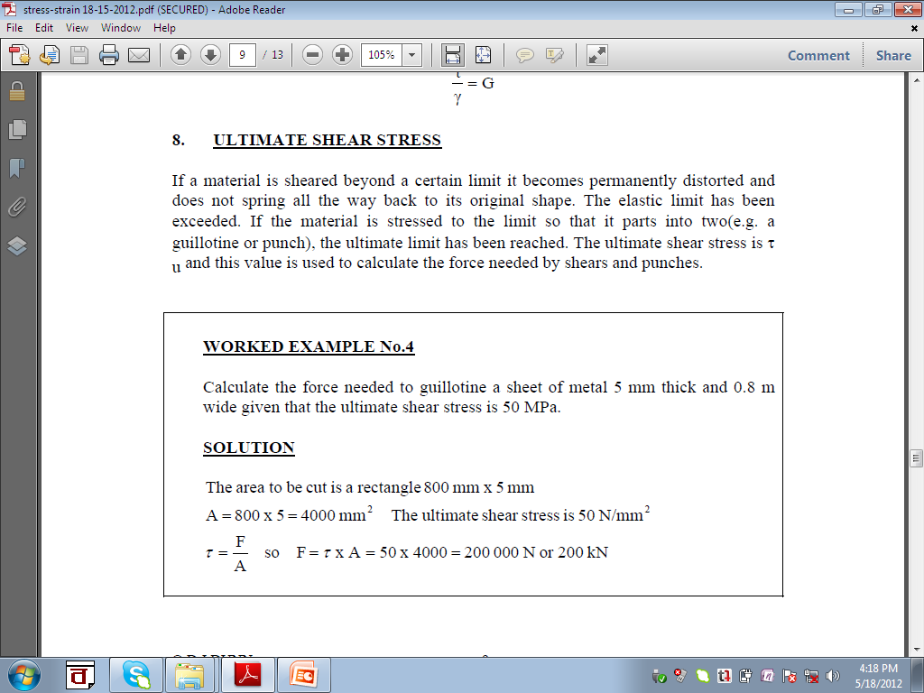
Stress and Strain

Slide 21
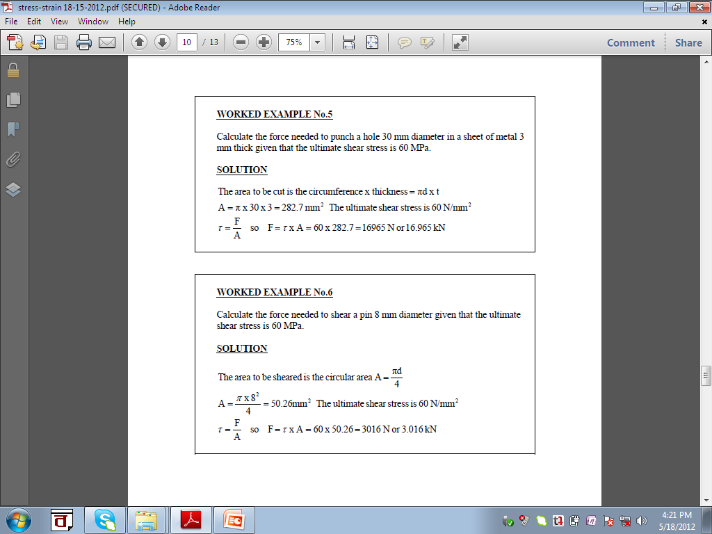
Stress and Strain

Slide 22
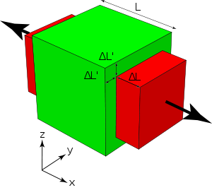

9. Poisson’s Ratio
Rubber: 0.5
Glass: 0.18-0.30
Concrete: 0.2
Steel: 0.27-0.30

Slide 23
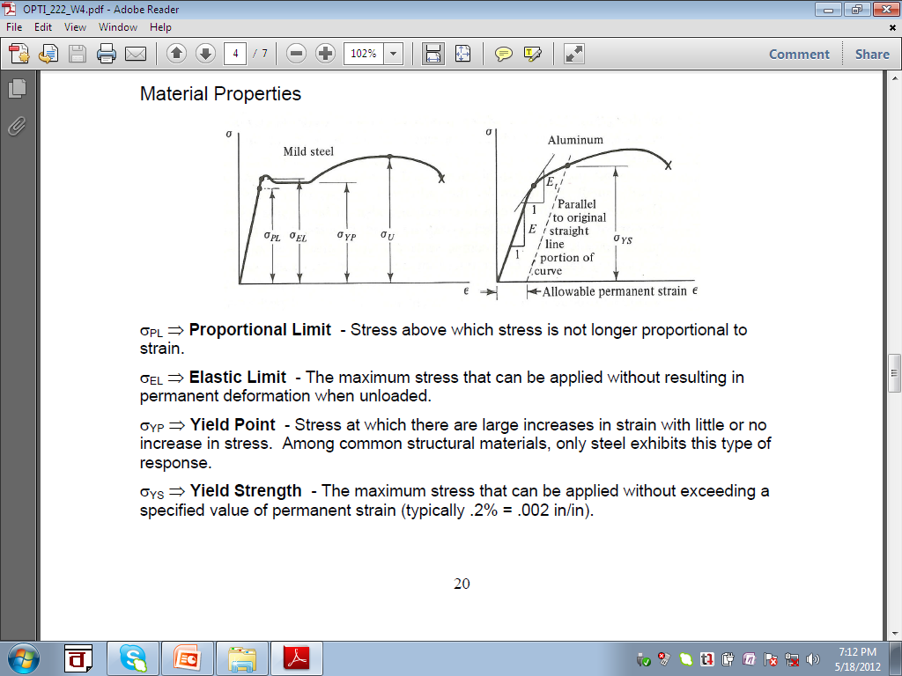
10. Definitions Related to Stress-Strain Curves
Plastic flow zone
U
E
R
Y
P

Slide 24
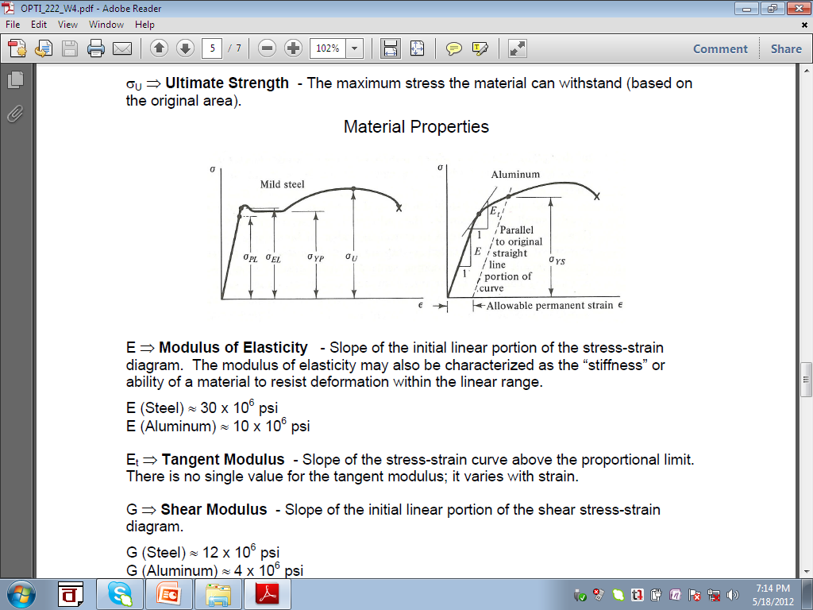
10. Definitions Related to Stress-Strain Curves

Slide 25
10. Definitions Related to Stress-Strain Curves

Slide 26
10. Definitions Related to Stress-Strain Curves
Plastic flow zone
U
E
R
Y
P
Modulus of Resilience: ability to absorb energy without causing any permanent deformation

Slide 27
10. Definitions Related to Stress-Strain Curves
Plastic flow zone
U
E
R
Y
P
Modulus of Toughness: ability to absorb energy without causing it to break

Slide 28
11. Ductile and Brittle Material
Plastic flow zone
U
E
R
Y
P
Ductile Material: associated with large plastic deformation before failure

Slide 29
11. Ductile and Brittle Material
Stress
R
Strain
Brittle Material: does not show any large plastic deformation before failure

Slide 30
Typical Stress-Strain Behaviour of Steel
STRESS
εe
εe = elastic strain
εp = plastic strain
STRAIN
εp
εe

Slide 31
Load-Strain Behaviour with Time
(Elastic Material)
LOAD
B
C
P
A
D
E
t₀
t₁
t₂
TIME
Figure . Loading-unloading sequence for identifying strain components
ε_{T}
ε_{T} = ε_{E} = ε_{R}
ε_{T} = Total Strain
ε_{E} = Elastic Strain
ε_{R} =Recoverable Strain
B
C
ε_{E}
ε_{R} = ε_{E}
A
D
E
t₀
t₁
t₂
t
Figure . Strain components of an elastic material

Slide 32
Characteristics of Elastic Strain
. Elastic strain develops in a material immediately upon application of a load.
. The amount of elastic strain that develops upon application of a load can be completely recovered if the load is removed.

Slide 33
Load-Strain Behaviour with Time
(Plastic Material)
LOAD
B
C
P
A
D
E
t₀
t₁
t₂
TIME
Figure . Loading-unloading sequence
ε_{T}
ε_{T} = ε_{P}
ε_{T} = Total Strain
ε_{P} = Plastic Strain
ε_{L}=Locked-in Strain
C/D
E
ε_{P}
A/B
t₀
t₁
t₂
t
Figure. Strain components of plastic materials

Slide 34
Characteristics of Plastic Strain
. Plastic strain develops in a material with time under a sustained load.
. The amount of plastic strain that develops upon application of a sustained load can never be recovered even if the load is fully removed.

Slide 35
Load-Strain Behaviour with Time
(Elasto-Plastic Material)
LOAD
B
C
P
A
D
E
t₀
t₁
t₂
TIME
Figure . Loading-unloading sequence
ε_{T} = Total Strain
ε_{E} = Elastic Strain
ε_{P} = Plastic Strain
ε_{R} =Recoverable Strain
ε_{L} = Locked-in Strain
ε_{T}
ε_{T} = ε_{E} + ε_{P}
= ε_{R} + ε_{L}
C
ε_{R} = ε_{E}
ε_{P (t = t1)}
B
ε_{P}
D
E
ε_{E}
ε_{P(t=t2)} = ε_{P (t = t1)}
A
t₀
t₁
t₂
t
Figure . Strain components of elasto-plastic materials

Slide 36
Load-Strain Behaviour with Time
(Elasto-Visco-Plastic Material)
LOAD
B
C
P
A
D
E
t₀
t₁
t₂
TIME
Figure . Loading-unloading sequence
ε_{T}
ε _{T} = ε _{E}+ ε _{V}+ ε _{P}
= ε _{R}+ ε _{L}
ε_{T} = Total Strain
ε_{E} = Elastic Strain
ε_{P} = Plastic Strain
ε_{R} =Recoverable Strain
ε_{L} = Locked-in Strain
=ε _{V}+ ε _{P}
ε _{T (t = t1)}
C
ε_{R}= ε _{Ε}
ε _{P}+ ε _{V}
D
B
ε _{V}
ε _{L (t = t1)} = ε _{V}+ ε _{P}
E
ε _{E}
ε _{P (t = t2)} = ε _{L(t = t2)}
A
t₀
t₁
t₂
t
Figure. Strain components of elasto-visco-plastic materials

Slide 37
Characteristics of Viscous Strain
. Viscous strain develops in a material with time under a sustained load.
. The amount of viscous strain that develops upon application of a sustained load does not recover immediately upon removal of the load.
This strain gets recovered at a certain period of time after removal of the load.

Slide 38
Response of Diff. Materials
LOAD
D
E
P
B
C
G
F
P
A
H
t₀
t₁
t₂
t₃
TIME
Figure . Loading-unloading sequence
STRAIN
D (2ε_{E})
E (2ε_{E})
ε_{E}
ε_{E}
B (ε_{E})
C (ε_{E})
G (ε_{E})
F (ε_{E})
ε_{E}
ε_{E}
A
H
t₀
t₁
t₂
t₃
TIME
Figure . Strain response of an elastic material to the above loading regime

Slide 39
Response of Diff. Materials
LOAD
D
E
P
B
C
G
F
P
A
H
t₀
t₁
t₂
t₃
TIME
Figure . Loading-unloading sequence
STRAIN
G/H (4ε_{p})
ε_{p}
S
E/F (3ε_{P})
2ε_{P}
2S
C/D (ε_{P})
ε_{p}
S
A/B
t₀
t₁
t₂
t₃
TIME
Figure . Strain response of a plastic material to the above loading regime

Slide 40
Response of Diff. Materials
E (2ε_{E} + 3ε_{P})
G (ε_{E} + 4ε_{P})
2ε_{P}
ε_{E}
ε_{p}
2S
S
D (2ε_{E} + ε_{P})
ε_{E}
STRAIN
F (ε_{E} + 3ε_{P})
ε_{p}
ε_{E}
H (4ε_{P})
ε_{p}
C (ε_{E} + ε_{P})
B
S
ε_{E}
A
t₀
t₁
t₂
t₃
TIME
Figure . Strain response of an elasto-plastic material to the above loading regime

Slide 41
Response of Diff. Materials
E (2ε_{E} + 3ε_{P}+3ε_{v})
G [ (ε_{E}+3ε_{P}+3ε_{V})+ε_{P}+ε_{V} - ε_{V}]
= (ε_{E}+4ε_{P}+3ε_{V})
2ε_{P+}2ε_{V}
ε_{E}
ε_{p}
S
ε_{E}
D (2ε_{E} + ε_{P} + ε_{V})
F (ε_{E}+3ε_{P}+3ε_{V})
STRAIN
H (4ε_{P}+3ε_{V})
ε_{E}
I (4ε_{P}+2ε_{V})
ε_{p}+ε_{V}
C (ε_{E} + ε_{P})
J (4ε_{P}+ ε_{V})
B
K (4ε_{P})
ε_{E}
A
t₀
t₁
t₂
t₃
t₄
t₅
t₆
TIME
ΝΟΤΕ: Δt = t₁-t₀ = t₂-t₁ = t₃-t₂ = t₄-t₃ = t₅-t₄ = t₆-t₅
Figure . Strain response of an elasto-visco-plastic material to the above loading regime

Slide 42
Creep Behaviour of Materials
LOAD
B
C
D
E
P
A
t₀
t₁
t₂
t₃
TIME
Figure . Loading sequence
STRAIN
Creep Strain
C (ε_{E} + ε_{p}+ε_{V})
E (ε_{E} + 3ε_{p}+ 3ε_{V})
D (ε_{E} + 2ε_{p}+ 2ε_{V})
B (ε_{E} )
A
t₀
t₁
t₂
t₃
TIME
ΝΟΤΕ: Δt = t₁-t₀ = t₂-t₁ = t₃-t₂
Figure . Creep behaviour of an elasto-visco-plastic material

Slide 43
ISOCHRONOUS LOAD-STRAIN CURVES
P
SPECIMEN 1
SPECIMEN 2
SPECIMEN 3
/ / / / /
/ / / / /
/ / / / /
P₃
P₂
P₁
P₁
P₂
P₃
t₀
t
Figure . Series of loading verses time for deriving Isochronous curves

Slide 44
ISOCHRONOUS LOAD-STRAIN CURVES
(a) Total strain-time plot
(b) Isochronous load-strain curves
ε_{T}
ε_{T}= ε_{E} + ε_{V} + ε_{P}
P
t₀
P₃
P₂
P₃
t₁
P₁
P₂
t₂
P₁
t₃
ε_{T2}
ε_{T3}
ε_{T1}
t₀
t₁
t
ε_{T1}
ε_{T2}
ε_{T3}
ε_{T}
Figure . Deriving Isochronous load-strain curves for elasto-visco-plastic materials

Slide 45
SIGNIFICANCE OF ISOCHRONOUS LOAD-STRAIN CURVES
P
t₀
t₁
t₂
P₁
t₃
P₂
P₃
ε_{D} = Design Strain
ε_{D}
ε_{T}
Load carrying capacity of a creeping material reduces with time for a particular design strain

Slide 46

EXAMPLES AND APPLICATIONS OF DIFFERENT MATERIALS
1) Elastic material: Steel up to proportional limit.
2) Elasto-plastic material: Jute geotextile, Bitumen, Steel up to ultimate stress, Sandy soil etc.
3) Elasto-visco-plastic material: Synthetic geotextile, Synthetic geogrid and saturated clay soil.
Geotextile/Geogrid
RC Cantilever Wall
Reinforced Earth Wall

Slide 47
1
2
Conventional Earth Embankment
Material savings
1
1
Land savings
Geotextiles /Geogrids
Reinforced Earth Embankment

Slide 48

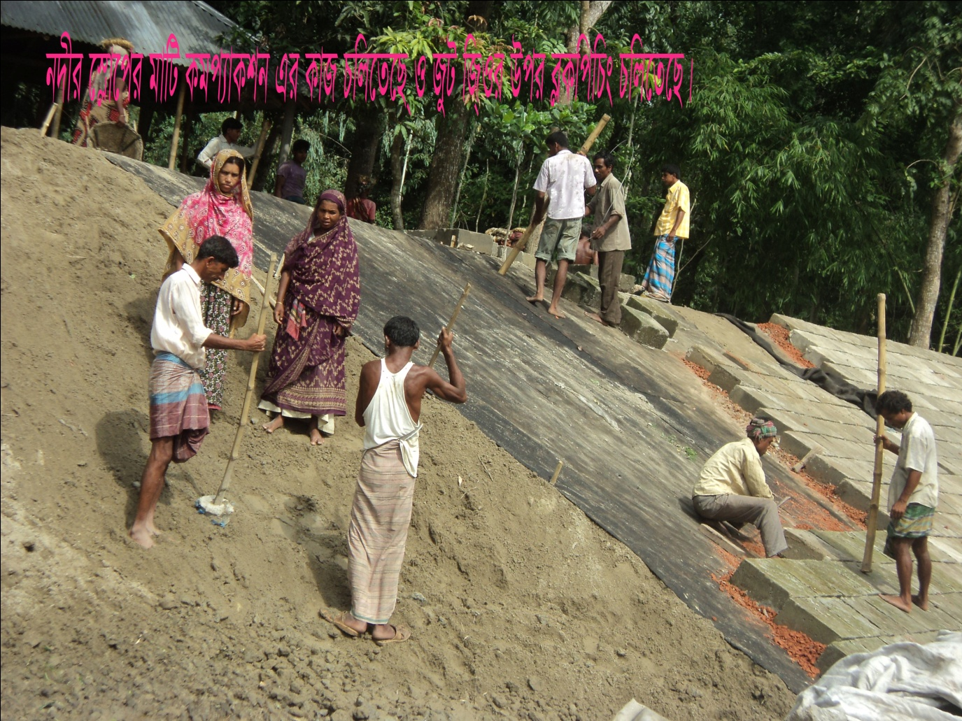
Concrete Armour
Brick Khoa Layer
Geotextile
River Bank Protection Scheme

Slide 49
