Slide 1
FERROCEMENT

Slide 2

Typical Section of Ferrocement
Wire mesh
Mortar
6mm ~ 20 mm
Component Materials:
Cement
Aggregate (sand)
Water
Reinforcement

Slide 3
Specifications of Materials as Per
Bangladesh National Building Code, BNBC (1993)
Cement:
shall comply with ASTM C150-85a , ASTM c595-85 or equivalent
shall be fresh
Shall be of uniform consistency
shall be free from lumps and foreign matter
shall be stored under dry conditions for as short duration as possible
Aggregate (sand):
shall comply with ASTM C33-86 requirements (for fine aggregate) or equivalent
shall be clean
shall be inert
shall be free from organic matter and detrimental substances
shall be relatively free of silt and clay (particles passing #200 sieve)
Max particles size should be less than #16 (1.18mm)
Grading of sand should comply with the following Table

Slide 4
Table: Guidelines for Grading of Sand
Sieve Size (%) Passing by Weight
#8 (2.36) 80-100
#16 (1.18) 50-85
#30 (0.60) 25-60
#50 (0.30) 10-30
#100 (0.15) 2-10
(%) Finer
Size (mm)

Slide 5
Water:
shall be fresh, clean and potable
shall be relatively free from organic matter, silt, oil, sugar, chloride and acidic material.
Salt water is not acceptable
shall have a pH>= 7 (non-acidic)
Reinforcement:
shall be clean and free from deleterious materials such as dust, loose rust, coating of paint, oil or similar substance
SQUARE
HEXAGONAL
EXPANDED MESH

Slide 6
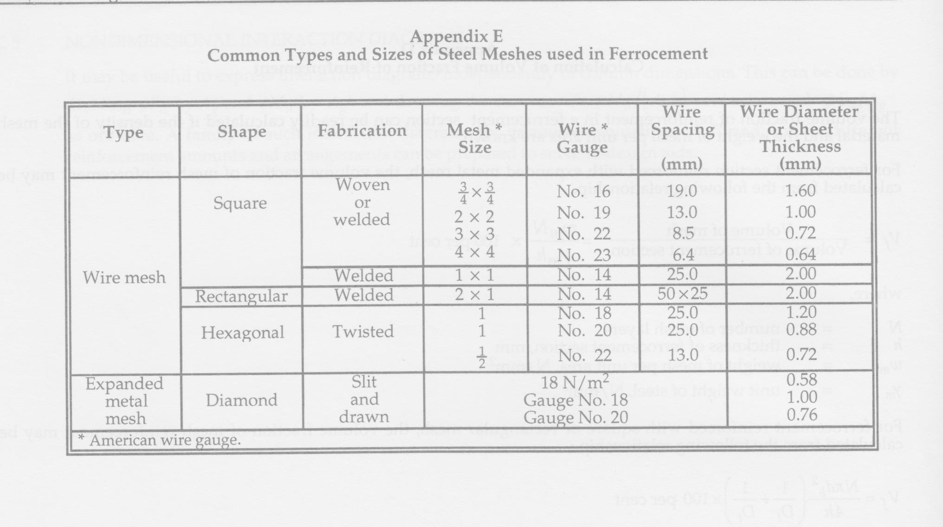

Slide 7
USE OF FERROCEMENT FOR REPAIRING NON-STRUCTURAL DISTRESSES
Air (O₂) enters through porous concrete + Fe = Fe₃O₄ (Rust)
Concrete boundary
Increased volume of Fe₃O₄ exerts swelling pressure on the surrounding concrete and pushes it to fall apart. This is called Spalling of Concrete. This opens up concrete against weather effect so that corrosion of reinforcements is accelerated. Eventually the structural element (slab, beam, column etc.) becomes vulnerable to collapse.

Slide 8
REPAIR OF SLABS WITH SPALLING USING FERROCEMENT
Spalled area (Reinforcement not shown)
Stage - 1 Use chisel for chipping loose plaster, concrete etc.
30 cm
30 cm
Spalled area
30 cm
Stage -2 Brush off the debris from the chiseled surface
Spalled area
30 cm
(a) Area to be repaired
Stage - 3 Apply 6mm thick or as required (1:4) plaster and prepare levelled surface
37 mm
6 mm or as required thick plaster (1:4 ratio)
5 mm
Stage - 4 Lay single layer 18 gauge wire mesh of 12mm x 12mm opening. Insert 37 mm long screws @ 200 mm c/c
37 mm
7 mm thick plster (1: 4 ratio)
Stage - 5 Apply 7 mm thick plaster (1:4 ratio)
(b) Repair technique to be adopted

Slide 9
WHAT DOES FERROCEMENT REPAIR DO?
Such repair with ferrocement increases the tensile stress capacity of concrete.
Therefore, no further micro cracks can occur in concrete under normal loading on the slab.
As this reduces the possibility of further ingress of air through micropores of concrete, the chances of spalling of concrete becomes remote.

Slide 10
REPAIR OF WALLS WITH DAMPNESS
Probable present condition
Damp surface
Damp surface
Repair technique
Chip off the existing plaster
Chip off the existing plaster
Stage - 1
Clean the surface
Stage - 2
30 cm
30 cm
30 cm
Apply 6 mm thick plaster or as required (1:4 ratio)
Stage - 3
Spalled area of the wall
30 cm
(a)Area to be repaired
37 mm
Stage - 4
5 mm
Lay single layer 18 gauge wire mesh of 12 mm x 12 mm opening. Insert 37 mm long screws @200 mm c/c
Apply 7 mm thick plaster (1:4 ratio)
Stage - 5
37 mm
7 mm
(b)Repair technique to be adopted

