Slide 1
CE 401 – PROJECT PLANNING AND CONSTRUCTION MANAGEMENT
INTRODUCTION
WHAT IS A PROJECT?
“A temporary endeavor undertaken to create a unique
product or service”
definite beginning and end with specific objectives.
different owner, designers, contractors, location (may have repetitive elements from previous projects).
Composed of jobs, activities, functions or tasks that are related one to the other in some manner, and all of these should be completed in order to complete the project.

Slide 2
CE 401
INTRODUCTION
WHAT IS PROJECT MANAGEMENT?
Application of Knowledge, skills, tools, and techniques to
project activities in order to meet or exceed stakeholders
expectations from the project
Balancing competing demands among
- Scope, time, cost and quality
- Stakeholders with differing needs and expectations
Identified requirements ( needs) and unidentified requirements
(expectations)

Slide 3
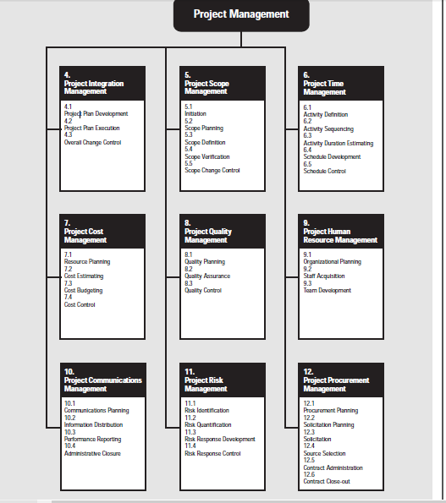
CE 401
PM Knowledge Areas and Processes

Slide 4
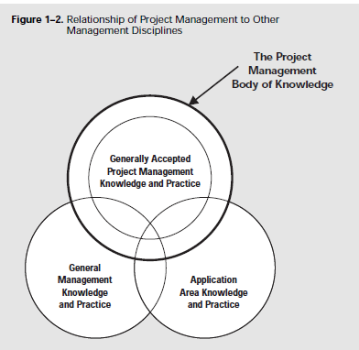
CE 401
Relationship To Other Management Disciplines

Slide 5
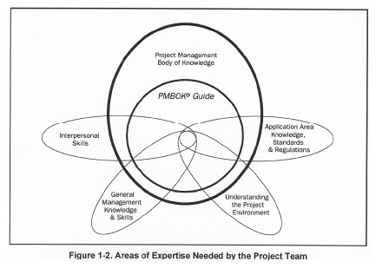
CE 401
Areas of Expertise Required

Slide 6
CE 401
The Project Management Context
Project Phases and the Project Life Cycle
Project stakeholders
Organizational Influence
Key General Management Skills
Socioeconomic Influences

Slide 7
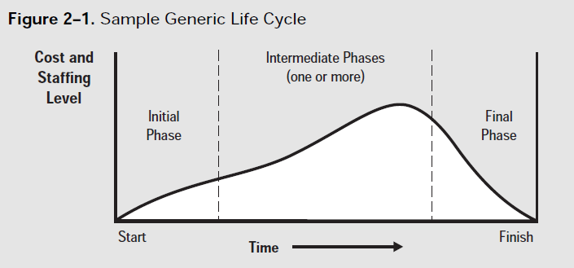
CE 401
Project Phases and Project Life cycle

Slide 8
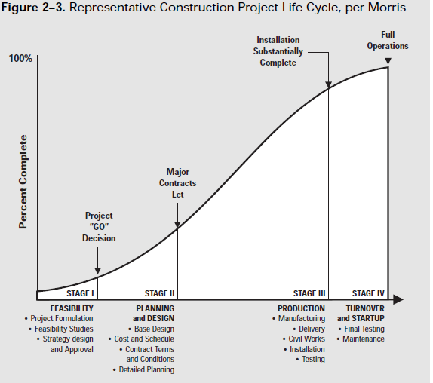
CE 401
Representative Construction Project Life Cycle

Slide 9
CE 401
Representative Construction Project Life Cycle
Feasibility – Project formulation, feasibility studies, and strategy design and approval
Planning and Design – base design, cost and schedule, contract terms and conditions and detailed planning. Major contracts are let
Production – manufacturing, delivery, civil works, installation and testing. The facility is substantially complete at the end of this phase
Turnover and start-up – final testing and maintenance. The facility is in full operation at the end of this phase

Slide 10
CE 401
Project Stakeholders
Project Manager
Customer
Performing Organization
Project Team Member
Sponsor

Slide 11
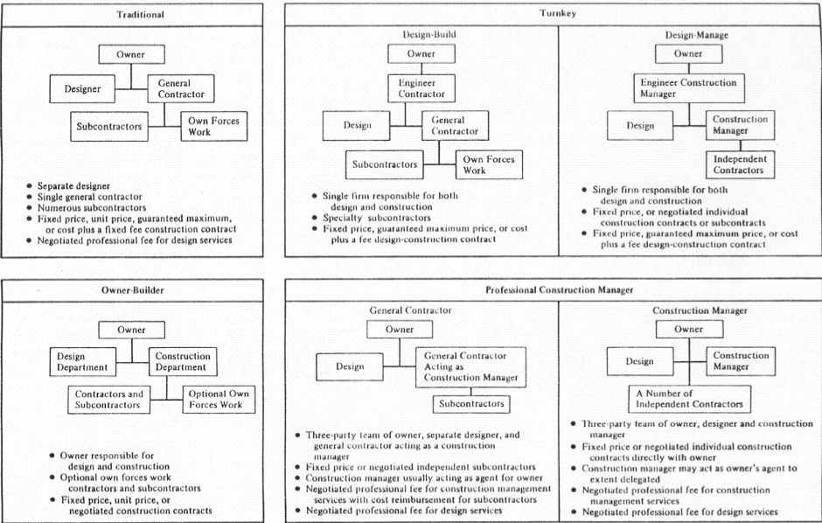
CE 401
Contractual Relationships

Slide 12
CE 401
Key General Management Skills
Leading
Communicating
Negotiating
Problem Solving
Influence the Organization

Slide 13
CE 401
SOCIAL-ECONOMIC-ENVIRONMENTAL
INFLUENCES
Standard and Regulations
Internationalization
Cultural Influences
Social – Economic- Environmental Sustainability

Slide 14
CE 401
Project Organization
Projects are typically part of organization larger than
Government agencies
Corporation
Healthcare institution
Joint ventures, Partnering

Slide 15
CE 401
Project Organization
Systems
Derive revenue from projects
Management by projects
Non-project based organization – manufacturing company, financial service firm (will have departments and other sub-units that operate as project-based organization

Slide 16
CE 401
Project Organization
Organizational Culture and style
Unique and describable culture
Reflected in their shared values, norms, belief and expectations
(i.e. team proposing high risk will get approval from Aggressive organization)

Slide 17
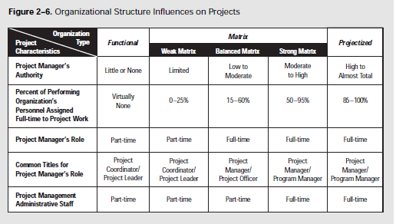
CE 401
Project Organization
Organizational Structure
Can be characterized as spanning a spectrum from ‘functional’ to ‘projectized’, with variety of matrix structure in between

Slide 18
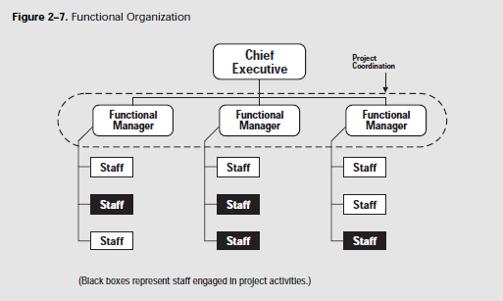
CE 401
Project Organization
Organizational Structure
Classic Functional Organization

Slide 19
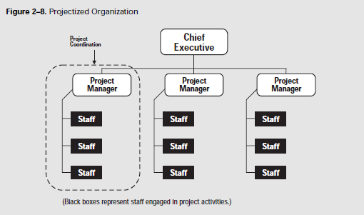
CE 401
Project Organization
Organizational Structure
Projectized Organization

Slide 20
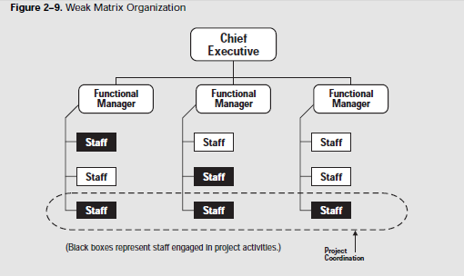
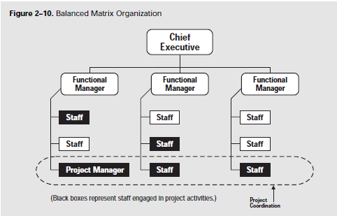
CE 401
Project Organization
Matrix Organization

Slide 21
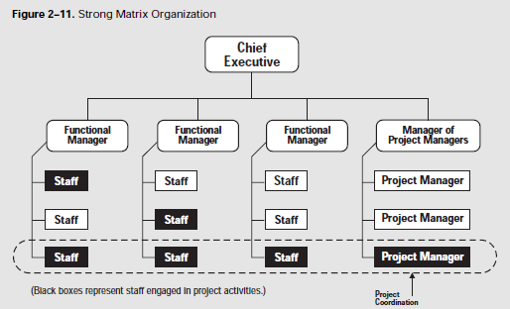
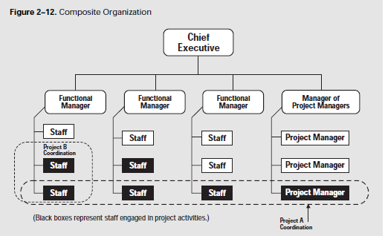
CE 401
Project Organization
Matrix Organization

Slide 22
CE 401
Project Organization
Organization Planning
Involves identifying, documenting and assigning project roles, responsibilities and reporting relationships to individuals or to group

Slide 23
CE 401
Project Organization
Inputs to Organization Planning
Project Interfaces
Organizational Interfaces
Technical Interfaces
Interpersonal Interfaces
2. Staffing Requirements
3. Constraints
Organizational structures of the performing organization
Collective bargaining agreements
Preferences of the project management team
Expected staff assignments

Slide 24
CE 401
Project Organization
Tools and Techniques for Organization Planning
Templates
Human Resource Practices
Organizational Theory
Stakeholder Analysis

Slide 25
CE 401
Project Organization
Output from Organization Planning
Roles and responsibility assignment
Staffing Management Plan
Organization Chart
Supporting details

