Slide 1
Problem of Road based & horse/engine driven travel system:
Discomfort due to uneven riding surface
Rutting Problem
Low speed
Poor riding quality
Low hauling capacity

Slide 2
Track based travel system was introduced:
To improve riding quality/comfort
To increase speed
To carry more payload (freight/passenger)
To make it energy efficient (wt./hp)

Slide 3
Main Advantages/Hallmarks of MRT
Most Reliable Mode of Transport
Huge Ridership Potential
Effective Congestion Relieving Tool
Most importantly it is a demand responsive sustainable mode

Slide 4
Sustainable System:
Which give solution for present problem/travel demand as well as has the potential to respond to ever growing future demand without requiring heavy investment.

Slide 5
MRT responds to demand by Increasing Riding capacity in following ways:
Increasing frequency
Increasing compartment number
Increasing Speed
Improving Compartment Capacity by-
Eliminating seating service
Packing passengers
Improving Space efficiency by-
Double decker trains
Double decker tracks

Slide 6
Problems of having single track route:
Need careful scheduling
Delay is unavoidable
Operation is inefficient
Capacity is limited
Operation is very sensative
Vulnerable to natural and operational disasters
Relatively unreliable system

Slide 7
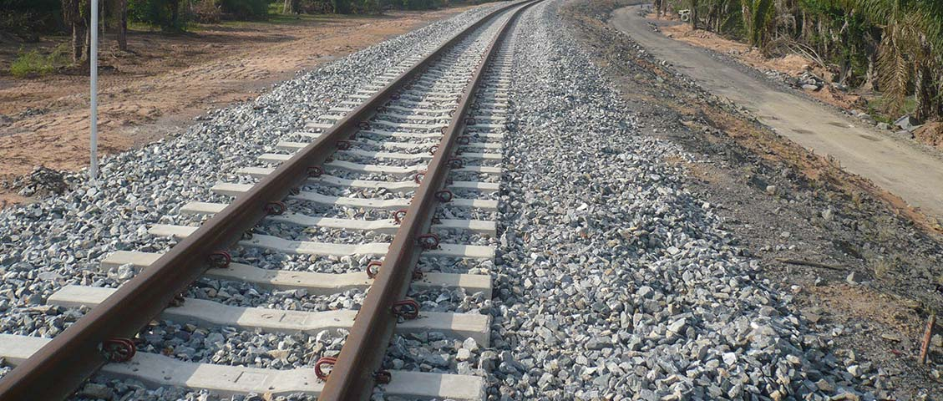
Elements of railway system:

Slide 8
Advantages of Flat Footed Rails:
Chairs: No Chairs are required
Stiffness: This is more stiffer, both vertically & laterally
Kinks: Less liable to develop kinks
Cost: This type of rail is cheaper
Load Distribution: Distributes the load over a wider area.

