Slide 1
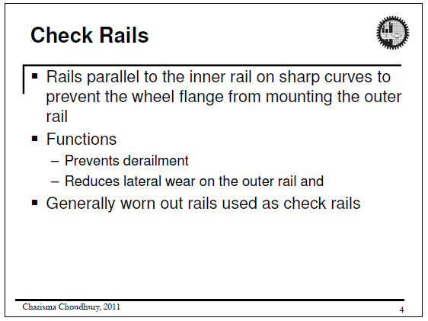

Slide 2
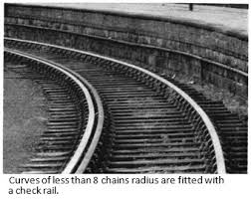
Check Rail:

Slide 3
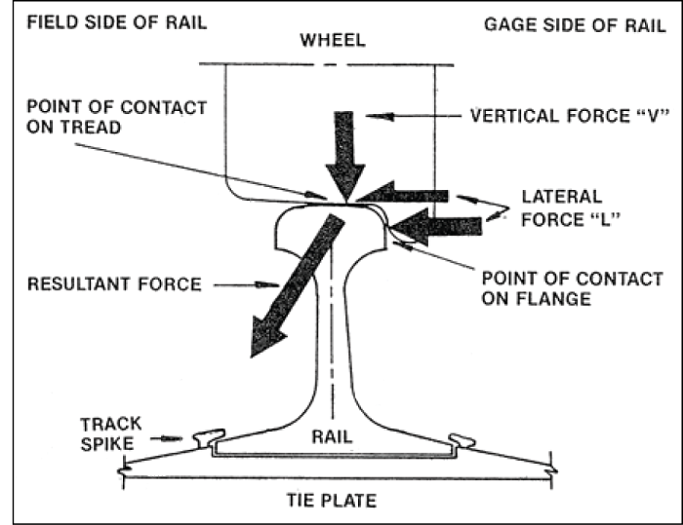
Coning of wheels:
  If flanges of wheel are made flat, it can easily move laterally while running due to wind force and centrifugal force at bend.
  It will result in unwanted friction and successive hitting at the sides of the rail
  That’s why wheel flanges are never made flat

Slide 4
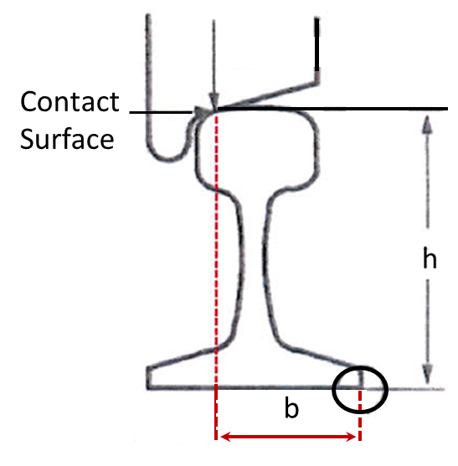
Coning of wheels:
  In order to induce central tendency they are in shape of a cone with a slope of 1 in 20
  Coning of wheel reduces side friction and helps in even distribution of load on rail

Slide 5
Coning of wheels:
  Disadvantages:
  Stress concentration causes wear on rail quickly
  Horizontal component causes the rail to turn outwardly, hence the gauge is widened.

Slide 6
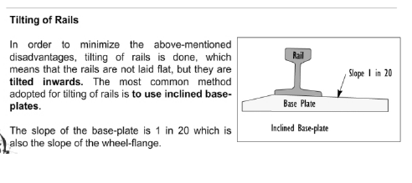
Tilting of Rail:
  To minimize the disadvantages of conning of wheels, tilting of rails is done.
  Rails are not laid flat but they are tilted inwards
  Most commonly it is done by using inclined base plates
  The slope of base-plate is 1 in 20 which is also the slope of wheel flange

Slide 7
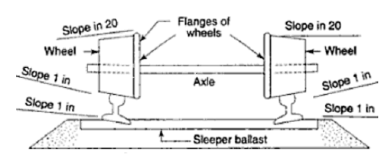
Coning of wheels & Tilting of Rail:

Slide 8
Advantages of Coning of Wheel & Tilting of Rails:
  Increase the contact area between rail and wheel
  Ensure uniform wear of the head of rail
  Induce central tendency & thereby reduces side friction
  Maintains the gauge properly
  Even distribution of load on rail
  Eliminates slipping action of wheel on curves

Slide 9
Interaction of Wheels & Bogies with Rails:
Web link: http://www.railway-technical.com/whlbog.shtml

Slide 10
Mode of Distresses of Rail (cont..):
2. Corrugation of Rails/Roaring Rails:
The rail heads are sometimes found not straight but corrugated (with a wavy surface). Roaring sound is created when trains pass over such corrugated rails
Corrugation occurs at-
  At the points of starting and stopping of trains
  If ballasts are made of broken bricks
  At steep gradient
  On electrified section of a railway track
  At long tunnel

Slide 11
Mode of Distresses of Rail (cont..):
2. Corrugation of Rails (cont..):
The phenomena is very complex. However possible causes of commencement and development of corrugation of rails are-
  Soft formation and uneven support condition
  Sudden application of brakes
  Slipping of driving wheels and engines
  Excessive slack or excessive tight gauge
  High speed of trains
  Presence of high humidity and dust
  Use of steel having high nitrogen content and high tensile strength

Slide 12
Mode of Distresses of Rail (cont..):
2. Corrugation of Rails (cont..):
Effects of corrugation of rails are-
  Discomfort to passengers due to uneven rail top
  Discomfort due to heavy roaring sound
  It leads to overall deterioration of the railway track, loosening of the fastenings, disturbance in ballast bed etc.
  It also affects the rolling stocks and accelerate their depreciation process

Slide 13
Mode of Distresses of Rail (cont..):
2. Corrugation of Rails (cont..):
Remedy of corrugation of rails :
  Only remedy at present is to grind the corrugated rails by special machines
  A purpose built rail-grinding-train is repeatedly run on the affected section at a specified speed until the corrugation disappears
  It’s not a permanent solution and it reduces the fatigue strength of rail section

Slide 14
Mode of Distresses of Rail (cont..):
3. Corrosion of Rails:
Corrosion of rails means rusting or loss of material.
Corrosion occurs -
  Due to presence of damp conditions
  Usually seen in swampy/water logged areas, sea front, active industrial areas, wet tunnels etc.

Slide 15
Mode of Distresses of Rail (cont..):
3. Corrosion of Rails (cont...):
Effects of Corrosion of rails -
  Reduction in area of rail section
  Lowering of fatigue strength
Corrosion Prevention Measures -
  Use of high quality rail (special steel/alloy steel) where corrosion is likely to occur
  Periodic surface treatment by using non-corrosive paint

Slide 16
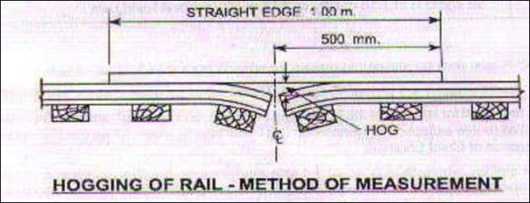
Mode of Distresses of Rail (cont..):
4. Hogged Rails:
Vertically bent rails at the end are called hogged rails.
Hogging occurs due to wear of rails on ends.
It causes deterioration in the running quality of the track

Slide 17
Mode of Distresses of Rail (cont..):
4. Hogged Rails (cont...):
Methods to rectify hogged rails -
  Removing and replacing by new rails
  End portions of rails are cut-off and fresh holes are provided for fish-plates
  Welding the worn ends of the rails
  Using de-hogged machine

Slide 18
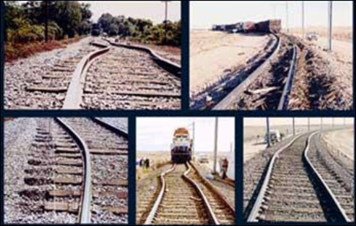
Mode of Distresses of Rail (cont..):
5. Buckling of Rails:

Slide 19
Mode of Distresses of Rail (cont..):
5. Buckling of Rails (cont...):
  Buckling occurs when track goes out of alignment specially at curves where expansion is prevented. Prevention of expansion may causes due to -
  Insufficient expansion gap
  excessive tightness of the joints
  Trapping of solid materials inside the expansion gap

Slide 20
Mode of Distresses of Rail (cont..):
5. Buckling of Rails (cont...):
  Buckling of rails are often responsible for the derailments of the trains. Preventive measures to avoid buckling are as follows:
  Sufficient expansion gap should be provided
  Joints should not be tightly jointed to the extent which may prevent expansion and contraction of the rails.
  Number of welded rails should not be too large.
  Contact surfaces between rails and fishplates should be lubricated.

