Slide 1
Bangladesh Transport Review
Moazzem Hossain, PhD
Professor,
Civil Engineering Department, BUET.

Slide 2
Summary
Historical development
Road sector
Organisation Involved
Standards and Design
Vehicles and Users
Railway sector
Waterway sector
Airway sector

Slide 3
Historical development
Before British Colonial Period
During Colonial Period
During Pakistan era
After Liberation in 1971
Flow of aid fund after 1975
Sporadic, Piecemeal and politically biased transport development

Slide 4
Road sector: Players
Roads and Highways Department (RHD)
Local Government Engineering Department (LGED):
Bangladesh Road Transport Authority (BRTA)
Jamuna Multipurpose Bridge Authority (JMBA)
Dhaka Transport Co-ordination Board (DTCB)
Bangladesh Road Transport Corporation (BRTC)
Bangladesh Land Port Authority (BLPA)

Slide 5
Road sector

Slide 6
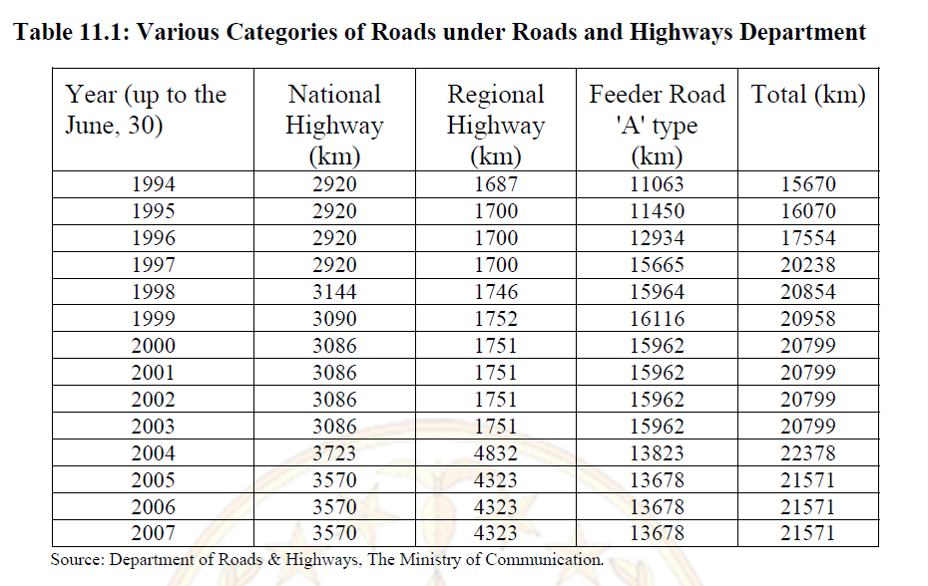
Road sector

Slide 7
Road sector
Three types of RHD road are recognised:
National Highways:
National highways connect the capital with Divisional HQs or sea ports or land ports.
National highways connect the capital with international borders. A National Highway must branch of from another National Highway, National Highways cannot connect between Regional Highways or Zilla Roads. N1 - N8 Major national routes. N101 - N809 National routes of lesser importance, where the first number is the major national route and the second digit (chronological order) designates a serial number.
Regional Highways:
Regional highways connect the National highway network with District HQs or main river and land ports not connected by National Highways. Regional highways connect District HQs. Regional Highways must branch of from National or Regional Highways, Regional Highways cannot connect between Zilla Roads. R101 - R899 Where the first number is the national road number from which is branches of and the second two digits (chronological order) designates a serial number.
Zilla Roads:
Zilla roads connect Upazilla HQs with the National/Regional road network (single shortest route). Zilla roads connect Upazilla HQs. Zilla roads branches of from National or Regional Highways or other Zilla roads. Z1001 - Z8999 Where the first number is the national/regional road number from which is branches of and the next three digits (chronological order) designates the feeder road (serial number).

Slide 8
Road sector
Link Number
A Link is the part of a road between two intersections on that road (of RHD roads).
Links are used exclusively for traffic purposes and not in connection with other types of
data collection (except traffic counts) or in connection with locating maintenance works.
Link Numbering
Rule 1. The Number of Main Carriageway lanes is constant
Rule 2. The Link is either one way or two way traffic flow
Rule 3. Ramps and roundabouts are to be treated as single links unless the number of main carriageway lanes change, or the traffic flow change. In these cases the ramp or roundabout must be split and apportioned to more than one Link.
Rule 4. A link must start a Connecting LRP (Location Reference Point) but might end at a Connecting LRP or an End LRP, except in the special case of a roundabout where the
Link starts and ends at the same Connecting LRP. The link must be either split or extended in accordance with Rules 1. to 3.
Rule 5. If the length of a Link (between two LRPs) is less than approximately 200 meters, then the Link is not to be considered a separate Link but to be included in the shorter of the Links either before or after. Each Link is given a serial number starting with 1, 2, 3 etc. from the beginning of the road and increasing in the direction (increasing chainage) of the road. A unique serial number is given to each Link within each Road.
For example:
N1.1, N1.2, N1.3 etc
R101.1, R101.2, R101.3 etc
Z3015.1, Z3015.2, Z3015.3 etc.

Slide 9
Road sector

Slide 10
Road sector
SSD-stopping sight distance
ISD- Intersection sight distance
OSD- Overtaking sight distance

Slide 11
Road sector

Slide 12
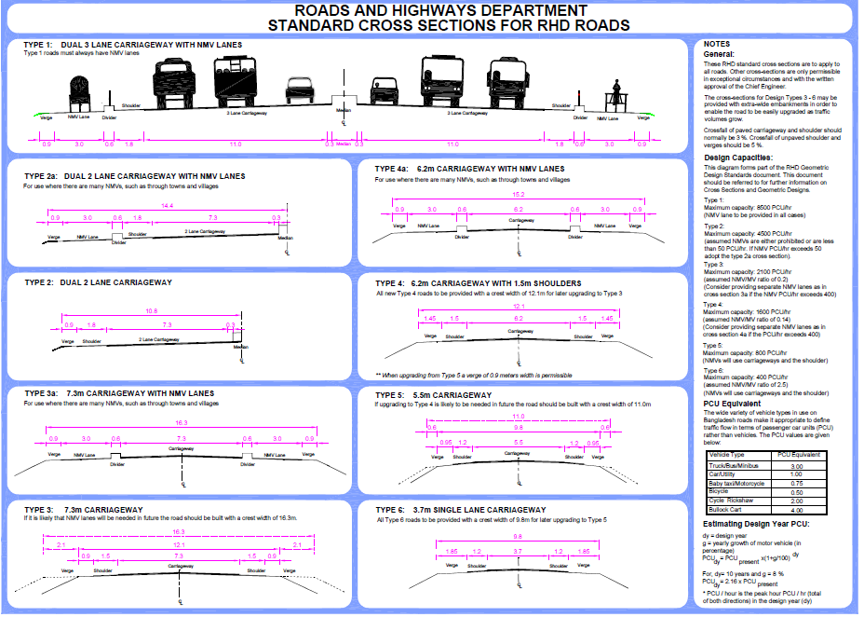
Road sector

Slide 13
Road sector

Slide 14
Road sector: LGED

Slide 15
Bangladesh railway

Slide 16
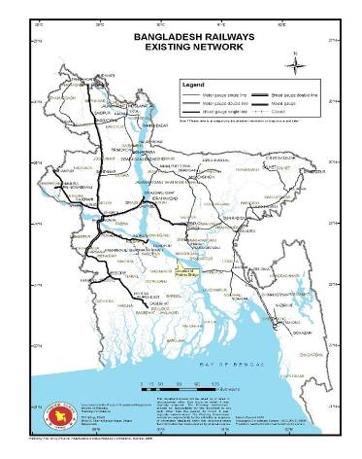
Bangladesh railway

Slide 17
Bangladesh railway
Table 2‑1 : Bangladesh Railway Routes Network in kilometre
Item | East Zone |  |  | West Zone
 | Metre Gauge | Dual Gauge | Total | Metre Gauge | Broad Gauge | Dual Gauge | Total
Route under operation | 1283.04 | 83.60 | 1366.64 | 501.64 | 507.10 | 280.55 | 1289.29
Closure of route | 24.14 | - | 24.14 | 29.51 | 175.09 | - | 204.60
Total route | 1307.18 | 83.60 | 1390.78 | 531.15 | 682.19 | 280.55 | 1493.89
Item | Metre Gauge | Broad Gauge | Dual Gauge | Total
Route under operation | 1,784.68 | 507.10 | 364.15 | 2,655.93
Closure of route | 53.65 | 175.09 | 0 | 228.74
Total route | 1,838.33 | 682.19 | 364.15 | 2,884.67

Slide 18
Bangladesh railway

Slide 19
Bangladesh railway
An analysis of railway traffic, the commodity carried, their volume and origin-destination revealed that most passenger and freight movement takes place on a limited number of key corridors. In order to enable BR to carry the anticipated traffic in the future, the Railway Master Plan focussed its attention on the major corridors where almost 90% of all traffic movement takes place. These eight major corridors are:
Corridor 1: Dhaka – Chittagong –- Cox’s Bazar
Corridor 2: Chilahati – Khulna – Mongla
Corridor 3: Dhaka – Darsana/Benapole
Corridor 4: Dhaka – JMB – Rajshahi – Rohanpur
Corridor 5: Dhaka – Sylhet/Shahbazpur
Corridor 6A: Dhaka – JMB – Ishwardi – Chilahati
6B: Dhaka – JMB – Sirajganj/Roypur – Burimari
Corridor 7A: Dhaka – Mawa – Khulna – Mongla
7B: Dhaka – Mawa – Jesore – Benapole
Corridor 8: Dhaka – Mymensingh – Jamalpur – Tarakandi- JMB

Slide 20
water sector: Players
Chittagong Port Authority (CPA)
Mongla Port Authority (MPA)
Bangladesh Shipping Corporation (BSC)
Bangladesh Inland Water Transport Corporation (BIWTC)
Department of Shipping

Slide 21
Bangladesh Inland Water Transport Corporation (BIWTC)
Historically, Bangladesh was used to utilizing its vast network of rivers for communication purpose. A number of river ports had been evolved over the years. Important ones are Dhaka, Narayanganj, Barisal, Chandpur, Akhaura, etc. In past, navigable river route was about 9000km which has been dried out to about 3500km in recent times mainly due to various river water diversion measures undertaken by India in recent time.
Major cities like Dhaka, Chittagong, Khulna, Narayanganj and Barisal are connected by water transport network. Due to inadequate investment over the years this mode lost its image through poorer service design and lack of proper infrastructure. Modernization of infrastructure such as inland freight and passenger terminals and use of IT can improve the image and efficiency of the sector. Integration of road and rail with this mode can be very useful in improving overall transport sector efficiency.

Slide 22
Air Sector
Air Transport Civil Aviation Authority (CAA)
It is now maintaining 3 international airports and 5 domestic airports. Apart from this, 1 domestic airport and 5 STOL ports have been built for the convenience of airlines. Out of the 14 operative and 13 non-operative airports and STOL ports
Biman Bangladesh Airlines Limited
Other Private Airlines

