Slide 1
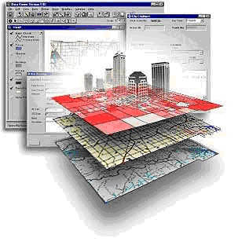
An Introduction to GIS

Slide 2

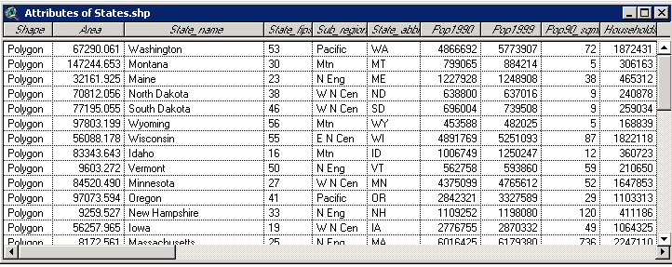
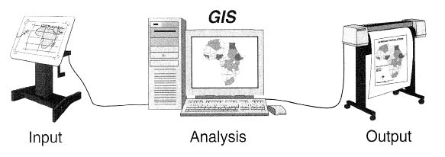
What does GIS stand for?
Geographic
(Geography)
Information
System
Notes:
Geography – refers to the Earth surface and near surface.
Spatial refers to any space including geographic
Geospatial is synonymous with geographic.

Slide 3
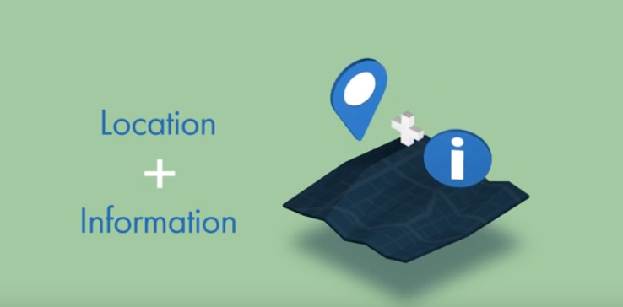
GIS
Notes:
Geography – refers to the Earth surface and near surface.
Spatial refers to any space including geographic
Geospatial is synonymous with geographic.

Slide 4
What is a Geographic Information System?
Geographic Information System (GIS) – A computer-based system for the collection, storage, organization, maintenance, and analysis of spatially-referenced data, and the output of spatially-referenced information.
  Data – Any collection of related facts; the basic elements of information.
  Information - Data that have been processed to be useful; provides answers to "who", "what", "where", and "when" questions
Notes:
T

Slide 5
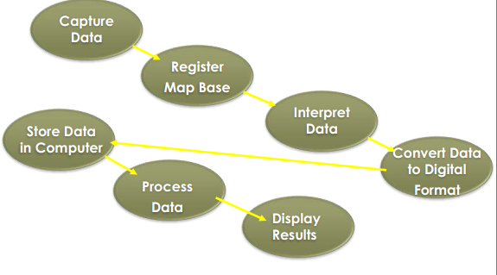
How Does a GIS Work??

Slide 6
Existing Technology
Google Map.
Bing Map etc.
Notes:
T

Slide 7
WHO ARE YOU AND WHAT KIND OF TECHNOLOGY DO YOU NEED?
Notes:
T

Slide 8
Application of Google Map
You run a local service, you represent chain store, you own a restaurant, or some other kind of service customers are looking for. The main idea in your case is “looking for” – this means you need to display your location on a map as a point of interest (POI). Once this is done, you can help your customers to find closest location or get directions to your POI.
You represent a company that rents/sells properties – you need to show your properties on a map to help customers identify suitable options in the area they are interested in.
Notes:
T

Slide 9
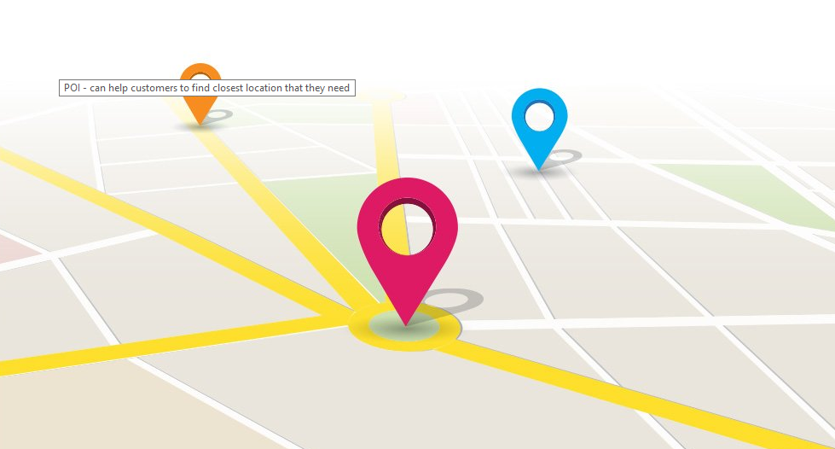
Application of Google Map
Notes:
T

Slide 10
Application of Google Map
You represent a transport company and you’re tired of endless calls asking where customer’s cargo is, your passengers are waiting for their driver to arrive and want to know if he’s on time, you want to give an estimate for transport costs, or you simply want to be better than your competitors and become more user-friendly – you need to use maps to display the location of a vehicle or transported item and its routes. You can also include real-time traffic information for better visualization.
Notes:
T

Slide 11
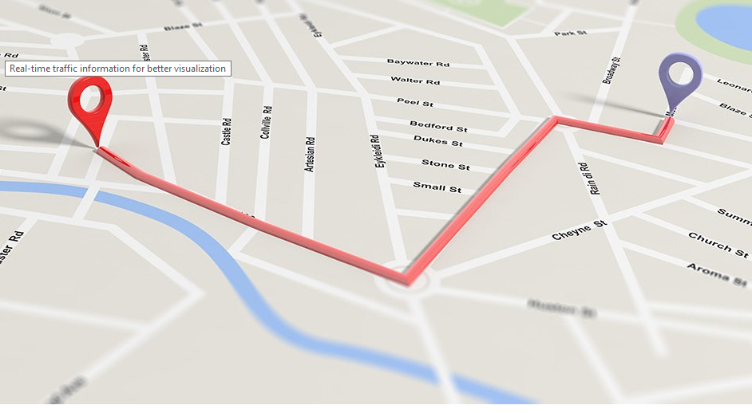
Application of Google Map
Notes:
T

Slide 12
Why GIS?????
Notes:
T

Slide 13
Advantages
With help of GIS, we can easily analyze and identify the
Expected Location.
Easy to Use
General Purpose Solving Application.
Allocates the map(How to reach).
Estimate the Availability of end user(visiting office).
Notes:
T

Slide 14
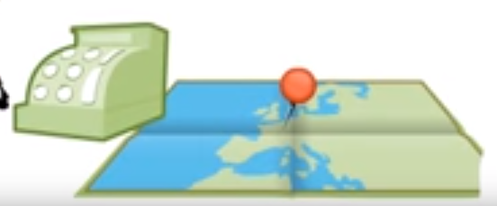
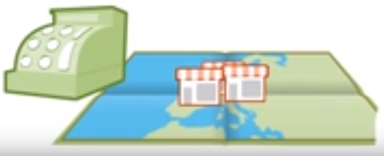
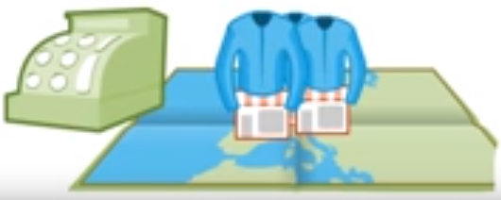
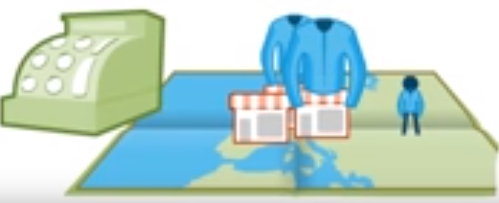
Applications of GIS_Commercial……..
Retailers use GIS to pin-point the best location for new stores and stock items according to customers needs.

Slide 15
Applications of GIS_Commercial……..
Model can be made for predicting consumer spatial behavior, delineating trade areas, locating retail and service facilities, analyzing market performance, simulating different market scenarios, and forecasting sales.
Your company is looking for a way to visualize your sales data based on geographic, demographic and other types of unstructured data in order to increase profits.

Slide 16
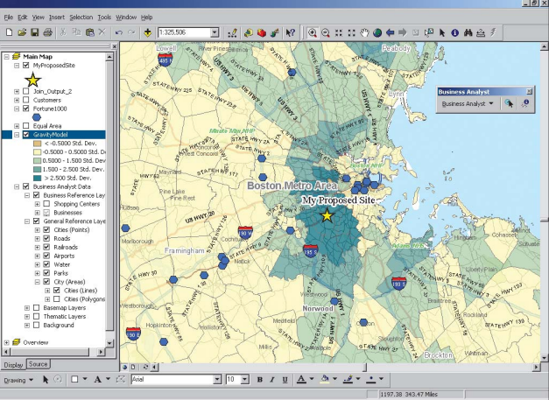
Applications of GIS_Commercial……..

Slide 17
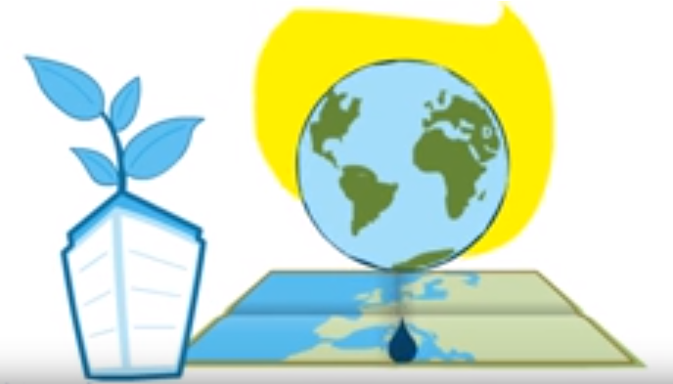
Applications of GIS_Organizations……..
GIS is used by the conservation organizations to predict the likely consequences of global warming.

Slide 18
Applications of GIS_Organizations……..
A company’s aim is to provide a construction plan or path for a new pipeline/fiber optic cable installation. This task involves displaying a variety of data, such as environmental data, topographical information, parcel boundaries, a disaster risk layer and other factors that influence how the project will be carried out. For a project like this, even information about where the trees on a site are located is important.

Slide 19
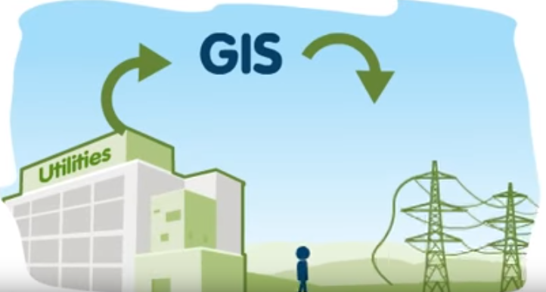
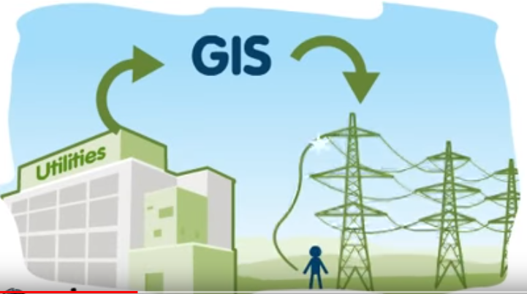
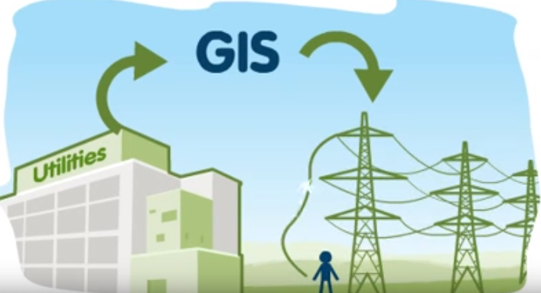
Applications of GIS_Utilities……..
Utilities organizations use GIS to respond promptly and efficiently to reported power outages.

Slide 20

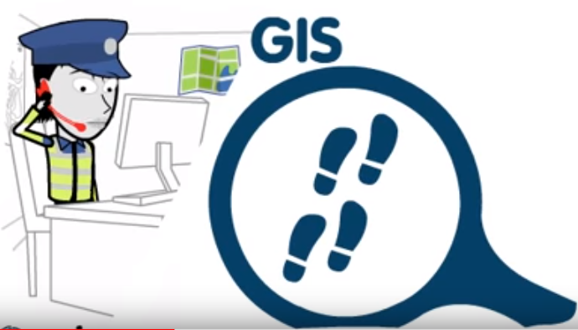
Applications of GIS_……..
Police forces use GIS to discover criminal activity and plan operations much more strategically.

Slide 21
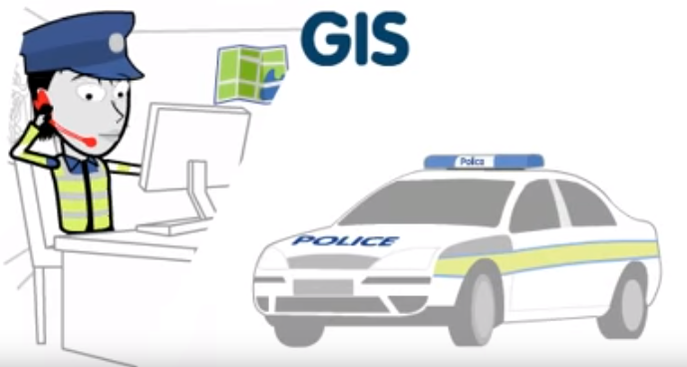
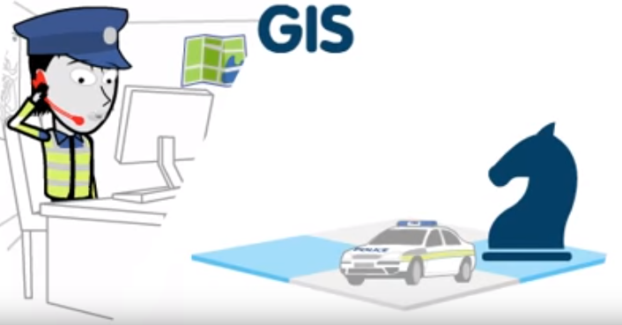
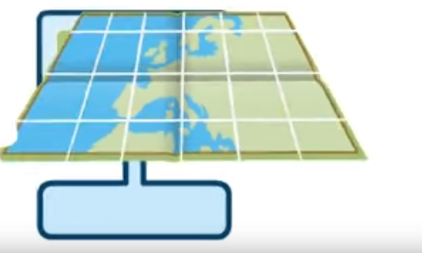
Applications of GIS……..
Resulting trends can then be seen on a digital map much easier.

Slide 22
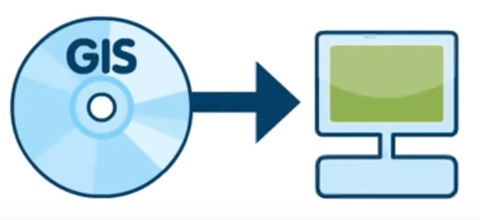
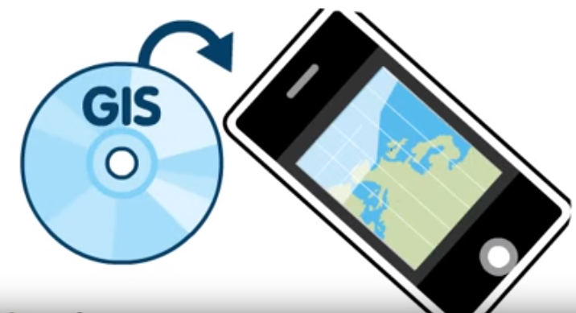
How Does a GIS Work??
GIS software runs on your computer ranging from the most powerful server to software on your mobile phone.

Slide 23
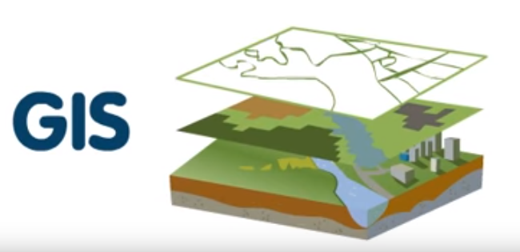

How Does a GIS Work??
In a GIS information about real world is stored as a collection of thematic layers linked by geography.

Slide 24
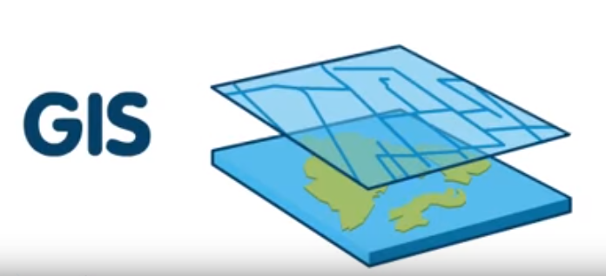
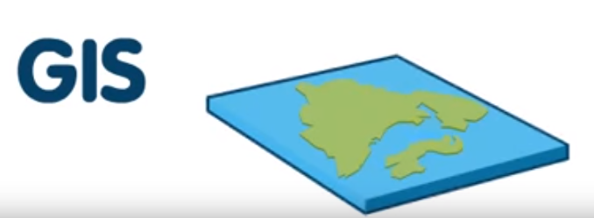
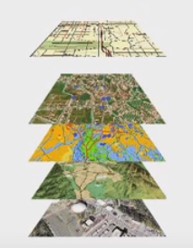
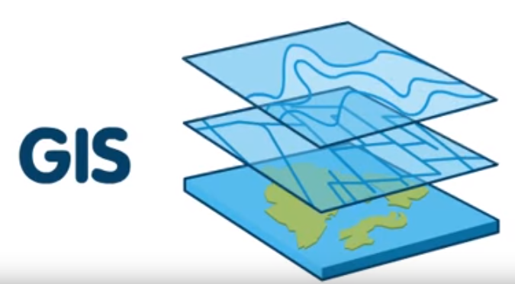
How Does a GIS Work??
Each layer contains similar feature such as streets or rivers.

Slide 25
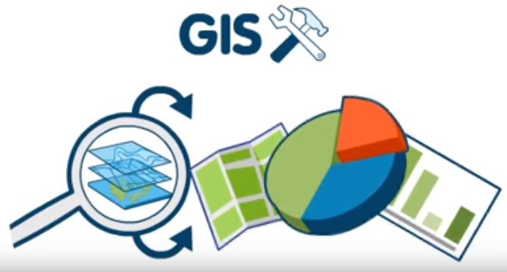
How Does a GIS Work??
People can analyze the geographic data using GIS tools and visualize data as maps, graphs or charts.

Slide 26

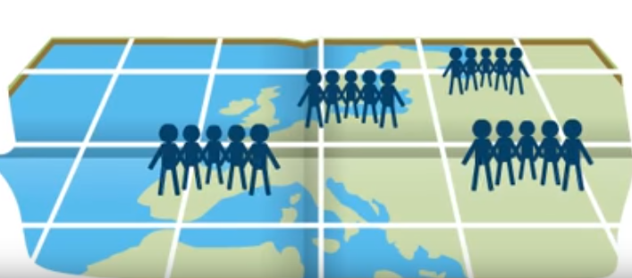

How Does a GIS Work??
patterns and trends can be easily identified. Information contained in spread sheet previously now comes to life.

Slide 27
Thank You!!

