Slide 1
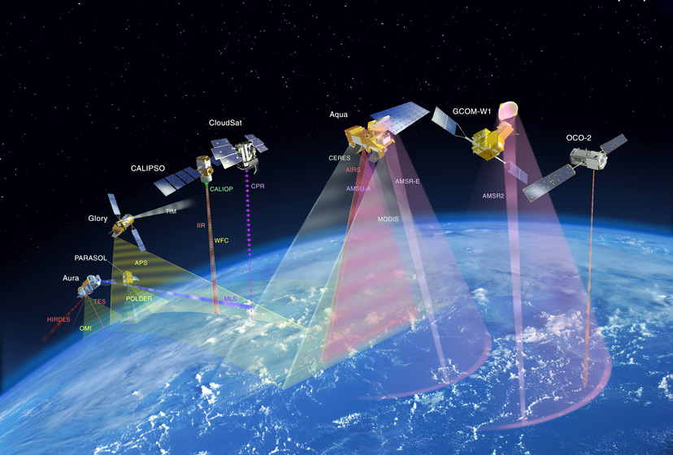
REMOTE SENSING
Md. Ashraful Imran
Lecturer
Department of Civil Engineering
Rajshahi University of Engineering & Technology (RUET)
Rajshahi-6204, Bangladesh

Slide 2
Contents
Introduction and Definition
Principles of Remote Sensing
Classification of Remote Sensing
Remote Sensing Observation Platform
Electromagnetic energy
Applications of Remote Sensing
Advantages of Remote Sensing

Slide 3
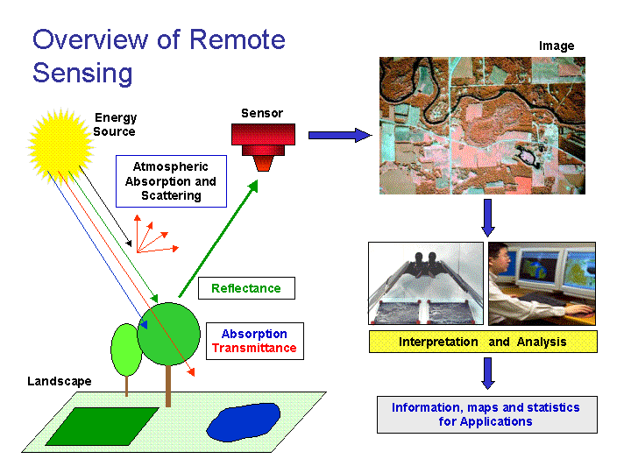
Definition
Remote sensing is the art or science of obtaining information about an object, an area or a phenomena, through analyzing of data collected by a given device or sensor that has no direct physical contact with the object, area or phenomena being investigated. In simple terms, remote sensing is the process of acquiring data or information about an object without any physical contact.

Slide 4
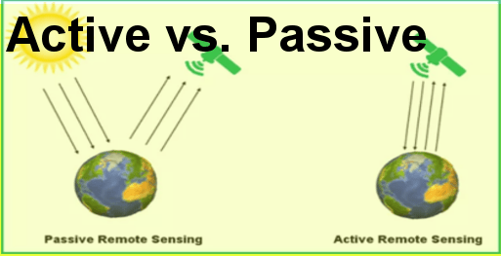
Classification of Remote Sensing
Remote sensing is broadly classified into two categories:
Passive remote sensing: It uses sun as a source of EM energy and records the energy that is naturally radiated and/or reflected from the objects.
Active remote sensing: It uses its own source of EM energy, which is directed towards the object and return energy is measured.

Slide 5
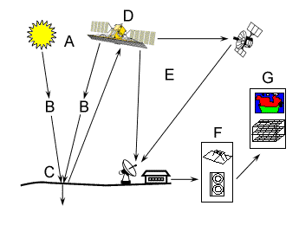
Principles of Remote Sensing
Remote sensing involves the detection and measurement of the radiations of different wavelengths reflected or emitted from distant objects or materials, which helps in their identification and categorization. It offers the following basic components to measure:

Slide 6
Principles of Remote Sensing
1. Energy Source or Illumination (A) - the first requirement for remote sensing is to have an energy source which illuminates or provides electromagnetic energy to the target of interest.
2. Radiation and the Atmosphere (B) - as the energy travels from its source to the target, it will come in contact with and interact with the atmosphere it passes through. This interaction may take place a second time as the energy travels from the target to the sensor.
3. Interaction with the Target (C) - once the energy makes its way to the target through the atmosphere, it interacts with the target depending on the properties of both the target and the radiation.
4. Recording of Energy by the Sensor (D) - after the energy has been scattered by, or emitted from the target, we require a sensor (remote - not in contact with the target) to collect and record the electromagnetic radiation.
5. Transmission, Reception, and Processing (E) - the energy recorded by the sensor has to be transmitted, often in electronic form, to a receiving and processing station where the data are processed into an image (hardcopy and/or digital).

Slide 7
Principles of Remote Sensing
6. Interpretation and Analysis (F) - the processed image is interpreted, visually and/or digitally or electronically, to extract information about the target which was illuminated.
7. Application (G) - the final element of the remote sensing process is achieved when we apply the information we have been able to extract from the imagery about the target in order to better understand it, reveal some new information, or assist in solving a particular problem.

Slide 8
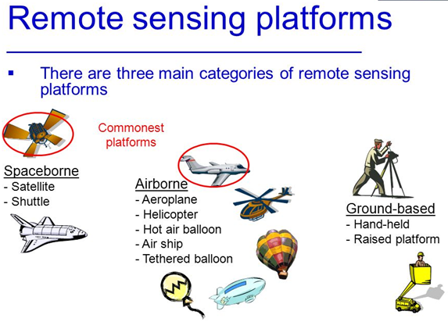
Remote Sensing Observation Platform

Slide 9
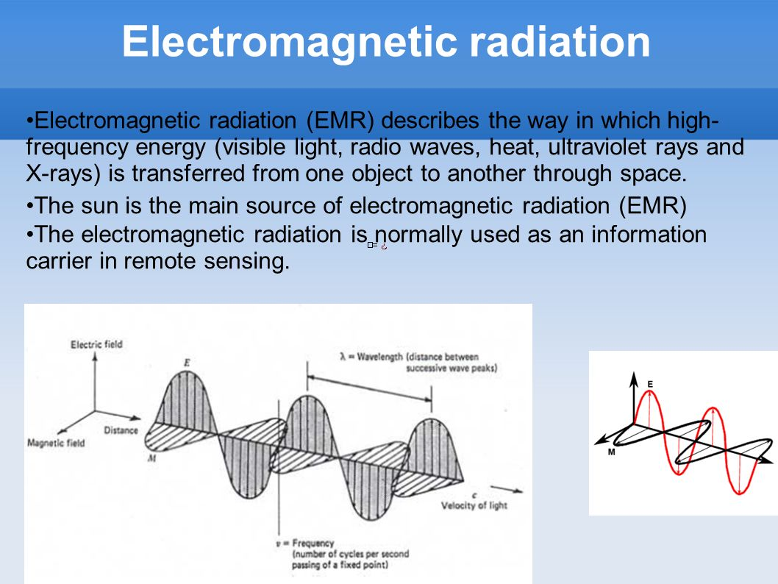

Slide 10
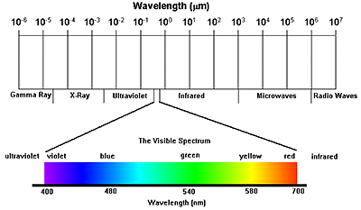
Wavelength region and their application in remote sensing

Slide 11
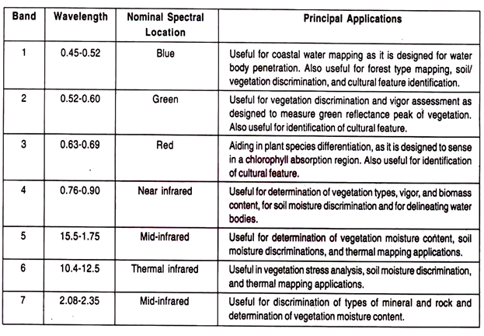
Wavelength region and their application in remote sensing

Slide 12
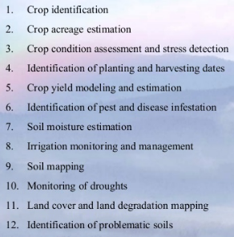
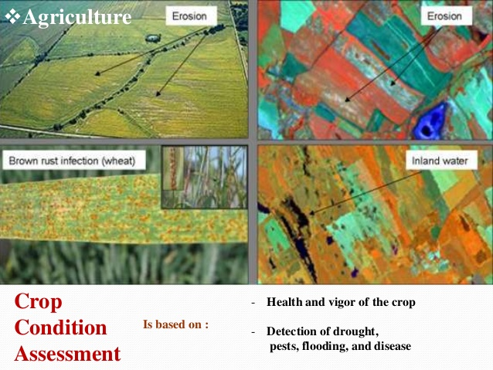
Application of Remote Sensing
Application in Agriculture

Slide 13
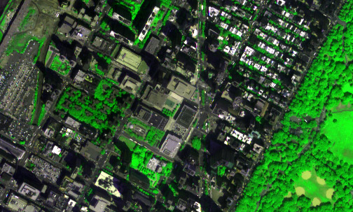
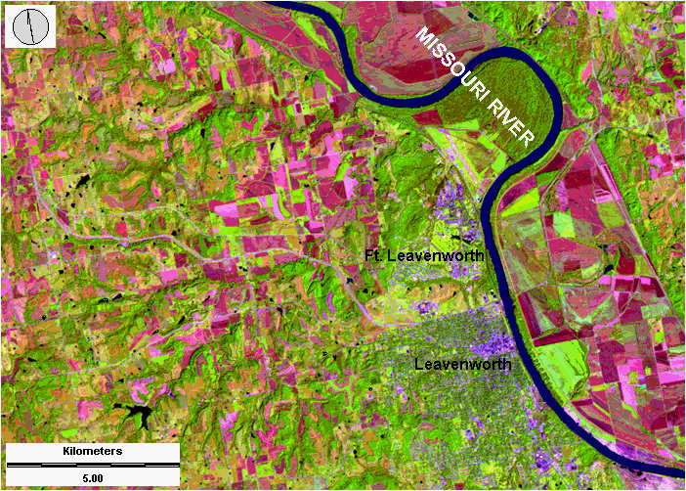
Application of Remote Sensing
Urbanization & Transportation
Urban planning
Roads network and transportation planning
City expansion
City boundaries by time

Slide 14
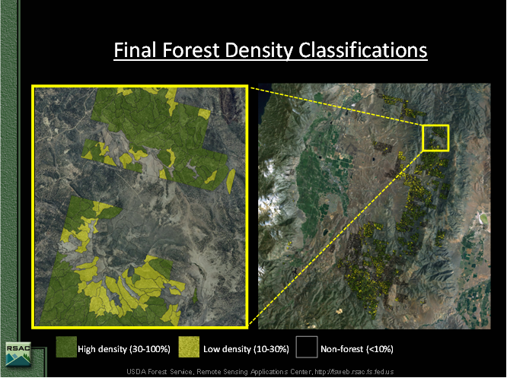
Application of Remote Sensing
Natural resource Management
Forestry: Monitoring urban forestry, forest deforestation
Water source management
Habitat analysis
Environmental assessment
Impervious surface mapping
Hydrology
Mineral province
Geomorphology

Slide 15
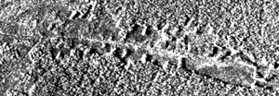
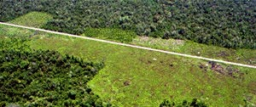
Satellite image of deforestation
Comparison of an aerial photograph (bottom) with a radar image (top) of deforestation along a road

Slide 16
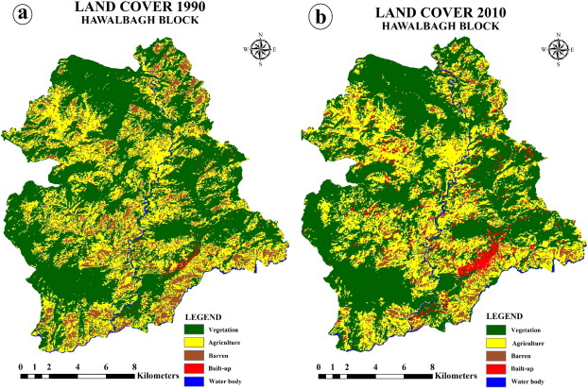
Application of Remote Sensing
Land use
Land cover means any surface cover on the ground which can include vegetation, urban infrastructure, water, lake, mountain, transportation networks, buildings or any other. The attributes measured by remote sensing techniques relate to land cover, from which land use can be inferred, particularly with ancillary data or a priori cognition.

Slide 17
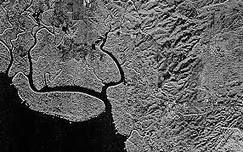
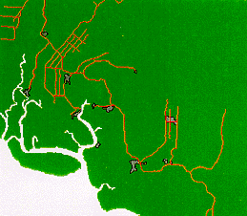
Application of Remote Sensing
Mapping
Generating different maps from remotely sensed data can be so effective and valuable. A classification of sensing elements and methodologies to generate theses remotely sensed models are essential for mapping. Two primary methods of generating elevation data are:
1. Stereogrammetry techniques by air photos
2. Radar interferometry
Radar image of a continuously clouded area
Map with the road network

Slide 18
Advantages of Remote Sensing
Provides a view for the large region
Offers Geo-referenced information and digital information
Most of the remote sensors operate in every season, every day, every time and even in real tough weather

Slide 19
THANK YOU ALL

