Slide 1
CE 2111
Mechanics of Materials-I
(Shear Force and Bending Moment)

Slide 2
Shear Force and Bending Moment
The algebraic sum of the vertical forces at any section of a beam to the right or left of the section is known as shear force
A shear force diagram (SFD) is one which shows the variation of shear force along the length of the beam.
The algebraic sum of the moments of all the forces acting to the right or left of any section of a beam is known as bending moment
A bending moment diagram (BMD) is one which shows the variation of bending moment along the length of the beam.

Slide 3
Guidelines for drawing SFD and BMD
Consider left or right portion of the section
Add the forces normal to the beam on one of the portion. If right portion of the section is chosen, a force on the right portion acting downward is positive while a force acting upward is downward
The positive values of shear force and bending moments are plotted above the base line and negative values below the base line
The shear force diagram increase or decrease suddenly i.e. by vertical straight line at a section where there is a vertical point load
The shear force between any two vertical loads will be constant and hence the shear force diagram between two vertical loads will be horizontal
Bending moment at any hinge or roller support, at the end of beam, is zero

Slide 4
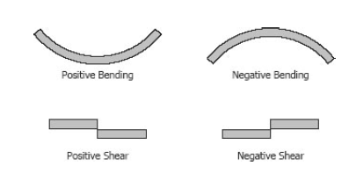
SIGN CONVENTIONS

Slide 5
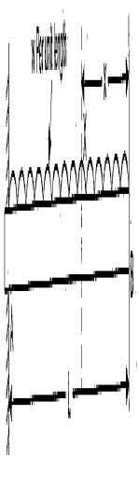
A
B
M_{A}
R_{A} = wL
M_{A} = wL²/2
R_{A}
Shear force at any section x from right end V_{x} = wx
Bending moment at any section x from right end M_{x} = wx*x/2 = wx²/2

Slide 6
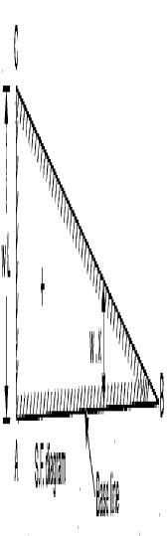
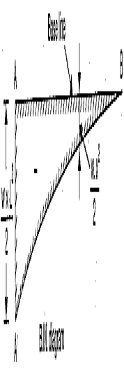

Slide 7
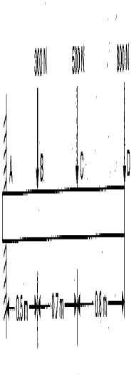
300N
500N
800N
M
R
R = 1600 N
M = 2350 N-m

Slide 8
Shear force at D V_{D} = 800N
Shear force at C V_{C} = 800N + 500N = 1300N
Shear force at B V_{B} = 800N+500N+300N = 1600N
Shear force at A V_{A} = +1600N
Bending moment at the free end D is zero
Bending moment between D and C at a distance x from D M_{x} = -800*x
At C, x = 0.8m M_{C} = -800*0.8 = 640N-m
Bending moment between B and C at a distance x from D M_{x} = -800*x – 500(x-0.8)
Bending moment between B and A at a distance x from D M_{x} = -800*x – 500(x-0.8) – 300(x-1.5)

Slide 9
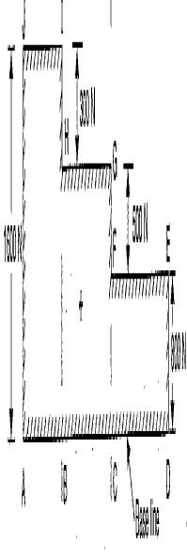
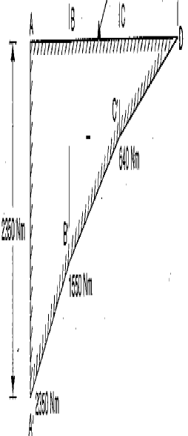

Slide 10
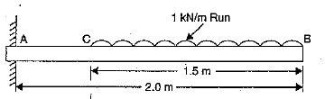
Draw SFD and BMD for the Cantilever Beam
A
C
B
M_{A}
R_{A} = 1.5 kN
M_{A} = 1.875 kN-m
R_{A}

Slide 11
A
C
B
M_{A}
R_{A}
Consider any section between C and B V_{x} = 1.0*x kN
At B; x =0 V_{B} = 0
At C; x = 1.5 V_{C} = 1.5 kN
Between A and C there is no load, the shear will remain constant
Bending moment at any section between C and B, M_{x} = -1.0*x*x/2 = -x²/2
At B x =0 M_{B} = 0
At C, x = 1.5 MC = -1.125 N-m
Bending moment between A and C, M_{x} = -(Load due to UDL)* (x-0.75) [ x =1.5-2.0m]

Slide 12
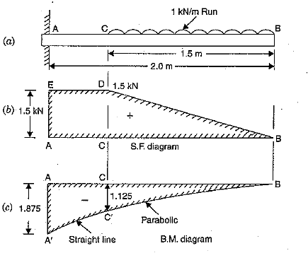

Slide 13
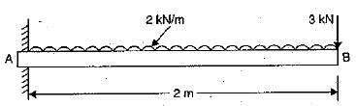
A
3 kN
M_{A}
B
R_{A}
R_{A} = 7 kN
M_{A} = 10 kN-m

Slide 14
A
3 kN
M_{A}
B
R_{A}
Shear force at B V_{B} = 3.0 kN
Shear force at any section x from free end
Vx = 3.0 + w*x = 3.0 + 2*x
At B x =0 V_{B} = 3.0N
At A x = 2.0 V_{A} = 3.0 + 2*2 = 7 N
Bending moment at any section from free end
M_{x} = -(3*x + 2*x*x/2) = - (3x + x²)
At B x =0 M_{B} = 0
At A, x = 2 M_{A} = -10 kN-m
Bending moment between A and C, Mx = -(Load due to UDL)* (x-0.75) [ x =1.5-2.0m]

Slide 15
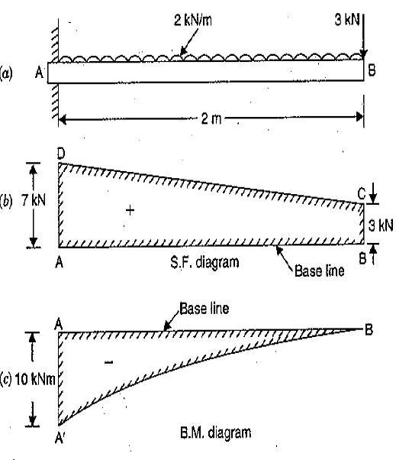

Slide 16
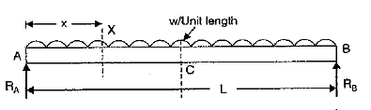
Draw SFD and BMD for the simple Supported Beam
R_{A} = R_{B} = wL/2

Slide 17
Consider any section at distance x from left support V_{x} = R_{L} – w*x = wL/2 – w*x
At A, x=0 =>V_{A} = wL/2
At B, x=L => V_{B} = -wL/2
At C, x = L/2 => Vc = 0
Bending moment at any section x from A
M_{x} = R_{L}*x – wx²/2 = w(Lx-x²)/2
At A, x=0 =>M_{A} = 0
At B, x=L => M_{B} = 0
At C, x = L/2 => M_{c} = wL²/8

Slide 18
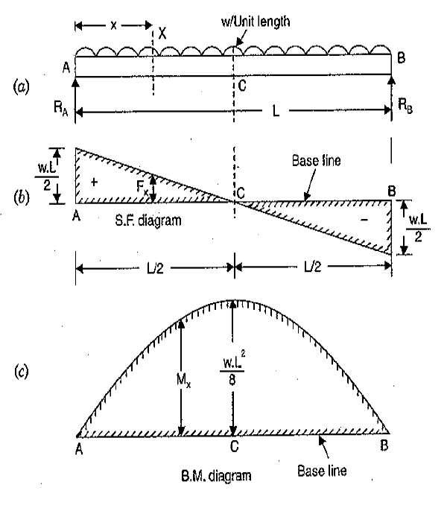

Slide 19
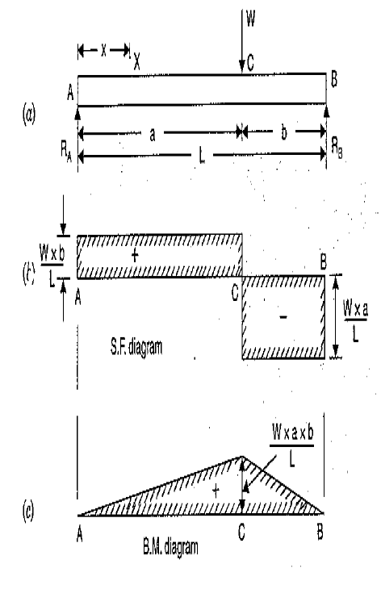

Slide 20
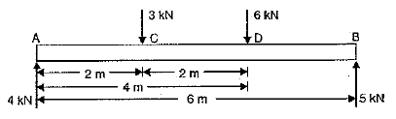
R_{B} = 5 kN
R_{A} = 4 kN

Slide 21
Shear force at A = R_{A} = 4kN
Shear force between A and C is constant and equal to 4 kN
Shear force at C V_{C} = 4-3 = 1 kN
Shear force at D V_{D} = 1-6 = -5 kN
Shear force at B V_{B} = -5 kN
Bending moment at A M_{A} = 0
Bending moment at C M_{C} = R_{A} *2 = 4*2 =8 kN-m
Bending moment at D M_{D} = R_{A} *4 – 3*2 =10 kN-m
Bending moment at B M_{B} = 0

Slide 22
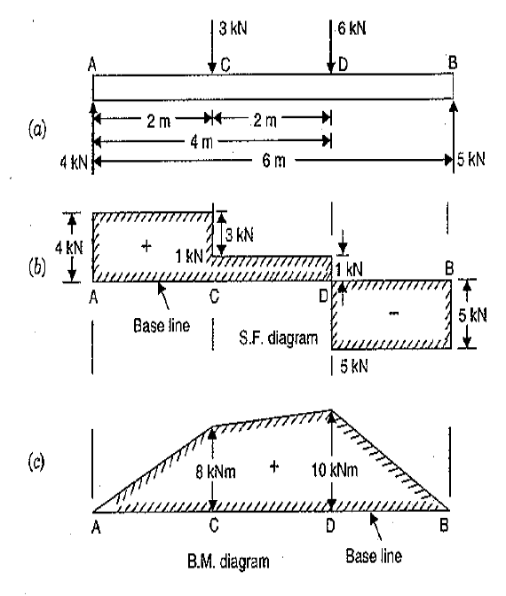

Slide 23
Relations among load, shear and moment
dx
wdx
dx/2
M
B
M+dM
V
V+dV
∑F_{y} = V + w dx - (V+dV) =0
dx
dV = w dx
∑ M_{B} = M + V dx + (w dx) dx/2 – (M + dM) =0
dM = V dx
V₂ – V₁ = ΔV = (Area)_{load}
M₂ – M₁ = ΔM = (Area)_{shear}

Slide 24
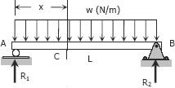
Relation among Load Shear and Moment
Consider a simple beam shown of length L that carries a uniform load of w (N/m) throughout its length and is held in equilibrium by reactions R₁ and R₂.
R₁ = R₂ = wL/2

Slide 25
V_{x} = R₁ – wx = wL/2 – wx
M_{x} = R₁ *x – w*x²/2
M_{x} = wLx/2 – w*x²/2
Differentiate M with respect to x
Thus, the rate of change of the bending moment with respect to x is equal to the shearing force, or the slope of the moment diagram at the given point is the shear at that point.

Slide 26
Differentiating V with respect to x
Thus, the rate of change of the shearing force with respect to x is equal to the load or the slope of the shear diagram at a given point equals the load at that point.

Slide 27
PROPERTIES OF SHEAR AND MOMENT DIAGRAMS
The following are some important properties of shear and moment diagrams:
The area of the shear diagram to the left or to the right of the section is equal to the moment at that section.
The slope of the moment diagram at a given point is the shear at that point.
The slope of the shear diagram at a given point equals the load at that point.
The maximum moment occurs at the point of zero shears.
When the shear diagram is increasing, the moment diagram is concave upward.
When the shear diagram is decreasing, the moment diagram is concave

Slide 28

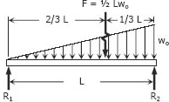
Draw SFD and BMD

Slide 29
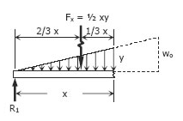







When x= 0; V = 1/6Lw₀ = R₁
X= L; V= -1/3Lw₀ = -R₂
Location of zero shear from left end V= 0 i.e. a = 0.577L
When x= 0; M =0
X= L; M=0
Moment at zero shear M_{max} = 0.064L²w₀

Slide 30
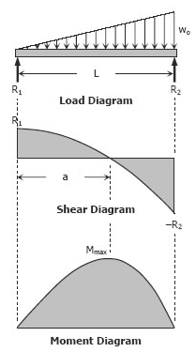

Slide 31
Nature of Load, SF and BM
w(x) | Concentrated load | UDL | Triangular
V(x) | Straight Line, No slope | Sloped Straight Line | Parabolic
M(x) | Sloped Straight Line | Parabolic | Cubic

Slide 32

Draw the SFD and BMD for the simple supported beam shown in figure below
C
10 kN/m
A
D
B
1m
4m
3m
C
10 kN/m
A
D
B
R₁
1m
4m
3m
R₂
R₁ =25 kN
R₂ =15 kN

Slide 33
C
10 kN/m
A
D
B
R₁
1m
4m
3m
R₂
Shear force at A V_{A} = R_{A} = 25 kN
Shear force at C V_{C} = 25 kN
Shear force at any section between C and D at a distance x from A
Vx = 25 – 10*(x – 1)
At D x = 5 and V_{D} = 25 – 10*(5-1) = -15 kN
Shear force at B V_{B} = -15 kN
Location of zero shear
0 = 25 – 10*(x-1)
x = 35/10 = 3.5 m from A

Slide 34
C
10 kN/m
A
D
B
R₁
1m
4m
3m
R₂
Simply supported beam
Bending moment at A and B is 0
Bending moment at any section between C and D at a distance x from A
M_{x} = R_{A}*x – 10* (x-1)*(x-1)/2
M_{x} = 25x – 5 (x-1)²
At C x = 1 M_{C} = 25 kN-m
At D x = 5 M_{D} = 25*5 – 5*(5-1)² = 45 kN-m
B.M. at zero shear M_{max} = 25*3.5 – 5*(3.5-1)² = 56.25 kN-m

Slide 35
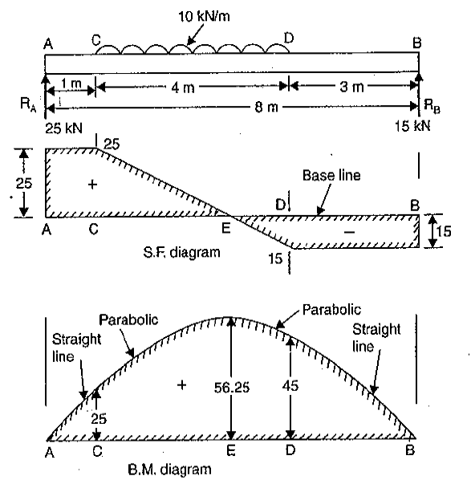

Slide 36
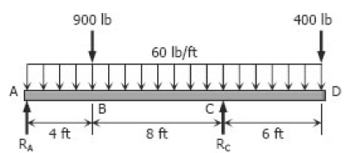



Slide 37


Part AB
At x = 0 ft V_{AB} = 670 – 60*0 = 670 lb
At x = 4 ft V_{AB} = 670 – 60*4 = 430 lb
At x = 0 ft M_{AB} = 0
At x = 4 ft V_{AB} = 670*4 – 30*4² = 2200 lb-ft

Slide 38
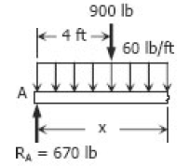
Part BC
At x = 4 ft V_{BC} = -230 - 60*4 = -470 lb
At x = 12 ft V_{BC} = -230 – 60*12 = -950 lb
At x = 4 ft M_{BC} = 3600 - 230*4 – 30*4² = 2200 lb-ft
At x = 12 ft M_{BC} = 3600 - 230*12 – 30*12² = -3480 lb-ft
Location of zero bending moment
M_{BC} = 0 or x = 15.44 ft and 7.77 ft

Slide 39
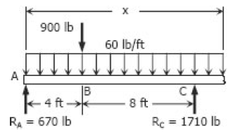
Part CD
V_{CD} = 670 + 1710 – 900 – 60x
V_{CD} = 1480 -60x
At x =12ft V_{CD} = 1480 -60 * 12 = 760 lb
At x = 18 ft V_{CD} = 1480 -60 * 18 = 400 lb
M_{CD} = 670x + 1710 (x-12) – 900(x-4) – 60x(x/2)
M_{CD} = -16920 + 1480x – 30x²
At x = 12ft M_{CD} = -16920 + 1480*12 – 30*12² = -3480 lb-ft
At x = 18ft M_{CD} = -16920 + 1480*18 – 30*18² = 0 lb-ft

Slide 40
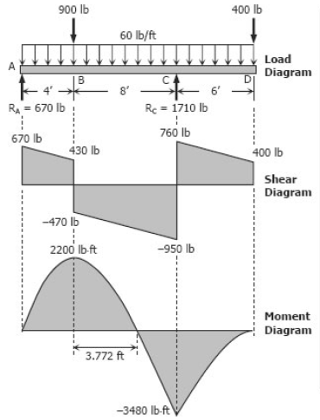

Slide 41
6K/ft
4k/ft
B
C
A
D
3ft
4ft
8ft
4ft
12k-ft
6/ft
4k/ft
B
C
A
D
3ft
4ft
8ft
4ft
R_{B}
R_{C}
12k-ft
∑M_{B}= -½*3*6*(⅓*3)+4*8(4+4)+12 - R_{C}*12=0
R_{B}= 19.42k, R_{C}= 21.58K

Slide 42
6/ft
4k/ft
B
C
A
D
X=0.59ft
3ft
4ft
E
8ft
4ft
R_{B}
R_{C}
12k-ft
R_{B}= 19.42k, R_{C}= 21.58K
Shear at D V_{D} = 0
Shear at C V_{C} = -R_{C} = -21.58K
Shear at E V_{E} = -21.58 + 4*8 = 10.42K
Shear at B V_{B} = -21.58 + 4*8 – 19.42 = -9 K
Shear at A = 0
Location of zero shear between C and E
-21.58 + 4*x = 0; x = 5.4 ft from C
Bending moment at D M_{D} = -12 k-ft
Bending moment at C M_{C} = -12 k-ft
Bending moment at E M_{E} = -12 + (21.58*8) – 4*8*8/2 = 32.64 k-ft
Bending moment at B M_{B} = -12 + (21.58*12) – 4*8* (4+8/2) = - 9 k-ft
Maximum moment M_{max} = -12 + 21.58*5.4 – 4*5.4*5.4/2 = 46.2 k-ft

Slide 43
6K/ft
4k/ft
B
C
A
D
3ft
4ft
8ft
4ft
12k-ft
10.42K
Dangerous section
+ve
-ve
0.0 K
2.6ft
-ve
9K
SFD
21.58K
46.23-ft
32.64 k-ft
Point of inflection
+ve
Point of inflection
-ve
3.14ft
-ve
12k-ft
9k-ft
BMD
0.59ft

Slide 44
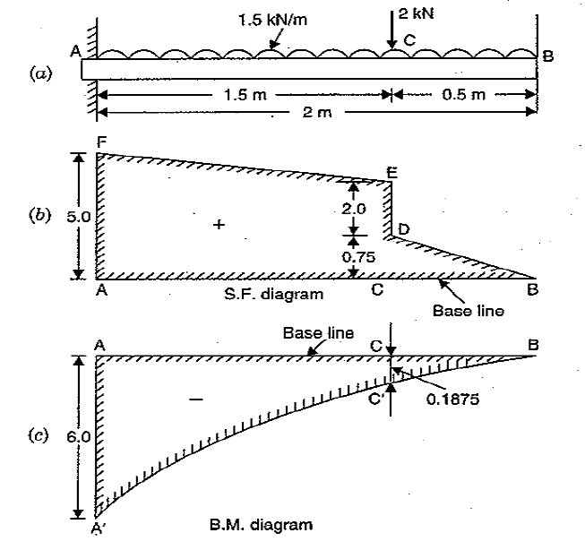

Slide 45
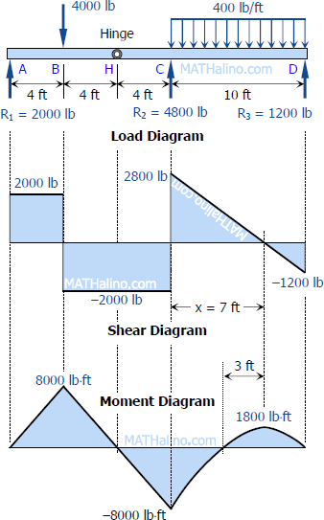
4000 lb
R_{H} = 2000
4000 lb
4ft
4ft
4ft
5ft
5ft
R_{A}
R_{H}
R_{D}
R_{C}
∑M_{A} = 0; 4000*4 - R_{H}*8 = 0
R_{H} = 2000 lb
∑M_{D} = 0; R_{C}*10 - 4000*5 -2000*14 = 0
R_{C} =4800 lb
R_{D} =1200 lb

Slide 46
4000 lb
2000
400 lb/ft
4ft
4ft
4ft
R_{A}
R_{H}
4800
1200
2800
2000
7ft
2000
2000
1200
16000
1800
8000

Slide 48
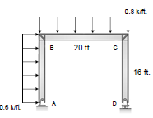
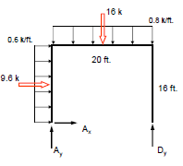
∑M_{A} = 0 ; D_{y} = 11.84 k
A_{y} = 4.16 k
A_{x} = -9.6 k
Free body diagram

Slide 49
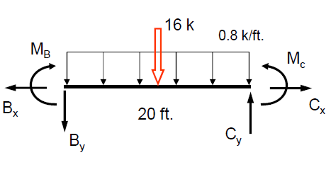
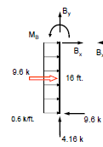
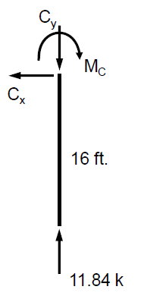

Slide 50
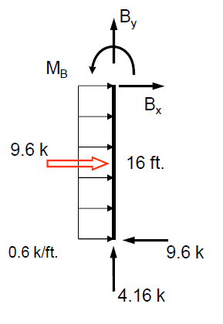
∑M_{B} = 0 ; M_{B} = 76.8 k-ft
B_{y} = -4.16 k
B_{x} = 0k
V_{y} = 9.6 – 0.6 x
M_{y} = 9.6*x – (0.6 x*x/2)

Slide 51
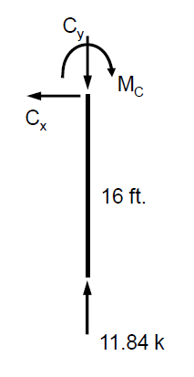


C_{x} = 0k

Slide 52
V_{x} = 4.16 – 0.8 x
M_{x} = 4.16*x + 76.8 – (0.8 x*x/2)

Slide 53
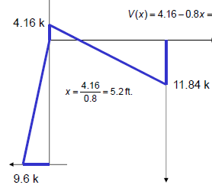
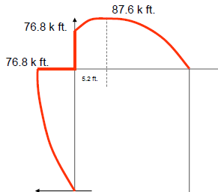
SFD
Free body diagram
BMD

Slide 54
24kN/m
C
_{B}
60kN
_{3m}
D
A
_{2m}
_{2m}
_{4m}

Slide 55
24kN/m
_{C}
_{B}
60kN
C_{y}
_{3m}
_{A}
A_{x}
_{2m}
_{2m}
_{4m}
A_{y}
∑M_{A} = 0; 60*2 + 24*4*(4+4/2) – C_{y} *8 = 0
C_{y} = 87 kN
∑F_{y} = 0; A_{y} = 69 kN
∑F_{x} = 0; A_{x} = 0 kN

Slide 56
24kN/m
_{C}
_{B}
cos θ = 4/5
60kN
sin θ = 3/5
F₁
C_{y}
F₂
_{3m}
D
θ
A₁
_{A}
A₂
_{2m}
_{2m}
_{4m}
A_{y}
A₁ = A_{y} cos θ = 69* 4/5 = 55.2 kN
A₂ = -A_{y} sin θ = - 69* 3/5 = -41.4 kN
F₁ = 60cos θ = 60* 4/5 = 48 kN
F₂ = -60 sin θ = - 60* 3/5 = - 36 kN

Slide 57
V
M
7.2
48kN
156
D
55.2
138
A₂
55.2
∑M_{B} = 0; 55.2*2.5- 48*2.5 –M = 0
M = 156 kN-m
M_{A} = 0
M_{D} = 55.2* 2.5 = 138 kN-m
M_{B} = 55.2* 5 – 48*2.5 = 156 kN-m

Slide 58
24kN/m
_{C}
_{B}
M
87 kN
F_{B} = 7.2/cosθ = 9 kN
F_{B} = 87 – 24*4 = 9 kN
V_{x} = 9 – 24*x
M_{x} = 156+ 9*x – 24*x*x/2

Slide 59
24kN/m
_{C}
M
_{B}
87 kN

Slide 60
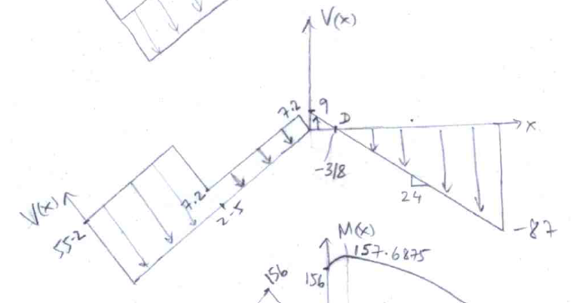
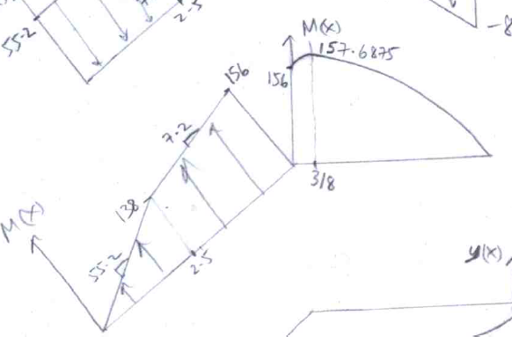
SFD
BMD

Slide 61
5k/ft
_{7k}
4
3
_{A}
_{B}
_{C}
_{D}
5ft
12ft
4ft
14ft
0.0 k
0.0 k
_{B}
14ft
_{C}
_{E}
H_{E}=4.2k
_{F}
_{E}
4.2k
V_{E} =63.24k
R_{F} =27.36k
_{F}
SFD
BMD
_{7k}
BMD
SFD
63.24k
5k/ft
27.36k
_{A}
_{B}
_{C}
_{D}
5.6k
5ft
12ft
4ft
63.24k
27.36k
38.24k
Dangerous section
+ve
+ve
5.6k
-ve
7.65ft
-ve
25k
21.76k
24.97k-ft
Point of inflection
Point of inflection
+ve
-ve
-ve
62.5k-ft
22.4k-ft
121.3k-ft

