Slide 1
CE 2121 (Fluid Mechanics-I)
Text Book | Writer | Link
A Textbook of Fluid Mechanics and Hydraulic Machines | Dr. R. K. Bansal | http://www.mediafire.com/file/d61ib5kkt62a1vy/Dr._R._K._Bansal.pdf/file
A Textbook of Fluid Mechanics | R. K. Rajput | Soft Copy not available
Hydraulics and Fluid Mechanics including Hydraulic Machines | Dr. P. N. Modi | http://www.mediafire.com/file/7lc8041nqobco7s/Dr._P._N._Modi.pdf/file

Slide 2
Syllabus related to Fluid
Semester | Courses
3rd | CE 2121 Fluid Mechanics
3rd | CE 2122 Fluid Mechanics Sessional
5th | CE 3121 Engineering Hydraulics
5th | CE 3122 Engineering Hydraulics Sessional
7th | CE 4121 Irrigation and Flood Engineering
8th | CE 4227 Hydraulic Structures
8th | CE 4220 Water Resources Engineering Sessional-I

Slide 3
Why study of fluid mechanics is essential for civil engineering?

Slide 4
Organization | Full Form
BWDB | Bangladesh Water Development Board
WASA | Water Supply and Sewerage Authorities
BADC | Bangladesh Agricultural Development Corporation
BMDA | Barind Multipurpose Development Authority
IWM | Institute of Water Modeling

Slide 5
Course Content
Fluid Dynamics.
Fluid Measurement.
Flow Through Pipes.
Laminar and Turbulent Flow.
Study in Compressible flow in Pressure Conduits.
Similitude and Dimensional analysis.

Slide 6

Fluid Dynamics

Slide 7
Types of Head of Fluid in Motion
Potential head or Potential energy: This is due to configuration or position above some suitable datum line. It is denoted by z.
Velocity head or kinetic energy: This is due to velocity of flowing liquid and is measured as V²/2g.
Pressure head or Pressure energy: This is due to the pressure of liquid and reckoned as p/γ or p/w

Slide 8
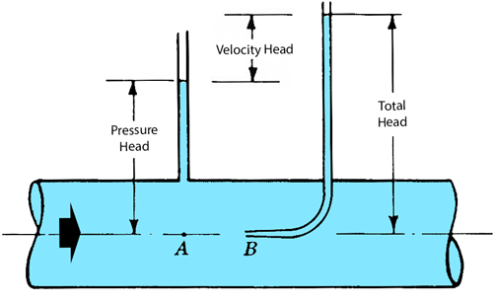
Total Head

Slide 9
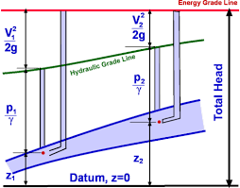
Total Head
Total Head = Potential head+ Pressure Head + Velocity Head
H= Z + V²/2g + p/γ meter of Liquid

Slide 10
Example Problem 1
Water is flowing through a pipe of 5 cm diameter under a pressure of 29.43 N/cm² with mean velocity of 2.0 m/s. Find the total head or total energy per unit weight of the water at a cross section, which is 5m above the datum line.

Slide 11
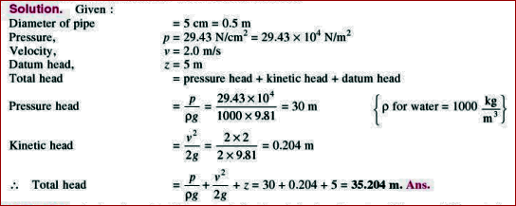

Slide 12
Next Class….
Statement of Bernoulli’s Equation
Derivation of Bernoulli’s Equation
Problems related to Bernoulli’s Equation

