Slide 1
Laminar Flow
জীবনে চলার পথে লেমিনার (Laminar) হতে হয়। তাতে জীবনে চলার পথটা মসৃণ হয় । মানুষের সাথে বিবাদ কম হয়। আর টারবুলেন্ট (Turbulent) হলে আসলে সমস্যা, দিকবিদিক ঠিক থাকেনা, ঝামেলা লেগেই থাকবে।

Slide 2
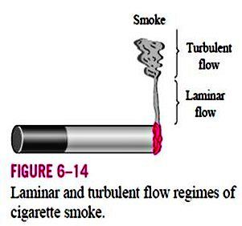
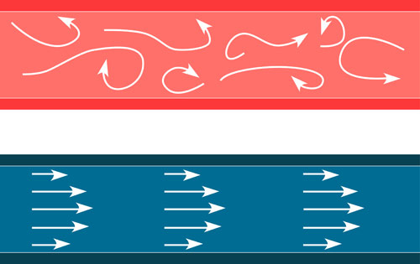
Laminar Flow
Laminar means arranged.
Paths taken by individual fluid particles do not cross one another.

Slide 3
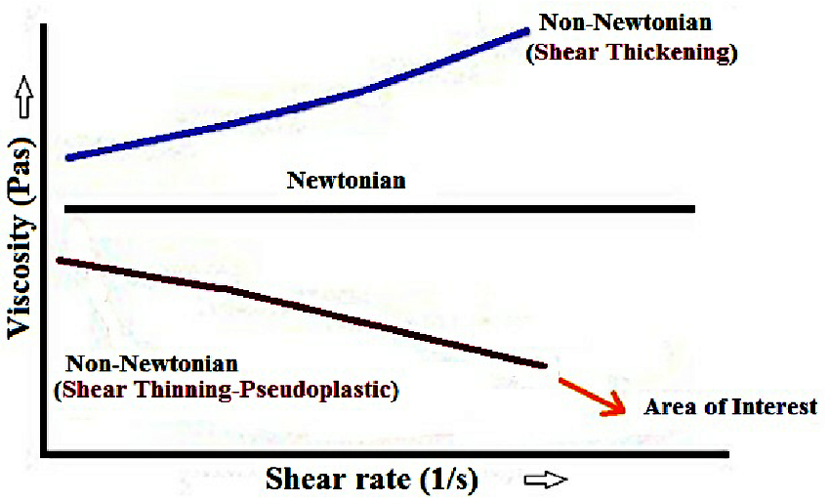
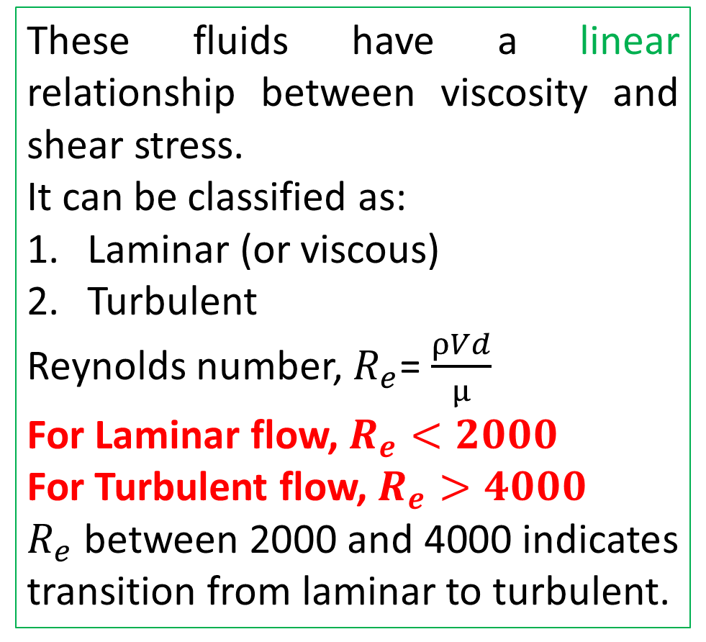
Newtonian Fluid
These fluids have a linear relationship between viscosity and shear stress.
It can be classified as:
Laminar (or viscous)
Turbulent
Reynolds number, $R_{e}$= $\frac{ρVd}{μ}$
For Laminar flow, $R_{e}<2000$
For Turbulent flow, $R_{e}>4000$
$R_{e}$ between 2000 and 4000 indicates transition from laminar to turbulent.

Slide 4
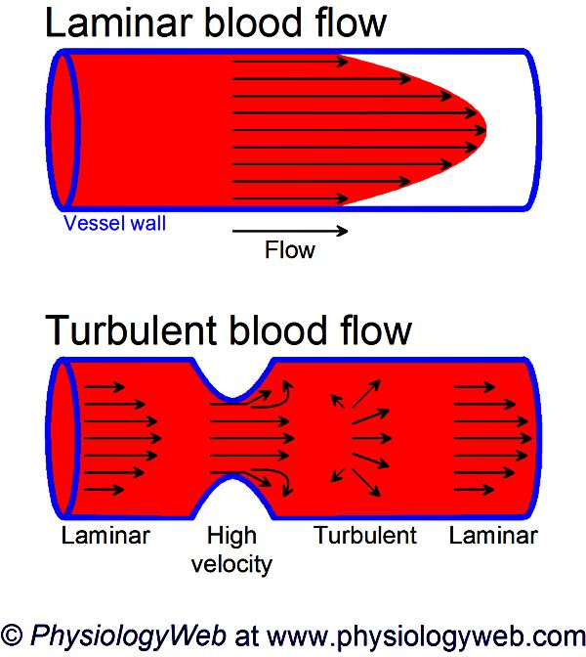
Examples of Laminar/ Viscous flow
Flow past tiny bodies.
Underground flow.
Movement of blood in the arteries of a human body.
Flow of oil in measuring instruments.
Rise of water in plants through their roots.

Slide 5
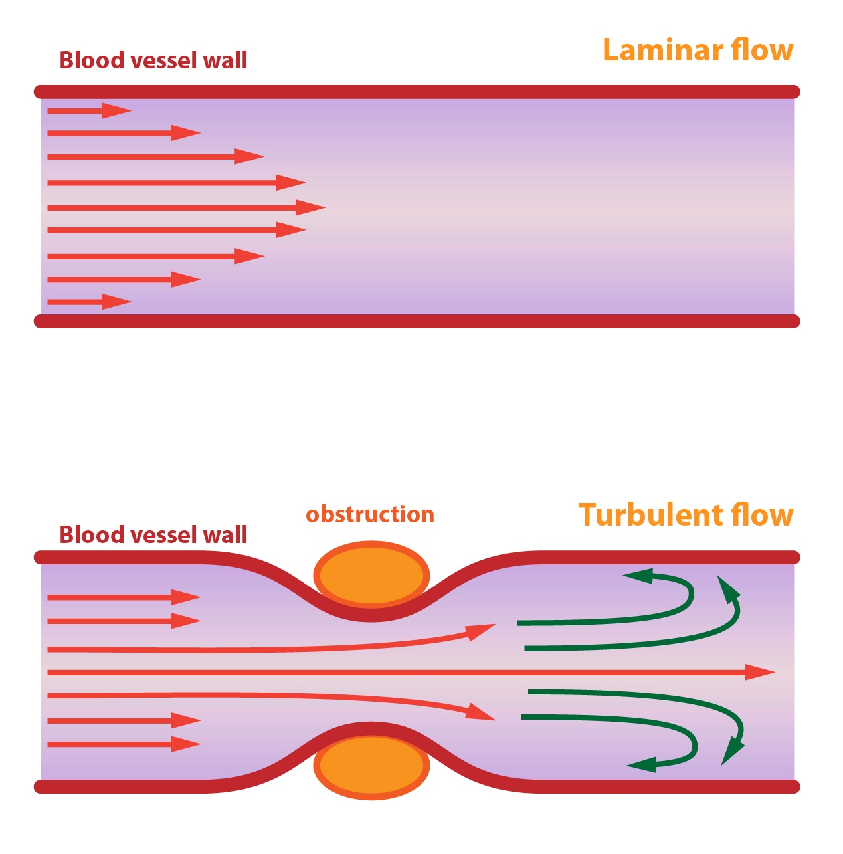
Laminar and Turbulent flow in Blood Vessel

Slide 6
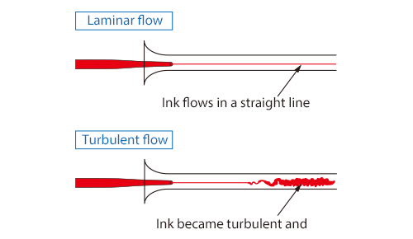
Reynolds Experiment
Osborne Reynolds in 1883, with the help of a simple experiment demonstrated the existence of the following two types of flows.

Slide 7
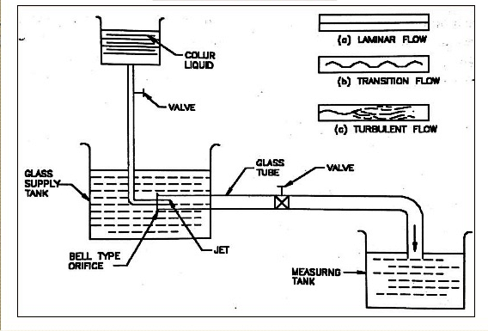
Reynolds Experiment

Slide 8
Reynolds Experiment: Apparatus
A constant head tank filled with water.
A small tank containing dye.
A horizontal glass tube provided with a bell mouthed entrance.
A regulating valve.

Slide 9
Reynolds Experiment: Procedure
The water was made to flow from the tank through the glass tube into the atmosphere.
The velocity of flow was varied by adjusting valve.
The liquid dye was introduced into the flow at the bell mouth through a small tube.

Slide 10
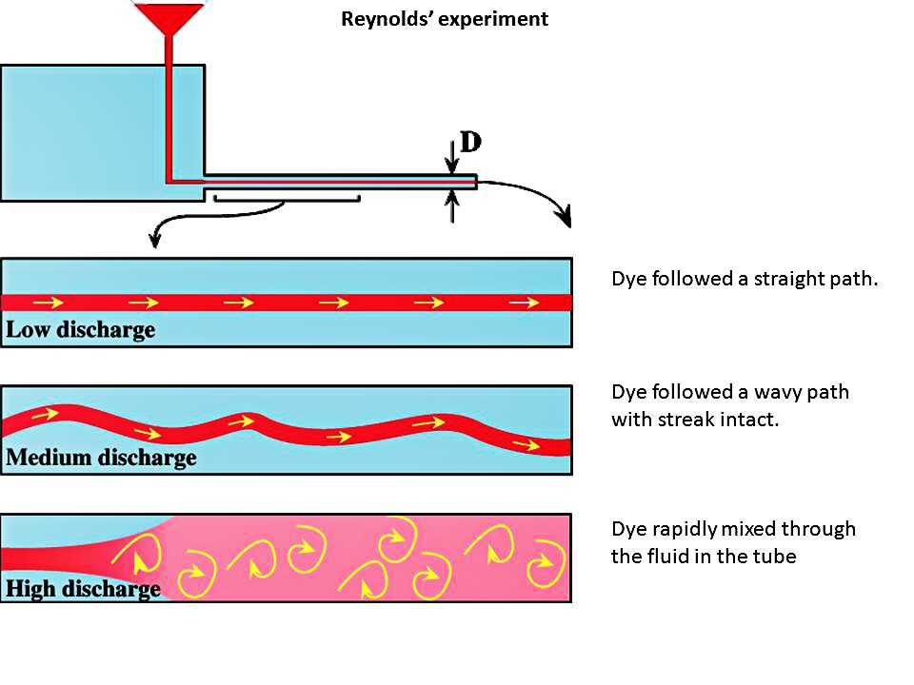
Observations made

Slide 11
Observations made
When velocity of flow is low, the dye remained in the form of a straight and stable filament passing through the glass tube. (laminar flow)
With the increase in velocity, a critical state was reached at which the dye filament showed irregularity and began to weaver. This is transitional state.
With further increase in velocity of flow in the filament of dye become more intense and ultimately the dye diffused over the entire cross-section (turbulent flow)

Slide 12
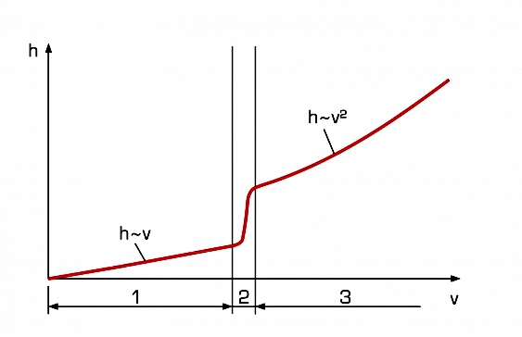
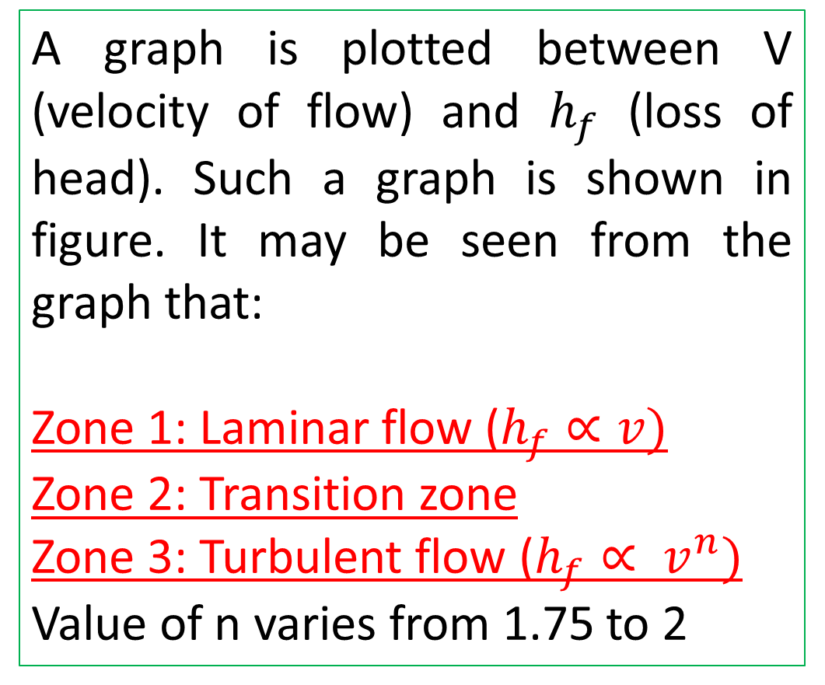
Loss of Head and Velocity of flow relationship
A graph is plotted between V (velocity of flow) and $h_{f}$ (loss of head). Such a graph is shown in figure. It may be seen from the graph that:
Zone 1: Laminar flow ($h_{f}∝v)$
Zone 2: Transition zone
Zone 3: Turbulent flow ($h_{f}∝ v^{n})$
Value of n varies from 1.75 to 2

Slide 13
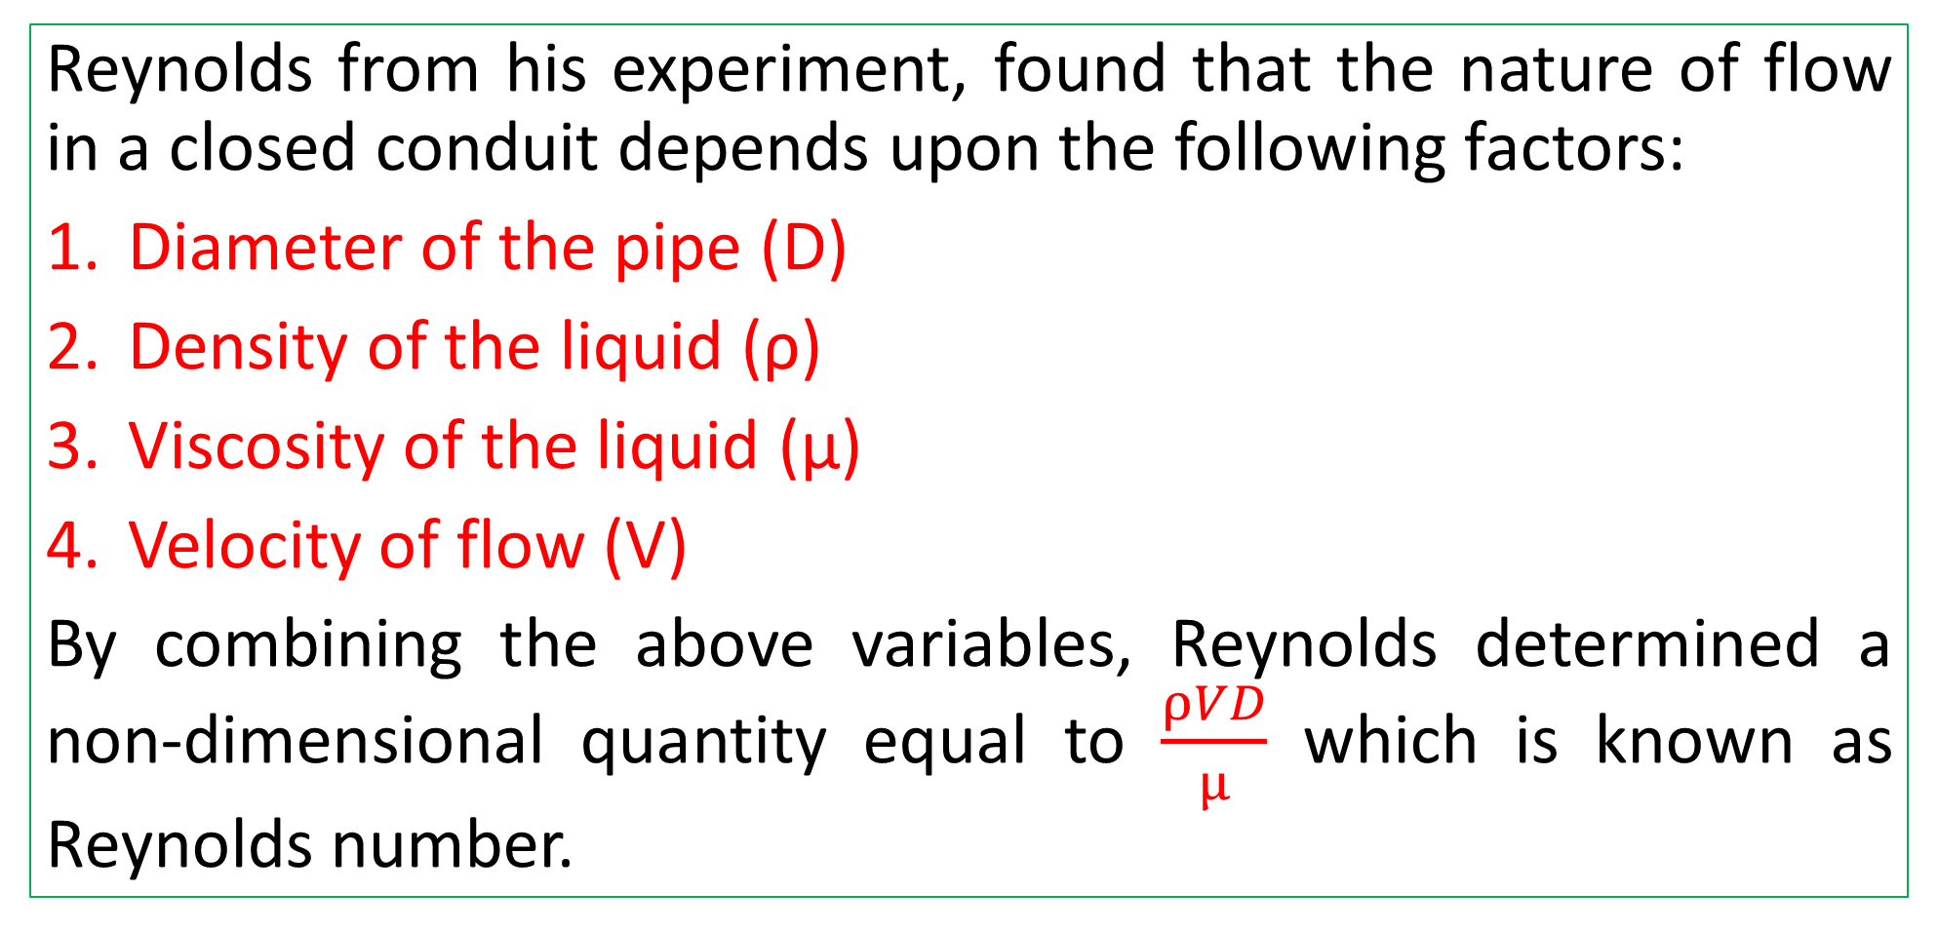
Reynolds Number, $R_{e}$
Reynolds from his experiment, found that the nature of flow in a closed conduit depends upon the following factors:
Diameter of the pipe (D)
Density of the liquid (ρ)
Viscosity of the liquid (μ)
Velocity of flow (V)
By combining the above variables, Reynolds determined a non-dimensional quantity equal to $\frac{ρVD}{μ}$ which is known as Reynolds number.

Slide 14
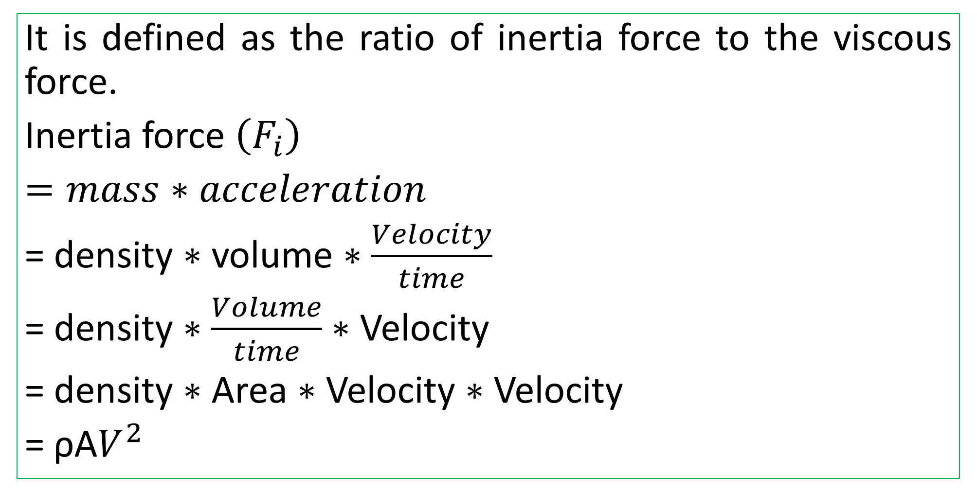
Reynolds Number, $R_{e}$
It is defined as the ratio of inertia force to the viscous force.
Inertia force $\left(F_{i}\right)$
$=mass∗acceleration$
= density $∗$ volume $∗$ $\frac{Velocity}{time}$
= density $∗$ $\frac{Volume}{time}$ $∗$ Velocity
= density $∗$ Area $∗$ Velocity $∗$ Velocity
= ρA$V^{2}$

Slide 15
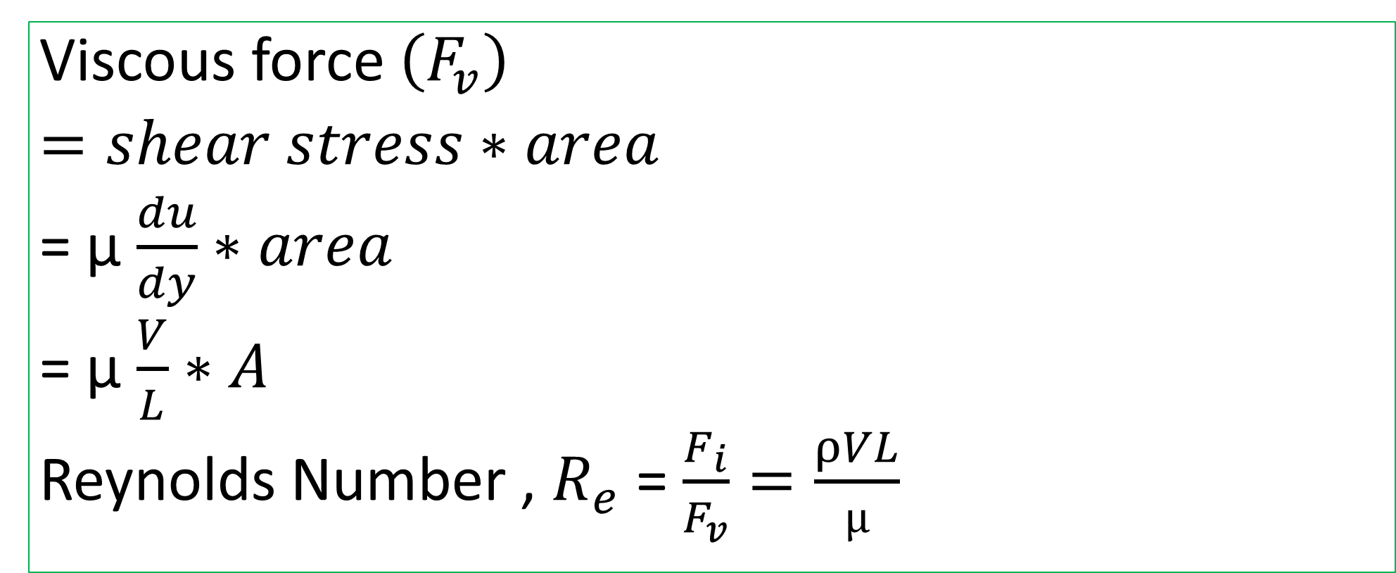
Reynolds Number, $R_{e}$
Viscous force $\left(F_{v}\right)$
$=shear stress∗area$
= µ $\frac{du}{dy}∗area$
= µ $\frac{V}{L}∗A$
Reynolds Number , $R_{e}$ = $\frac{F_{i}}{F_{v}}=\frac{ρVL}{µ}$

Slide 16
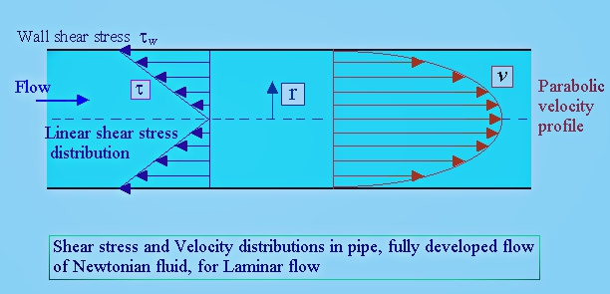
Shear Stress and Velocity Profile

Slide 17
Why Laminar Flow is AWESOME??
https://www.youtube.com/watch?v=y7Hyc3MRKno

