Slide 1
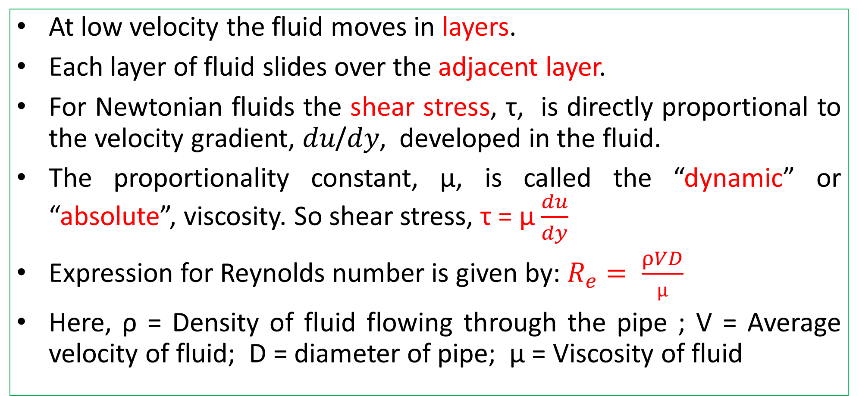
Flow of Viscous Fluid through Circular Pipe
At low velocity the fluid moves in layers.
Each layer of fluid slides over the adjacent layer.
For Newtonian fluids the shear stress, τ, is directly proportional to the velocity gradient, 𝑑𝑢/𝑑𝑦, developed in the fluid.
The proportionality constant, μ, is called the “dynamic” or “absolute”, viscosity. So shear stress, τ = µ $\frac{du}{dy}$
Expression for Reynolds number is given by: $R_{e}= \frac{ρVD}{µ}$
Here, ρ = Density of fluid flowing through the pipe ; V = Average velocity of fluid; D = diameter of pipe; µ = Viscosity of fluid

Slide 2
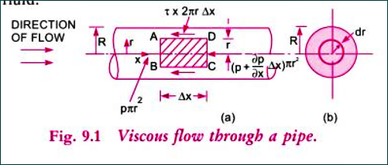
Consider a horizontal pipe of radius R.
The viscous fluid is flowing from left to right in the pipe as shown in figure.
Consider a fluid element of radius r sliding in a cylindrical fluid element of radius (r+ dr)
Let, length of fluid element = ∆x

Slide 3

Shear Stress τ across a section = $−\frac{∂p}{∂x} \frac{r}{2}$
If p is the intensity of pressure on the face AB,
then the intensity of pressure on the face CD will be p+ $\frac{∂p}{∂x} ∆x$

Slide 4
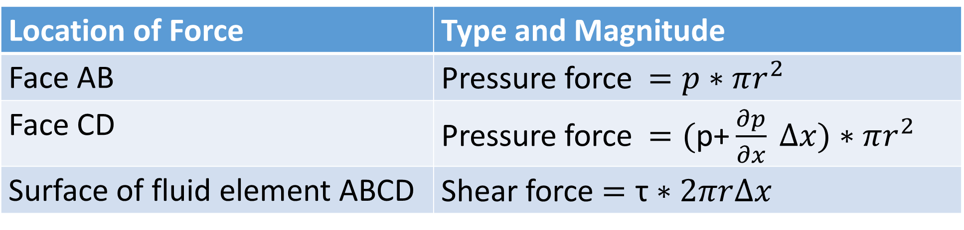
Forces acting on the fluid Element
Location of Force | Type and Magnitude
Face AB | Pressure force $=p∗πr^{2}$
Face CD | Pressure force $=\text{(}\text{p}\text{+}\frac{∂p}{∂x} ∆x)∗πr^{2}$
Surface of fluid element ABCD | Shear force $=\text{τ}∗2πr∆x$

Slide 5
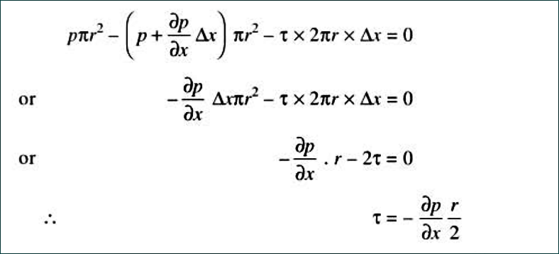
Sum of all forces in the direction of flow must be zero

Slide 6
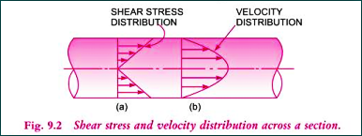
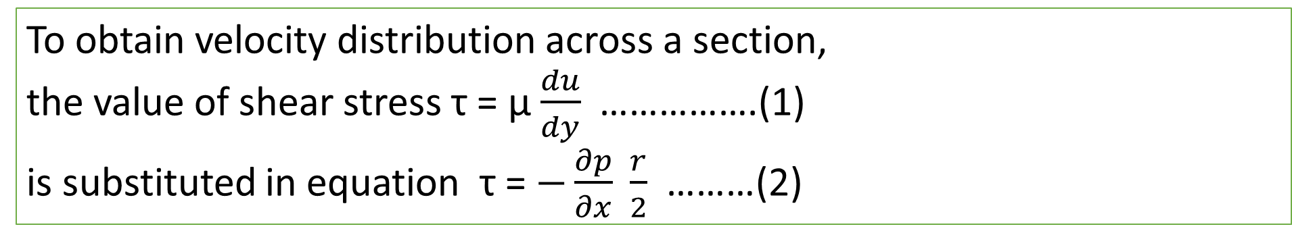
Shear stress and Velocity distribution
To obtain velocity distribution across a section,
the value of shear stress τ = µ $\frac{du}{dy}$ …………….(1)
is substituted in equation τ = $−\frac{∂p}{∂x} \frac{r}{2}$ ………(2)

Slide 7
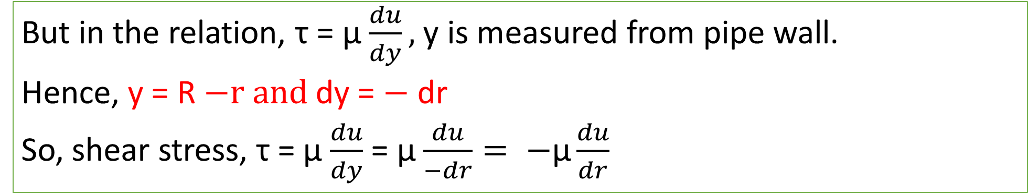
Velocity Distribution: $u=\frac{1}{4µ}\frac{∂p}{∂x}[R^{2}−r^{2}]$
But in the relation, τ = µ $\frac{du}{dy},$y is measured from pipe wall.
Hence, y = R $−r and$dy = $−$ dr
So, shear stress, τ = µ $\frac{du}{dy}$ = µ $\frac{du}{−dr}= −\text{µ}\frac{du}{dr}$

Slide 8
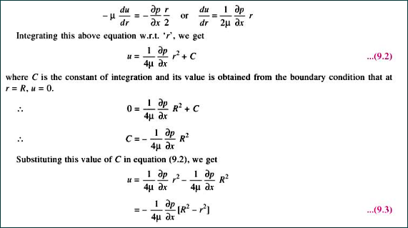
Velocity Distribution: $u=\frac{1}{4µ}\frac{∂p}{∂x}[R^{2}−r^{2}]$

Slide 9
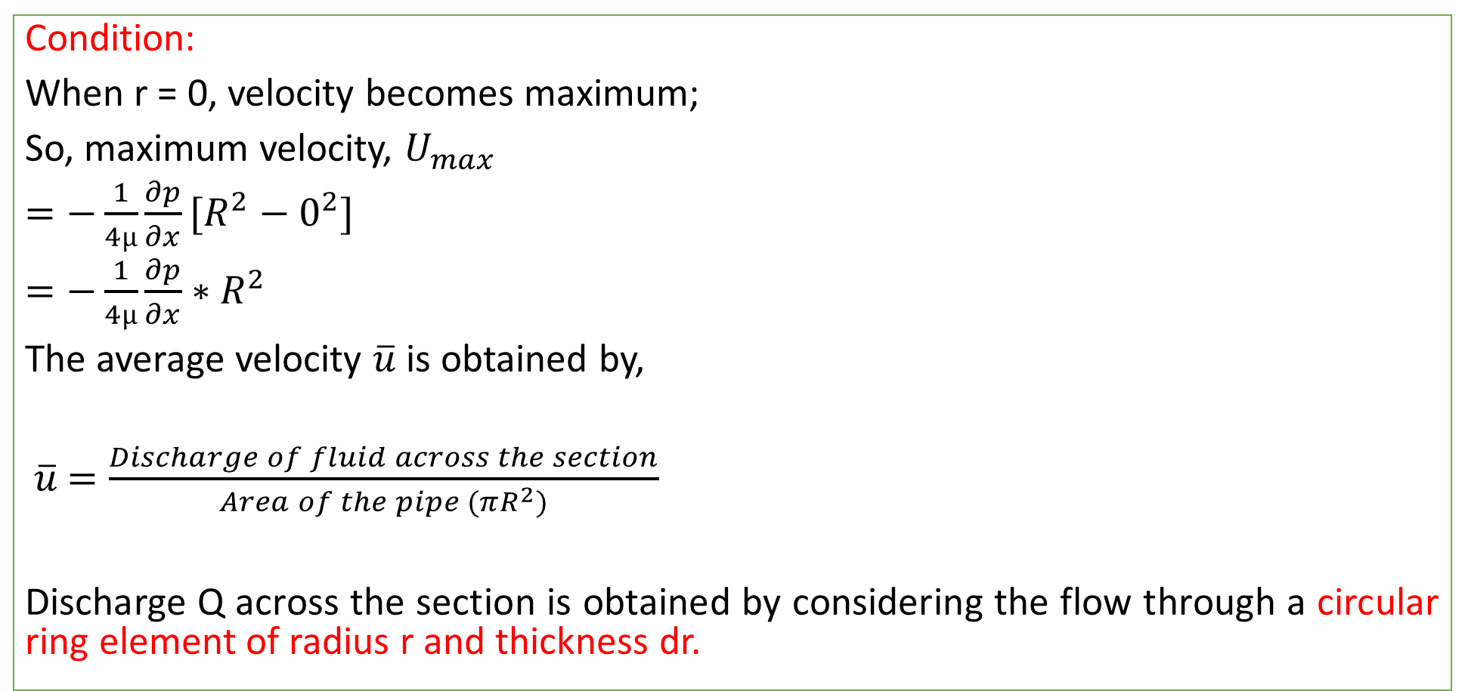
Ratio of maximum velocity to average velocity
Condition:
When r = 0, velocity becomes maximum;
So, maximum velocity, $U_{max}$
$=−\frac{1}{4µ}\frac{∂p}{∂x}[R^{2}−0^{2}]$
$=−\frac{1}{4µ}\frac{∂p}{∂x}∗R^{2}$
The average velocity $\overline{u}$ is obtained by,
$\overline{u}$ $=\frac{Discharge of fluid across the section}{Area of the pipe (πR^{2})}$
Discharge Q across the section is obtained by considering the flow through a circular ring element of radius r and thickness dr.

Slide 10
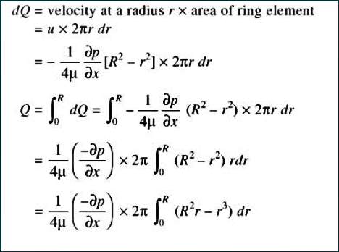
Discharge Q:

Slide 11
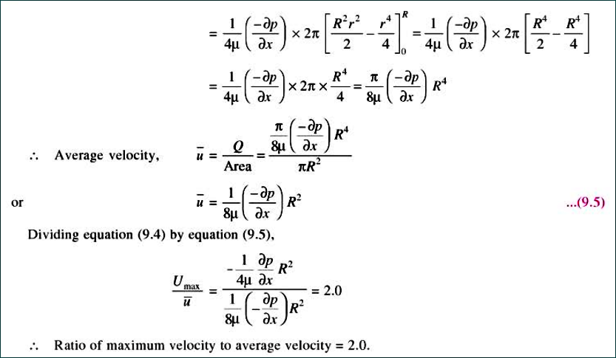

Slide 12
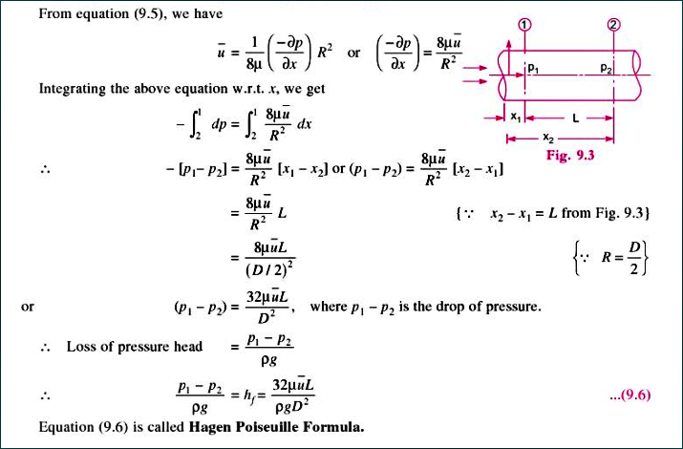
Drop of Pressure for a given length L of the pipe (Hagen Poiseuille Formula)

Slide 13
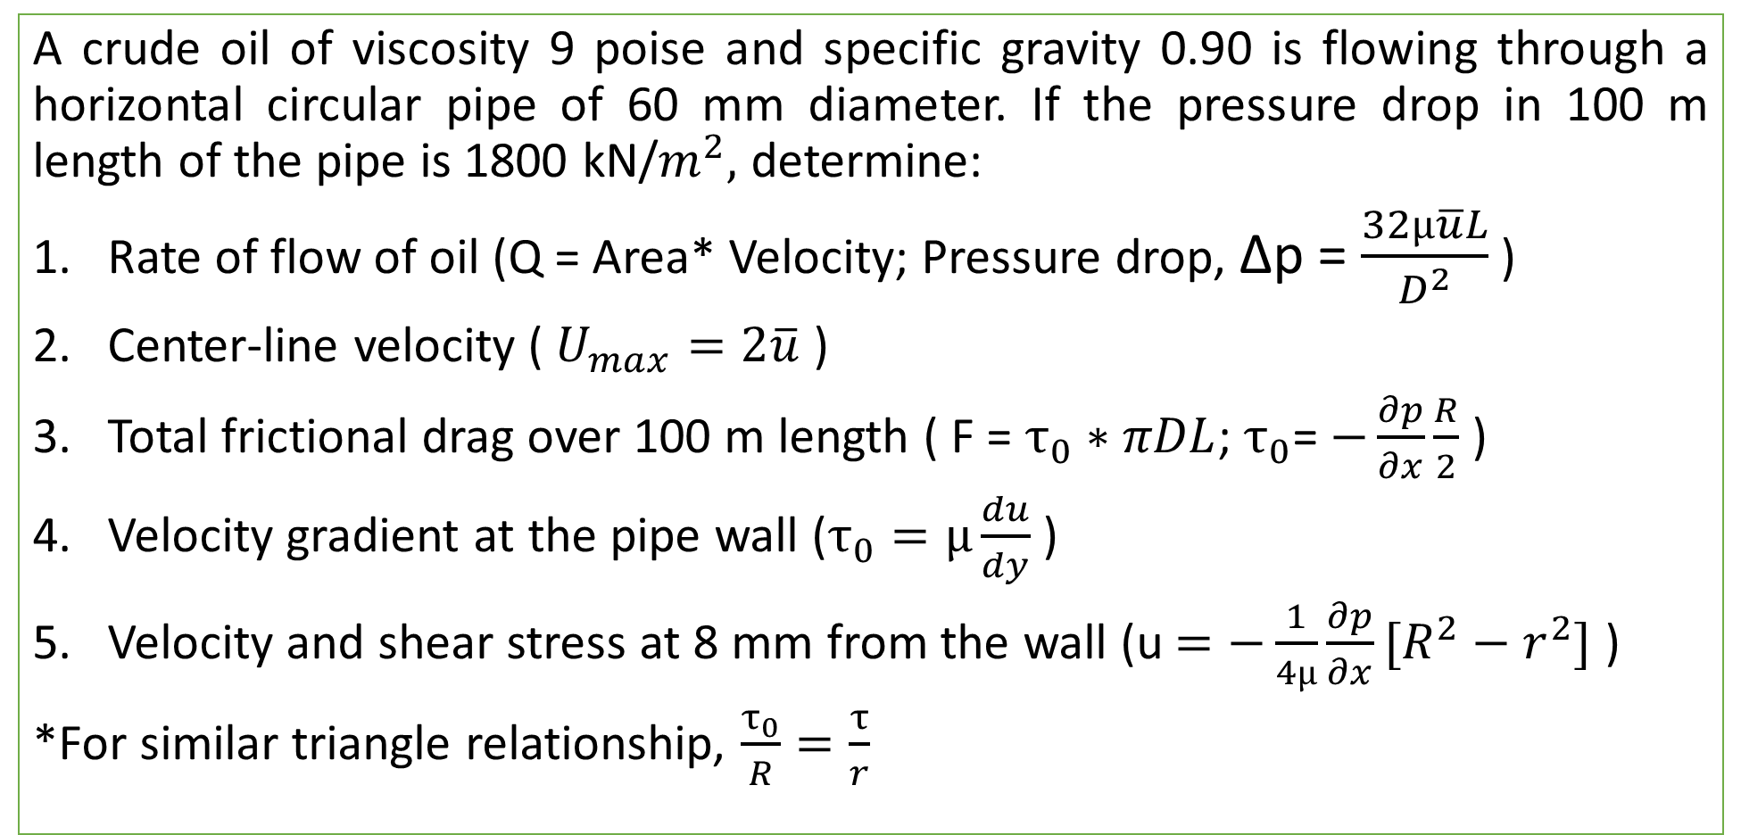
Practice Problem#18 (Rajput= Page 534)
A crude oil of viscosity 9 poise and specific gravity 0.90 is flowing through a horizontal circular pipe of 60 mm diameter. If the pressure drop in 100 m length of the pipe is 1800 kN/$m^{2},$ determine:
Rate of flow of oil (Q = Area* Velocity; Pressure drop, ∆p = $\frac{32µ\overline{u}L}{D^{2}}$ )
Center-line velocity ( $U_{max}=2\overline{u}$ )
Total frictional drag over 100 m length ( F = $τ_{0}∗πDL$; $τ_{0}$= $−\frac{∂p}{∂x}\frac{R}{2}$ )
Velocity gradient at the pipe wall ($τ_{0}=µ\frac{du}{dy}$ )
Velocity and shear stress at 8 mm from the wall (u $=−\frac{1}{4µ}\frac{∂p}{∂x}[R^{2}−r^{2}]$ )
*For similar triangle relationship, $\frac{τ_{0}}{R}=\frac{τ}{r}$

Slide 14
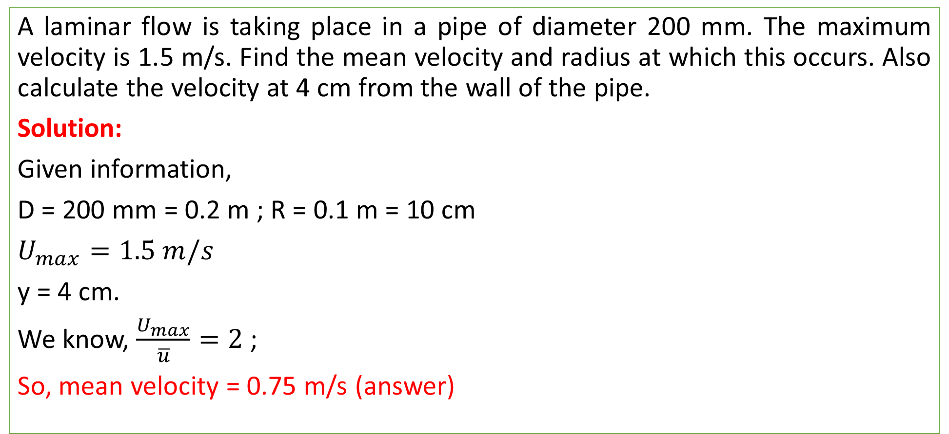
Practice Problem#19
A laminar flow is taking place in a pipe of diameter 200 mm. The maximum velocity is 1.5 m/s. Find the mean velocity and radius at which this occurs. Also calculate the velocity at 4 cm from the wall of the pipe.
Solution:
Given information,
D = 200 mm = 0.2 m ; R = 0.1 m = 10 cm
$U_{max}=1.5 m/s$
y = 4 cm.
We know, $\frac{U_{max}}{\overline{u}}=2$ ;
So, mean velocity = 0.75 m/s (answer)

Slide 15
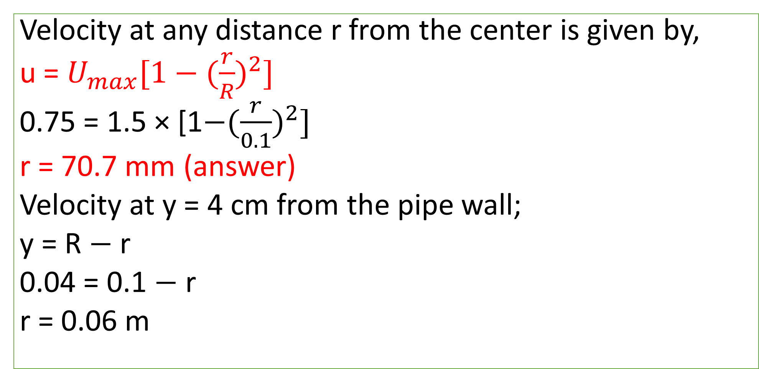
Solution
Velocity at any distance r from the center is given by,
u = $U_{max}[1−({\frac{r}{R})}^{2}]$
0.75 = 1.5 × [1$−({\frac{r}{0.1})}^{2}]$
r = 70.7 mm (answer)
Velocity at y = 4 cm from the pipe wall;
y = R $−$ r
0.04 = 0.1 $−$ r
r = 0.06 m

Slide 16
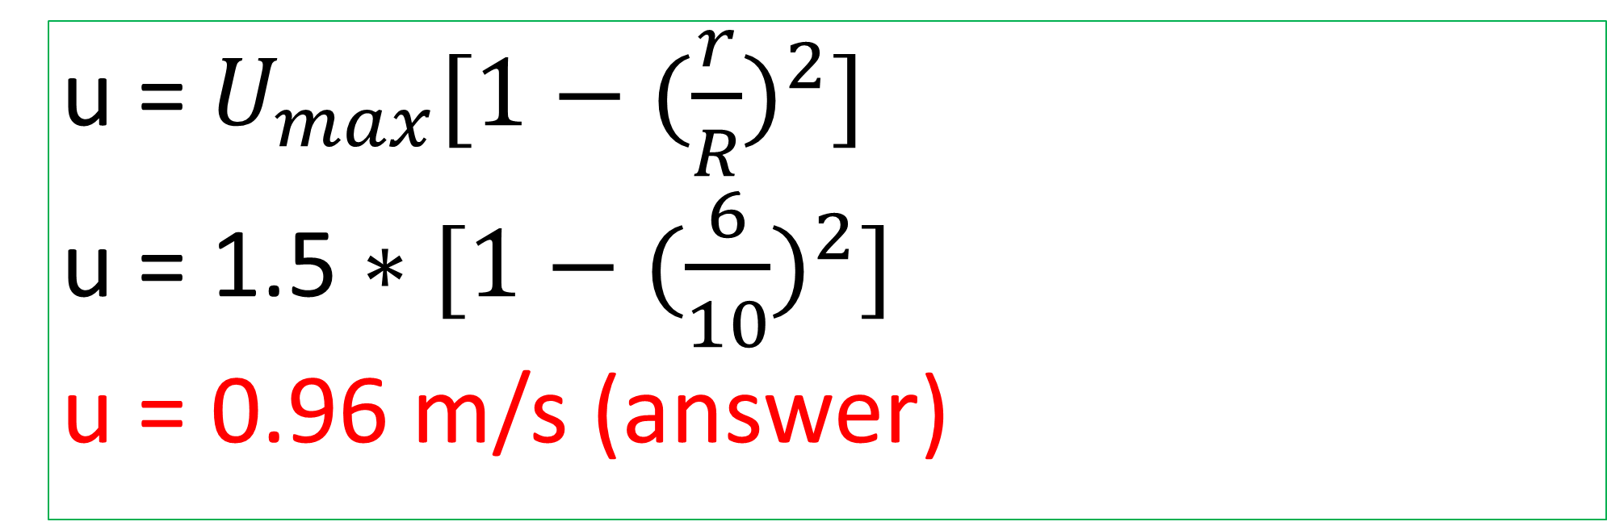
Velocity at y = 4 cm or r = 6 cm from the pipe wall
u = $U_{max}[1−({\frac{r}{R})}^{2}]$
u = 1.5 $∗[1−({\frac{6}{10})}^{2}]$
u = 0.96 m/s (answer)

Slide 17
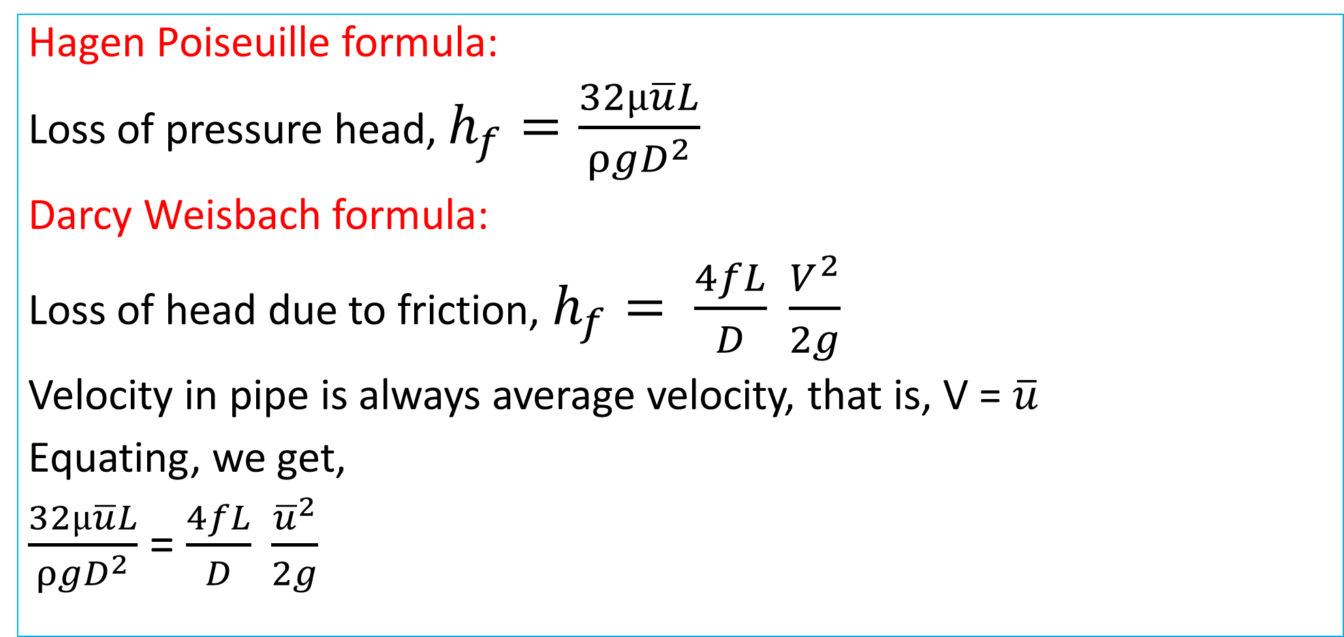
Loss of Head due to friction in Viscous flow
Hagen Poiseuille formula:
Loss of pressure head, $h_{f}=\frac{32µ\overline{u}L}{ρgD^{2}}$
Darcy Weisbach formula:
Loss of head due to friction, $h_{f}= \frac{4fL}{D} \frac{V^{2}}{2g}$
Velocity in pipe is always average velocity, that is, V = $\overline{u}$
Equating, we get,
$\frac{32µ\overline{u}L}{ρgD^{2}}$ = $\frac{4fL}{D} \frac{{\overline{u}}^{2}}{2g}$

Slide 18
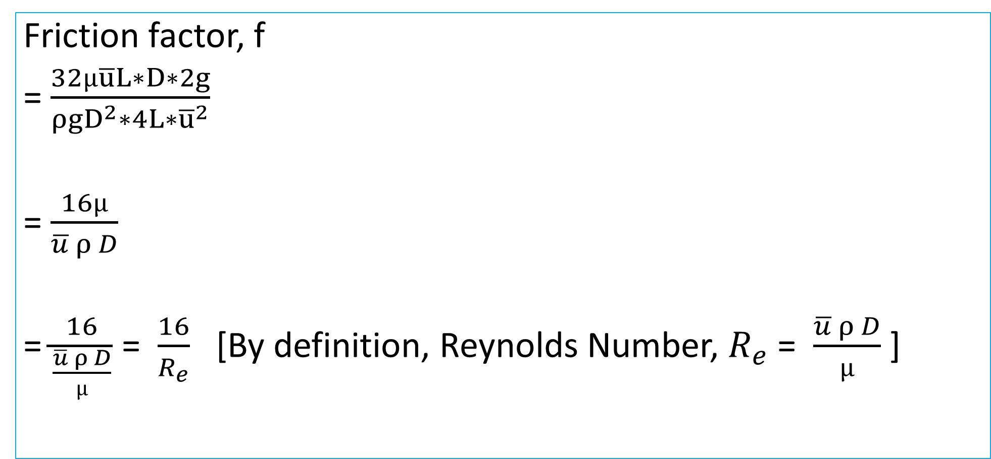
Loss of Head due to friction in Viscous flow
Friction factor, f
= $\frac{32µ\overline{u}L∗D∗2g}{ρgD^{2}∗4L∗{\overline{u}}^{2}}$
= $\frac{16µ}{\overline{u} ρ D}$
= $\frac{16}{\frac{\overline{u} ρ D}{µ}}$ = $\frac{16}{R_{e}}$ [By definition, Reynolds Number, $R_{e}$ = $\frac{\overline{u} ρ D}{µ}$ ]

Slide 19
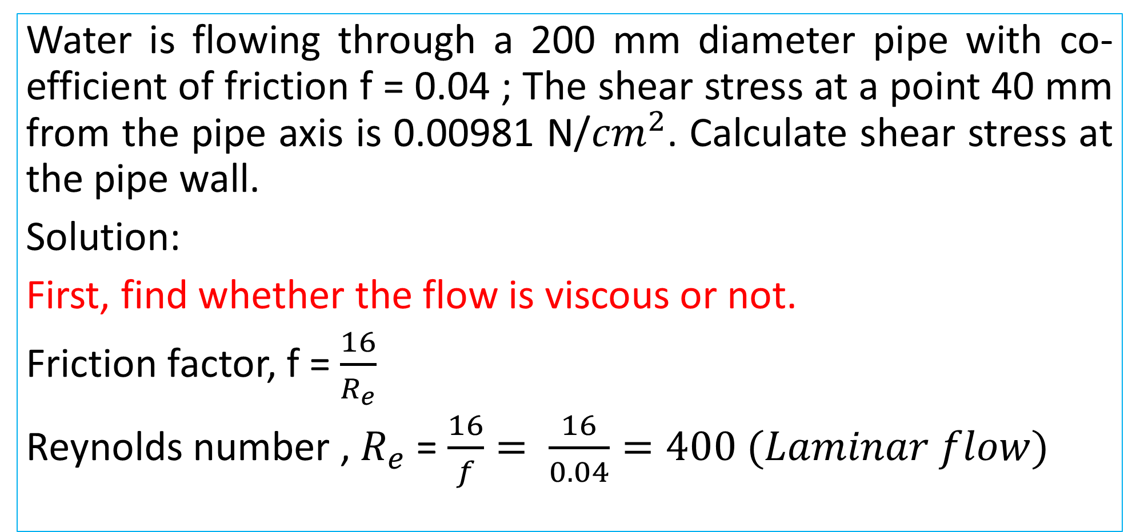
Practice Problem#20
Water is flowing through a 200 mm diameter pipe with co-efficient of friction f = 0.04 ; The shear stress at a point 40 mm from the pipe axis is 0.00981 N/${cm}^{2}$. Calculate shear stress at the pipe wall.
Solution:
First, find whether the flow is viscous or not.
Friction factor, f = $\frac{16}{R_{e}}$
Reynolds number , $R_{e}$ = $\frac{16}{f}= \frac{16}{0.04}=400 (Laminar flow)$

Slide 20

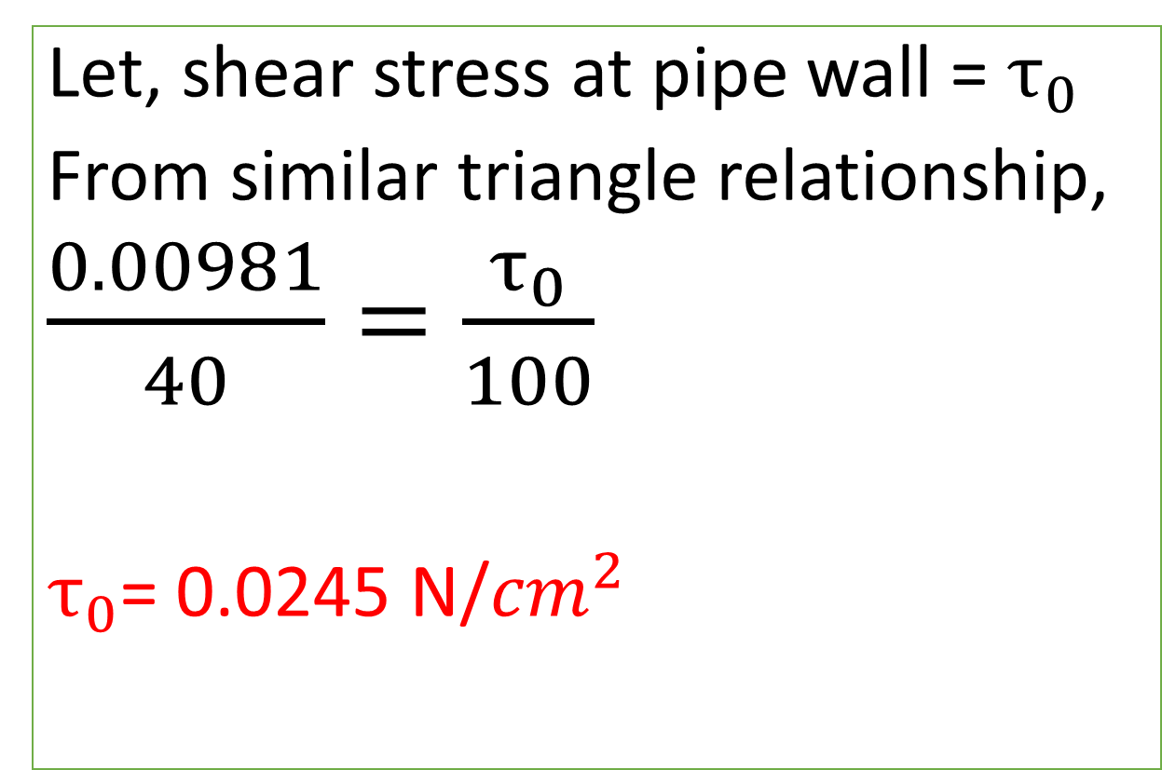
Solution
Let, shear stress at pipe wall = $τ_{0}$
From similar triangle relationship,
$\frac{0.00981}{40}=\frac{τ_{0}}{100}$
$τ_{0}$= 0.0245 N/${cm}^{2}$
$$τ_{0}$$
100 mm
τ = 0.00981
40 mm

