Slide 1
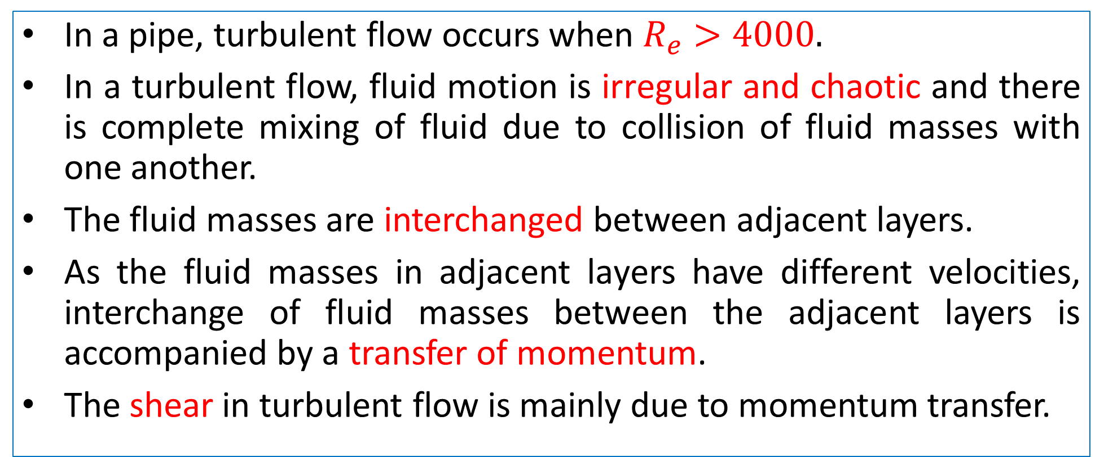
Turbulent Flow
In a pipe, turbulent flow occurs when $R_{e}>4000.$
In a turbulent flow, fluid motion is irregular and chaotic and there is complete mixing of fluid due to collision of fluid masses with one another.
The fluid masses are interchanged between adjacent layers.
As the fluid masses in adjacent layers have different velocities, interchange of fluid masses between the adjacent layers is accompanied by a transfer of momentum.
The shear in turbulent flow is mainly due to momentum transfer.

Slide 2
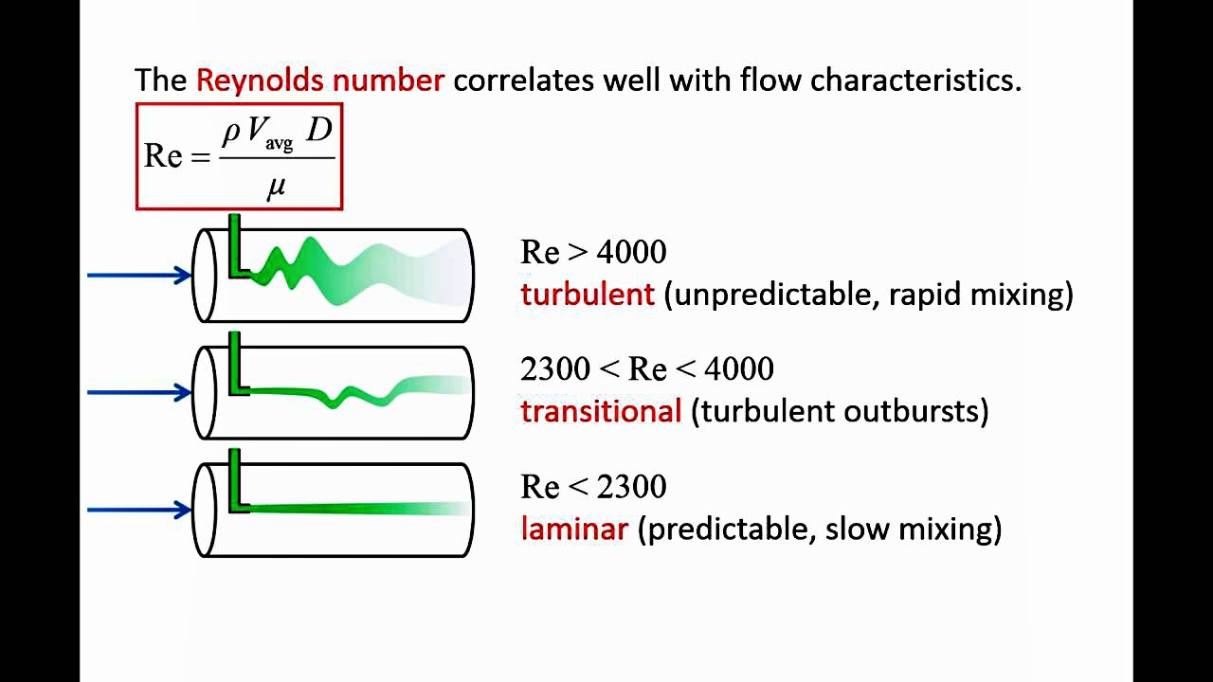
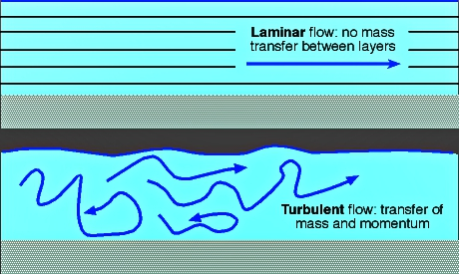
Transfer of Momentum in Turbulent flow

Slide 3
Velocity distribution curve for Laminar and Turbulent flow
The velocity distribution in turbulent flow is more uniform than in laminar flow.
In turbulent flow, the velocity gradients near the boundary wall shall be quite large resulting in more shear.
In turbulent flow, the flatness of velocity distribution curve in the core region away from the wall is because of mixing of fluid layers and exchange of momentum between them.
The velocity distribution which is paraboloid in laminar flow tends to follow logarithmic variation in turbulent flow.
Random orientation of fluid particles in a turbulent flow gives rise to additional stresses, called Reynolds stresses.

Slide 4
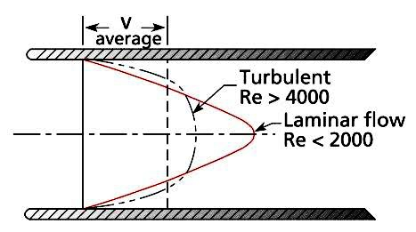
Velocity Distribution Curve

Slide 5
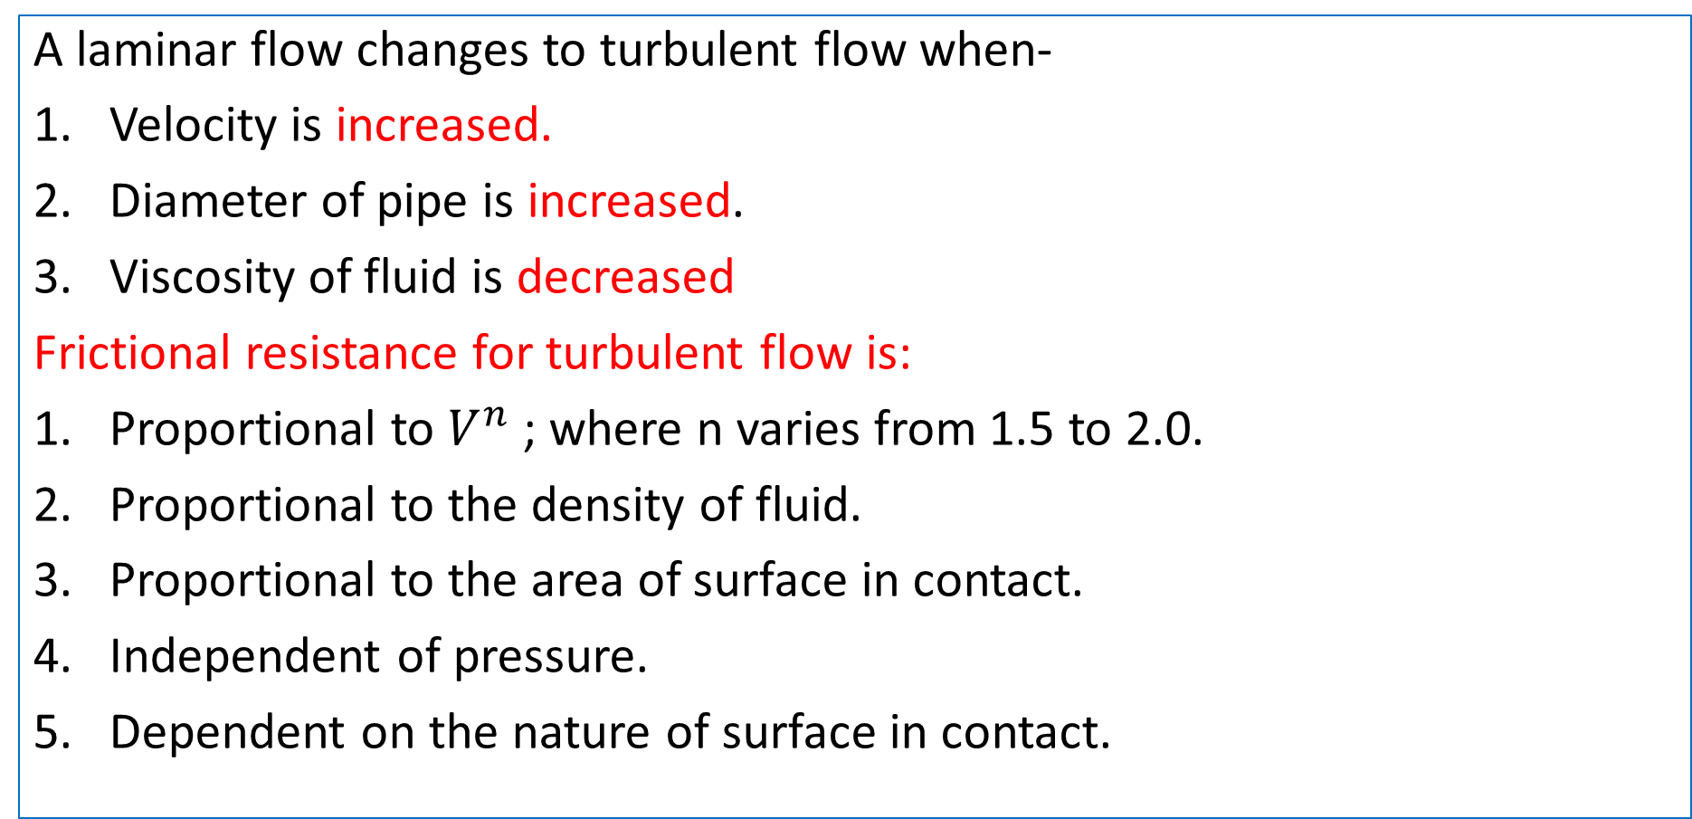
Laminar-Turbulent
A laminar flow changes to turbulent flow when-
Velocity is increased.
Diameter of pipe is increased.
Viscosity of fluid is decreased
Frictional resistance for turbulent flow is:
Proportional to $V^{n}$; where n varies from 1.5 to 2.0.
Proportional to the density of fluid.
Proportional to the area of surface in contact.
Independent of pressure.
Dependent on the nature of surface in contact.

Slide 6
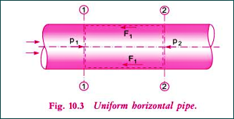
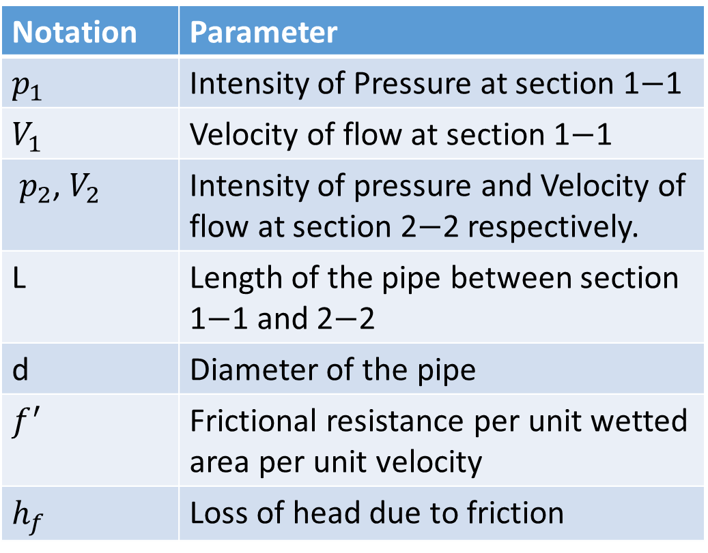
Loss of Head due to Friction in Pipe flow (Darcy Equation)
Notation | Parameter
$p_{1}$ | Intensity of Pressure at section 1$−$1
$V_{1}$ | Velocity of flow at section 1$−$1
$p_{2}$, $V_{2}$ | Intensity of pressure and Velocity of flow at section 2$−$2 respectively.
L | Length of the pipe between section 1$−$1 and 2$−$2
d | Diameter of the pipe
$f^{′}$ | Frictional resistance per unit wetted area per unit velocity
$h_{f}$ | Loss of head due to friction

Slide 7
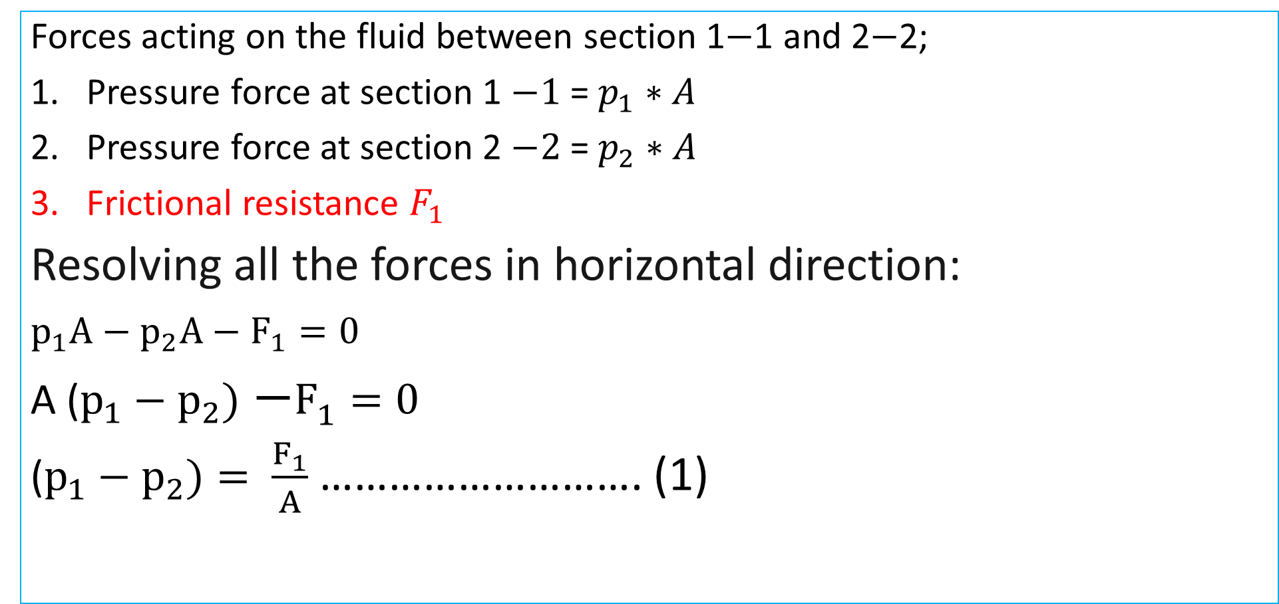
Loss of Head due to Friction in Pipe flow (Darcy Equation)
Forces acting on the fluid between section 1$−$1 and 2$−$2;
Pressure force at section 1 $−1$= $p_{1}∗A$
Pressure force at section 2 $−2$= $p_{2}∗A$
Frictional resistance $F_{1}$
Resolving all the forces in horizontal direction:
$p_{1}A−p_{2}A−F_{1}=0$
A ($p_{1}−p_{2})$ $−F_{1}=0$
($p_{1}−p_{2})$ $= \frac{F_{1}}{A}$ ………………………. (1)

Slide 8
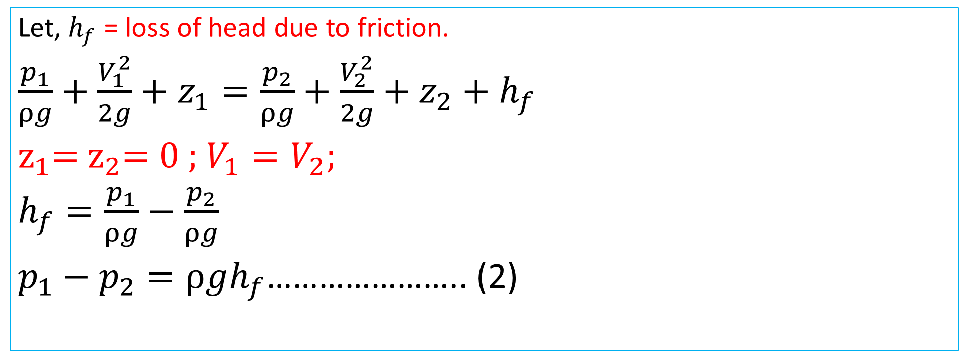
Applying Bernoulli's equation at section 1$−$1 and 2$−$2;
Applying Bernoulli's equation at section 1−1 and 2−2;
Let, $h_{f}$ = loss of head due to friction.
$\frac{p_{1}}{ρg}+\frac{V_{1}^{2}}{2g}+z_{1}=\frac{p_{2}}{ρg}+\frac{V_{2}^{2}}{2g}+z_{2}+h_{f}$
$z_{1}$= $z_{2}$= 0 ; $V_{1}=V_{2};$
$h_{f}=\frac{p_{1}}{ρg}−\frac{p_{2}}{ρg}$
$p_{1}−p_{2}=ρgh_{f}$………………….. (2)

Slide 9
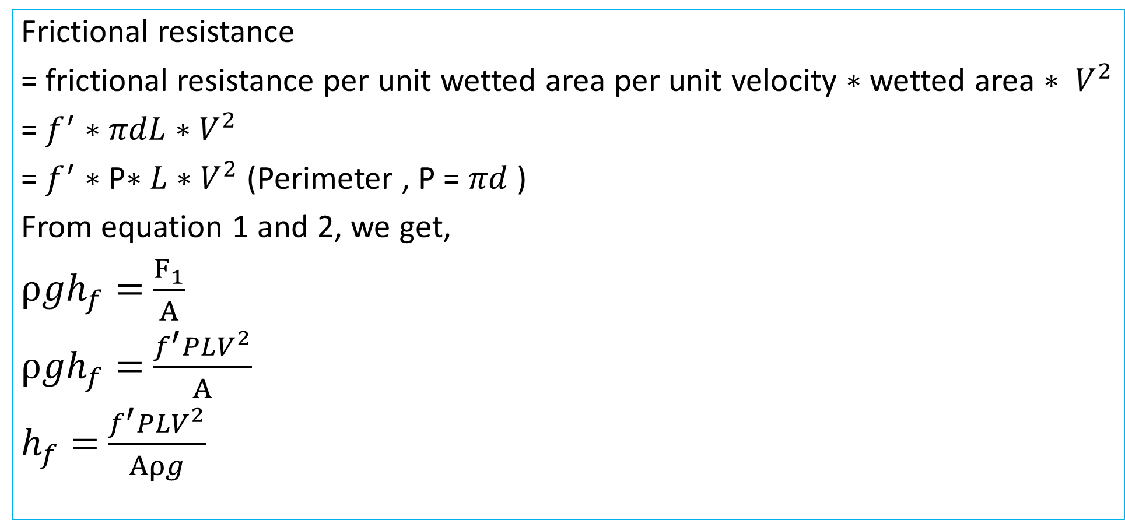
Frictional Resistance, $F_{1}$
Frictional resistance
= frictional resistance per unit wetted area per unit velocity $∗$ wetted area $∗ V^{2}$
= $f^{′}∗$ $πdL∗V^{2}$
= $f^{′}∗$ P$∗L∗V^{2}$ (Perimeter , P = $πd$ )
From equation 1 and 2, we get,
$ρgh_{f}=$ $\frac{F_{1}}{A}$
$ρgh_{f}=$ $\frac{f^{′}PLV^{2}}{A}$
$h_{f}=$ $\frac{f^{′}PLV^{2}}{Aρg}$

Slide 10
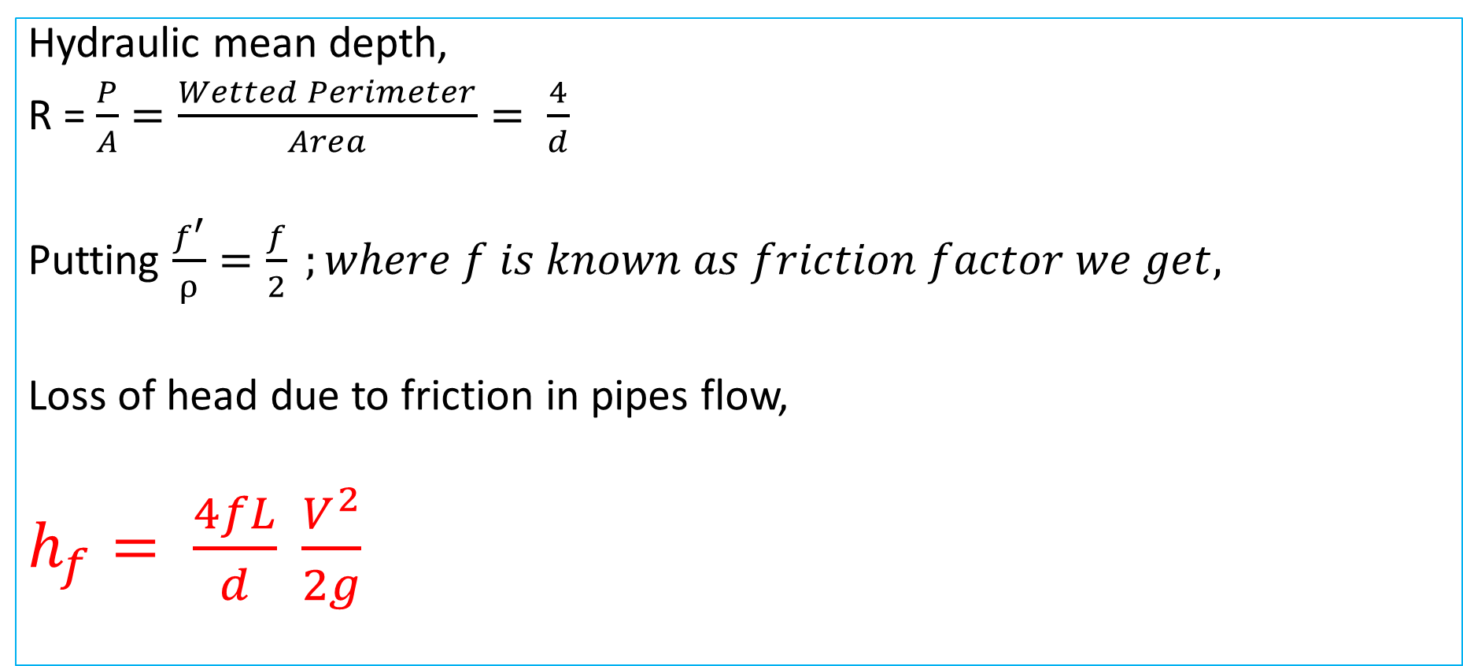
Darcy Weisbach Equation
Hydraulic mean depth,
R = $\frac{P}{A}=\frac{Wetted Perimeter}{Area}= \frac{4}{d}$
Putting $\frac{f^{′}}{ρ}=\frac{f}{2} ;where f is known as friction factor we get,$
Loss of head due to friction in pipes flow,
$h_{f}= \frac{4fL}{d} \frac{V^{2}}{2g}$

