Slide 1
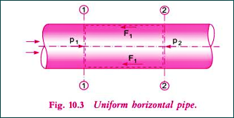
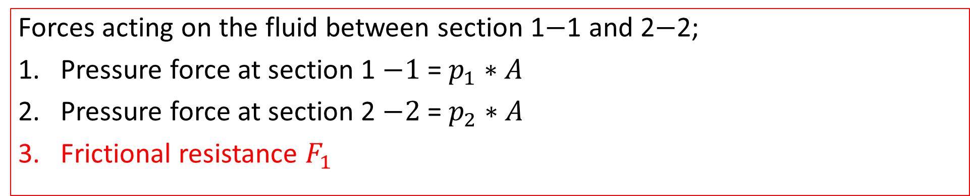
Expression for Co-efficient of Friction in terms of shear stress
Forces acting on the fluid between section 1$−$1 and 2$−$2;
Pressure force at section 1 $−1$= $p_{1}∗A$
Pressure force at section 2 $−2$= $p_{2}∗A$
Frictional resistance $F_{1}$

Slide 2
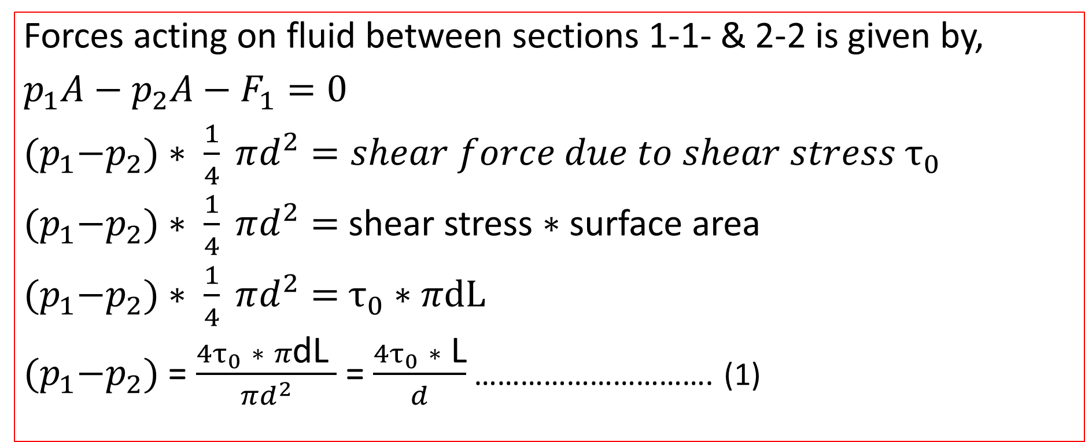
Expression for Co-efficient of Friction in terms of shear stress
Forces acting on fluid between sections 1-1- & 2-2 is given by,
$p_{1}A−p_{2}A−F_{1}=0$
${(p}_{1}−p_{2})∗ \frac{1}{4} πd^{2}=shear force due to shear stress$ $τ_{0}$
${(p}_{1}−p_{2})∗ \frac{1}{4} πd^{2}=$ shear stress $∗$ surface area
${(p}_{1}−p_{2})∗ \frac{1}{4} πd^{2}=$ $τ_{0}$ $∗$ $πdL$
${(p}_{1}−p_{2})$ = $\frac{{4τ}_{0} ∗ π\text{dL} }{πd^{2}}$ = $\frac{{4τ}_{0} ∗ \text{L}}{d}$ …………………………. (1)

Slide 3

Expression for Co-efficient of Friction in terms of shear stress
From Darcy-Weisbach equation,
$h_{f}= \frac{4fL}{d} \frac{V^{2}}{2g}$
$\frac{p_{1}−p_{2}}{ρg}=\frac{4fL}{d} \frac{V^{2}}{2g}$
$p_{1}−p_{2}=\frac{4fL}{d} \frac{V^{2}}{2g}∗ρg$ ………………….(2)
Equating, we get,
Friction factor , f = $\frac{2τ_{0}}{ρV^{2}}$

Slide 4
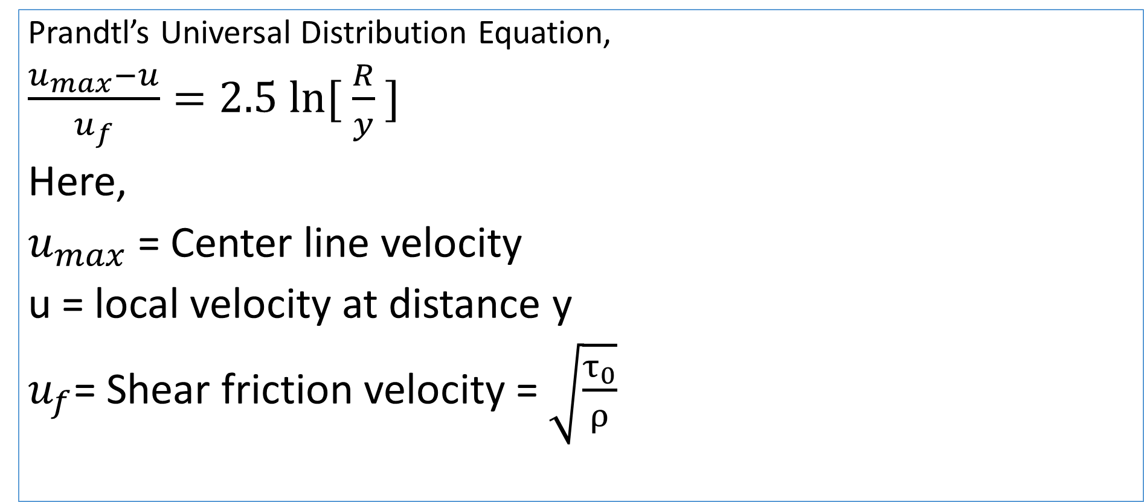
Velocity distribution in turbulent flow:
Prandtl’s Universal Distribution Equation,
$\frac{u_{max}−u}{u_{f}}=2.5 ln⁡[ \frac{R}{y} ]$
Here,
$u_{max}$ = Center line velocity
u = local velocity at distance y
$u_{f}$= Shear friction velocity = $\sqrt{\frac{τ_{0}}{ρ}}$

Slide 5
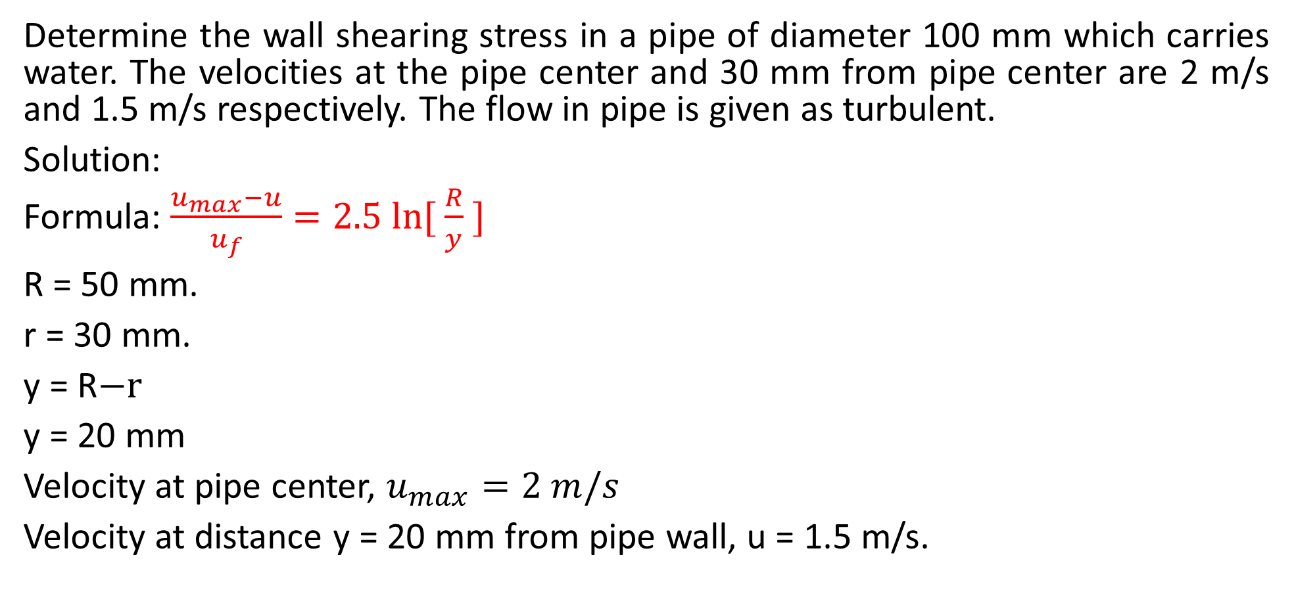
Practice Problem#21 (Bansal= 445)
Determine the wall shearing stress in a pipe of diameter 100 mm which carries water. The velocities at the pipe center and 30 mm from pipe center are 2 m/s and 1.5 m/s respectively. The flow in pipe is given as turbulent.
Solution:
Formula: $\frac{u_{max}−u}{u_{f}}=2.5 ln⁡[ \frac{R}{y} ]$
R = 50 mm.
r = 30 mm.
y = R$−r$
y = 20 mm
Velocity at pipe center, $u_{max}=2 m/s$
Velocity at distance y = 20 mm from pipe wall, u = 1.5 m/s.

Slide 6
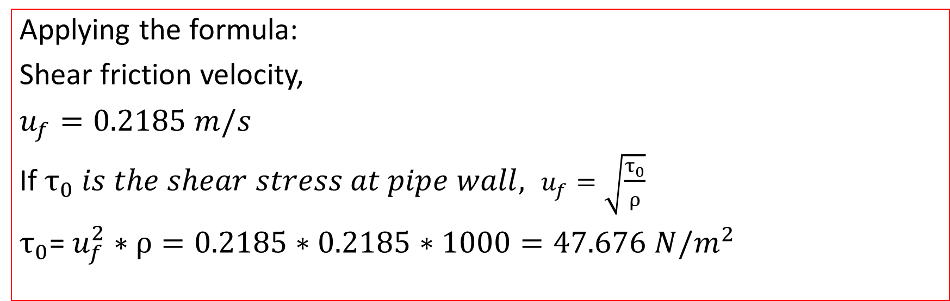
Solution
Applying the formula:
Shear friction velocity,
$u_{f}=0.2185 m/s$
If $τ_{0} is the shear stress at pipe wall, u_{f}=\sqrt{\frac{τ_{0}}{ρ}}$
$τ_{0}$= $u_{f}^{2}∗ρ=0.2185∗0.2185∗1000=47.676 N/m^{2}$

