Slide 1
Download Class Lecture Slides from here:
https://plus.google.com/+AhmedHossain090001
http://www.ruet.ac.bd/teacher/CE/Ahmed%20Hossain

Slide 2
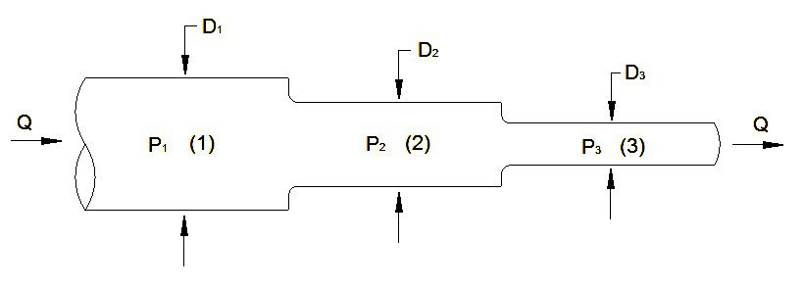
Flow Through Pipes
Definition of Pipe:
A pipe is a closed conduit (generally of circular section) which is used for carrying fluid under pressure.
The flow in a pipe is termed as pipe flow only when the fluid completely fills the cross-section and there is no free surface of fluid.

Slide 3
Loss of Energy (or Head) in Pipes
When water flows in a pipe, it experiences some resistance to its motion, due to which its velocity and ultimately the head of water available is reduced.
Loss of energy (or head) is classified as follows:
Major Energy Losses: Loss due to friction.
Minor Energy Losses:
Sudden enlargement of pipe.
Sudden contraction of pipe.
Bend of Pipe.
An obstruction in pipe.
Pipe fittings, etc.

Slide 4
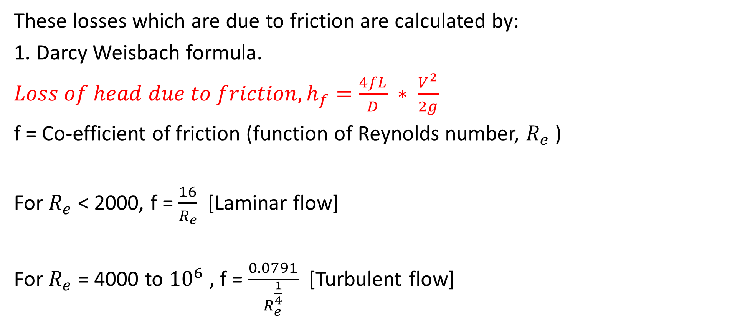
Major Energy Losses
These losses which are due to friction are calculated by:
1. Darcy Weisbach formula.
${Loss of head due to friction, h}_{f}=\frac{4fL}{D} ∗ \frac{V^{2}}{2g}$
f = Co-efficient of friction (function of Reynolds number, $R_{e}$ )
For $R_{e}$ < 2000, f = $\frac{16}{R_{e}}$ [Laminar flow]
For $R_{e}$ = 4000 to ${10}^{6}$ , f = $\frac{0.0791}{R_{e}^{\frac{1}{4}}}$ [Turbulent flow]

Slide 5
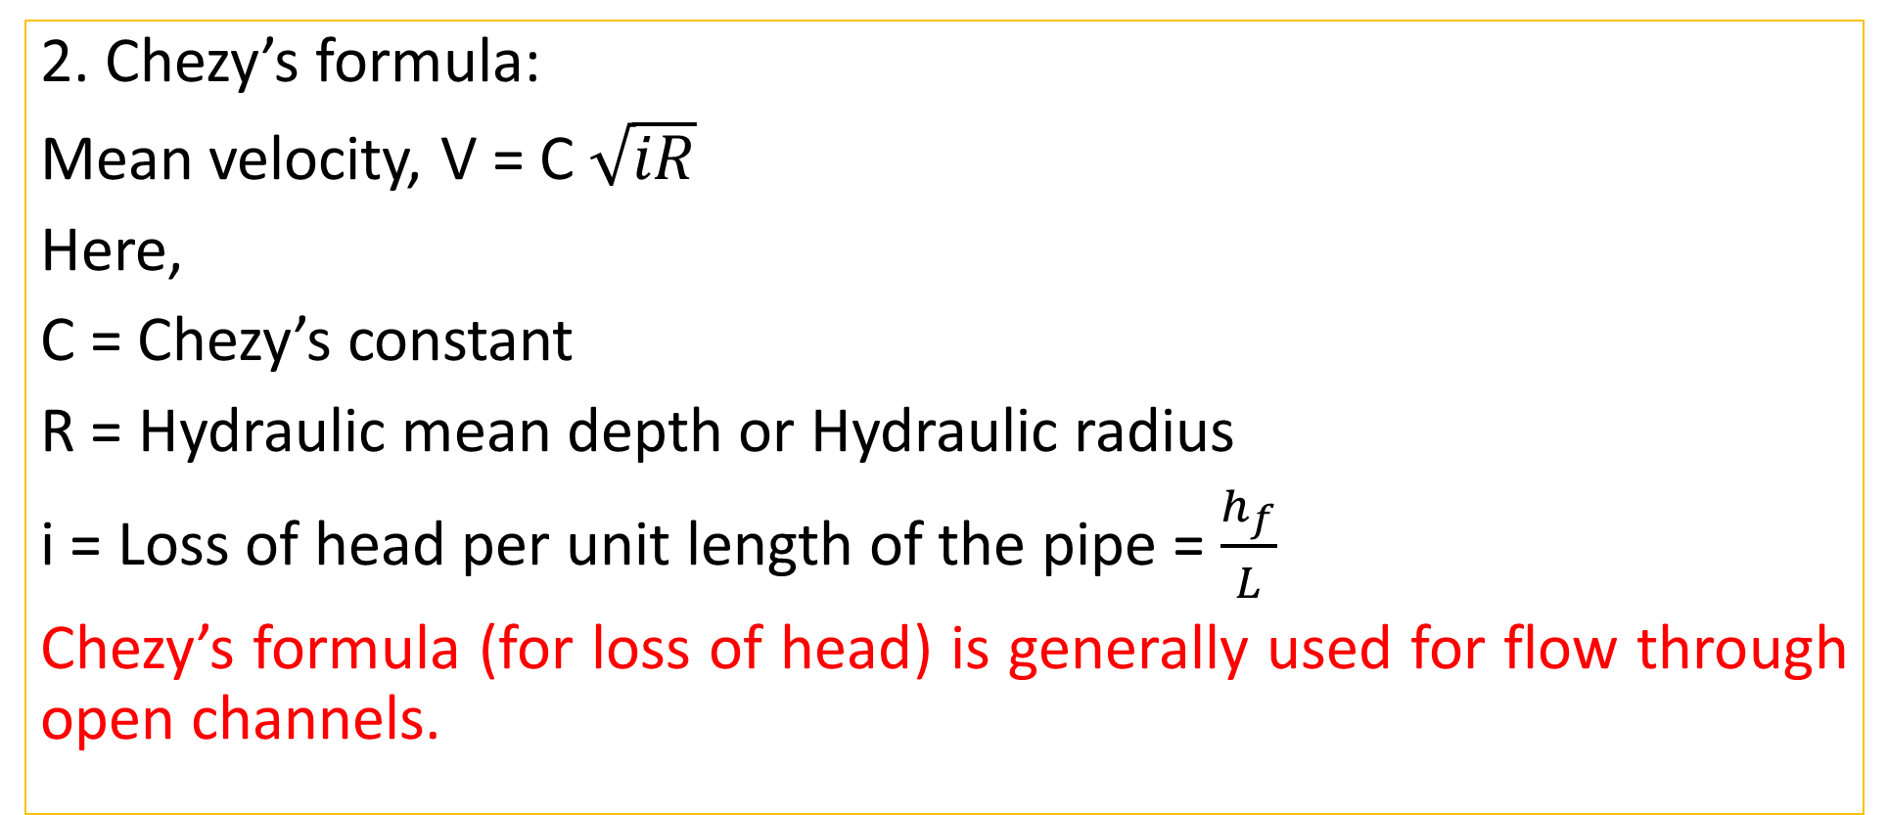
Major Energy Losses
2. Chezy’s formula:
Mean velocity, V = C $\sqrt{iR}$
Here,
C = Chezy’s constant
R = Hydraulic mean depth or Hydraulic radius
i = Loss of head per unit length of the pipe = $\frac{h_{f}}{L}$
Chezy’s formula (for loss of head) is generally used for flow through open channels.

Slide 6
Practice Problem#21
Water is to be applied to the students of Zia Hall of RUET through a supply main. The following data is given:
Distance of the reservoir from the campus = 3000 meter.
Number of inhabitants = 4000
Consumption of water per day of each inhabitant = 180 Liters.
Loss of head due to friction = 18 meter
Co-efficient of friction for the pipe, f = 0.007
If half of the daily supply is pumped in 8 hours, determine size of the supply main.

Slide 7
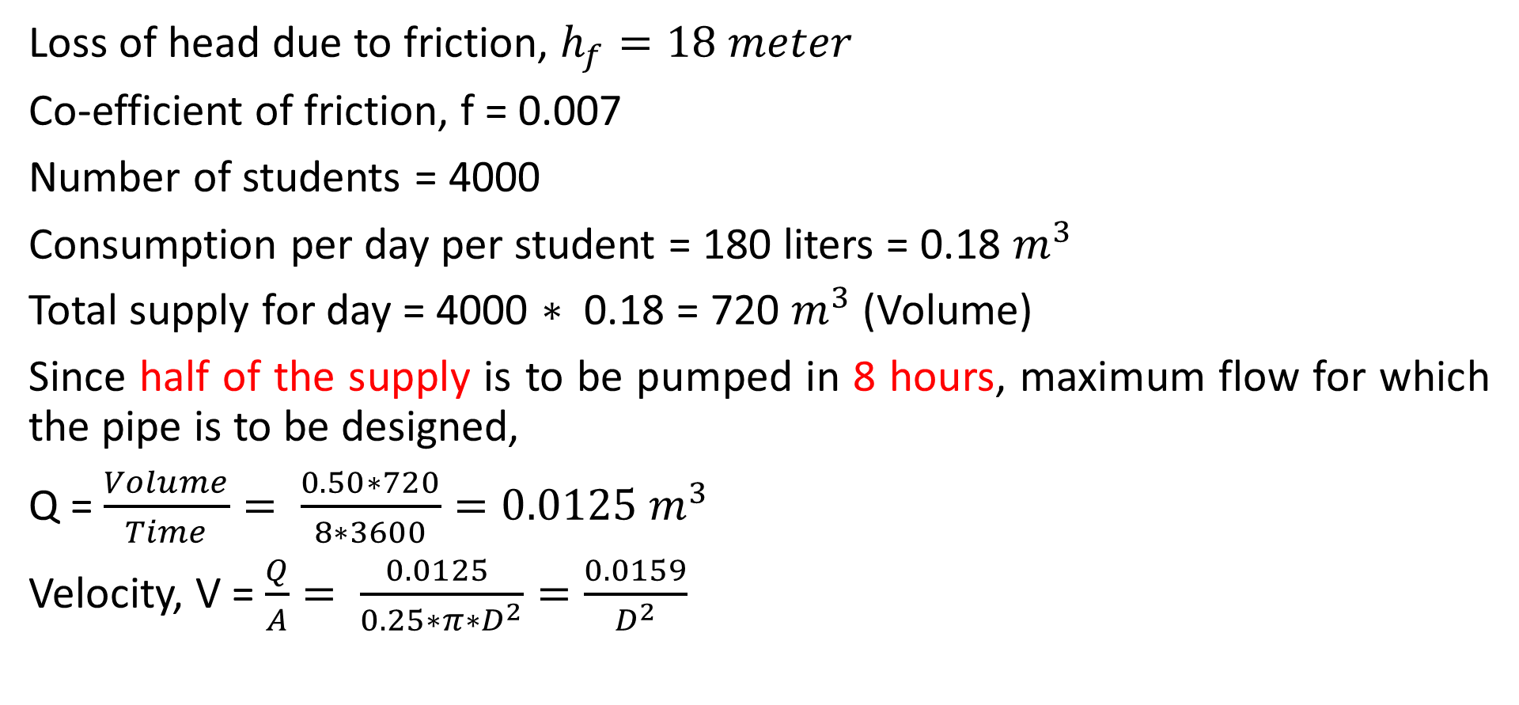
Solution
Loss of head due to friction, $h_{f}=18 meter$
Co-efficient of friction, f = 0.007
Number of students = 4000
Consumption per day per student = 180 liters = 0.18 $m^{3}$
Total supply for day = 4000 $∗$ 0.18 = 720 $m^{3}$ (Volume)
Since half of the supply is to be pumped in 8 hours, maximum flow for which the pipe is to be designed,
Q = $\frac{Volume}{Time}= \frac{0.50∗720}{8∗3600}=0.0125 m^{3}$
Velocity, V = $\frac{Q}{A}= \frac{0.0125 }{0.25∗π∗D^{2}}=\frac{0.0159}{D^{2}}$

Slide 8

Solution
Using the relation,
${Loss of head due to friction, h}_{f}=\frac{4fL}{D} ∗ \frac{V^{2}}{2g}$
Diameter, D = 0.143 meter or 143 mm.

Slide 9
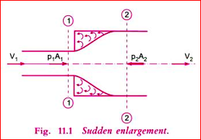
Minor Energy Losses
Loss of Head due to sudden enlargement:
Video link: https://vimeo.com/193012607

Slide 10
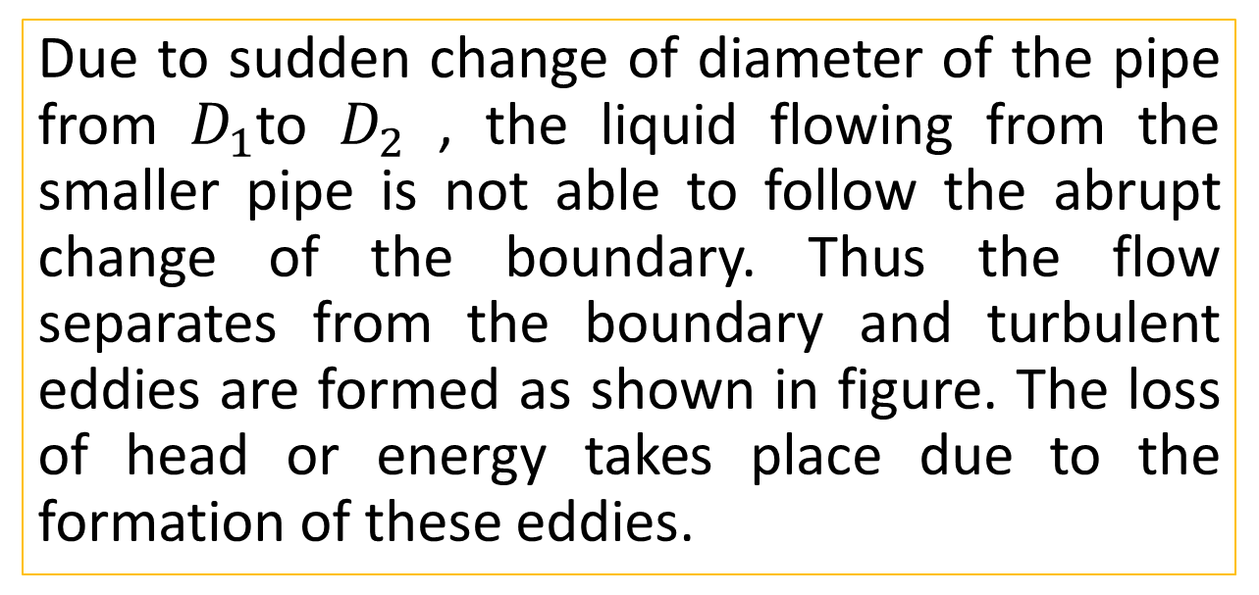

Step 1: Apply Bernoulli’s equation
Due to sudden change of diameter of the pipe from $D_{1}$to $D_{2}$ , the liquid flowing from the smaller pipe is not able to follow the abrupt change of the boundary. Thus the flow separates from the boundary and turbulent eddies are formed as shown in figure. The loss of head or energy takes place due to the formation of these eddies.
Applying Bernoulli’s Equation to section 1-1 and 2-2,
$$\frac{p_{1}}{γ}+\frac{V_{1}^{2}}{2g}+Z_{1}=\frac{p_{2}}{γ}+\frac{V_{2}^{2}}{2g}+Z_{2}+ h_{e}$$
$h_{e}$= $(\frac{p_{1}}{γ}−$ $\frac{p_{2}}{γ}$) + ( $\frac{V_{1}^{2}}{2g}−$ $\frac{V_{2}^{2}}{2g}$ )

Slide 11
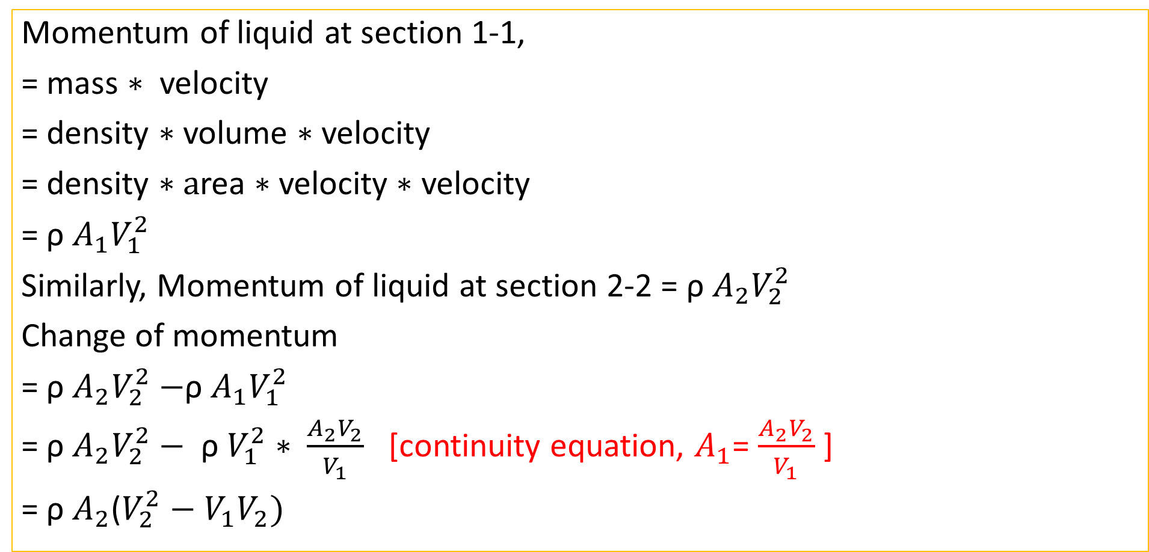
Step 2: Change of Momentum
Momentum of liquid at section 1-1,
= mass $∗$ velocity
= density $∗$volume $∗$velocity
= density $∗a$rea $∗$velocity $∗$ velocity
= ρ $A_{1}V_{1}^{2}$
Similarly, Momentum of liquid at section 2-2 = ρ $A_{2}V_{2}^{2}$
Change of momentum
= ρ $A_{2}V_{2}^{2}−$ρ $A_{1}V_{1}^{2}$
= ρ $A_{2}V_{2}^{2}−$ ρ $V_{1}^{2}∗ \frac{A_{2}V_{2}}{V_{1}}$ [continuity equation, $A_{1}$= $\frac{A_{2}V_{2}}{V_{1}}$ ]
= ρ $A_{2}$($V_{2}^{2}−V_{1}V_{2})$

Slide 12
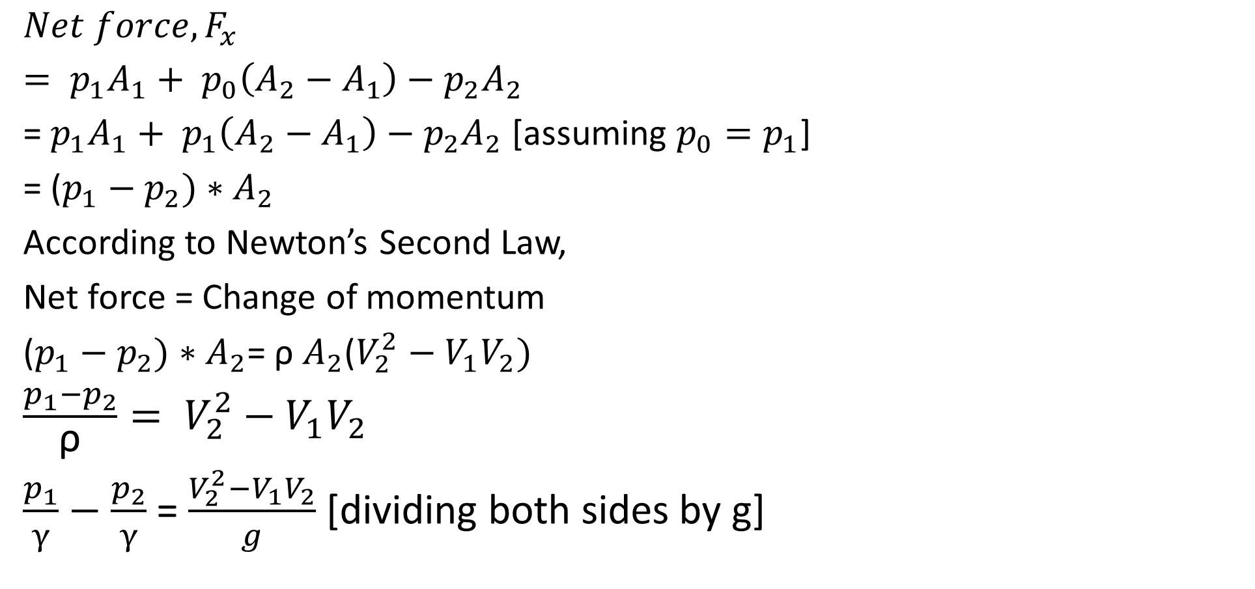
Step 3: Net force acting on the liquid
${Net force, F}_{x}$
$= p_{1}A_{1}+ p_{0}\left(A_{2}−A_{1}\right)−p_{2}A_{2}$
= $p_{1}A_{1}+ p_{1}\left(A_{2}−A_{1}\right)−p_{2}A_{2}$ [assuming $p_{0}=p_{1}$]
= ($p_{1}−p_{2})∗A_{2}$
According to Newton’s Second Law,
Net force = Change of momentum
($p_{1}−p_{2})∗A_{2}$= ρ $A_{2}$($V_{2}^{2}−V_{1}V_{2})$
$\frac{p_{1}−p_{2}}{\text{ρ}}= V_{2}^{2}−V_{1}V_{2}$
$\frac{p_{1}}{γ}−$ $\frac{p_{2}}{γ}$ = $\frac{V_{2}^{2}−V_{1}V_{2}}{g}$ [dividing both sides by g]

Slide 13
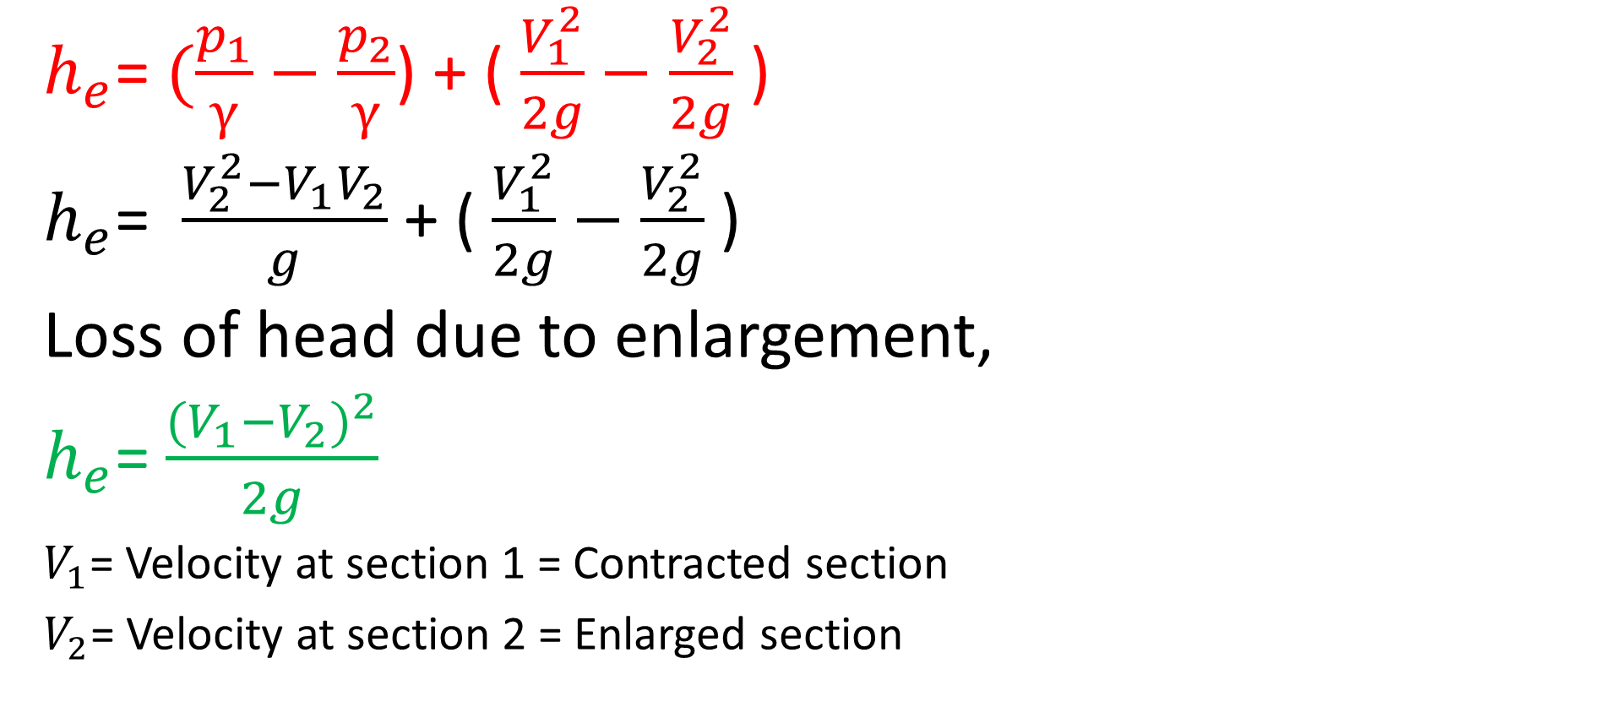
Loss of Head due to sudden Enlargement
$h_{e}$= $(\frac{p_{1}}{γ}−$ $\frac{p_{2}}{γ}$) + ( $\frac{V_{1}^{2}}{2g}−$ $\frac{V_{2}^{2}}{2g}$ )
$h_{e}$= $\frac{V_{2}^{2}−V_{1}V_{2}}{g}$ + ( $\frac{V_{1}^{2}}{2g}−$ $\frac{V_{2}^{2}}{2g}$ )
Loss of head due to enlargement,
$h_{e}$= $\frac{{{(V}_{1}{−V}_{2})}^{2}}{2g}$
$V_{1}$= Velocity at section 1 = Contracted section
$V_{2}$= Velocity at section 2 = Enlarged section

Slide 14
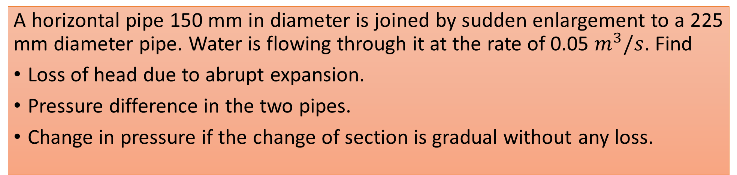
Practice Problem#22 [Rajput= 639]
A horizontal pipe 150 mm in diameter is joined by sudden enlargement to a 225 mm diameter pipe. Water is flowing through it at the rate of 0.05 $m^{3}/s$. Find
Loss of head due to abrupt expansion.
Pressure difference in the two pipes.
Change in pressure if the change of section is gradual without any loss.

