Slide 1
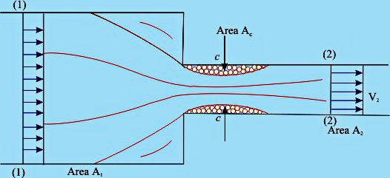
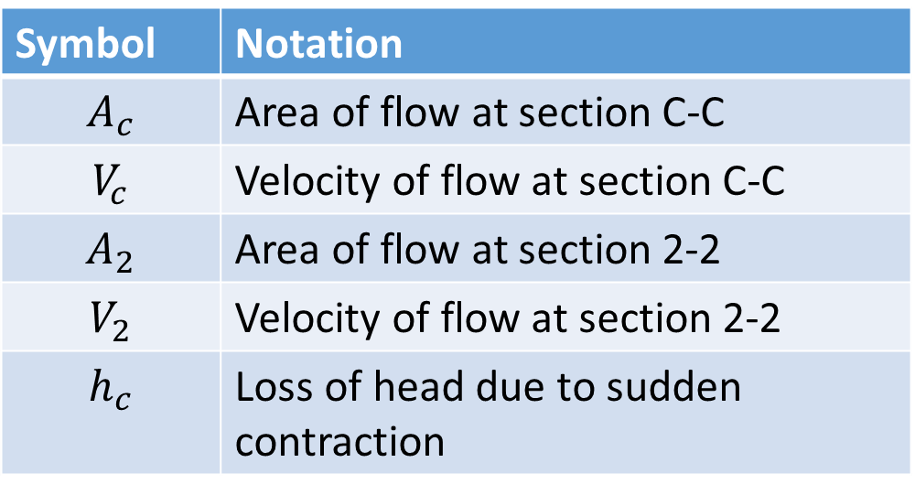
Loss of Head due to sudden contraction
Symbol | Notation
$$A_{c}$$ | Area of flow at section C-C
$$V_{c}$$ | Velocity of flow at section C-C
$$A_{2}$$ | Area of flow at section 2-2
$$V_{2}$$ | Velocity of flow at section 2-2
$$h_{c}$$ | Loss of head due to sudden contraction
Loss of head due to sudden contraction
= Loss up to vena contracta + Loss due to sudden enlargement beyond vena contracta

Slide 2
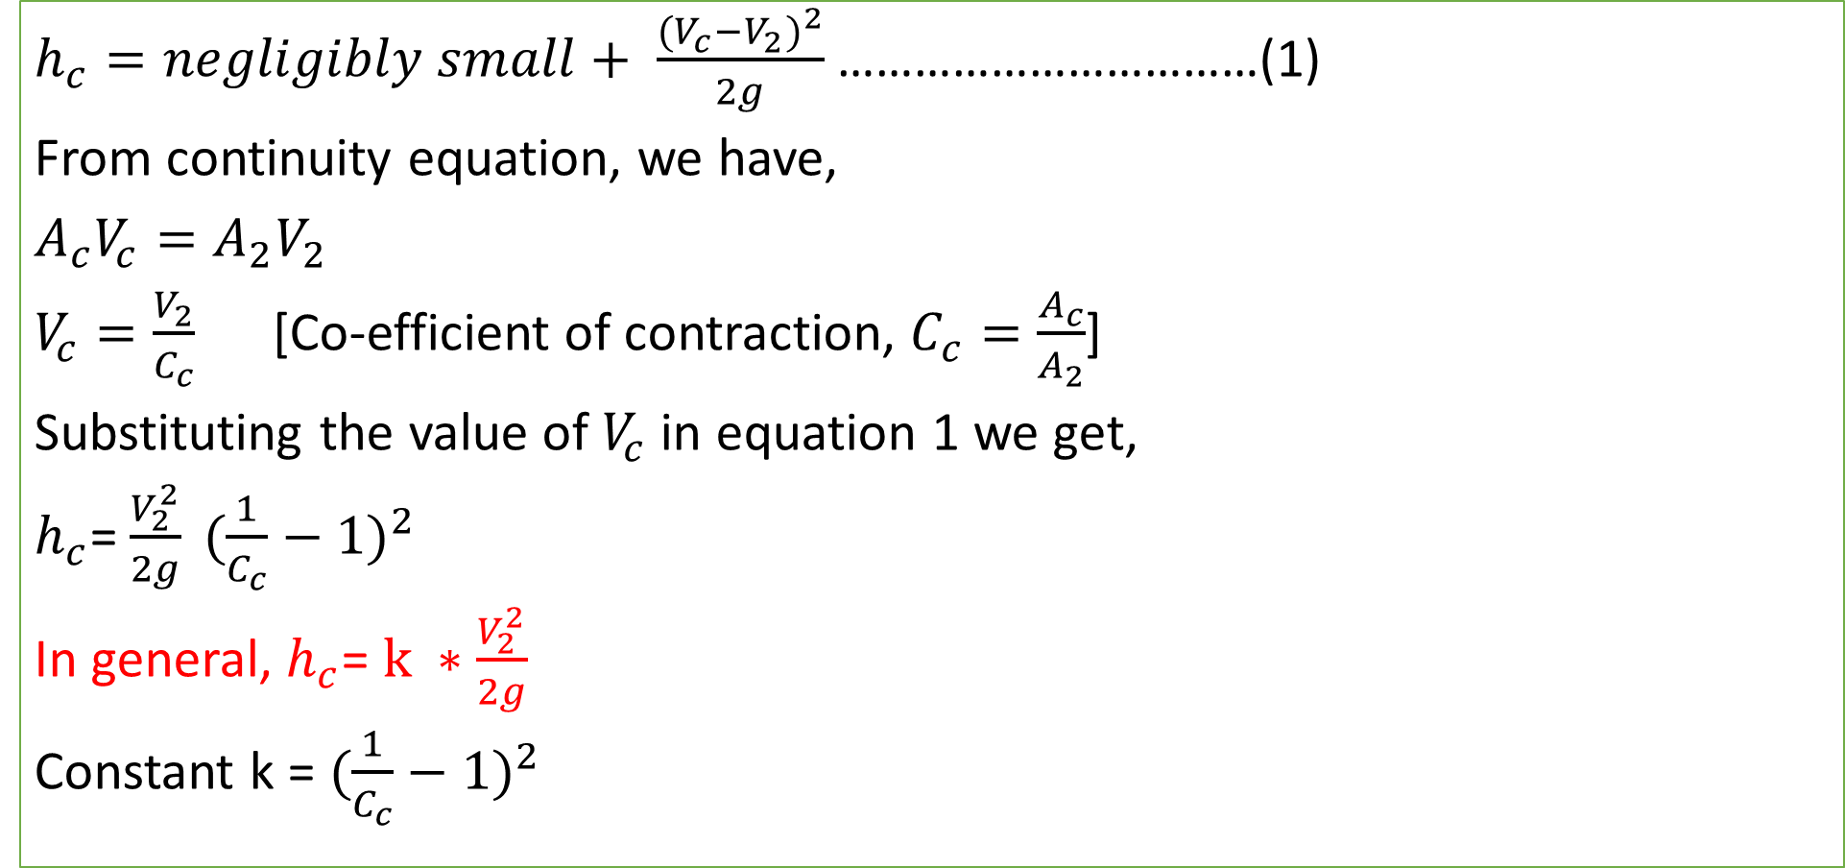
Loss of Head due to sudden contraction
$h_{c}=negligibly small+ \frac{{(V_{c}−V_{2})}^{2}}{2g}$ ……………………………(1)
From continuity equation, we have,
$A_{c}V_{c}=A_{2}V_{2}$
$V_{c}=\frac{V_{2}}{C_{c}}$ [Co-efficient of contraction, $C_{c}=\frac{A_{c}}{A_{2}}$]
Substituting the value of $V_{c}$ in equation 1 we get,
$h_{c}$= $\frac{V_{2}^{2}}{2g} {(\frac{1}{C_{c}}−1)}^{2}$
In general, $h_{c}$= $k ∗\frac{V_{2}^{2}}{2g}$
Constant k = ${(\frac{1}{C_{c}}−1)}^{2}$

Slide 3
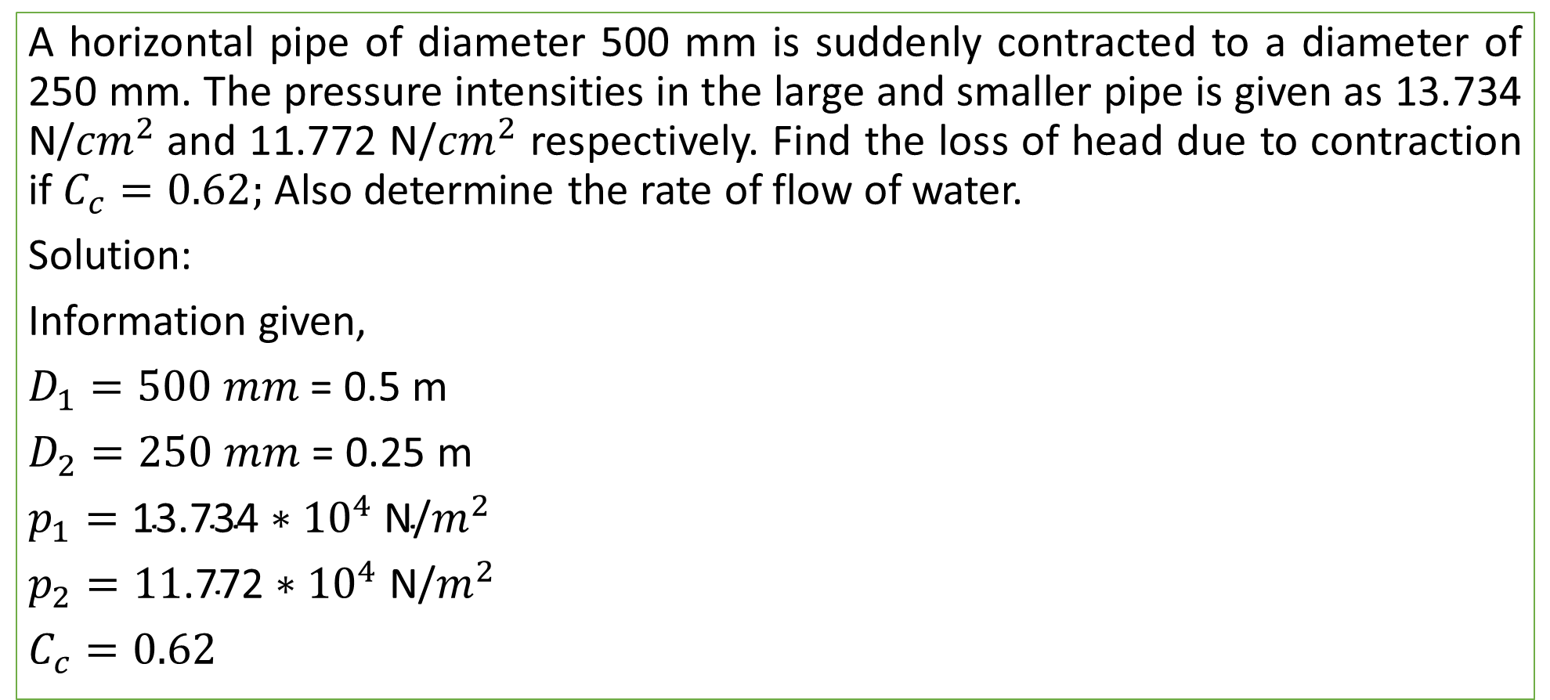
Practice problem#23 (Bansal = 476)
A horizontal pipe of diameter 500 mm is suddenly contracted to a diameter of 250 mm. The pressure intensities in the large and smaller pipe is given as 13.734 N/${cm}^{2}$and 11.772 N/${cm}^{2}$ respectively. Find the loss of head due to contraction if $C_{c}=0.62;$Also determine the rate of flow of water.
Solution:
Information given,
$D_{1}=500 mm$ = 0.5 m
$D_{2}=250 mm$ = 0.25 m
$p_{1}=\text{13.734}∗{10}^{4} \text{N}\text{/}m^{2}$
$p_{2}=\text{11}\text{.7}\text{72}∗{10}^{4} \text{N}\text{/}m^{2}$
$C_{c}=0.62$

Slide 4
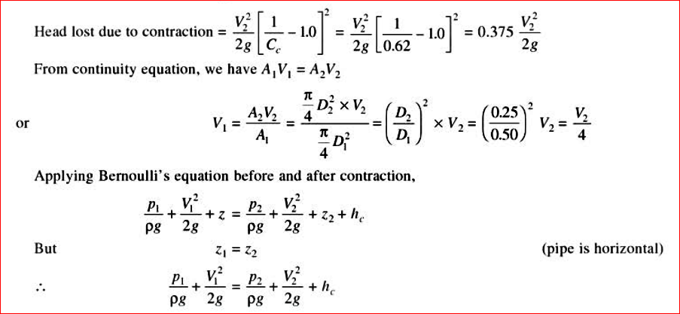
Solution

Slide 5
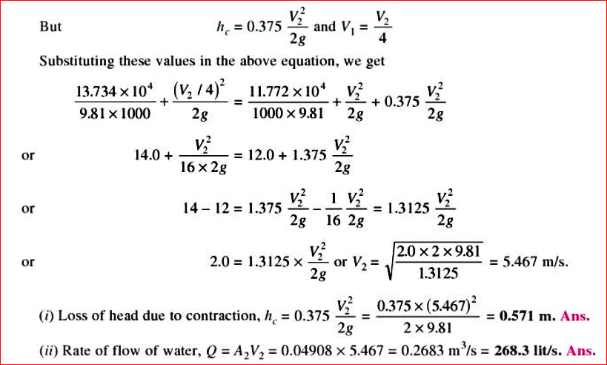
Solution

Slide 6
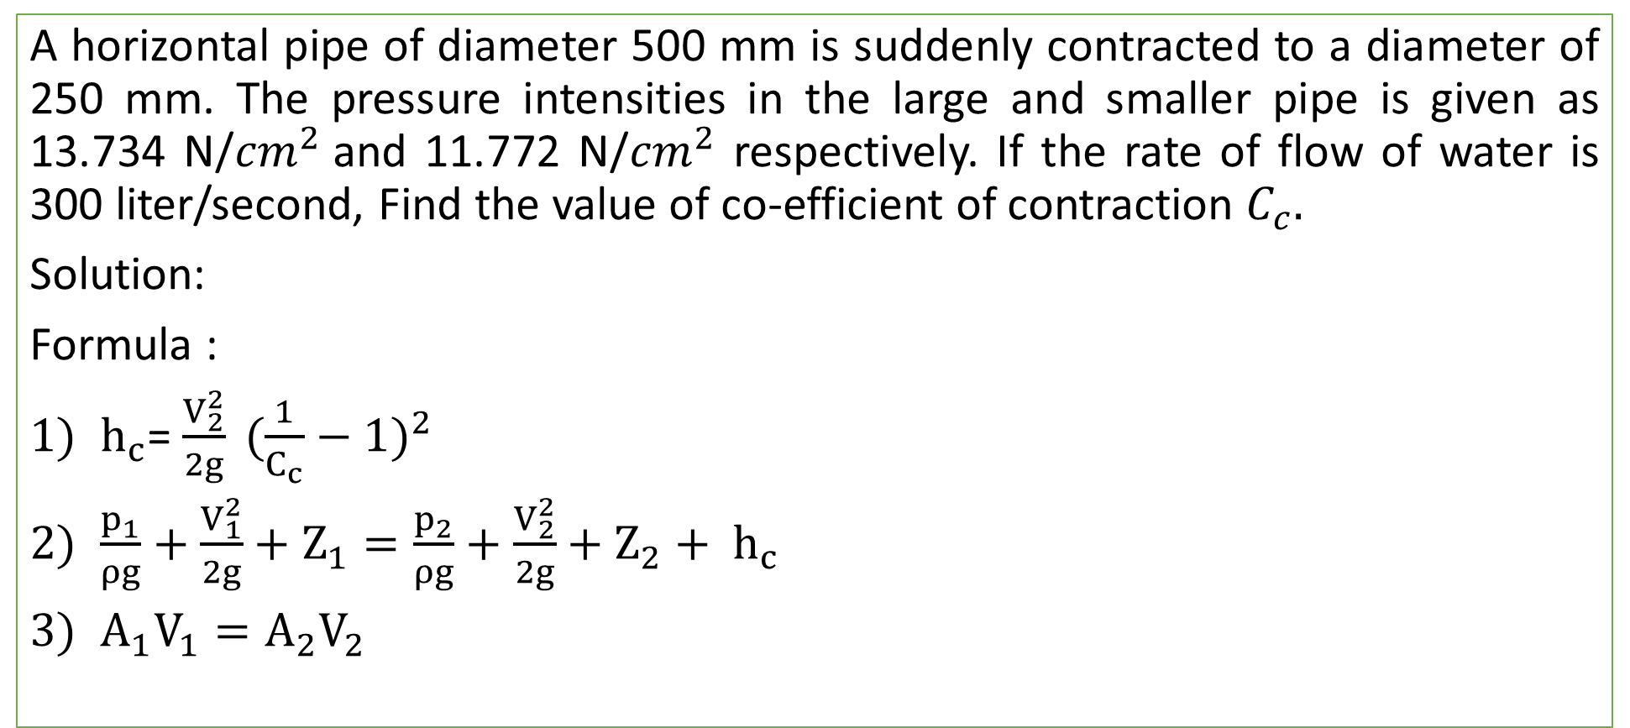
Practice Problem#24
A horizontal pipe of diameter 500 mm is suddenly contracted to a diameter of 250 mm. The pressure intensities in the large and smaller pipe is given as 13.734 N/${cm}^{2}$and 11.772 N/${cm}^{2}$ respectively. If the rate of flow of water is 300 liter/second, Find the value of co-efficient of contraction $C_{c}.$
Solution:
Formula :
$h_{c}$= $\frac{V_{2}^{2}}{2g} {(\frac{1}{C_{c}}−1)}^{2}$
$\frac{p_{1}}{ρg}+\frac{V_{1}^{2}}{2g}+Z_{1}=\frac{p_{2}}{ρg}+\frac{V_{2}^{2}}{2g}+Z_{2}+ h_{c}$
$A_{1}V_{1}=A_{2}V_{2}$

Slide 7
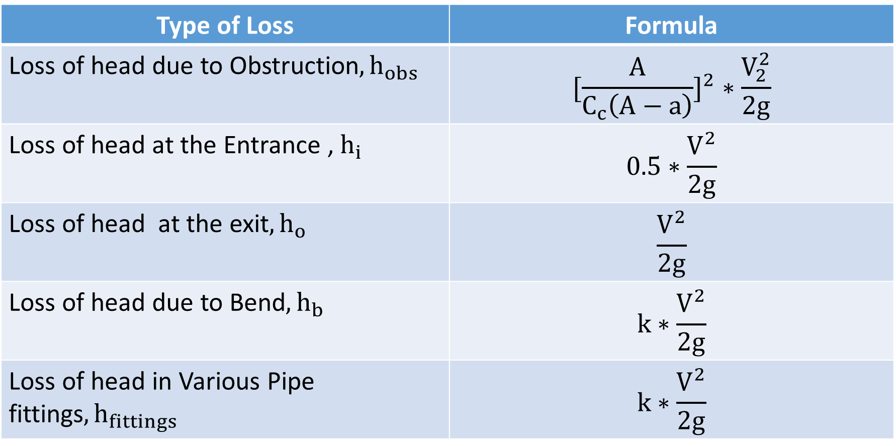
Other Minor Losses in Pipe Flow
Type of Loss | Formula
Loss of head due to Obstruction${, h}_{obs}$ | $$[{\frac{A}{C_{c}\left(A−a\right)}]}^{2}∗\frac{V_{2}^{2}}{2g}$$
Loss of head at the Entrance , $h_{i}$ | $$0.5∗\frac{V^{2}}{2g}$$
Loss of head at the exit${, h}_{o}$ | $$\frac{V^{2}}{2g}$$
Loss of head due to Bend${, h}_{b}$ | $$k∗\frac{V^{2}}{2g}$$
Loss of head in Various Pipe fittings${, h}_{fittings}$ | $$k∗\frac{V^{2}}{2g}$$

Slide 8
