Slide 1
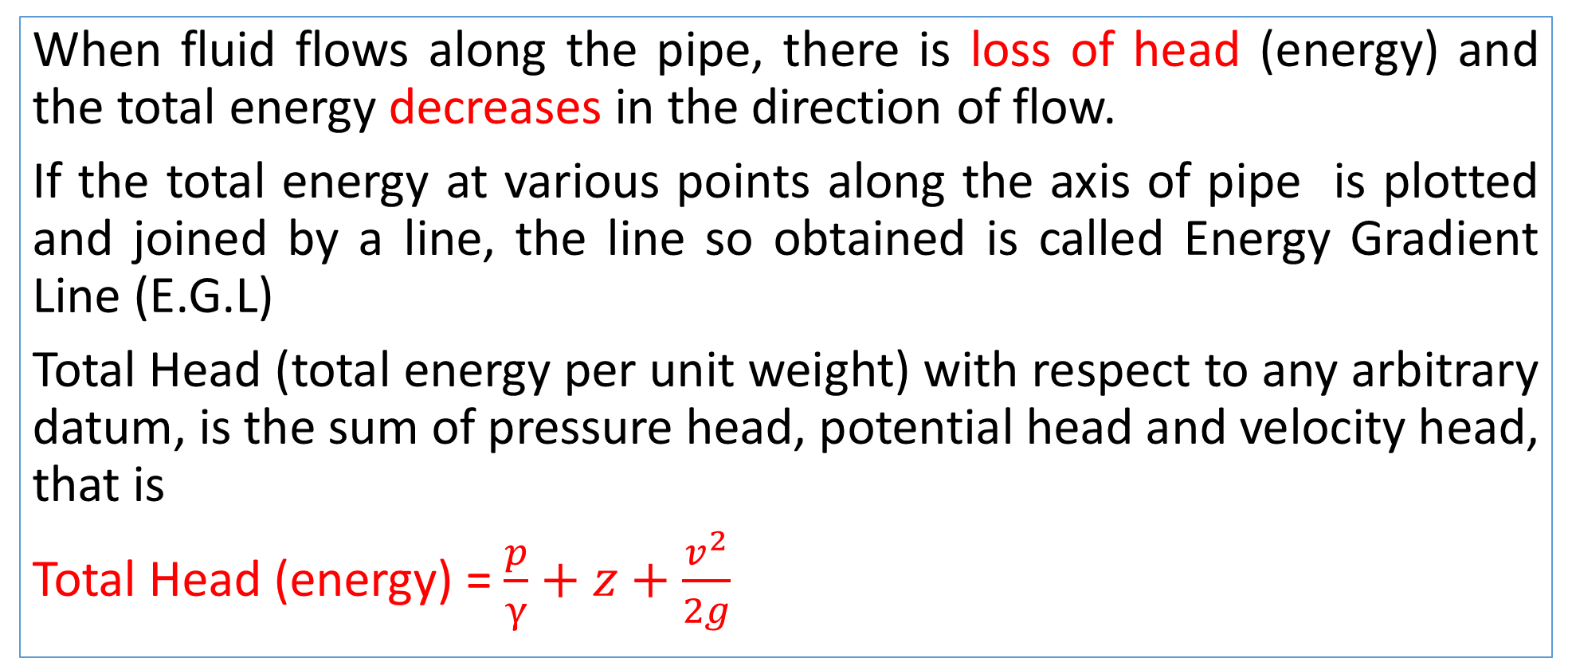
Total Energy Line/ Energy Gradient Line
When fluid flows along the pipe, there is loss of head (energy) and the total energy decreases in the direction of flow.
If the total energy at various points along the axis of pipe is plotted and joined by a line, the line so obtained is called Energy Gradient Line (E.G.L)
Total Head (total energy per unit weight) with respect to any arbitrary datum, is the sum of pressure head, potential head and velocity head, that is
Total Head (energy) = $\frac{p}{γ}+z+\frac{v^{2}}{2g}$

Slide 2
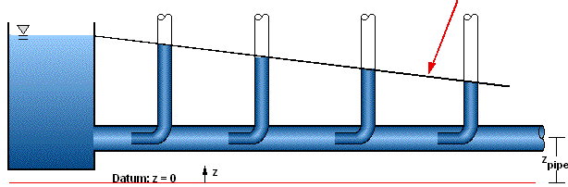
EGL (Energy Gradient Line)

Slide 3
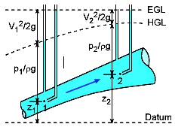
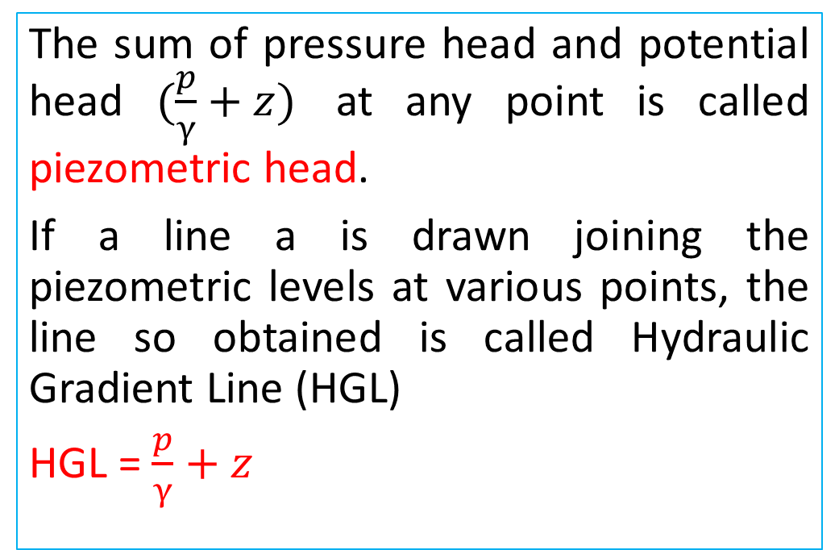
Hydraulic Gradient Line (HGL)
The sum of pressure head and potential head $(\frac{p}{γ}+z)$ at any point is called piezometric head.
If a line a is drawn joining the piezometric levels at various points, the line so obtained is called Hydraulic Gradient Line (HGL)
HGL = $\frac{p}{γ}+z$

Slide 4
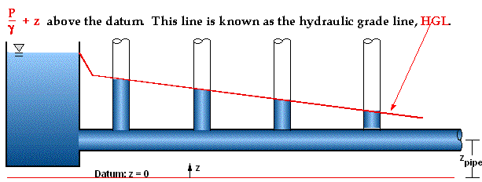
Hydraulic Gradient Line (HGL)

Slide 5
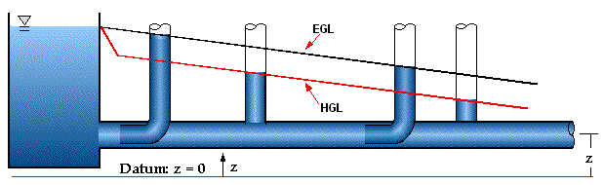

EGL and HGL
EGL
HGL

Slide 6
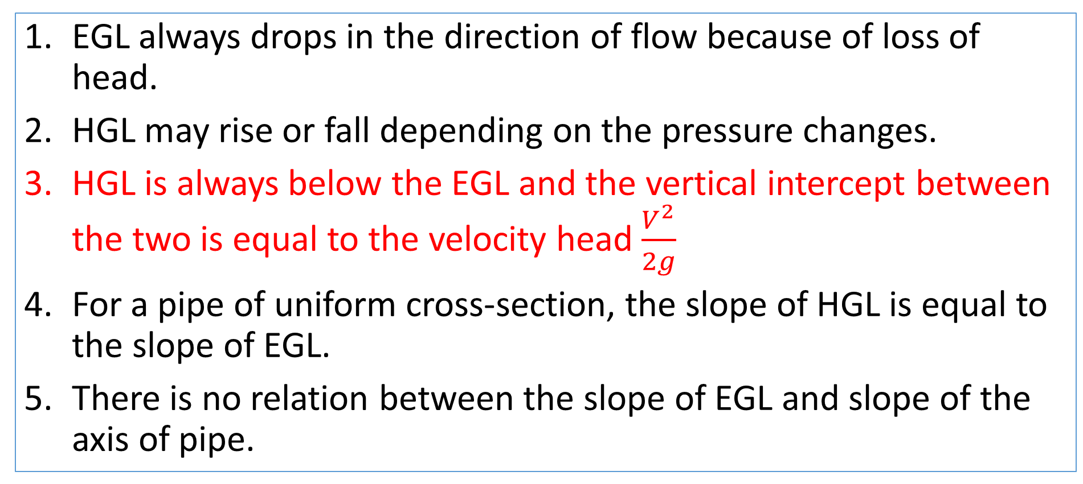
The following points are worth noting
EGL always drops in the direction of flow because of loss of head.
HGL may rise or fall depending on the pressure changes.
HGL is always below the EGL and the vertical intercept between the two is equal to the velocity head $\frac{V^{2}}{2g}$
For a pipe of uniform cross-section, the slope of HGL is equal to the slope of EGL.
There is no relation between the slope of EGL and slope of the axis of pipe.

Slide 7
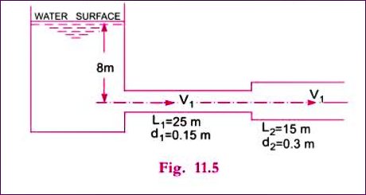
Practice Problem
A horizontal pipe 40 meter long is connected to a water tank at one end and discharges freely into the atmosphere at the other end. For the first 25 meter length from the tank, the pipe is 150 mm diameter and its diameter is suddenly enlarged to 300 mm. The height off water level in the tank is 8 meter above the center of the pipe. Considering all the losses of head which occur, determine the rate of flow. Take f = 0.01 for the both sections. Also draw EGL and HGL.
Solutions:
Total Length, L = 40 meter
Height of Water, H = 8 meter
Co-efficient of friction, f = 0.01

Slide 8
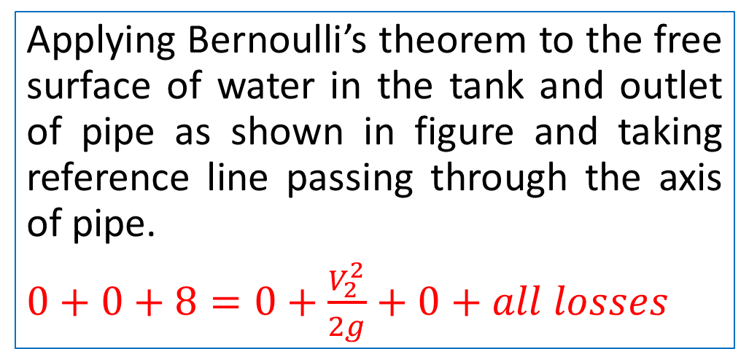
Bernoulli’s Equation
Applying Bernoulli’s theorem to the free surface of water in the tank and outlet of pipe as shown in figure and taking reference line passing through the axis of pipe.
$0+0+8=0+\frac{V_{2}^{2}}{2g}+0+all losses$
Here, all losses included are:
Loss of head at entrance
Loss of head due to friction in pipe 1
Loss of head due to sudden enlargement
Loss of head due to friction in pipe 2
Loss of head at outlet

Slide 9
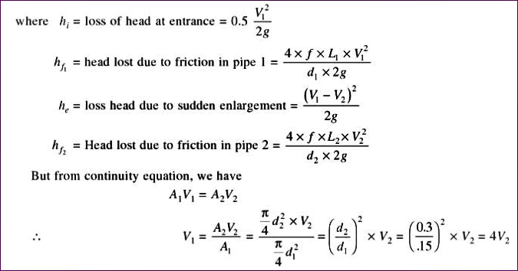
Head Losses in the direction of flow

Slide 10
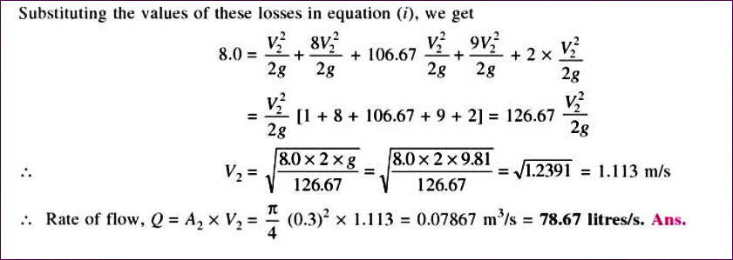
Discharge, Q = $A_{2}V_{2}$

Slide 11
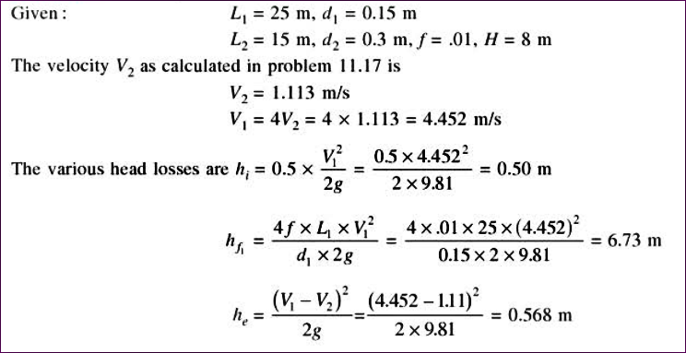
Plotting of EGL, HGL

Slide 12
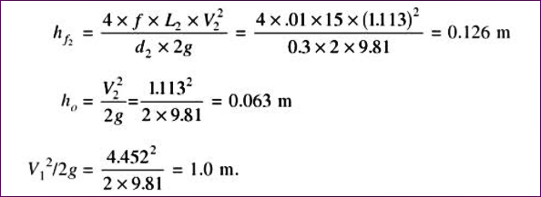
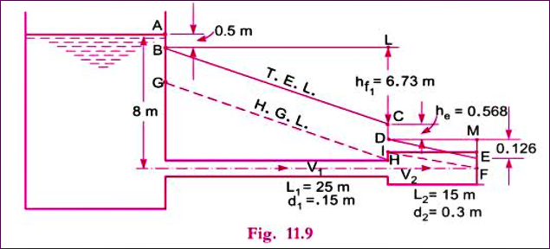
Plotting of EGL, HGL

Slide 13
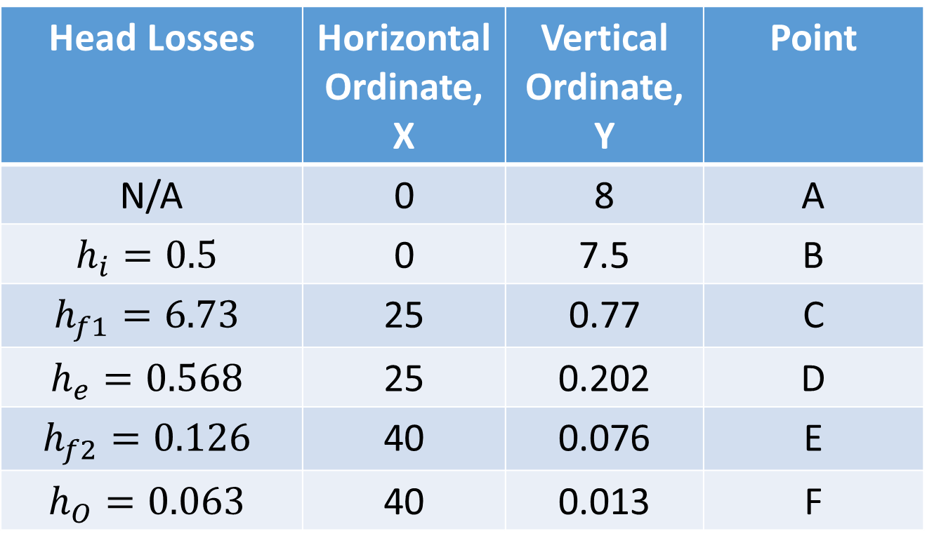
EGL
Head Losses | Horizontal Ordinate, X | Vertical Ordinate, Y | Point
N/A | 0 | 8 | A
$$h_{i}=0.5$$ | 0 | 7.5 | B
$$h_{f1}=6.73$$ | 25 | 0.77 | C
$$h_{e}=0.568$$ | 25 | 0.202 | D
$$h_{f2}=0.126$$ | 40 | 0.076 | E
$$h_{O}=0.063$$ | 40 | 0.013 | F

Slide 15
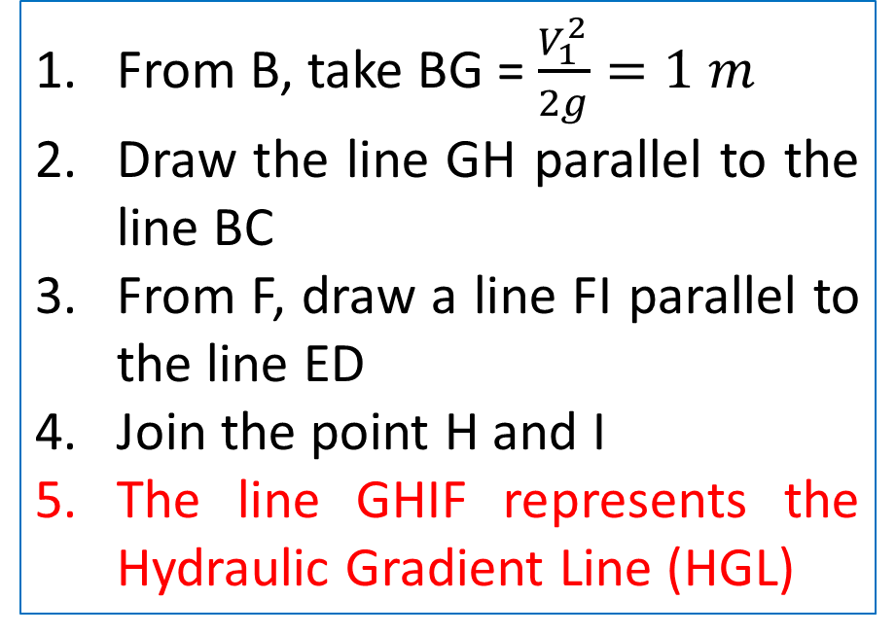
HGL
From B, take BG = $\frac{V_{1}^{2}}{2g}=1 m$
Draw the line GH parallel to the line BC
From F, draw a line FI parallel to the line ED
Join the point H and I
The line GHIF represents the Hydraulic Gradient Line (HGL)

