Slide 1
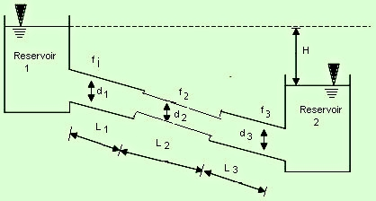
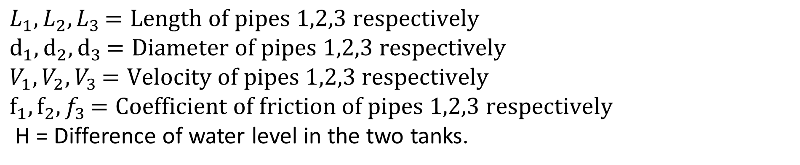
Pipes in Series or Compound Pipes
Pipes in series or compound pipes is defined as the pipes of different length and diameters connected end to end (series) to form a pipe line as shown in figure.
$L_{1},L_{2}{,L}_{3}=Length of pipes 1,2,3 respectively$
$d_{1},d_{2}{,d}_{3}=Diameter of pipes 1,2,3 respectively$
$V_{1},V_{2}{,V}_{3}=Velocity of pipes 1,2,3 respectively$
$f_{1},f_{2}{,f}_{3}=Coefficient of friction of pipes 1,2,3 respectively$
H = Difference of water level in the two tanks.

Slide 2
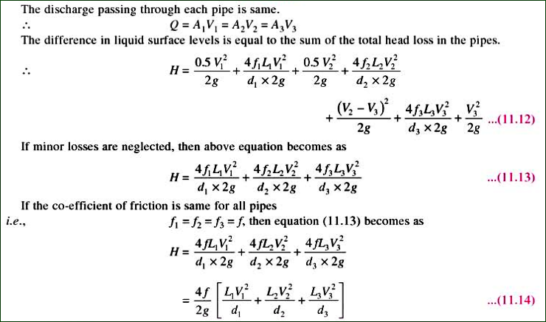
Pipes in Series or Compound Pipes

Slide 3
Practice Problem
Three pipes of 400 mm, 200 mm, 300 mm diameters have lengths of 400 m , 200 m and 300 m respectively. They are connected in series to make a compound pipe. The ends of this compound pipe are connected with two tanks whose difference in water levels is 16 meter. If coefficient of friction for the three pipes are same and equal to 0.005, determine the discharge through the compound pipe considering:
Neglecting minor losses
Including minor losses

Slide 4
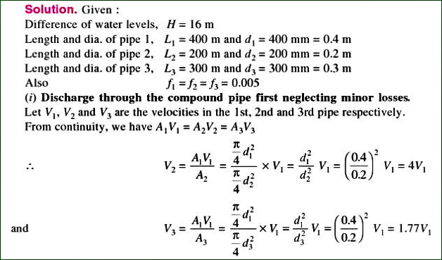
Solution

Slide 5
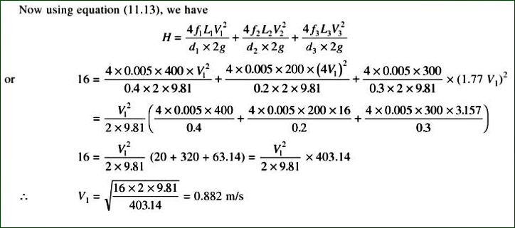
Solution

Slide 6
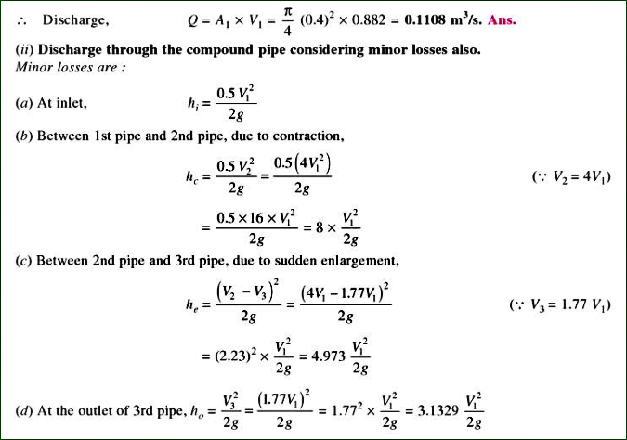
Solution

Slide 7
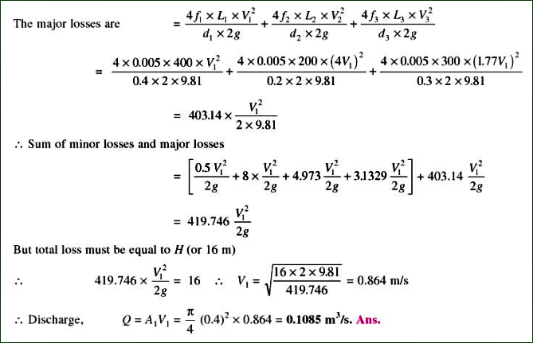
Solution

