Slide 1
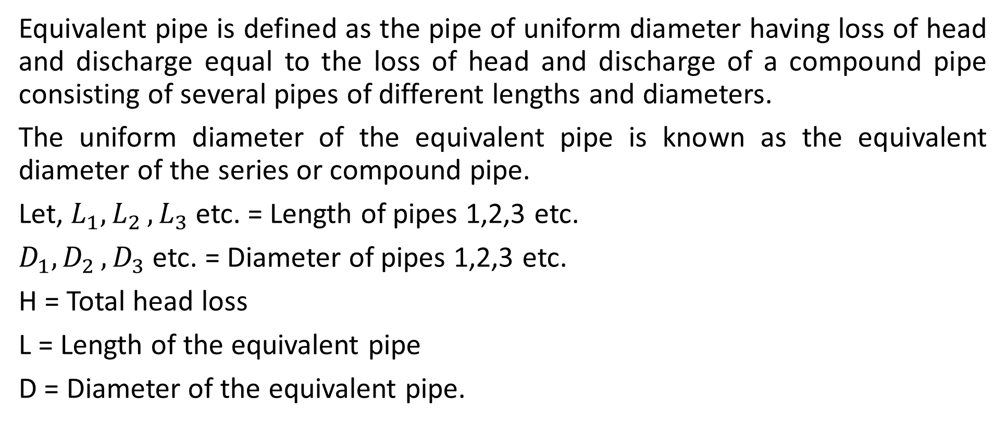
Equivalent Pipe (Pipes in Series)
Equivalent pipe is defined as the pipe of uniform diameter having loss of head and discharge equal to the loss of head and discharge of a compound pipe consisting of several pipes of different lengths and diameters.
The uniform diameter of the equivalent pipe is known as the equivalent diameter of the series or compound pipe.
Let, $L_{1}{,L}_{2},L_{3}$ etc. = Length of pipes 1,2,3 etc.
$D_{1}{,D}_{2},D_{3}$ etc. = Diameter of pipes 1,2,3 etc.
H = Total head loss
L = Length of the equivalent pipe
D = Diameter of the equivalent pipe.

Slide 2
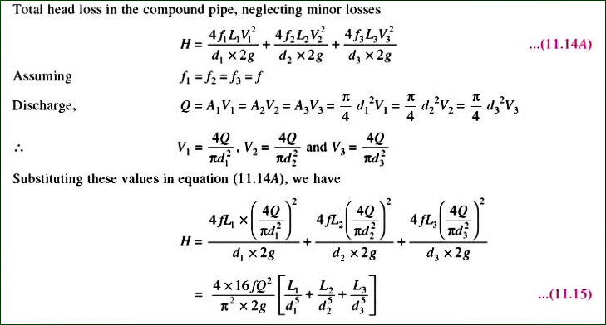
Total Head Loss in Compound Pipe

Slide 3
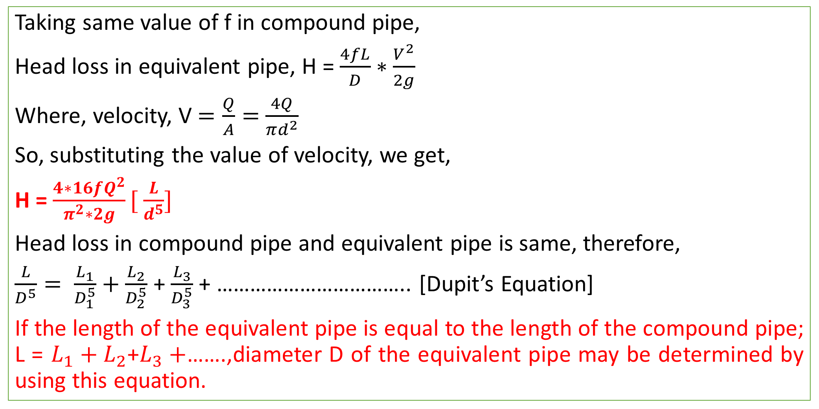
Head Loss in Equivalent Pipe
Taking same value of f in compound pipe,
Head loss in equivalent pipe, H = $\frac{4fL}{D}∗\frac{V^{2}}{2g}$
Where, velocity, V $=\frac{Q}{A}=$ $\frac{4Q}{πd^{2}}$
So, substituting the value of velocity, we get,
H = $\frac{4∗16fQ^{2}}{π^{2}∗2g}[ \frac{L}{d^{5}}]$
Head loss in compound pipe and equivalent pipe is same, therefore,
$\frac{L}{D^{5}}= \frac{L_{1}}{D_{1}^{5}}+$ $\frac{L_{2}}{D_{2}^{5}}$ + $\frac{L_{3}}{D_{3}^{5}}$ + …………………………….. [Dupit’s Equation]
If the length of the equivalent pipe is equal to the length of the compound pipe; L = $L_{1}+L_{2}$+$L_{3}+$…….,diameter D of the equivalent pipe may be determined by using this equation.

Slide 4
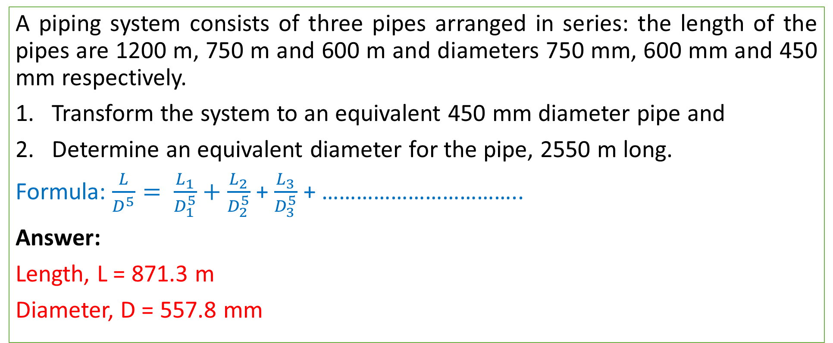
Problem# Rajput (663 page)
A piping system consists of three pipes arranged in series: the length of the pipes are 1200 m, 750 m and 600 m and diameters 750 mm, 600 mm and 450 mm respectively.
Transform the system to an equivalent 450 mm diameter pipe and
Determine an equivalent diameter for the pipe, 2550 m long.
Formula: $\frac{L}{D^{5}}= \frac{L_{1}}{D_{1}^{5}}+$ $\frac{L_{2}}{D_{2}^{5}}$ + $\frac{L_{3}}{D_{3}^{5}}$ + ……………………………..
Answer:
Length, L = 871.3 m
Diameter, D = 557.8 mm

Slide 5
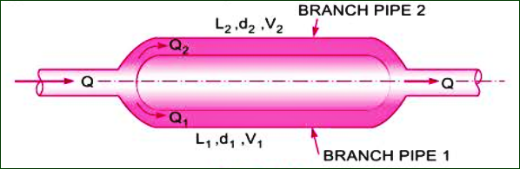
Pipes in Parallel
The pipes are said to be in parallel when a main line divides into two or more parallel pipes which again join together downstream and continues as a main line.

Slide 6
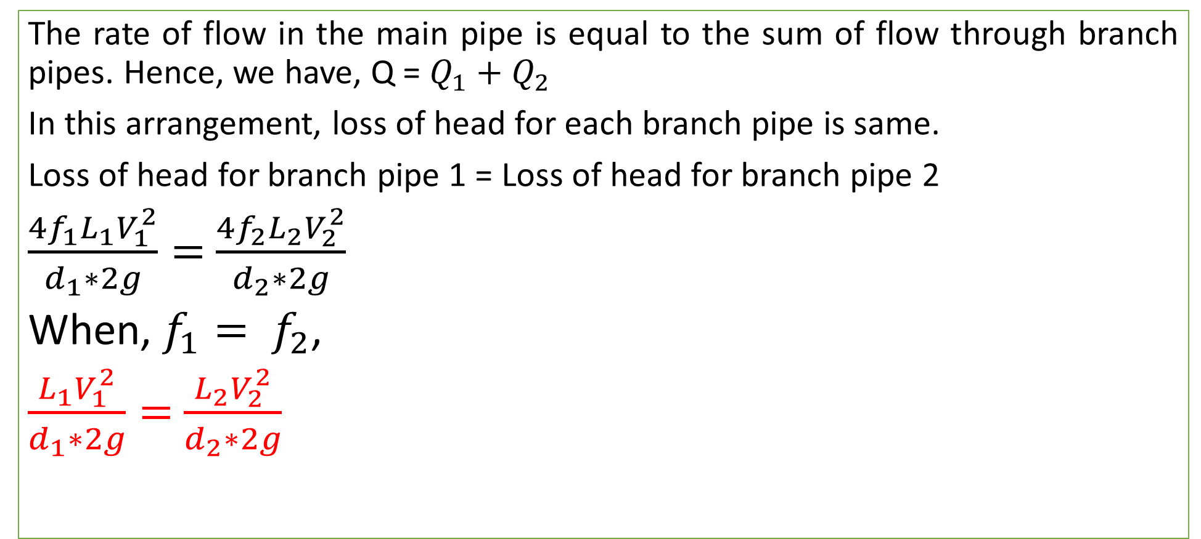
Pipes in Parallel
The rate of flow in the main pipe is equal to the sum of flow through branch pipes. Hence, we have, Q = $Q_{1}+Q_{2}$
In this arrangement, loss of head for each branch pipe is same.
Loss of head for branch pipe 1 = Loss of head for branch pipe 2
$\frac{4f_{1}L_{1}V_{1}^{2}}{d_{1}∗2g}=$ $\frac{4f_{2}L_{2}V_{2}^{2}}{d_{2}∗2g}$
When, $f_{1}= f_{2}$,
$\frac{L_{1}V_{1}^{2}}{d_{1}∗2g}=$ $\frac{L_{2}V_{2}^{2}}{d_{2}∗2g}$

Slide 7
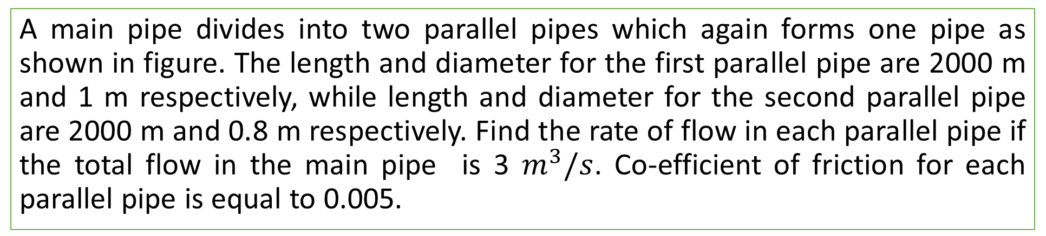
Problem # Bansal (Page=509)
A main pipe divides into two parallel pipes which again forms one pipe as shown in figure. The length and diameter for the first parallel pipe are 2000 m and 1 m respectively, while length and diameter for the second parallel pipe are 2000 m and 0.8 m respectively. Find the rate of flow in each parallel pipe if the total flow in the main pipe is 3 $m^{3}/s$. Co-efficient of friction for each parallel pipe is equal to 0.005.

Slide 8
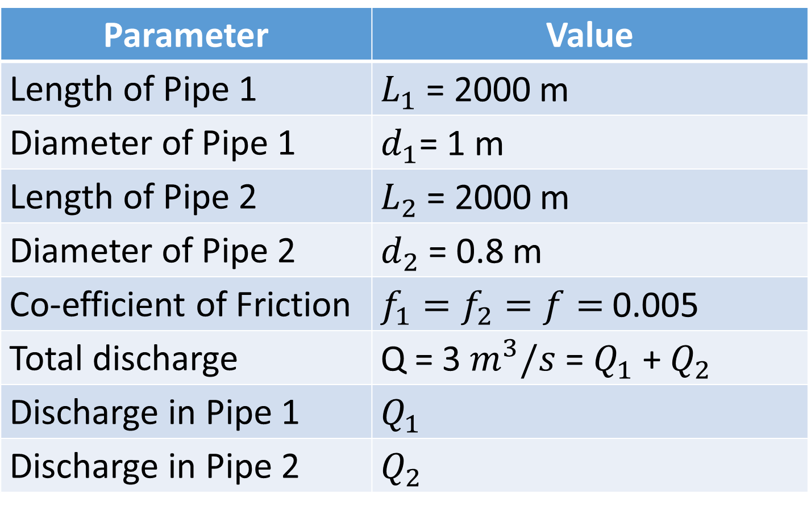
Solution
Parameter | Value
Length of Pipe 1 | $L_{1}$ = 2000 m
Diameter of Pipe 1 | $d_{1}$= 1 m
Length of Pipe 2 | $L_{2}$ = 2000 m
Diameter of Pipe 2 | $d_{2}$ = 0.8 m
Co-efficient of Friction | $f_{1}=f_{2}=f=$ 0.005
Total discharge | Q = 3 $m^{3}/s$ = $Q_{1}$ + $Q_{2}$
Discharge in Pipe 1 | $Q_{1}$
Discharge in Pipe 2 | $Q_{2}$

Slide 9
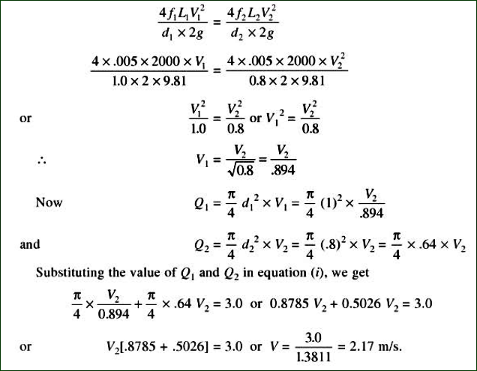
Solution

Slide 10
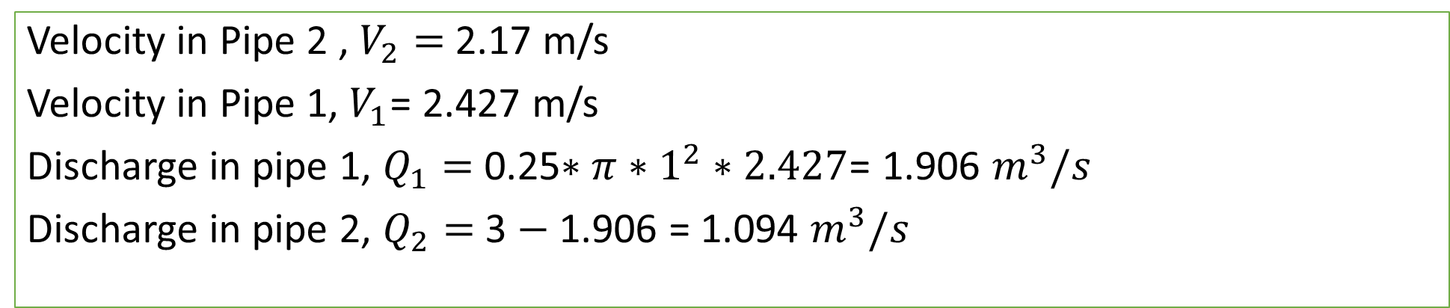
Solution
Velocity in Pipe 2 , $V_{2}=$2.17 m/s
Velocity in Pipe 1, $V_{1}$= 2.427 m/s
Discharge in pipe 1, $Q_{1}=$ 0.25$∗π∗1^{2}∗2.427$= 1.906 $m^{3}/s$
Discharge in pipe 2, $Q_{2}=$3 $−$ 1.906 = 1.094 $m^{3}/s$

