Slide 1
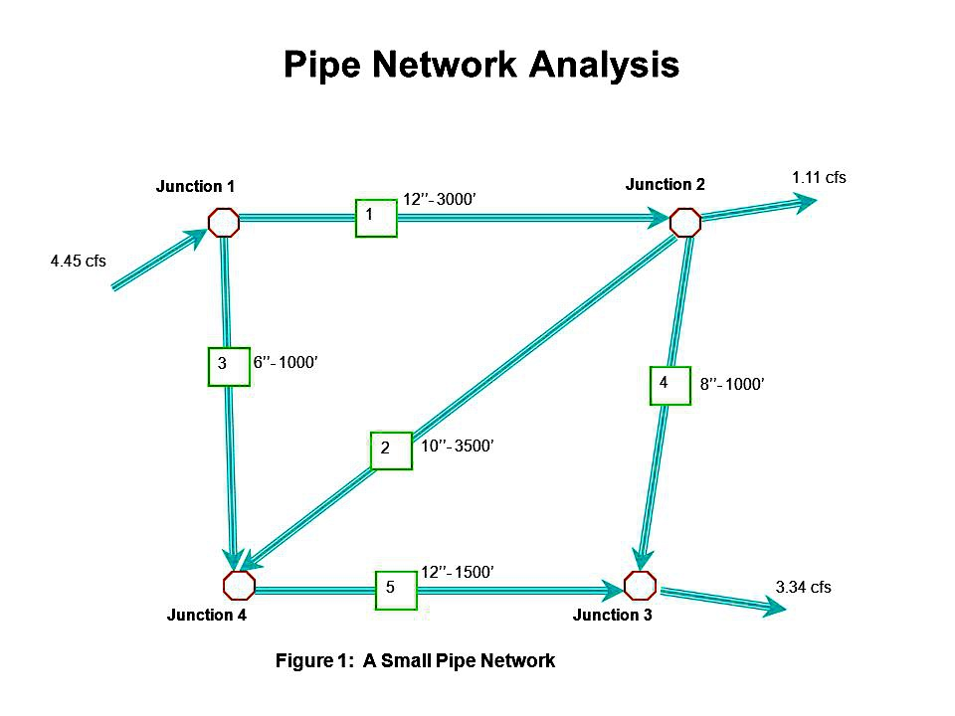
Pipe Network Analysis
A pipe network is an interconnected system of pipes forming several loops and circuits.

Slide 2
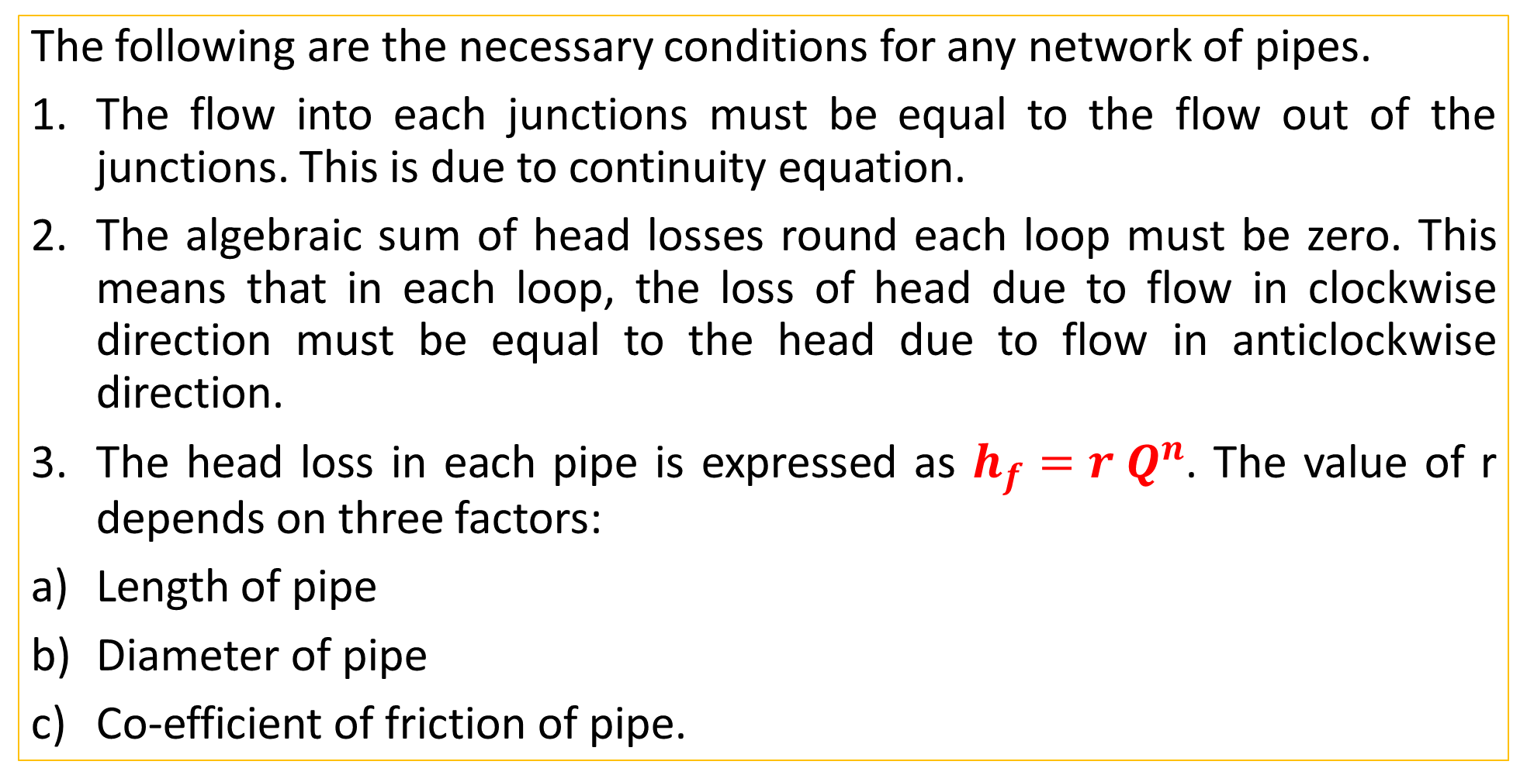
Pipe Network
The following are the necessary conditions for any network of pipes.
The flow into each junctions must be equal to the flow out of the junctions. This is due to continuity equation.
The algebraic sum of head losses round each loop must be zero. This means that in each loop, the loss of head due to flow in clockwise direction must be equal to the head due to flow in anticlockwise direction.
The head loss in each pipe is expressed as $h_{f}=r Q^{n}$. The value of r depends on three factors:
Length of pipe
Diameter of pipe
Co-efficient of friction of pipe.

Slide 3
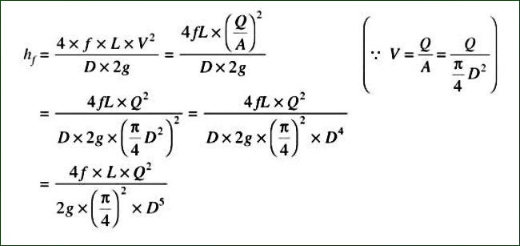
Pipe Network
$$h_{f}=r Q^{2};n=2 for turbulent flow$$

Slide 4
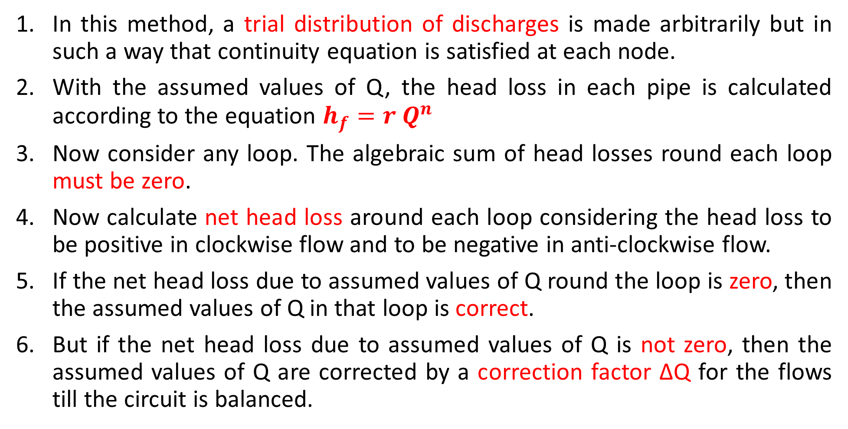
Hardy Cross Method
In this method, a trial distribution of discharges is made arbitrarily but in such a way that continuity equation is satisfied at each node.
With the assumed values of Q, the head loss in each pipe is calculated according to the equation $h_{f}=r Q^{n}$
Now consider any loop. The algebraic sum of head losses round each loop must be zero.
Now calculate net head loss around each loop considering the head loss to be positive in clockwise flow and to be negative in anti-clockwise flow.
If the net head loss due to assumed values of Q round the loop is zero, then the assumed values of Q in that loop is correct.
But if the net head loss due to assumed values of Q is not zero, then the assumed values of Q are corrected by a correction factor ΔQ for the flows till the circuit is balanced.

Slide 5
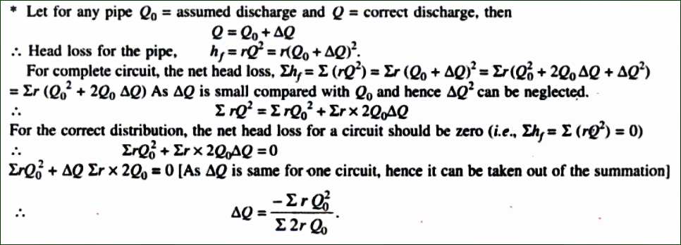
Hardy Cross Method

Slide 6
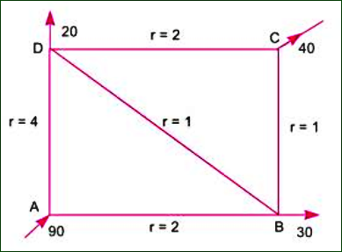
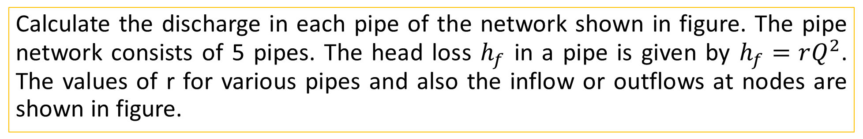
Problem: Bansal#549
Calculate the discharge in each pipe of the network shown in figure. The pipe network consists of 5 pipes. The head loss $h_{f}$ in a pipe is given by $h_{f}=rQ^{2}$. The values of r for various pipes and also the inflow or outflows at nodes are shown in figure.

Slide 7
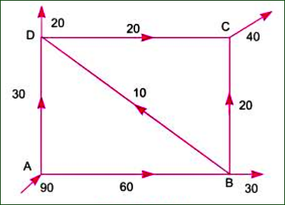
First trial
For the first trial, the discharges are assumed as shown in figure so that continuity equation is satisfied at each node (flow into node = flow out of the node). For this distribution of discharge, the corrections ΔQ for the loops ABD and BCD are calculated.

Slide 8
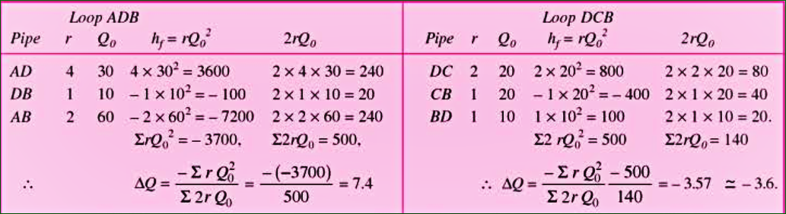
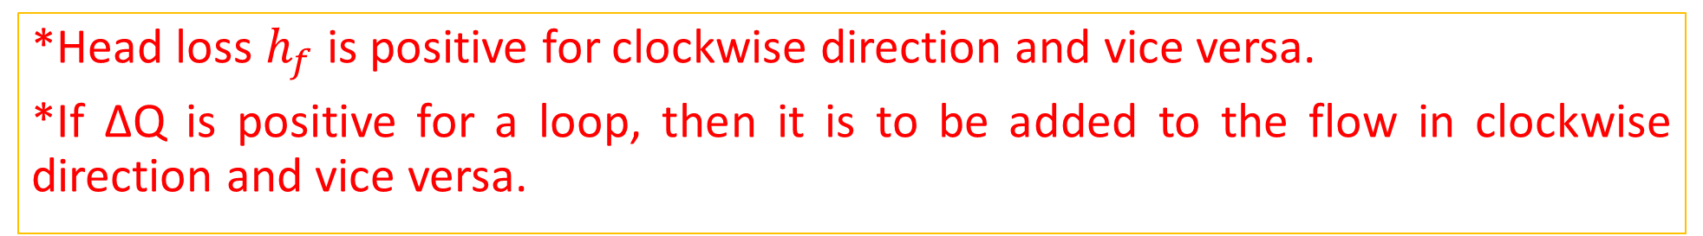
First trial
*Head loss $h_{f}$ is positive for clockwise direction and vice versa.
*If ΔQ is positive for a loop, then it is to be added to the flow in clockwise direction and vice versa.

Slide 9
First trial
Corrected flow for each pipe is given as:
Loop ADB (ΔQ= +7.4)
Pipe AD = 30 + 7.4 = 37.4 (flow is clockwise)
Pipe AB = 60 – 7.4 = 52.6 (flow is anti-clockwise)
Pipe BD = 10 – 7.4 = 2.6 (flow is anti-clockwise)
Corrected flow for each pipe is given as:
Loop DCB (ΔQ= – 3.6)
Pipe DC = 20 – 3.6 = 16.4 (flow is clockwise)
Pipe BC = 20 + 3.6 = 23.6 (flow is anti-clockwise)
Pipe BD = 2.6 – 3.6 = – 1 (flow is clockwise)
*The pipe BD is common in two loops, Hence this pipe will get two corrections.

Slide 10
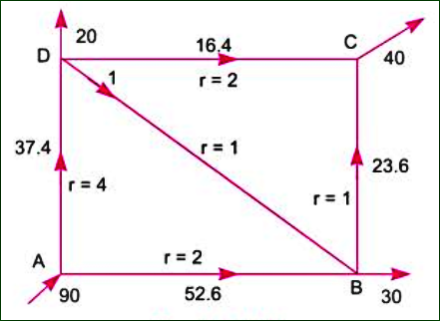
First trial: Results

Slide 11
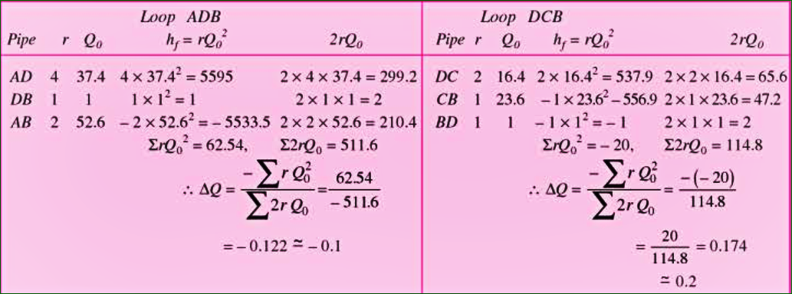
Second trial

Slide 12
Second trial: Results
Loop ADB ( ΔQ = -0.1) | Loop DCB ( ΔQ = + 0.2)
Pipe AD = 37.4 – 0.1 = 37.3 (Clockwise) | Pipe DC = 16.4 + 0.2 = 16.6 (Clockwise)
Pipe DB = 1– 0.1 = 0.90 (Clockwise) | Pipe CB = 23.6 - 0.2 = 23.4 (Anti-clockwise)
Pipe AB = 52.6 + 0.10 = 52.7 (Anticlockwise) | Pipe BD = 0.9 – 0.2 = 0.7 (Clockwise)
Final distribution of Discharges
Pipe AD = 37.3 ( from A to D)
Pipe AB = 52.7 ( from A to B)
Pipe DB = 0.70 ( from D to B)
Pipe DC = 16.6 ( from D to C)
Pipe BC = 23.4 ( from B to C)

Slide 13
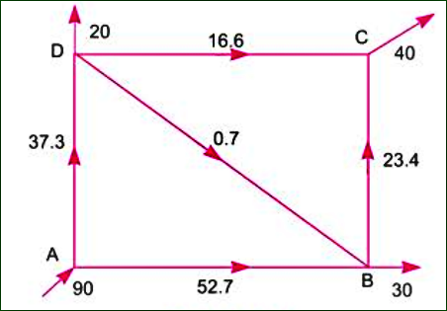
Second trial: Results

