Slide 1
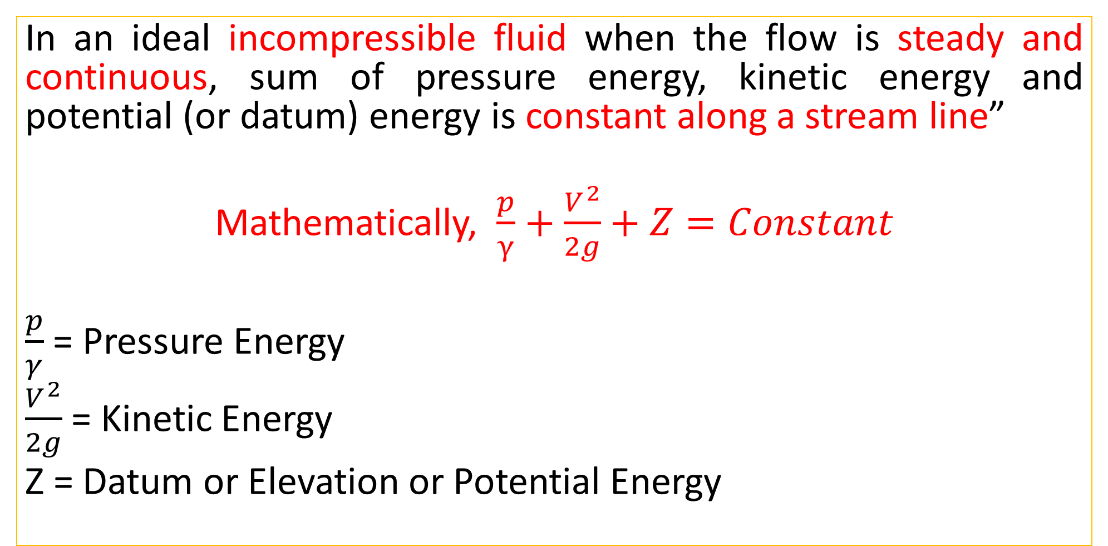
Bernoulli’s Equation: Statement
In an ideal incompressible fluid when the flow is steady and continuous, sum of pressure energy, kinetic energy and potential (or datum) energy is constant along a stream line”
Mathematically, $\frac{p}{γ}+\frac{V^{2}}{2g}+Z=Constant$
$\frac{p}{γ}$= Pressure Energy
$\frac{V^{2}}{2g}$= Kinetic Energy
Z = Datum or Elevation or Potential Energy

Slide 2
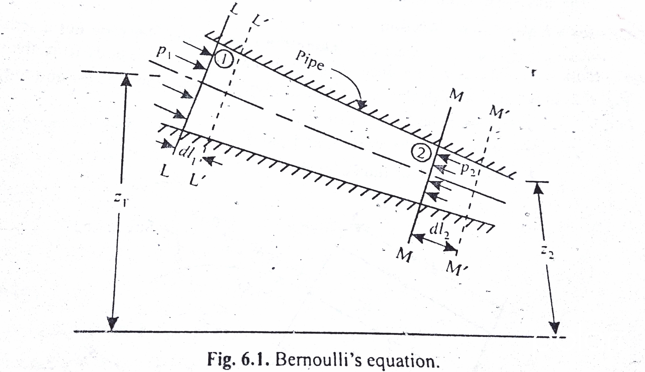
Derivation of Bernoulli’s Equation

Slide 3
Let us consider two sections: LL and MM
Pressure at LL= P₁ | Pressure at MM= P₂
Velocity at LL= V₁ | Velocity at MM= V₂
Height of LL above datum = Z₁ | Height of MM above datum = Z₂
Area of Pipe at LL= A₁ | Area of Pipe at MM= A₂

Slide 4
Weight of Liquid = Unit Weight × Volume (Area*Length)
Work Done = Force × Distance
Force = Pressure × Area

Slide 5
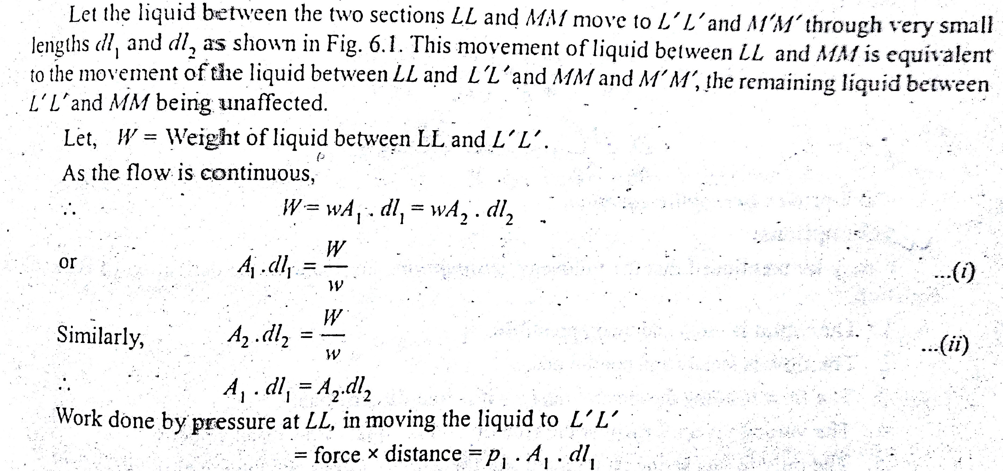

Slide 6
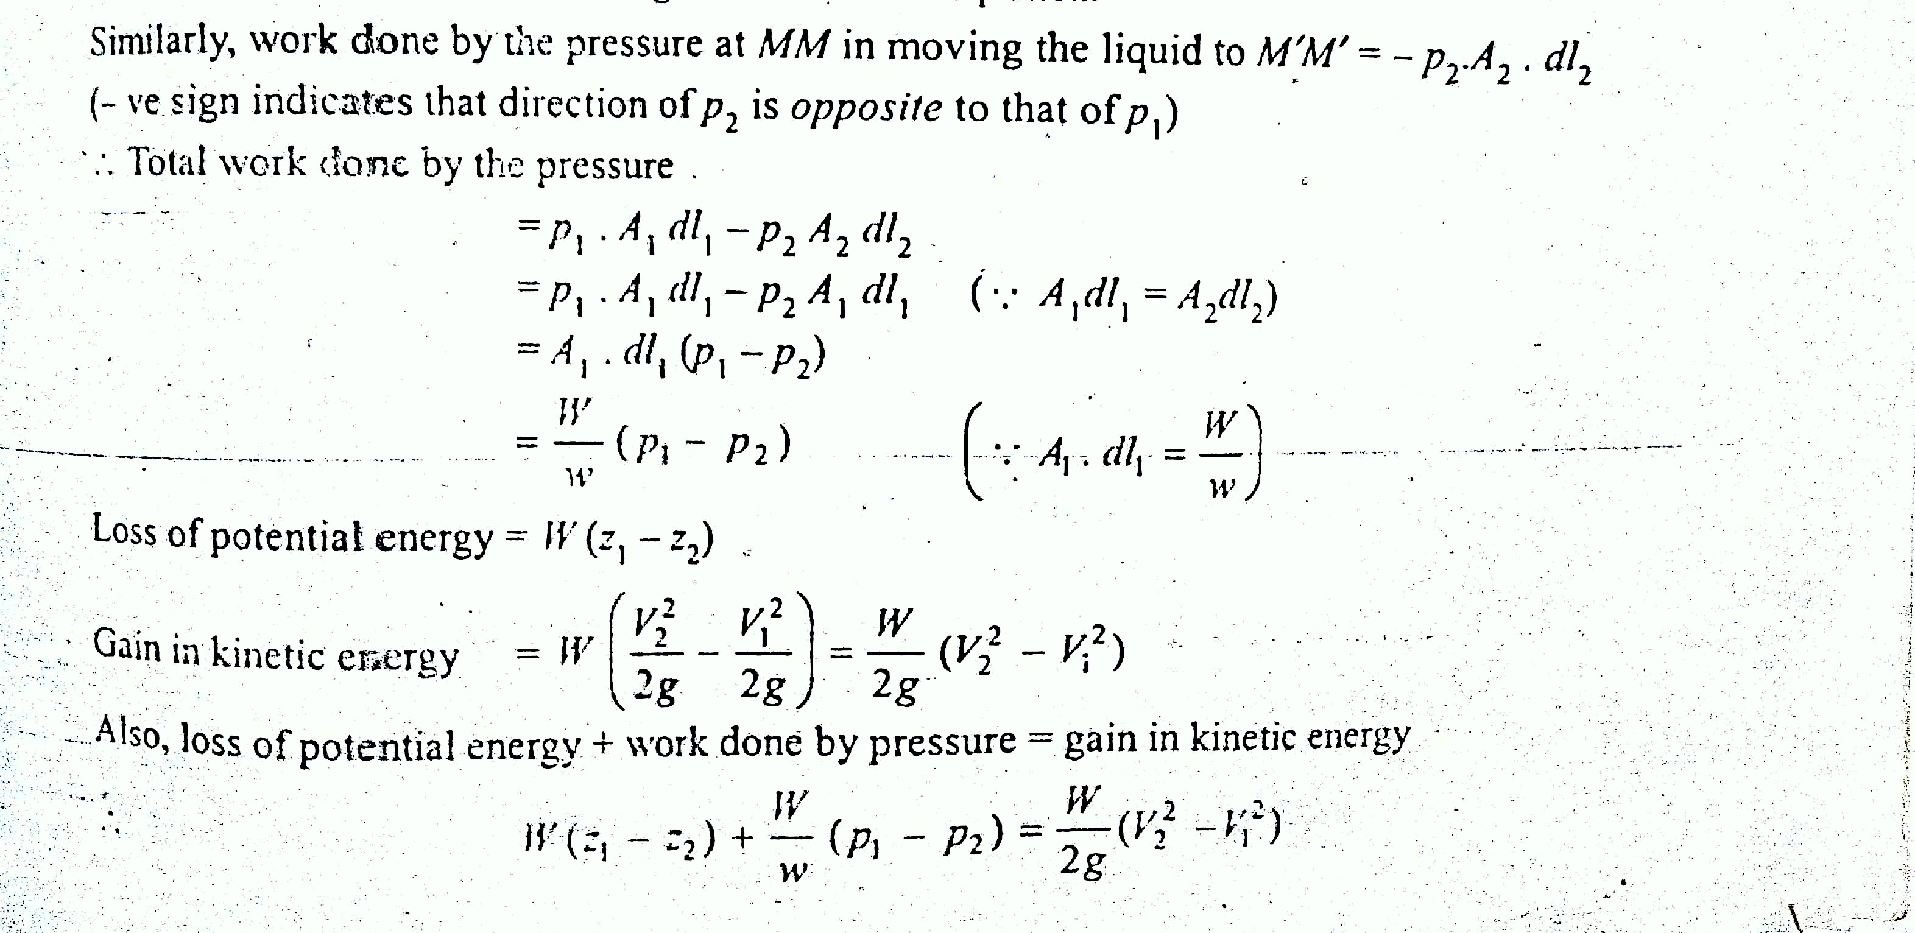

Slide 7
Bernoulli’s Equation: Assumptions
The Liquid is ideal and incompressible
The flow is steady and continuous.
The flow is along the streamline i.e. it is one dimensional
The velocity is uniform over the section and is equal to mean velocity
The only forces acting on the fluid are gravity forces and pressure forces.

Slide 8
Important Terms
Incompressible = Incompressible means that the effect of pressure on the fluid density are zero or negligible.
Ideal Fluid = An ideal fluid is one which is incompressible and has zero viscosity (In reality, no such fluid exists)
Steady Flow = The type of flow in which the fluid characteristics like velocity, pressure, density etc. at a particular point do not change with time.
Stream Line = Defined as an imaginary line within the flow so that the tangent at any point on it indicates velocity at that point.

Slide 9
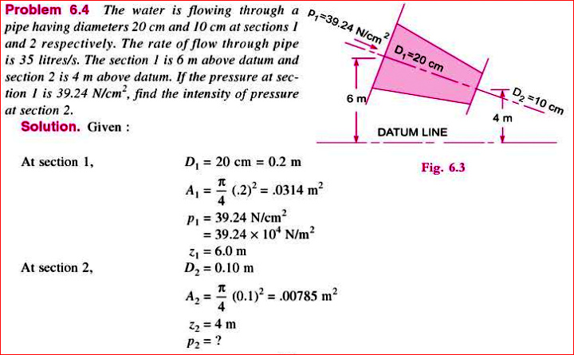
Practice Problem#2

Slide 10
