Slide 1
Dimensional Analysis
Dimensional analysis is a mathematical technique which makes the use of the study of the dimensions for solving several engineering problems.
Dimensional analysis helps in determining a systematic arrangement of the variables in the physical relationship, combining dimensional variables to form non-dimensional parameters.
Uses of Dimensional Analysis:
To test the dimensional homogeneity of any equation of fluid motion.
To derive rational formulae for a flow phenomenon.
To derive equations expressed in terms of non-dimensional parameters to show the relative significance of each parameter.
To plan model tests and present experimental results in a systematic manner; thus making it possible to analyze the complex fluid flow problems.

Slide 2
Dimensional Analysis
Advantages of Dimensional Analysis:
It expresses the functional relationship between the variables in dimensionless terms.
In hydraulic model studies , it reduces the number of variables involved in a physical phenomenon.
By proper selection of variables, the dimensionless parameters can be used to make certain logical deductions about the problem.
Design curves, by the use of dimensional analysis can be developed from experimental data or direct solution of the problem.
It enables getting up a theoretical equation in a simplified dimensional form.

Slide 3
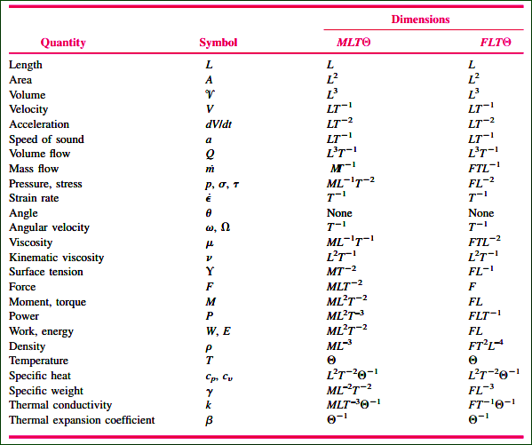
Dimensions: Rajput#380

Slide 4
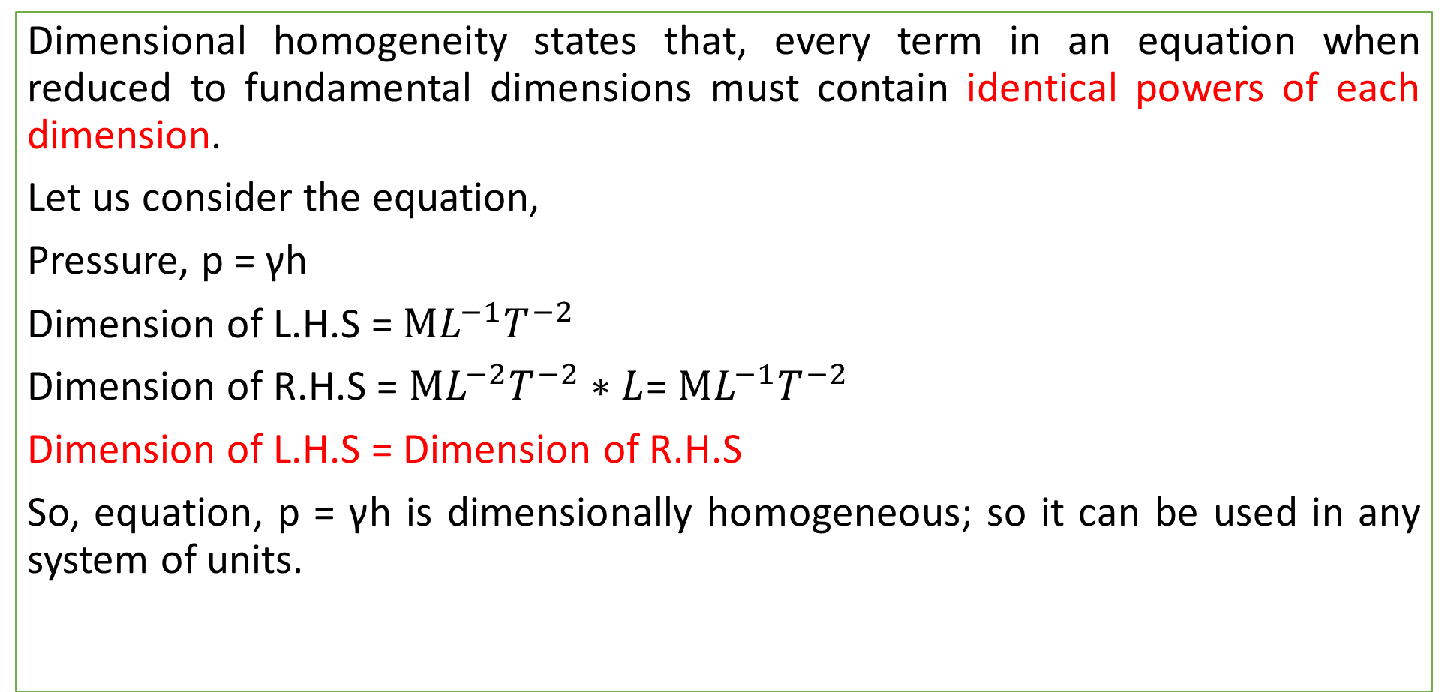
Dimensional Homogeneity
Dimensional homogeneity states that, every term in an equation when reduced to fundamental dimensions must contain identical powers of each dimension.
Let us consider the equation,
Pressure, p = γh
Dimension of L.H.S = $ML^{−1}T^{−2}$
Dimension of R.H.S = $ML^{−2}T^{−2}∗L$= $ML^{−1}T^{−2}$
Dimension of L.H.S = Dimension of R.H.S
So, equation, p = γh is dimensionally homogeneous; so it can be used in any system of units.

Slide 5
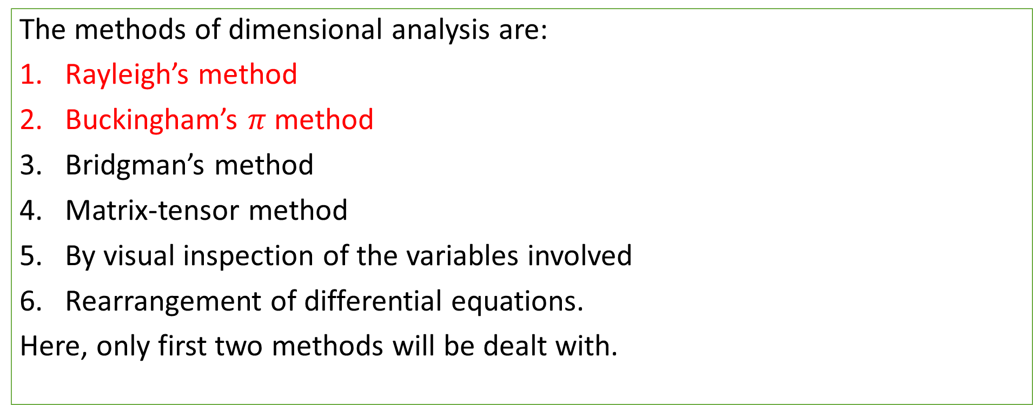
Methods of Dimensional Analysis
The methods of dimensional analysis are:
Rayleigh’s method
Buckingham’s $π$ method
Bridgman’s method
Matrix-tensor method
By visual inspection of the variables involved
Rearrangement of differential equations.
Here, only first two methods will be dealt with.

Slide 6
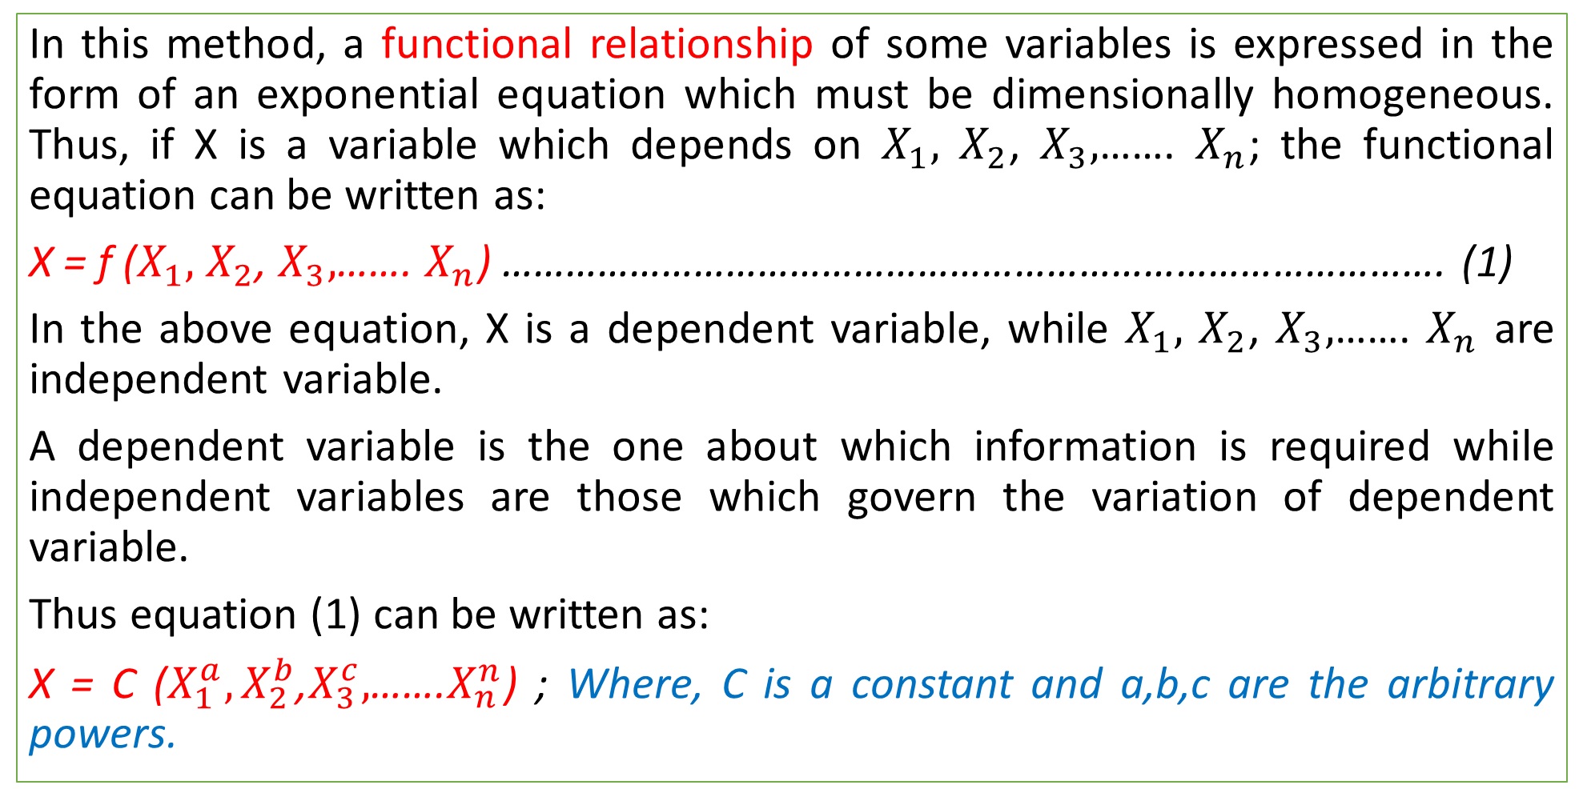
Rayleigh’s Method
In this method, a functional relationship of some variables is expressed in the form of an exponential equation which must be dimensionally homogeneous. Thus, if X is a variable which depends on $X_{1},$ $X_{2}$, $X_{3},$……. $X_{n}$; the functional equation can be written as:
X = f ($X_{1},$ $X_{2}$, $X_{3},$……. $X_{n}$) ……………………………………………………………………………. (1)
In the above equation, X is a dependent variable, while $X_{1},$ $X_{2}$, $X_{3},$……. $X_{n}$ are independent variable.
A dependent variable is the one about which information is required while independent variables are those which govern the variation of dependent variable.
Thus equation (1) can be written as:
X = C ($X_{1}^{a},X_{2}^{b}$,$X_{3}^{c},$…….$X_{n}^{n}$) ; Where, C is a constant and a,b,c are the arbitrary powers.

Slide 7
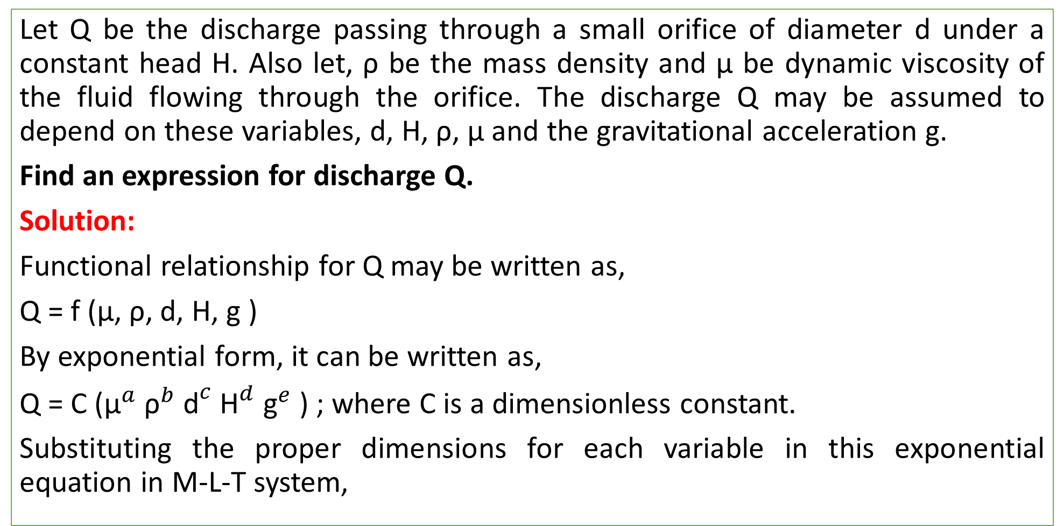
Rayleigh’s Method (Modi#842)
Let Q be the discharge passing through a small orifice of diameter d under a constant head H. Also let, ρ be the mass density and µ be dynamic viscosity of the fluid flowing through the orifice. The discharge Q may be assumed to depend on these variables, d, H, ρ, µ and the gravitational acceleration g.
Find an expression for discharge Q.
Solution:
Functional relationship for Q may be written as,
Q = f (µ, ρ, d, H, g )
By exponential form, it can be written as,
Q = C (${\text{µ}}^{a} {\text{ρ}}^{b} {\text{d}}^{c} {\text{H}}^{d} {\text{g}}^{e}$) ; where C is a dimensionless constant.
Substituting the proper dimensions for each variable in this exponential equation in M-L-T system,

Slide 8
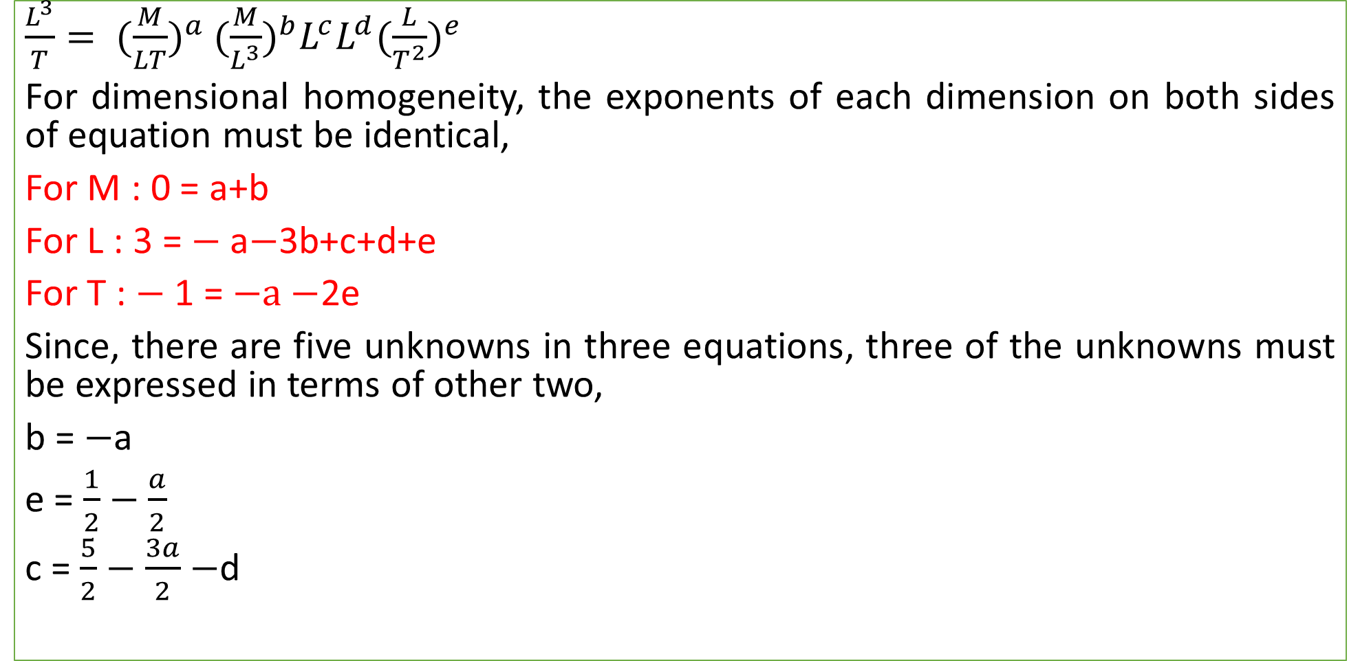
Rayleigh’s Method (Modi#842)
$\frac{L^{3}}{T}= {(\frac{M}{LT})}^{a}$ ${(\frac{M}{L^{3}})}^{b}L^{c}{L^{d}(\frac{L}{T^{2}})}^{e}$
For dimensional homogeneity, the exponents of each dimension on both sides of equation must be identical,
For M : 0 = a+b
For L : 3 = $−$a$−$3b+c+d+e
For T : $−$1 = $−a−$2e
Since, there are five unknowns in three equations, three of the unknowns must be expressed in terms of other two,
b = $−$a
e = $\frac{1}{2}$ $−$ $\frac{a}{2}$
c = $\frac{5}{2}−\frac{3a}{2}$ $−$d

Slide 9
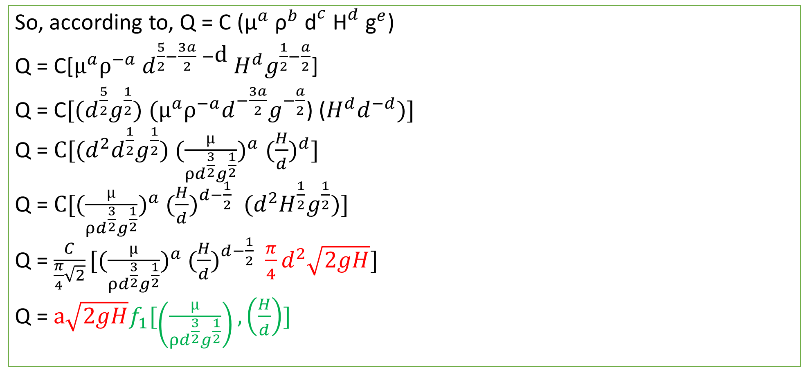
Rayleigh’s Method (Modi#842)
So, according to, Q = C (${\text{µ}}^{a} {\text{ρ}}^{b} {\text{d}}^{c} {\text{H}}^{d} {\text{g}}^{e}$)
Q = C[$µ^{a}ρ^{−a}$ $d^{\frac{5}{2}−\frac{3a}{2} −\text{d} }H^{d}g^{\frac{1}{2}−\frac{a}{2}}$]
Q = C$[(d^{\frac{5}{2}}g^{\frac{1}{2}})$ $(µ^{a}ρ^{−a}{d^{−\frac{3a}{2}}g}^{−\frac{a}{2}}$) ($H^{d}d^{−d})]$
Q = $C[(d^{2}{d^{\frac{1}{2}}g}^{\frac{1}{2}})$ $({\frac{µ}{ρd^{\frac{3}{2}}g^{\frac{1}{2}}})}^{a}$ ${(\frac{H}{d})}^{d}]$
Q = $C[({\frac{µ}{ρd^{\frac{3}{2}}g^{\frac{1}{2}}})}^{a}$ ${(\frac{H}{d})}^{d−\frac{1}{2}}{ (d}^{2}{H^{\frac{1}{2}}g}^{\frac{1}{2}})]$
Q = $\frac{C}{\frac{π}{4}\sqrt{2}}[({\frac{µ}{ρd^{\frac{3}{2}}g^{\frac{1}{2}}})}^{a}$ ${(\frac{H}{d})}^{d−\frac{1}{2}}{ \frac{π}{4}d}^{2}\sqrt{2gH}]$
Q = $a\sqrt{2gH}f_{1}[\left(\frac{µ}{ρd^{\frac{3}{2}}g^{\frac{1}{2}}}\right), \left(\frac{H}{d}\right)]$

Slide 10
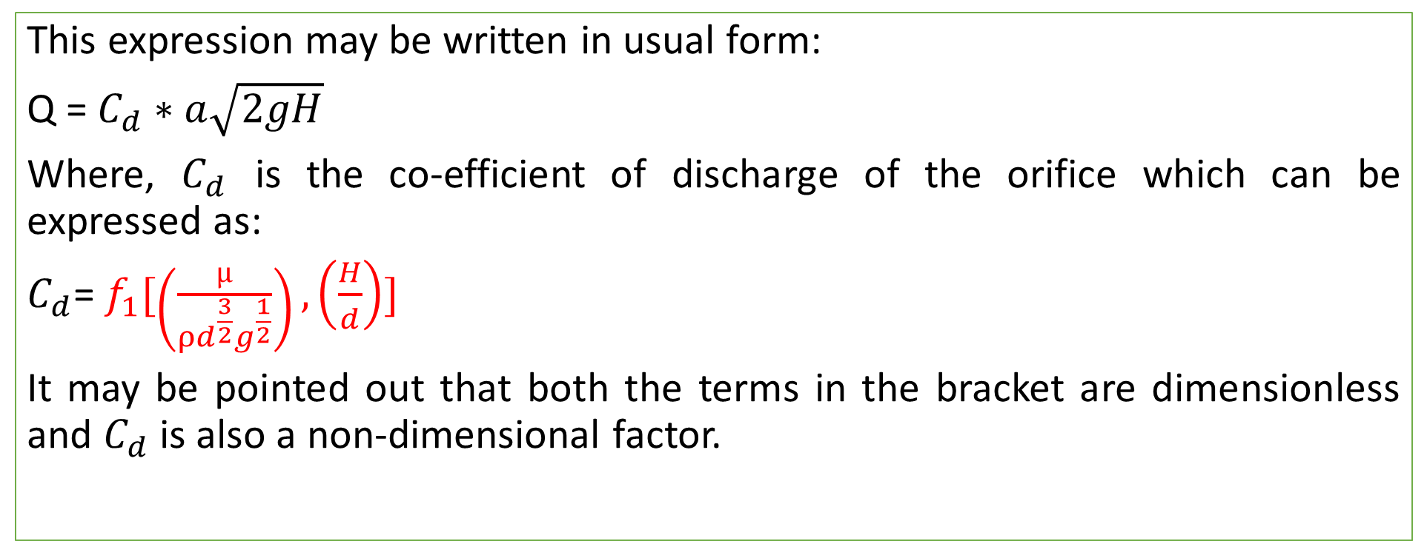
Rayleigh’s Method (Modi#842)
This expression may be written in usual form:
Q = $C_{d}∗a\sqrt{2gH}$
Where, $C_{d}$ is the co-efficient of discharge of the orifice which can be expressed as:
$C_{d}$= $f_{1}[\left(\frac{µ}{ρd^{\frac{3}{2}}g^{\frac{1}{2}}}\right), \left(\frac{H}{d}\right)]$
It may be pointed out that both the terms in the bracket are dimensionless and $C_{d}$ is also a non-dimensional factor.

Slide 11
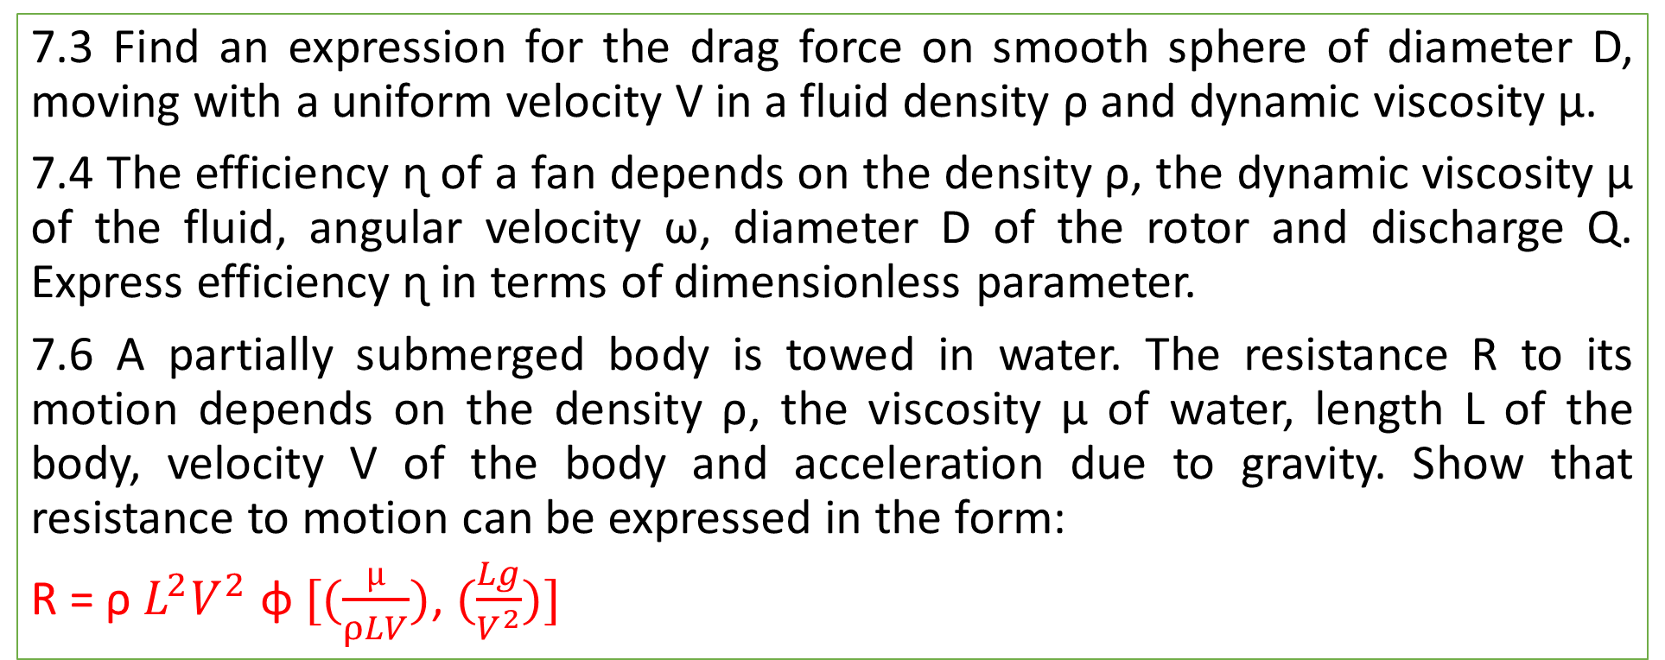
Practice Problem: Rajput#383
7.3 Find an expression for the drag force on smooth sphere of diameter D, moving with a uniform velocity V in a fluid density ρ and dynamic viscosity µ.
7.4 The efficiency ɳ of a fan depends on the density ρ, the dynamic viscosity µ of the fluid, angular velocity ω, diameter D of the rotor and discharge Q. Express efficiency ɳ in terms of dimensionless parameter.
7.6 A partially submerged body is towed in water. The resistance R to its motion depends on the density ρ, the viscosity µ of water, length L of the body, velocity V of the body and acceleration due to gravity. Show that resistance to motion can be expressed in the form:
R = ρ $L^{2}V^{2}$ ɸ $[(\frac{µ}{ρLV})$, $(\frac{Lg}{V^{2}})]$

