Slide 1
Bansal: Dimensional and Model Analysis
https://books.google.co.in/books?id=nCnifcUdNp4C&pg=PA554&source=gbs_toc_r&hl=en#v=onepage&q&f=true

Slide 2
Buckingham’s π Method
When a large number of physical variables are involved, Rayleigh’s method of dimensional analysis becomes increasingly laborious and cumbersome. Buckingham’s method is an improvement over the Rayleigh’s method. Buckingham designated the dimensionless group by the Greek capital letter π (Pi). It is therefore often called Buckingham’s π method.
The advantage of this method over Rayleigh’s method is that it let us know, in advance of the analysis, as to how many dimensionless groups are to be expected.

Slide 3
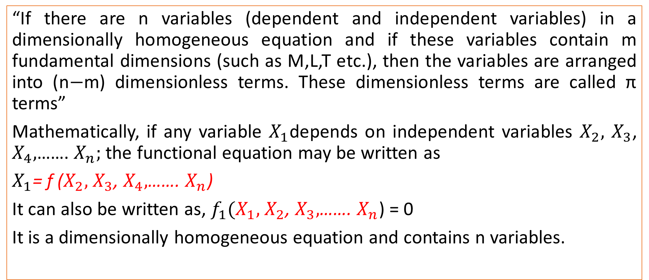
Buckingham’s π Method (Statement)
“If there are n variables (dependent and independent variables) in a dimensionally homogeneous equation and if these variables contain m fundamental dimensions (such as M,L,T etc.), then the variables are arranged into (n$−$m) dimensionless terms. These dimensionless terms are called π terms”
Mathematically, if any variable $X_{1}$depends on independent variables $X_{2},$ $X_{3}$, $X_{4},$……. $X_{n};$ the functional equation may be written as
$X_{1}$= f ($X_{2},$ $X_{3}$, $X_{4},$……. $X_{n}$)
It can also be written as, $f_{1}(X_{1},$ $X_{2}$, $X_{3},$……. $X_{n}$) = 0
It is a dimensionally homogeneous equation and contains n variables.

Slide 4
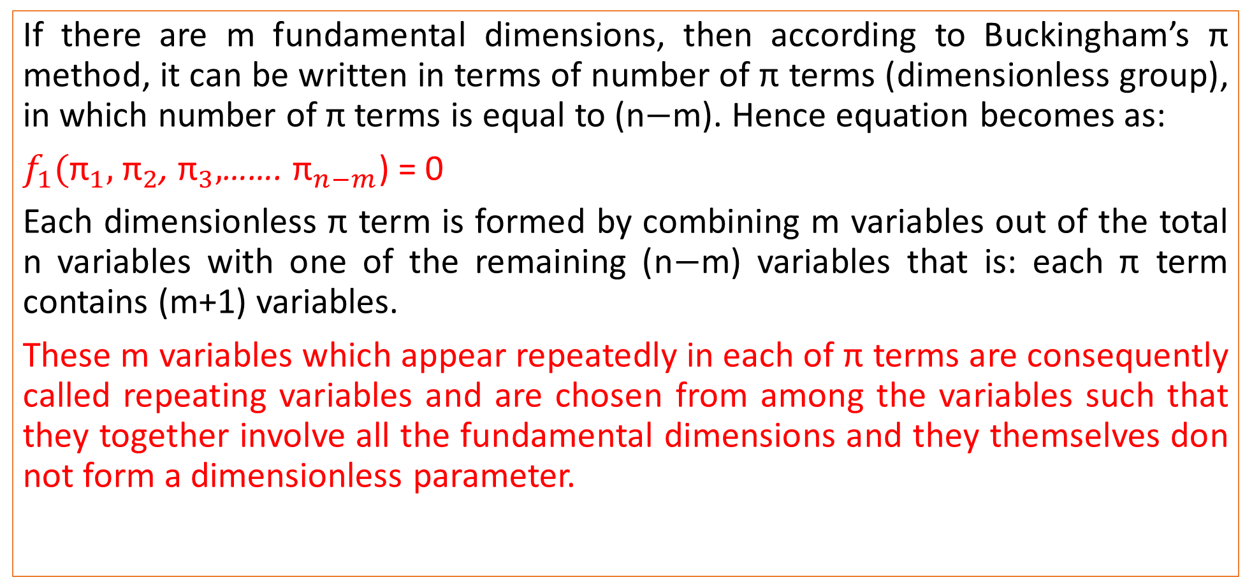
Buckingham’s π Method (Statement)
If there are m fundamental dimensions, then according to Buckingham’s π method, it can be written in terms of number of π terms (dimensionless group), in which number of π terms is equal to (n$−$m). Hence equation becomes as:
$f_{1}({\text{π}}_{1},$ ${\text{π}}_{2}$, ${\text{π}}_{3},$……. ${\text{π}}_{n−m}$) = 0
Each dimensionless π term is formed by combining m variables out of the total n variables with one of the remaining (n$−$m) variables that is: each π term contains (m+1) variables.
These m variables which appear repeatedly in each of π terms are consequently called repeating variables and are chosen from among the variables such that they together involve all the fundamental dimensions and they themselves don not form a dimensionless parameter.

Slide 5
Selection of repeating Variables
Repeating variables must contain jointly all the fundamental dimensions involved in the phenomenon. Usually the fundamental dimensions are M,L and T.
The repeating variables must not form the non-dimensional parameters among themselves.
As far as possible, dependent variables should not be selected as repeating variables.
No two repeating variables should have the same dimensions.
Repeating variables should be chosen in such a way that one variable contains geometric property (length, diameter, height), other variable contains flow property (velocity, acceleration) and third variable contains fluid property (mass density, weight density, dynamic viscosity).

Slide 6
Problem: Bansal#568
The pressure difference Δp in a pipe of diameter D and length l due to viscous flow depends on velocity V, viscosity µ and density ρ. Using Buckingham’s π theorem, obtain an expression for Δp.

Slide 7
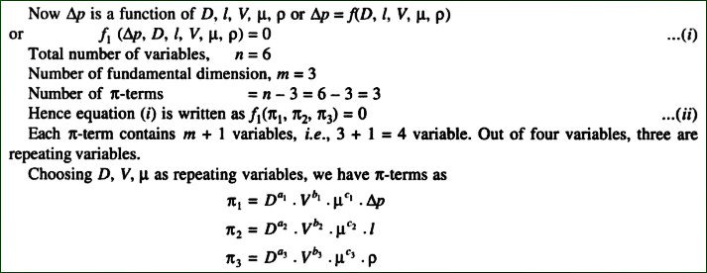
Step 1: Selection of repeating variables

Slide 8
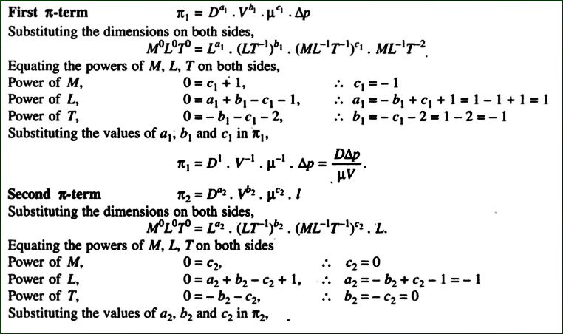
Step 2: Calculate π terms

Slide 9
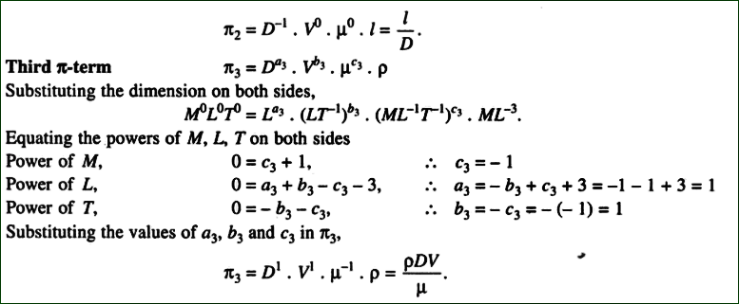
Step 2: Calculate π terms

Slide 10
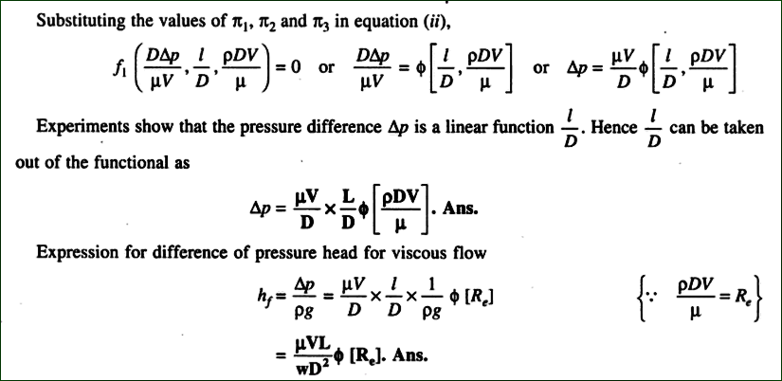
Step 3: Final expression

