Slide 1
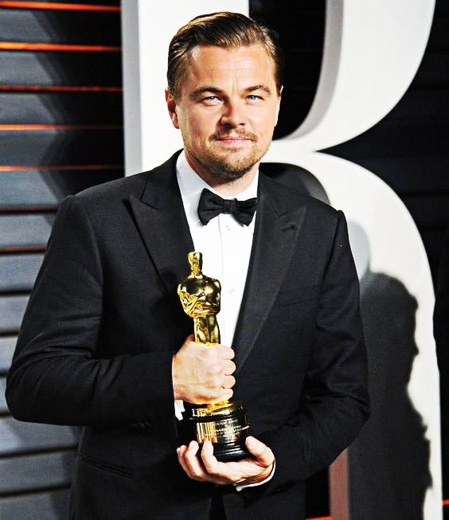
Model Analysis
Google Search: Model
a three-dimensional representation of a person or thing or of a proposed structure, typically on a smaller scale than the original.
a thing used as an example to follow or imitate.
Leonardo DiCaprio Wins Oscar For Best Actor For ‘The Revenant’

Slide 2
Model Analysis
In order to know about the performance of the hydraulic structures (dams, spillways etc.) or hydraulic machines (turbines, pumps etc.) before actually constructing or manufacturing them, their models are made and tested to get the required information.
The model is the small scale replica of the actual structure or machine.
The actual structure or machine is called Prototype.
The models are not always smaller than the prototype.
In some cases, a model may be even larger or of the same size as prototype depending upon the need and purpose.

Slide 3
Advantages of model testing:
The model tests are quite economical and convenient.
With the use of models, the performance of hydraulic structures/hydraulic machines can be predicted in advance.
While designing a particular portion of the structure, if clear cut analytical and reliable method is not available then in such cases it becomes absolutely necessary to know about the safety and reliability of such parts which is possible by means of model testing.
Model testing can be used to detect and rectify the defects of an existing structure which is not functioning properly.

Slide 4
Applications of the model testing:
Civil engineering structures such as dams, spillways, weirs, canals etc.
Flood control, investigation of silting and scour in rivers, irrigation channels.
Turbines, pumps and compressors.
Design of harbours, ships and submarines.
Aeroplanes, rockets and missiles.
Tall buildings (to predict the wind loads on buildings, the stability characteristics of the buildings and airflow patterns in their vicinity.

Slide 5
Similitude
Google search results:
the quality or state of being similar to something.
a comparison between two things.
a person or thing resembling someone or something else.
The following three similarities must be ensured between the model and the prototype:
Geometric similarity
Kinematic similarity
Dynamic similarity

Slide 6
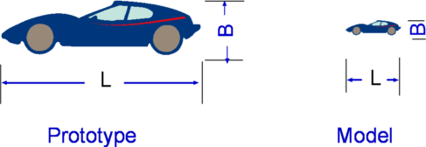
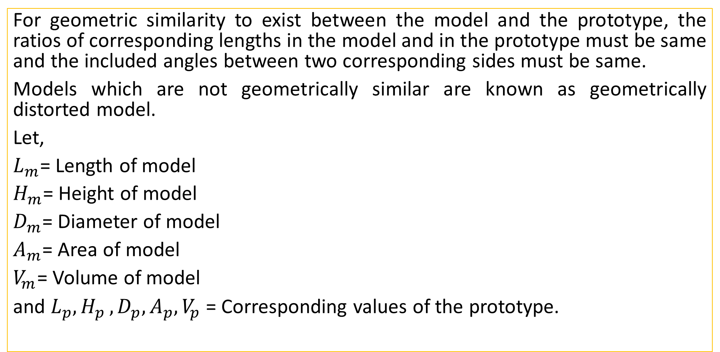
Geometric Similarity
For geometric similarity to exist between the model and the prototype, the ratios of corresponding lengths in the model and in the prototype must be same and the included angles between two corresponding sides must be same.
Models which are not geometrically similar are known as geometrically distorted model.
Let,
$L_{m}$= Length of model
$H_{m}$= Height of model
$D_{m}$= Diameter of model
$A_{m}$= Area of model
$V_{m}$= Volume of model
and $L_{p}{,H}_{p},D_{p},A_{p},V_{p}$ = Corresponding values of the prototype.

Slide 7
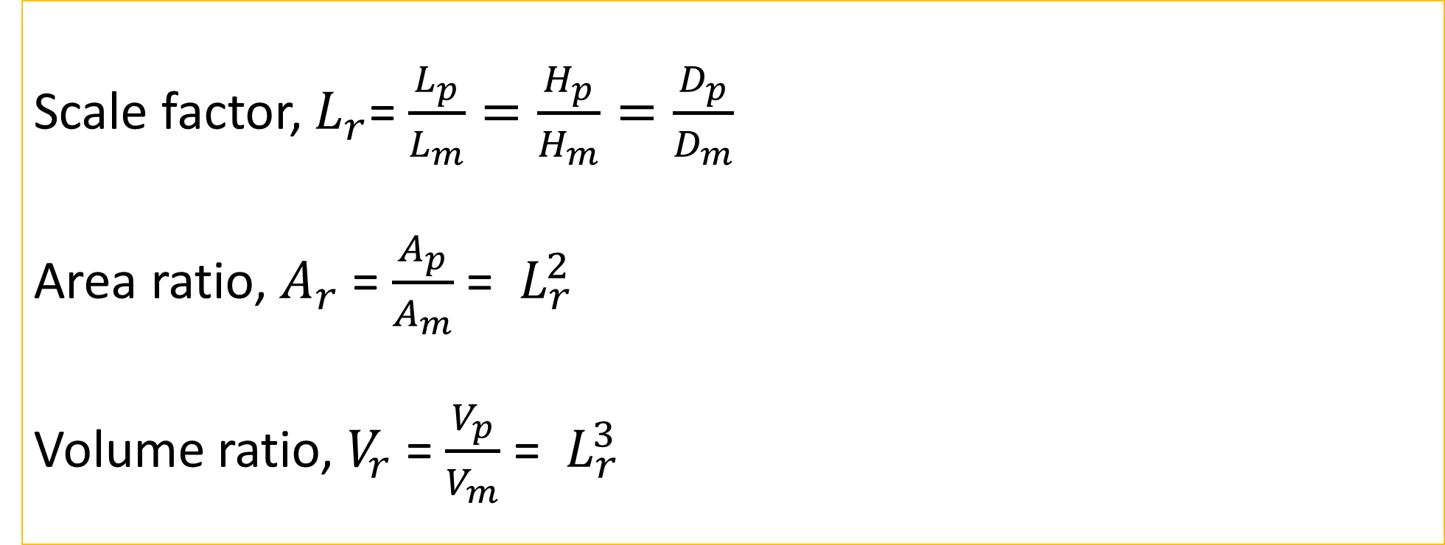
Geometric Similarity
Scale factor, $L_{r}$= $\frac{L_{p}}{L_{m}}=\frac{H_{p}}{H_{m}}=\frac{D_{p}}{D_{m}}$
Area ratio, $A_{r}$ = $\frac{A_{p}}{A_{m}}$ = $L_{r}^{2}$
Volume ratio, $V_{r}$ = $\frac{V_{p}}{V_{m}}$ = $L_{r}^{3}$

Slide 8
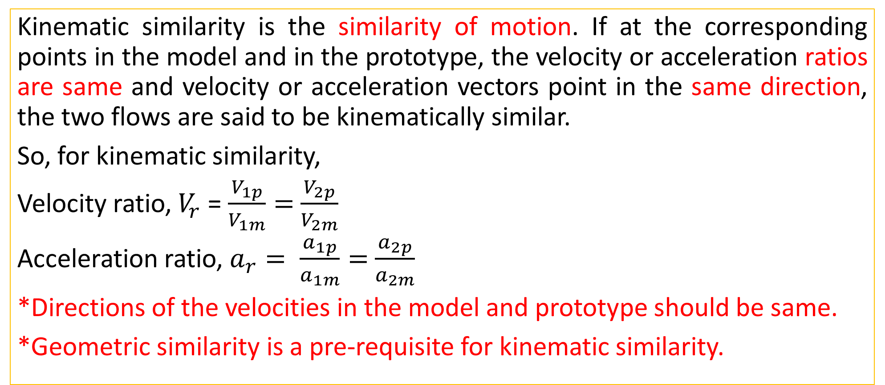
Kinematic Similarity
Kinematic similarity is the similarity of motion. If at the corresponding points in the model and in the prototype, the velocity or acceleration ratios are same and velocity or acceleration vectors point in the same direction, the two flows are said to be kinematically similar.
So, for kinematic similarity,
Velocity ratio, $V_{r}$ = $\frac{V_{1p}}{V_{1m}}=$ $\frac{V_{2p}}{V_{2m}}$
Acceleration ratio, $a_{r}= \frac{a_{1p}}{a_{1m}}=$ $\frac{a_{2p}}{a_{2m}}$
*Directions of the velocities in the model and prototype should be same.
*Geometric similarity is a pre-requisite for kinematic similarity.

Slide 9
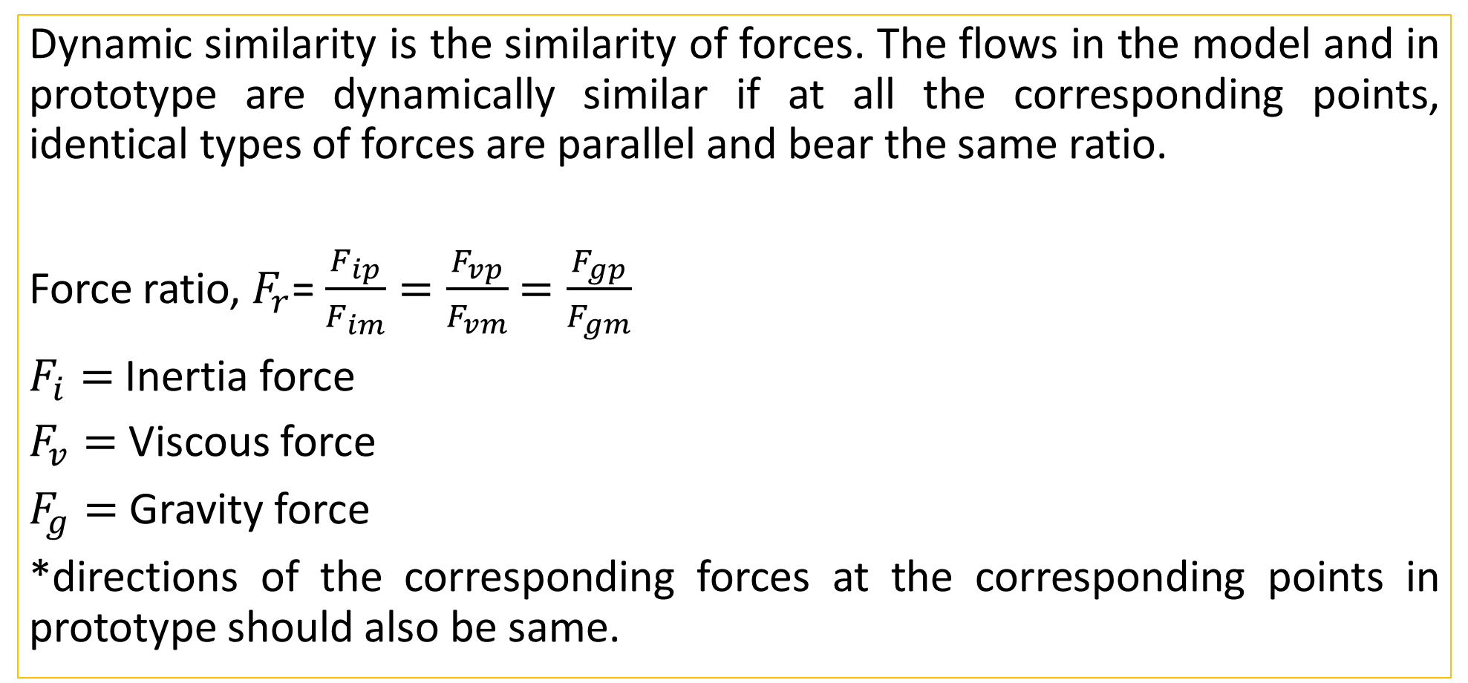
Dynamic Similarity
Dynamic similarity is the similarity of forces. The flows in the model and in prototype are dynamically similar if at all the corresponding points, identical types of forces are parallel and bear the same ratio.
Force ratio, $F_{r}$= $\frac{F_{ip}}{F_{im}}=\frac{F_{vp}}{F_{vm}}$ $=\frac{F_{gp}}{F_{gm}}$
$F_{i}=$ Inertia force
$F_{v}=$ Viscous force
$F_{g}=$ Gravity force
*directions of the corresponding forces at the corresponding points in prototype should also be same.

Slide 10
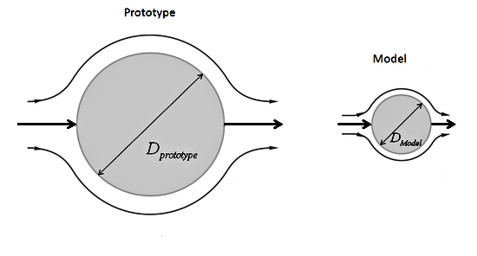
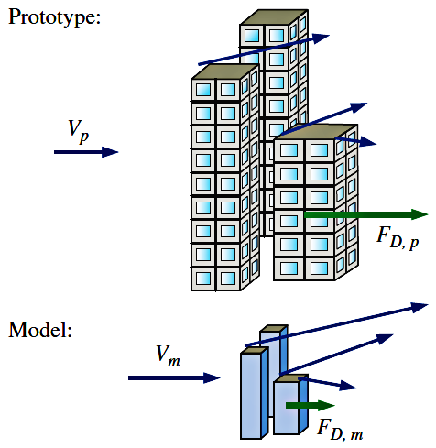
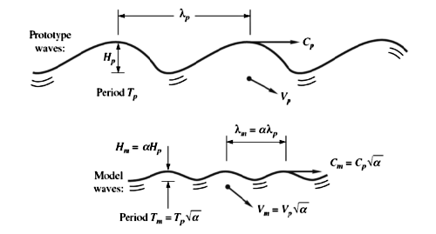
Similitude

