Slide 1
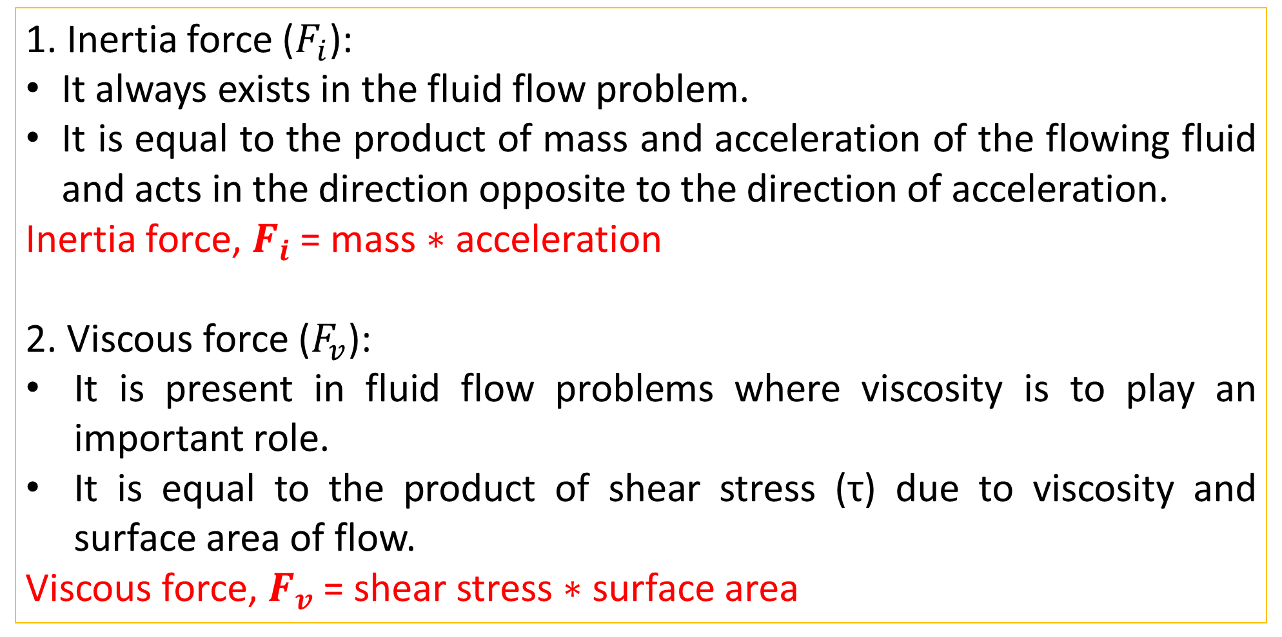
Factors influencing Hydraulic Phenomena
1. Inertia force ($F_{i}$):
It always exists in the fluid flow problem.
It is equal to the product of mass and acceleration of the flowing fluid and acts in the direction opposite to the direction of acceleration.
Inertia force, $F_{i}$ = mass$∗$ acceleration
2. Viscous force ($F_{v}$):
It is present in fluid flow problems where viscosity is to play an important role.
It is equal to the product of shear stress (τ) due to viscosity and surface area of flow.
Viscous force, $F_{v}$ = shear stress $∗$ surface area

Slide 2
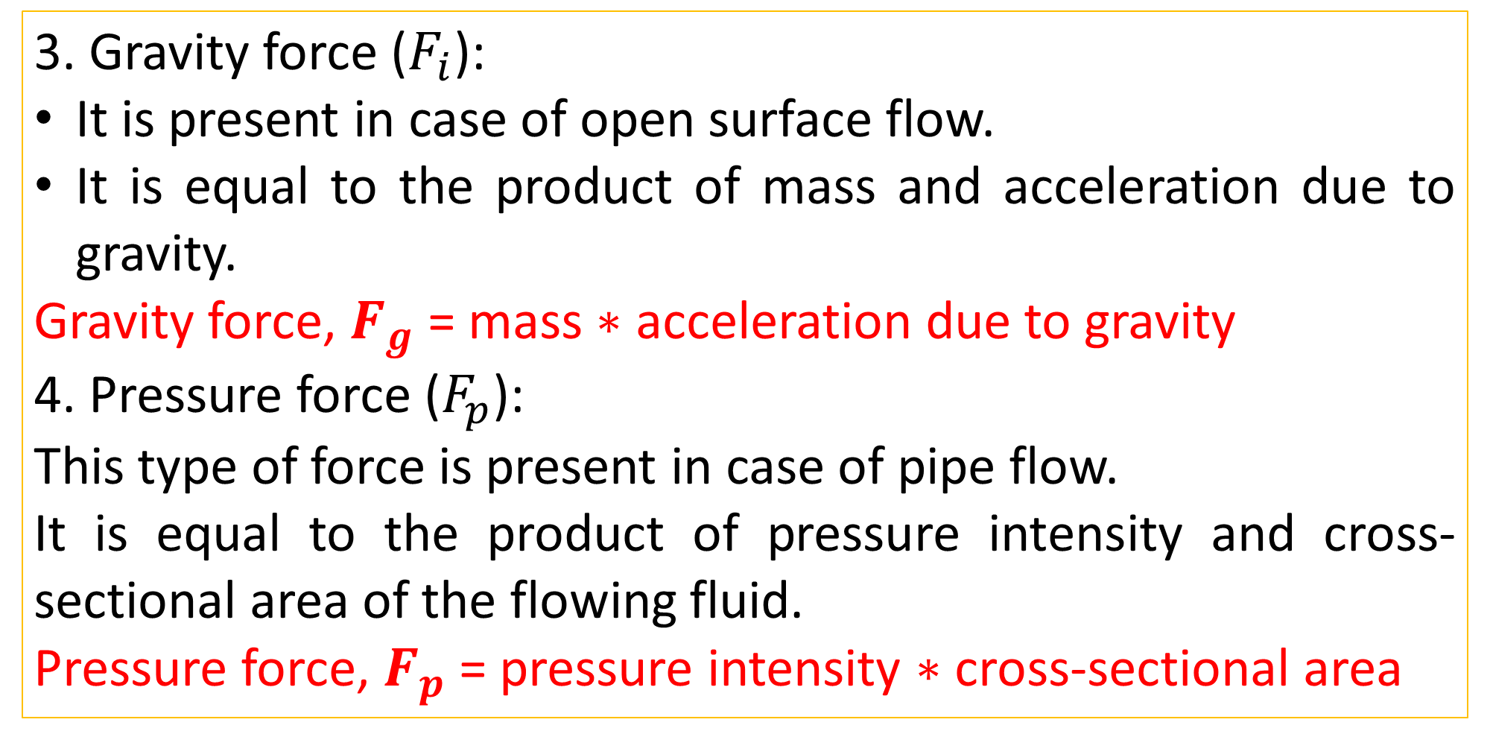
Factors influencing Hydraulic Phenomena
3. Gravity force ($F_{i}$):
It is present in case of open surface flow.
It is equal to the product of mass and acceleration due to gravity.
Gravity force, $F_{g}$ = mass$∗$ acceleration due to gravity
4. Pressure force ($F_{p}$):
This type of force is present in case of pipe flow.
It is equal to the product of pressure intensity and cross-sectional area of the flowing fluid.
Pressure force, $F_{p}$ = pressure intensity $∗$ cross-sectional area

Slide 3
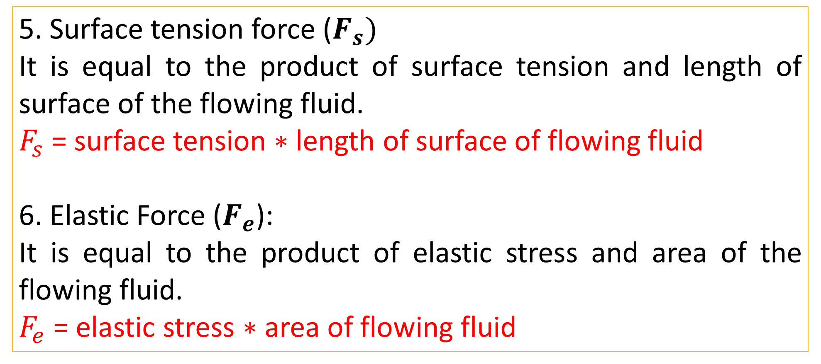
Factors influencing Hydraulic Phenomena
5. Surface tension force ($F_{s})$
It is equal to the product of surface tension and length of surface of the flowing fluid.
$F_{s}$ = surface tension $∗$ length of surface of flowing fluid
6. Elastic Force ($F_{e}$):
It is equal to the product of elastic stress and area of the flowing fluid.
$F_{e}$ = elastic stress $∗$ area of flowing fluid

Slide 4


Slide 5
Dimensionless numbers and their significance
Reynolds number
Froude’s number
Euler’s number
Weber’s number
Mach’s number

Slide 6
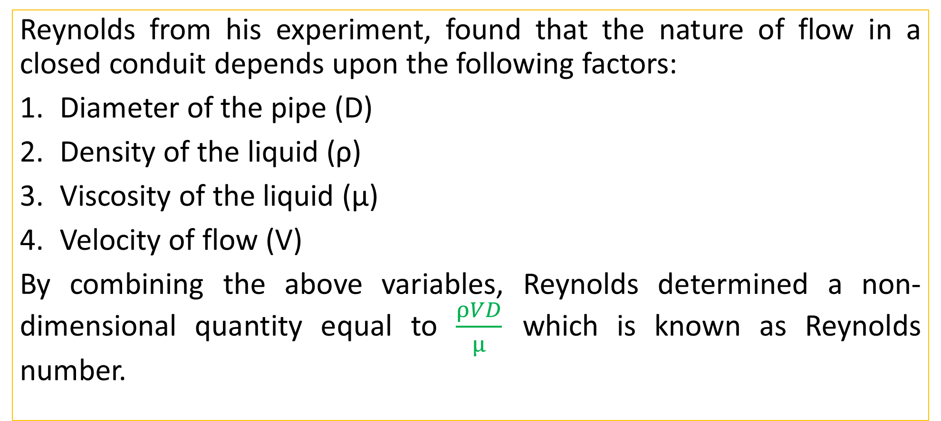
Reynolds Number, $R_{e}$
Reynolds from his experiment, found that the nature of flow in a closed conduit depends upon the following factors:
Diameter of the pipe (D)
Density of the liquid (ρ)
Viscosity of the liquid (μ)
Velocity of flow (V)
By combining the above variables, Reynolds determined a non-dimensional quantity equal to $\frac{ρVD}{μ}$ which is known as Reynolds number.

Slide 7
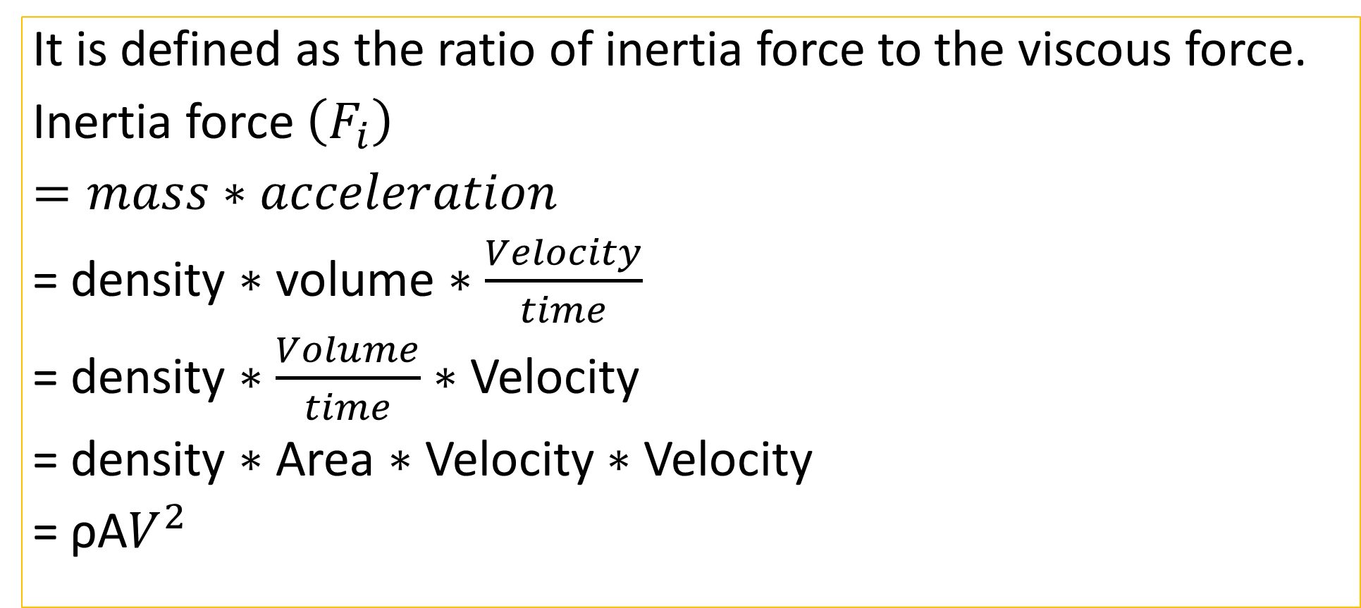
Reynolds Number, $R_{e}$
It is defined as the ratio of inertia force to the viscous force.
Inertia force $\left(F_{i}\right)$
$=mass∗acceleration$
= density $∗$ volume $∗$ $\frac{Velocity}{time}$
= density $∗$ $\frac{Volume}{time}$ $∗$ Velocity
= density $∗$ Area $∗$ Velocity $∗$ Velocity
= ρA$V^{2}$

Slide 8

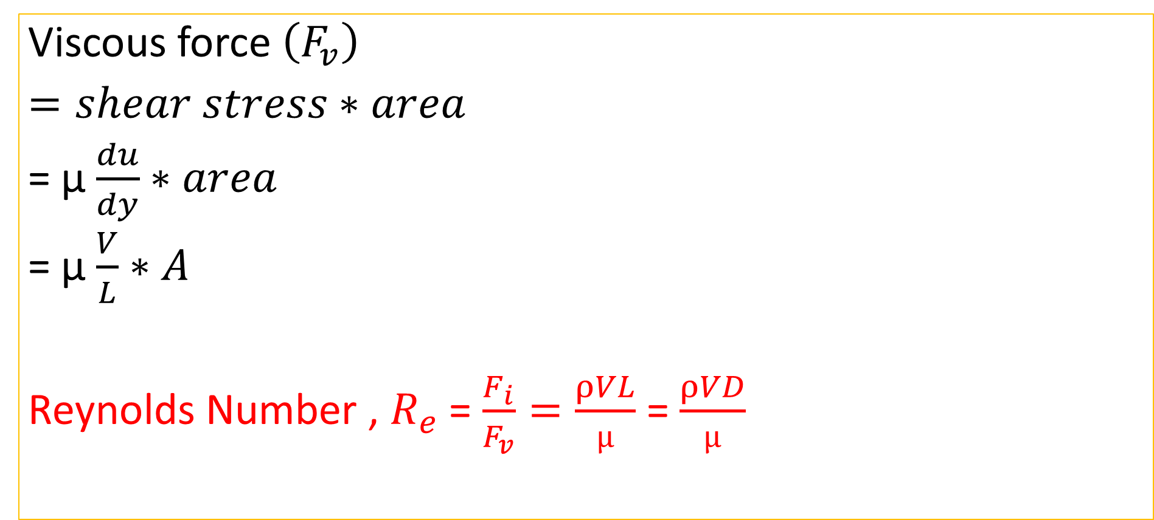
Reynolds Number, $R_{e}$
Viscous force $\left(F_{v}\right)$
$=shear stress∗area$
= µ $\frac{du}{dy}∗area$
= µ $\frac{V}{L}∗A$
Reynolds Number , $R_{e}$ = $\frac{F_{i}}{F_{v}}=\frac{ρVL}{µ}$ = $\frac{ρVD}{µ}$

Slide 9
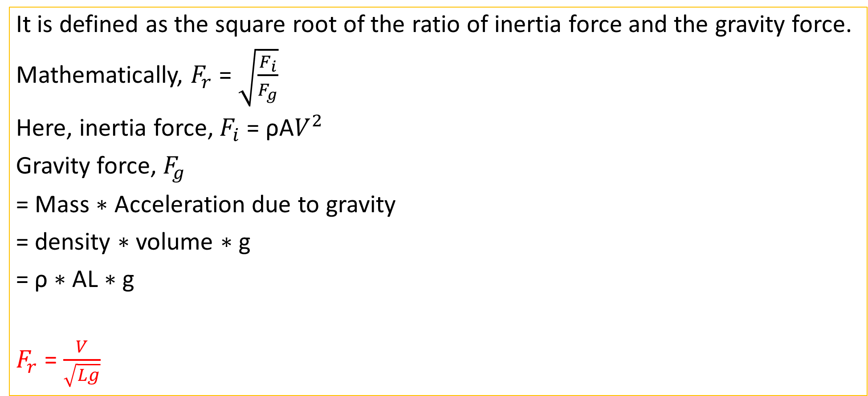
Froude Number
It is defined as the square root of the ratio of inertia force and the gravity force.
Mathematically, $F_{r}$ = $\sqrt{\frac{F_{i}}{F_{g}}}$
Here, inertia force, $F_{i}$ = ρA$V^{2}$
Gravity force, $F_{g}$
= Mass $∗$ Acceleration due to gravity
= density $∗$ volume $∗$ g
= ρ $∗$AL $∗$g
$F_{r}$ = $\frac{V}{\sqrt{Lg}}$

Slide 10
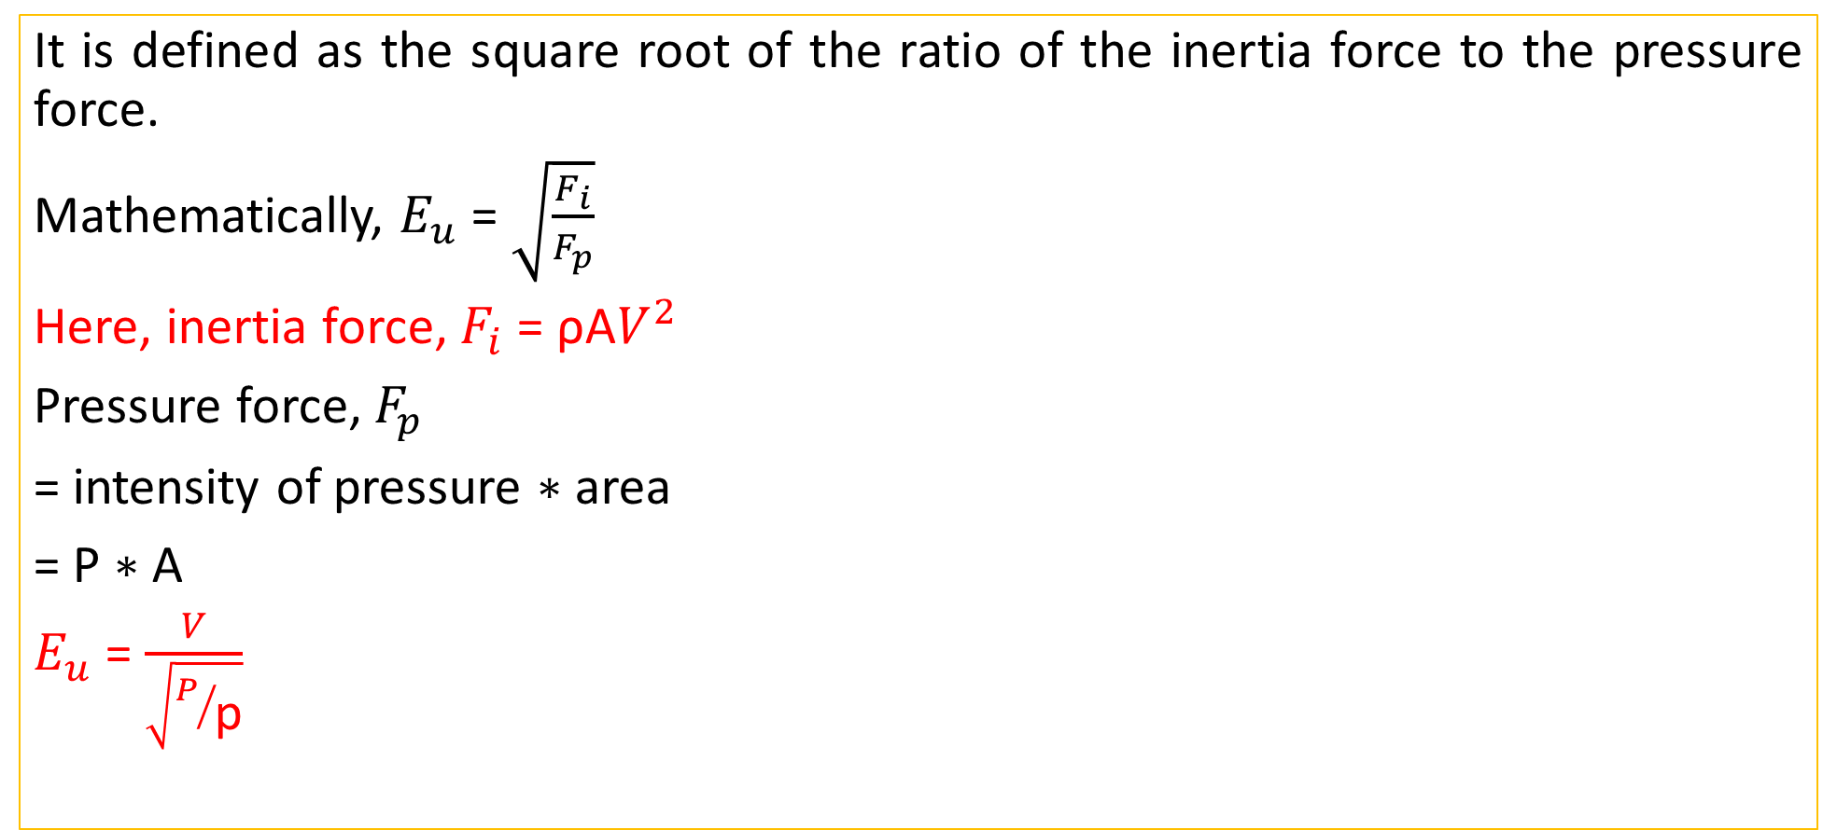
Euler’s Number
It is defined as the square root of the ratio of the inertia force to the pressure force.
Mathematically, $E_{u}$ = $\sqrt{\frac{F_{i}}{F_{p}}}$
Here, inertia force, $F_{i}$ = ρA$V^{2}$
Pressure force, $F_{p}$
= intensity of pressure $∗$ area
= P $∗$ A
$E_{u}$ = $\frac{V}{\sqrt{P/{\text{p}}}}$

Slide 11
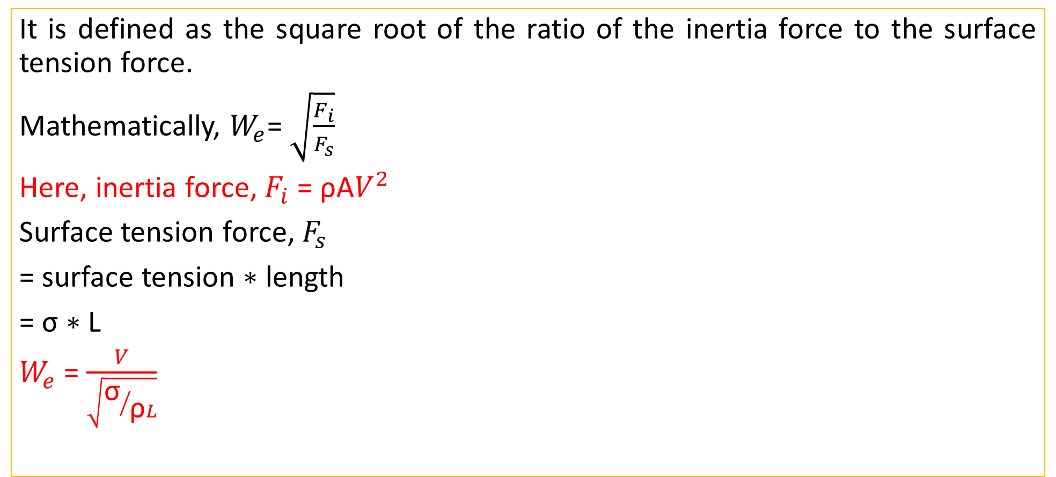
Weber Number
It is defined as the square root of the ratio of the inertia force to the surface tension force.
Mathematically, $W_{e}$= $\sqrt{\frac{F_{i}}{F_{s}}}$
Here, inertia force, $F_{i}$ = ρA$V^{2}$
Surface tension force, $F_{s}$
= surface tension $∗$ length
= σ $∗$ L
$W_{e}$ = $\frac{V}{\sqrt{{\text{σ}}/{\text{ρ}L}}}$

Slide 12
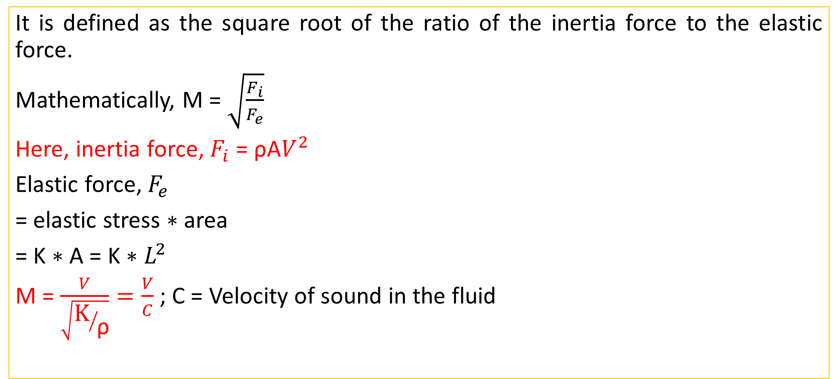
Mach Number
It is defined as the square root of the ratio of the inertia force to the elastic force.
Mathematically, M = $\sqrt{\frac{F_{i}}{F_{e}}}$
Here, inertia force, $F_{i}$ = ρA$V^{2}$
Elastic force, $F_{e}$
= elastic stress $∗$ area
= K $∗$ A = K $∗L^{2}$
M = $\frac{V}{\sqrt{{\text{K}}/{\text{ρ}}}}=\frac{V}{C}$ ; C = Velocity of sound in the fluid

Slide 13
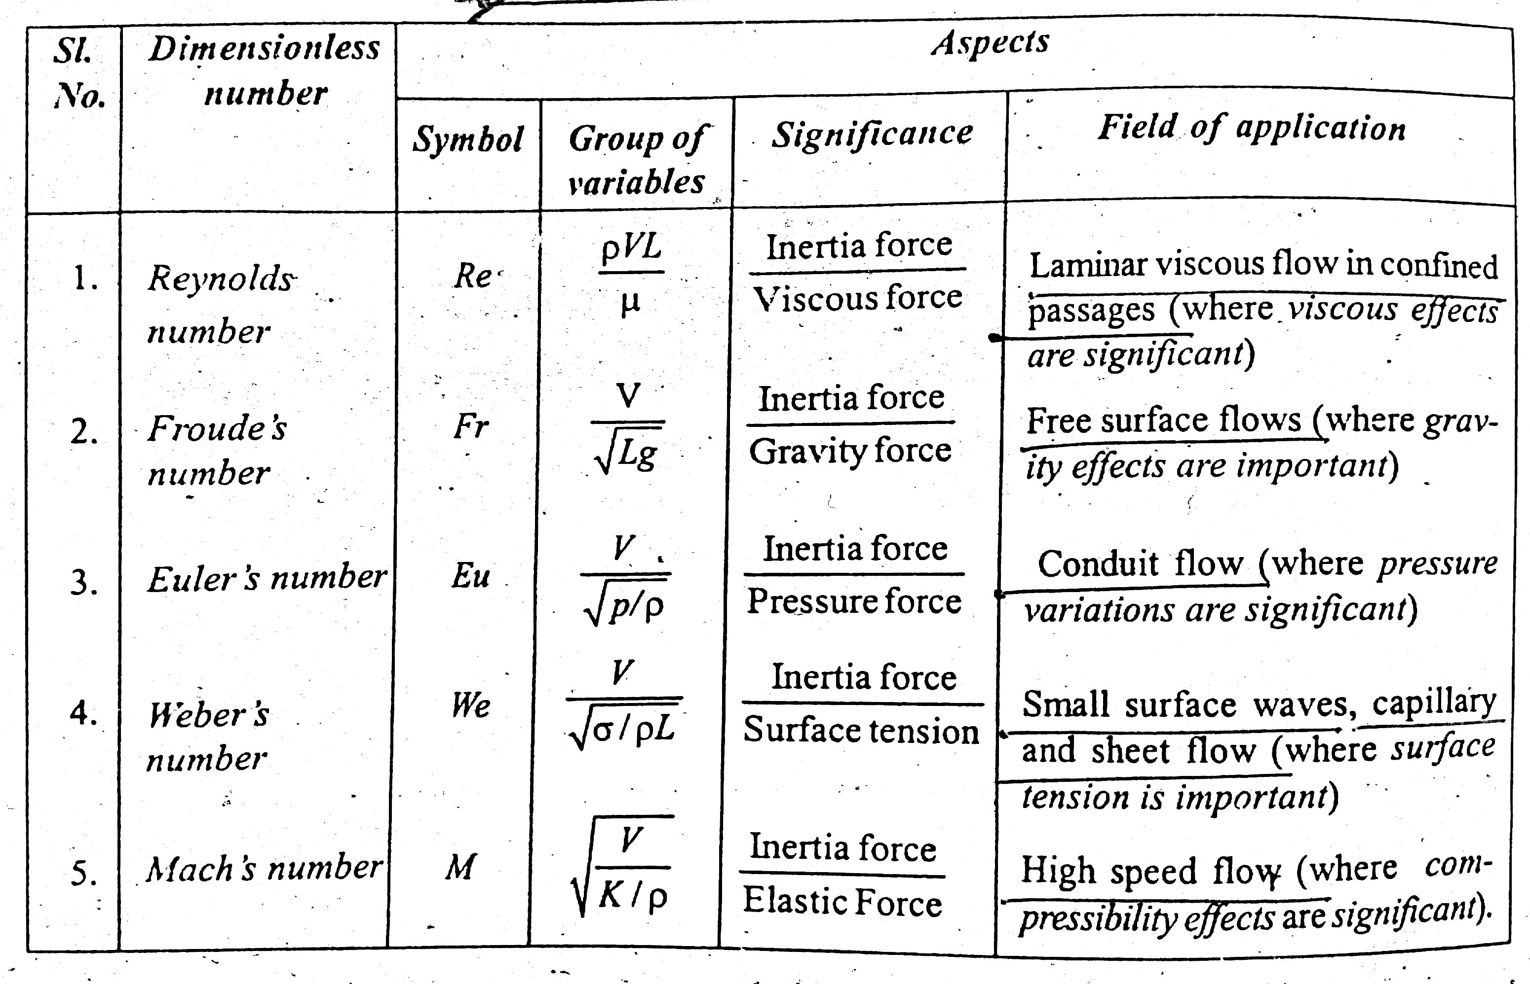
Summary

