Slide 1
Model (or Similarity Laws)
Dimensionless number should be same for the model as well as the prototype; this condition is difficult to be satisfied for all dimensionless numbers.
Hence, models are designed on the basis of the force which is dominating in the flow situation. The laws on which the models are designed for dynamic similarity are called model or similarity laws.
Reynold’s model law.
Froude Model law.
Euler model law.
Weber model law
Mach model law.

Slide 2
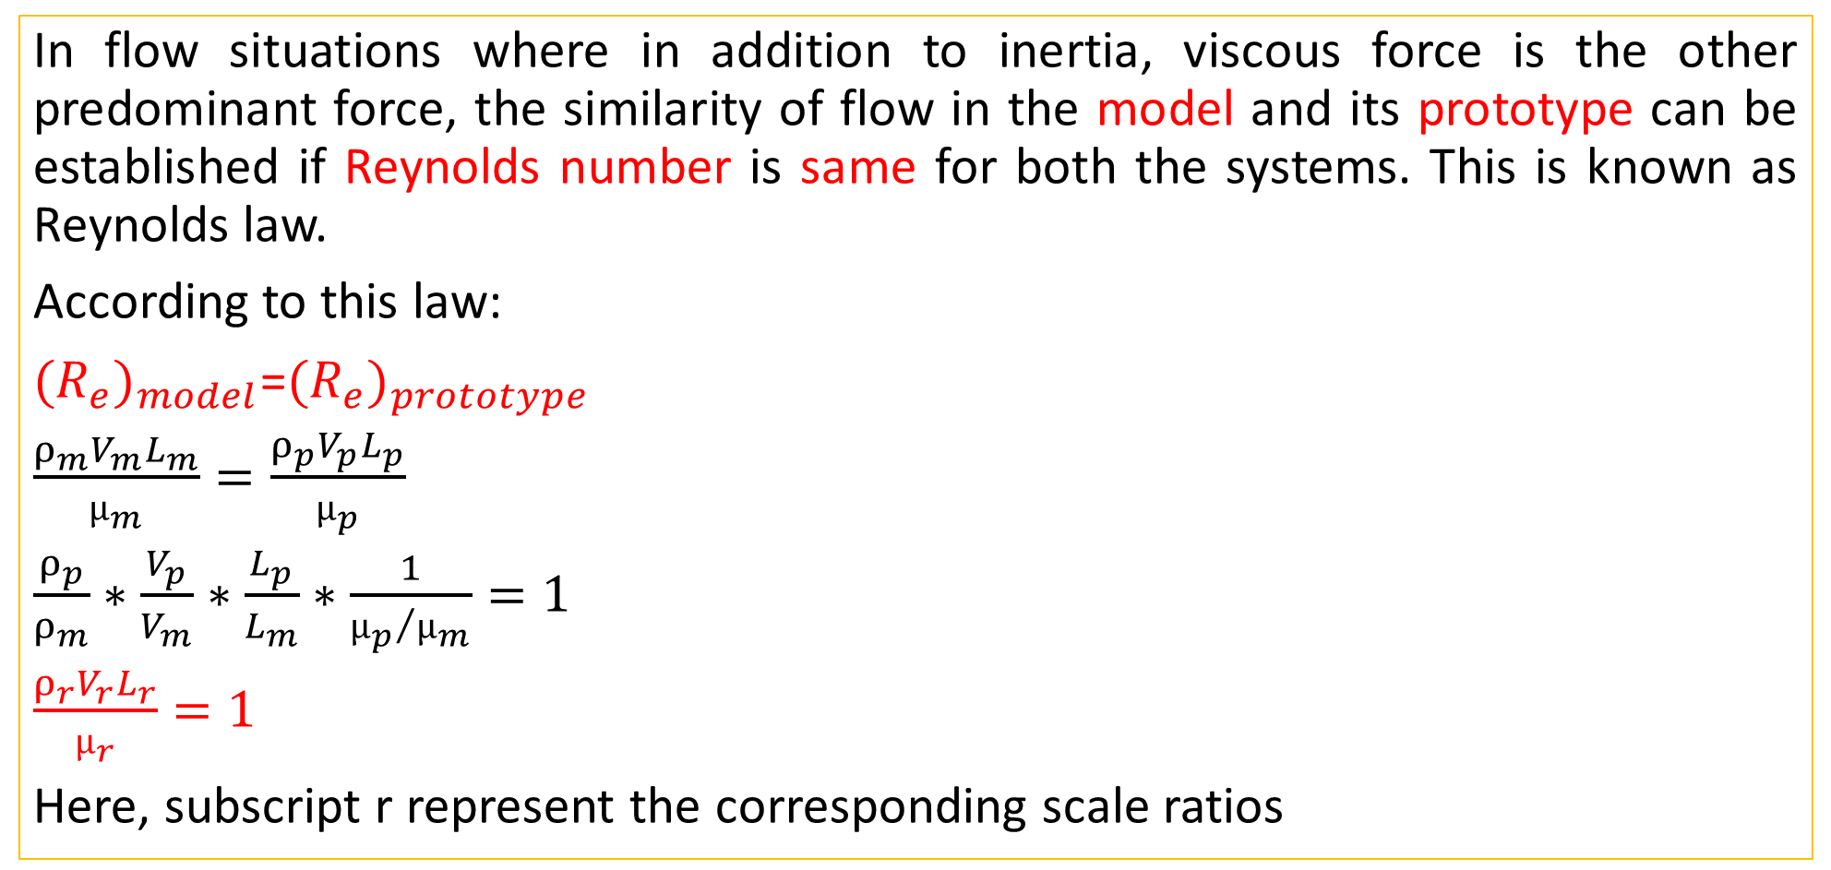
Reynolds Model Law
In flow situations where in addition to inertia, viscous force is the other predominant force, the similarity of flow in the model and its prototype can be established if Reynolds number is same for both the systems. This is known as Reynolds law.
According to this law:
${(R_{e})}_{model}$=${(R_{e})}_{prototype}$
$\frac{ρ_{m}V_{m}L_{m}}{µ_{m}}=\frac{ρ_{p}V_{p}L_{p}}{µ_{p}}$
$\frac{ρ_{p}}{ρ_{m}}∗\frac{V_{p}}{V_{m}}∗\frac{L_{p}}{L_{m}}∗\frac{1}{{µ_{p}}/{µ_{m}}}=1$
$\frac{ρ_{r}V_{r}L_{r}}{µ_{r}}=1$
Here, subscript r represent the corresponding scale ratios

Slide 3
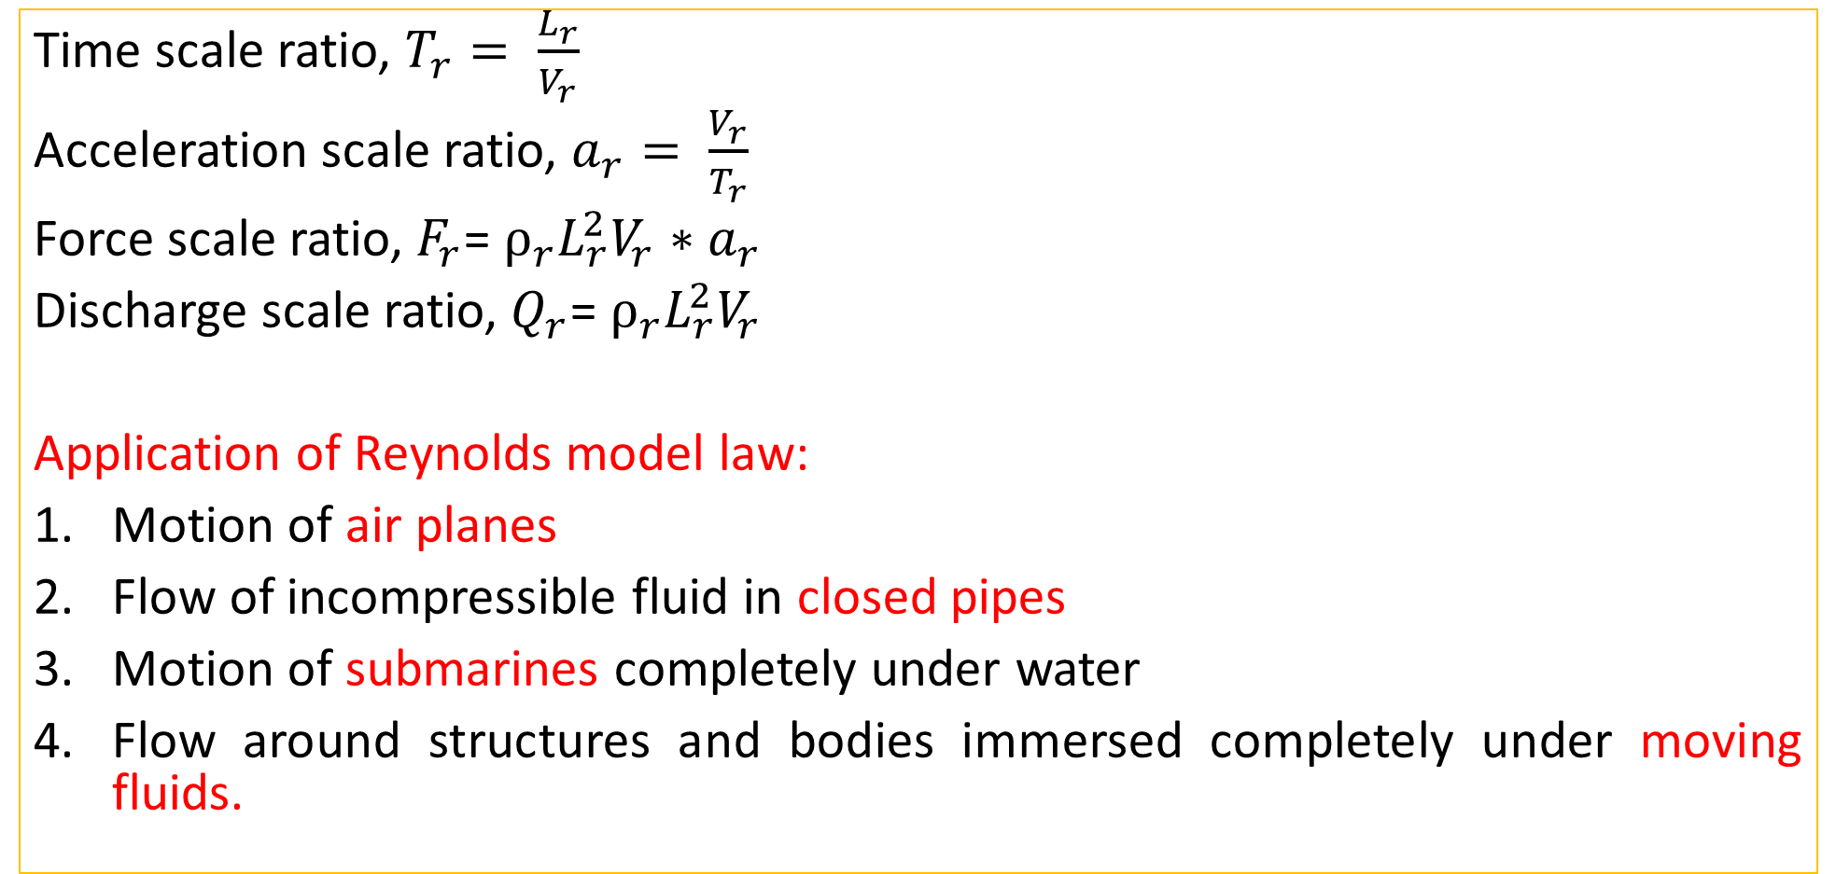
Reynolds Model Law: Scale ratio
Time scale ratio, $T_{r}= \frac{L_{r}}{V_{r}}$
Acceleration scale ratio, $a_{r}= \frac{V_{r}}{T_{r}}$
Force scale ratio, $F_{r}$= $ρ_{r}L_{r}^{2}V_{r}{∗a}_{r}$
Discharge scale ratio, $Q_{r}$= $ρ_{r}L_{r}^{2}V_{r}$
Application of Reynolds model law:
Motion of air planes
Flow of incompressible fluid in closed pipes
Motion of submarines completely under water
Flow around structures and bodies immersed completely under moving fluids.

Slide 4
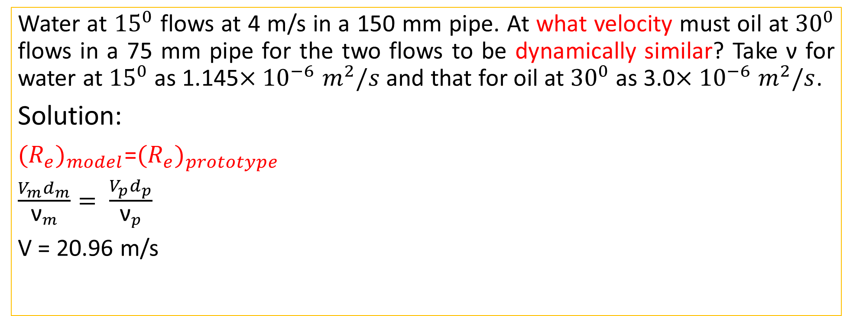
Reynolds Model Law
Water at ${15}^{0}$ flows at 4 m/s in a 150 mm pipe. At what velocity must oil at ${30}^{0}$ flows in a 75 mm pipe for the two flows to be dynamically similar? Take ν for water at ${15}^{0}$ as 1.145$×{10}^{−6}$ $m^{2}/s$ and that for oil at ${30}^{0}$ as 3.0$×{10}^{−6}$ $m^{2}/s$.
Solution:
${(R_{e})}_{model}$=${(R_{e})}_{prototype}$
$\frac{V_{m}d_{m}}{{\text{ν}}_{m}}= \frac{V_{p}d_{p}}{{\text{ν}}_{p}}$
V = 20.96 m/s

Slide 5
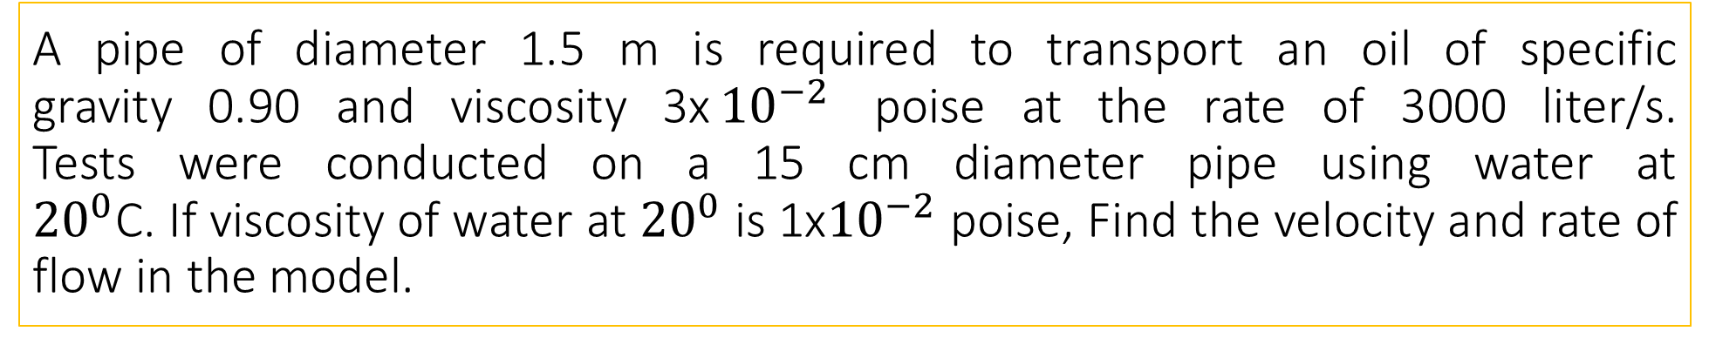
A pipe of diameter 1.5 m is required to transport an oil of specific gravity 0.90 and viscosity 3x${10}^{−2}$ poise at the rate of 3000 liter/s.
Tests were conducted on a 15 cm diameter pipe using water at
${20}^{0}$C. If viscosity of water at ${20}^{0}$ is 1x${10}^{−2}$ poise, Find the velocity and rate of flow in the model.
Reynolds Model Law: Problem

Slide 6
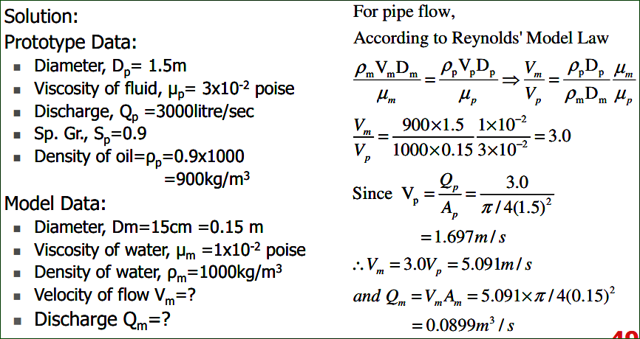
Solution

Slide 7
Froude Model Law
When the gravitational force can be considered to be only predominant force which controls the motion in addition to the inertia force, the similarity of the flow in any two such systems can be established if the Froude number for the both system is same. This is known as Froude Model law.
Application of Froude model law:
Free surface flows such as flow over spillways, sluices etc.
Flow of jet from an orifice or nozzle.
Where waves are likely to be formed on the surface.
Where fluids of the different mass densities flow over one another.

Slide 8
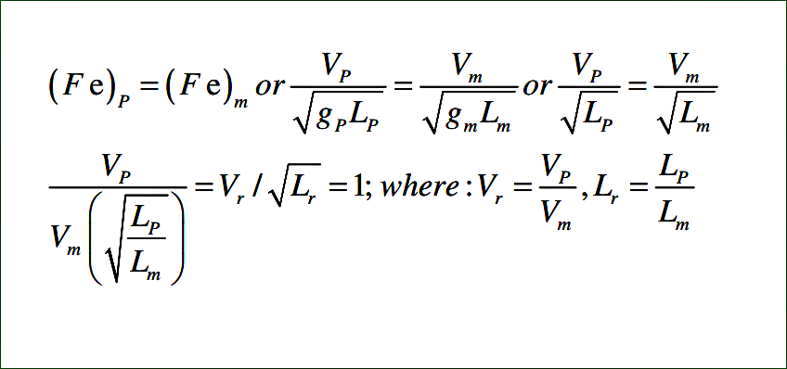
Froude Model Law

Slide 9
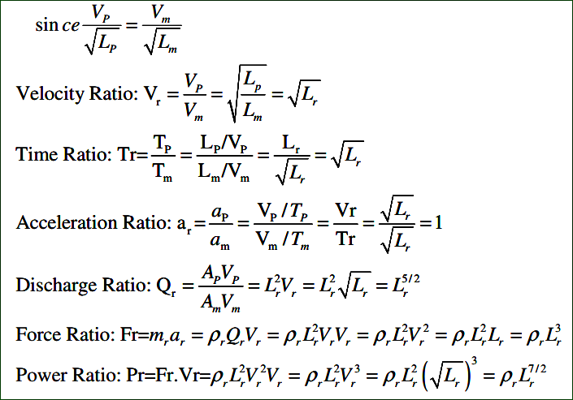
Froude Model Law

Slide 10
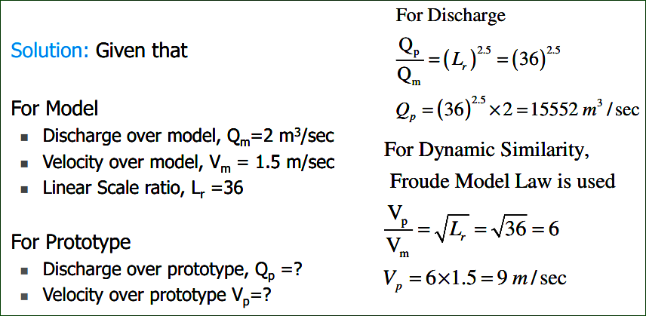
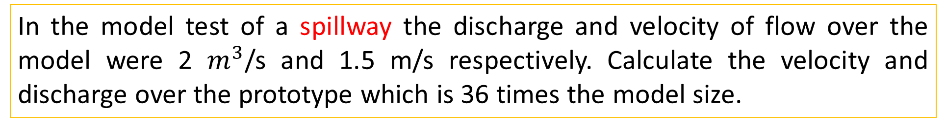
In the model test of a spillway the discharge and velocity of flow over the model were 2 $m^{3}$/s and 1.5 m/s respectively. Calculate the velocity and discharge over the prototype which is 36 times the model size.

Slide 11
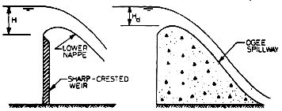
Spillway

Slide 12
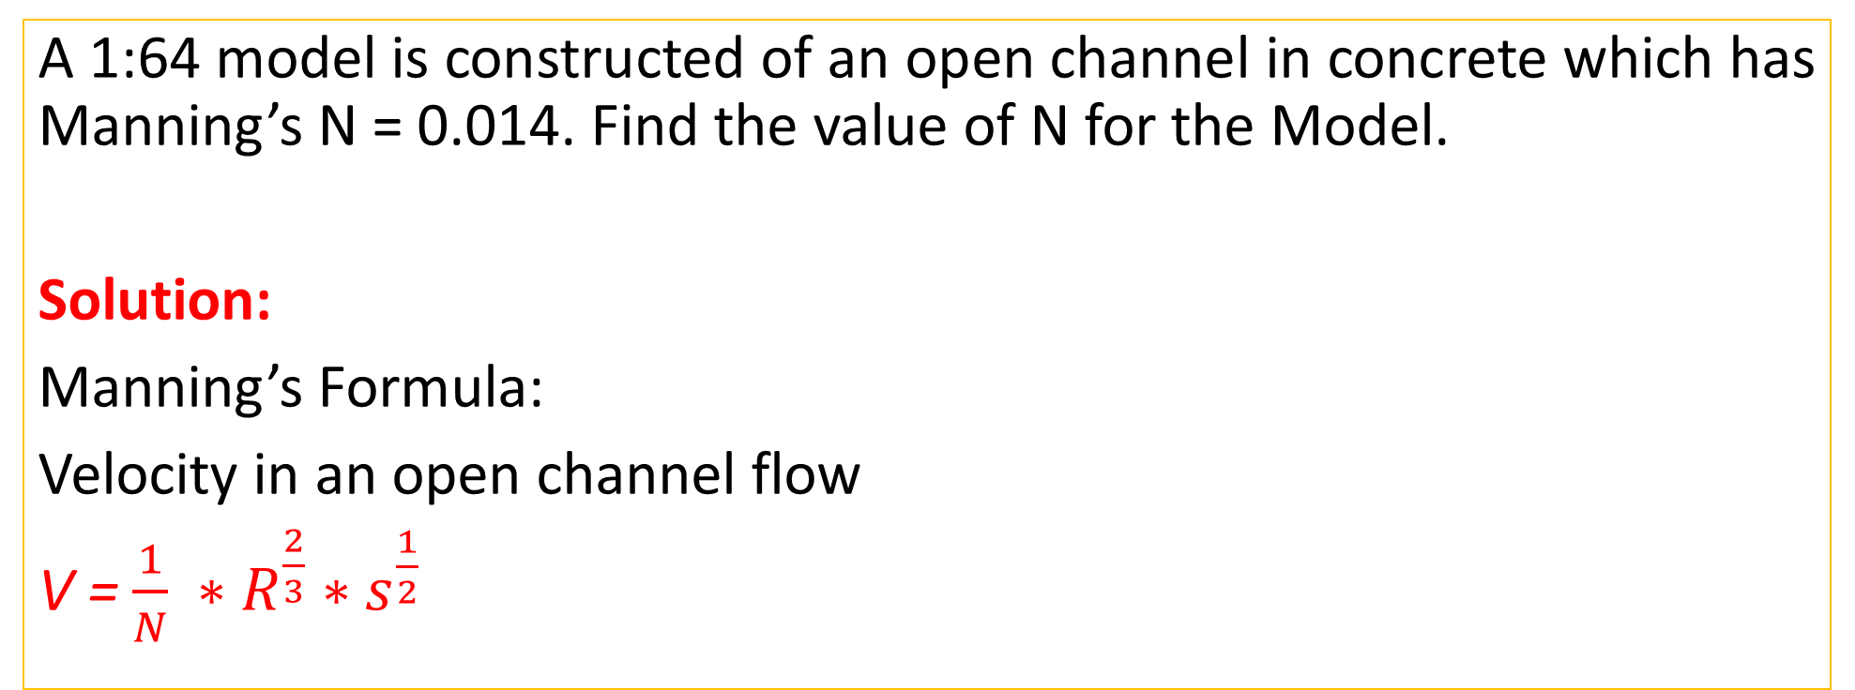
Problem: Rajput#432 [Semester Final=2017]
A 1:64 model is constructed of an open channel in concrete which has Manning’s N = 0.014. Find the value of N for the Model.
Solution:
Manning’s Formula:
Velocity in an open channel flow
V = $\frac{1}{N} {∗R}^{\frac{2}{3}} ∗s^{\frac{1}{2}}$

