Slide 1
Bernoulli’s Equation for Real Fluid
Bernoulli’s equation based on the assumption that fluid is non-viscous and therefore friction-less.
Practically, all fluids are viscous and as such there are always some losses in fluid flows.
These losses have to be taken into consideration in the application of Bernoulli’s equation which gets modified for real fluid.

Slide 2
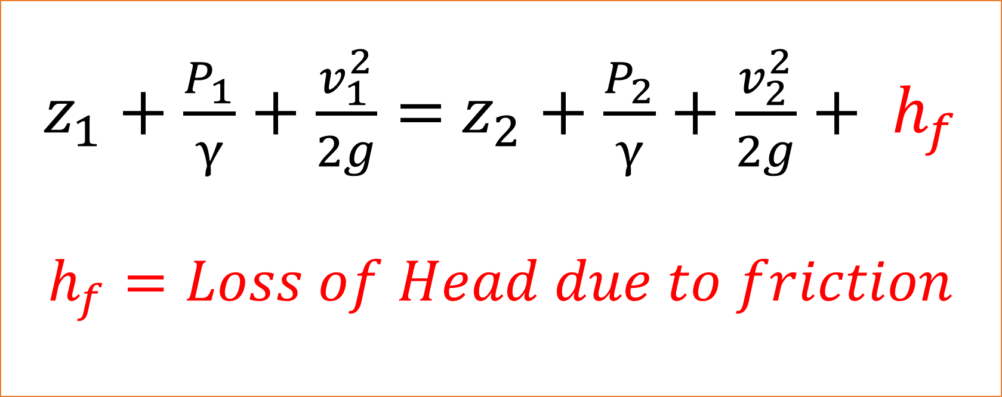
Bernoulli’s Equation for Real Fluid
$z_{1}+\frac{P_{1}}{γ}+\frac{v_{1}^{2}}{2g}=$ $z_{2}+\frac{P_{2}}{γ}+\frac{v_{2}^{2}}{2g}+ h_{f}$
$$h_{f}=Loss of Head due to friction$$

Slide 3
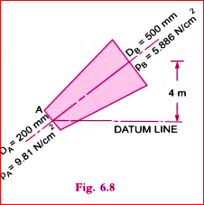
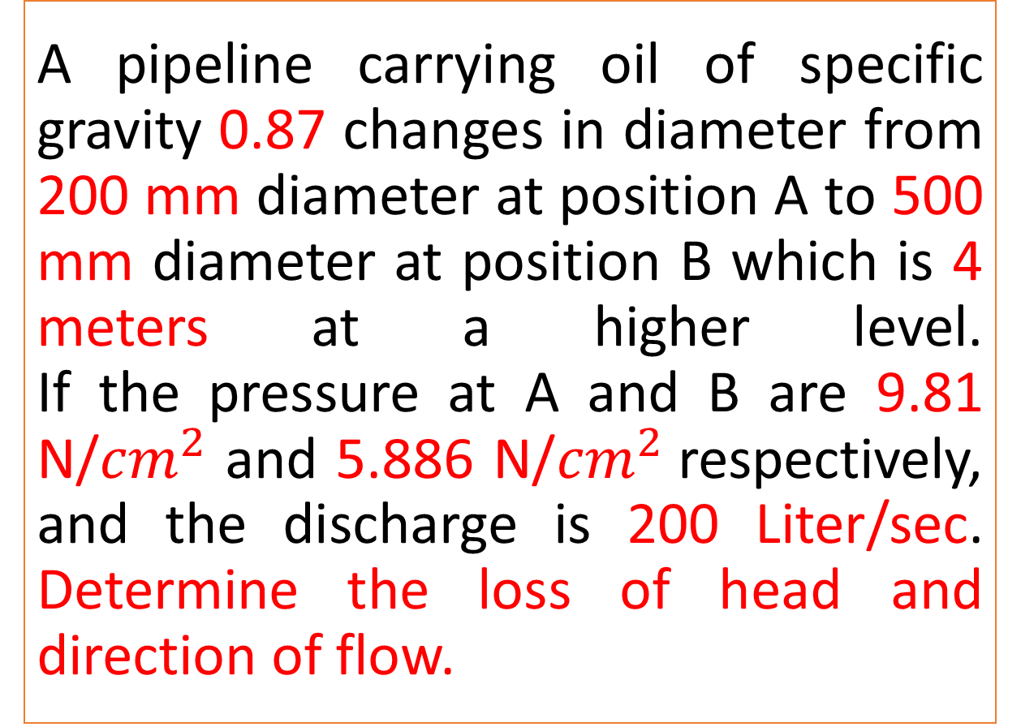
A pipeline carrying oil of specific gravity 0.87 changes in diameter from 200 mm diameter at position A to 500 mm diameter at position B which is 4 meters at a higher level. If the pressure at A and B are 9.81 N/${cm}^{2}$ and 5.886 N/${cm}^{2}$respectively, and the discharge is 200 Liter/sec. Determine the loss of head and direction of flow.
Practice Problem#3

Slide 4
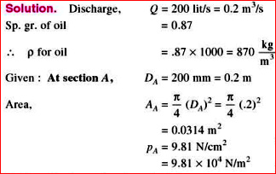
Solution

Slide 5
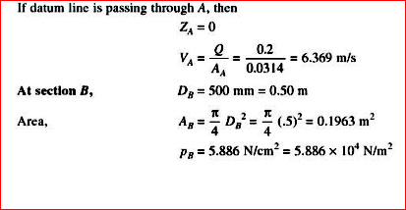
Solution

Slide 6
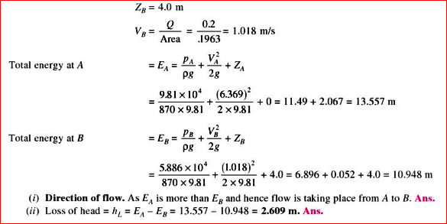
Solution

Slide 7
Practical Application of Bernoulli’s Equation
Venturimeter
Orificemeter
Rotameter and Elbow Meter
Pitot Tube

Slide 8
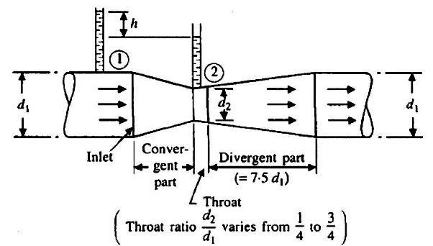
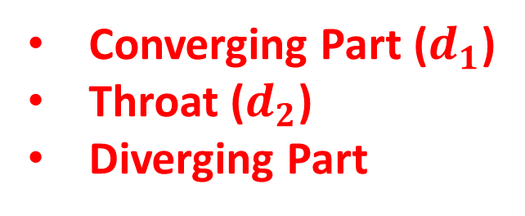
Venturimeter
Converging Part ($d_{1}$)
Throat ($d_{2}$)
Diverging Part

Slide 9
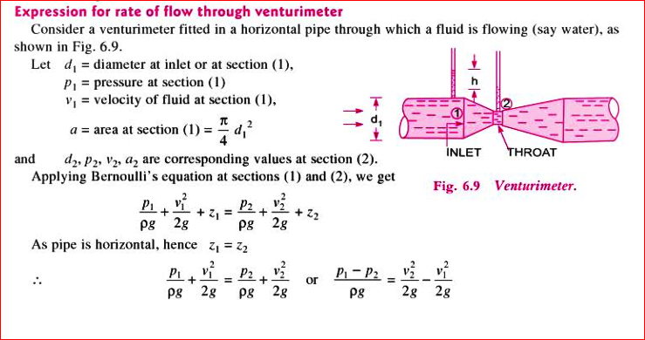

Slide 10
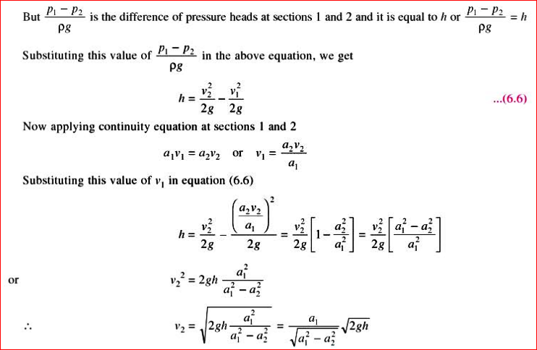

Slide 11
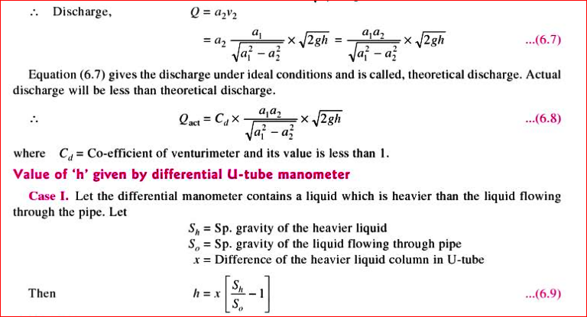

Slide 12
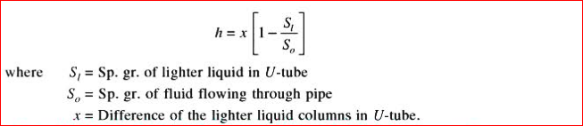
Value of h given by Differential U-tube Manometer : Case II
If the differential manometer contains a liquid which is lighter than the liquid flowing through the pipe, the value of h is given by:

Slide 13
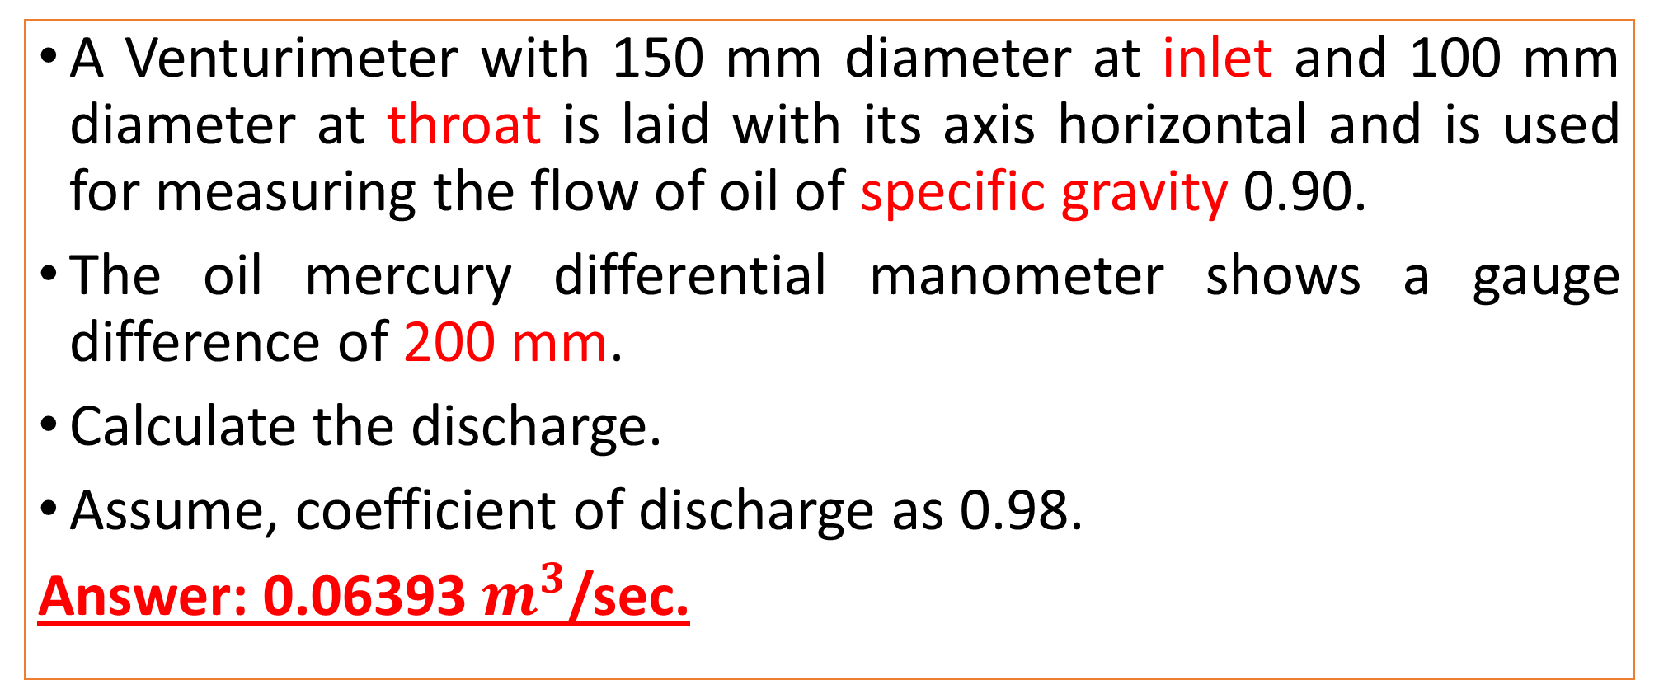
Practice Problem#4
A Venturimeter with 150 mm diameter at inlet and 100 mm diameter at throat is laid with its axis horizontal and is used for measuring the flow of oil of specific gravity 0.90.
The oil mercury differential manometer shows a gauge difference of 200 mm.
Calculate the discharge.
Assume, coefficient of discharge as 0.98.
Answer: 0.06393 $m^{3}$/sec.

