Slide 1
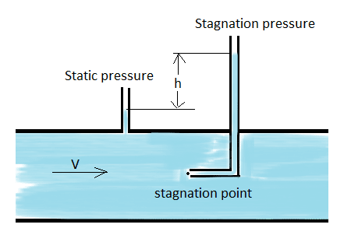
Pitot Tube
Pitot Tube is one of the most accurate devices for velocity measurement.
It works on the principle that, if the velocity of flow becomes zero, the pressure there is increased due to conversion of kinetic energy into pressure

Slide 2
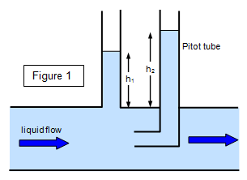
Working of Pitot Tube
It consists of a glass tube in the form of a 90 degree bend of short length open at both its ends.
It is placed in the flow with its bent leg directed upstream so that a stagnation point is created immediately in front of the opening.
Kinetic energy at this point gets converted into pressure energy causing the liquid to rise in the vertical limb, to a height equal to the stagnation pressure.
UPSTREAM

Slide 3
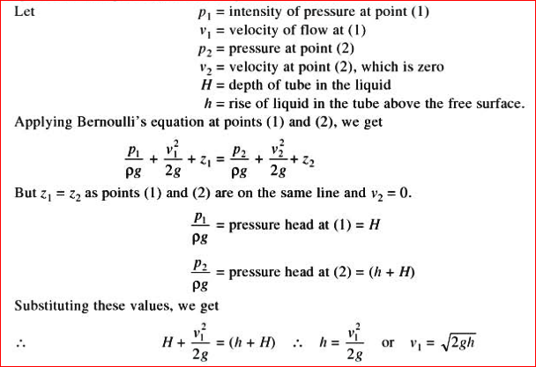
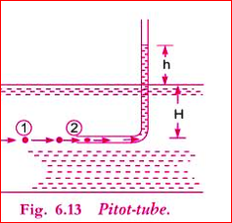
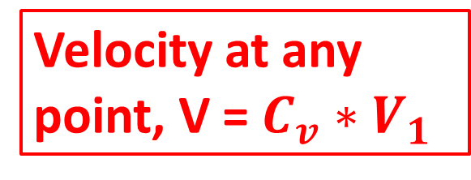
Theory of Pitot Tube
Velocity at any point, V = $C_{v}∗V_{1}$

Slide 4
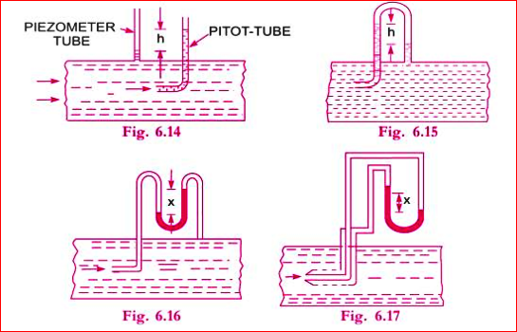
Arrangements of Pitot tube

Slide 5
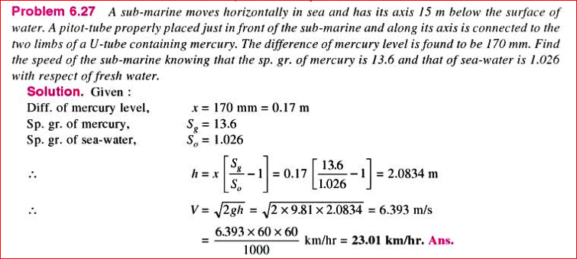
Practice Problem#5

Slide 6
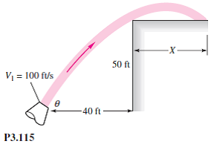
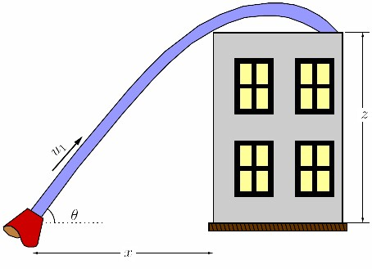
Free Liquid Jet

Slide 7
Free Liquid Jet
A jet of liquid issuing from the nozzle in atmosphere is called a free liquid jet.
The parabolic path traversed by the liquid jet under the action of gravity is known as trajectory.
A nozzle is a device designed to control the direction or characteristics of a fluid flow (especially to increase velocity) as it exits (or enters) an enclosed chamber or pipe.

Slide 8
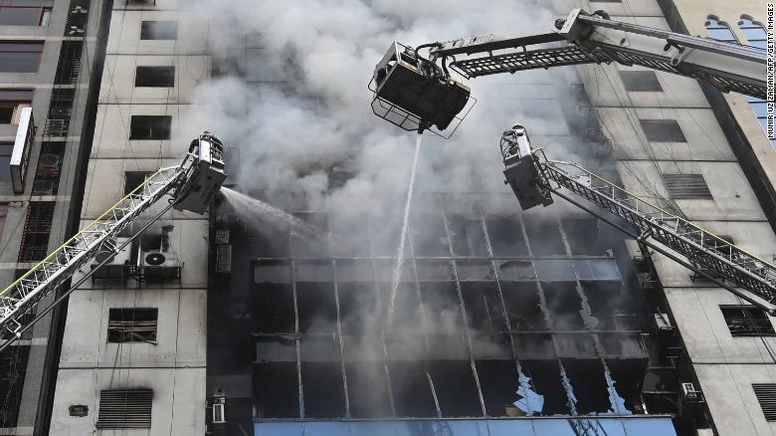
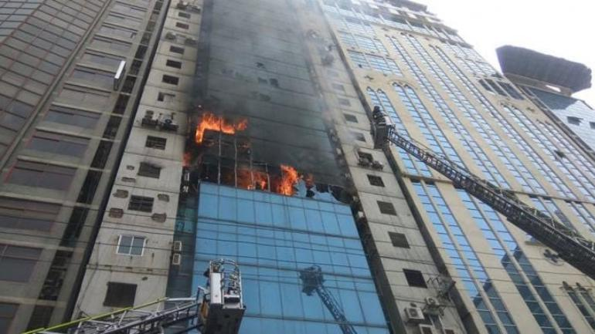
Application of Free Liquid Jet
Banani fire: Death toll rises to 25 (Source: The Daily Star)

Slide 9
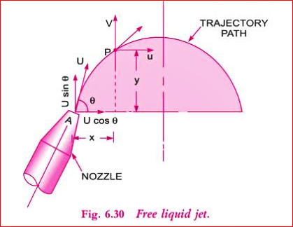
Equation of a Free Liquid Jet
Let, the jet A make an angle with the horizontal direction. If U is the velocity of the water jet, then,
Horizontal Component
= U Cos θ
Vertical Component
= U Sin θ
Consider another point
P( X,Y) on the center of the line of the jet.

Slide 10
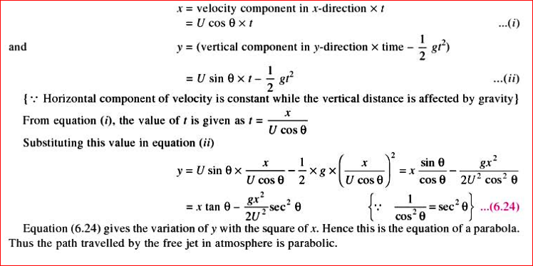

Slide 11
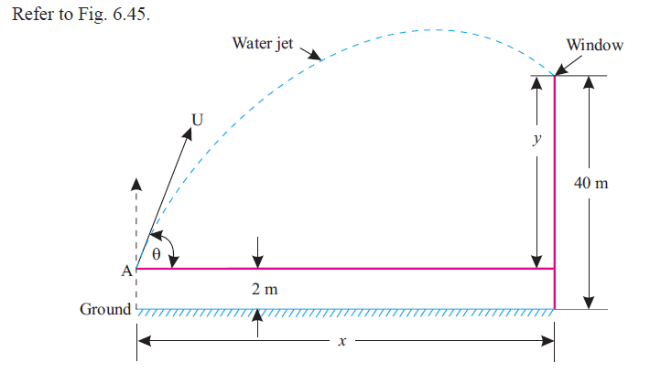
A fireman must reach a window 40 m above the ground of Banani tower with a water jet, issued from a nozzle 30 mm in diameter and discharging 30 kg/s. Assuming the nozzle height to be 2 m above the ground, determine the greatest horizontal distance from the building where the fireman can stand and still reach the jet into the window.
Problem : Rajput
Page: 311

