Slide 1
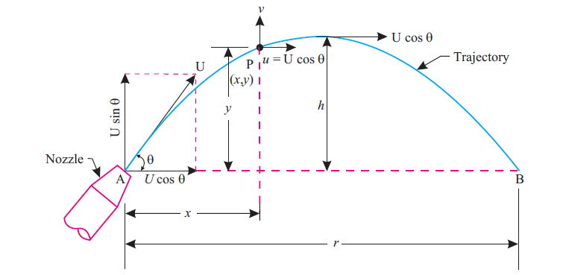
Maximum Height attained by Jet

Slide 2
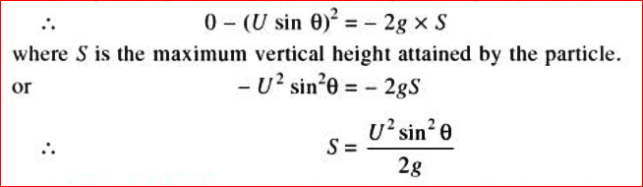
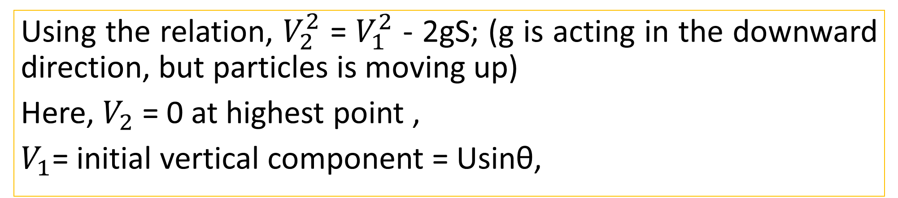
Maximum Height attained by Jet
Using the relation, $V_{2}^{2}$ = $V_{1}^{2}$ - 2gS; (g is acting in the downward direction, but particles is moving up)
Here, $V_{2}$ = 0 at highest point ,
$V_{1}$= initial vertical component = Usinθ,

Slide 3
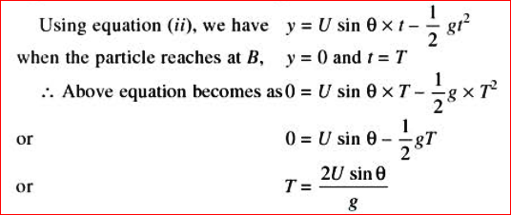
Time of Flight
It is the time taken by the fluid particle in reaching from A to B as shown in figure. Let, T is the time of flight.

Slide 4
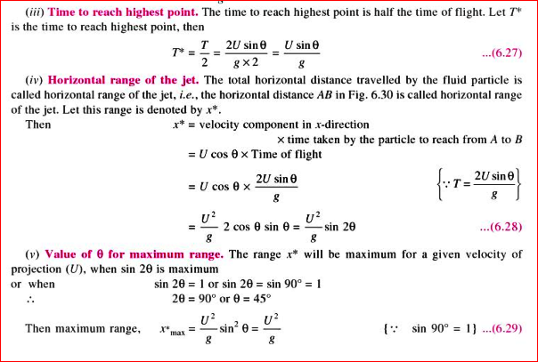

Slide 5
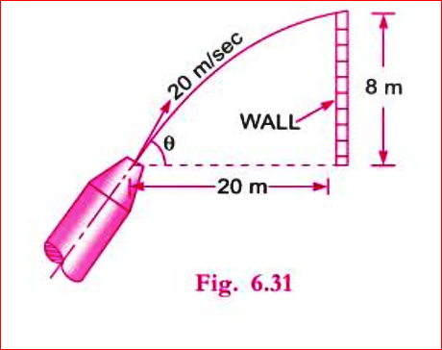
A vertical wall is of 8m height. A jet of water is coming out from a nozzle with a velocity of 20 m/s. The nozzle is situated at a distance of 20m from the vertical wall. Find the angle of projection of the nozzle to the horizontal so that the jet of water just clears the top of wall.
Practice Problem #6

Slide 6
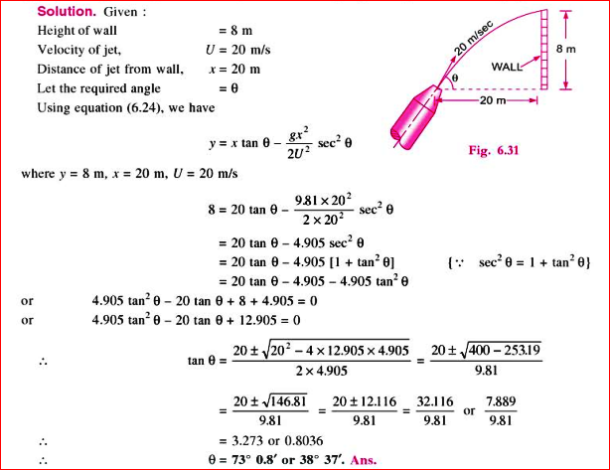

Slide 7
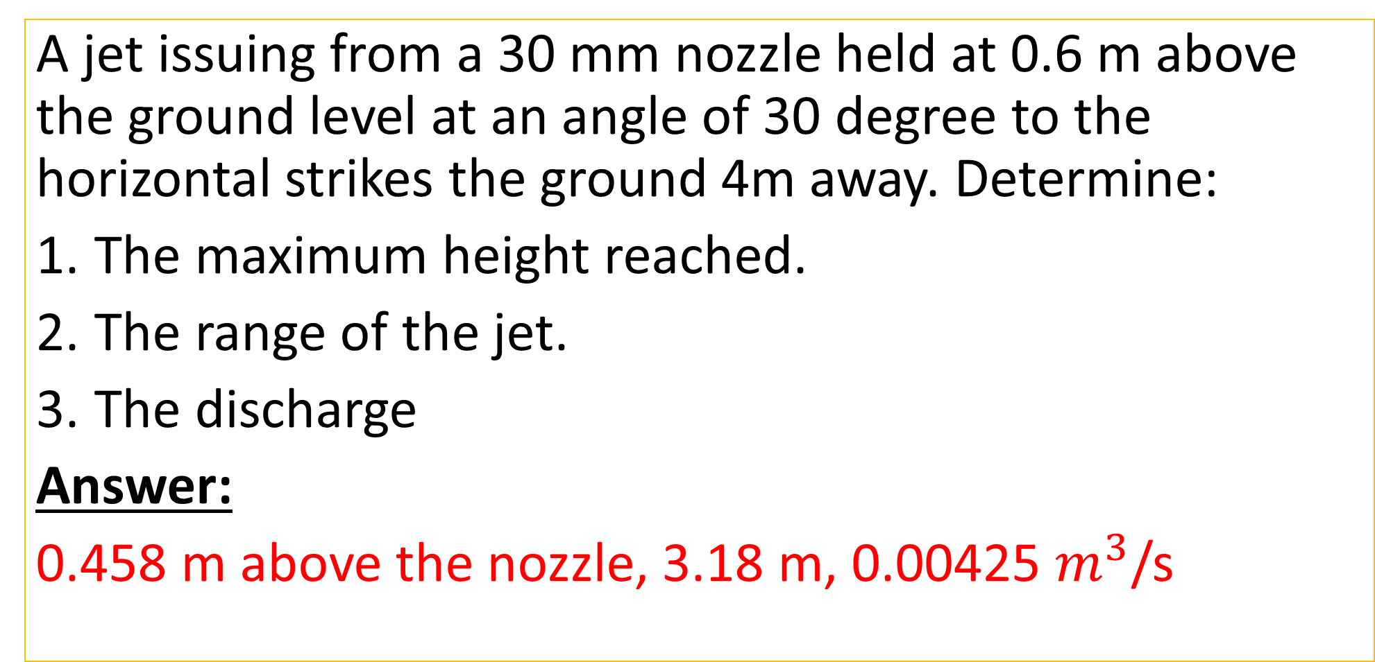
Practice Problem#7 (Rajput, 376 page)
A jet issuing from a 30 mm nozzle held at 0.6 m above the ground level at an angle of 30 degree to the horizontal strikes the ground 4m away. Determine:
The maximum height reached.
The range of the jet.
The discharge
Answer:
0.458 m above the nozzle, 3.18 m, 0.00425 $m^{3}$/s

Slide 8
Practice Problem#8
It is required to place an orifice in the side of a tank at such an elevation that the jet will attain a maximum horizontal distance from the tank at the level of its base.
What is the proper distance from the orifice to the free surface when the depth of liquid in the tank is maintained at 1.2 m?

Slide 9
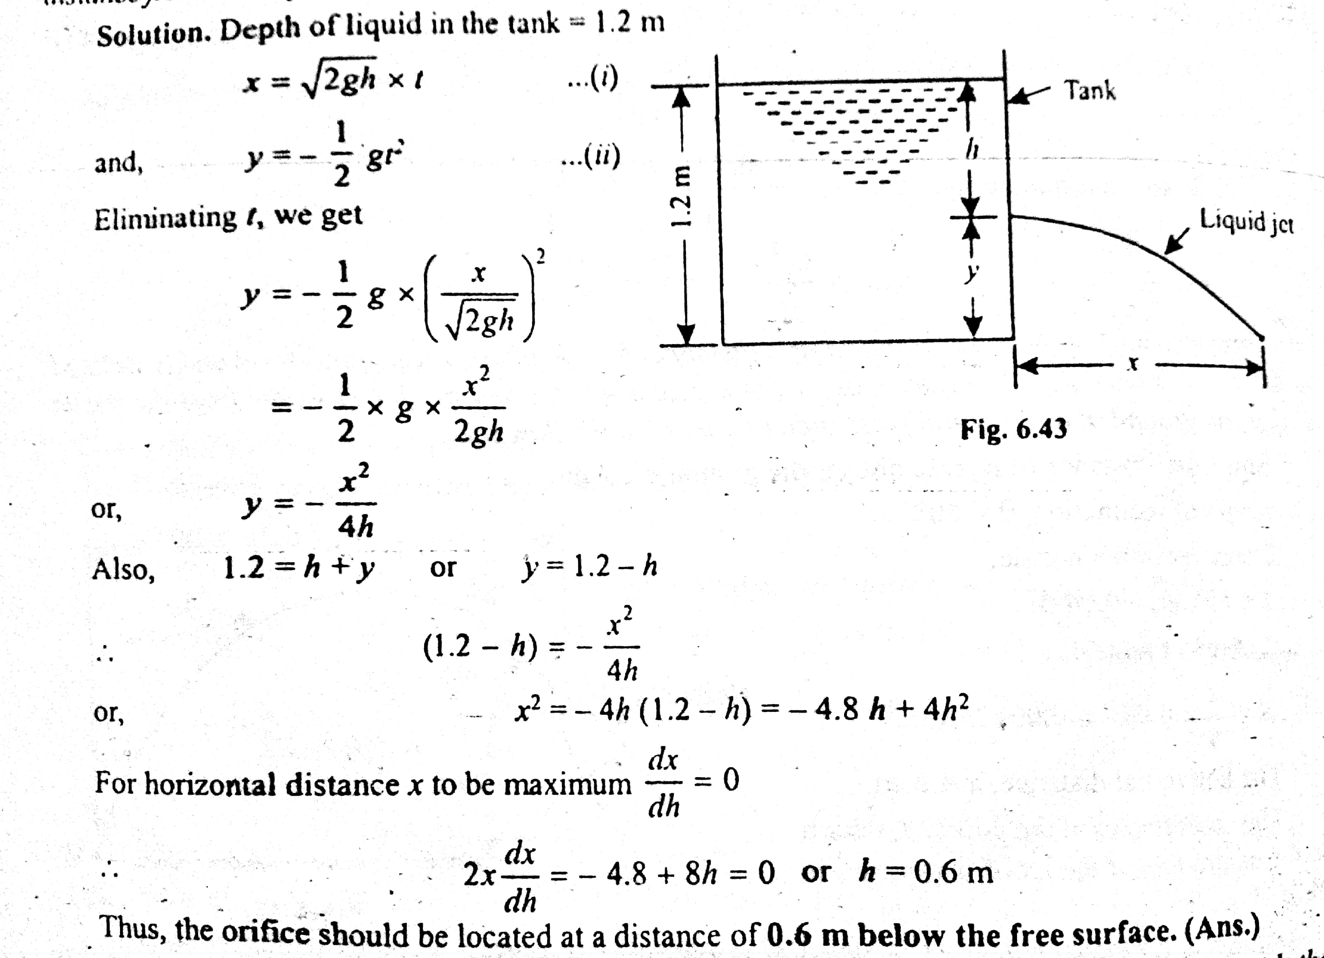

Slide 10
Overview of Fluid Dynamics
Bernoulli’s Equation: Statement and Derivation
Bernoulli’s Equation for Real Fluid
Practical Application of Bernoulli’s Equation (Venturimeter, Pitot Tube)
Free Liquid Jet
*1st Class test on Fluid Dynamics

