Slide 1
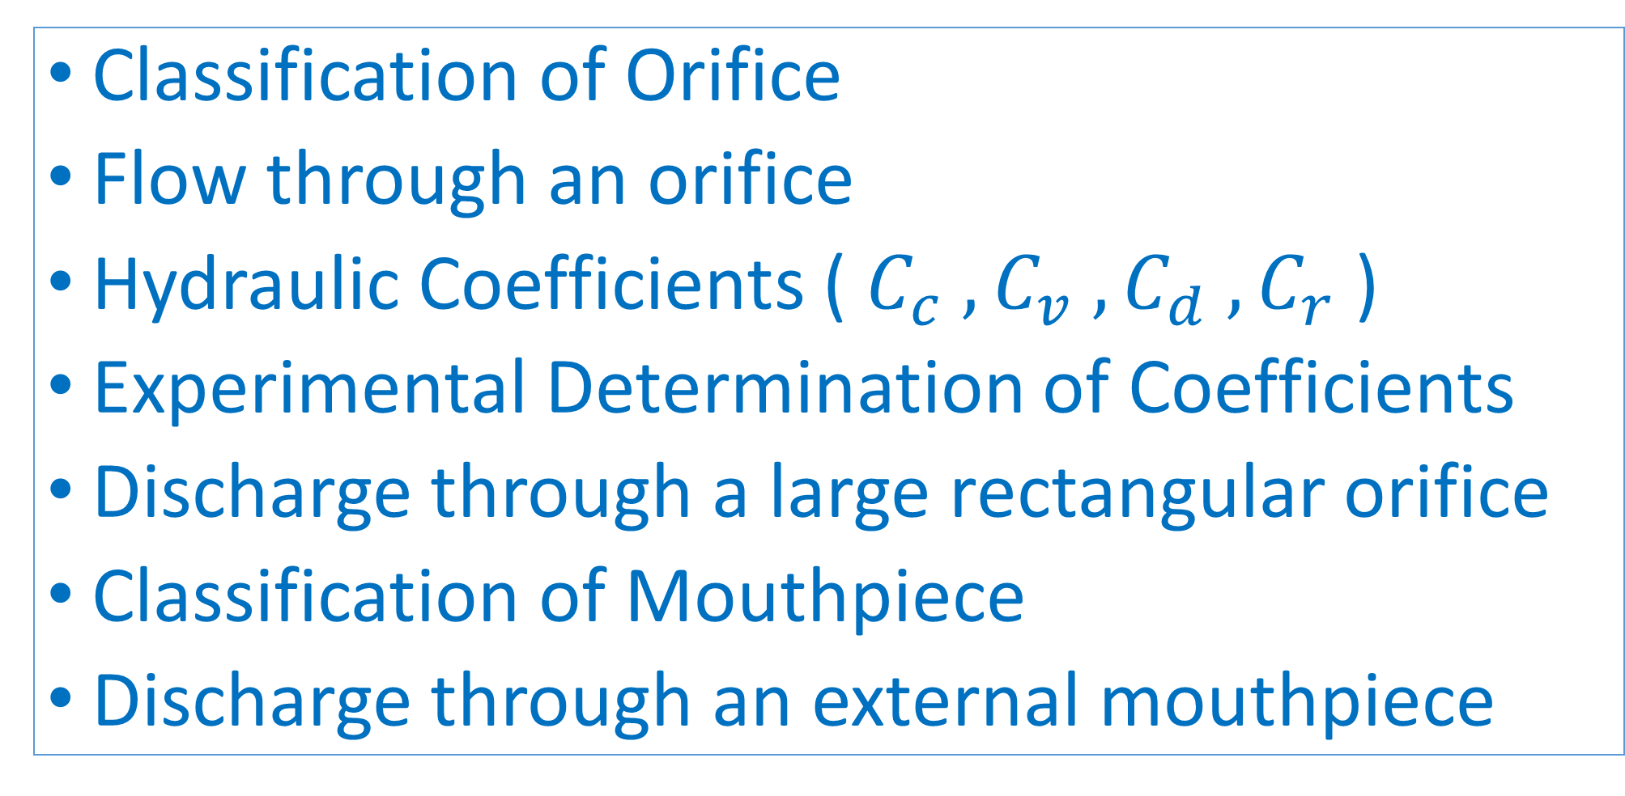
Flow through Orifice and Mouthpieces
Classification of Orifice
Flow through an orifice
Hydraulic Coefficients ( $C_{c} ,C_{v} ,C_{d} ,C_{r}$ )
Experimental Determination of Coefficients
Discharge through a large rectangular orifice
Classification of Mouthpiece
Discharge through an external mouthpiece

Slide 2
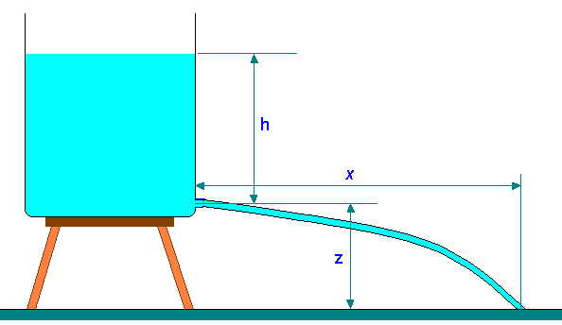
Orifice
An orifice is an opening in the wall or base of a vessel through which fluid flows.
The top edge of orifice is always below the free surface.
Orifices are used to measure the discharge of fluid flow.

Slide 3
Classification of Orifice
Parameter | Type of Orifice
According to Size | Small orifice
 | Large orifice
According to Shape | Circular Orifice
 | Rectangular Orifice
 | Square Orifice
 | Triangular Orifice
Shape of Upstream edge | Sharp Edged Orifice
 | Bell Mouthed Orifice
According to Discharge Condition | Free Discharge Orifice
 | Submerged Orifice
 | Fully Submerged Orifice
 | Partially Submerged Orifice

Slide 4
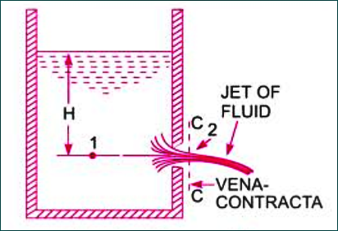
Torricelli’s Theorem (flow through an orifice)
Consider two points 1 and 2 as shown in figure.
Point 1 is inside the tank and point 2 at the vena contracta.
Let the flow is steady and at a constant head H. Applying Bernoulli’s equation at point 1 and point 2 gives:

Slide 5
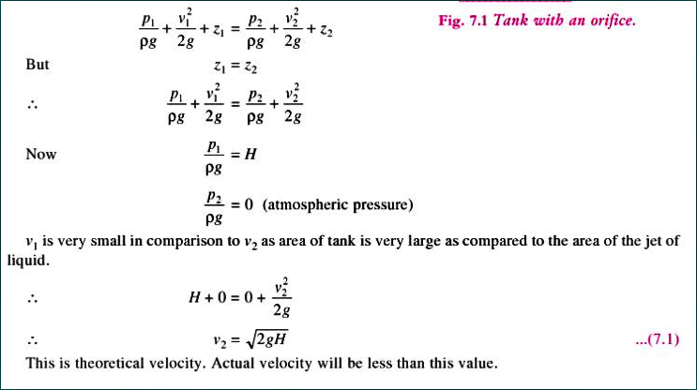
Torricelli’s Theorem

Slide 6
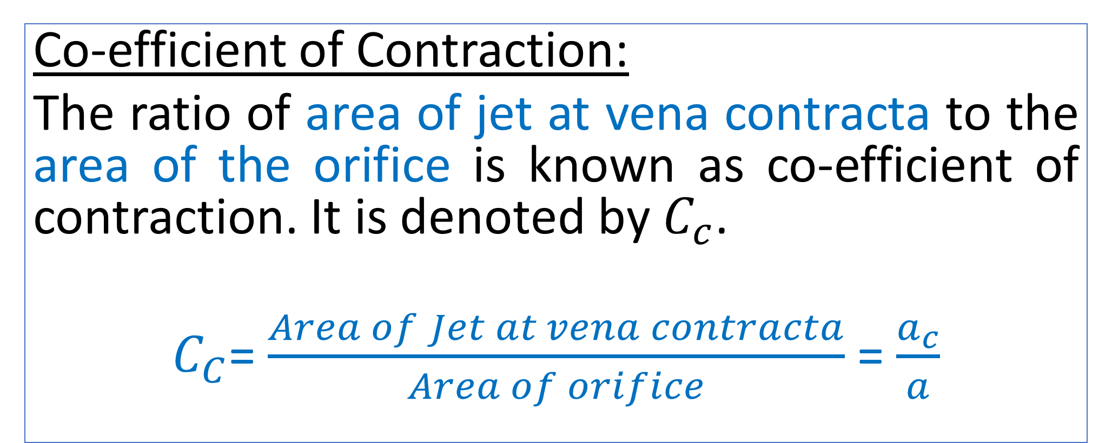
Hydraulic Coefficients (${ C}_{c} ,C_{v} ,C_{d} ,C_{r}$ )
Co-efficient of Contraction:
The ratio of area of jet at vena contracta to the area of the orifice is known as co-efficient of contraction. It is denoted by $C_{c}$.
$C_{C}$= $\frac{Area of Jet at vena contracta}{Area of orifice}$ = $\frac{a_{c}}{a}$

Slide 7
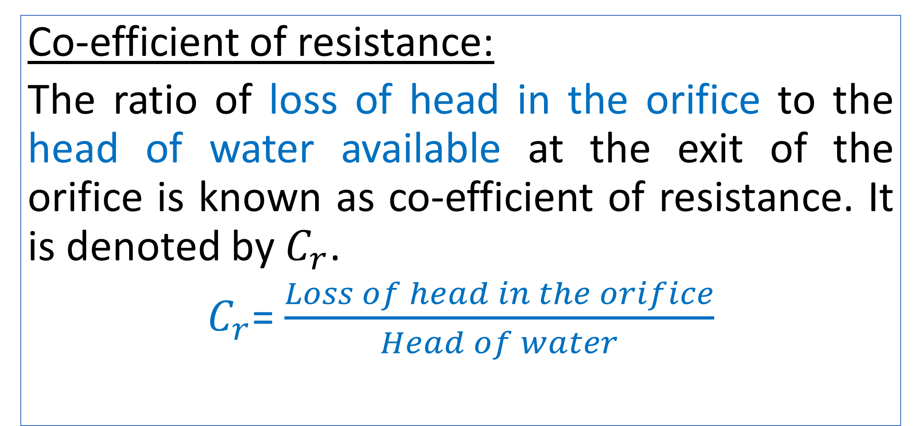
Hydraulic Coefficients (${ C}_{c} ,C_{v} ,C_{d} ,C_{r}$ )
Co-efficient of resistance:
The ratio of loss of head in the orifice to the head of water available at the exit of the orifice is known as co-efficient of resistance. It is denoted by $C_{r}$.
$C_{r}$= $\frac{Loss of head in the orifice}{Head of water}$

Slide 8
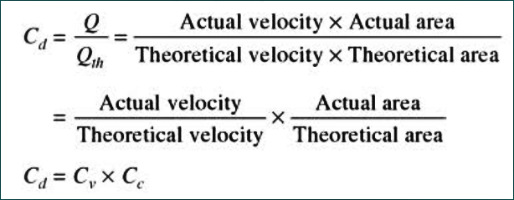
Relationship: $C_{d}=C_{c}×C_{v}$

Slide 9
Standard Value for Hydraulic Coefficients
Hydraulic Coefficients | Range of Values
Co-efficient of Velocity | 0.95-0.99
Co-efficient of Contraction | 0.61-0.69
Co-efficient of Discharge | 0.61-0.65

Slide 10
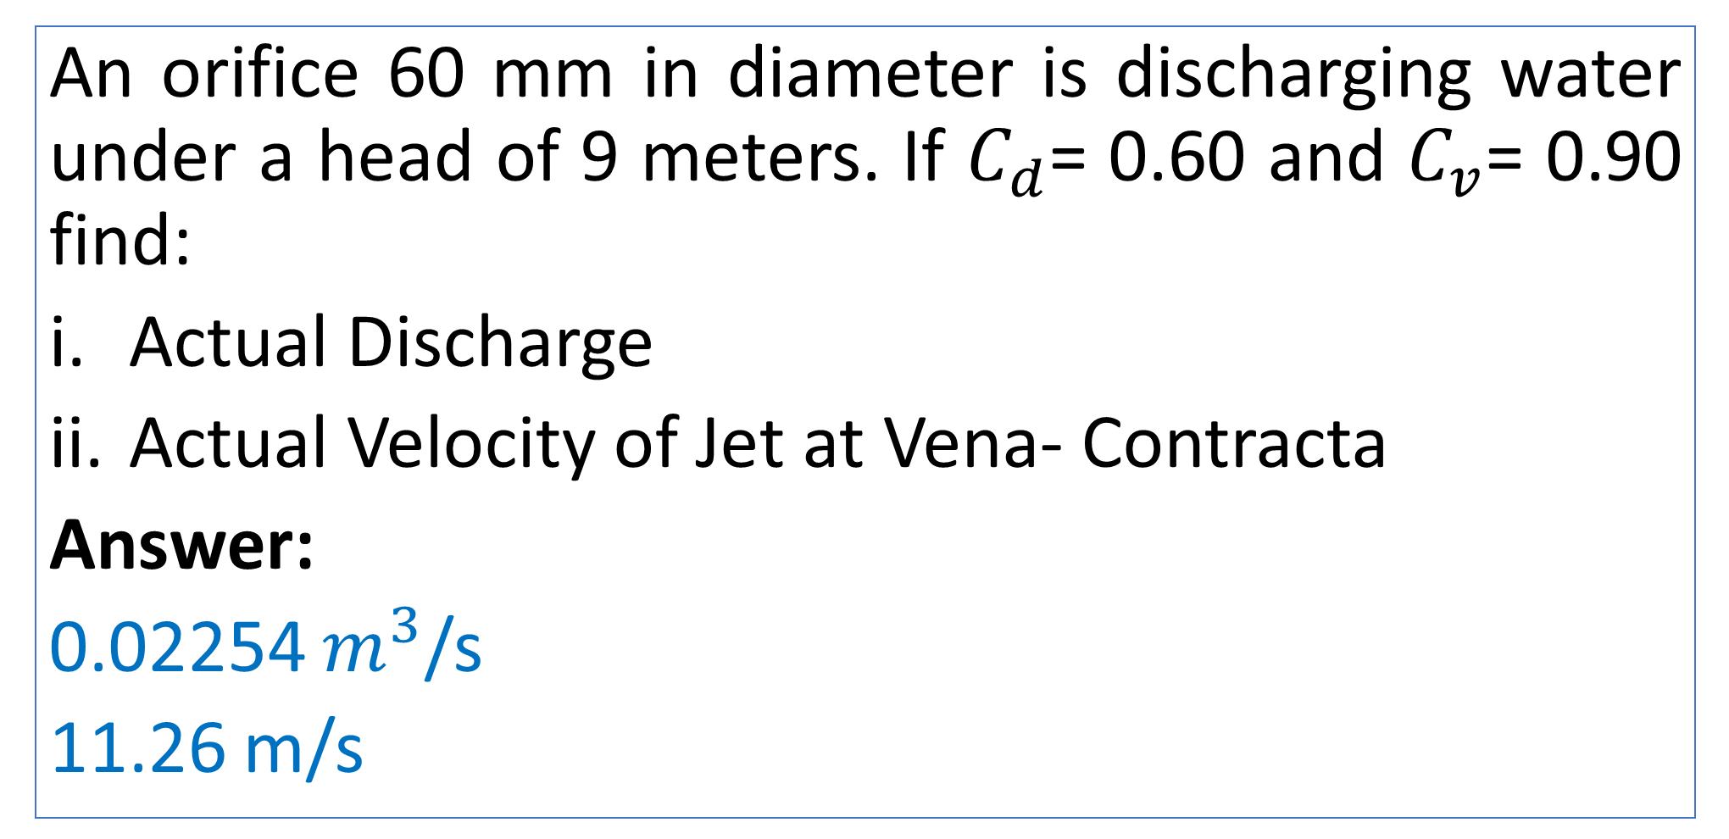
Practice Problem#9 (Rajput 495 page)
An orifice 60 mm in diameter is discharging water under a head of 9 meters. If $C_{d}$= 0.60 and $C_{v}$= 0.90 find:
Actual Discharge
Actual Velocity of Jet at Vena- Contracta
Answer:
0.02254 $m^{3}$/s
11.26 m/s

Slide 11
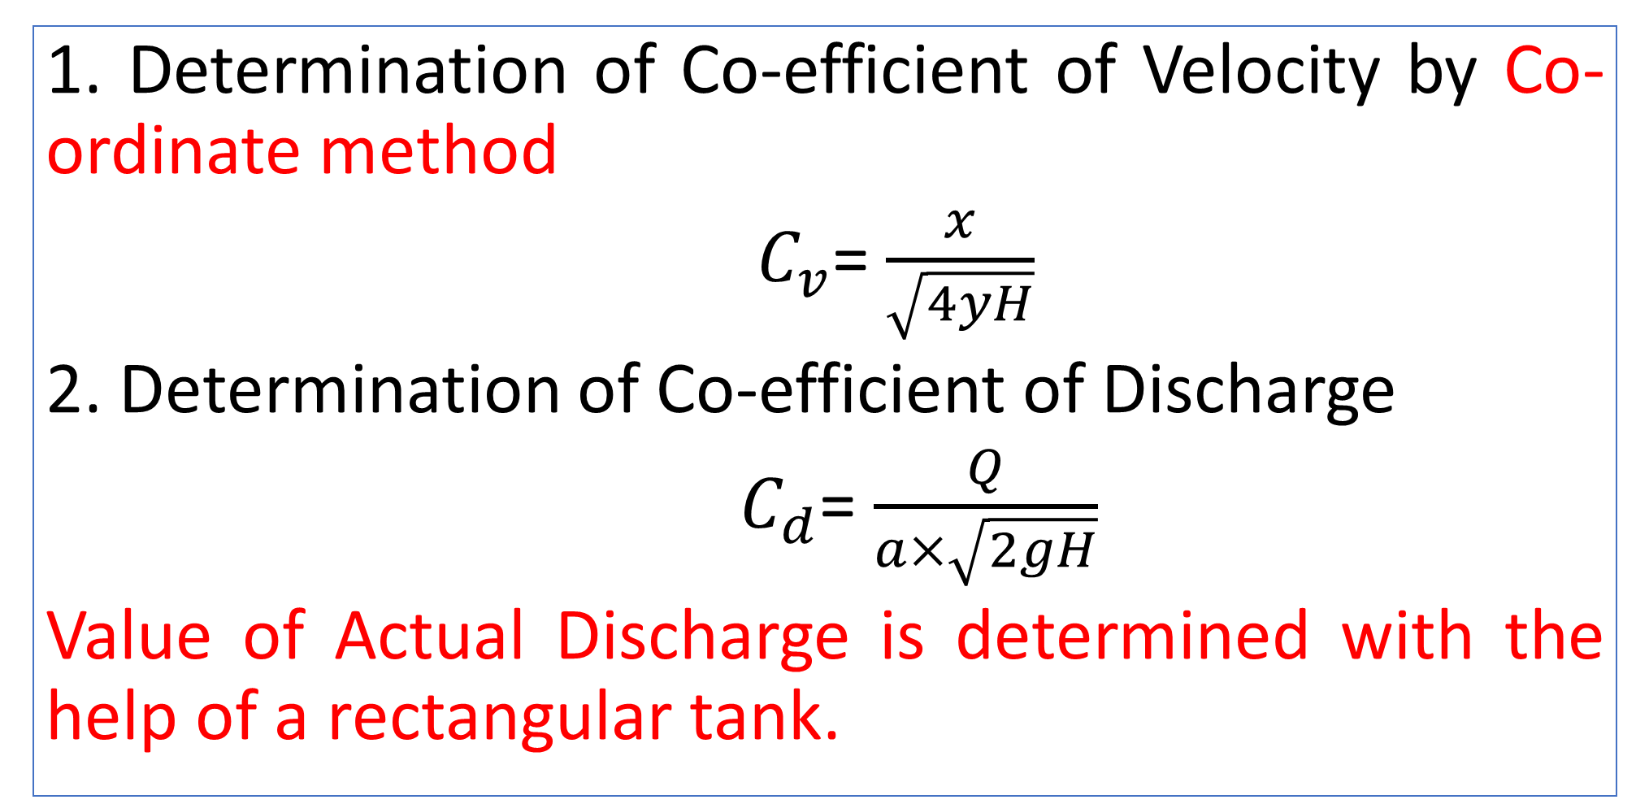
Experimental Determination of Hydraulic Coefficients
1. Determination of Co-efficient of Velocity by Co-ordinate method
$C_{v}$= $\frac{x}{\sqrt{4yH}}$
2. Determination of Co-efficient of Discharge
$C_{d}$= $\frac{Q}{a×\sqrt{2gH}}$
Value of Actual Discharge is determined with the help of a rectangular tank.

Slide 12
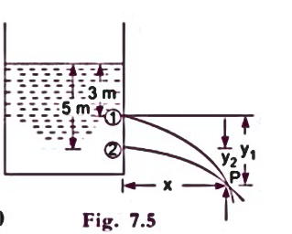
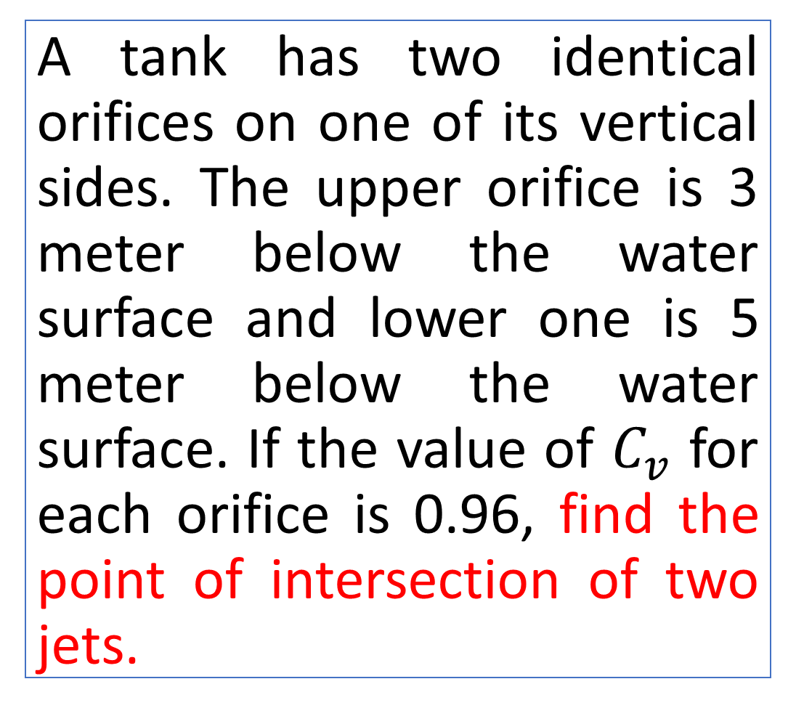
Practice Problem#10 (Bansal)
A tank has two identical orifices on one of its vertical sides. The upper orifice is 3 meter below the water surface and lower one is 5 meter below the water surface. If the value of $C_{v}$ for each orifice is 0.96, find the point of intersection of two jets.

Slide 13
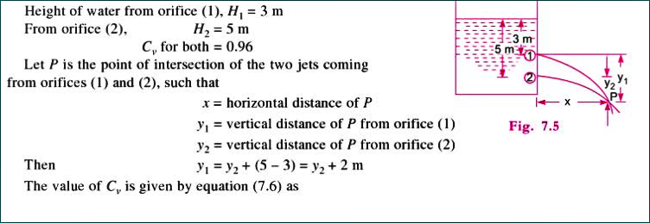
Solution

Slide 14
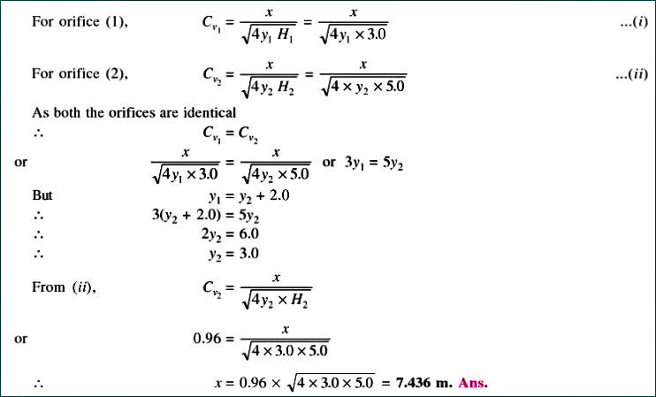

Slide 15
Practice Problem#11 (Rajput, Page= 457)
A 3 m tank standing on the ground is kept full of water. There is a small orifice in its vertical side with its center at depth h meters below the free surface of liquid in the tank. Find the value of h so that the liquid strikes the ground at the maximum distance from the tank. Assuming Cv= 0.97, calculate the maximum value of horizontal distance.

Slide 16
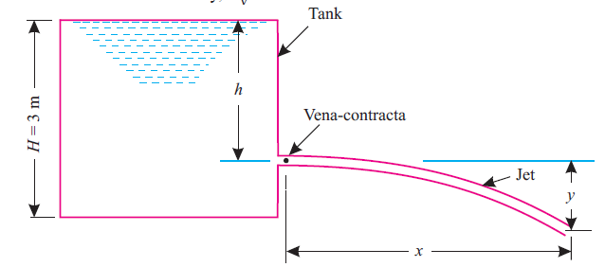
Practice Problem#11 (Rajput, Page= 457)

