Slide 1
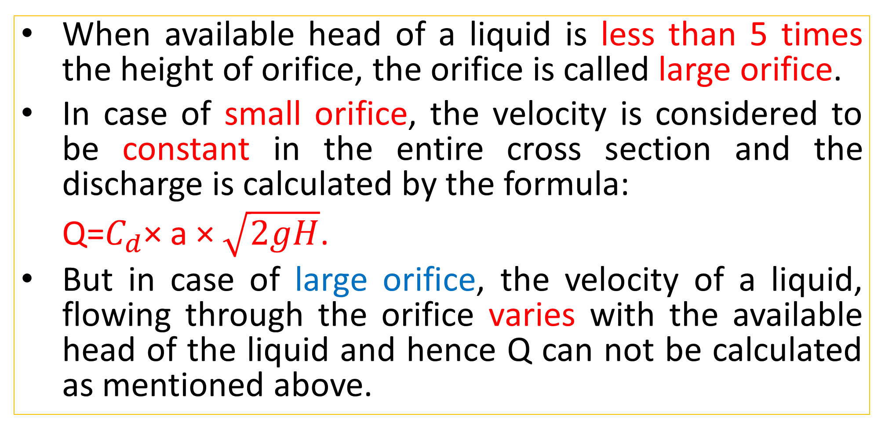
Flow through Large Orifice
When available head of a liquid is less than 5 times the height of orifice, the orifice is called large orifice.
In case of small orifice, the velocity is considered to be constant in the entire cross section and the discharge is calculated by the formula:
Q=$C_{d}$× a × $\sqrt{2gH}$.
But in case of large orifice, the velocity of a liquid, flowing through the orifice varies with the available head of the liquid and hence Q can not be calculated as mentioned above.

Slide 2
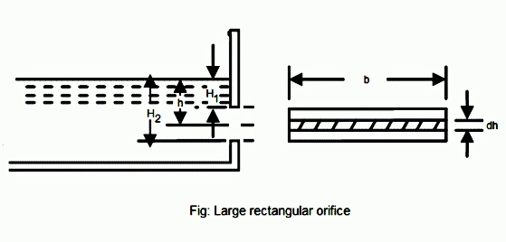
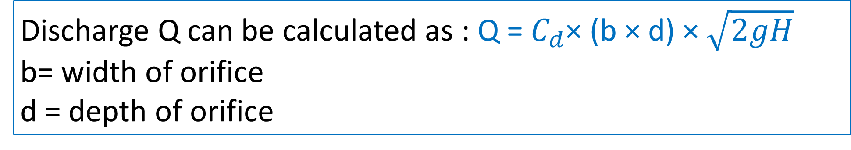
Flow through Large Orifice
Discharge Q can be calculated as : Q =${ C}_{d}$× (b × d) × $\sqrt{2gH}$
b= width of orifice
d = depth of orifice

Slide 3
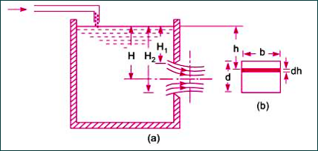
Discharge through a large Rectangular Orifice

Slide 4
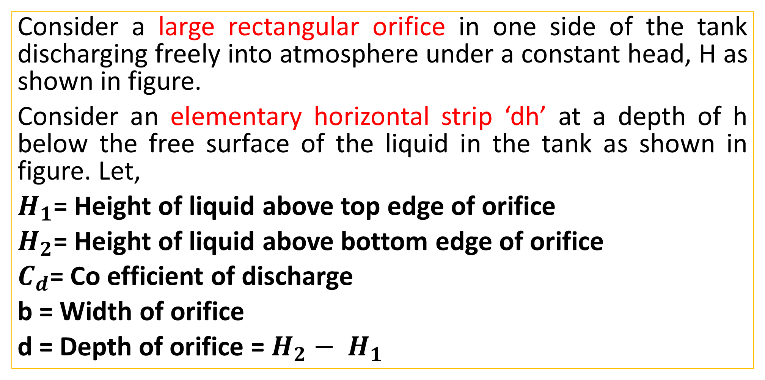
Discharge through a large Rectangular Orifice
Consider a large rectangular orifice in one side of the tank discharging freely into atmosphere under a constant head, H as shown in figure.
Consider an elementary horizontal strip ‘dh’ at a depth of h below the free surface of the liquid in the tank as shown in figure. Let,
$H_{1}$= Height of liquid above top edge of orifice
$H_{2}$= Height of liquid above bottom edge of orifice
$C_{d}$= Co efficient of discharge
b = Width of orifice
d = Depth of orifice = $H_{2}− H_{1}$

Slide 5
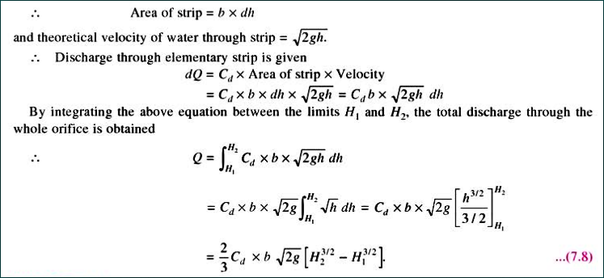

Slide 6
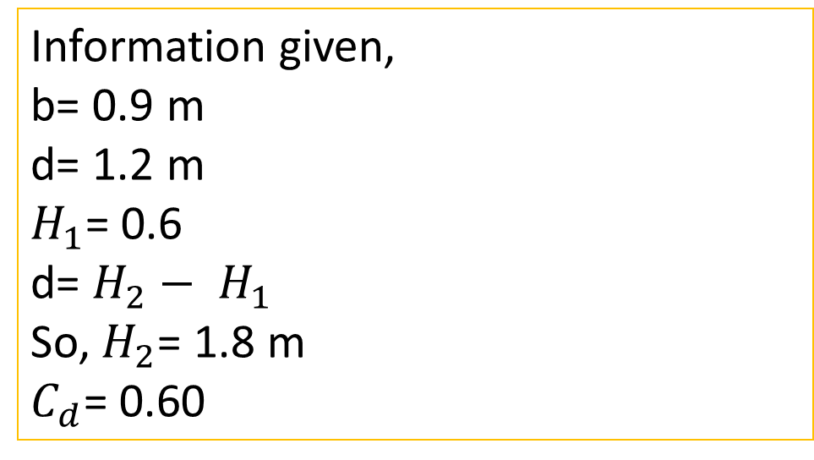
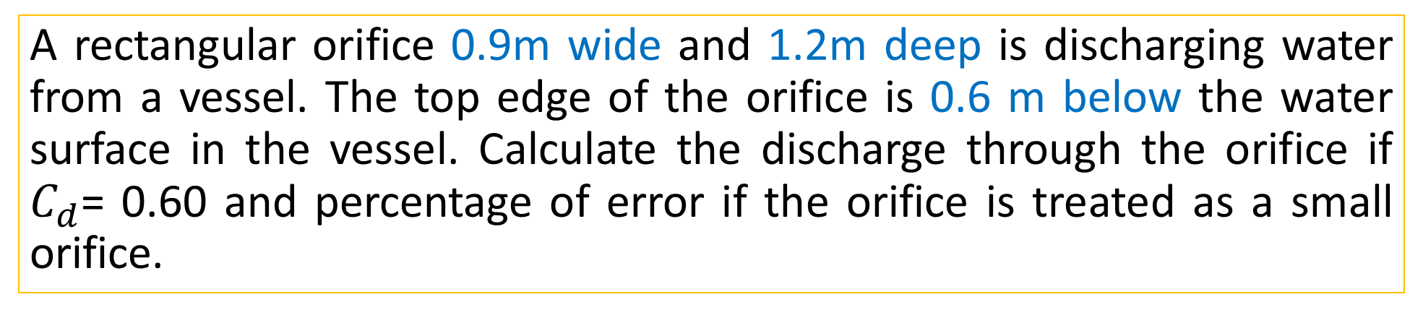
Practice Problem #12
A rectangular orifice 0.9m wide and 1.2m deep is discharging water from a vessel. The top edge of the orifice is 0.6 m below the water surface in the vessel. Calculate the discharge through the orifice if $C_{d}$= 0.60 and percentage of error if the orifice is treated as a small orifice.
Information given,
b= 0.9 m
d= 1.2 m
$H_{1}$= 0.6
d= $H_{2}− H_{1}$
So, $H_{2}$= 1.8 m
$C_{d}$= 0.60

Slide 7
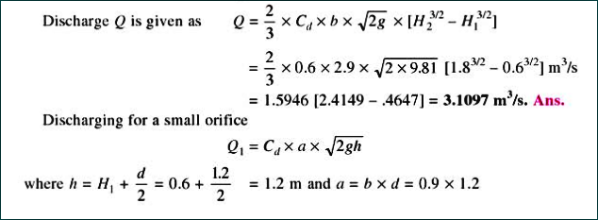
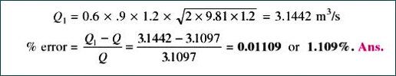
Solution

Slide 8
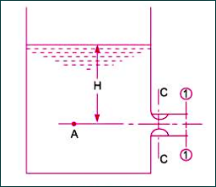
Mouthpiece
A mouthpiece is an attachment in the form of a small tube or pipe fixed to the orifice.
The length of pipe extension is usually 2 to 3 times the orifice diameter and is used to increase the amount of discharge.

Slide 9
Classification of Mouthpiece
Parameter | Type
According to Position of Mouthpiece | 1. Internal Mouthpiece
 | 2. External Mouthpiece
According to shape of Mouthpiece | 1. Cylindrical Mouthpiece
 | 2. Convergent Mouthpiece
 | 3. Convergent- Divergent Mouthpiece
According to nature of discharge | 1. Mouthpiece running full
 | 2. Mouthpiece running free

Slide 10
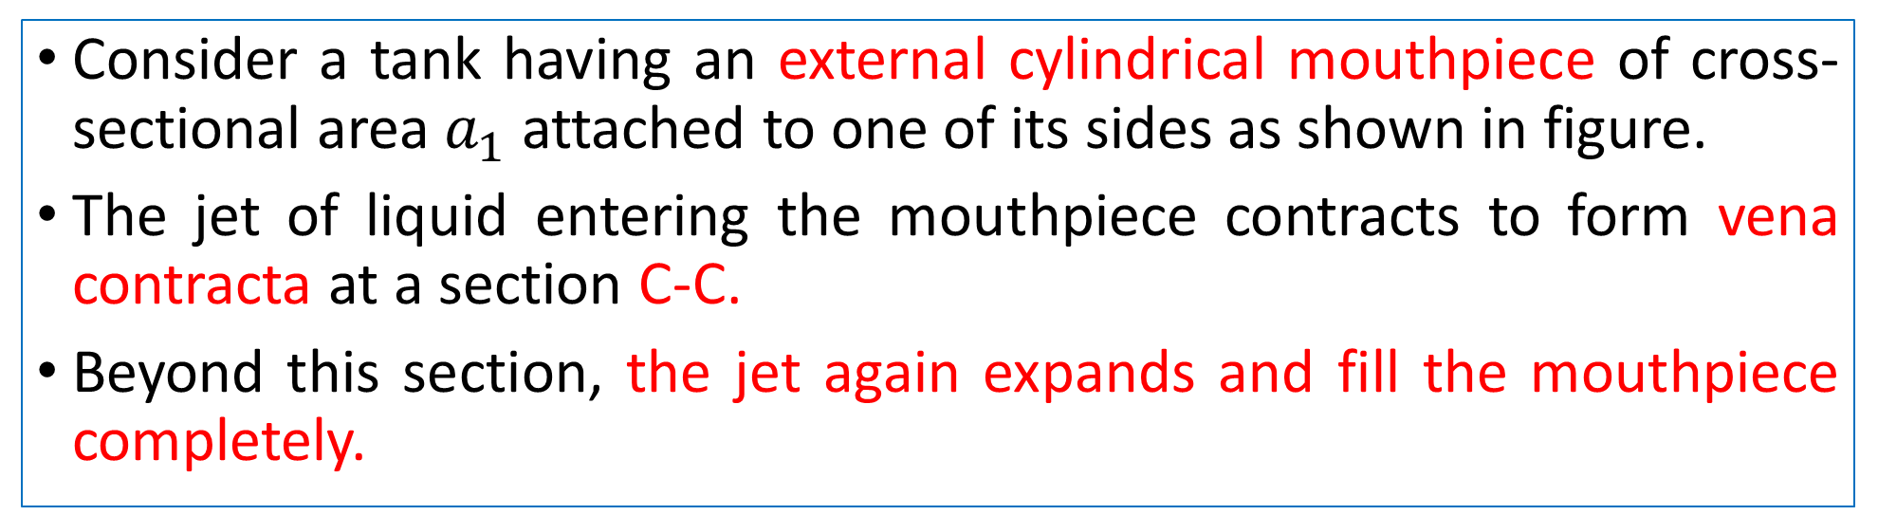
Flow through an External Cylindrical Mouthpiece
Consider a tank having an external cylindrical mouthpiece of cross-sectional area $a_{1}$ attached to one of its sides as shown in figure.
The jet of liquid entering the mouthpiece contracts to form vena contracta at a section C-C.
Beyond this section, the jet again expands and fill the mouthpiece completely.

Slide 11
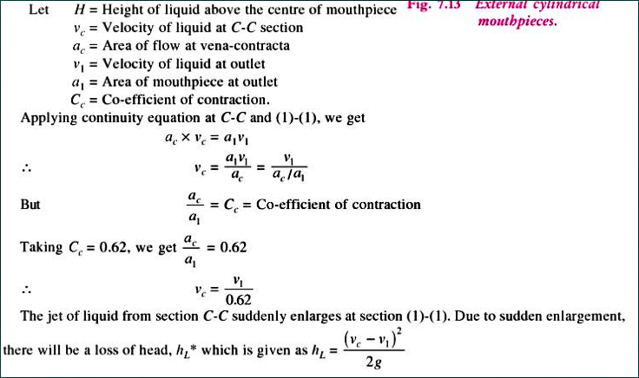

Slide 12
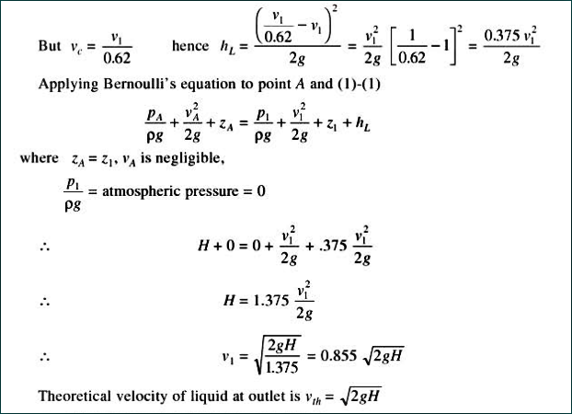

Slide 13
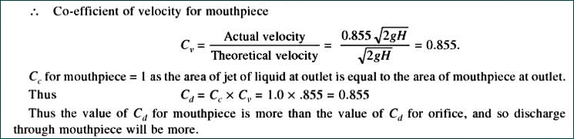
Discharge through Mouthpiece is greater than Orifice.

Slide 14
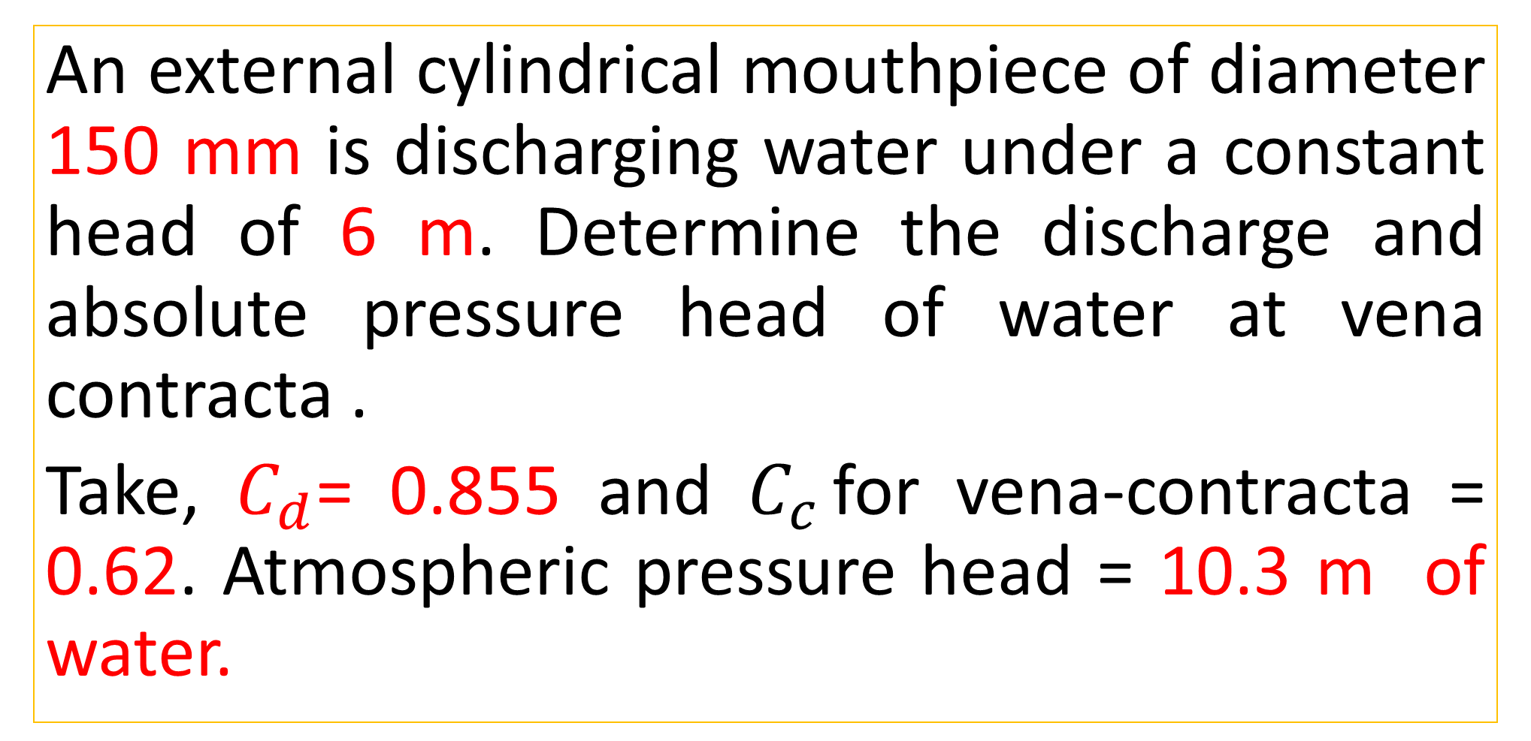
Practice Problem#13 (Bansal = 343 page)
An external cylindrical mouthpiece of diameter 150 mm is discharging water under a constant head of 6 m. Determine the discharge and absolute pressure head of water at vena contracta .
Take, $C_{d}$= 0.855 and $C_{c }$for vena-contracta = 0.62. Atmospheric pressure head = 10.3 m of water.

Slide 15
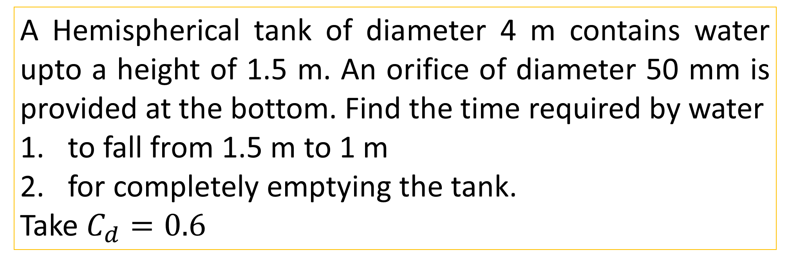
Time Required for Emptying a Hemispherical Tank
A Hemispherical tank of diameter 4 m contains water upto a height of 1.5 m. An orifice of diameter 50 mm is provided at the bottom. Find the time required by water
to fall from 1.5 m to 1 m
for completely emptying the tank.
Take $C_{d}=0.6$
Semester Final Examination, 2018
Bansal: Problem No. 7.19 (Page 336)

Slide 16
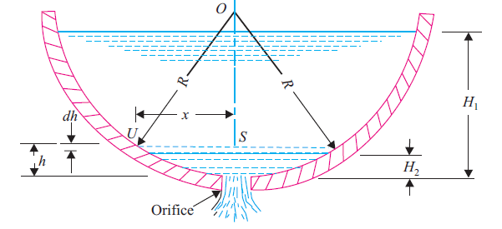
Time Required for Emptying a Hemispherical Tank

Slide 17
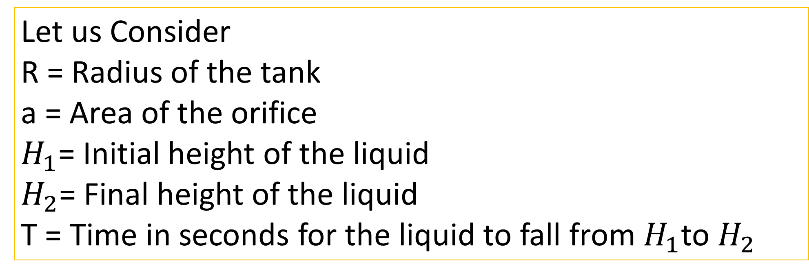
Time Required for Emptying a Hemispherical Tank
Let us Consider
R = Radius of the tank
a = Area of the orifice
$H_{1}$= Initial height of the liquid
$H_{2}$= Final height of the liquid
T = Time in seconds for the liquid to fall from $H_{1}$to $H_{2}$

Slide 18
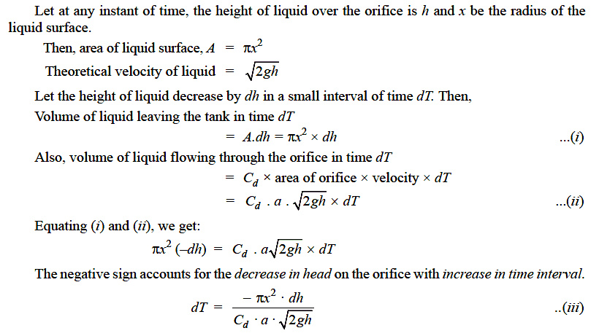
Step: Determine small time interval dT

Slide 19
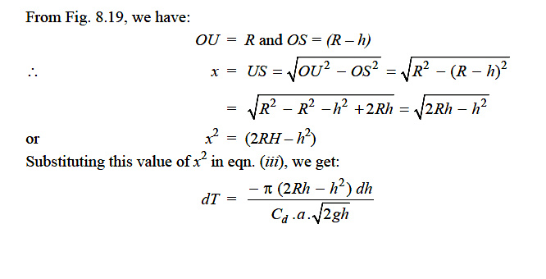
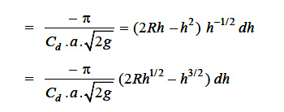
Step: Determine small time interval dT

Slide 20
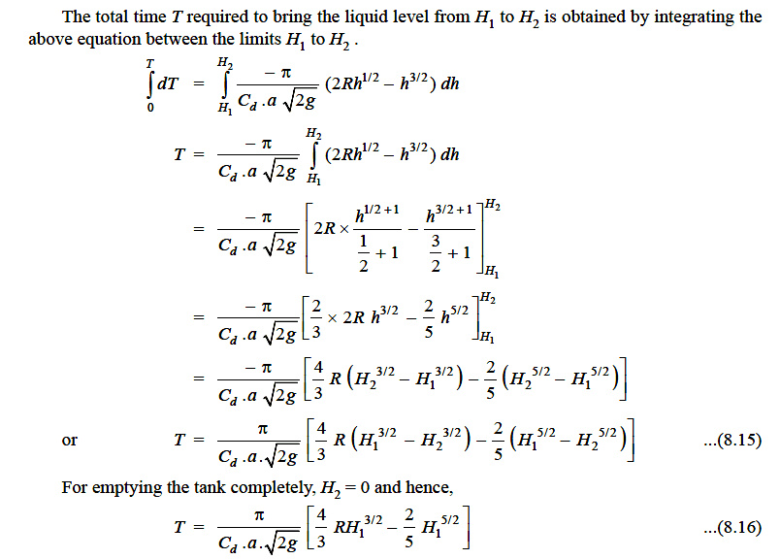
Integrate dT to get total time T

