Slide 1
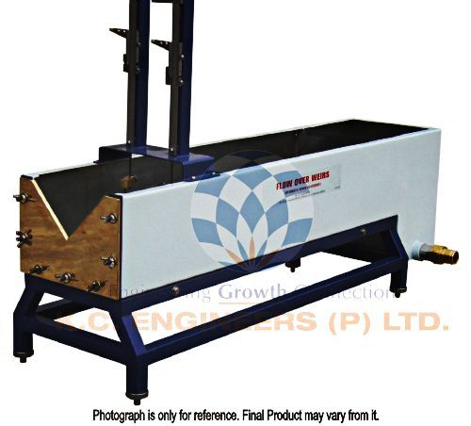
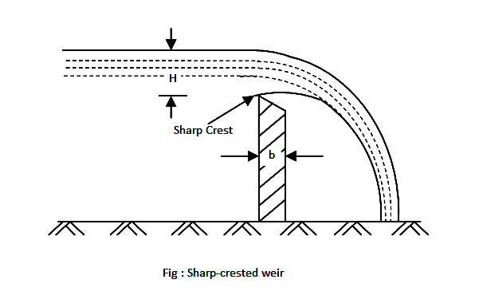
Flow over Notches and Weirs

Slide 2
Notch and Weir
Notch may be defined as an opening provided in the side of a tank or vessel such that the liquid surface in the tank is below the top edge of the opening. It is generally made of metallic plate.
Weir may be defined as any regular obstruction in an open stream over which the flow takes place. It is made of masonry or concrete.
*Notch is sometimes called as a weir and vice versa.

Slide 3
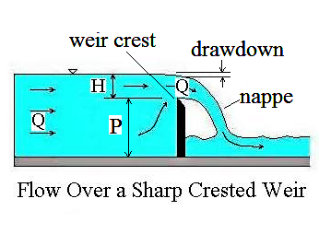
Nappe and Crest
Nappe or Vein:
The sheet of water flowing through a notch or over a weir is known as Nappe or Vein.
Sill or Crest :
The top of the weir over which the water flows is known as sill or crest.

Slide 4
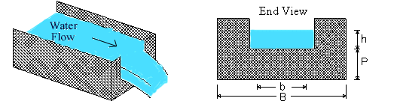
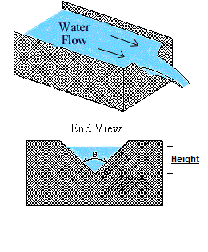
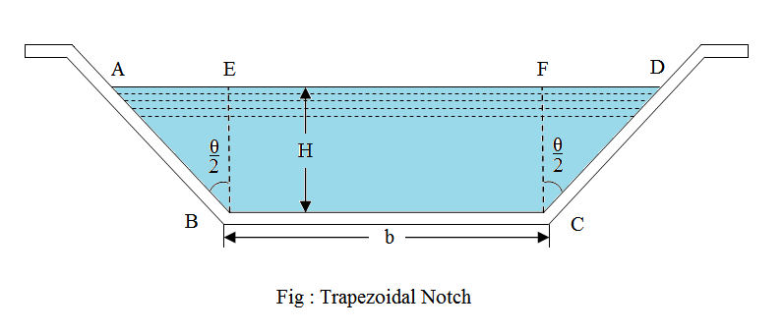
Types of Notches
Sl. No. | Type of Notch
1. | Rectangular Notch
2. | Triangular Notch
3. | Trapezoidal Notch
4. | Stepped Notch

Slide 5
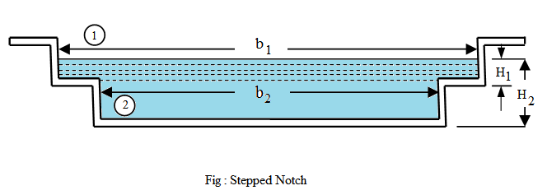
Stepped Notch

Slide 6
Types of Weir
Parameter | Type
Shape | 1. Rectangular Weir | 2. Cippoletti weir
Nature of Discharge | 1. Ordinary Weir | 2. Submerged Weir
Width of Crest | 1. Narrow Crested Weir | 2. Broad Crested Weir
Nature of Crest | 1. Sharp Crested Weir | 2. Ogee Weir

Slide 7
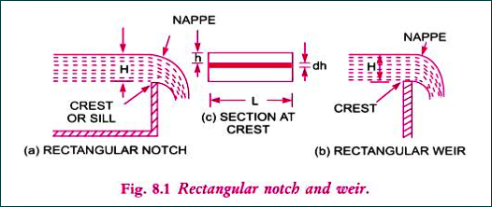
Discharge over a Rectangular Notch or Weir
Head of Water over the crest= H
Length of the Notch or Weir =L
Consider an elemental horizontal strip of water of thickness dh and length L at a depth h from the free surface of water as shown in figure.

Slide 8
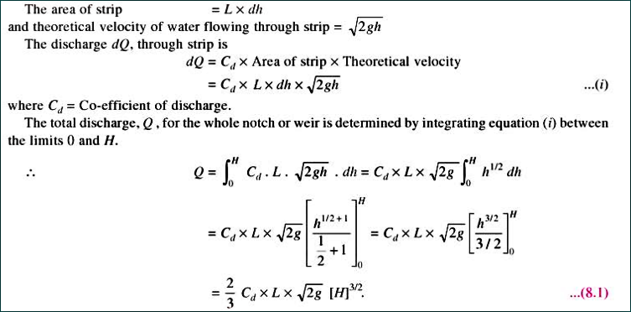

Slide 9
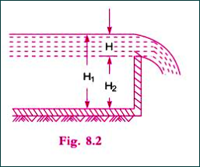
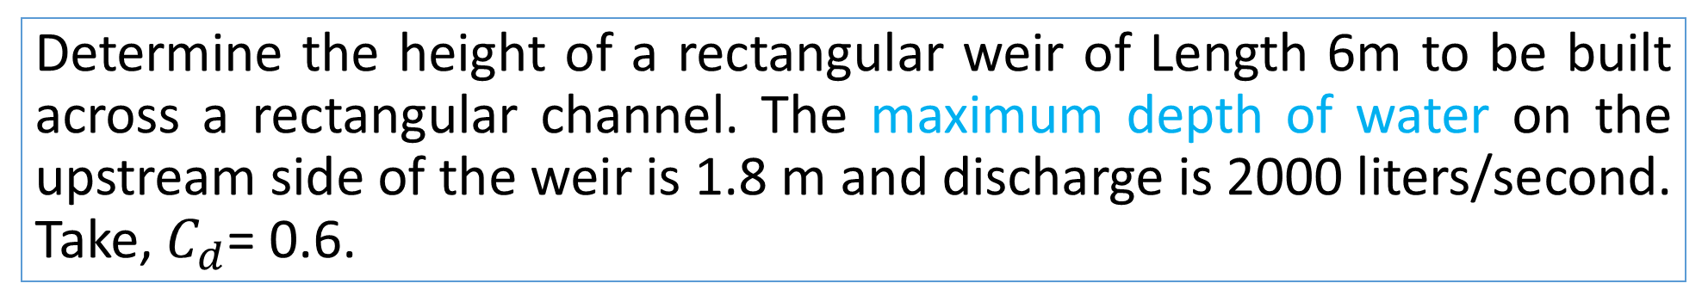
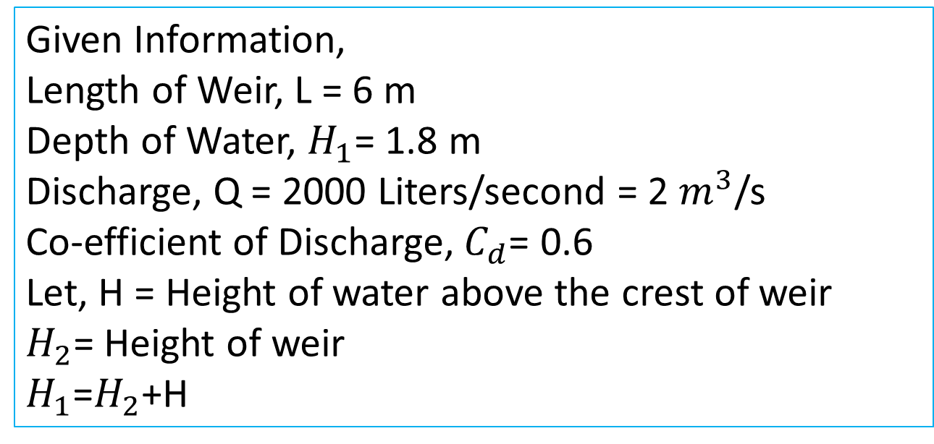
Practice Problem#14
Determine the height of a rectangular weir of Length 6m to be built across a rectangular channel. The maximum depth of water on the upstream side of the weir is 1.8 m and discharge is 2000 liters/second. Take, $C_{d}$= 0.6.
Given Information,
Length of Weir, L = 6 m
Depth of Water, $H_{1}$= 1.8 m
Discharge, Q = 2000 Liters/second = 2 $m^{3}$/s
Co-efficient of Discharge,${ C}_{d}$= 0.6
Let, H = Height of water above the crest of weir
$H_{2}$= Height of weir
$H_{1}$=$H_{2}$+H

Slide 10
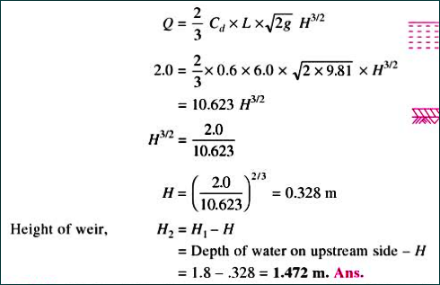
Solution

Slide 11
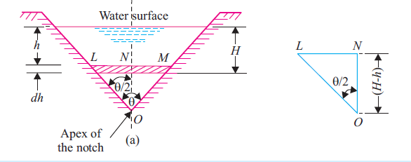
Discharge over a Triangular Notch or Weir

Slide 12
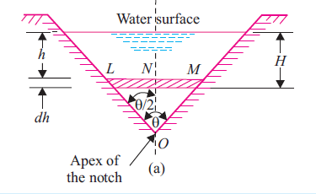
Discharge over a Triangular Notch or Weir
Let,
H = Head of water above V- notch
θ = Angle of Notch
Consider a horizontal strip of water of thickness “dh” at a depth of h from the free surface of water.

Slide 13
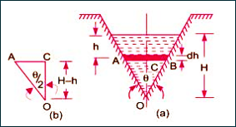
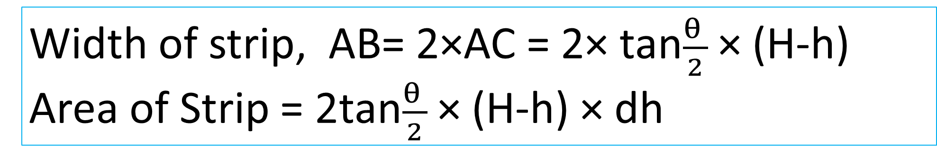
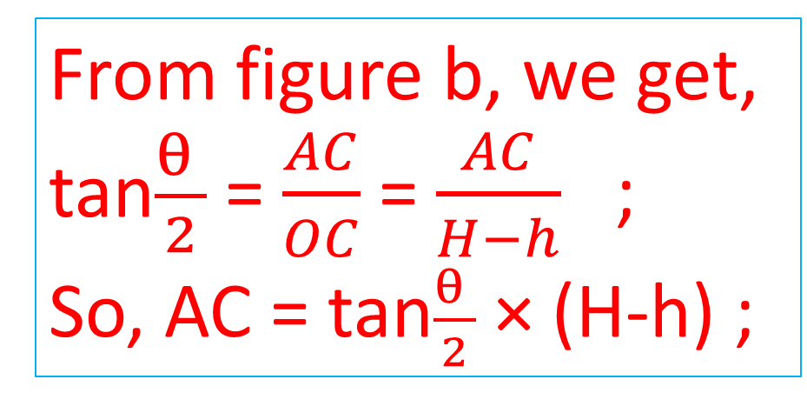
From figure b, we get,
tan$\frac{θ }{2}$ = $\frac{AC}{OC}$ = $\frac{AC}{H−h}$ ;
So, AC = tan$\frac{θ }{2}$ × (H-h) ;
Width of strip, AB= 2×AC = 2× tan$\frac{θ }{2}$ × (H-h)
Area of Strip = 2tan$\frac{θ }{2}$ × (H-h) × dh

Slide 14
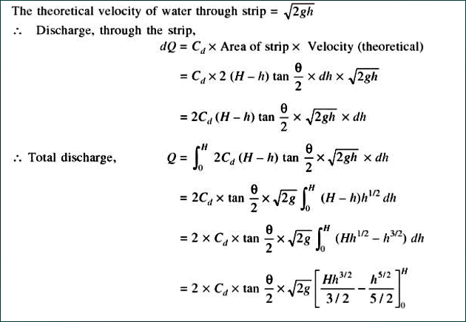

Slide 15
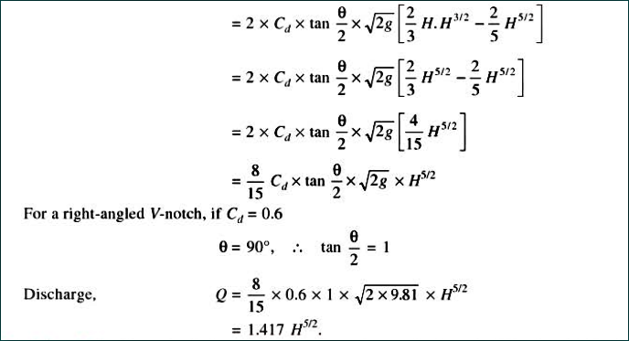

Slide 16
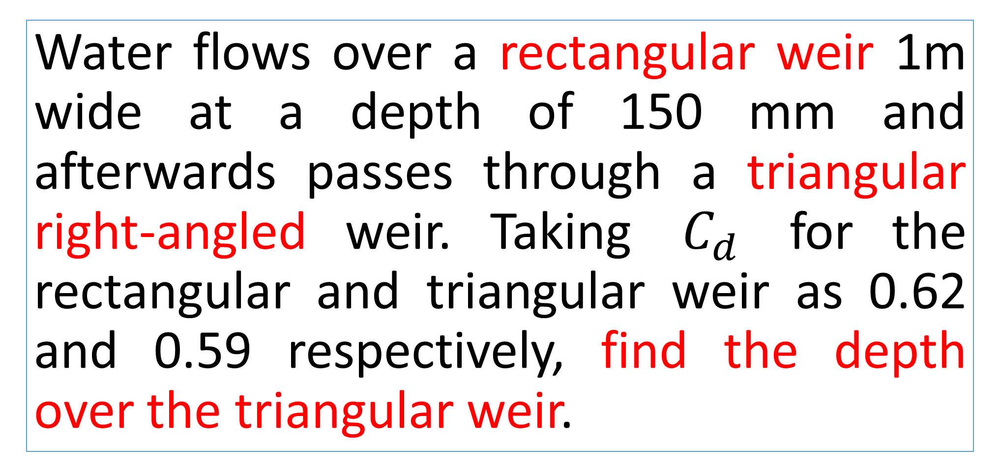
Practice Problem#15 (Bansal 359 page)
Water flows over a rectangular weir 1m wide at a depth of 150 mm and afterwards passes through a triangular right-angled weir. Taking ${ C}_{d}$ for the rectangular and triangular weir as 0.62 and 0.59 respectively, find the depth over the triangular weir.

Slide 17
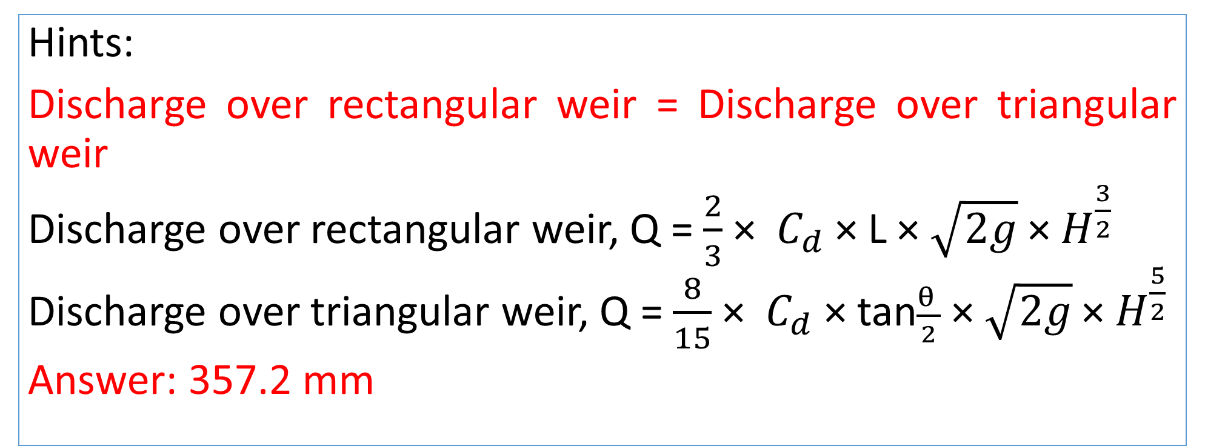
Practice Problem#15 (Bansal 359 page)
Hints:
Discharge over rectangular weir = Discharge over triangular weir
Discharge over rectangular weir, Q = $\frac{2}{3}$ × ${ C}_{d}$ × L × $\sqrt{2g}$ × $H^{\frac{3}{2}}$
Discharge over triangular weir, Q = $\frac{8}{15}$ × ${ C}_{d}$ × tan$\frac{θ }{2}$ × $\sqrt{2g}$ × $H^{\frac{5}{2}}$
Answer: 357.2 mm

