Slide 1
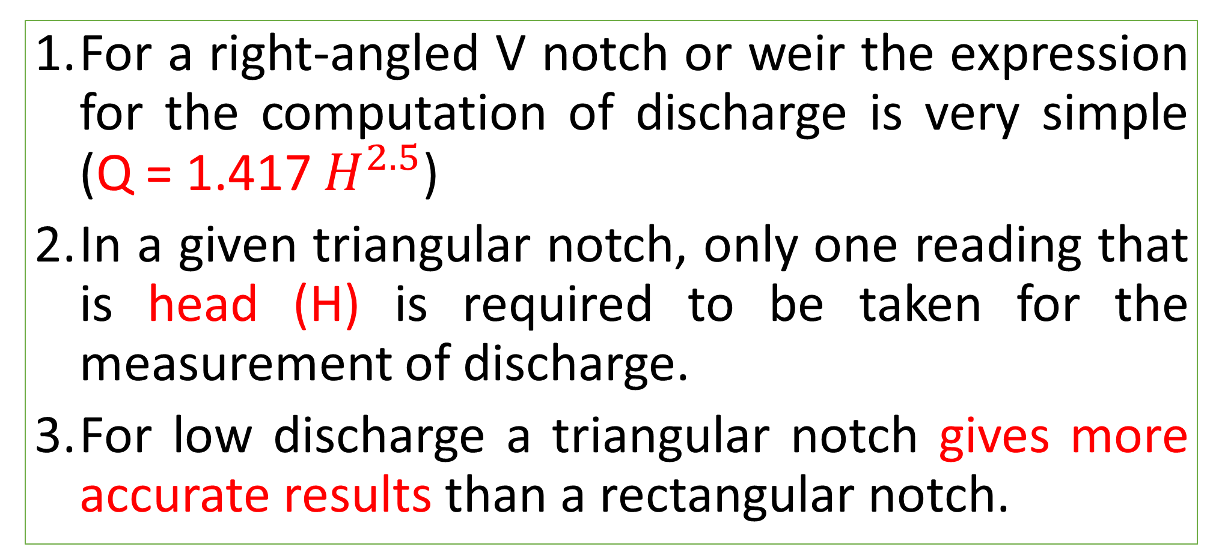
Advantages of Triangular notch over a rectangular weir
For a right-angled V notch or weir the expression for the computation of discharge is very simple (Q = 1.417 $H^{2.5}$)
In a given triangular notch, only one reading that is head (H) is required to be taken for the measurement of discharge.
For low discharge a triangular notch gives more accurate results than a rectangular notch.

Slide 2
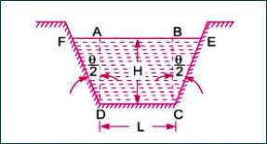
Discharge over a Trapezoidal Notch or Weir

Slide 3
Discharge over a Trapezoidal Notch or Weir
A trapezoidal notch or weir is a combination of a rectangular and triangular notch or weir.
Thus, total discharge will be equal to the sum of discharge through rectangular weir+ discharge through triangular weir.

Slide 4
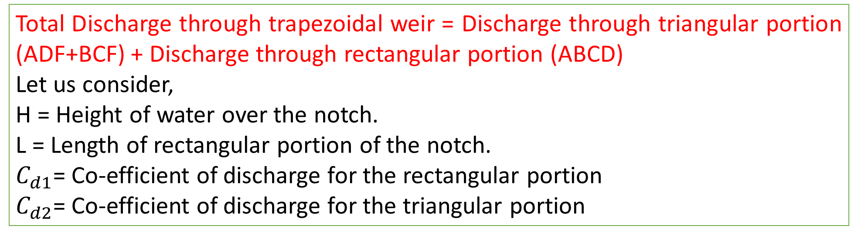
Discharge over a Trapezoidal Notch or Weir
Total Discharge through trapezoidal weir = Discharge through triangular portion (ADF+BCF) + Discharge through rectangular portion (ABCD)
Let us consider,
H = Height of water over the notch.
L = Length of rectangular portion of the notch.
$C_{d1}$= Co-efficient of discharge for the rectangular portion
$C_{d2}$= Co-efficient of discharge for the triangular portion

Slide 5

Discharge over a Trapezoidal Notch or Weir
Discharge through rectangular portion ABCD is given by,
$Q_{1}$= $\frac{2}{3}$ × ${ C}_{d}$ × L × $\sqrt{2g}$ × $H^{\frac{3}{2}}$
Discharge through two triangular notches ADF and BCE is equal to the discharge through a single triangular notch of angle θ and is given by,
$Q_{2}$= $\frac{8}{15}$ × ${ C}_{d}$ × tan$\frac{θ }{2}$ × $\sqrt{2g}$ × $H^{\frac{5}{2}}$
Discharge through trapezoidal notch or weir,
Q
= $Q_{1}$ + $Q_{2}$
= $\frac{2}{3}$ × ${ C}_{d}$ × L × $\sqrt{2g}$ × $H^{\frac{3}{2}}$ + $\frac{8}{15}$ × ${ C}_{d}$ × tan$\frac{θ }{2}$ × $\sqrt{2g}$ × $H^{\frac{5}{2}}$

Slide 6
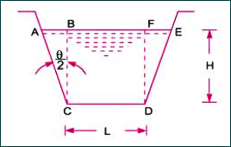
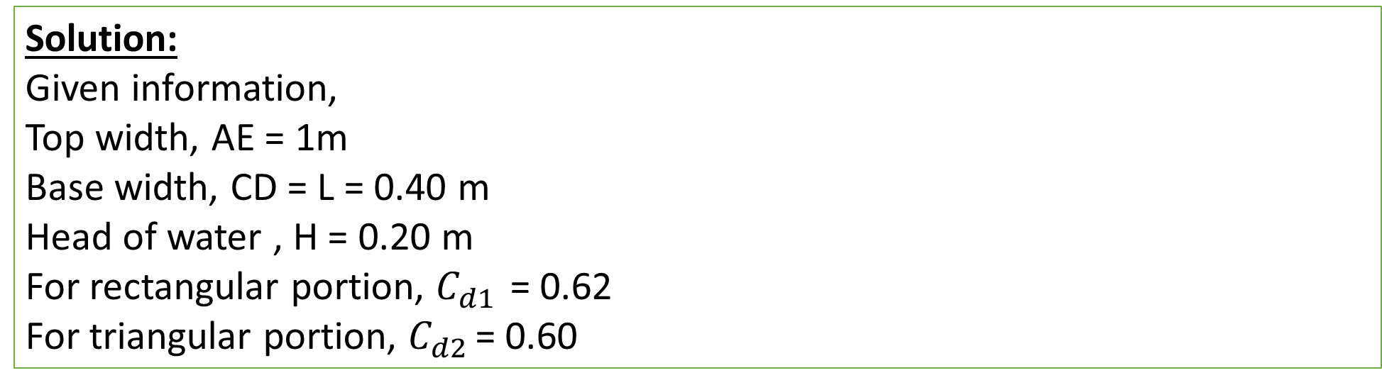
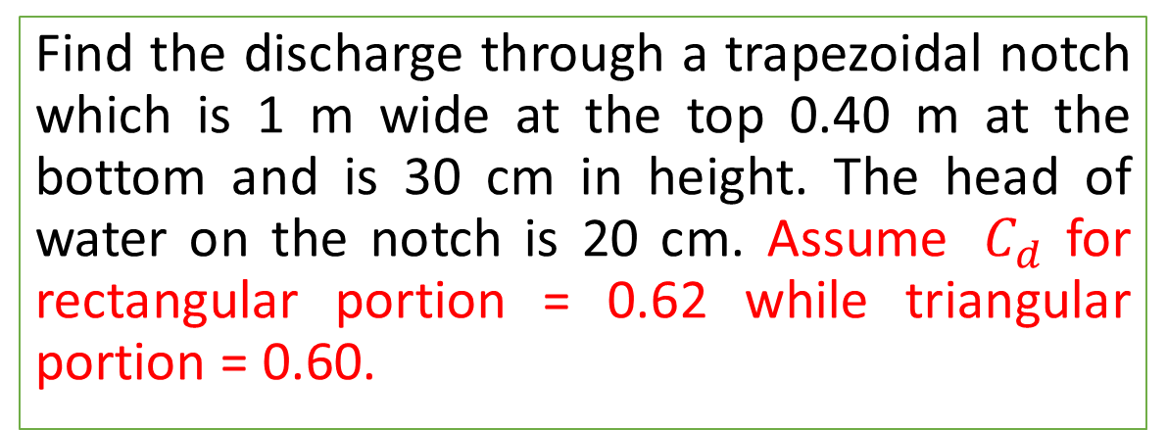
Practice Problem#16
Find the discharge through a trapezoidal notch which is 1 m wide at the top 0.40 m at the bottom and is 30 cm in height. The head of water on the notch is 20 cm. Assume ${ C}_{d}$ for rectangular portion = 0.62 while triangular portion = 0.60.
Solution:
Given information,
Top width, AE = 1m
Base width, CD = L = 0.40 m
Head of water , H = 0.20 m
For rectangular portion, $C_{d1 }$= 0.62
For triangular portion, $C_{d2 }$= 0.60

Slide 7
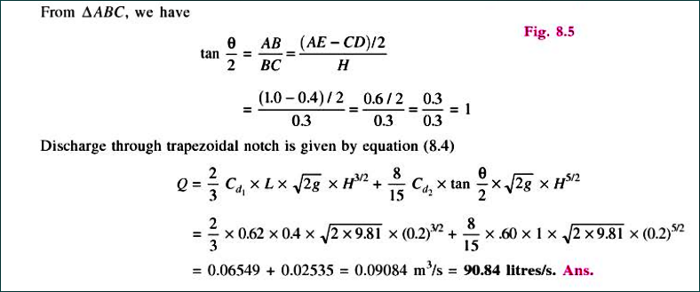
Solution

Slide 8
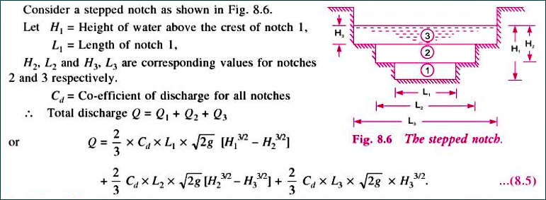
Discharge over Stepped Notch
A stepped notch is a combination of rectangular notches. The discharge through stepped notch is equal to the sum of discharges through different rectangular notches.

Slide 9
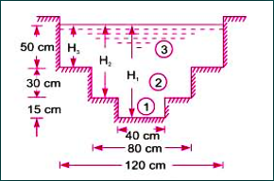

Practice Problem#17
The following figure shows a stepped notch. Find the discharge through the notch if $C_{d}$ for all section = 0.62
Solution:
Given information,
$C_{d}$=0.62
$L_{1}$= 40 cm
$L_{2}$= 80 cm
$L_{3}$= 120 cm
$H_{1}$= 50+30+15 = 95 cm
$H_{2}$= 50+30 = 80 cm
$H_{3}$= 50 cm

Slide 10
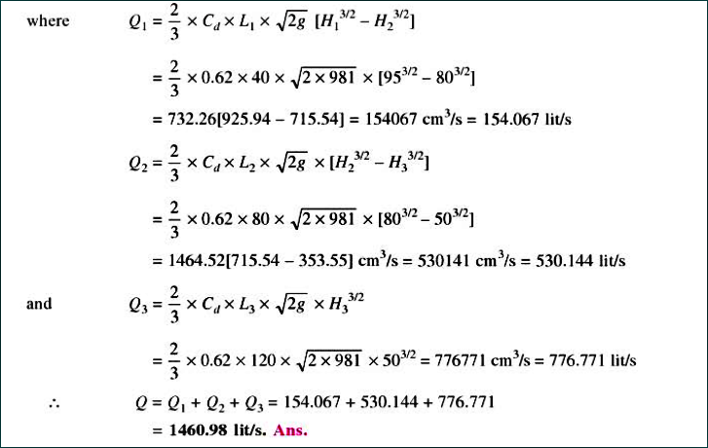
Solution: Total Discharge = $Q_{1}{+Q}_{2}+Q_{3}$

Slide 11
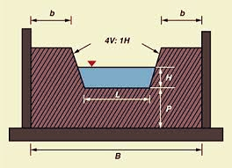
Cipolletti Weir or Notch
Cipolletti weir is a trapezoidal weir which has side slopes of 1 horizontal to 4 vertical.

Slide 12
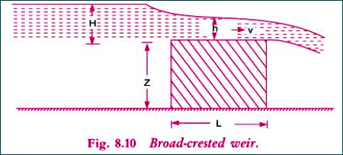
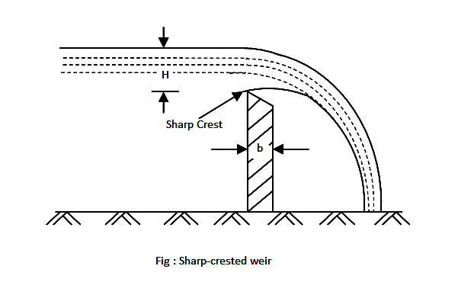
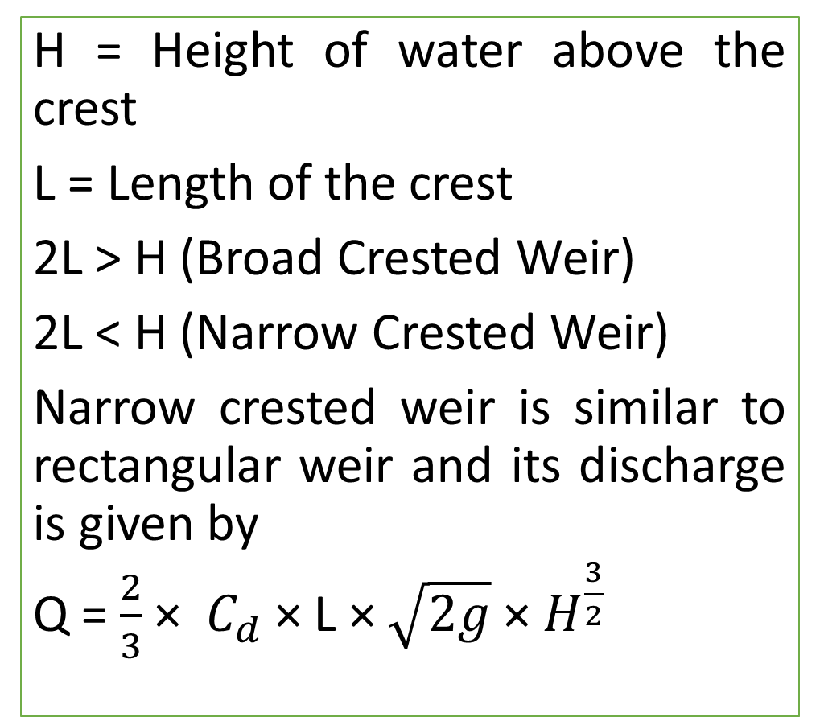
Broad Crested Weir, Narrow crested Weir
H = Height of water above the crest
L = Length of the crest
2L > H (Broad Crested Weir)
2L < H (Narrow Crested Weir)
Narrow crested weir is similar to rectangular weir and its discharge is given by
Q = $\frac{2}{3}$ × ${ C}_{d}$ × L × $\sqrt{2g}$ × $H^{\frac{3}{2}}$

Slide 13
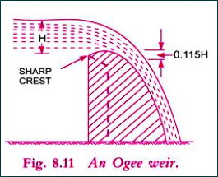
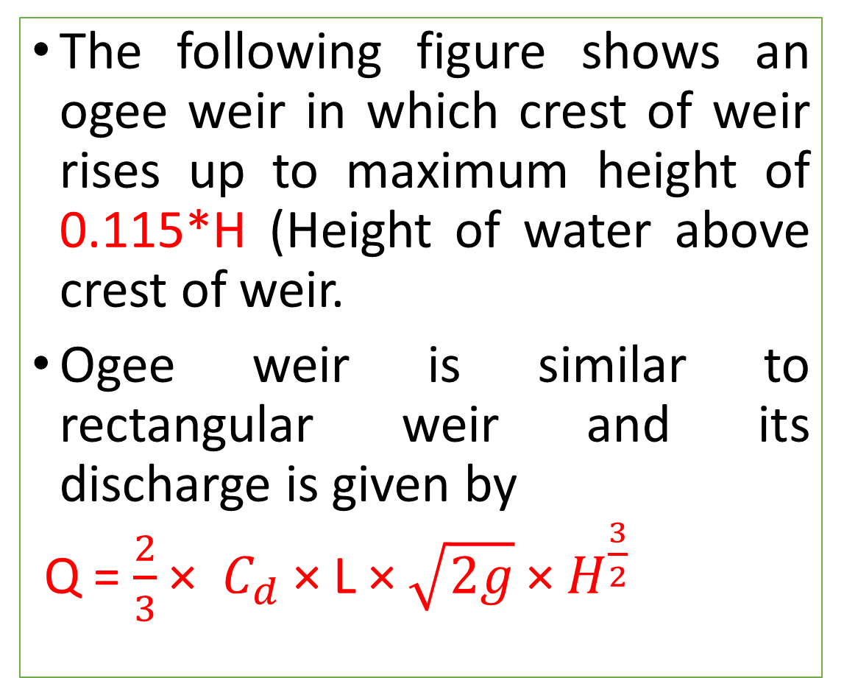
Ogee Weir
The following figure shows an ogee weir in which crest of weir rises up to maximum height of 0.115*H (Height of water above crest of weir.
Ogee weir is similar to rectangular weir and its discharge is given by
Q = $\frac{2}{3}$ × ${ C}_{d}$ × L × $\sqrt{2g}$ × $H^{\frac{3}{2}}$

