Slide 1
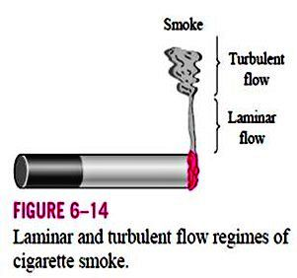
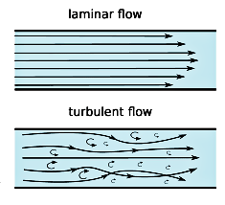
Laminar Flow
Laminar means arranged.
Paths taken by individual fluid particles do not cross one another.

Slide 2
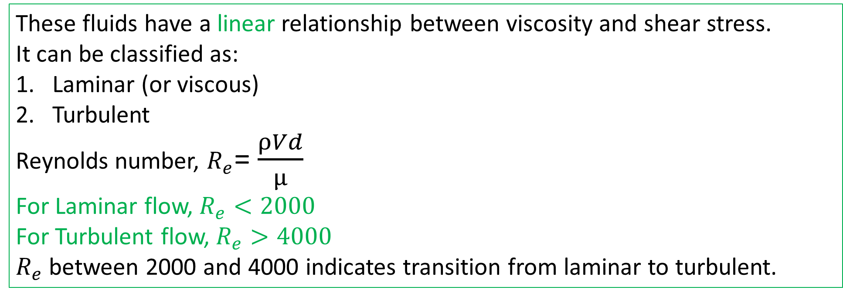
Newtonian Fluid
These fluids have a linear relationship between viscosity and shear stress.
It can be classified as:
Laminar (or viscous)
Turbulent
Reynolds number, $R_{e}$= $\frac{ρVd}{μ}$
For Laminar flow, $R_{e}<2000$
For Turbulent flow, $R_{e}>4000$
$R_{e}$ between 2000 and 4000 indicates transition from laminar to turbulent.

Slide 3
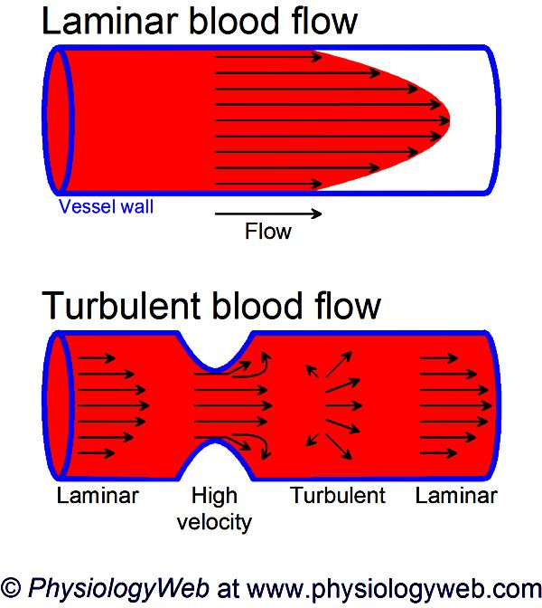
Examples of Laminar/ Viscous flow
Flow past tiny bodies.
Underground flow.
Movement of blood in the arteries of a human body.
Flow of oil in measuring instruments.
Rise of water in plants through their roots.

Slide 4
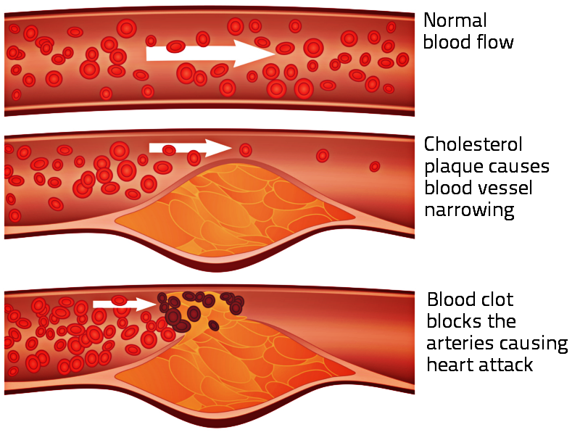
Laminar and Turbulent flow

Slide 5
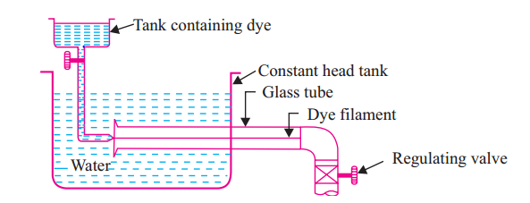
Reynolds Experiment
Osborne Reynolds in 1883, with the help of a simple experiment demonstrated the existence of the following two types of flows.

Slide 6
Reynolds Experiment
Apparatus:
A constant head tank filled with water.
A small tank containing dye.
A horizontal glass tube provided with a bell mouthed entrance
A regulating valve.
Procedure followed:
The water was made to flow from the tank through the glass tube into the atmosphere.
The velocity of flow was varied by adjusting valve.
The liquid dye was introduced into the flow at the bell mouth through a small tube.

Slide 7
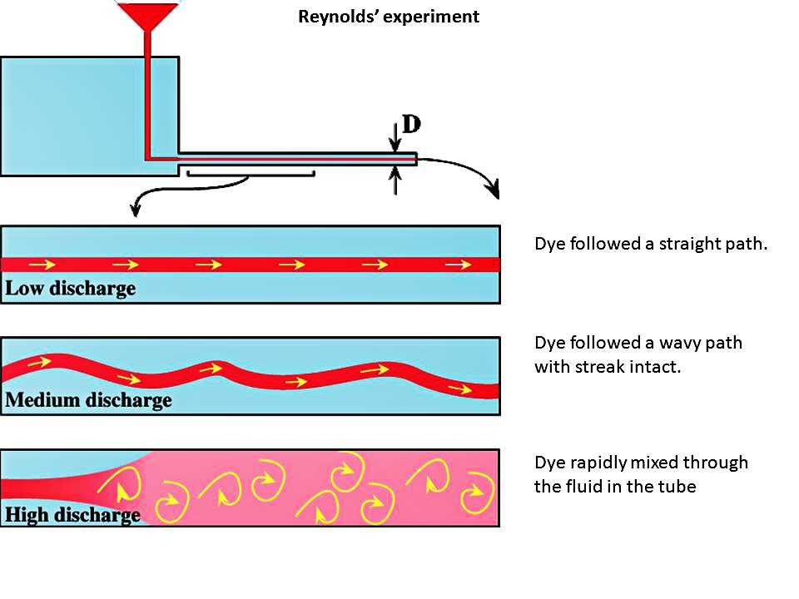
Observations made
When velocity of flow is low, the dye remained in the form of a straight and stable filament passing through the glass tube. (laminar flow)
With the increase in velocity, a critical state was reached at which the dye filament showed irregularity and began to weaver. This is transitional state.
With further increase in velocity of flow in the filament of dye become more intense and ultimately the dye diffused over the entire cross-section (turbulent flow)

Slide 8
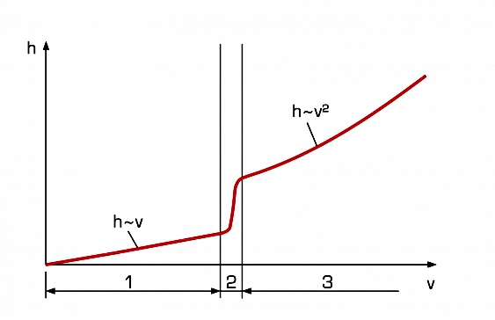
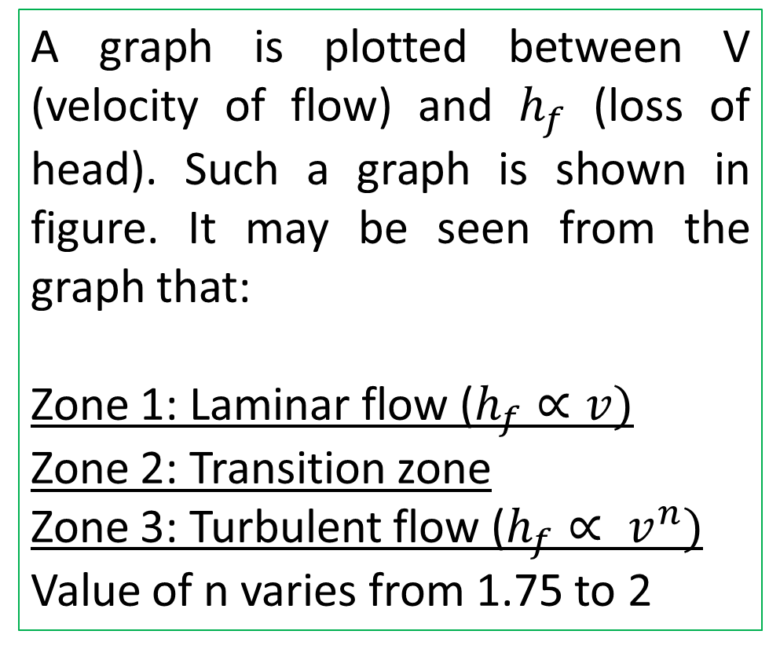
Loss of Head and Velocity of flow relationship
A graph is plotted between V (velocity of flow) and $h_{f}$ (loss of head). Such a graph is shown in figure. It may be seen from the graph that:
Zone 1: Laminar flow ($h_{f}∝v)$
Zone 2: Transition zone
Zone 3: Turbulent flow ($h_{f}∝ v^{n})$
Value of n varies from 1.75 to 2

Slide 9
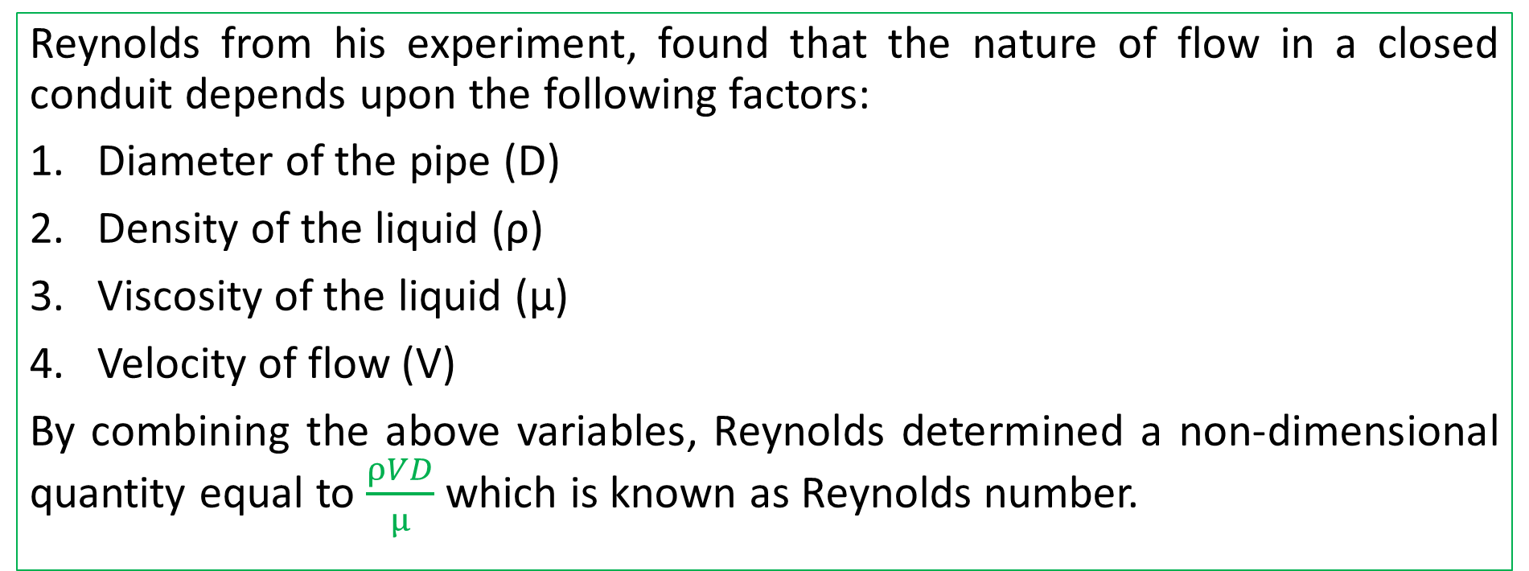
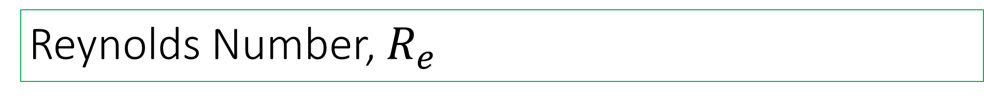
Reynolds Number, $R_{e}$
Reynolds from his experiment, found that the nature of flow in a closed conduit depends upon the following factors:
Diameter of the pipe (D)
Density of the liquid (ρ)
Viscosity of the liquid (μ)
Velocity of flow (V)
By combining the above variables, Reynolds determined a non-dimensional quantity equal to $\frac{ρVD}{μ}$ which is known as Reynolds number.

Slide 10
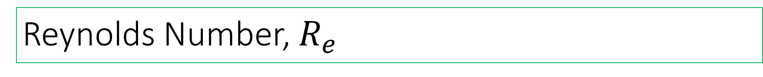
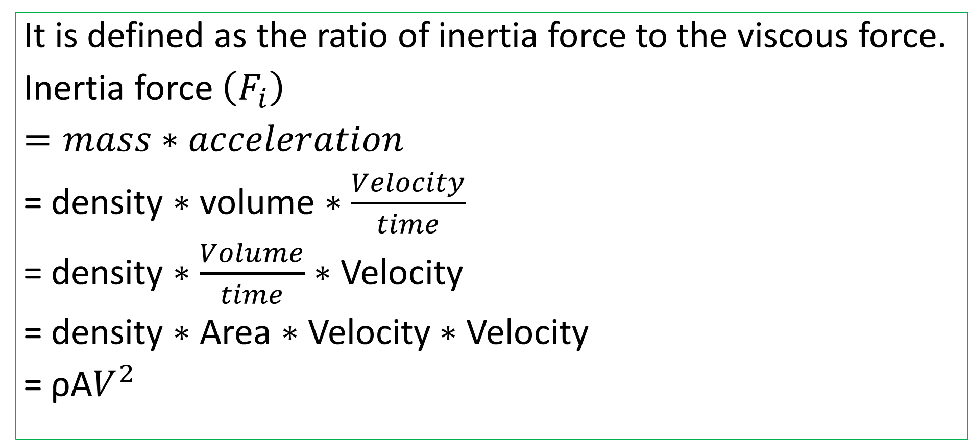
Reynolds Number, $R_{e}$
It is defined as the ratio of inertia force to the viscous force.
Inertia force $\left(F_{i}\right)$
$=mass∗acceleration$
= density $∗$ volume $∗$ $\frac{Velocity}{time}$
= density $∗$ $\frac{Volume}{time}$ $∗$ Velocity
= density $∗$ Area $∗$ Velocity $∗$ Velocity
= ρA$V^{2}$

Slide 11

Reynolds Number, $R_{e}$
Viscous force $\left(F_{v}\right)$
$=shear stress∗area$
= µ $\frac{du}{dy}∗area$
= µ $\frac{V}{L}∗A$
Reynolds Number , $R_{e}$ = $\frac{F_{i}}{F_{v}}=\frac{ρVL}{µ}$

Slide 12
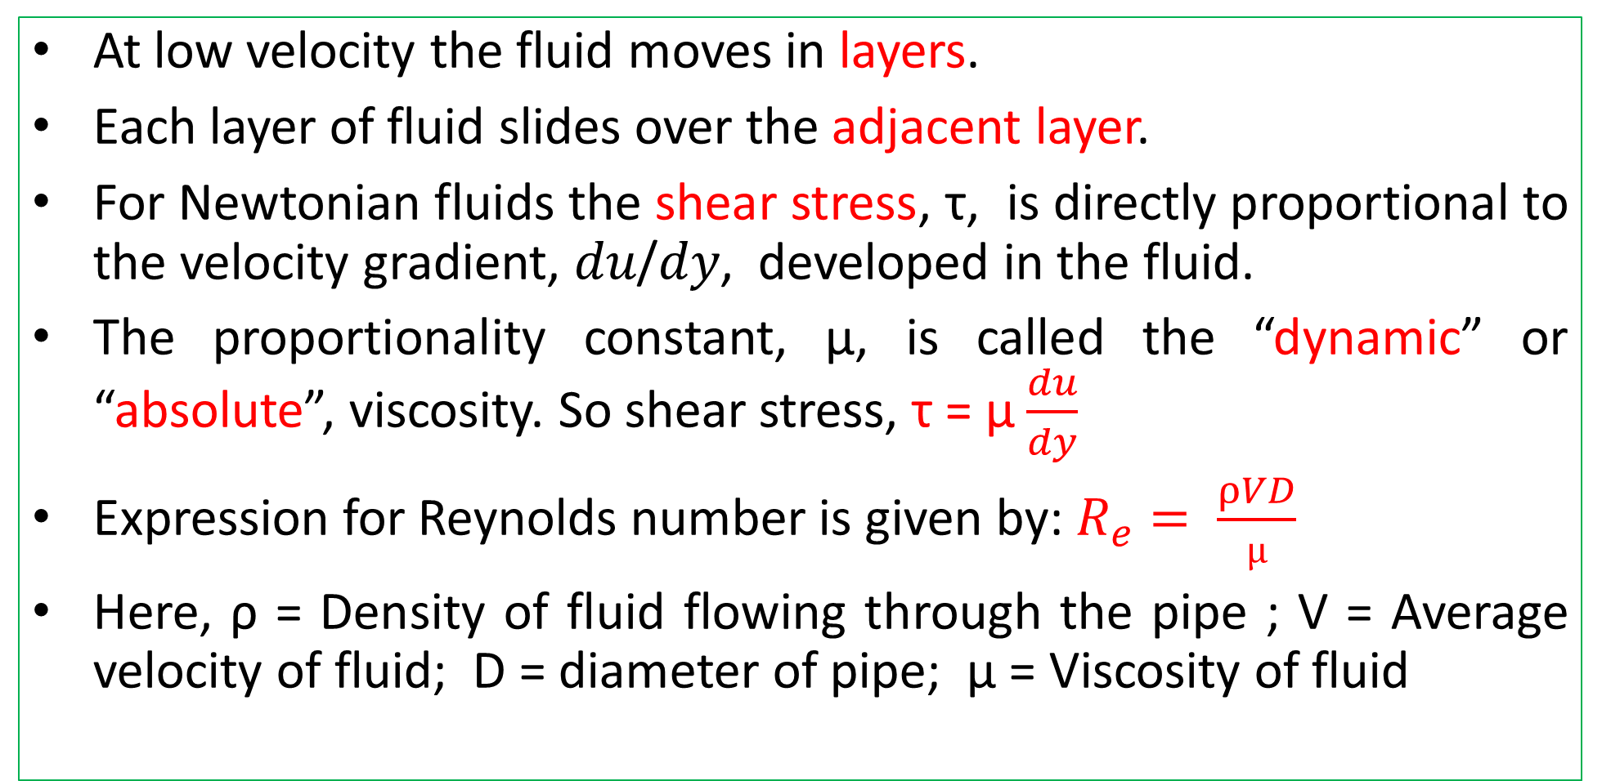
Flow of Viscous Fluid through Circular Pipe
At low velocity the fluid moves in layers.
Each layer of fluid slides over the adjacent layer.
For Newtonian fluids the shear stress, τ, is directly proportional to the velocity gradient, 𝑑𝑢/𝑑𝑦, developed in the fluid.
The proportionality constant, μ, is called the “dynamic” or “absolute”, viscosity. So shear stress, τ = µ $\frac{du}{dy}$
Expression for Reynolds number is given by: $R_{e}= \frac{ρVD}{µ}$
Here, ρ = Density of fluid flowing through the pipe ; V = Average velocity of fluid; D = diameter of pipe; µ = Viscosity of fluid

Slide 13
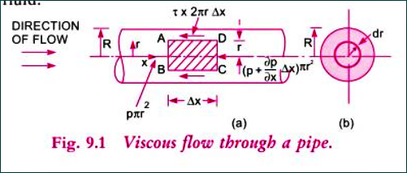
Consider a horizontal pipe of radius R.
The viscous fluid is flowing from left to right in the pipe as shown in figure.
Consider a fluid element of radius r sliding in a cylindrical fluid element of radius (r+ dr)
Let, length of fluid element = ∆x

Slide 14
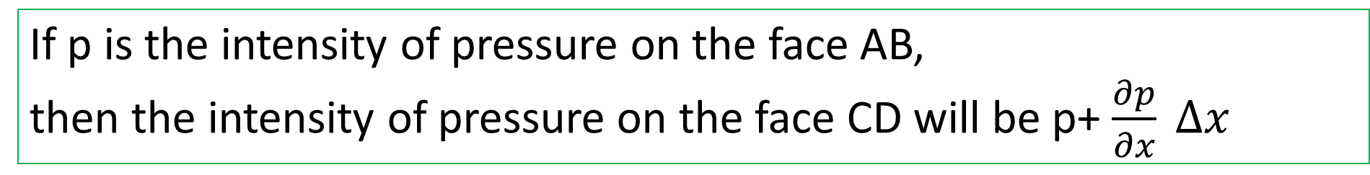
If p is the intensity of pressure on the face AB,
then the intensity of pressure on the face CD will be p+ $\frac{∂p}{∂x} ∆x$

Slide 15
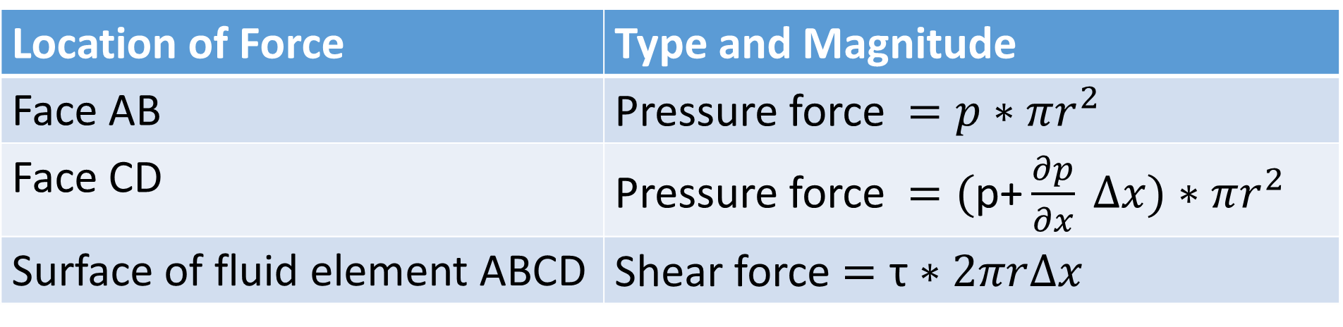
Forces acting on the fluid Element
Location of Force | Type and Magnitude
Face AB | Pressure force $=p∗πr^{2}$
Face CD | Pressure force $=\text{(}\text{p}\text{+}\frac{∂p}{∂x} ∆x)∗πr^{2}$
Surface of fluid element ABCD | Shear force $=\text{τ}∗2πr∆x$

Slide 16
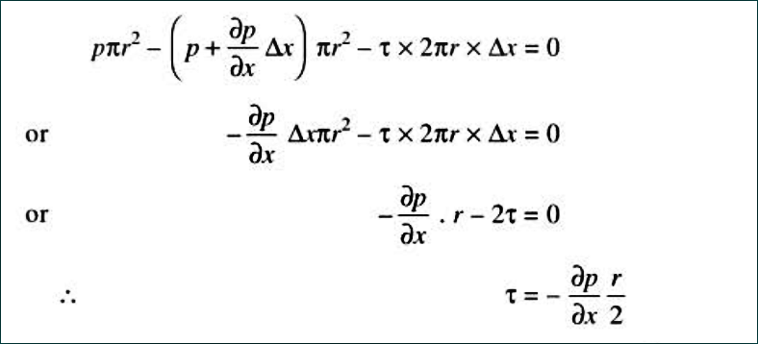
Sum of all forces in the direction of flow must be zero

Slide 17
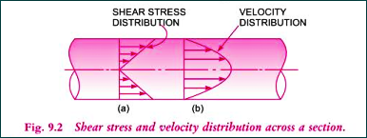
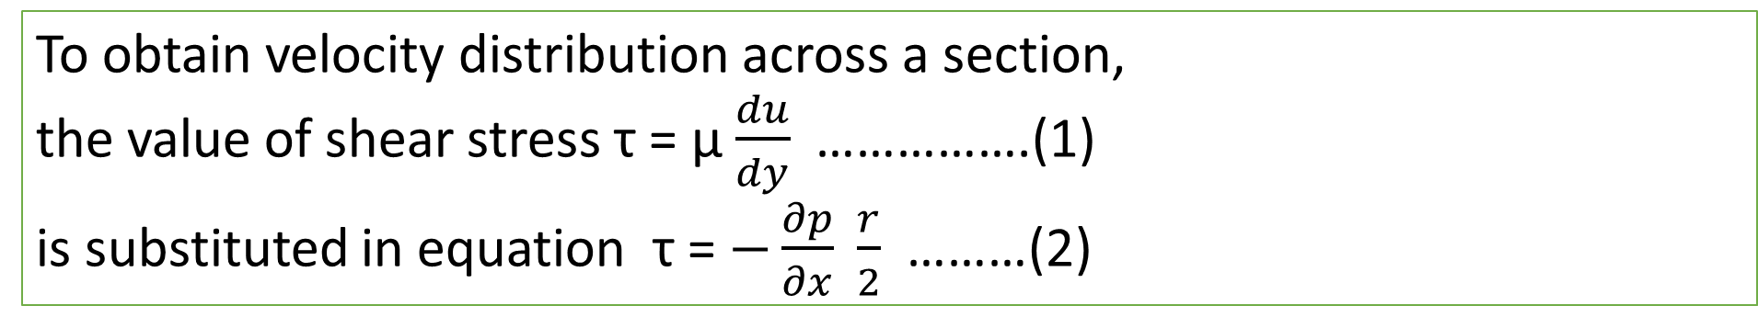
Shear stress and Velocity distribution
To obtain velocity distribution across a section,
the value of shear stress τ = µ $\frac{du}{dy}$ …………….(1)
is substituted in equation τ = $−\frac{∂p}{∂x} \frac{r}{2}$ ………(2)

Slide 18
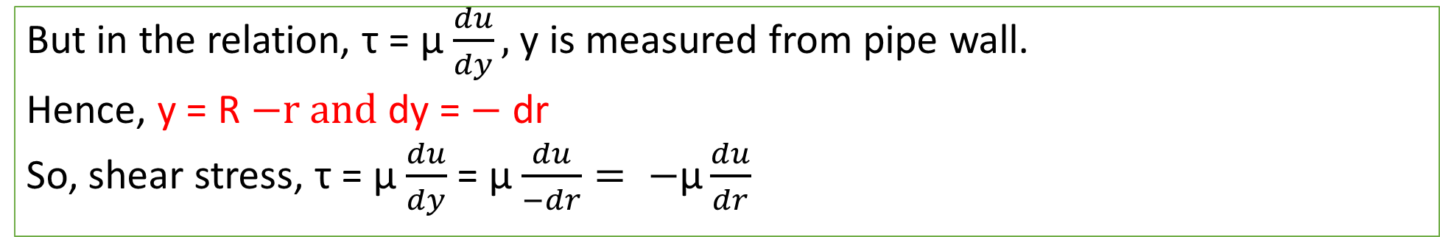
Velocity Distribution: $u=\frac{1}{4µ}\frac{∂p}{∂x}[R^{2}−r^{2}]$
But in the relation, τ = µ $\frac{du}{dy},$y is measured from pipe wall.
Hence, y = R $−r and$dy = $−$ dr
So, shear stress, τ = µ $\frac{du}{dy}$ = µ $\frac{du}{−dr}= −\text{µ}\frac{du}{dr}$

Slide 19
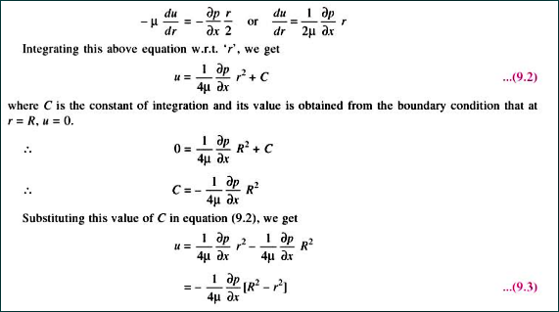
Velocity Distribution: $u=\frac{1}{4µ}\frac{∂p}{∂x}[R^{2}−r^{2}]$

Slide 20


Slide 21
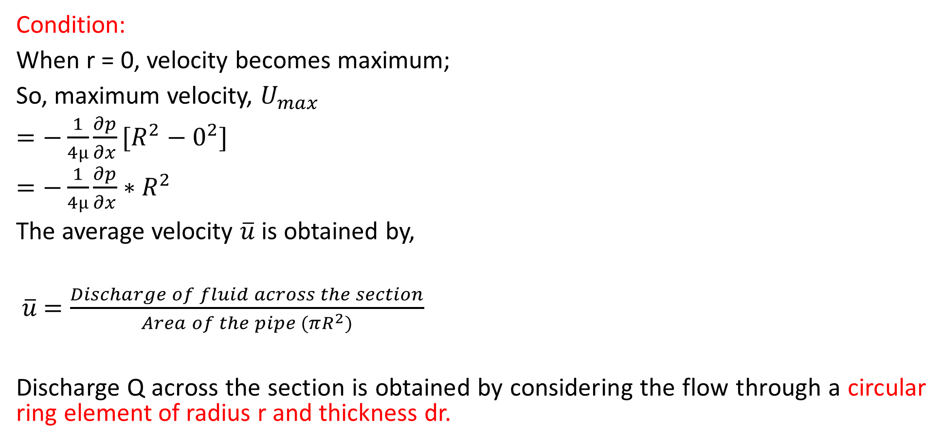
Ratio of maximum velocity to average velocity
Condition:
When r = 0, velocity becomes maximum;
So, maximum velocity, $U_{max}$
$=−\frac{1}{4µ}\frac{∂p}{∂x}[R^{2}−0^{2}]$
$=−\frac{1}{4µ}\frac{∂p}{∂x}∗R^{2}$
The average velocity $\overline{u}$ is obtained by,
$\overline{u}$ $=\frac{Discharge of fluid across the section}{Area of the pipe (πR^{2})}$
Discharge Q across the section is obtained by considering the flow through a circular ring element of radius r and thickness dr.

Slide 22
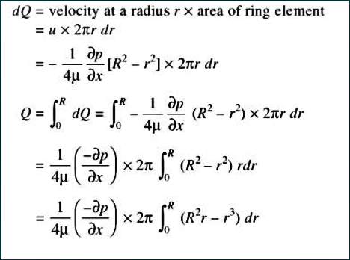
Discharge Q:

Slide 23
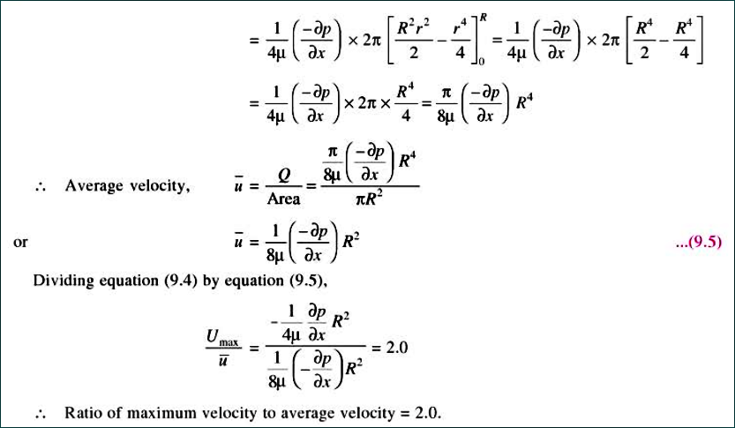

Slide 24
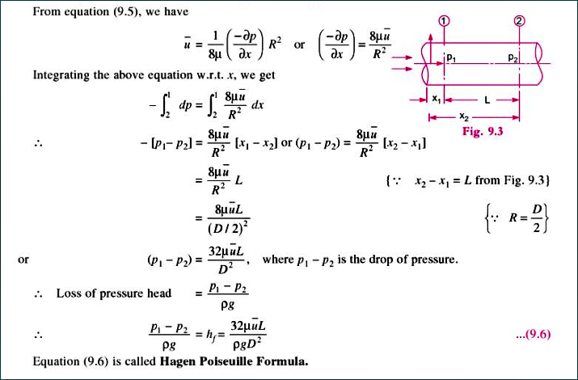
Drop of Pressure for a given length L of the pipe (Hagen Poiseuille Formula)

Slide 25
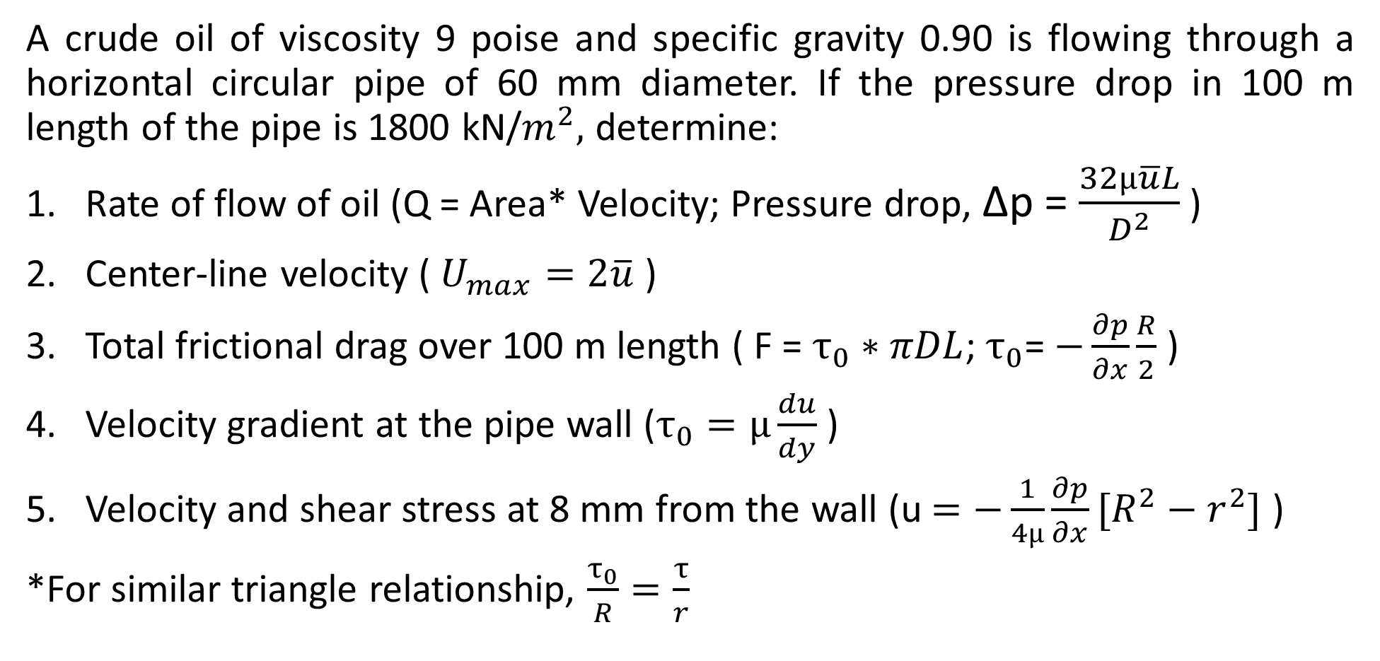
Practice Problem#18 (Rajput= Page 534)
A crude oil of viscosity 9 poise and specific gravity 0.90 is flowing through a horizontal circular pipe of 60 mm diameter. If the pressure drop in 100 m length of the pipe is 1800 kN/$m^{2},$ determine:
Rate of flow of oil (Q = Area* Velocity; Pressure drop, ∆p = $\frac{32µ\overline{u}L}{D^{2}}$ )
Center-line velocity ( $U_{max}=2\overline{u}$ )
Total frictional drag over 100 m length ( F = $τ_{0}∗πDL$; $τ_{0}$= $−\frac{∂p}{∂x}\frac{R}{2}$ )
Velocity gradient at the pipe wall ($τ_{0}=µ\frac{du}{dy}$ )
Velocity and shear stress at 8 mm from the wall (u $=−\frac{1}{4µ}\frac{∂p}{∂x}[R^{2}−r^{2}]$ )
*For similar triangle relationship, $\frac{τ_{0}}{R}=\frac{τ}{r}$

Slide 26
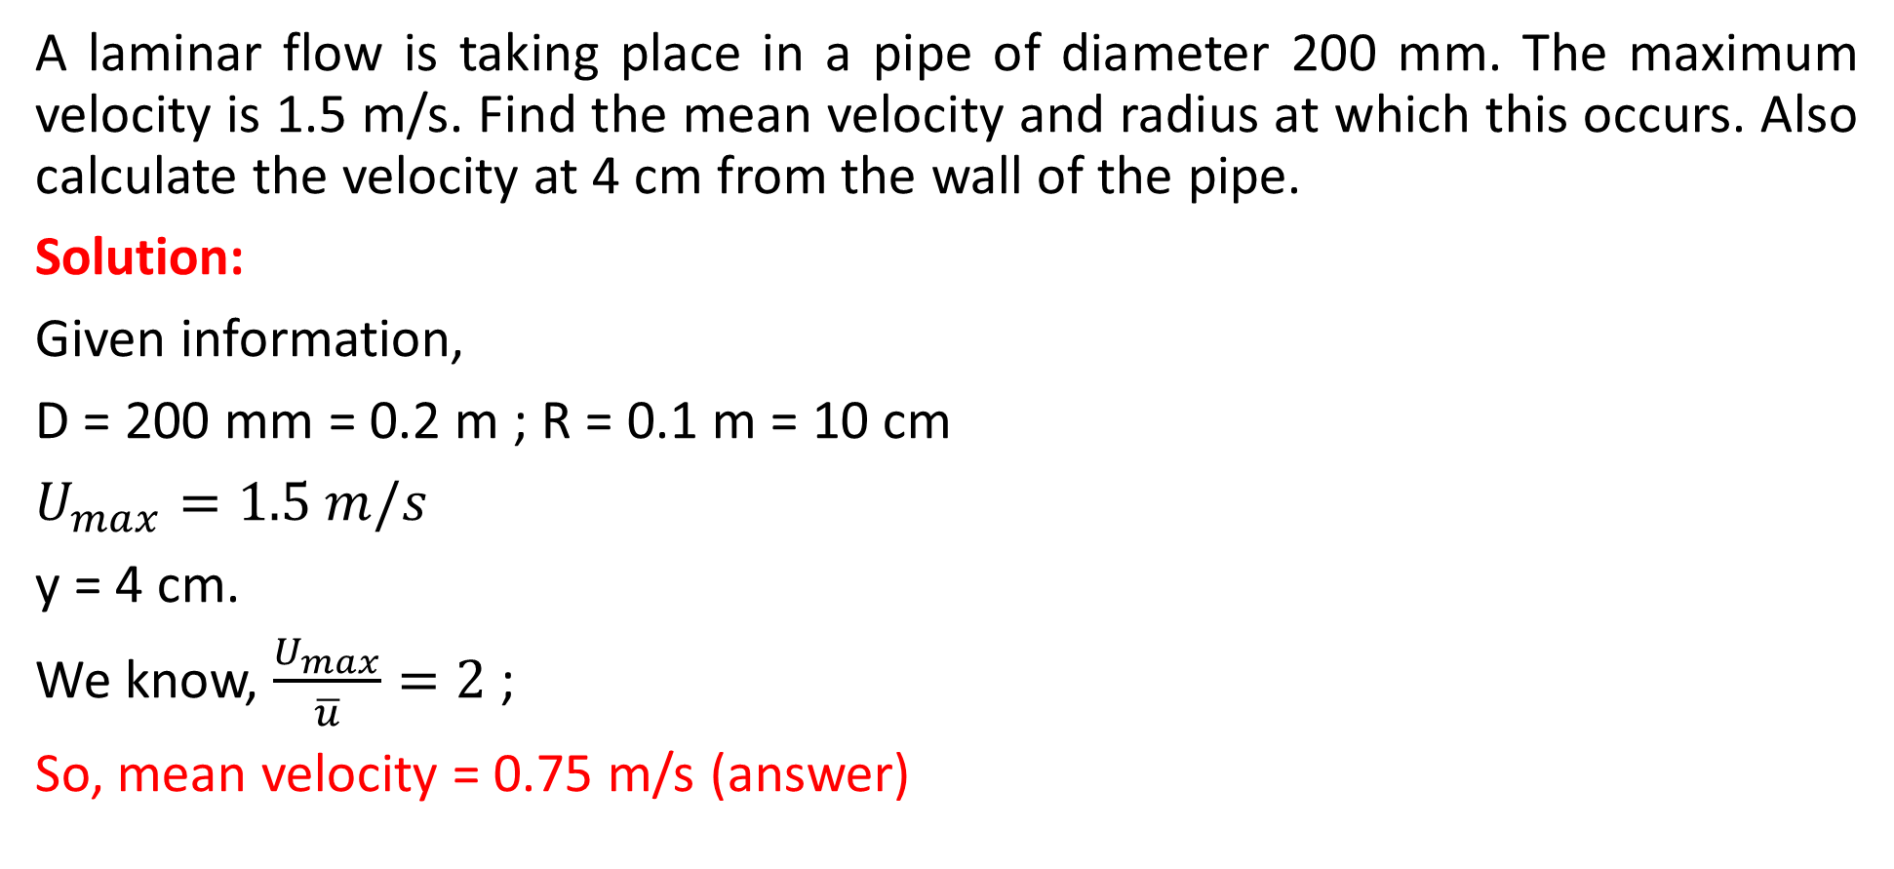
Practice Problem#19
A laminar flow is taking place in a pipe of diameter 200 mm. The maximum velocity is 1.5 m/s. Find the mean velocity and radius at which this occurs. Also calculate the velocity at 4 cm from the wall of the pipe.
Solution:
Given information,
D = 200 mm = 0.2 m ; R = 0.1 m = 10 cm
$U_{max}=1.5 m/s$
y = 4 cm.
We know, $\frac{U_{max}}{\overline{u}}=2$ ;
So, mean velocity = 0.75 m/s (answer)

Slide 27
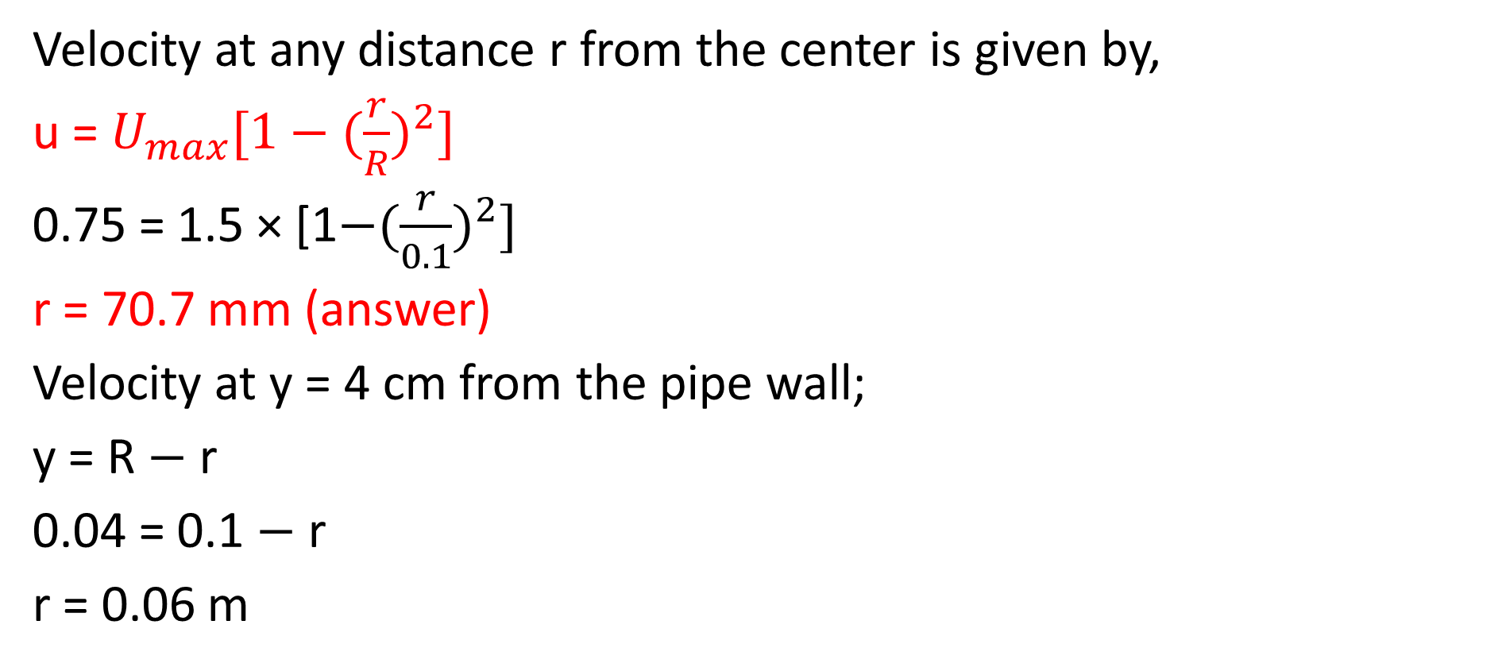
Solution
Velocity at any distance r from the center is given by,
u = $U_{max}[1−({\frac{r}{R})}^{2}]$
0.75 = 1.5 × [1$−({\frac{r}{0.1})}^{2}]$
r = 70.7 mm (answer)
Velocity at y = 4 cm from the pipe wall;
y = R $−$ r
0.04 = 0.1 $−$ r
r = 0.06 m

Slide 28
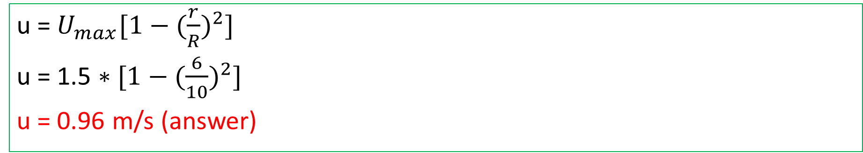
Velocity at y = 4 cm or r = 6 cm from the pipe wall
u = $U_{max}[1−({\frac{r}{R})}^{2}]$
u = 1.5 $∗[1−({\frac{6}{10})}^{2}]$
u = 0.96 m/s (answer)

Slide 29
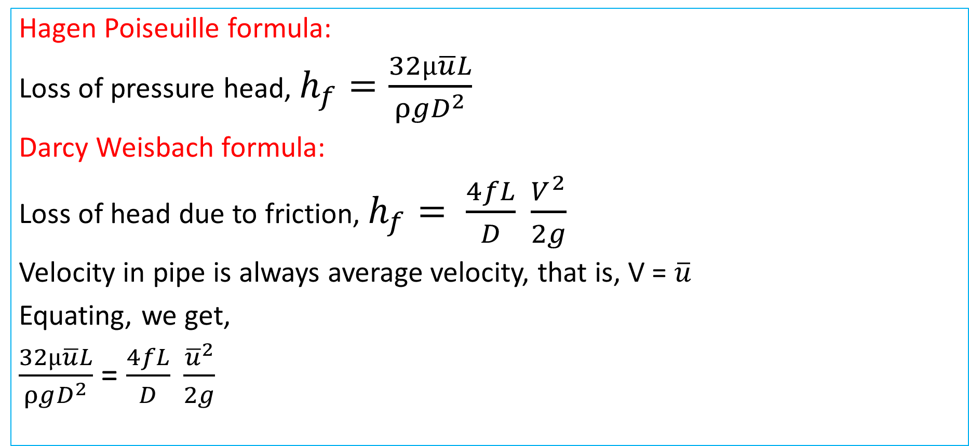
Loss of Head due to friction in Viscous flow
Hagen Poiseuille formula:
Loss of pressure head, $h_{f}=\frac{32µ\overline{u}L}{ρgD^{2}}$
Darcy Weisbach formula:
Loss of head due to friction, $h_{f}= \frac{4fL}{D} \frac{V^{2}}{2g}$
Velocity in pipe is always average velocity, that is, V = $\overline{u}$
Equating, we get,
$\frac{32µ\overline{u}L}{ρgD^{2}}$ = $\frac{4fL}{D} \frac{{\overline{u}}^{2}}{2g}$

Slide 30
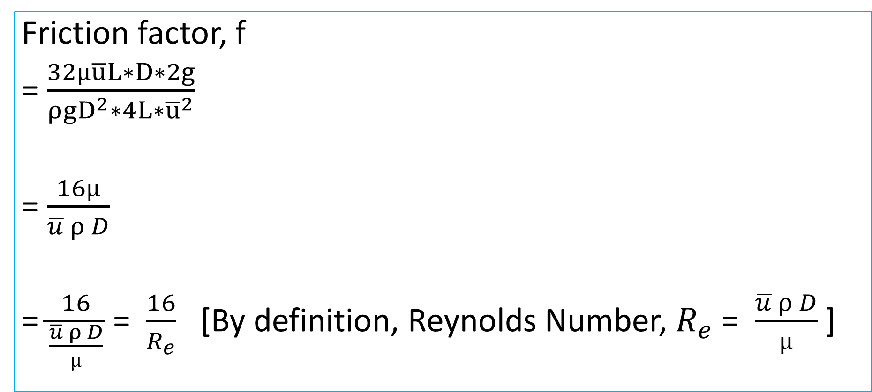
Loss of Head due to friction in Viscous flow
Friction factor, f
= $\frac{32µ\overline{u}L∗D∗2g}{ρgD^{2}∗4L∗{\overline{u}}^{2}}$
= $\frac{16µ}{\overline{u} ρ D}$
= $\frac{16}{\frac{\overline{u} ρ D}{µ}}$ = $\frac{16}{R_{e}}$ [By definition, Reynolds Number, $R_{e}$ = $\frac{\overline{u} ρ D}{µ}$ ]

Slide 31
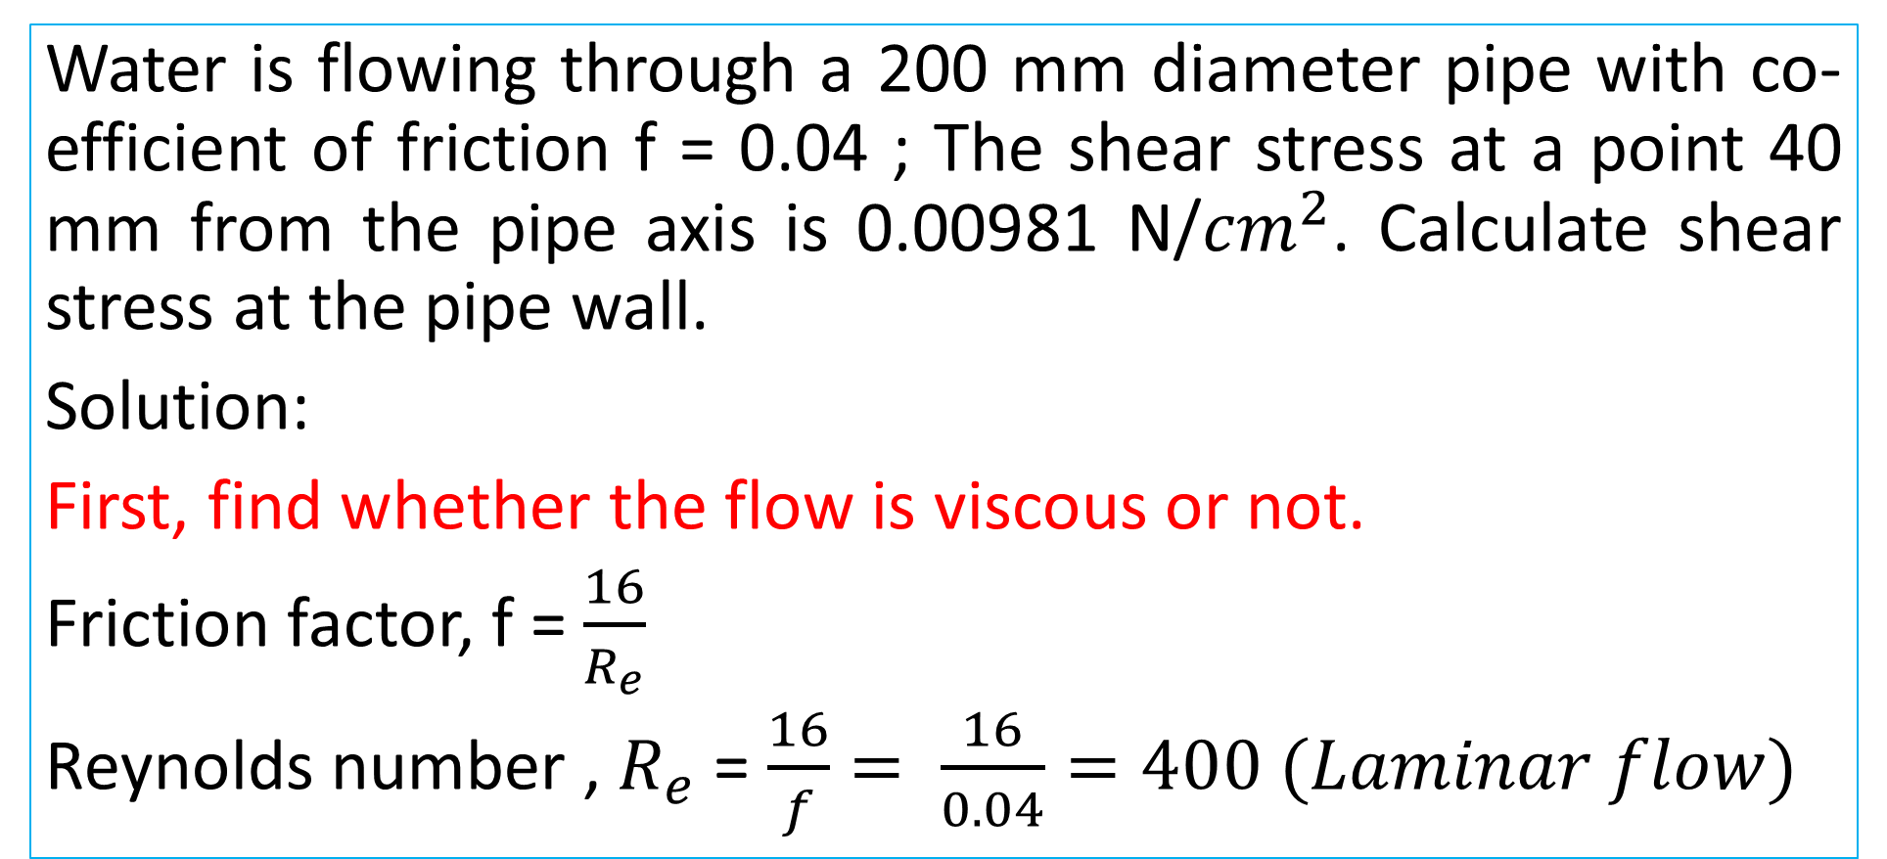
Practice Problem#20
Water is flowing through a 200 mm diameter pipe with co-efficient of friction f = 0.04 ; The shear stress at a point 40 mm from the pipe axis is 0.00981 N/${cm}^{2}$. Calculate shear stress at the pipe wall.
Solution:
First, find whether the flow is viscous or not.
Friction factor, f = $\frac{16}{R_{e}}$
Reynolds number , $R_{e}$ = $\frac{16}{f}= \frac{16}{0.04}=400 (Laminar flow)$

Slide 32


Solution
$$τ_{0}$$
Let, shear stress at pipe wall = $τ_{0}$
From similar triangle relationship,
$\frac{0.00981}{40}=\frac{τ_{0}}{100}$
$τ_{0}$= 0.0245 N/${cm}^{2}$
100 mm
τ = 0.00981
40 mm

