Slide 1
FACTORS AFFECTING ACOUSTIC OF BUILDING AND THEIR
REMEDIES

Slide 2
The Various Factors Affecting The Acoustic of Building :
1.Reverberation Time
2.Loudness
3.Focussing
4.Echo
5.Echelon Effect
6.Resonance And Noise.

Slide 3
1. REVERBERATION TIME
REVERBERATION IS THE PERSISTENCE OR PROLONGATION OF SOUND IN A HALL EVEN AFTER THE SOURCE STOPPED EMITTING SOUND.
IN ORDER TO HAVE GOOD ACOUSTIC EFFECT, THE REVERBERATION TIME HAS TO BE MAINTAINED AT OPTIMUM VALUE. THE REASON IS, IF THE REVERBERATION TIME IS TOO SMALL, THE LOUDNESS BECOMES INADEQUATE. AS A RESULT THE SOUND MAY NOT REACH TO THE LISTENER.
THUS, THIS GIVE THE HALL A DEAD EFFECT. ON THE OTHER HAND, IF THE REVERBERATION TIME IS TOO LONG, IT WILL LEAD TO MORE CONFUSION DUE TO MIXING OF DIFFERENT STYLE.
HENCE TO MAINTAIN GOOD EFFECT REVERBERATION TIME SHOULD BE MAINTAINED.

Slide 4
REMEDIES
THE REVERBERATION TIME CAN BE MAINTAINED AT AN OPTIMUM VALUE BY ADOPTING THE FOLLOWING WAYS:
BY PROVIDING WINDOWS AND OPENINGS.
BY HAVING FULL CAPACITY OF AUDIENCE IN THE HALL OR ROOM.
BY USING HEAVY CURTAINS WITH FOLDS.
BY DECORATING THE WALLS BY BEAUTIFUL PICTURES, MAPS, ETC.
BY COVERING FLOOR WITH CARPETS.
BY COVERING THE CEILING AND WALLS WITH GOOD SOUND- ABSORBING MATERIALS LIKE
FELT, FIBRE BOARD, FLASE ROOFING, ETC.
THE REVERBERATION TIME DEPENDS ON THE SIZE OF THE HALL AND THE QUANTITY OF SOUND. THUS, THE REVERBERATION TIME CAN BE CONTROLLED EITHER BY INSERTING OR REMOVING SOUND-ABSORBING MATERIAL IN A HALL OR ROOM.

Slide 5
LOUDNESS
THE UNIFIRM DISTRIBUTION OF LOUDNESS IN A HALL OR A ROOM IS AN IMPORTANT FACTOR FOR SATISFACTORY HEARING. SOMETIMES, THE LOUDNESS MAY GET REDUCED DUE TO EXCESS OF SOUND- ABSORBING MATERIALS IN A HALL OR A ROOM.
REMEDIES
IF THE LOUDNESS OF SOUND IS NOT ADEQUATE, THE LOUDNESS CAN BE INCREASED BY ADOPTING THE FOLLOWING METHODS.
BY USING SUITABLE ABSORBANTS AT PLACE WHERE NOISE IS HIGH. AS A RESULT, THE
DISTRIBUTION OF LOUDNESS MAY BECOME UNIFORM.
BY CONSTRUCTING LOW CEILING FOR THE REFLECTION OF SOUND TOWARDS THE LISTENER.
BY USING LARGE SOUNDING BOARDS BEHIND THE SPEAKER.
BY USING PUBLIC ADRESS SYSTEM LIKE LOUDSPEAKERS.

Slide 6
FOCUSING AND INTERFERENCE EFFECTS
THE PRESENCE OF ANY CONCAVE SURFACE OR ANY OTHER CURVED SURFACE IN THE HALL OR ROOM MAY MAKE THE SOUND TO BE CONCENTRATED AT THIS FOCUS REGION. AS A RESULT, THE SOUND MAY NOT BE HEARD AT ALL AT OTHER REGIONS. THE SOUNDS MAY NOT BE HEARD AT ALL AT OTHER REGIONS. THESE REGIONS ARE REFERRED AS DEAD SPACE. HENCE, SUCH SURFACES MUST BE AVOIDED.
IN ADDITION TO FOCUSING THERE SHOULD NOT BE INTERFERENCE OF DIRECT AND REFLECTED WAVES. THIS IS BECAUSE, A CONSTRUCTIVE INTERFERANCE MAY PRODUCE A SOUND OF MAXIMUM INTENSITY IN SOME PLACES AND A DESTRUCTIVE INTERFERENCE MAY PRODUCE A SOUND OF MINIMUM INTENSITY IN OTHER PLACES. THUS, THERE WILL BE AN UNEVEN DISTRIBUTION OF SOUND INTENSITY.
REMEDY
CURVED SURFACE CAN BE AVOIDED. IF CURVED SURFACE ARE PRESENT, THEY SHOULD BE COVERED
WITH SUITABLE SOUND ABSORBING MATERIAL.

Slide 7
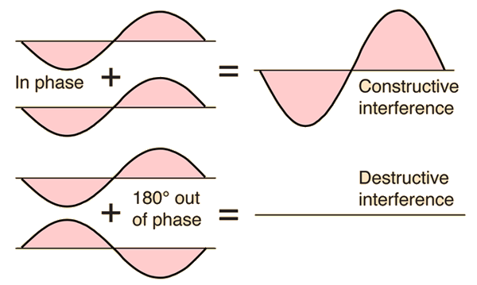
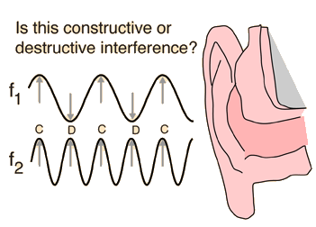
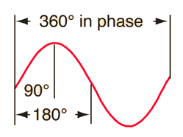
TWO TRAVELING WAVES WHICH EXIST IN THE SAME MEDIUM WILL INTERFERE WITH EACH OTHER. IF THEIR AMPLITUDES ADD, THE INTERFERENCE IS SAID TO BE CONSTRUCTIVE INTERFERENCE, AND DESTRUCTIVE INTERFERENCE IF THEY ARE "OUT OF PHASE" AND SUBTRACT. PATTERNS OF DESTRUCTIVE AND CONSTRUCTIVE INTERFERENCE MAY LEAD TO "DEAD SPOTS" AND "LIVE SPOTS" IN AUDITORIUM ACOUSTICS.

Slide 8
ECHO
AN ECHO IS HEARD DUE TO REFLECTION OF SOUND FROM A DISASTER SOUND- REFLECTING OBJECT.
IF THE TIME INTERVEL BETWEEN THE DIRECT SOUND AND REFLECTED SOUND IS LESS THAN
0.066 SECONDS, THE REFLECTED SOUND IS HELPFUL IN INCREASING THE LOUDNESS. BUT, THOSE
SOUNDS ARRIVING LATER THEN THIS CAUSE CONFUSION.
REMEDY
AN ECHO CAN BE AVOIDED BY COVERING A LONG DISTENCE WALLS AND HIGH CEILING WITH
SUITABLE SOUND ABSORBING MATERIAL.
THIS PREVENTS REFLECTION OF SOUND.

Slide 9
ECHLON EFFECT
IT REFERS TO THE GENERATION OF A NEW SEPARATE SOUND DUE TO MULTIPLE ECHOS.A SET OF RAILINGS OR ANY REGULAR REFLECTING SURFACE IS SAID TO PRODUCE THE ECHLON EFFECT. THIS ECHLON EFFECTS AFFECTS THE QUALITY OF THE ORIGINAL SOUND.
REMEDY
THE REMEDY TO AVOID ECHLON EFFECT IS TO COVER SUCH SURFACE WITH SOUND ABSORBING
MATERIALS.

Slide 10
RESONANCE
RESONANCE OCCURS DUE TO THE MATCHING OF FREQUENCY. IF THE WINDOW PANELS AND SECTIONS OF WOODEN PORTIONS HAVE NOT BEEN TIGHTLY FITTED, THEY MAY START VIBRATING, THEREBY CREATING AN EXTRA SOUND IN ADDITION TO THE SOUND PRODUCED IN THE HALL OR ROOM.
REMEDY
THE RESONANCE MAY BE AVOIDED BY FIXING THE WINDOW PANELS PROPERLY. ANY OTHER VIBRATING OBJECT WHICH MAY PRODUCE RESONANCE CAN BE PLACED OVER A SUITABLE SOUND ABSORBING MATERIAL.

Slide 11
NOISE
THE UNWANTED SOUND IS CALLED A NOISE. THE HALL OR ROOM SHOULD BE PROPERLY INSULATED FROM EXTERNAL AND INTERNAL NOISE. IN GENERAL, THERE ARE THREE TYPES OF NOISES:
AIR-BORNE NOISE,
STRUCTURE-BORNE NOISE,
INSIDE NOISE.

Slide 12
AIR-BORNE NOISE
EXTRANEOUS NOISE WHICH ARE COMING FROM OUTSIDE THROUGH OPEN WINDOWS, DOORS AND VENTILATORS ARE KNOWN AS AIR-BORNE NOISE. THE AIR-BORNE NOISE CAN BE AVOIDED BY FOLLOWING THE REMEDIES MENTIONED.
REMEDIES
THE HALL OR ROOM CAN BE MADE AIR CONDITIONED.
BY USING DOORS AND WINDOWS WITH SEPARATE FRAMES WITH PROPER SOUND INSULATING
MATERIAL.

Slide 13
STRUCTURE-BORNE NOISE
THE NOISE WHICH IS CONVEYED THROUGH THE STRUCTURE OF THE BUILDING IS CALLED STRUCTURE-BORNE NOISE. THE STRUCTURAL VIBRATION MAY OCCUR DUE TO STREET TRAFFIC, OPERATION OF HEAVY MACHINES, ETC.
REMEDIES
THIS NOISE CAN BE ELIMINATE DBY USING DOUBLE WALLS WITH AIR SPACE BETWEEN THEM.
BY USING ANTI-VIBRATION MOUNTS THIS TYPE OF NOISE CAN BE REDUCED.
BY COVERING THE FLOOR AND WALL WITH PROPER SOUND-ABSORBING MATERIAL THIS NOISE
CAN BE ELIMINATED.

Slide 14
INSIDE NOISE
THE LOISE WHICH ARE PRODUCED INSIDE THE HALL OR ROOM IS CALLED INSIDE NOISE. THE INSIDE NOISE MAY BE PRODUCED DUE TO MACHINARIES LIKE AIR CONDITIONERS, GENERATORS, FANS, TYPEWRITERS, ETC.
REMEDIES
THE SOUND PRODUCING MACHINARIES CAN BE PLACED OVER SOUND ABSORBING MATERIALS
LIKE CARPET, PADS, WOOD, FELT, ETC.
BY USING CURTAINS OF SOUND ABSORBING MATERIALS.
BY COVERING TH EFLOOR, WALL AND CEILING WITH SOUND ABSORBING MATERIALS.

