Slide 1

Course Title: Details of Construction Course Code: CE 2110
Course Co-ordinator:
Dr. Anupam Chowdhury
Assistant Professor
Department of Civil Engineering
Rajshahi University of Engineering & Technology
Email: anupam.19ce@gmail.com

Slide 2
Learning Objectives
To introduce with different types of construction materials
To introduce with different types of construction techniques and equipments
Proper selection of construction materials and techniques based on engineering judgement

Slide 3
Course Outlines
Brick masonry
Framed structure
Arches and lintels
Details of floors and roofs
Pointing and plastering
Scaffolding
Shoring and underpinning
Thermal insulation and acoustics
Stairs

Slide 4
Reference Books
Building construction - Sushil kumar
Building Construction Handbook (Seventh edition) - R. Chudley and R. Greeno.
Building Construction: Principles, Materials, and Systems (3rd Edition) - Madan L Mehta, Walter Scarborough, Diane Armpriest.

Slide 5
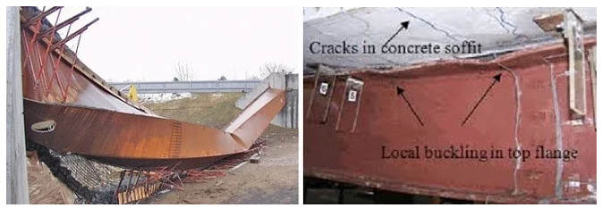
Failure Caused by Steel as a Construction Material

Slide 6
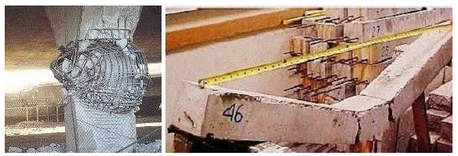
Failures Caused by Concrete as a Construction Material

Slide 7
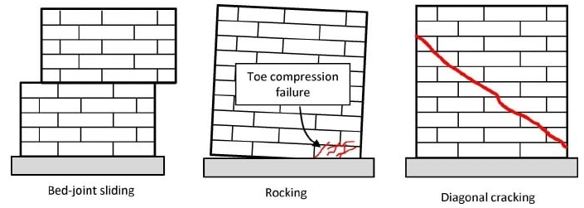
Failures Caused by Masonry as a Construction Material

Slide 8
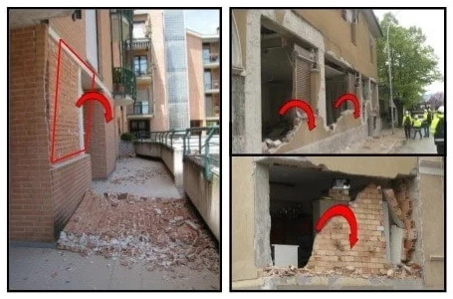
Failures Caused by Masonry as a Construction Material

Slide 9
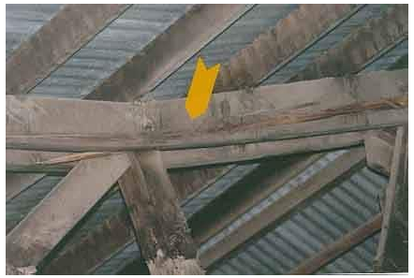
Failures in Wood as a Construction Material

Slide 10
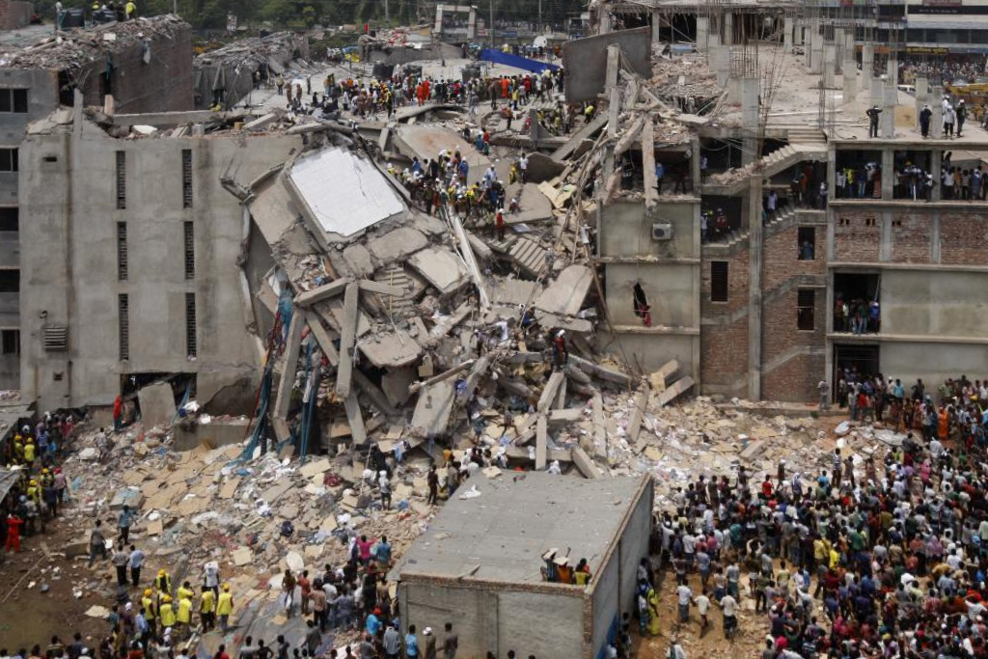
Collapse of Building in Dhaka, Bangladesh

Slide 11
Collapse of Building in Dhaka, Bangladesh
Rana plaza collapse, 2013

Slide 12
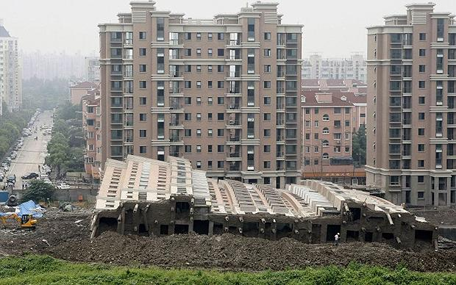
Collapse of Building in Shanghai, Chaina

Slide 13
Distribution of Marks
Class participation and attendance 08
Quizzes/viva voce 20
Board Viva (Compulsory) 25
Performance/reports 47
Total 100

Slide 14
Report Format
Details of student in cover page
Chapter name
Topic title
Date
Objective of the task
Contents
Figure & Table numbering
Page numbering
Conclusions/summary of the task

Slide 15
Any Question?
Thank you

Slide 16
Let’s see a video about construction materials

